Slide 1
Troubleshooting the OvS Data Plane
Jan Scheurich – Ericsson Rohith Basavaraja - Ericsson
November 16-17, 2017 | San Jose, CA

Slide 2
Troubleshooting the OVS Data Plane
Typical data plane issues in NFV
Unexpected packet drop, low throughput, excessive latency or jitter
Sporadic packet drop bursts at OvS boundaries
Supervise real-time behavior of PMD on iteration level
Packet drop in OvS pipeline and datapath
Complete packet drop survey
Dynamic debug handlers
Upstreaming status and outlook

Slide 3
Real-time Packet Drop at OvS Boundaries

Slide 4
Real-time Packet Drop at OvS Boundaries
PMD forwards packets at rates of 4 Mpps or more
Typical traffic load very smooth
Large statistical ensemble of end-user flows (> 100K)
Traffic generators!
Want to operate PMDs near saturation level
Qemu virtio queue pair hardcoded to 256 slots
DPDK virtio PMD uses two slots per packet ➔ 128 packets
Weakest link in datapath: Queue runs full in 32 us!
Note: Latest Qemu version 2.10 makes virtio queue length configurable up to 1024 in both directions. Better, but still not safe.
Any 50us real-time disturbance can trigger packet loss
Internal locking or slow-down of OvS PMD
Interrupt of PMD thread by Linux OS
Interrupt of some VNF forwarding thread
Many typical causes identified already
A lot can be avoided by careful tuning of system and OS
But: New ones popping up over and again
Qemu KVM
Typical user plane VNF
DPDK Application
Receive thread
Transmit thread
1-2 K packets
user space
virtio PMD
Tx
128 packets
Rx
Virtio queues
vhostuser port
OvS-DPDK datapath
PMD
NIC
Tx
2048 packets
Rx
Physical port

Slide 5
Troubleshooter’s Nightmare
Drops only occur only at maximum load levels
Incomplete data
Packets dropped by VNF due to overrun of virtio tx queue not visible as rx drops in OvS port stats
Low frequency
Bursts of packet drops happen sporadically
Typically interval 10 seconds to 10 minutes
In the best case periodic → Easier to reproduce and pin down
Insufficient time resolution
Drop bursts last at most a few PMD iterations 1000 packets dropped in 250 us
Time resolution of existing port stats commands in the range of a second (sleep)
Hard to correlate drop bursts with other events
Statistically insignificant
Average loss over time: 10-100 ppm
Too high for RFC 2544 type performance benchmarks
No visible impact on anything but packet drop counters
Qemu KVM
Typical user plane VNF
DPDK Application
1-2 K packets
user space
virtio PMD
Tx
128 packets
Rx
Virtio queues
vhostuser port
OVS-DPDK datapath
PMD
NIC
Tx
2048 packets
Rx
Physical port

Slide 6
OvS PMD Performance Metrics
Originally developed for Ericsson’s Cloud SDN Switch (OVS 2.6)
Main tool for trouble-shooting DPDK data plane issues
Capture raw PMD metrics in every iteration
Collect a histogram for each PMD metric
Record iteration metrics in circular history (1000 iterations)
Compute millisecond values and record in a circular history (1000 ms)
Less than 1% performance impact!
Can be always active

Slide 7
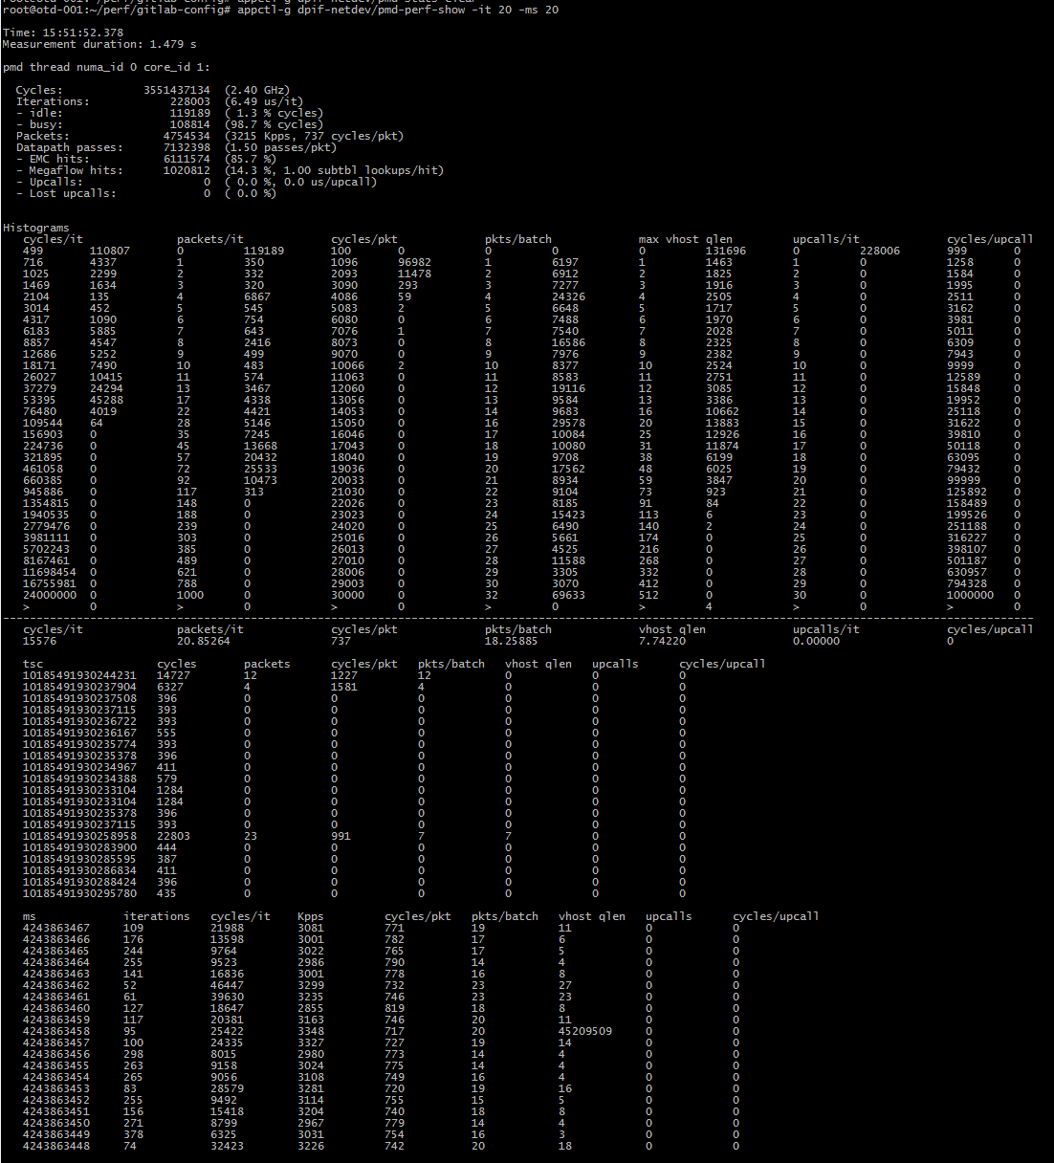
New ovs-appctl CLI Commands
ovs-appctl dpif-netdev/pmd-perf-show [-nh] [-it iter_len]
[-ms ms_len] [-pmd core] [dp]
The options are
-nh: Suppress the histograms
-it iter_len: Display the last iter_len iteration stats
-ms ms_len: Display the last ms_len millisecond stats
-pmd core: Display only the specified PMD stats
The performance statistics are reset with the existing
dpif-netdev/pmd-stats-clear command

Slide 8
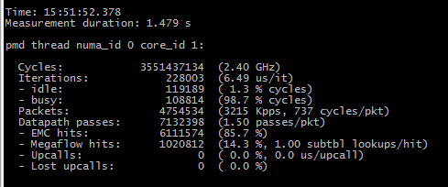
PMD Performance Summary
Time since the last pmd-stats-clear
Nominal TSC frequency: Cycles/duration
Average iteration length
Percent of cycles spent in iterations with at least one processed packet.
Processed packets/second and average processing TSC cycles per packet
Avg. number of datapath passes per packets
Percentage of Megaflow hits and avg. number of subtable lookups per hit
Similar information as in pmd-stats-show but hopefully easier for human interpretation
Percentage of EMC hits

Slide 9
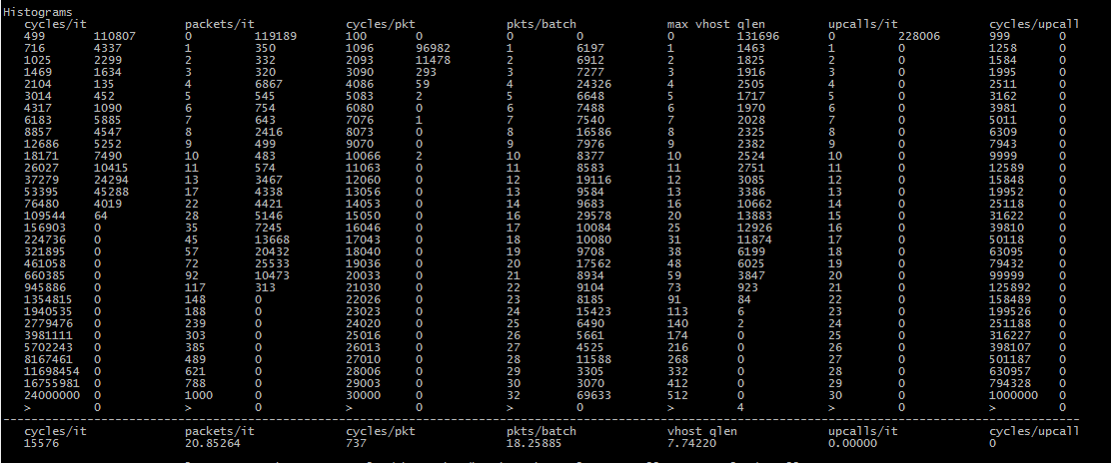
PMD Performance Histograms
Histogram for packets processed per iteration
Upper bound of the bin: 4 packets
Average values for performance metrics
6867 iterations with 4 processed packets
Upper bound: more than 1M cycles

Slide 10
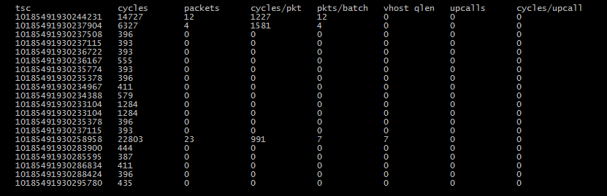
PMD Iteration Metrics History
TSC time stamp at end of iteration (Last iteration on top)
Duration of iteration in TSC cycles
TSC cycles per processed packet
Maximum vhostuser rx queue fill level in iteration
Average number of TSC cycles spent per upcall
Number of upcalls in iteration
Avg. number of packet per rx batch
Number of packets processed in iteration

Slide 11
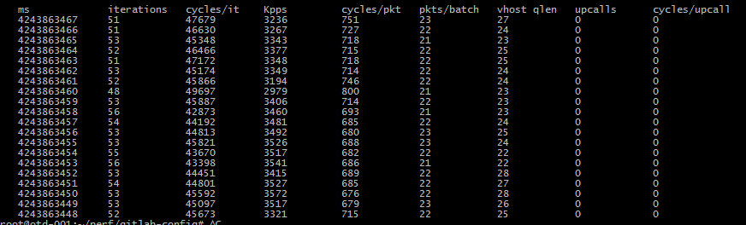
PMD Millisecond Metrics History
Millisecond time stamp (Last ms on top)
Number of iterations in millisecond
Number of processed packets in millisecond
Average number of packets per rx batch in millisecond
Total number of upcalls in milliseconds
Average number of TSC cycles spent per upcall
Maximum vhostuser rx queue fill level in millisecond
Avg. TSC cycles per packet in millisecond
Average cycles per iteration in ms

Slide 12
How to Capture the Iteration History Around a Sub-millisecond Drop Burst?
ovs-appctl dpif-netdev/pmd-perf-log-set [on|off]
[-b before] [-a after] [-us usec] [-q qlen]
Turn logging on or off at run-time (on|off).
-b before: The number of iterations before the suspicious iteration to
be logged (default 5).
-a after: The number of iterations after the suspicious iteration to
be logged (default 5).
-q qlen: Suspicious vhost queue fill level threshold. Increase this
to 512 if the Qemu supports 1024 virtio queue length.
(default 128).
-us usec: change the duration threshold for a suspicious iteration
(default 250 us).
If more than 100 iterations before or after a suspicious iteration have
been logged once, OVS falls back to the safe default values (5/5) to
avoid that logging itself causes continuous further logging.
Solution: Let PMD supervise the metrics for suspicious iterations:
The iteration duration exceeds a specified limit
The maximum vhostuser queue fill level reaches a critical threshold
Write iteration history neighborhood to ovs-vswitchd.log when triggered
Off-line log analysis of
exact timing of drop events and
transient behavior for up to 1000 iterations (typically 2-5 ms) around an event

Slide 13





Development Status
Downstream version
Implemented in Q1 2017 to support packet drop investigations
Several months of heavy duty use in NFV System Test
In production in Ericsson NFVI deployments since May 2017
Upstream Version
Patch set v2 submitted on October 17
[ovs-dev,v2,0/3] dpif-netdev: Detailed PMD performance metrics and supervision
[ovs-dev,v2,1/3] dpif-netdev: Refactor PMD performance into
[ovs-dev,v2,2/3] dpif-netdev: Detailed performance stats for PMDs
[ovs-dev,v2,3/3] dpif-netdev: Detection and logging of suspicious PMD
Please review and test!

Slide 14
Real-world Drop Issues Resolved with PMD Performance Metrics and Supervision (1/3)
i40e PMD Link State Polling
Symptoms
ovs-vswitchd thread uses more than 40% CPU
20-30% packet drop in conjunction with frequent upcalls
Many extremely long upcalls in histogram
Findings
The i40e driver busy loops the ovs-vswitchd thread for 30-40 ms every time it polls the link state from the NIC
Upcalls block the PMD threads for extended period of time, presumably because of a lock contention with ovs-vswitchd in busy loop
Solution
Switch to link state change interrupt mode with i40e NIC
Linux NUMA balancing
Symptoms
Periodic packet drops (every 60s) in VMs due to virtio tx queue overrun
Histogram shows excessive cycles/iteration for a single iteration just prior to suspicious vhost qlen iteration
Findings
Linux kernel marks memory pages inaccessible every minute to trap the first process accessing it. The data is used to optimize NUMA locality between processes and accessed memory
Soft page fault interrupts PMD thread long enough to let virtio queue run full
Solution
Disable NUMA balancing feature in kernel. Not useful in NFVI where all critical processed are pinned anyhow

Slide 15
Real-world Drop Issues Resolved with PMD Performance Metrics and Supervision (2/3)
Qemu 2.5 Emulator Thread Pinning
Symptoms
Periodic bursts of 2000 packets dropped in VM due to virtio tx queue overrun
Iteration history shows a large burst of traffic coming from DPDK VNF: 2x the normal level for 2-3 milliseconds.
Findings
The Qemu emulator thread is pinned by Nova/Libvirt to the same CPU as the sending DPDK PMD in the guest
A regression in Qemu 2.5 causes the emulator thread to block the CPU for 100s of us
Packets queued internally in the VNF are pushed out after the interrupt at maximum speed of the sending PMD
Solution
Pin the emulator thread to a non-critical CPU

Slide 16
Real-world Drop Issues Resolved with PMD Performance Metrics and Supervision (3/3)
ToR switch flooding IGMP multicast membership queries
Symptoms
Periodic bursts of packets dropped in VM due to virtio tx queue overrun
Iteration history shows a stretch of successive iterations with an abnormally high number of upcalls (total 4000)
Findings
A dpctl/dump-flows output after the event contains 4000 drop flows for IGMP packets, each with a separate VLAN tag
The ToR switch flooded the links with IGMP membership queries for all 4K pre-configured VLANs in 200 ms
Solution
Disable IGMP snooping in ToR or reduce number of configured VLANs to below 1000

Slide 17
Packet Drop in OvS Pipeline and Datapath

Slide 18
OvS DPDK Architecture
OpenFlow
OVSDB
Qemu KVM
Qemu KVM
Guest
Guest
ovs-vswitchd
DPDK Application
Application
user
user space
Socket API
netdev
ofproto
virtio PMD
virtio-net
kernel
OVS Slow Path
netdev provider
ofproto-dpif
virtio multi-queue
virtio multi-queue
netdev-dpdk
netdev-linux
OpenFlow Pipeline
3.
dpif provider
dpif-netdev
dpif-netlink
DPDK vhost-user
1.
EMC
Megaflow cache
PMD
PMD
Netlink API
Datapath
2.
DPDK PMD Driver
openvswitch kernel module
Physical port
Physical port
Mult. Rx/Tx queues
Mult. Rx/Tx queues
DPDK Datapath
Kernel Datapath

Slide 19
OvS Packet Drop Scenarios
OpenFlow
OVSDB
Qemu KVM
Qemu KVM
Guest
Guest
ovs-vswitchd
DPDK Application
Application
user
user space
Socket API
netdev
ofproto
virtio PMD
virtio-net
kernel
OVS Slow Path
netdev provider
ofproto-dpif
ofproto errors
virtio multi-queue
virtio multi-queue
netdev-dpdk
netdev-linux
OpenFlow Pipeline
3.
dpif provider
dpif-netdev
dpif-netlink
DPDK vhost-user
1.
EMC
Megaflow cache
PMD
PMD
Netlink API
Datapath
2.
DPDK PMD Driver
openvswitch kernel module
Physical port
Physical port
Mult. Rx/Tx queues
Mult. Rx/Tx queues
DPDK Datapath
Kernel Datapath

Slide 20
OvS Packet Drop Scenarios
OpenFlow
OVSDB
Qemu KVM
Qemu KVM
Guest
Guest
ovs-vswitchd
DPDK Application
Application
user
user space
Socket API
netdev
ofproto
virtio PMD
virtio-net
kernel
OVS Slow Path
netdev provider
ofproto-dpif
ofproto errors
virtio multi-queue
virtio multi-queue
netdev-dpdk
netdev-linux
OpenFlow Pipeline
3.
dpif provider
dpif-netdev
dpif-netlink
DPDK vhost-user
“drop” action
1.
EMC
Megaflow cache
PMD
PMD
Netlink API
Datapath
2.
DPDK PMD Driver
openvswitch kernel module
Physical port
Physical port
Mult. Rx/Tx queues
Mult. Rx/Tx queues
DPDK Datapath
Kernel Datapath

Slide 21
OvS Packet Drop Scenarios
OpenFlow
OVSDB
Qemu KVM
Qemu KVM
Guest
Guest
ovs-vswitchd
DPDK Application
Application
user
user space
Socket API
netdev
ofproto
virtio PMD
virtio-net
kernel
OVS Slow Path
netdev provider
ofproto-dpif
ofproto errors
virtio multi-queue
virtio multi-queue
interface/port drops
netdev-dpdk
netdev-linux
OpenFlow Pipeline
3.
dpif provider
dpif-netdev
dpif-netlink
DPDK vhost-user
“drop” action
1.
EMC
Megaflow cache
PMD
PMD
Netlink API
Datapath
2.
DPDK PMD Driver
interface/port drops
openvswitch kernel module
Physical port
Physical port
Mult. Rx/Tx queues
Mult. Rx/Tx queues
DPDK Datapath
Kernel Datapath

Slide 22
OvS Packet Drop Scenarios
OpenFlow
OVSDB
Qemu KVM
Qemu KVM
Guest
Guest
ovs-vswitchd
DPDK Application
Application
user
user space
Socket API
netdev
ofproto
virtio PMD
virtio-net
kernel
OVS Slow Path
netdev provider
ofproto-dpif
ofproto errors
virtio multi-queue
virtio multi-queue
interface/port drops
netdev-dpdk
netdev-linux
OpenFlow Pipeline
3.
dpif provider
dpif-netdev
dpif-netlink
DPDK vhost-user
“drop” action
datapath errors
1.
EMC
Megaflow cache
PMD
PMD
Netlink API
Datapath
2.
DPDK PMD Driver
interface/port drops
openvswitch kernel module
Physical port
Physical port
Mult. Rx/Tx queues
Mult. Rx/Tx queues
DPDK Datapath
Kernel Datapath

Slide 23
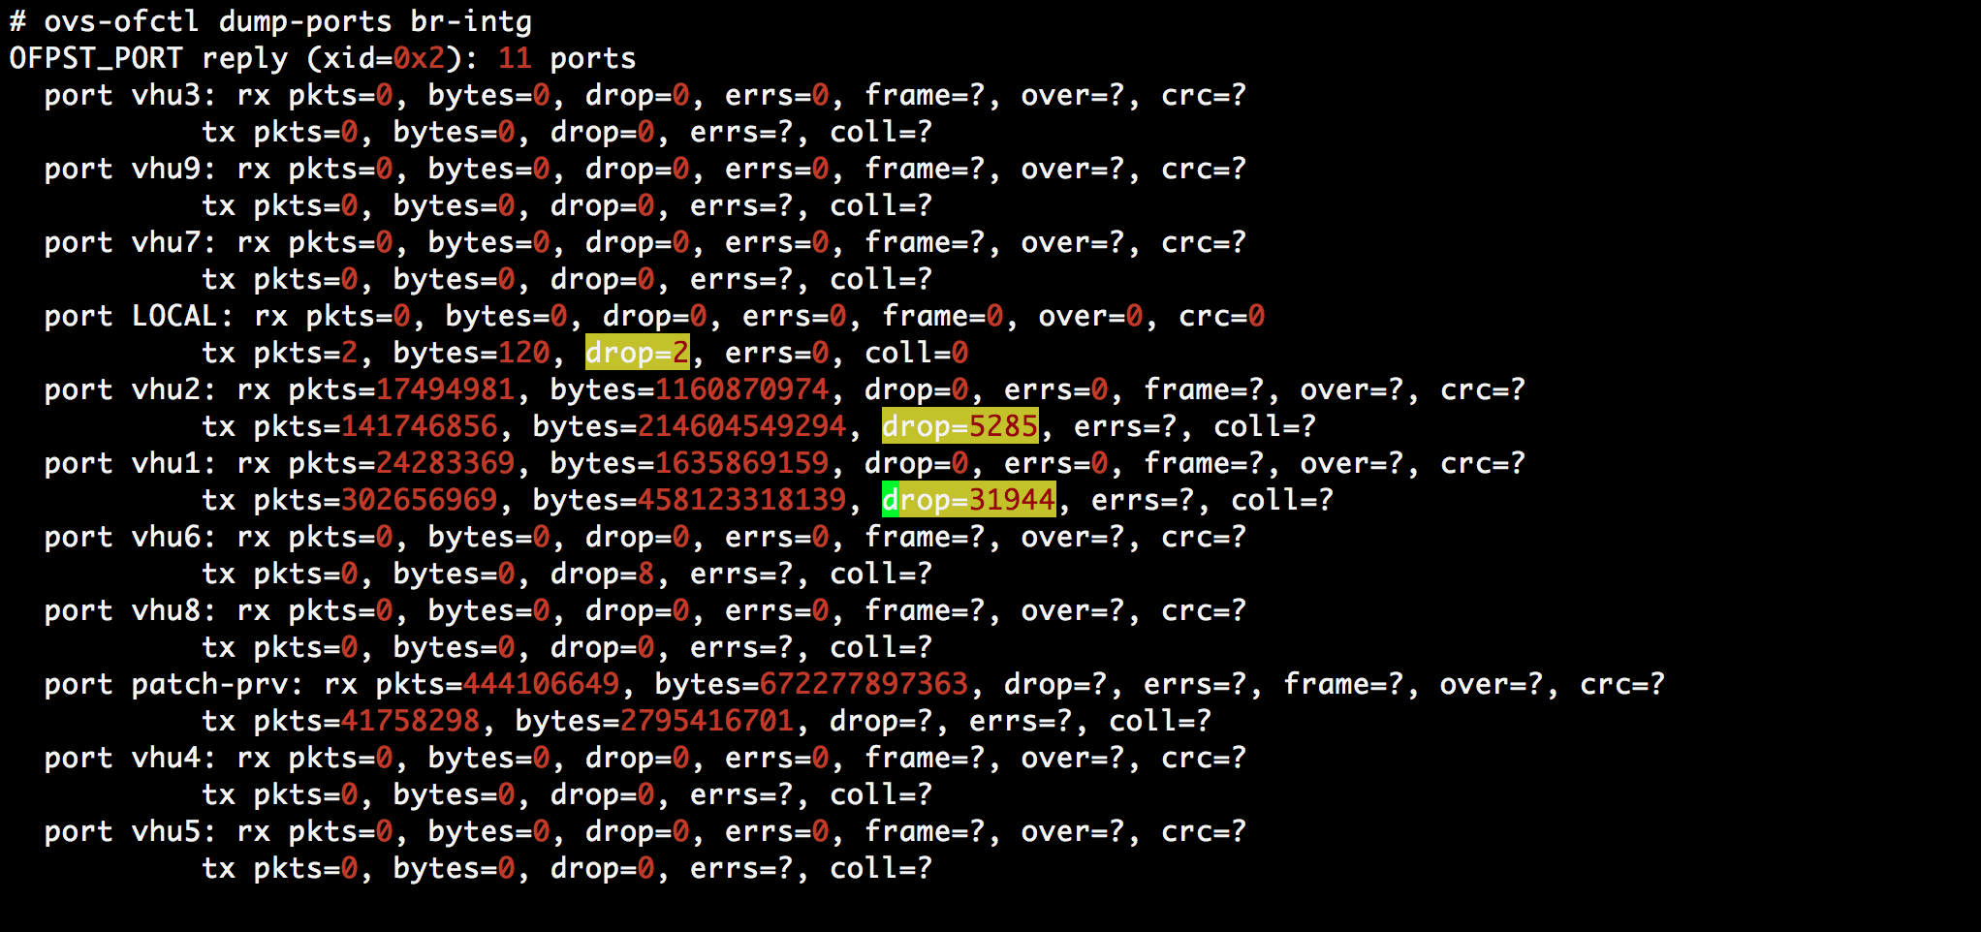
What Do We Have Today?
Qemu KVM
Qemu KVM
Guest
Guest
ovs-vswitchd
DPDK Application
Application
user
user space
Socket API
kernel
netdev
ofproto
virtio PMD
virtio-net
netdev provider
virtio multi-queue
virtio multi-queue
ofproto-dpif
interface/port drops
netdev-dpdk
netdev-linux
OpenFlow Pipeline
3.
dpif provider
dpif-netdev
dpif-netlink
DPDK vhost-user
1.
EMC
PMD
PMD
Megaflow cache
Netlink API
DPDK PMD Driver
2.
interface/port drops
openvswitch kernel module
Physical port
Physical port
Mult. Rx/Tx queues
Mult. Rx/Tx queues

Slide 24
What Do We Have Today?
What about packets dropped by ”drop action”?
Some (resulting from xlate errors) not accounted or reported anywhere
Some are accounted as part of OpenFlow stats, but can be interpreted by only controllers
Datapath errors drop packets silently
Some may by chance create a DBG log entry, if DBG logging was enabled

Slide 25
What Do Troubleshooters Need?
Trouble-shooters need

Slide 26
What Do Troubleshooters Need?
Complete packet drop overview
To confirm packet drop
Trouble-shooters need

Slide 27
What Do Troubleshooters Need?
Complete packet drop overview
To confirm packet drop
Categorize Drops by Drop Reason
Categorization will help to narrow down the problem area quickly
Trouble-shooters need

Slide 28
What Do Troubleshooters Need?
Complete packet drop overview
To confirm packet drop
Categorize Drops by Drop Reason
Categorization will help to narrow down the problem area quickly
Trouble-shooters need
Easy Accessibility
Simple and single interface to get the entire consolidated drop statistics

Slide 29
What Do Troubleshooters Need?
Complete packet drop overview
To confirm packet drop
Categorize Drops by Drop Reason
Categorization will help to narrow down the problem area quickly
Trouble-shooters need
Possibility to selectively dig in to certain drop categories for more detail on demand
Dynamic Debugging
Easy Accessibility
Simple and single interface to get the entire consolidated drop statistics

Slide 30
What Do Troubleshooters Need?
Complete packet drop overview
To confirm packet drop
No Runtime Overhead
Categorize Drops by Drop Reason
Debug enhancements should have minimal/no effect on real-time performance
Categorization will help to narrow down the problem area quickly
Trouble-shooters need
Possibility to selectively dig in to certain drop categories for more detail on demand
Dynamic Debugging
Easy Accessibility
Simple and single interface to get the entire consolidated drop statistics

Slide 31

What are we doing to improve OvS packet drop infrastructure ?

Slide 32
Enhanced Drop Action Handling

Slide 33
Enhanced Drop Action Handling
ovs-vswitchd
ofproto
ofproto-dpif
OpenFlow Pipeline
3.
dpif-netdev
DPDK vhost-user
1.
EMC
Megaflow cache
PMD
PMD
2.
DPDK PMD Driver

Slide 34
Enhanced Drop Action Handling
ovs-vswitchd
ofproto
Add a reason to drop action and propagate to the datapath
ofproto-dpif
OpenFlow Pipeline
3.
dpif-netdev
DPDK vhost-user
1.
EMC
Megaflow cache
PMD
PMD
2.
DPDK PMD Driver

Slide 35
Enhanced Drop Action Handling
ovs-vswitchd
ofproto
Add a reason to drop action and propagate to the datapath
ofproto-dpif
OpenFlow Pipeline
3.
Xlate error drops
Open Flow generated drops
Classify and count packet drops based on “drop action” reason
dpif-netdev
DPDK vhost-user
1.
EMC
Megaflow cache
PMD
PMD
2.
DPDK PMD Driver
Port state related drops

Slide 36
Track Datapath Packet Drops
UPCALL Detour
]
Read Max 32
Packets
Parse
Packets
Find Matching Flows
Group Packets
by Flows
Execute
Actions
Existing OvS DPDK datapath processing flow

Slide 37
Track Datapath Packet Drops
UPCALL Detour
]
Read Max 32
Packets
Parse
Packets
Find Matching Flows
Group Packets
by Flows
Execute
Actions
Packets dropped in each of DP processing stage are accounted

Slide 38
Packet Drop Classification
Rx Drops
DP Processing Drops
Tx Drops
Resource Exhaustion
Parsing Error / Invalid Packets
Ingress Policer
Rx Port Drops
Rx Errors
”drop” action
UPCALL related
Datapath Exceptions/Errors
Egress Policer
Invalid Port/ Port state
Queue full
Resource Exhaustion
Tx Port Drops
Tx Errors

Slide 39
Drop Action Classification
XLATE Error
Port State Drops
Conntrack Drops
OpenFlow Drops
Bridge not found
Recursion too deep
Too many resubmits
Stack too deep
No recirculation context
Recirculation conflict.
Too many MPLS labels
Invalid tunnel metadata
Fragment drop enabled.
ECN mismatch at tunnel decapsulation
Tunnel Tx errors
Tunnel Rx packet_type mismatch
Tunnel decap errors
Tunnel encap errors.
Stack underflow
MPLS decrement TTL exception
IP decrement TTL exception
Unsupported action
Invalid port
Port config drops
Forwarding disabled
Port down/disabled
No input bundle
Partial VLAN tag drop
Rx on exclusive mirror port
Pending, needs further investigation
Drop in flow entry/ action set
Drop in group bucket
Table miss
Group table lookup miss/ non-existent group
Fragmentation drops
Checksum error drops
Invalid header length drops
Invalid state drops

Slide 40
Other DP Processing Drops
Your Logo
UPCALL drops
Datapath exceptions/errors
UPCALL lock contention drops
UPCALL error drops
Tunnel POP action errors
Tunnel PUSH action errors
NSH DECAP errors
NSH ENCAP errors
RECIRCULATION errors
Encapsulation errors
MPLS PUSH action errors
MPLS POP action errors
Invalid config errors.

Slide 41
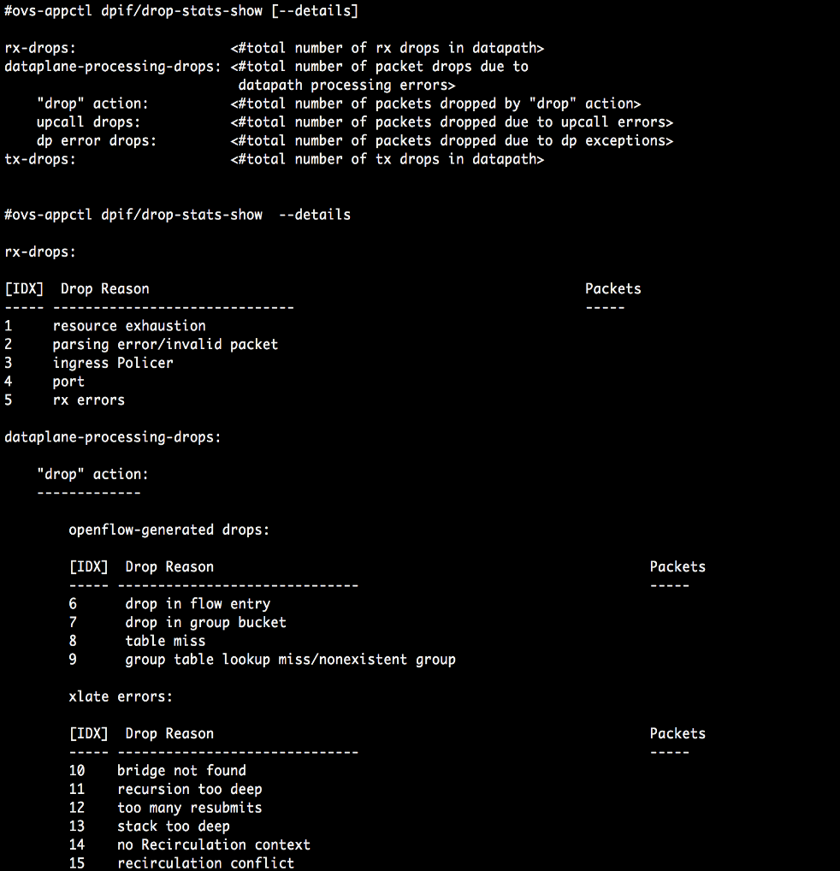
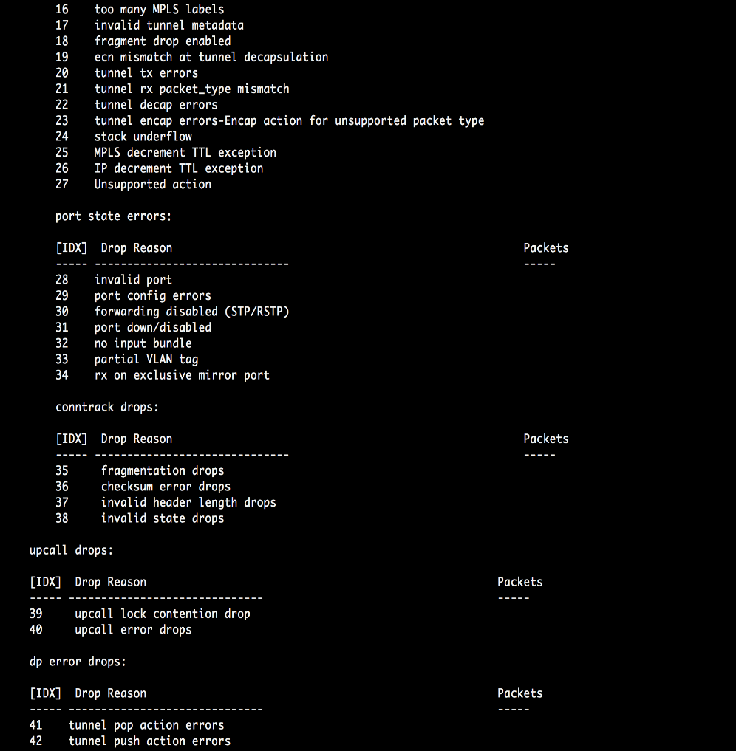
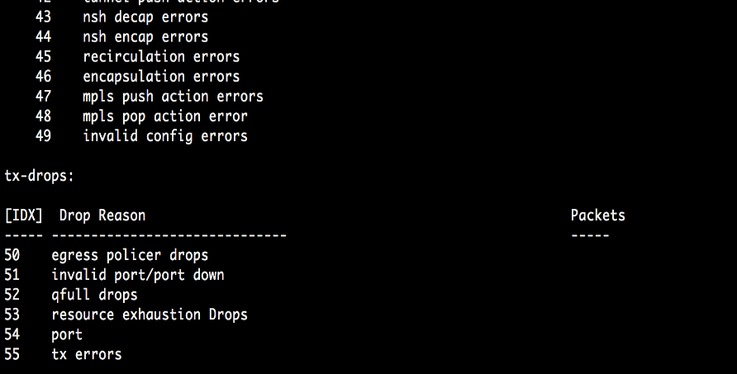
Simple & Overall Drop Statistics CLI

Slide 42


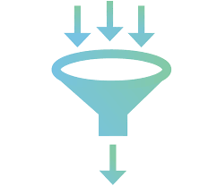

Dynamic Debug Infrastructure
We can enable/disable/combine following extra information retrieval features for each drop counter level. Also the type/kind of information we can collect can be configurable at each drop counter level.
Packet Dump
Dynamic
Debug Infra
Packet Metadata Dump
Packet Trace/OF Trace
Debug Logs

Slide 43
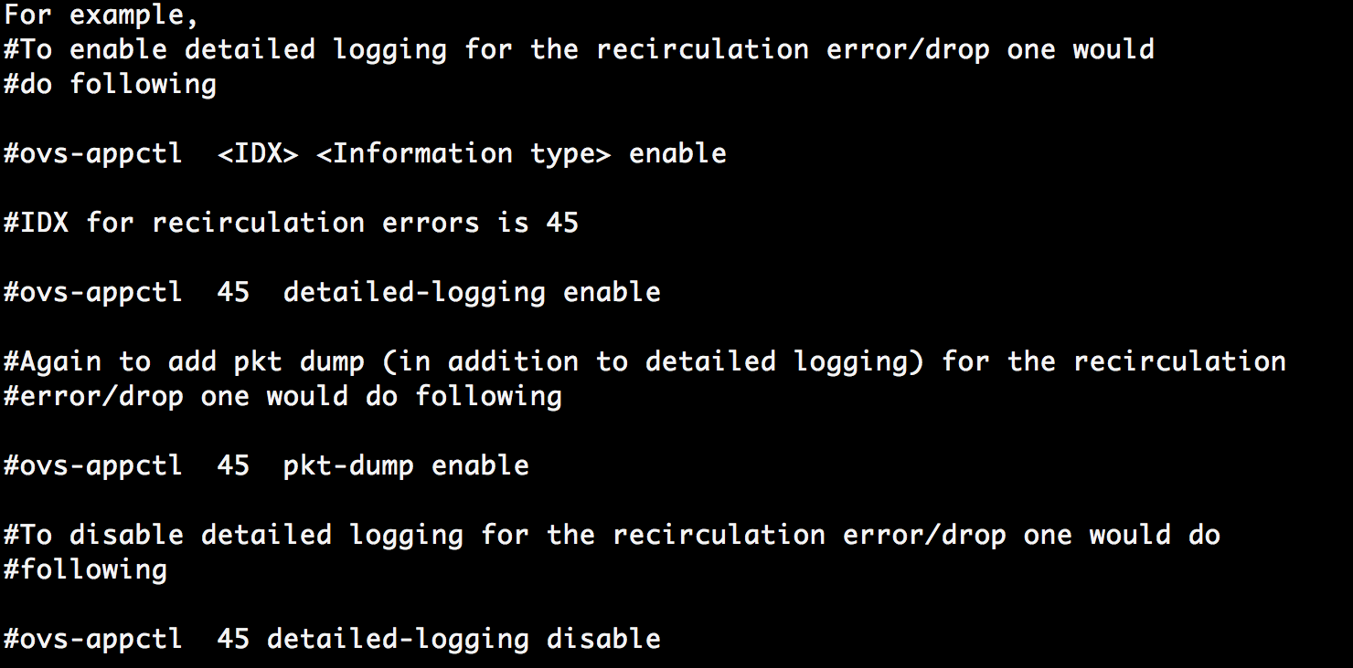
Dynamic Debug Infrastructure
We can enable/disable/combine following extra information retrieval features for each drop counter level. Also the type/kind of information we can collect can be configurable at each drop counter level.
Packet Dump
Dynamic
Debug Infra
Packet Metadata Dump
Packet Trace/OF Trace
Debug Logs

Slide 44
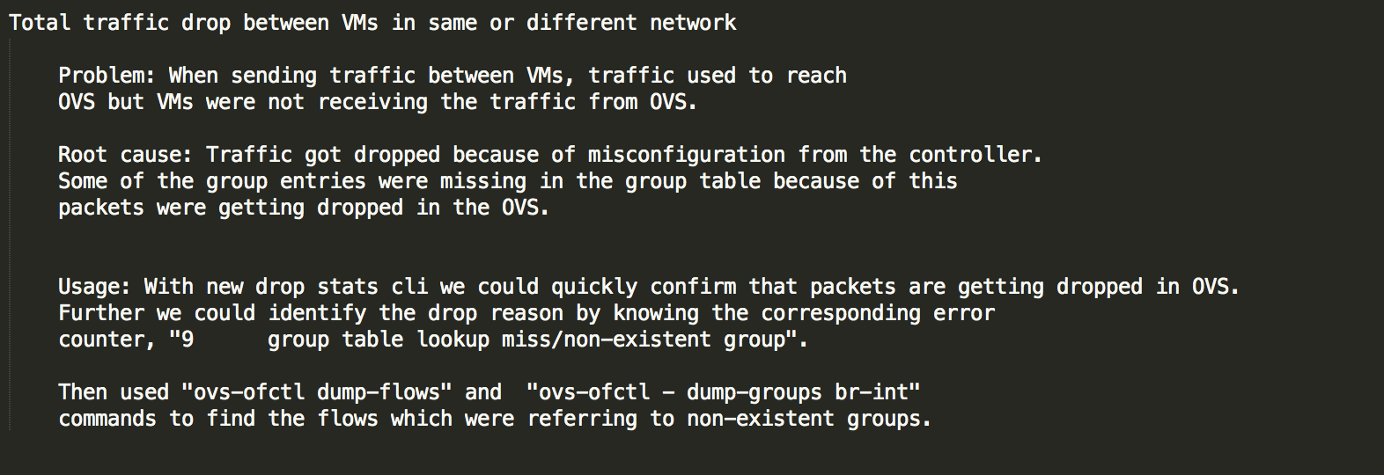

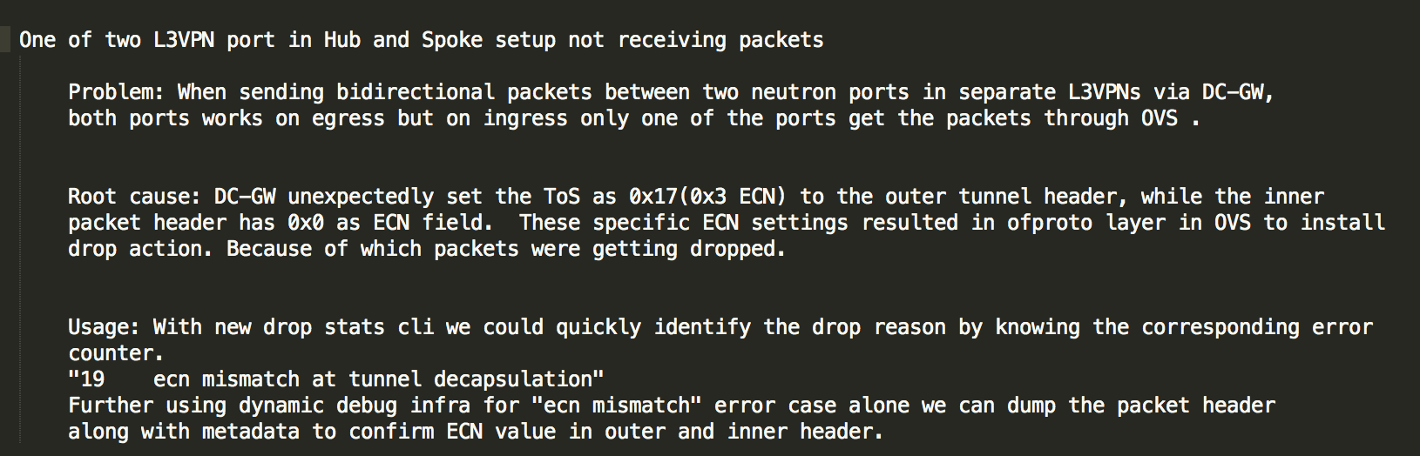
Debugging Examples (1/2)

Slide 45
Debugging Examples (2/2)
Connectivity issue between DC-GW and VM
Problem: L3-VPN traffic (MPLSoGRE) packets were lost with between DC-Gw and a VM. The more and longer L3-VPN traffic ran the higher that packet drop rate became. Root cause: Packets were dropped in OVS during parsing in miniflow_extract() because the packet metadata indicated it was an l2.5 (MPLS) packet even though it had been received as plain Ethernet packet from the physical port. The reason was that the dp_packet mbuf had previously been occupied by an MPLS packet decapsulated from a GRE tunnel. The packet l2.5 metadata was not properly reset when the dp_packet was released and not initialized to l2 either when the mbuf was received from the physical port the next time. So miniflow_extract() was trying to decode an Ethernet packet as MPLS packet and failed.
Usage: With the packet drop infrastructure we would have immediately seen that the packets were dropped during parsing, and by enabling packet and metadata dump for parsing errors, we could have detected the mismatch between metadata and packet buffer content straight away.
Without it it took significant effort and considerable amount of time to find root cause and localize the fault. This involved building and deploying several debug OVS versions with dedicated DBG log added.

Slide 46

Next Steps…
OF Proto Improvements
Extend to Debug Packet Misforwarding
Drop Statistics CLI
Dynamic Debug Infra Improvements
“trace” Action
Packet Drop Classification

Slide 47
Debug Packet Misforwarding…
“trace” action
to enable tracing at each flow level
(leverage dynamic debug infra)

Slide 48
Debug Packet Misforwarding…
orchestrate “trace” action from ofproto
“trace” action
to enable tracing at each flow level
(leverage dynamic debug infra)

Slide 49
Debug Packet Misforwarding…
orchestrate “trace” action from ofproto
“trace” action
to enable tracing at each flow level
(leverage dynamic debug infra)
Any further suggestion/ inputs are welcome

Slide 50
Summary
Troubleshooting packet drop in live NFVI systems under load is hard!
Introduced two new families of troubleshooting tools
Real-time PMD performance metrics & supervision (ready for upstreaming)
For hunting down sporadic packet drop bursts at OvS boundaries
Packet drop statistics and Dynamic debug handlers (work in progress)
To efficiently identify and debug packet all types of packet drop inside OvS
Minimal impact on performance. Can be used in live systems
We welcome suggestions and collaboration for improving these tools!
Notes:
As OVS is getting adopted in wide variety of deployments, both the complexity of the OVS configuration and of the environment in which OVS operates are constantly increasing.
Data plane issues, such as packet drops, misrouting of packets, or performance degradation (throughput or latency) are often extremely difficult to troubleshoot.
Currently available OVS debug commands and tools do not provide much aid in troubleshooting such problems, especially on target systems.
In this talk we present new debugging tools and techniques tailored for an efficient root cause analysis of data plane problems in OVS. These tools are designed to be used in production deployments with only minimal disturbance on the real-time performance of OVS even under very high load.
We are addressing two complementary classes of problems that have emerged in our testing of OVS-DPDK in Telco Cloud (NFVI) environment: 1. Sporadic latency spikes and bursts of dropped packets due to non-deterministic real-time behavior of OVS PMDs. 2. Systematic packet drops or misrouted packets due to unexpected packet format/content, OVS configuration errors or software faults in OVS.
The presented debugging tools and techniques are work in progress and will be upstream soon (targeting OVS 2.9).

Slide 51
Thank You! Questions?

