Slide 1
Enabling hardware acceleration in OVS-DPDK using DPDK ‘Framework’
Sugesh Chandran

Slide 2

Notice & Disclaimers
Intel technologies’ features and benefits depend on system configuration and may require enabled hardware, software or service activation. Performance varies depending on system configuration. Check with your system manufacturer or retailer or learn more at intel.com.
No computer system can be absolutely secure.
Tests document performance of components on a particular test, in specific systems. Differences in hardware, software, or configuration will affect actual performance. Consult other sources of information to evaluate performance as you consider your purchase. For more complete information about performance and benchmark results, visit http://www.intel.com/benchmarks .
Software and workloads used in performance tests may have been optimized for performance only on Intel microprocessors. Performance tests, such as SYSmark and MobileMark, are measured using specific computer systems, components, software, operations and functions. Any change to any of those factors may cause the results to vary. You should consult other information and performance tests to assist you in fully evaluating your contemplated purchases, including the performance of that product when combined with other products. For more complete information visit http://www.intel.com/benchmarks .
Intel's compilers may or may not optimize to the same degree for non-Intel microprocessors for optimizations that are not unique to Intel microprocessors. These optimizations include SSE2, SSE3, and SSSE3 instruction sets and other optimizations. Intel does not guarantee the availability, functionality, or effectiveness of any optimization on microprocessors not manufactured by Intel. Microprocessor-dependent optimizations in this product are intended for use with Intel microprocessors. Certain optimizations not specific to Intel microarchitecture are reserved for Intel microprocessors. Please refer to the applicable product User and Reference Guides for more information regarding the specific instruction sets covered by this notice.
Cost reduction scenarios described are intended as examples of how a given Intel-based product, in the specified circumstances and configurations, may affect future costs and provide cost savings. Circumstances will vary. Intel does not guarantee any costs or cost reduction.
Intel does not control or audit third-party benchmark data or the web sites referenced in this document. You should visit the referenced web site and confirm whether referenced data are accurate.
© 2017 Intel Corporation.
Intel, the Intel logo, and Intel Xeon are trademarks of Intel Corporation in the U.S. and/or other countries.
*Other names and brands may be claimed as property of others.

Slide 3
Introduction
Hardware acceleration in OVS-DPDK.
Challenges of enabling hardware acceleration in OVS-DPDK
DPDK ‘Framework’ , what is it?
DPDK Framework components primer.
Hardware acceleration enablement in OVS-DPDK using DPDK ‘Framework’
Future work/Next steps.

Slide 4
Hardware acceleration in OVS-DPDK
Partial acceleration:- Accelerate software datapath by offloading a portion from the packet processing pipeline.
Full acceleration:- Hardware can do end to end packet processing pipeline. Packets are either handled in Software or Hardware datapath.
Notes:
Hardware acceleration :- Use a hardware to offload packet processing, Eg: Smart NICs, FPGA, and etc

Slide 5

Partial HW acceleration in OVS-DPDK
User
OVSDB
vswitchd
Virtio
Datapath
Ingress
Match
Flow
Actions
Egress
Host
HW
NIC
Pre-processing
Post-processing
Notes:
OVS architecture with partial offload.
User daemon for control
Datapath with packet processing stages.
VMs and NIC connected to the datapath.
NIC does some partial packet processing.
Pre processing, Rx checksum offload
Post processing, TSO, GSO

Slide 6
Partial HW acceleration in OVS-DPDK
User
OVSDB
vswitchd
Virtio
Datapath
Ingress
Match
Flow
Actions
Egress
Host
HW
NIC
Pre-processing
Post-processing
6

Slide 7
Full HW acceleration in OVS-DPDK
User
OVSDB
vswitchd
Virtio/VF
Datapath
SW DP
Ingress
Match
Flow
Actions
Egress
Host
HW
HW DP
Ingress
Match
Flow
Actions
Egress
7
Notes:
HW has subset of software datapath. It can do end to end packet processing.
HW has its own PHY and VMs are connected via VFs/virtio. Keep note of this part. Will talk in the later part of presentation.

Slide 8
Challenges
Feature Parity and Interoperability.
Scalability.
Optimized hardware resource allocation.
Availability of HW acceleration support in OS, tools and other SW components.
Cost of Hardware acceleration setup Vs achievable performance improvement with it.
Live migration support.
Notes:
Features are not same between different vendors, different models.
Even features are same, capacity varies, Number of flows in flow offload.
Allocate the resources optimally to achieve best performance for the usecase.
Software dependency for the enablement., Bi-furcated driver need to have dependency on kernel. Why a userspace need a kernel support?
Hardware acceleration doesn’t yield best performance all the time. Simple eg: tx checksum offload in OVS-DPDK

Slide 9
Challenges
Feature Parity and Interoperability.
Scalability.
Optimized hardware resource allocation.
Availability of HW acceleration support in OS, tools and other SW components.
Cost of Hardware acceleration setup Vs achievable performance improvement with it.
Live migration support.
HW acceleration in
OVS-DPDK using DPDK ‘Framework’

Slide 10
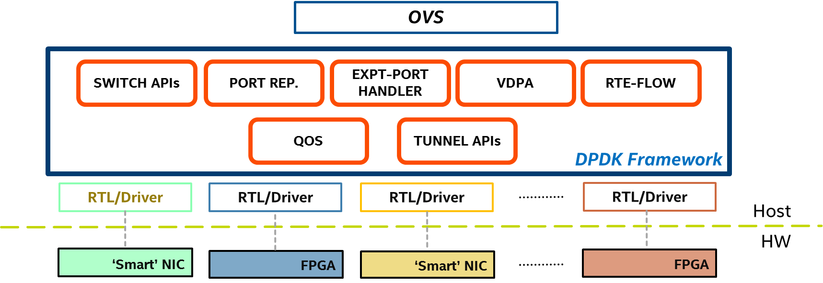
DPDK Framework
Notes:
Set of DPDK libraries to interact with different hardwares
Different Smart NICs, FPGAs in the platform.
Will go through each modules in brief in the next slides.

Slide 11
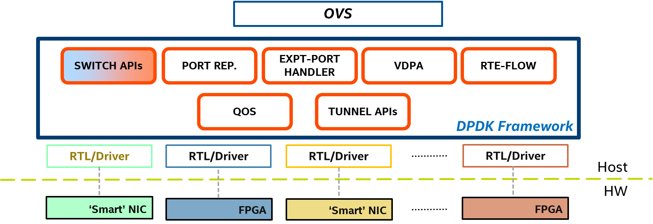
DPDK Framework
Notes:
Expose hardware capability matrix.
Device specific parameters, such as supported protocols for flow offload, number of flows that can offload.
Will talk about hows its used in OVS-DPDK

Slide 12
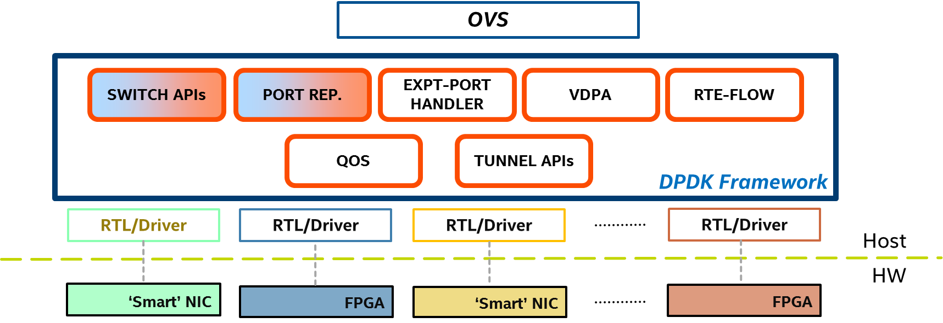
DPDK Framework
Notes:
Software representation of hardware ports.
Port representor work along with Exeception port handler.

Slide 13
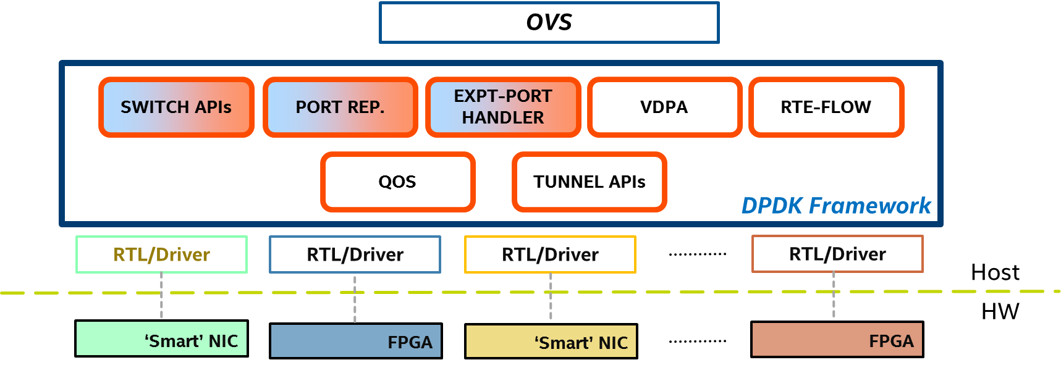
DPDK Framework
Notes:
Exception port handler to handle the exception packets.
Unhandled packets in FPGA reports to software via exception port handler.
Exception port handler steer that packet to software representor port through port rep.

Slide 14
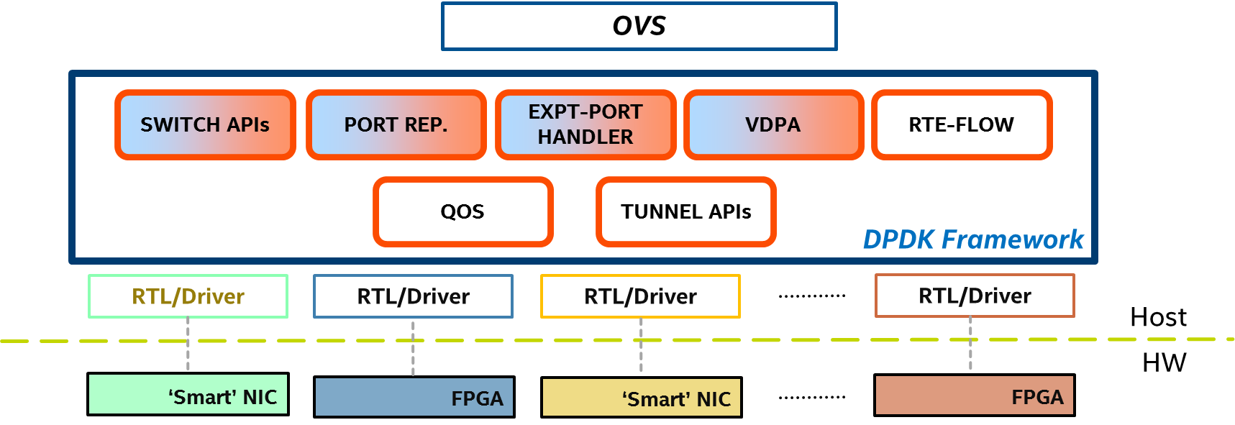
DPDK Framework
Notes:
Vhost Datapath Accelerator. :- Unified interface to abstract away hardware accelerated VM backends.
Standard SR-IOV, PCI-Pass through expose the hardware PCI directly to the VM. Very hardware dependant and not easy to do the migration.
VDPA model, hardware offers a vhost backend that can talk to virtio in the guest.
Virtio 1.1 std compliance

Slide 15
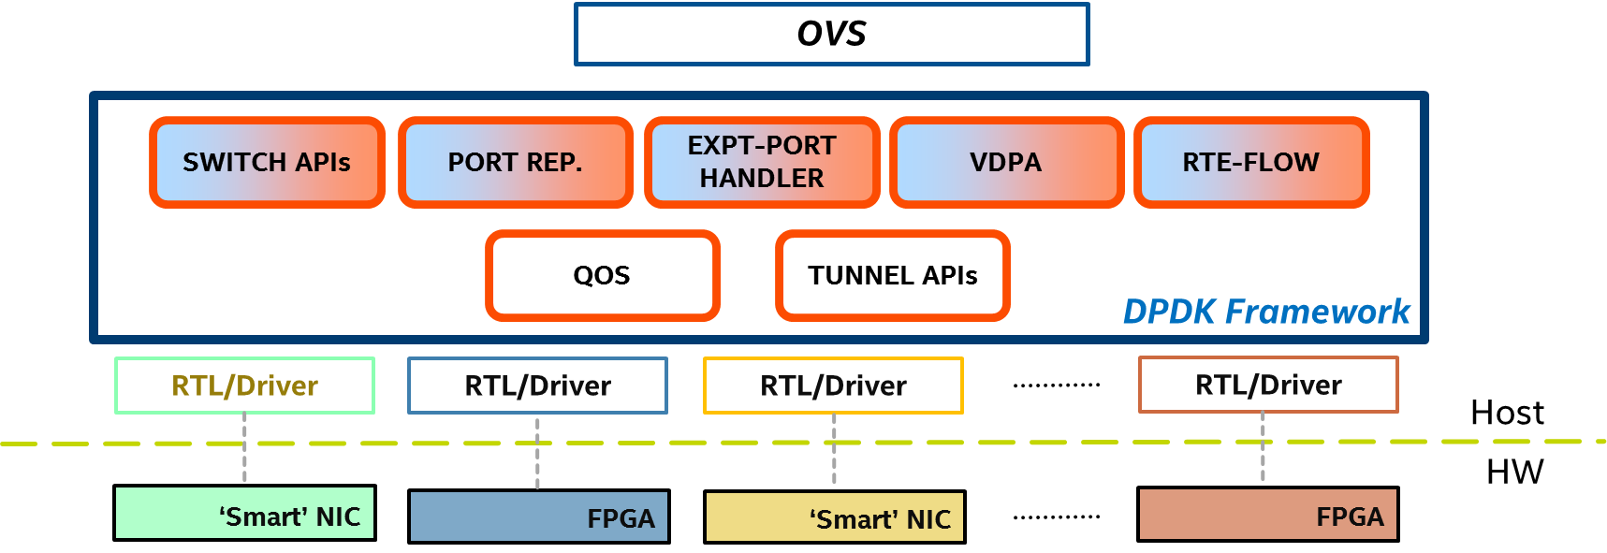
DPDK Framework
Notes:
Rte_flow used to program flows in hardware. Adding more extensions to support more protocols.

Slide 16
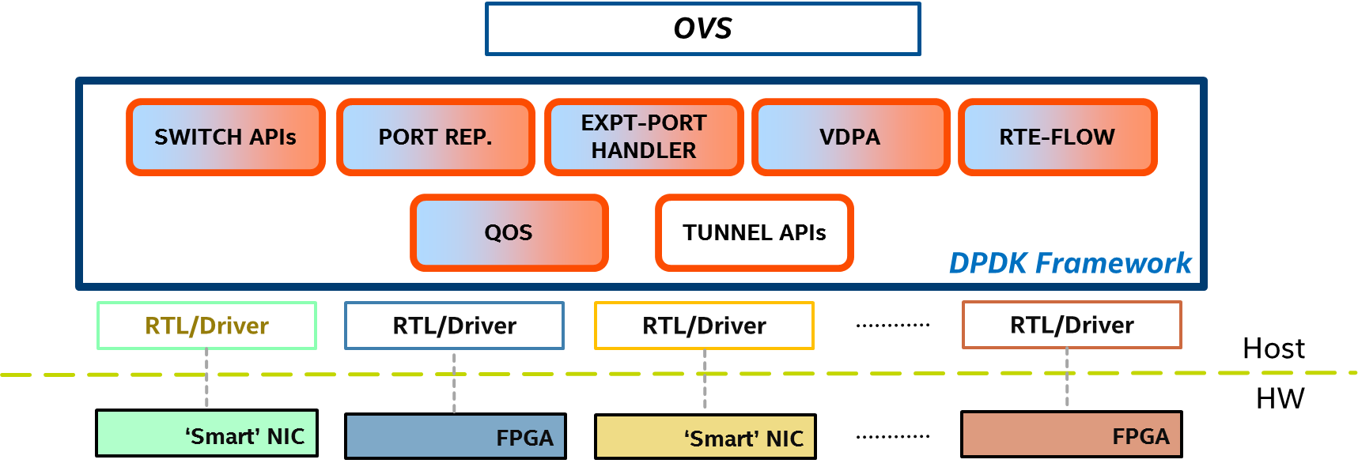
DPDK Framework
Notes:
QoS APIs. TBD.

Slide 17
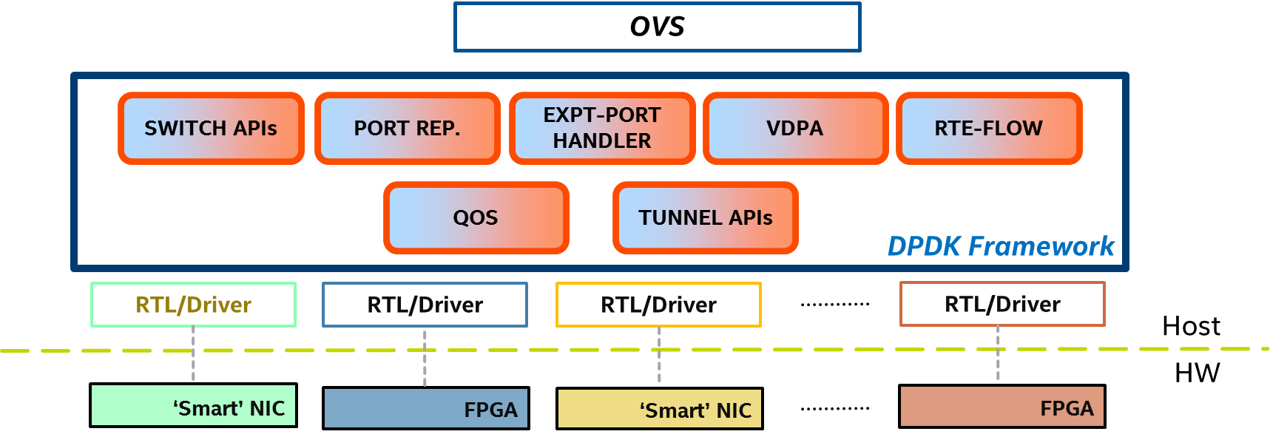
DPDK Framework
Notes:
Set of APIs to define and program tunnel end points in hardware.

Slide 18
DPDK ‘Framework’ in OVS-DPDK
OVS-DPDK init with hardware acceleration.
OVSDB
vswitchd
SW Datapath
DPDK Framework
SWITCH APIs
PORT REP.
EXPT- HANDLER
VDPA
RTE-FLOW
QOS
TUNNEL APIs
Host
FPGA Driver
HW
FPGA
PHY
18
Notes:
How the framework is used in OVS-DPDK?
Looking at the full acceleration usecase instead of partial acceleration.
OVS control path, SW datapath ,
FPGA interaction is via DPDK framework modules.

Slide 19
DPDK ‘Framework’ in OVS-DPDK
OVS-DPDK init with hardware acceleration.
$ ovs-vsctl set Open_vSwitch . other_config:dpdk-hw-offload-init=true
$ ovs-vsctl set Open_vSwitch . other_config:dpdk-hw-offload-ids="0000:5e:00.0“
OVSDB
vswitchd
1
SW Datapath
DPDK Framework
SWITCH APIs
PORT REP.
EXPT- HANDLER
VDPA
RTE-FLOW
QOS
TUNNEL APIs
Host
FPGA Driver
HW
FPGA
PHY

Slide 20
DPDK ‘Framework’ in OVS-DPDK
OVS-DPDK init with hardware acceleration.
$ ovs-vsctl set Open_vSwitch . other_config:dpdk-hw-offload-init=true
$ ovs-vsctl set Open_vSwitch . other_config:dpdk-hw-offload-ids="0000:5e:00.0“
OVSDB
vswitchd
1
SW Datapath
DPDK Framework
SWITCH APIs
PORT REP.
EXPT- HANDLER
VDPA
RTE-FLOW
QOS
TUNNEL APIs
Host
FPGA Driver
HW
2
FPGA
PHY
Notes:
Vswitchd init the hardware with PCI-ID, Possible to pass multiple PCI-IDs.

Slide 21
DPDK ‘Framework’ in OVS-DPDK
OVS-DPDK init with hardware acceleration.
$ ovs-vsctl set Open_vSwitch . other_config:dpdk-hw-offload-init=true
$ ovs-vsctl set Open_vSwitch . other_config:dpdk-hw-offload-ids="0000:5e:00.0“
OVSDB
vswitchd
1
SW Datapath
DPDK Framework
SWITCH APIs
PORT REP.
EXPT- HANDLER
VDPA
RTE-FLOW
3
QOS
TUNNEL APIs
Host
FPGA Driver
HW
2
FPGA
PHY
Notes:
When init is success,
Switch Apis collects the capability matrix.
Port representors are initialized based on number of backed ports. Assign port number to each initialized port.
Exception handler is initialized to handle the unhandled packets from HW
VDPA is initialized to handle the vhost messages.
HAPPENS AT VSWITCHD init.

Slide 22
DPDK ‘Framework’ in OVS-DPDK
OVS-DPDK init with hardware acceleration.
$ ovs-vsctl set Open_vSwitch . other_config:dpdk-hw-offload-init=true
$ ovs-vsctl set Open_vSwitch . other_config:dpdk-hw-offload-ids="0000:5e:00.0“
OVSDB
vswitchd
4
1
SW Datapath
DPDK Framework
SWITCH APIs
PORT REP.
EXPT- HANDLER
VDPA
RTE-FLOW
3
QOS
TUNNEL APIs
Host
FPGA Driver
HW
2
FPGA
PHY
Notes:
Populates a new table in OVS.
Table to expose the hardware capabilities.
Keep note of device-id, its been used later.

Slide 23
DPDK ‘Framework’ in OVS-DPDK -contd
Add a hardware accelerated port to OVS-DPDK.
ovs-vsctl --timeout 10 add-port br0 port0 – set Interface port0 type=dpdkhw options:device-id=0,port-id=0
OVSDB
vswitchd
1
SW Datapath
DPDK Framework
SWITCH APIs
PORT REP.
EXPT- HANDLER
VDPA
RTE-FLOW
QOS
TUNNEL APIs
Host
FPGA Driver
HW
FPGA
PHY
Notes:
Configuration is complete.

Slide 24
DPDK ‘Framework’ in OVS-DPDK -contd
Report exception packet to OVS-DPDK.
OVSDB
vswitchd
SW Datapath
DPDK Framework
SWITCH APIs
PORT REP.
EXPT- HANDLER
VDPA
RTE-FLOW
QOS
TUNNEL APIs
Host
FPGA Driver
HW
FPGA
PHY
Notes:
No rule to handle packets in FPGA/NIC.
Packets with a metadata send to software via exception handler.
Exception handler and port representor put the packet into right software port queue based on the metadata reported in packet.

Slide 25
DPDK ‘Framework’ in OVS-DPDK -contd
Report exception packet to OVS-DPDK.
OVSDB
vswitchd
SW Datapath
DPDK Framework
SWITCH APIs
PORT REP.
EXPT- HANDLER
VDPA
RTE-FLOW
QOS
TUNNEL APIs
Host
FPGA Driver
HW
FPGA
PHY
Notes:
Packet receive at SW datapath, No rule to handle it,
Send to control path.

Slide 26
DPDK ‘Framework’ in OVS-DPDK -contd
Install flow into SW datapath.
OVSDB
vswitchd
SW Datapath
DPDK Framework
SWITCH APIs
PORT REP.
EXPT- HANDLER
VDPA
RTE-FLOW
QOS
TUNNEL APIs
Host
FPGA Driver
HW
FPGA
PHY
Notes:
Vswitchd program the rule in SW datapath

Slide 27
DPDK ‘Framework’ in OVS-DPDK -contd
Install flow into FPGA hardware.
OVSDB
vswitchd
SW Datapath
DPDK Framework
SWITCH APIs
PORT REP.
EXPT- HANDLER
VDPA
RTE-FLOW
QOS
TUNNEL APIs
Host
FPGA Driver
HW
FPGA
PHY
Notes:
Flow get extended to HW via RTE_FLOW.
Also the exception packet forward back to hardware via port representor.

Slide 28
Current Status
% completed
OVSDB
vswitchd
SW Datapath
DPDK Framework
SWITCH APIs
PORT REP.
EXPT- HANDLER
VDPA
RTE-FLOW
QOS
TUNNEL APIs
Host
FPGA Driver
HW
FPGA
PHY

Slide 29
Next Steps
Continue the publishing of DPDK ‘Framework’ APIs and implementation in the DPDK ML.
Publish the RFC design to the OVS-DPDK mailing list to get early feedback on the proposal and implementation.
Publish OVS-DPDK implementation using DPDK ‘Framework’ to OVS mailing list.

Slide 30
Summary
The marriage of OVS-DPDK with hardware acceleration provides a compelling solution to meet the needs of telco NFV workloads.
Abstracting away all the hardware features by handling them implicitly doesn’t always yield an optimum solution .
OVS-DPDK hardware acceleration enablement should be flexible, extendable and capable of using the hardware features in generic way.
DPDK ‘Framework’ offers all the needed libraries for hardware acceleration enablement in applications such as OVS-DPDK.
Notes:
Looking for feedback to make it work for most of the hardware.

Slide 31
Questions? sugesh.chandran@intel.com

