Slide 1
Open vSwitch Offload: Conntrack and the Upstream Kernel
John Hurley Open vSwitch 2017 Fall Conference

Slide 2
Overview
Introduction to Conntrack in Open vSwitch Kernel
Current Open vSwitch and Conntrack offload approach
Offload results - benefits of offload
Open Source offload of Open vSwitch (TC flower)
Netfilter Conntrack and Open vSwitch offload
Current work on Conntrack offload (upstream)
Advantages of Conntrack offload approach

Slide 3
Open vSwitch and Netfilter Conntrack
Conntrack support integrated with Open vSwitch from version 2.5
Operates at kernel level by calling nf_conntrack functions
Includes nf_conntrack NAT support from version 2.6
ovs-vswitchd
User-space
Kernel
Openvswitch.ko
nf_conntrack.ko
Match
Action

Slide 4
Open vSwitch/Conntrack Offload
Custom patches applied to kernel Open vSwitch to offload rules
All Conntrack applied on SmartNIC
ovs-vswitchd
User-space
Kernel
Openvswitch.ko
Netronome Conntrack Offload
Match
Action
Netronome Offload Modules
SmartNIC
NFP
Match
Action
Conntrack

Slide 5
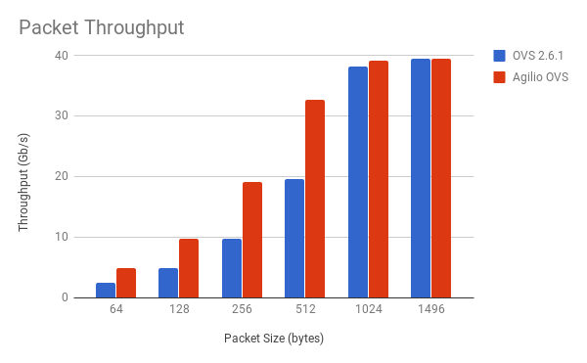
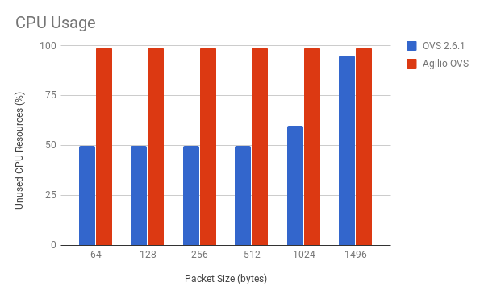
Offload Performance - CT + NAT Results
OVS Rules Applied: 1. ct_state=-trk,in_port=2,ip,action=
ct(commit,zone=1,nat(src=10.0.0.1),table=0)
2. ct_state=+trk+new,in_port=2,ip,action=1
Test Server Spec:
Intel(R) Xeon(R) CPU E5-2680 v2 @ 2.80GHz
Thread(s) per core: 2
Core(s) per socket: 10
Socket(s): 2

Slide 6
Offload without Patches - TC and OVS-TC
Open vSwitch patches merged upstream - experimental in 2.8
TC ingress qdisc and flower filter
TC offload hooks in upstream kernel
ovs-vswitchd
User-space
Kernel
TC Flower
Openvswitch.ko
Match
Action
NFP Driver
SmartNIC
NFP
Match
Action

Slide 7
OVS-TC and Netfilter Conntrack
TC filter imitates Open vSwitch kernel Conntrack match/action
Initial packets of all flows pass through Kernel Conntrack
ovs-vswitchd
User-space
Kernel
TC Flower
Netfilter
Conntrack
Openvswitch.ko
Match
Action
NFP Driver
SmartNIC
NFP
Match
Action
Conntrack Table

Slide 8
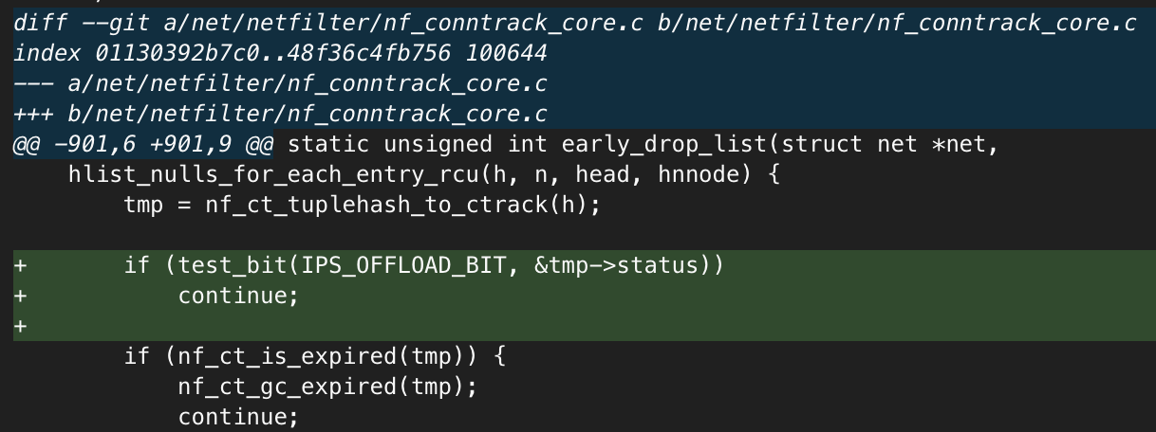
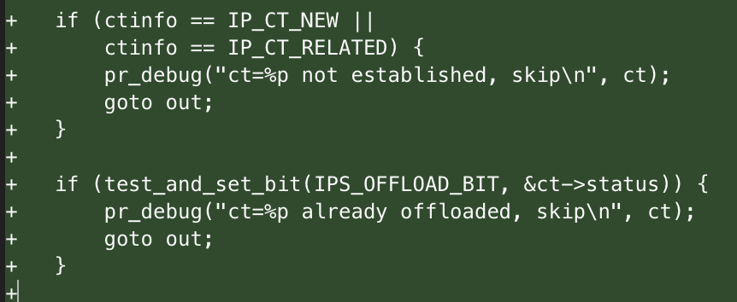
Netfilter Conntrack Offload - Pablo Neira Ayuso
‘Not offloading Conntrack, but offloading flows’
(RFC patches on netfilter-devel mailing list)
Flag to mark a flow as offloaded
Do not timeout
Report flow as offloaded
Only offload flows in Established state
First packet/s go via kernel
TCP state tracking interpreted
Choose which flows to offload
Flexibility for the user
Helper processing in the kernel

Slide 9
Key Advantages of Approach
Kernel still makes key decisions
Established state determination
See all flows whether offloaded or not - e.g. IP selection for NAT
Lessen code complexity on SmartNIC
Not restricted by SmartNIC resources
Can support ‘unlimited’ flows
Choose to support TCP win/seq/ack tracking
Offload is not transparent
User still gets Netfilter Conntrack - visible offloads
Key point in the Netfilter community
Synchronisation between Conntrack tables
Resolves issue with full table offload
User-space utilities should still work (minor patches required)

Slide 10

Dataplane Acceleration Developer Day (DXDD)
Date: December 11-12 (Monday & Tuesday)
Time: 8:30 a.m. – 8:00 p.m.
Location: Computer Science Museum (Mountain View, CA)
Why should you attend?
Discussions about recent dataplane acceleration development
P4-16 introduction
TC offload introduction
eBPF introduction
Extensive hands-on training
P4-14 labs
TC labs
Register: https://open-nfp.org/dxdd-2017

