Slide 1
November 16-17, 2017 | San Jose, CA
LXC Linux Containers over Open vSwitch
Gilbert Standen, Orabuntu-LXC Project, Principal Solution Architect

Slide 2







Acknowledgements
OVS
Ben Pfaff
LXC
Stéphane Graber
Christian Brauner
SCST
Vladislav Bolkhovitin
Bart Vanassche
AV SERVICES
Timothy Arthur
Ethan Hill

Slide 3
Presenter Information
Gilbert Standen
Presenter at AUSOUG, RMOUG, NYOUG, OOW many years
Author of nandydandyoracle blog
Creator of Orabuntu-LXC github project
20+ years hands-on build lead a number of major Oracle projects including:
Largest EPA superfund project in US history Oracle industrial-controls system
T-bill day trading and FX currency trading backend systems delivery
Massachusetts Health Insurance Exchange 4-node RAC (M-HIX)
Major projects for Pharmaceutical and Financial industry

Slide 4
What is Orabuntu-LXC ?
Purpose-built to run Oracle Enterprise software on any linux at physical speed
Deploys Oracle Linux 5, 6 and 7 LXC containers on OpenvSwitch
Built on a high-performance stack (LXC on OpenvSwitch), NO hypervisor
Builds and installs OpenvSwitch RPMs on Oracle Linux/RedHat Linux
Builds and installs LXC RPMs on Oracle Linux/RedHat Linux
Deploys containerized DNS/DHCP and optional Linux SAN
Can be used to build flexible OpenvSwitch development environment
Supports Oracle Linux, Ubuntu Linux, CentOS Linux, RedHat Linux
Provides standard VLAN tagging with OpenvSwitch
Installs with a single command from a simple configuration file in minutes
Used to install 6-node Oracle RAC on Ubuntu kernel using LXC containers
World-leader in running Oracle Enterprise products directly on Ubuntu kernels
The scst-files.tar #1 for building SCST DKMS-deb pkgs Ubuntu & Debian

Slide 5
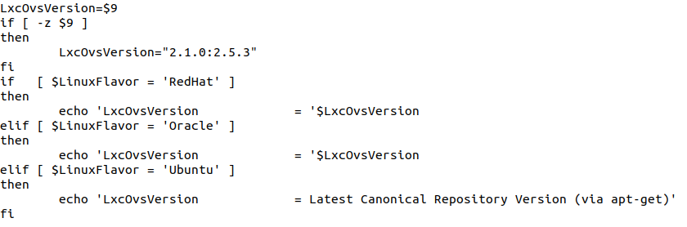
Using Orabuntu-LXC to Install OpenvSwitch (OVS)
Orabuntu-LXC builds Open vSwitch RPM’s and installs any OVS version
This is available for RedHat-family linuxes. Oracle Linux is the dev platform
You configure that in anylinux-services.sh as shown below (ovs 2.5.3 shown)

Slide 6
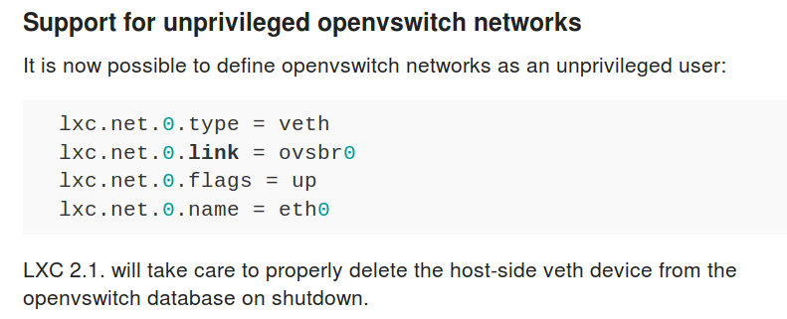
LXC 2.1.0+ Adds Explicit OpenvSwitch Support
LXC versions prior to 2.1.0+ also supported OpenvSwitch but indirectly.

Slide 7
LXC 2.1.0+ Adds Explicit OpenvSwitch Support
You can do one-off config edits per container or reconfigure lxc
Set USE_LXC_BRIDGE="false" in file: /etc/default/lxc-net
Change lxc.net.0.link in the /etc/lxc/default.conf file as shown below.
ubuntu@athens:~$ cat /etc/lxc/default.conf
lxc.net.0.type = veth
lxc.net.0.link = ovsbr1 ←
lxc.net.0.flags = up
lxc.net.0.hwaddr = 00:16:3e:xx:xx:xx
ubuntu@athens:~$

Slide 8
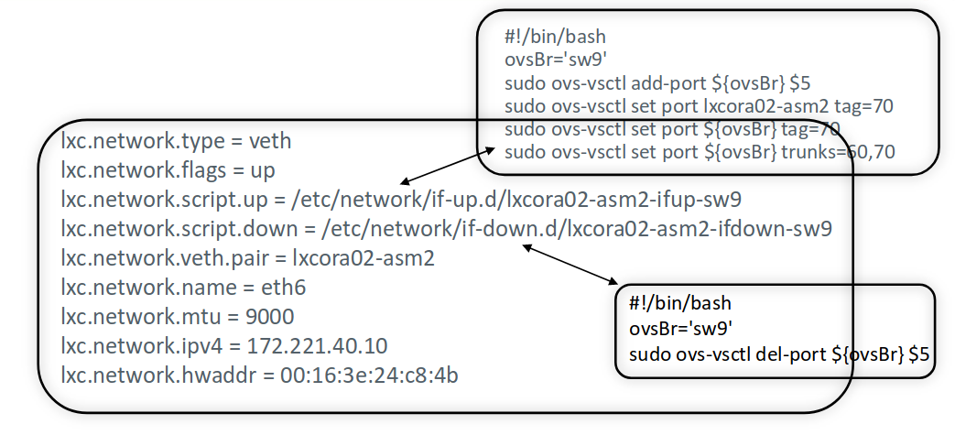
LXC 2.1.0+ Can Still Use lxc.network.script.up
But it’s been renamed to: lxc.net.0.script.up
lxc.net.0.script.down

Slide 9
LXC 2.1.0+ Adds Explicit OpenvSwitch Support
Using lxc.net.0.link together with lxc.net.0.script.up is optional
You can still specify the OVS switch name in lxc.net.0.script.up
Connecting multiple OVS switches is done as shown below.
# OpenvSwitch Networking
lxc.net.0.script.up = /etc/network/if-up.d/openvswitch/olive-pub-ifup-sw1
lxc.net.0.script.down = /etc/network/if-down.d/openvswitch/olive-pub-ifdown-sw1
lxc.net.0.veth.pair = olivew
lxc.net.1.script.up = /etc/network/if-up.d/openvswitch/olive-pub-ifup-sx1
lxc.net.1.script.down = /etc/network/if-down.d/openvswitch/olive-pub-ifdown-sx1
lxc.net.1.veth.pair = olivex

Slide 10
OpenvSwitch as a systemd service on Linux
[Unit]
Description=sw1 Service
Wants=network-online.target
After=network-online.target
[Service]
Type=oneshot
User=root
RemainAfterExit=yes
ExecStart=/etc/network/openvswitch/crt_ovs_sw1.sh
ExecStop=/usr/bin/ovs-vsctl del-br sw1
[Install]
WantedBy=multi-user.target
Ubuntu 16.04+
Oracle Linux 7.x+
LXC Containers are
Also setup as systemd services

Slide 11
Orabuntu-LXC Open vSwitch sw1: The "Brain"
Bridge "sw1"
Port "ora73c10"
tag: 10
Interface "ora73c10"
Port olivew
tag: 10
Interface olivew
Port "sw1"
Interface "sw1"
type: internal
Port "ora73c11"
tag: 10
Interface "ora73c11"
Detects Internet Connected Interface
Detects IP Address
Builds GRE tunnels
Checks if NetworkManager Installed
Checks if
Systemd-Resolved Installed
Detects Linux Flavor
Detects Wired or Wireless
Edits
Ifcfg-$ESSID ifcfg-$EXTIF
Sets iptables rules for sw1 internet
access
Sets routes
Cleans up iptables
Sets MTU

Slide 12
Orabuntu-LXC 4.0: Containerized DNS/DHCP
DNS/DHCP
SW1
By standardizing
DNS/DHCP by containerization for all deployments of Open vSwitch we have better control of the deployment and also only need to point customer environment to the containerized DNS/DHCP
LXC Containers
WAN via iptables
VLAN tags

Slide 13
OpenvSwitch Containerized DNS/DHCP
NetworkManager on desktops
Add "dns=dnsmasq" in NetworkManager.conf
NetworkManager
Systemd-resolved on server editions.
Add "DNS=<ip of DNS container on sw1> in /etc/systemd/resolved.conf
systemd-resolved
dnsmasq used by LXC lxcbr0 default bridge.
dnsmasq
Open vSwitch sw1 detects and helps with DNS setup

Slide 14
OpenvSwitch DNS DHCP Implementations
NetworkManager
root@athens:# cat /etc/NetworkManager/NetworkManager.conf
[main]
plugins=ifupdown,keyfile
dns=dnsmasq
[ifupdown]
managed=false
[device]
wifi.scan-rand-mac-address=no

Slide 15
OpenvSwitch DNS DHCP Implementations
NetworkManager
The “server” parameter is well-suited to container networks over OVS
Used with the dns=dnsmasq add-on to NetworkManager
root@athens:/etc/network/openvswitch# cat /etc/NetworkManager/dnsmasq.d/local
server=/urdomain1.com/10.207.39.2
server=/39.207.10.in-addr.arpa/10.207.39.2
server=/urdomain2.com/10.207.29.2
server=/29.207.10.in-addr.arpa/10.207.29.2
server=/gns1.urdomain1.com/10.207.39.3
A good way to handle large numbers of container networks over OvS.

Slide 16
OpenvSwitch DNS DHCP Implementations
NetworkManager
The “server” parameter is well-suited to container networks over OVS
Used with the dns=dnsmasq add-on to NetworkManager
Explicit support of OpenvSwitch is in but not yet out in linux distros
Highlights of latest NetworkManager 1.10 include OpenvSwitch support

Slide 17
OpenvSwitch DNS DHCP Implementations
Systemd-Resolved
Gaining widespread deployment, reception by community is mixed
For containers over OVS it’s actually well-suited.
[Resolve]
DNS=10.207.39.2 10.207.29.2
#FallbackDNS=
#Domains=
#LLMNR=yes
#MulticastDNS=yes
#DNSSEC=no
#Cache=yes
#DNSStubListener=udp
root@athens:/etc/network/openvswitch#

Slide 18
OpenvSwitch GRE endpoints VM-DHCP setups
Problem with VM snapshots they sometimes have DHCP “IP drift”
When using GRE tunnels to connect containers on OVS networks
If endpoints drift they must be reset somehow
When snapshots are restored IP addresses sometimes drift after awhile, breaking GRE endpoint. What is needed is some kind of daemon (?) or dynamic rebuild of the GRE port, but the problem is how to reset on the good end from the broken end.

Slide 19
OvS: Sending all switch traffic over 1 GRE tunnel
Bridge "sw1" 10.207.39.4
Port "s1"
tag: 11
Interface "s1"
type: patch
options: {peer="a1"}
Bridge "sx1" 10.207.29.4
Port "a1"
tag: 11
Interface "a1"
type: patch
options: {peer="s1"}
Bridge "sw1" 10.207.39.1
Port "s1"
tag: 11
Interface "s1"
type: patch
options: {peer="a1"}
Bridge "sx1" 10.207.29.1
Port "a1"
tag: 11
Interface "a1"
type: patch
options: {peer="s1"}
GRE
Patch ports with
VLANs are used

Slide 20

References and Contact Information
References, Contact Info, etc.
https://github.com/gstanden/orabuntu-lxc
https://sites.google.com/site/nandydandyoracle
http://www.consultingcommandos.us
gilbert@orabuntu-lxc.com
youtube videos (search “orabuntu-lxc” at youtube)
PLEASE “WATCH” THE
ORABUNTU-LXC PROJECT AT GITHUB !
Twitter: #LXC4Oracle
.

