Slide 1



Container Networking Solutions

Slide 2
Agenda
Introduction
Container Network Functions & Interfaces
Limitations
Container Interface Classifier
Community Solutions
Our Proposed Solution
Consolidation
Functionality Offload
P4 Sample -Kubeproxy
P4 Connection tracking
P4 L4-L7 Classifier

Slide 3
Container Networking

Slide 4





Current State of Deployment
Need for Scale
CSP Container Scale Needed
~10K
Device performance
Throughput, Programmability, Resource Scaling
has increased significantly
Effective utilization
of the system resources (cores, memory, network) to improve performance and packing of containers
Ideal
Container Network
Solution

Slide 5
5. Existing interfaces for containers
Shared (Pod Interfaces)
Stacked netdevs on a PCIe PF netdev
Assigned to container namespaces
Examples : MACVLAN, IPVLAN, bridge
Dedicated (Pod Interfaces)
SR-IOV VFs
Too heavy
Separate PCIE config space
HW based packet replication for broadcast, multicast – higher PCI BW utilization

Slide 6
Why Hardware Accelerate ?
End to end Maximize throughput
Avoid the SW long pole which limits how much a Server Pod can handle.
End to end Native Scale out.
By Reduce Latency and Jitter
Dedicated resources takes away the need for OS to schedule on a shared resource…..OS overhead for managing resources is gone.
Cpu scheduling, memory management etc
Security & Isolation
Queue level isolation.

Slide 7
Assignable Container interfaces using X-IOV (S-IOV)
Hardware Assisted Virtualization
Highly scalable and high- performance sharing of I/O devices across isolated domains
Assignable device Interfaces =>User Container Interfaces
Platform Scalability using PASID
Support Virtual Device Composition
RID and PASID identifies the address space associated with the request
ADI Memory Mapped regions

Slide 8
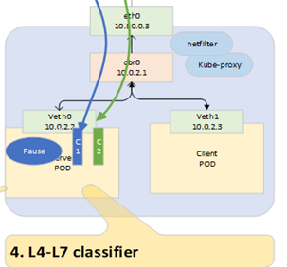
4. Container Interface Classifier: Solution
L4-L7 Classifier and forwarder in the HW
This extends the HW Offloaded vSwitch Classification End Point to the Container Interface.
Option1: HW Offload the classifier & forwarder
AF_XDP raw_socket bound to a HW vPort/QP through Side band filters.
Provide inline filters to be added in HW as part of TX packet.
ATR style in ADQ
Option2: HW Offload the Classifier
Provide a meta data classification hint to kernel/user with a packet.
Flow mark or a 32bit hash value based on L4-L7 fields.

Slide 9
3. Node: Load Balancer, DNAT, CT
Existing Solutions
Kube-proxy
Kernel Netfilters - Not performant
Iptables O(n) chains proportional to size of cluster, in-place rule modifications not possible.
IPVS O(1) - hash ipset but do not work well with other services requiring iptables for filtering
Kernel with eBF/XDP - Accelerated
Connection Tracking
Robust to syn floods but limited by max size
No flexibility, fixed hash algorithm and field selection for hash
Kernel Overall not very flexible, latencies due to irq processing, context switching, slow API configuration interfaces

Slide 10
Community’s Approach - eBPF/XDP
Benefits - Performant than the kernel
Designed as an alternative to DPDK.
Flexibility, code injected into the kernel
Ability to reload programs on-the-fly
Network Functions - Network Policy, Encryption, Load Balancer, Firewall, Monitoring etc
Plugins - Cilium, Callico, Katran (facebook), etc
Limitations -
Not HW offloadable.
Limited by performance and scalability.
Kernel/user space context switching
General purpose CPUs and Memory architecture is not ideal for Deep table Lookup
Scale in CPU usage/CPU cache with load

Slide 11
eBPF Implementation – Cilium
Cilium does connect-time load balancing by hooking into the BPF & XDP/TC hook on the receive. When a program tries to connect to a Kubernetes service, Cilium intercepts the connection attempt, load balances with DNAT’s to directly connect to the backend pod’s IP instead
Throughput in queries/s – test run with fortio and ngnix. 2 clients, 2 services
No-XDP and XDP performed similar with 1000 connections. CPU consumption in both reaches to >8 cores with more sessions
XDP path today does not take advance of hardware XDP_REDIRECT queue designed to send packet to another interface, so no significant performance gains

Slide 12
Our Approach – The H/W Datapath
Programmable MAT tables. Contract between control plane and data plane for runtime control
Device capability defined by architecture. Eg wildcard match -TCAM, Exact match-DRAM. Compiler responsible for mapping.
Parallel lookups, conditional actions & atomicity
Features are defined in the software. Faster introduction, verification, test and deployment.
Programmer defined 1) parser (parse graph); headers (inner/outer L2,L3,L4, app ) and orders 2) how the output packet will look on the wire
Counters, meters, stateful registers, hash functions, ALU, TTLs and counters per entry, PRE

Slide 13
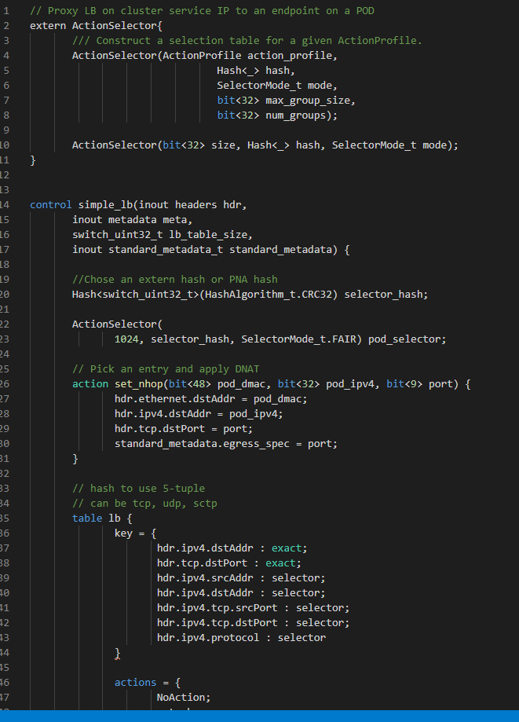
Node LB Data Plane P4

Slide 14
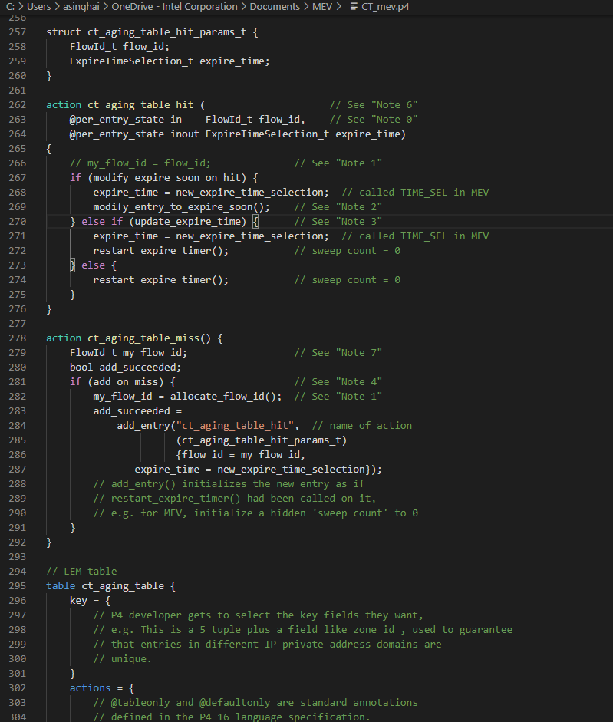
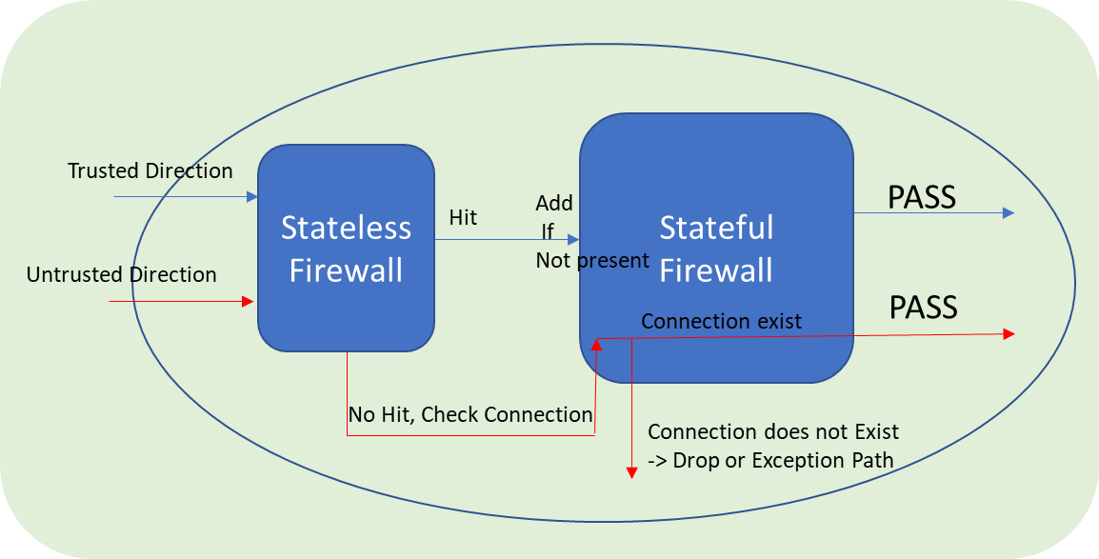
CT P4 Data Plane

Slide 15
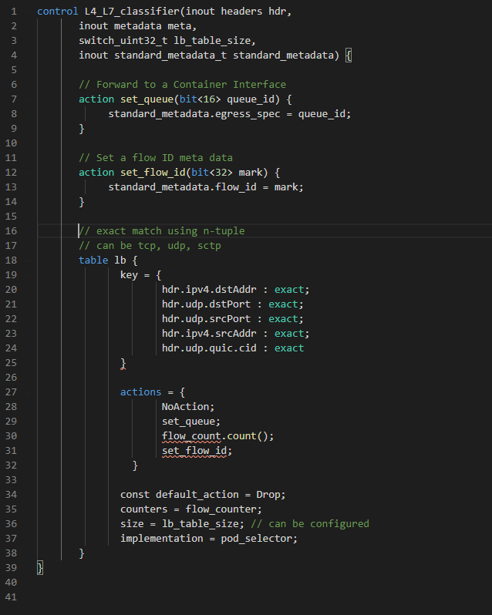
L4-L7 P4 Classifier

Slide 16
Opens
Not every eBPF program can be HW offloaded as is. We are looking at all use cases.
We would like to get community support in converting some well defined XDP implementations to p4 programs.
P4 extensions or externs is an option for complete packet transformations like Crypto, checksum, packet replication etc.

Slide 17
Conclusion:
Components for Native Scale out of Container Networking
Enhanced SW Container & Pod
Interfaces
Standard Container Control Plane SW
Platform to Support
Light-Weight Virtualization
FNIC/SNIC HW to
Support
Container Networking offload Through Programmable DP

Slide 18
Contacts
P4 Code will be on github soon…
Please email for more info…
Contacts: Anjali Singhai anjali.singhai@intel.com
Nupur Jain nupur.jain@intel.com
Intel Container Networking Team:
Anjali Singhai, Nupur Jain, Amritha Nambiar, Pawel Szymanski, Shaopeng He, Phani Burra, | Dan Daly, Yadong Li, Sridhar Samudrala, Kiran Patil, Liang Cunming , Edwin Verplanke

Slide 19
eBPF Implementation Characterization – Cilium
Stack trace (NO XDP)
Stack trace (XDP)
XDP vs No XDP, CPU utilization is quite similar
Benefits of XDP is being able to bypass the kernel stack in case of redirect.
Redirect to external port requires dedicate HW Redirect TX queue.
XDP Benefits can be derived from dedicated HW resources.

Slide 20
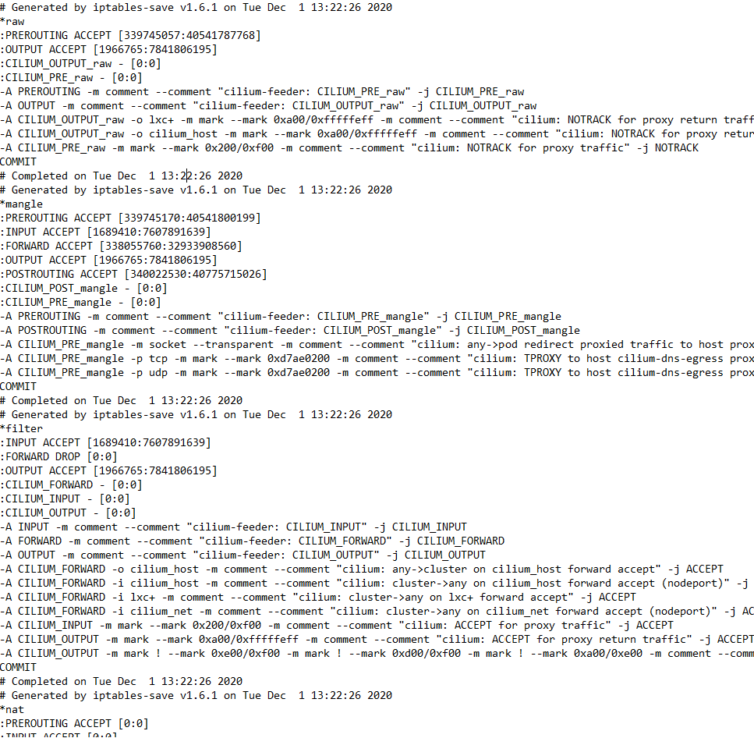
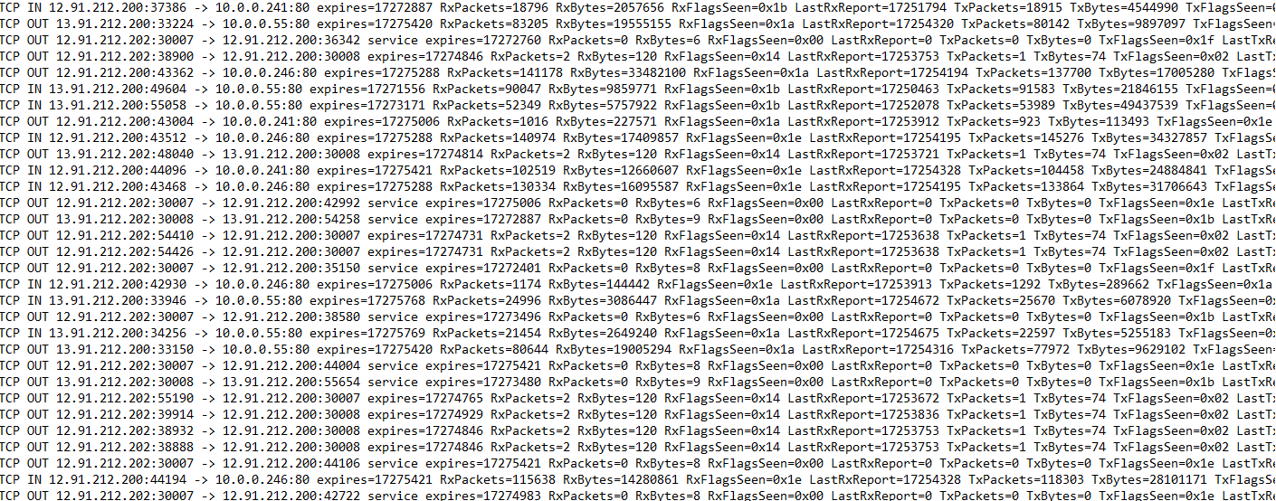
eBPF Implementation Characterization – Cilium - cont
Cilium chains in iptables
Cilium’s own conntrack table

Slide 21
Q&A

