Slide 1

Shortest Path Algorithm with Heaps
第三组
组员： 吴杰枫 秦嘉俊 黄文杰

Slide 2
目录
01. Dijkstra's algorithm
02. Fibonacci Heap
03. Binary Heap
04. Leftist Heap
05. Binomial Heap
06. Testing results & Analysis

Slide 3
01
Dijkstra's algorithm

Slide 4
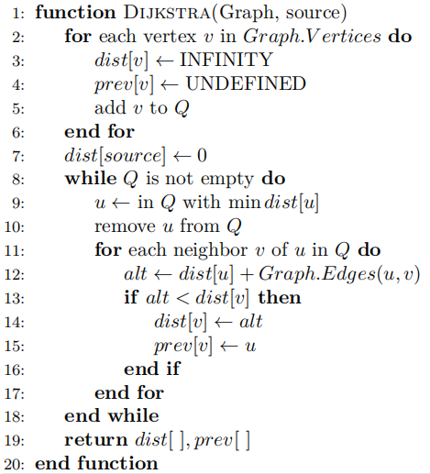
Dijkstra's algorithm
1.Initialization
2.search for theminimum
3.Update the distance
4.Repeat the steps(2-3) above

Slide 5
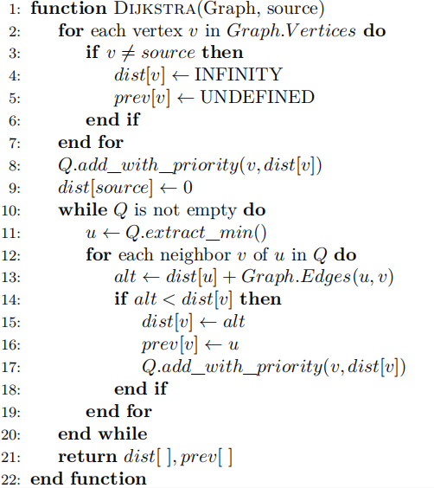
Heap Optimization
the time complexity of finding min dist[u]
O(n)
O(logn)
the total time complexity
O(n^2)
O(nlogn)

Slide 6
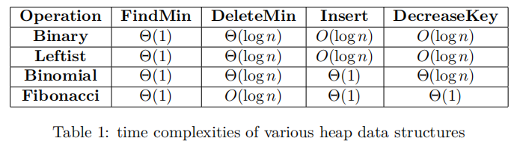
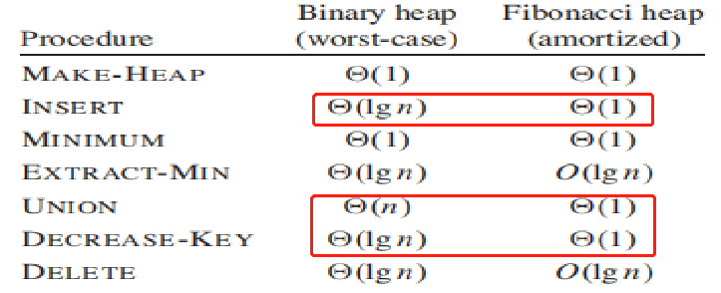
Four heaps
·Fibonacci Heap
·Binary Heap
·Leftist Heap
·Binomial Heap

Slide 7
02
Fibonacci Heap

Slide 8
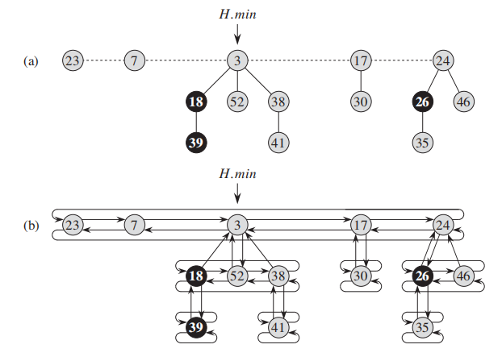
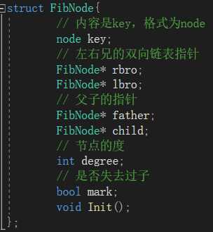
Fibonacci Heap
·Define
A Fibonacci heap is a collection of a series of rooted trees with a minimum heap order (min-heap ordered).
·The structure of the node
·key
·father（父结点）
·child（子结点）
·rbro、lbro（左右兄弟结点）
·degree（结点的度）
·mark（用于标记是否失去过孩子）

Slide 9
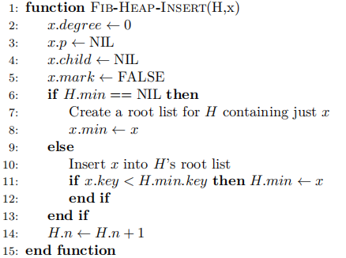
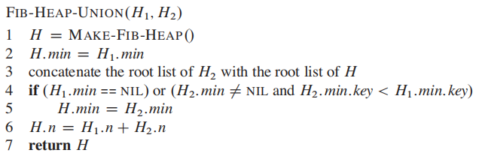
Fibonacci Heap Operations
• MAKE-HEAP
• INSERT
·UNION
Allocates and returns the Fibonacci heap object H,
where H.n = 0 and H.min = NIL
·MINIMUM
The minimum node of a Fibonacci heap H is given by the pointer H.min。

Slide 10
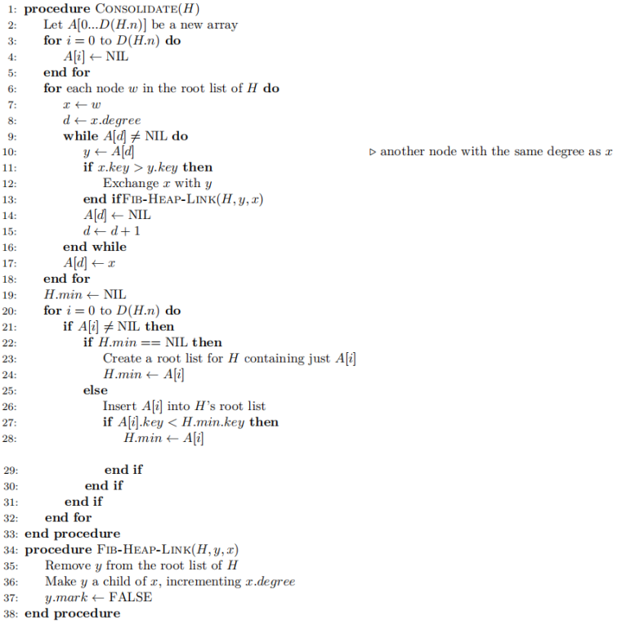
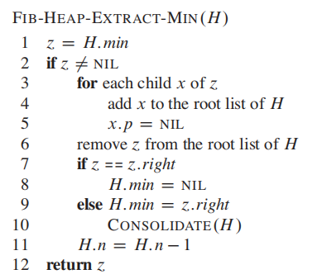
Fibonacci Heap Operations
• EXTRACT-MIN
01.First making a root out of each of the minimum node’s children and removing the minimum node from the root list.
02.Then consolidates the root list by linking roots of equal
degree until at most one root remains of each degree.
03.Finally consolidating the root list of H

Slide 11
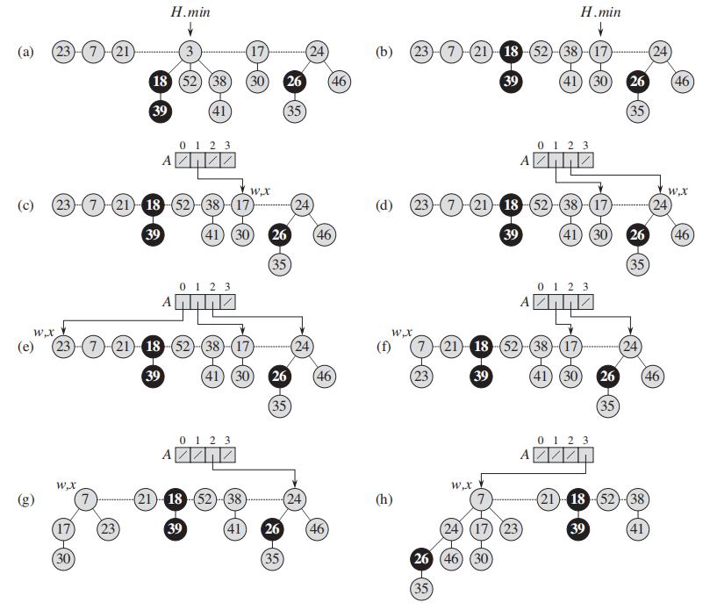
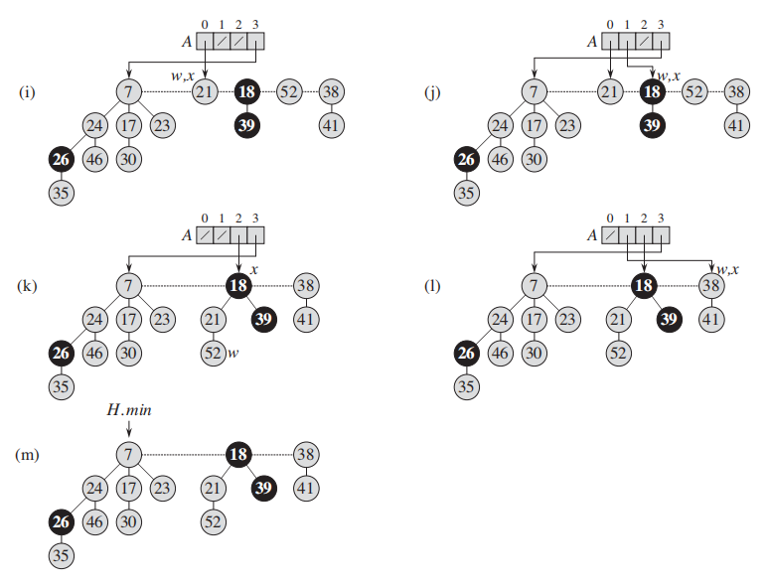
• CONSOLIDATE

Slide 12
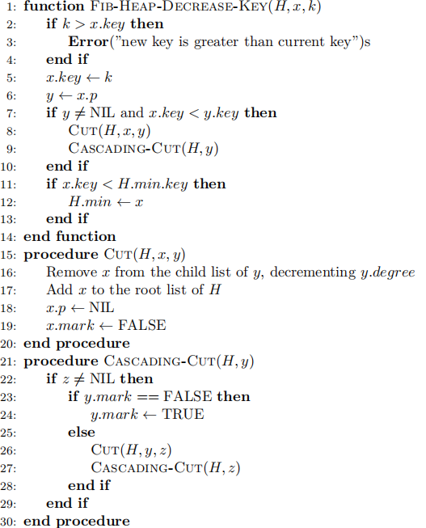
Fibonacci Heap Operations
·DECREASE-KEY
min-heap order be violated
The CUT procedure “cuts” the link between
x and its parent y, making x a root.
The CASCADING-CUT procedure recurses its way up the tree until it finds either a root or an unmarked node.

Slide 13
03
Binary Heap

Slide 14
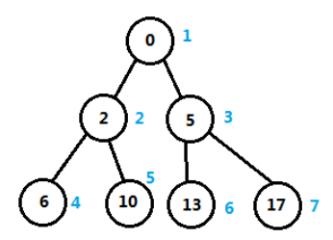
Binary Heap
·Define
Shape property: a binary heap is a complete binary tree. Except the deepest level, all internal nodes are fully filled, and the nodes of the deepest level are filled from left to right.
Heap property: the key stored in each node is either greater than or equal to (max-priority) or less than or equal to (min-priority) the keys in the node’s children, according to some total order.
For convenience, we use the STL priority_queue to achieve binary heap

Slide 15
04
Leftist Heap

Slide 16
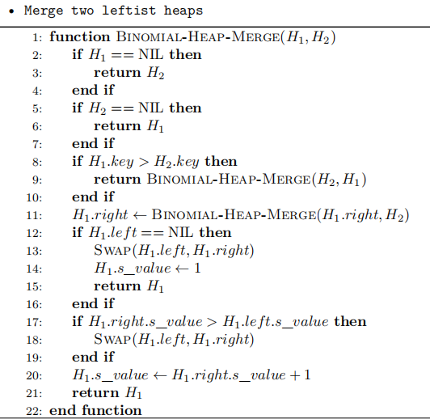
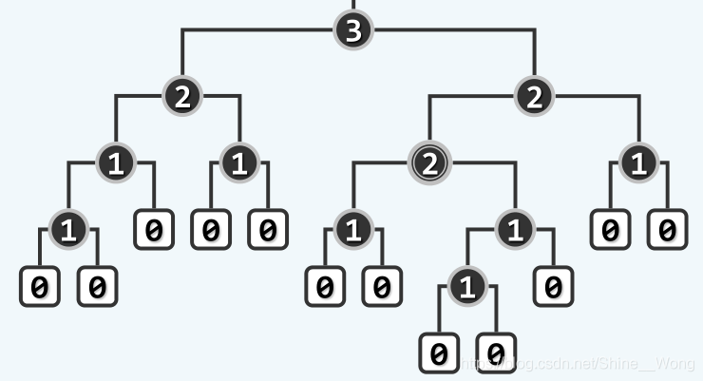
Leftist Heap
·Define
· common operation
The null path length, Npl(X), of any node X is the length of the shortest path from X to a node without two children
The leftist heap property is that for every node X in the heap, the null path length of the left child is at least as large as that of the right child.

Slide 17
05
Binomial Heap

Slide 18
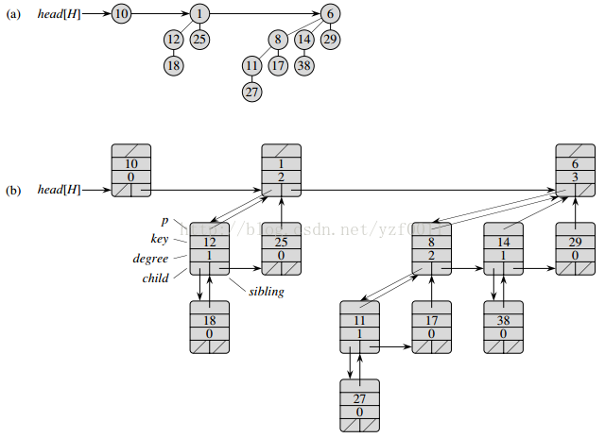
Binomial Heap
·Define
A binomial heap is implemented as a set of binomial trees , which are defined recursively as follows
A binomial tree of order 0 is a single node
A binomial tree of order k has a root node whose children are roots of binomial trees of orders k − 1, k −2, . . . , 1, 0.

Slide 19
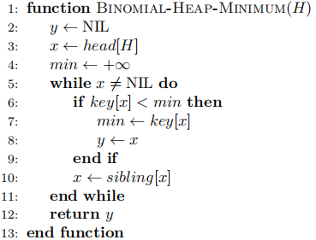
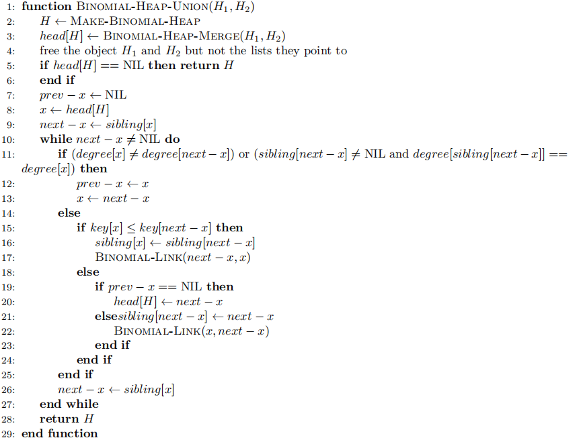
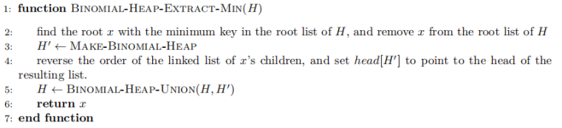
Some Common Operations
·MINIMUM
·UNION
• EXTRACT-MIN

Slide 20
06
Testing results & Analysis

Slide 21
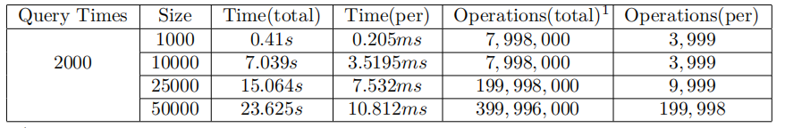
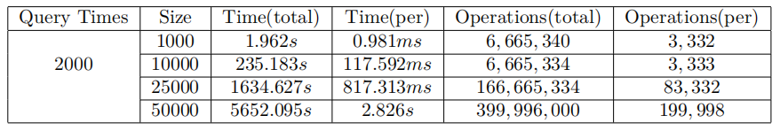
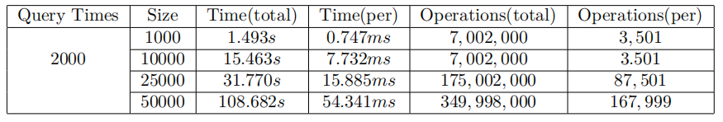
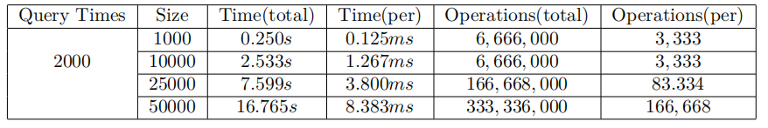
Running Time Table
1.Binary Heap
2.Fibonacci Heap
3. Binomial Heap
4.Leftist Heap

Slide 22
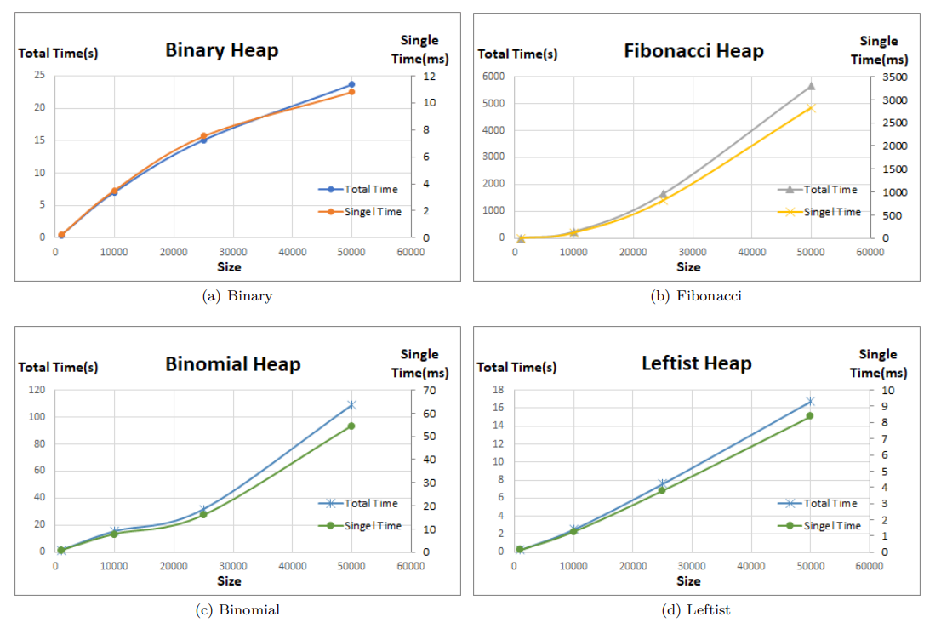
Running Time Diagram

Slide 23
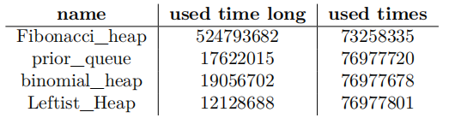
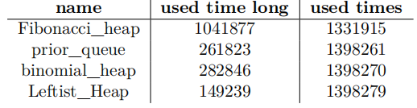
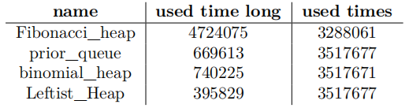
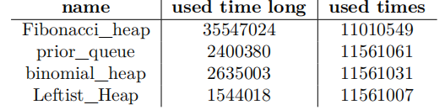
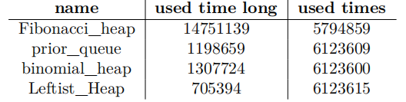
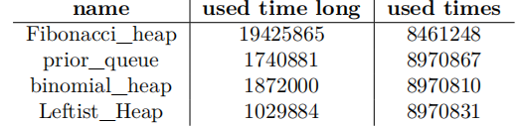
Test the USA Road Networks
1.USA(23,947,347 nodes and 58,333,344 arcs)
2.COL(435,666 nodes and 1,057,066 arcs)
3.FLA(1,070,376 nodes and 2,712,798 arcs)
4.E(3,598,623 nodes and 3,598,623 arcs)
5.CAL(1,890,815 nodes and 1,890,815 arcs)
6.LKS(2,758,119 nodes and 6,885,658 arcs)

Slide 24
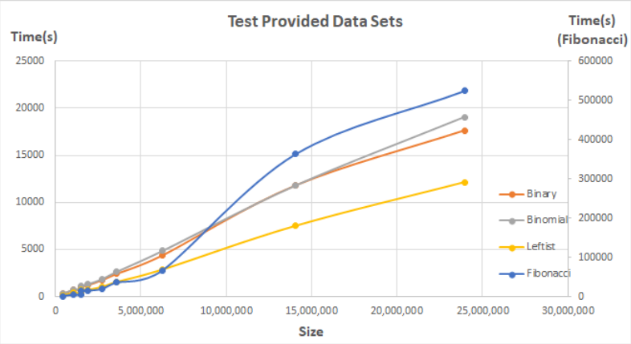
Run Time Diagram For USA Roads Test
Actual Result：
Best
Worst
Leftist heap
Fibonacci heap
Tips：since the time of Fibonacci is far greater than the other three heaps, we use a different axis for Fibonacci heap.

Slide 25
Analysis
Time Complexity
• For Dijkstra’s algorithm with a binary heap, a binomial heap or a leftist heap
Time complexity is O((E + V )log V ), where E is the number of edges and V is the number of vertices in the graph.
• For Dijkstra’s algorithm with a Fibonacci heap
Time complexity is O(E + V log V ), where E is the number of edges and V is the number of vertices in the graph.

Slide 26
Analysis
Space Complexity
In Dijkstra with heap optimization, space complexity is O(V + E), where E is the number of edges and V is the number of vertices in the graph.
Summary
Fibonacci heap has a better time complexity than binary heap for some operations, including decrease key and merge.
However, in practice, Fibonacci heap may not always be the best choice for Dijkstra’s algorithm due to its higher constant factor and more complex implementation compared to binary heap

Slide 27
References
[1] T. H. Cormen, C. E. Leiserson, R. L. Rivest, and C. Stein. Introduction to algorithms, third edition. In Single-Source Shortest Paths, chapter 24. The MIT Press, 3rd edition, 2009.
[2] T. H. Cormen, C. E. Leiserson, R. L. Rivest, and C. Stein. Introduction to algorithms, third edition. In Binomial Heaps, chapter 19. The MIT Press, 3rd edition, 2009.
[3] T. H. Cormen, C. E. Leiserson, R. L. Rivest, and C. Stein. Introduction to algorithms, third edition. In Fibonacci Heaps, chapter 20. The MIT Press, 3rd edition, 2009.
[4] G. R. ff. A. L. in C++. Graph Representation – Adjacency List in C++.
[5] M. A. Weiss. Data structures and algorithm analysis in c (2nd ed.). In Priority Queues(Heaps), chapter 6.Addison-Wesley Longman Publishing Co., Inc., USA, 1996.
[6] M. A. Weiss. Data structures and algorithm analysis in c (2nd ed.). In Amortized Analysis, chapter 11.Addison-Wesley Longman Publishing Co., Inc., USA, 1996.

Slide 28
THANKS

