Slide 1
6 THE TRANSPORT LAYER
TASK OF THE TRANSPORT LAYER：
  To provide reliable,cost-effective data transport from the source machine to the destination machine

Slide 2
6.1 THE TRANSPORT SERVICE
6.1.2 Transport Service Primitives
  Differences between transport service and network service
    The network service is generally unreliable, the connection-oriented transport service , in contrast, is reliable
    Different objects of the services:
      network service: transport entity
      transport service: application program and programmer
    Data transfer on network layer is much more difficult than on transport layer
  The primitives for a simple transport service-[see fig 6-2]
  Transport Protocol Data Unit(TPDU)
  Nesting of TPDUs, packets, and frames-[see fig 6-3]

Slide 3
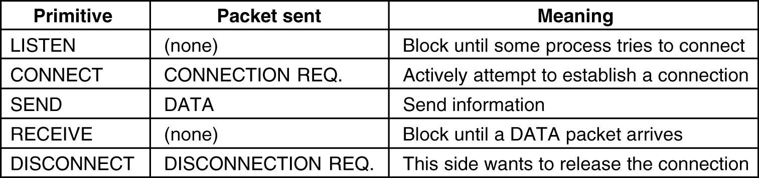
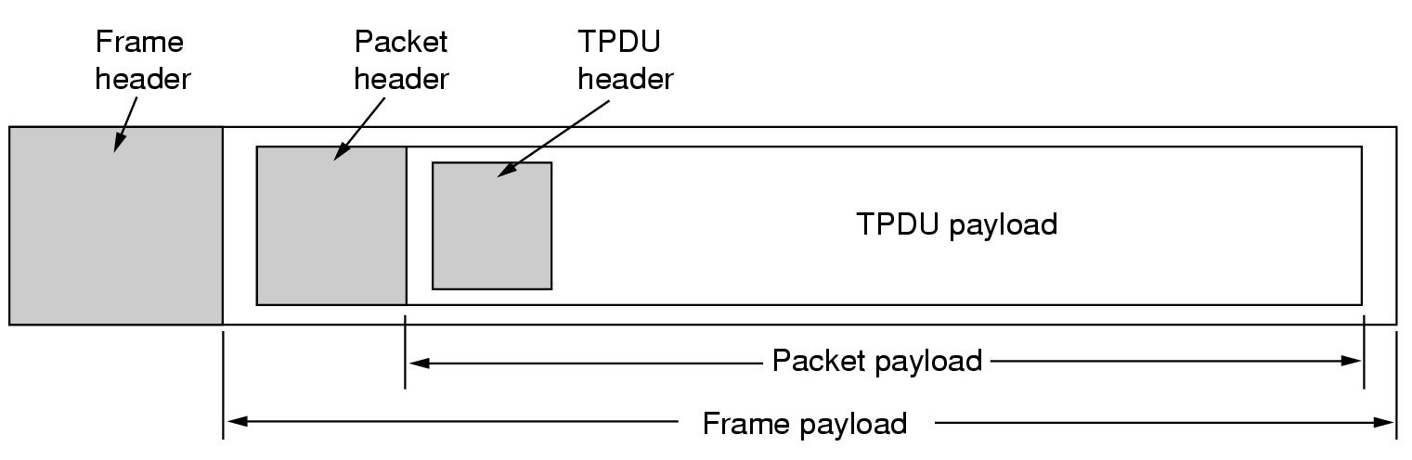
Fig. 6-2. The primitives for a simple transport service.
Fig. 6-3. Nesting of TPDUs,packets,and frames.
back

Slide 4
6.1 THE TRANSPORT SERVICE
  Disconnection has two variants：
    Asymmetric: one side does a disconnection, and the entire connection is closed.
    Symmetric: each side does a disconnection, one direction of connection is closed.
  Connection establishment and release-[see fig 6-4] show

Slide 5
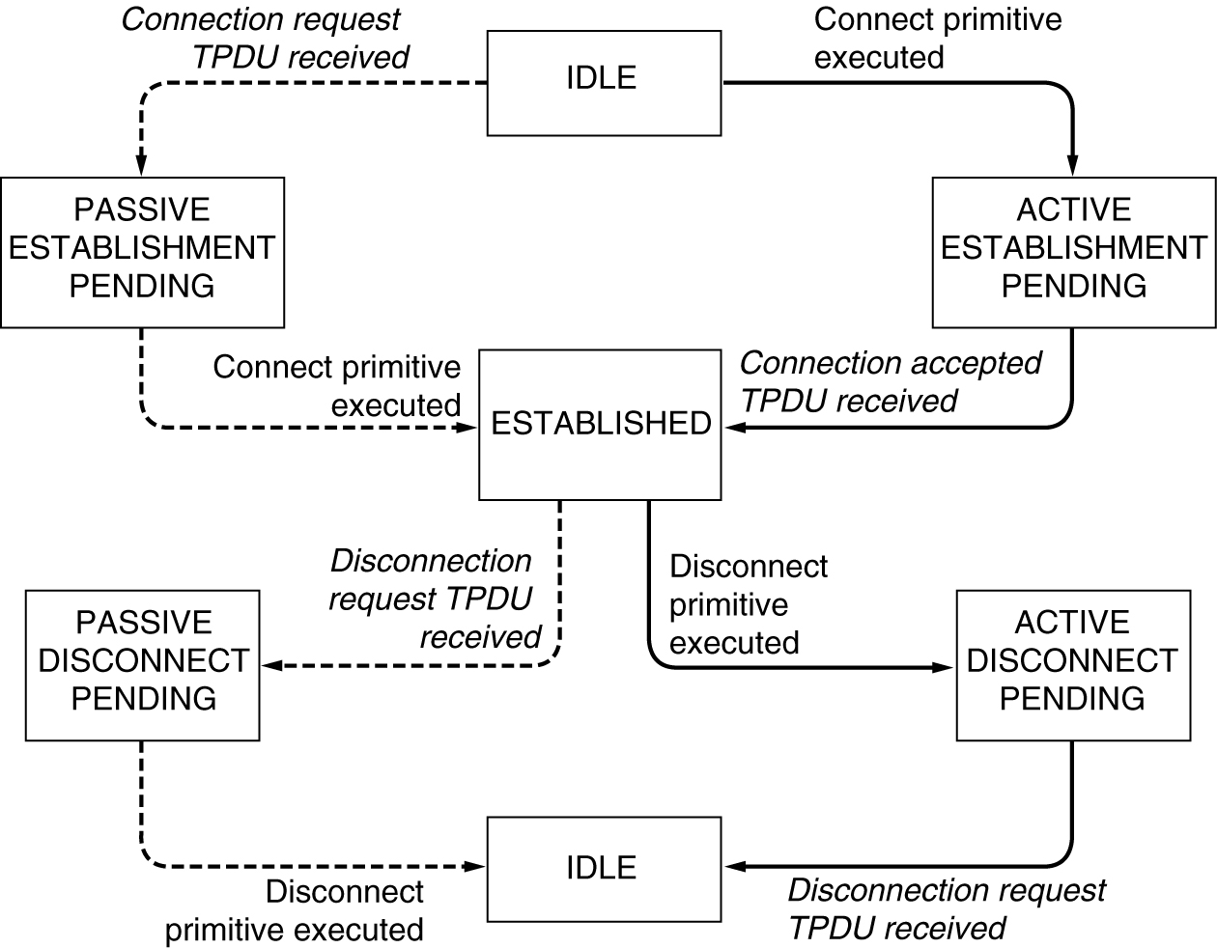
Fig. 6-4. A state diagram for a simple connection management scheme. Transition labeled in italics are caused by packet arrivals. The solid lines show the client’s state sequence. The dashed lines show the server’s state sequence.
back

Slide 6
6.1.3 Berkley Sockets(用于Unix的TCP中）-[see fig 6-5]
Primitive | Meaning
SOCKET | Create a new communication end point
BIND | Attach a local address to a socket
LISTEN | Announce willingness to accept connections; give queue size
ACCEPT | Block the caller until a connection attempt arrives
CONNECT | Actively attempt to establish a connection
SEND | Send some data over the connection
RECEIVE | Receive some data from the connection
CLOSE | Release the connection
Fig. 6-5. The socket primitives for TCP.
back

Slide 7
6.1.3 Berkley Sockets(用于Unix的TCP中）-[see fig 6-5]
Primitive
Meaning
SOCKET
Not block
BIND
Not block
LISTEN
Not block
ACCEPT
Block until a connection attempt arrives
CONNECT
Not block
SEND
Not block
RECEIVE
Block if no data available
CLOSE
Not block
Fig. 6-5. The socket primitives for TCP.
back

Slide 8
6.1 THE TRANSPORT SERVICE
6.1.4 An Example of Socket Programming:An Internet File Server -[see fig 6-6]
  Server code using sockets. show
    Create socket
    Bind socket
    Listen socket
    Accept: Block waiting for an incoming connection, and process it
  Client code using sockets. Show
    Useage:
      Client flits.cs.vu.nl /usr/tom/myfile > f
    Create socket
    Connect socket
    Send file name and get the file

Slide 9
gethostbyname(“flit.cs.vu.nl”)-->192.31.231.65
struct sockaddr_in {
    short sin_family; //2 byte e.g. AF_INET
    unsigned short sin_port; // 2 byte, e.g. 80
    struct in_addr sin_addr; // 4 byte, e.g. 8.32.4.51
    char sin_zero[8]
    }
struct sockaddr is similar to struct sockaddr_in.
INADDR_ANY: 0, its type is long (4 byte).
htonl(0x11223344) --> 0x44332211, in PC (little endian)
htons(0x7788) --> 0x8877, in PC (little endian)

Slide 10
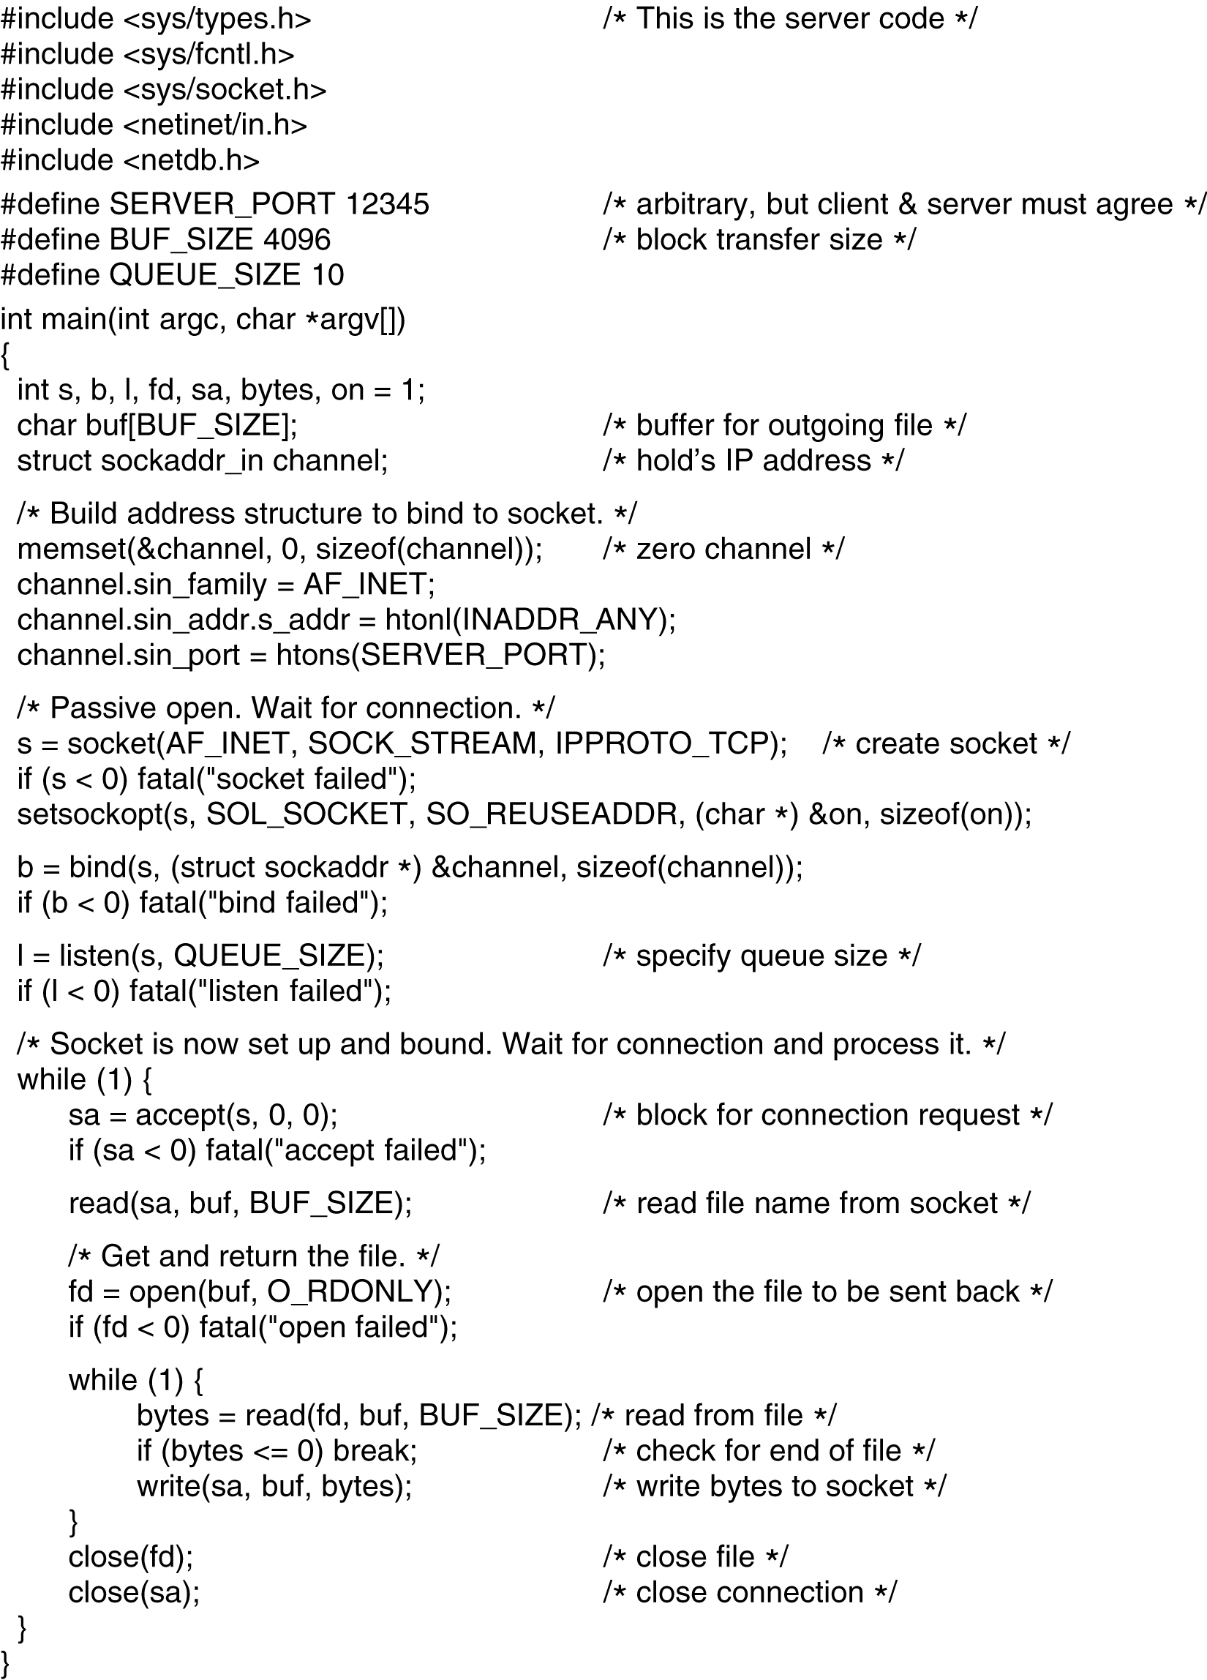
back
Fig. 6-6. Server code using sockets.

Slide 11
back
Fig. 6-6. Server code using sockets.

Slide 12
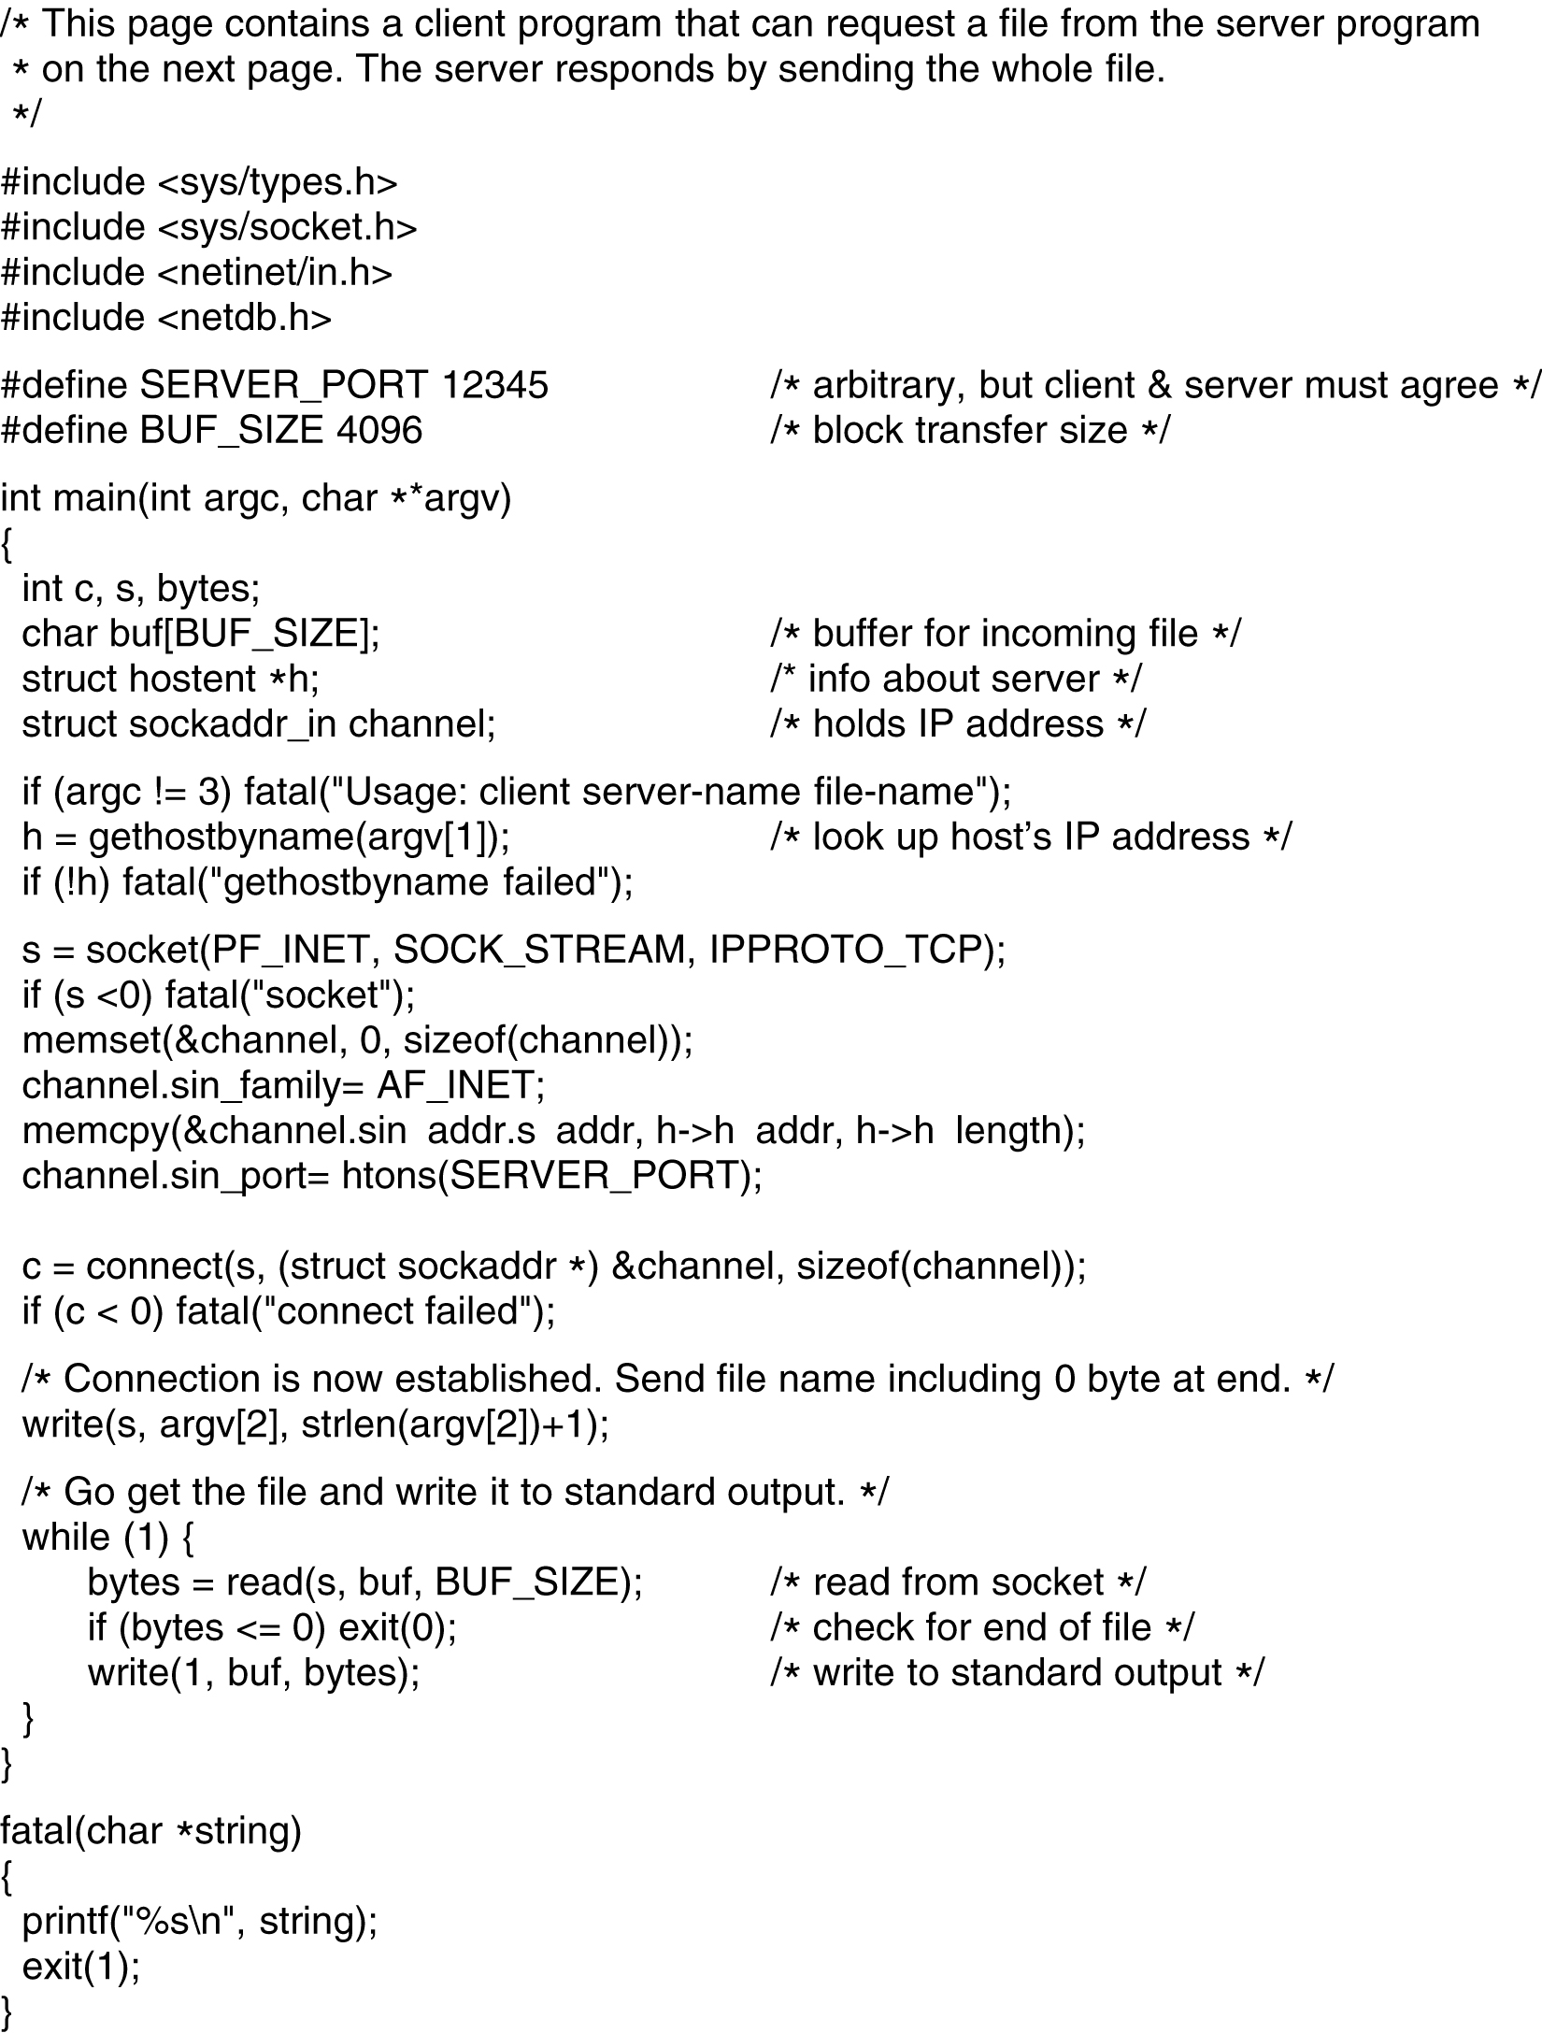
back

Slide 13
Fig. 6-6. Client code using sockets.
back

Slide 14
6.2 ELEMENT OF TRANSPORT PROTOCOLS
6.2.2 Connection Establishment
  A complex process：the existence of delayed duplicates
  Solution ：three-way handshake-[see fig 6-11] show
    To solve the problems of delayed duplicate control TPDUs and its duplicate ACK
  Two-way handshake will result in half-connection.
    One side of a connection is open while the other side is close;
    This will waste resource.

Slide 15
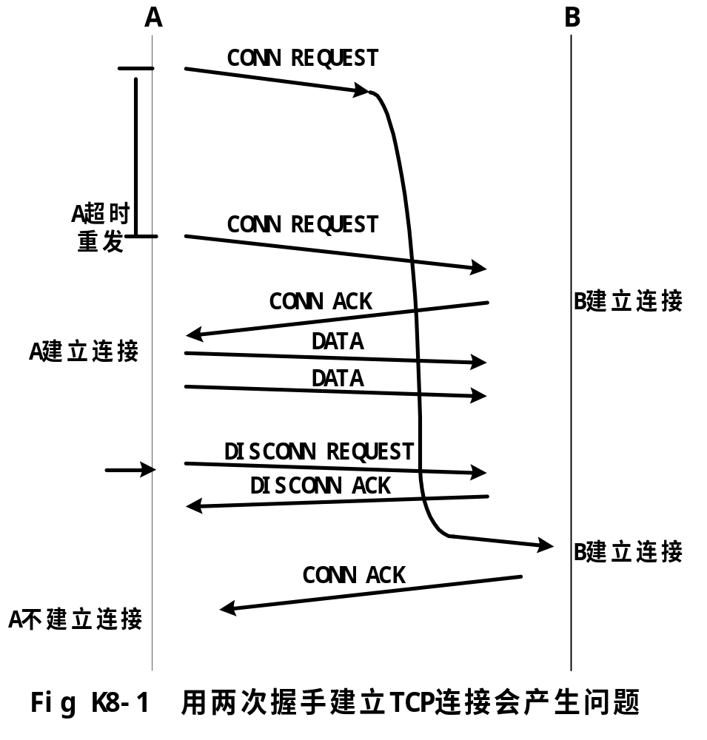
(补充)

Slide 16
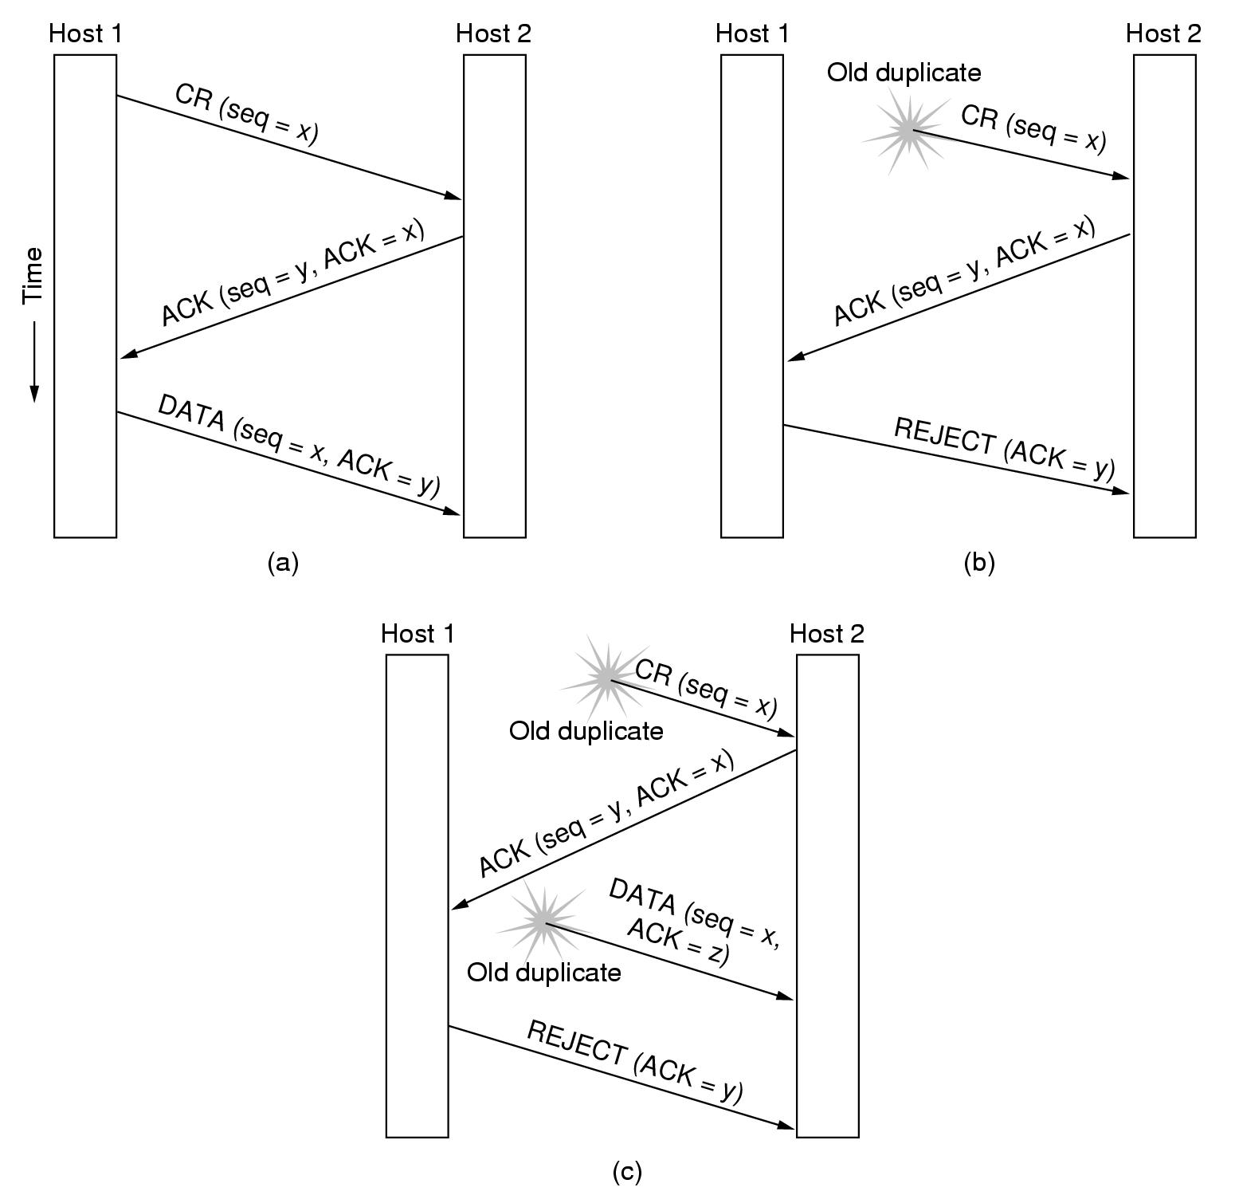
Fig. 6-11. Three protocol scenarios for establishing a connection using a three-way handshake.CR denotes CONNECTION REQUEST.(a)Normal operation.(b)Old duplicate CONNECTION REQUESED appearing out of nowhere.©Duplicate CONNECTION REQUEST and duplicate ACK.
back

