Slide 1


Slide 2
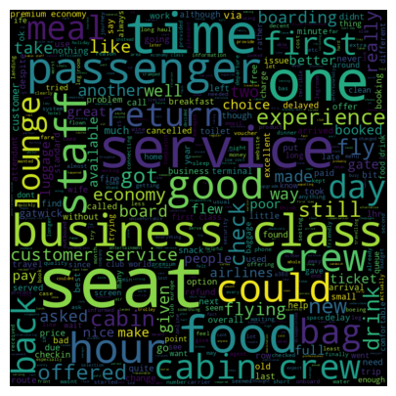
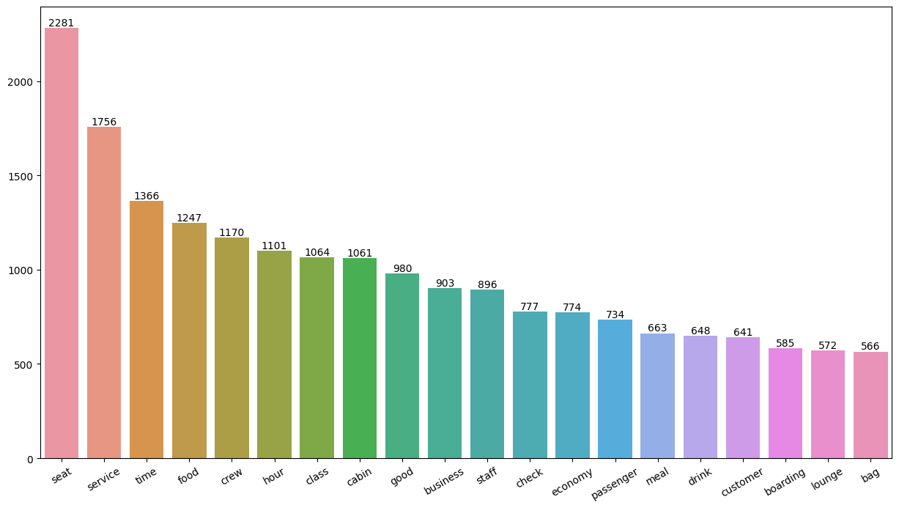
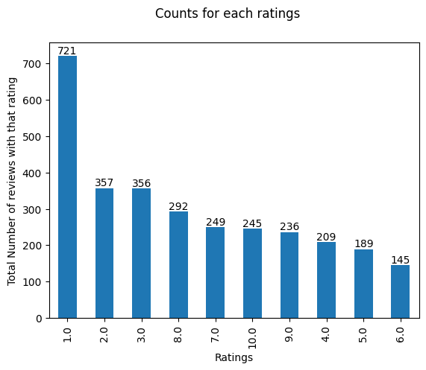
Average Overall Rating → 4.60/10
Total Countries → 67
Total Reviews → 3000
What stands out for customers and what doesn’t for different ratings distributions :
7-10 ratings people wrote about comfortable seats, good inflight entertainment, descent food quality
4-6 ratings people were not satisfied due to small entertainment screen, longer wait for passport check, bad business class experience
1-30 ratings people overall bad experience due to congested seating, small screen and limited food options
Most Passengers liked cabin crew service, food,
seats and extra leg room. Many travelled in Business Class
More Focus On – Economic class seats, enhancing inflight entertainment experience also the delays.
Enhance the experience of Business class as customer need value for money. Also improving the customer service on refund request and process

