Slide 1


FINAL PRESENTATION
Date: 04-20-2022

Slide 2
Schedule
Team presentation
Description of the problem to solve
Proposed solution
Solution explanation
Conclusions

Slide 3
Work team
Project Manager: Alcocer Durán Ángel Yazveck
Client: Hugo Omar Alejandres Sánchez
Members :
1 - Campos Salgado Rodolfo Fabian
2 - Jimenez Pascual Kemish Mahonri
3 - Mendoza Luna Max
4 - Torres Gatica Erick Nahum
5 - Villalobos Hernández Diego Araith

Slide 4


Problem to solve
Our client has asked us for help in solving his problems, he told us that the control and monitoring of his plants is important to him, however, he believes that the best thing is to know the different aspects related to them, so that they can have a long live and he can know when to meet their needs.

Slide 5

Proposed solution
We proposed the creation of an IoT prototype that would serve as an irrigation and control system for the temperature, humidity of the air and the soil of the plants, ensuring that it can be capable of performing different actions through the use of an application mobile, such actions would be the irrigation of the plants, the sampling of the data obtained, the total control of the system and the user who wishes to administer his own system.
It will be carried out through the IoT communication protocol known as MQTT for the manipulation of the embedded system, the React software and language will be used to cover the part of the mobile application, as well as the registered data will be saved within the manager of MySQL database.

Slide 6

Proposed solution
It should be noted that the importance of our project is the practical development involved in making an embedded system that can control different aspects related to the use of sensors and microcontrollers, having the opportunity to take it to a larger scale and that it can be used in the future for a bigger project.

Slide 7
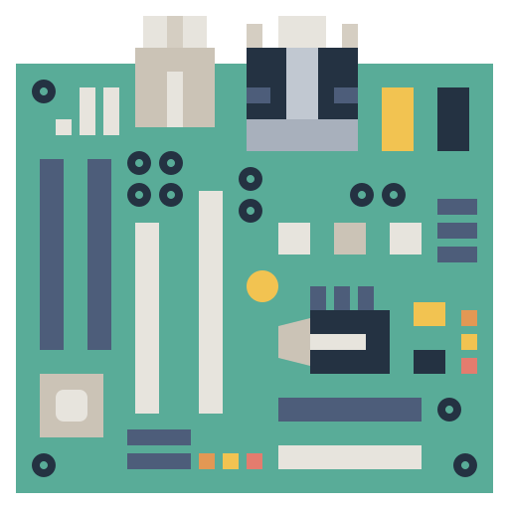




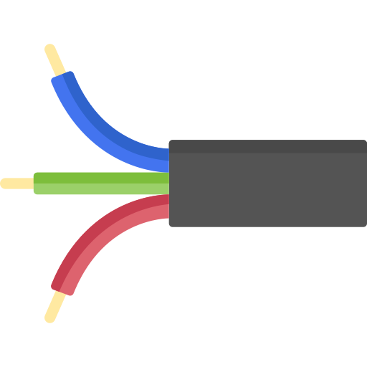
Solution explanation
Let’s show the project!

Slide 8

Final conclusions
As we have been able to verify, it must be admitted that it was a project that really tested our knowledge and skills acquired during the quarter in question, however, despite the complexity and adversities, we managed to successfully complete the project, taking it as a new experience and a great achievement in our lives, since it can be guaranteed that the client's need was solved and the problem was successfully covered.

