Slide 1
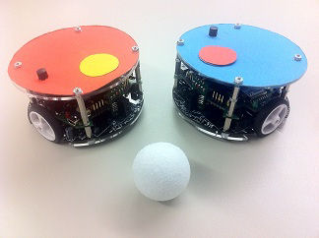
RoboSoccer Laboratory
Project Plan – Team C
Quoc-Nam Dessoulles
Duc Tung Dinh
Isabelle Janscha
Shu Liu
Chiraz Nafouki
Source: http://www.rcs.ei.tum.de/en/Lehre/Labs/pr_rs/

Slide 2

Objectives
Main goal: Win the Championship!
Essential: Have a working implementation by 06/07/15
Document the robots behaviour and limits by 04/05/15
Define an « efficient » and realistic strategy by 09/05/15
Make a suited code design by 11/05/15
Implement and test a first working version by 08/06/15
Read about adaptive algorithms and design an implementation by 29/06/15
… here comes the planning!
In addition: Improve our management / development skills
Understand the basics of SVN (commits, branches, merging) at the end of the project
Know the fundamentals of OOP / C++ at the end of the project
…

Slide 3

Team organization
PM: Quoc-Nam Dessoulles
QM: Shu Liu
CD: Tung Dinh
D1: Chiraz Nafouki
D2: Isabelle Janscha

Slide 4
Team organization
Project Manager (PM): Planning, work distribution, deadlines control, report, etc.
Quality manager (QM): Tests, compliance check, documentation, etc.
Chief Developer (CD): Main design, code control, debug help, etc.
Developers (D1/D2): Implementation, supervised by the CD.

Slide 5

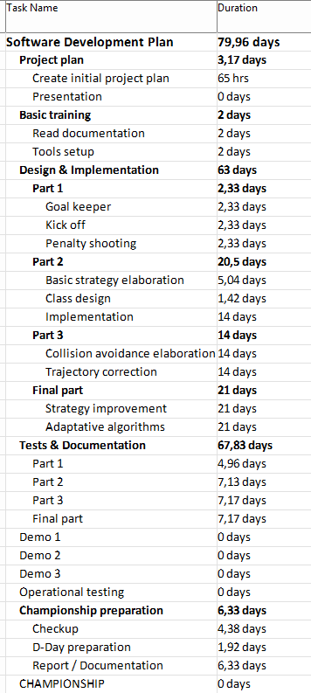
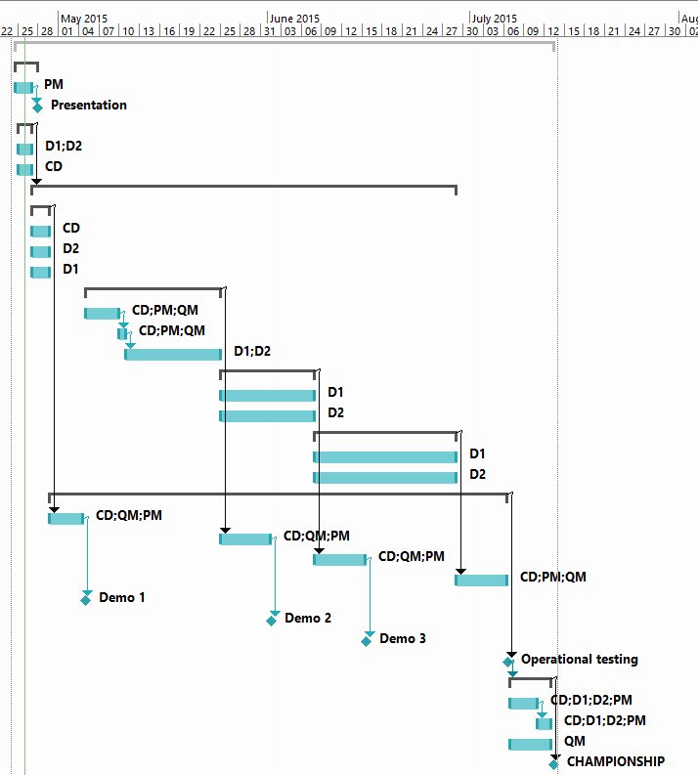
Planning

Slide 6
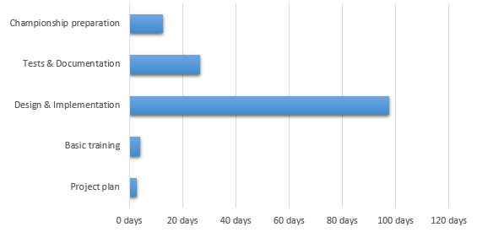
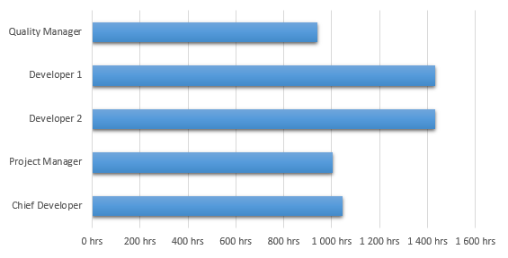
Planning
Summed duration of all phases
Theoretical work repartition

Slide 7

See you at the Championship!

