Slide 1
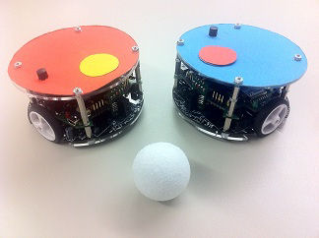
RoboSoccer Laboratory
Project Plan – Team C
Quoc-Nam Dessoulles
Duc Tung Dinh
Isabelle Janscha
Shu Liu
Chiraz Nafouki
Source: http://www.rcs.ei.tum.de/en/Lehre/Labs/pr_rs/

Slide 2

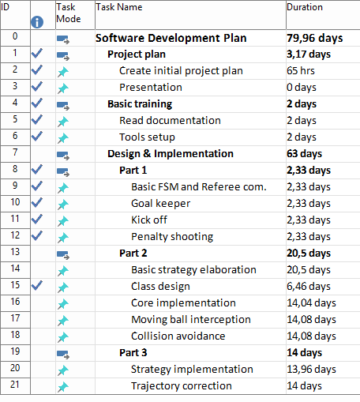
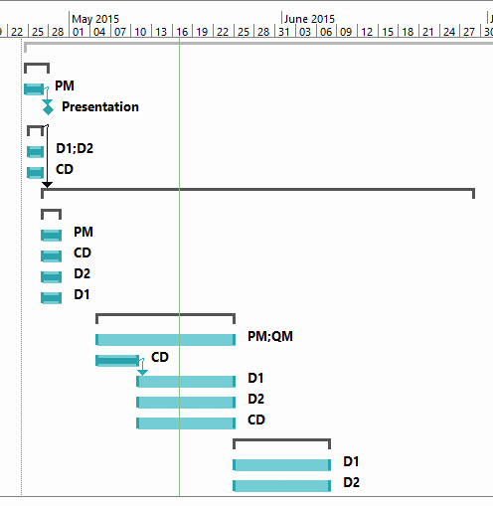
Reminder: Planning

Slide 3

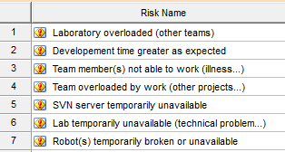
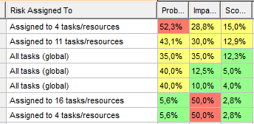
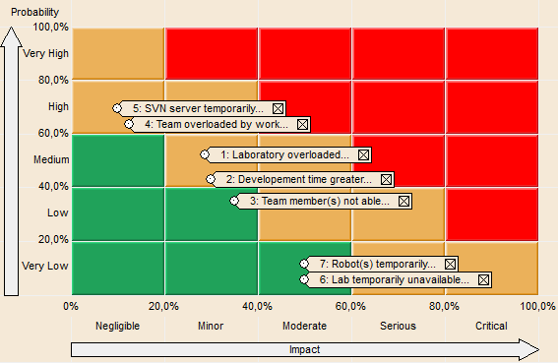
Risk analysis
Risks and
Risk matrix

Slide 4
Implementation risks analysis
Penalty shootout risks | Consequences | Level
Moving too slow | If the shooter is moving too slowly, the Kick will be too slow and the enemy goal keeper will easily stop the ball. Moreover, the trajectory of a slow ball is quite random, so the accuracy of the shooting becomes lower. | High
Moving not accurate | If the moving of the shooter is not accurate, it could miss the ball or hit it the wrong way, and thus miss the goal. | High
Targeting system not accurate | If the targeting system does not work well, the goal could be missed. However, a simple straight kick to the ball ensures in any case a high probability of targeting more or less correctly. | Medium
Inability to avoid enemy goal keeper | The shooter efficiency could be improved by making it avoiding the enemy goal keeper. However, inaccuracies in the system we used already ensure us some randomness when kicking, so this is not a requirement. | Low
Goal Keeper risks | Consequences | Level
Moving too slow | If the goal keeper is moving too slowly, it will not be able to efficiently prevent goals. | High
Moving not accurate | If the moving of the goal keeper is not accurate, the ball could go into the goal even if the goal keeper should prevent it. | Medium
Trajectory prevision not accurate | If the trajectory prevision does not work correctly, the goal keeper will not be efficient and will only prevent some of the goals. | Medium
Inability to drive backwards | The goal keeper efficiency can be greatly improved if it is able to drive forwards and backwards. However, this is not a requirement. | Low
Position risks | Consequences | Level
Wrong side | If the side is wrong, we cannot start the game… | High
Collision avoidance not effective | If the robots cannot avoid each other when moving to the initial position, they could collide and this would require a human intervention. | Medium
Moving too slow | If the robots are moving too slowly, it will become boring… However, this does not prevent the game from starting. | Low

Slide 5

Product Requirements
Req – 1 Kick off positioning
Req – 2 Penalty shooting
Req – 3 Goalkeeping
Req – 4 Collision avoidance
Req – 5 Moving ball interception
Req – 6 Shooting goal
Req – 7 Stop enemy take the ball

Slide 6

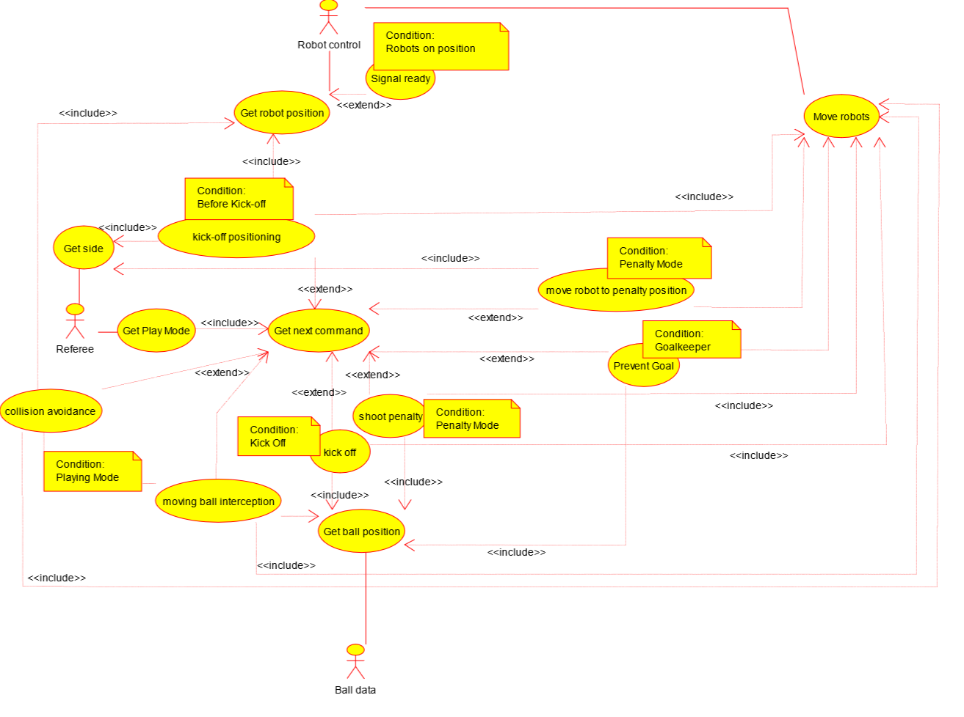
Use Case Diagram

Slide 7
Function Specifications
Req – 4 Collision avoidance
Req – 4-1 Get positions of all robots
Req – 4-2 Move robot around barriers
Req – 5 Moving ball interception
Req – 5-1 Get position of the ball
Req – 5-2 Calculate „ball-vector“
Req – 5-3 Move robot to calculated position
Req – 5-4 Shoot the ball back
Req – 1 Robots go to „Kick off positioning“
Req – 1-1 Get actual robot position
Req – 1-2 Move robots to kick off position
Req – 2 Penalty shooting
Req – 2-1 Get ball position
Req – 2-2 Get goal position
Req – 2-3 Calculate good angle to shoot
Req – 2-4 Move robot to calculated position
Req – 2-5 Shoot a goal
Req – 3 Goalkeeper prevent goal
Req – 3-1 Get ball position
Req – 3-2 Calculate way of the ball
Req – 3-3 Move robot to calculated position to defend the goal

Slide 8
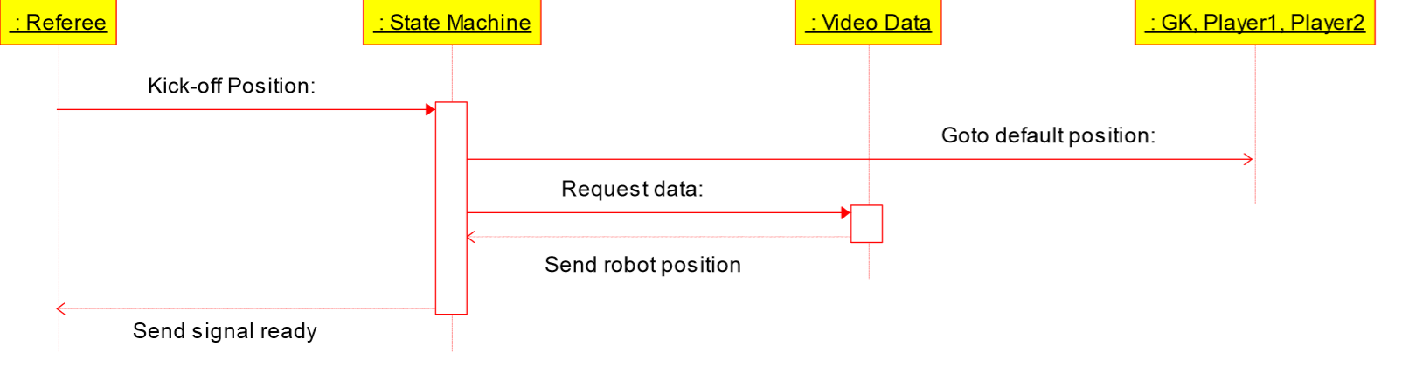
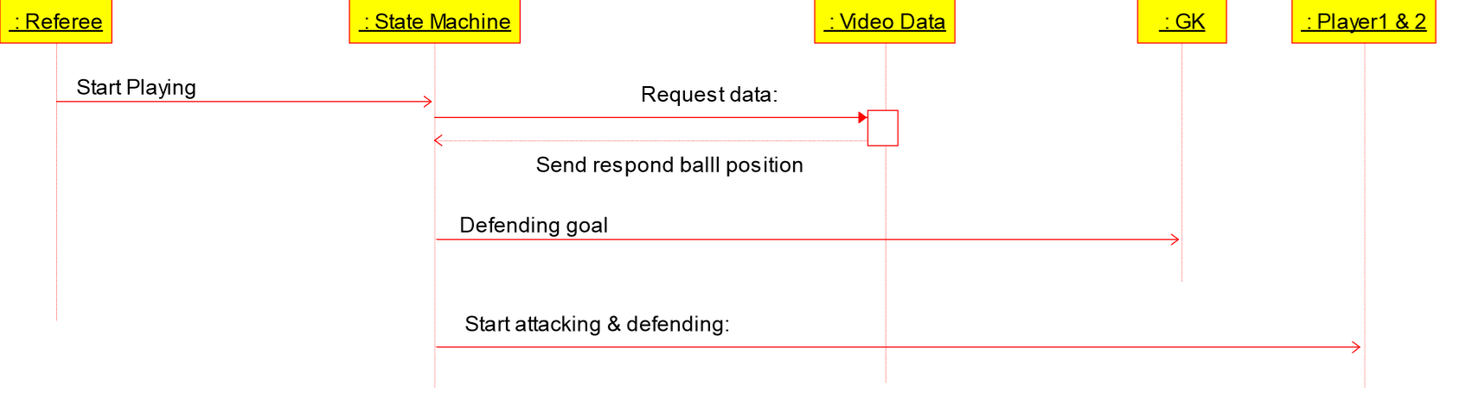
Sequences diagrams
Kick off
Playing mode

Slide 9
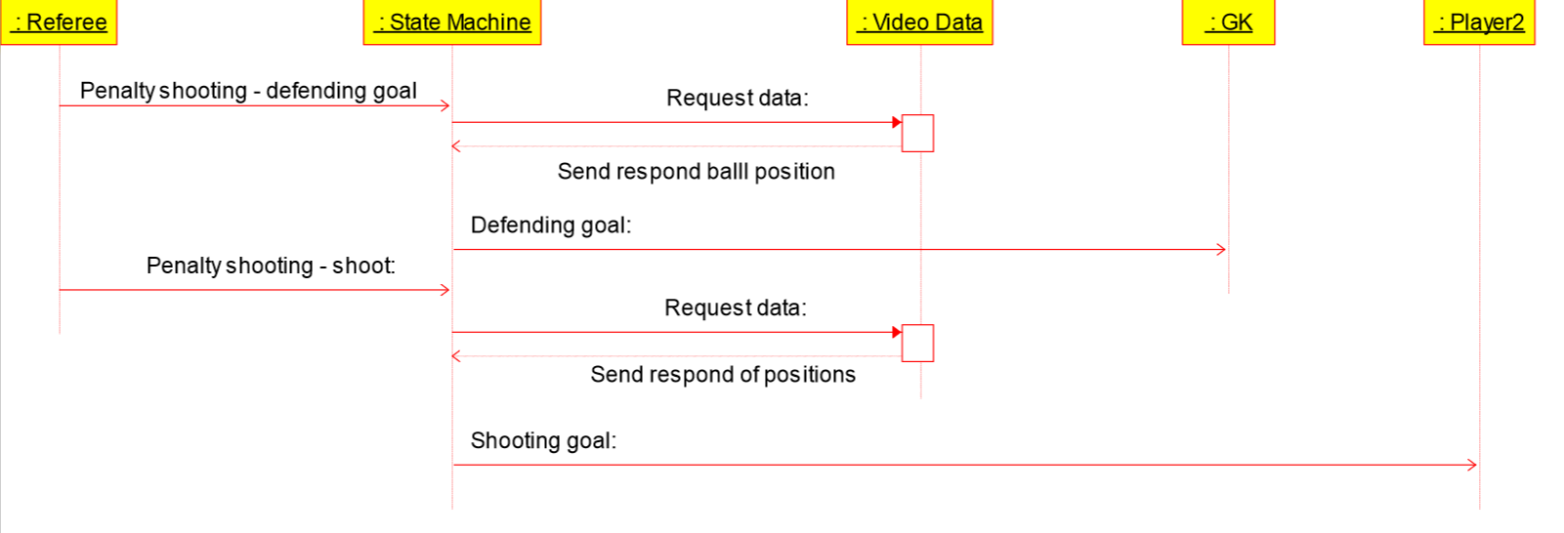
Sequences diagrams
Penalty shooting

Slide 10

See you at the Championship!

