Slide 1
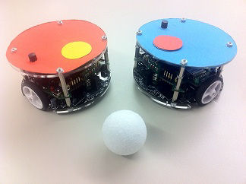
RoboSoccer Laboratory
Project Plan – Team C
Quoc-Nam Dessoulles
Duc Tung Dinh
Isabelle Janscha
Shu Liu
Chiraz Nafouki
Source: http://www.rcs.ei.tum.de/en/Lehre/Labs/pr_rs/

Slide 2

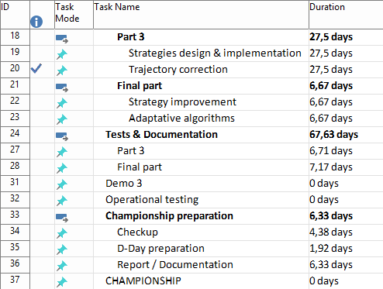
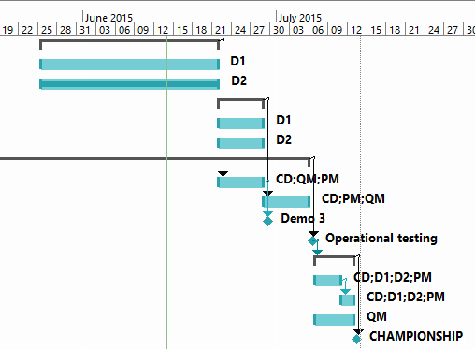
Reminder: Planning

Slide 3

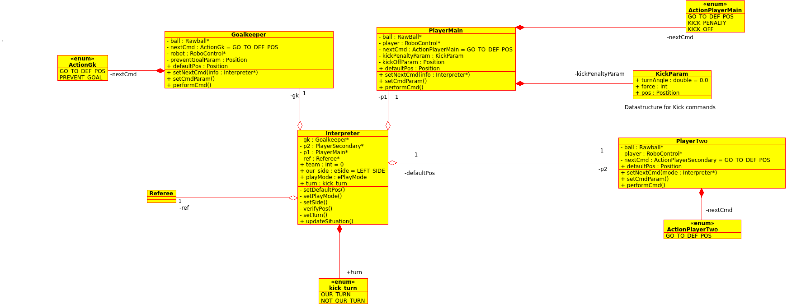
Class Diagram
Class Interpreter:
Retrieves field information and sets play modes, strategies, etc.
Player Classes (Goalkeeper, Player1, Player2):
Depending on play mode and strategy, commands and their parameters are calculated inside the class and sent to the RTDB

Slide 4

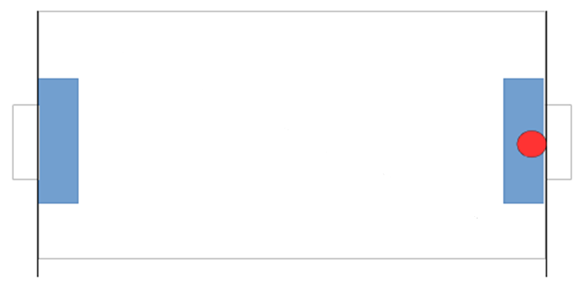
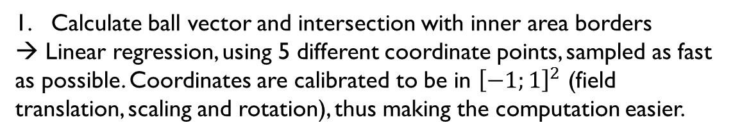
The moving ball interception
Calculate ball vector and intersection with inner area borders
→ Linear regression, using 5 different coordinate points, sampled as fast as possible. Coordinates are calibrated to be in ${\left[−1;1\right]}^{2}$ (field translation, scaling and rotation), thus making the computation easier.

Slide 5
The moving ball interception
Quickly move robot to target position

Slide 6
The moving ball interception
Proof and if necessary correct target position
As the target can move a lot due to prediction inaccuracy, robot does not have to be exactly on the target

Slide 7
The moving ball interception
Move robot behind the ball, wait until the ball gets closer (more precise) or does not move anymore → SHOOT
The shooting speed is decided by the distance between the robot and the ball (more precise), but must not be too slow

Slide 8

The collision avoidance
Before the robot runs to the destination, program will calculate the line between the moving robot itself and the destination. This line is called route. By comparing the coordinates of obstacle robots and the coordinates of the moving robot and the destination, we can know which obstacles are between the moving robot and the destination.

Slide 9
The collision avoidance
d₁ > threshold
d₂ < threshold
After this step, the distances between potential obstacles and the route are calculated. Here we can set a threshold value. Only if the distance is smaller than the threshold, the obstacle is considered dangerous.

Slide 10
The collision avoidance
temporary destination
In the case of no dangerous obstacle, the moving robot will move directly to the destination. In the case there are dangerous obstacles, the robot will turn 60 degree with respect to the original route and change its destination to a temporary destination. After it moves to the temporary destination, it will focus on the original destination again.

Slide 11
The collision avoidance
old temporary destination
new temporary destination
It should be noted that, there may be a new obstacle between the moving robot and the temporary destination. The procedure to avoid the new obstacle is the same as previously. The moving robot will change its temporary destination again to avoid collision. After it reached the temporary destination, it will focus on original destination again.

Slide 12
The collision avoidance
vector₁ . vector₂ > 0
vector₁ . vector₂ < 0
temporary destination
vector₂
vector₁
vector₁
vector₂
temporary destination
The turning of the moving robot is not arbitrary. By comparing the vector₁, which is perpendicular to route and vector₂ between the moving robot and the nearest obstacle, a safer temporary destination can be chosen.

Slide 13
The collision avoidance
lower priority, wait
until danger passes.
temporary destination
In addition, the robots from the same team has different priorities. If obstacles are the robots from the same team, the robot with lower priority will wait 500 ms, so that the robot with higher priority can leave dangerous area first.

Slide 14
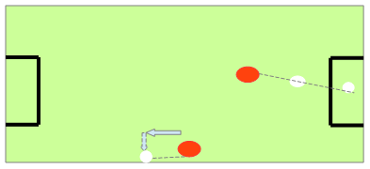
Collision avoidance with walls / penalty zone
Main task: follow the ball without hitting the wall or entering the penalty zone
→ Measure the limits of the wall / penalty zone.

Slide 15
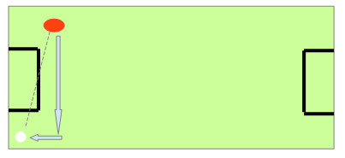
Collision avoidance with walls / penalty zone
Update frequently the position of the ball and the robot.
Define rules to follow the ball in case of interception with penalty zone.

Slide 16

See you at the Championship!

