Slide 1
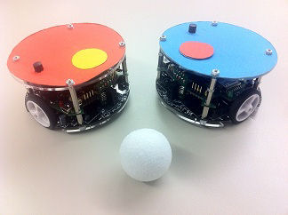
RoboSoccer Laboratory
Final presentation – Team C
Quoc-Nam Dessoulles
Duc Tung Dinh
Isabelle Janscha
Shu Liu
Chiraz Nafouki
Source: http://www.rcs.ei.tum.de/en/Lehre/Labs/pr_rs/

Slide 2
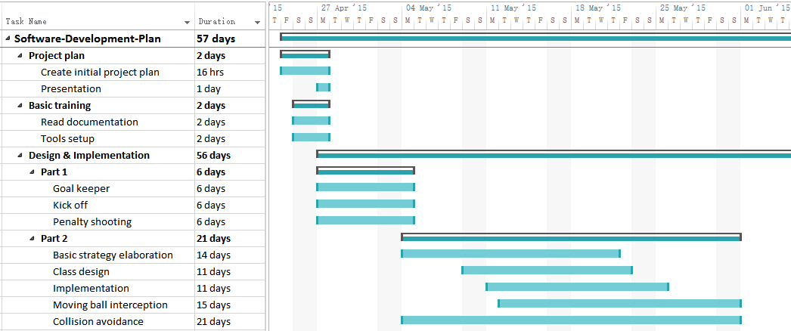
Original Gantt Diagram

Slide 3
Actual Gantt Diagram
Basic strategy elaboration not implemented due to lack of time.

Slide 4
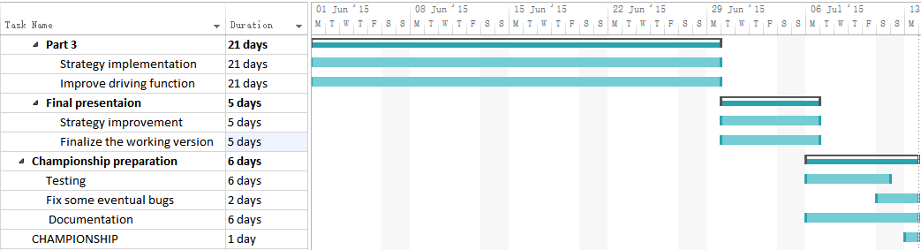
Original Gantt Diagram

Slide 5
Actual Gantt Diagram
Plan:
Finalize working version for final presentation
Fix small bugs before championship
Reality (Running out of time):
Small working version for final presentation
Much work before championship

Slide 6
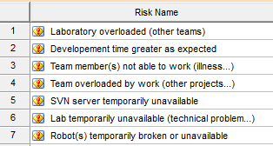
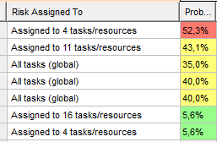
Risk analysis
Risks are taken into account → no problem for project development
Solutions:
Sick team member worked from home
Including weekends to work

Slide 7
Team Organization
PM: Quoc-Nam Dessoulles
QM: Shu Liu
CD: Tung Dinh
D1: Chiraz Nafouki
D2: Isabelle Janscha
RoboSoccer Lab – Team C
7

Slide 8
Team Organization
PM: Quoc-Nam Dessoulles
D
D: Shu Liu
D: Chiraz Nafouki
D: Tung Dinh
D: Isabelle Janscha
Testing / quality proofing was done by everyone
RoboSoccer Lab – Team C
8

Slide 9
High-level description
Class hierarchy:
RoboControl
Core functions
NewRoboControl
Low-level driving functions (abstract)
OpponentRobot
TeamRobot
High-level driving functions (abstract)
Goalkeeper
PlayerMain
PlayerTwo
High-level strategies and behaviors

Slide 10
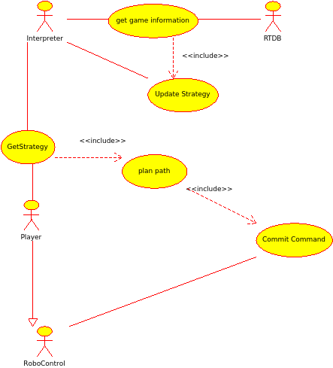
Use Case Diagram
Interpreter provides game strategy, formations, default positions…
Player actor represents single robot
For each robot separate threads

Slide 11
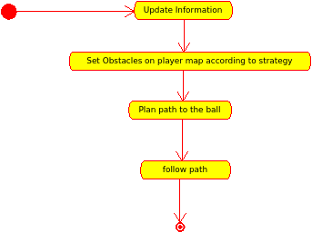
Main program loop
Single loop illustrated
Obstacle setting, determines player formations

Slide 12
Obstacle setting example
For the case of attacking player (own side: left)
Red objects: Obstacles
Left half is set as obstacle to force robot to attack
Obstacle pattern around ball to aim at goal

Slide 13
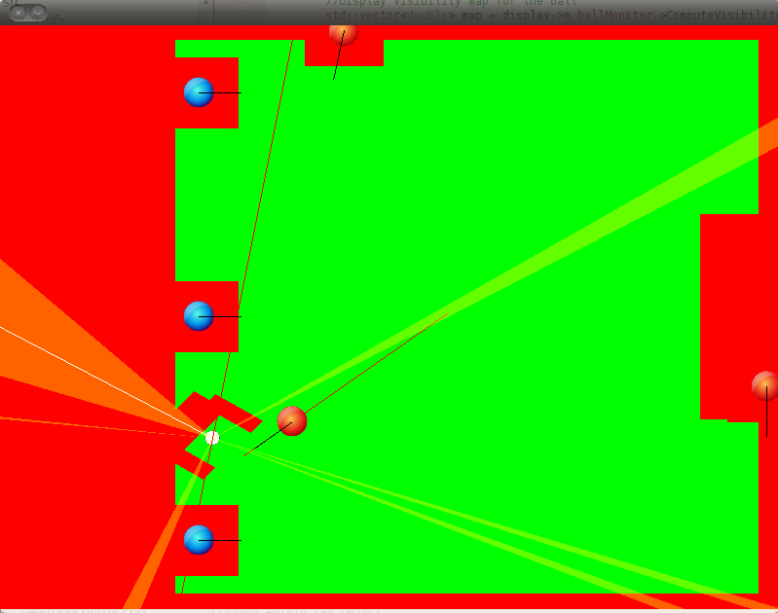
Interface
Creation of an interface to easily monitor the behavior of our algorithms in real time:
Bonus: direct control of the robots by drag & drop

Slide 14
Path planning
Based on the avoidance of polygons
Infinite virtual world populated with polygons:
Polygons = forbidden areas
Only convex polygons

Slide 15
Path planning
Computation of the visibility map of each vertex:
Two vertices can « see » each other if the line which links them does not cross any polygon

Slide 16
Path planning
Computation of a path between any two points: Just follow the map!
For the shortest path: Use of the Dijkstra’s Algorithm
Target not accessible ⇒ Use of a flood-fill algorithm to compute the nearest accessible point

Slide 17
Path planning
Advantages:
No need to discretize the world ⇒ Actual shortest path retrieved, independent from the discretization
A few points in the generated path ⇒ Easier to drive along
A few nodes and links ⇒ Faster computation
Computation time dependencies:
Number of vertices (polygons)
Move of the obstacles (remove & add = expensive operation)
Well suited in our case

Slide 18
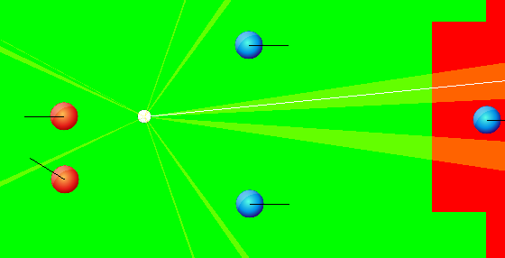
Penalty shooting / Kick off
Same function for the penalty shooting and the kick off
Kick of the ball in the direction of highest probability of success, depending on the position of the other robots:

Slide 19
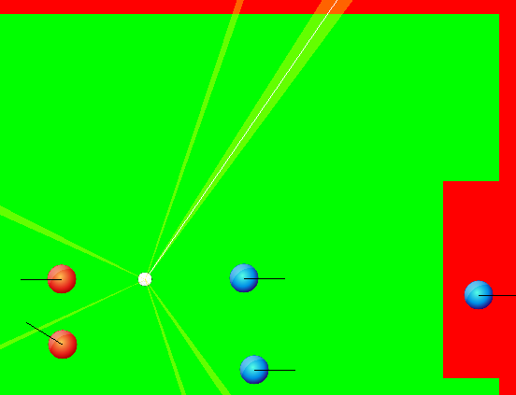
Penalty shooting / Kick off
Use of a recursive function able to take into account infinite number of rebounds against the walls:
However in practice: no search deeper than one rebound

Slide 20
Penalty shooting
Lack of precision when shooting
Use of the following routine for improvement:
Go in front of the ball (slowly)
Turn to be oriented towards the ball
Is the orientation / position good enough?
No
Drive back
Yes
Shoot

Slide 21
Evaluation of the robots behavior
Correct speed with the CruiseTo() function
Careful settings calibration
Good ball trajectory prevision function
Goal keeper effective against both teams…
Lack of precision when shooting (still)
Necessity of a compromise between speed and precision
Problem of collision with other team robots
Mutual avoidance with no communication ⇒ Time loss
Invasive kick function
No respect to the boundaries (especially the penalty area) when kicking

Slide 22
Conclusion
Main goal: Win the Championship!
Almost!!!
Big project
5000 lines of pure code (no blank line, no comment)
14 classes, nearly 400 functions / methods
Hundreds of hours spent
Additional skills
Understand the basics of SVN (commits, branches, merging)
Know the fundamentals of OOP / C++
Project management skills
Software engineering

Slide 23


See you at the Championship!
Thank you for your attention!

