Slide 1

Dr. D.Y.Patil Institute of Technology, Pimpri, Pune-18 Department of Electronics and Telecommunication Engineering Mini Project Presentation SOUND NAVIGATION AND RANGING (SONAR) USING ULTRA SONIC SENSOR
Group Members Project Guide
Jagtap Siddhesh (TETB42) Prof.Dhanashree Kulkarni
Mohammad Zahid (TETB59)
Nangare Swapnil (TETB63)

Slide 2

PROBLEM STATEMENT
Target/object detection, recognition position, movement speed, etc. is easy when the object is near or easily visible. But, the same doesn’t stand true especially when the object is far or not visible due to so many factors like weather conditions, day/night cycle, etc.
Therefore, Radio Detection and Ranging (RADAR) was invented, which uses radio waves to determine the range, angle, or velocity of objects. But, it uses long time to detect, has short detection range, not target specific because of wide range, oversensitive, costly, etc.
A cheaper, easy and effective alternate solution is to use ultrasonic sensor which use sound waves for detection and ranging (SONAR)

Slide 3

OBJECTIVES
The basic objective of our design is to ascertain the distance position and speed of the obstacle set at some distance from the sensor.
Ultrasonic sensor sends the ultrasonic wave in various ways by rotating with help of servo motors. This wave goes in air and gets reflected back subsequent to striking some object.
This wave is again detected by the sensor and its qualities is analyzed and output is shown in screen indicating parameters, for example, distance and position of object.

Slide 4
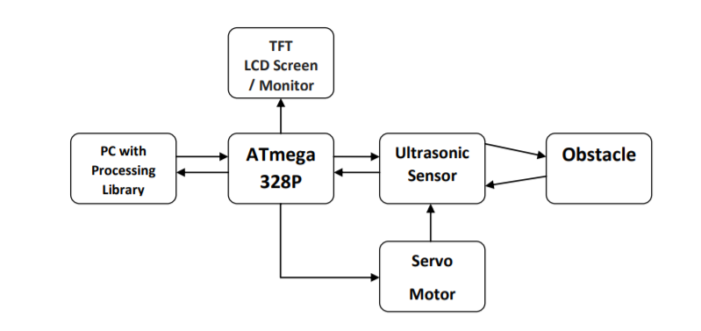
BLOCK DIAGRAM

Slide 5
Literature Survey
Sr no. | Name(Title of paper) | Method Used | Gap Identified
1 | Smart SONAR System | Innovative methodology and solution that enables a SONAR system with a generic configuration to provide real-time updates to its user and hence cancelling out the extra time taken for the Communication | The system detects the object by using an ultrasonic sensor which is connected to an Arduino UNO and is rotated 180 degrees throughout by using a servo motor
2 | RADAR based Object Detector using Ultrasonic Sensor | The software Arduino IDE is installed to program the code in C/C++. Another software used is the Processing IDE for creating the GUI in java language. The code is for running the devices to make the proposed work possible and to observe the output/results | Data was processed by the computer and Arduino Uno board.Object detection was done via the Ultrasonic sensor with servomotor attached to the boards and the distance and angel of object was detected

Slide 6
Sr no. | Name(Title of paper) | Method Used | Gap Identified
3 | ARDUINO BASED RADAR SYSTEM | Navigation and obstacle detection innovations and different systems where ultrasonic sensors are used efficiently. | The linear measurement problem because of which distance measurement was not possible between some objects.
4 | DESIGNING OF LOW COST ARDUINO BASED ULTRASONIC SONAR SYSTEM | The designing and implementation of Arduino based SONAR system using ultrasonic sensor | To present a SONAR which is cost effective and detect hurdle accurately. It provides cheaper solution for security purposes.

Slide 7
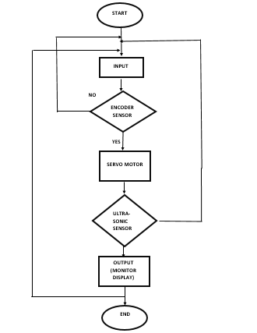
Proposed System
The flow chart explains the working and the decision flow of this framework. As it can be seen the system starts with an input i.e. when the ultrasonic sensor detects an object, or does not detects any object, at any condition the encoder feeds the information in the controller while the servo keeps constantly rotating.
As soon as any obstacle/object is detected by the ultrasonic sensor the data is immediately processed by the controller and is fed to the IDE which shows it on the display screen.
Here the process ends with an estimated distance of the object from the system with the angle at which it is placed.

Slide 8
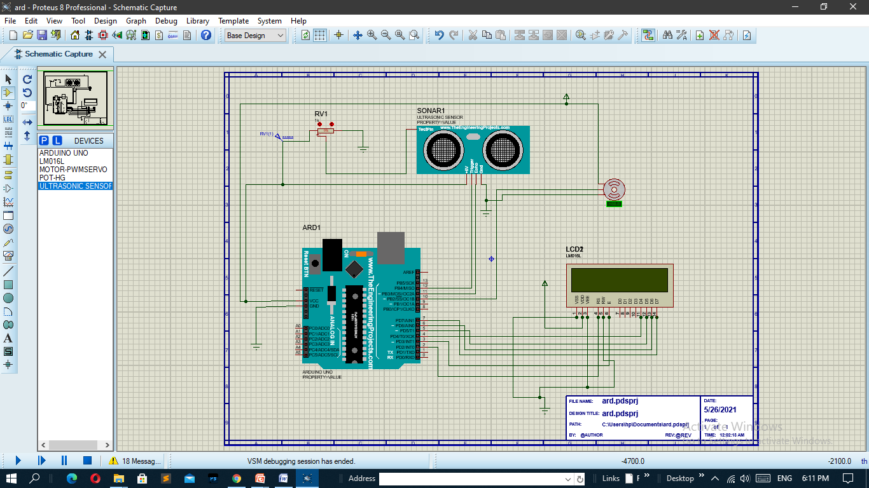
Circuit Digram

Slide 9
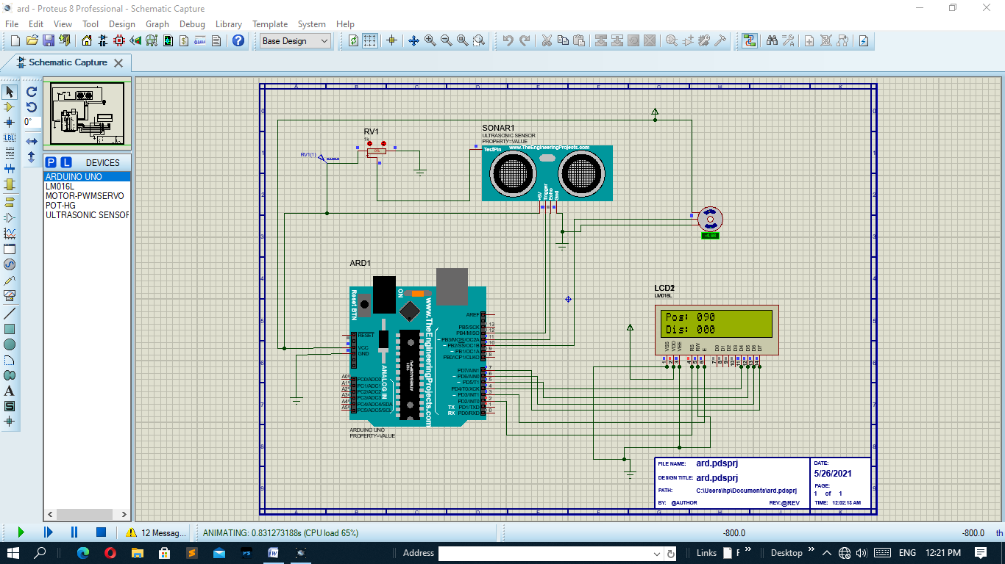
Simulation

Slide 10

Simultion Video

Slide 11
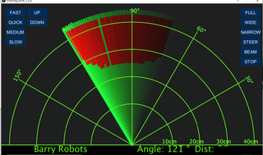
EXPECTED OUTCOME
The data collected through the sensor is the plotted and graphical represented via the processing app. It shows the distance of the object from the system with reference to the sensor values. Image shows the object detected in red color fading to black color as the arcs move (servo motor moves/rotates)

Slide 12

APPLICATION
This System have various applications for security purposes and it is mainly used for mapping.
APPLCATION IN AIR FORCE: It is used in airplanes or aircraft machines which have implemented radar system in it to detect the objects that comes in a way. It is also used to calculate height readings.
APPLICATION IN MARINE: This system also used in ships or marine. It is implemented on big ships to calculate the distance of other boats or ships, with the help of this sea accidents can also be reduced by not colliding. It can also be implemented on ports to see the distance of other ships and to monitor or control the ship movements.
APPLICATON IN METEROLOGY: Meteorologists also uses radar systems to track or monitor the wind. It has been become an important equipment for climate testing. For example to detect tornados, storm.

Slide 13
THANK YOU

