Slide 1
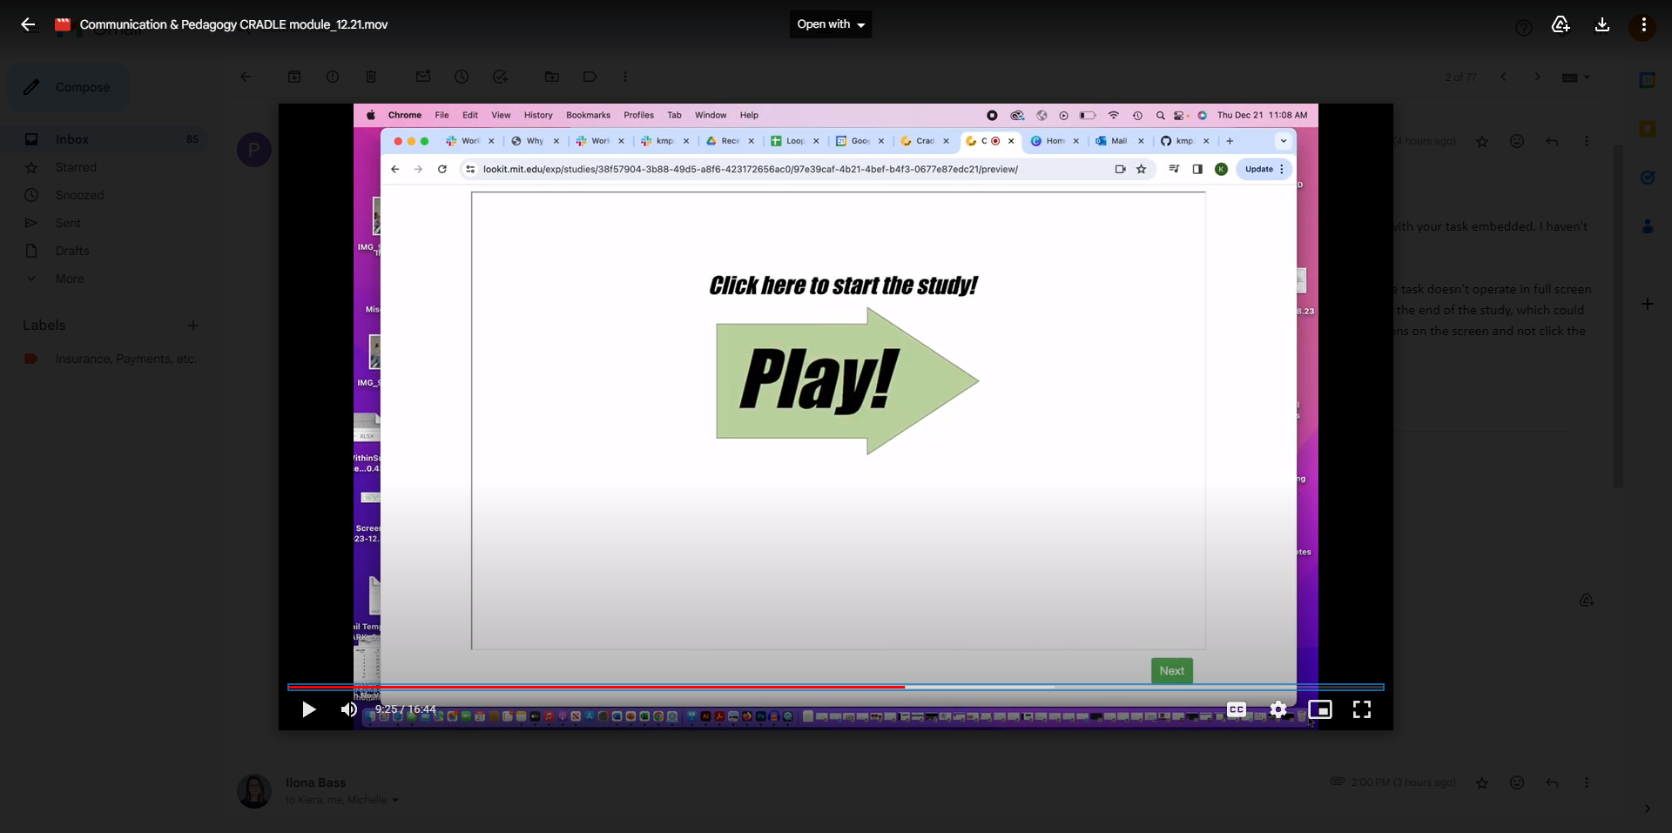
This is the problem
Embedded, there’s a green “Next” button on the page by default

Slide 2
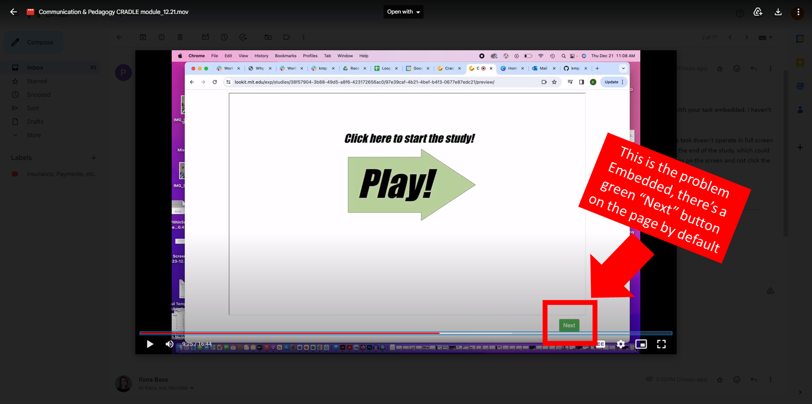

Slide 3
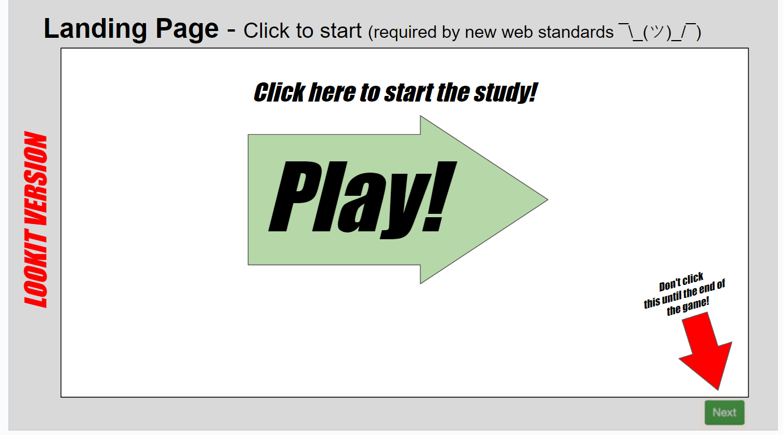
I could add an arrow like this

Slide 4
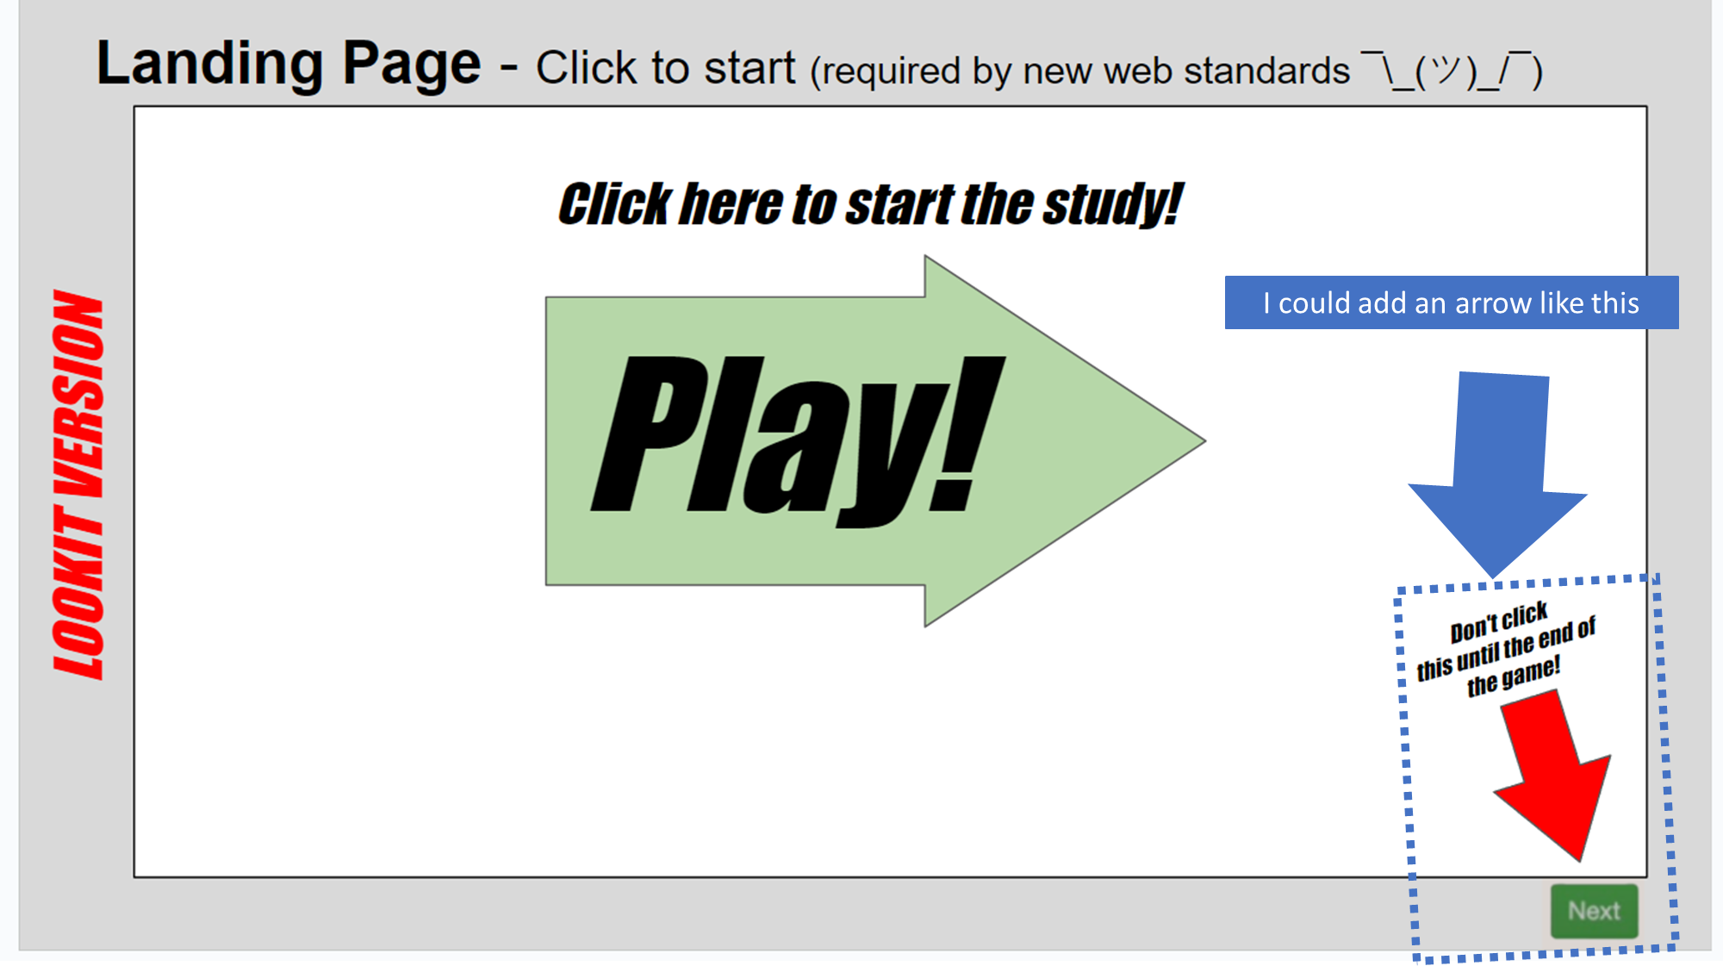

Slide 5
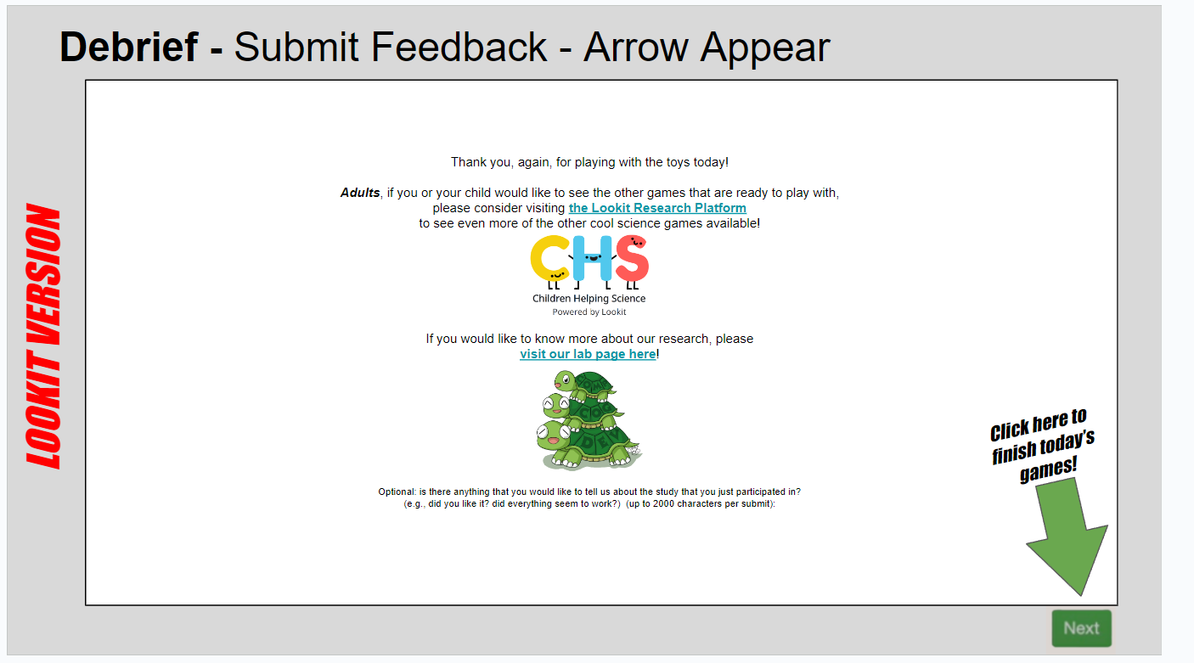
And this arrow/prompt

Slide 6
