Slide 1
    Parallel Computing Overview
    Levels of Abstraction
    Dr Len Freeman

Slide 2
Background
  We are primarily concerned with:
      Parallelism for
      Performance for
      Performance-Critical Applications.
  Creating any computer program, parallel or sequential, requires interactions between different facets of computing, ranging from the problem to be solved by the computation to the structure of the computers which execute the code that solves the problem. This covers several distinct Levels of Abstraction which encompass fundamentally different views.

Slide 3
Background
  The following five Levels of Abstraction indicate how these views gradually change from being Application-oriented, at one end of the spectrum, to Implementation-oriented, at the other.
    Application-oriented Levels of Abstraction:
        Application Level;
        Specification Level;
        Algorithm Level.
    Implementation-oriented Levels of Abstraction:
        Program Level;
        Computer Level.

Slide 4
Background
  Obtaining the highest performance from the resulting computation requires no significant performance loss as we transit from one Level of Abstraction to another.
  We now look at each of the Levels of Abstraction using an example application of predicting the weather to illustrate the kind of concerns encountered at each level. The application is termed Medium Range Weather Forecasting.

Slide 5
Application Level
Application Level
  The Application Level – here a relatively simple, and possibly informal, description of the application (i.e. the problem to be solved) is stated or developed.
  In the medium-range weather forecasting example, this description might be something like:
    “Once daily, forecast the state of the global weather system for a period of ten days from now. For operational reasons, the computation on which this forecast is based must be achieved within an 8 hour 'window' each day.”

Slide 6
Specification Level
  The Specification Level – here the simple (informal) application description is turned into a formal specification (abstract mathematical model) of the problem, expressed in a suitable mathematical notation.
  For the weather prediction example, the global situation is modelled (roughly) by five coupled partial differential equations (PDEs) acting on 6 key continuous variables.

Slide 7
Algorithm Level
The Algorithm Level – here a systematic procedure for solving the problem (abstract mathematical model) is developed, based on some discrete data domain. In many cases, the problem itself cannot be solved directly, and so an approximation is used to solve a closely related problem. The discrete data domains encountered here reflect the discrete nature of computer storage. Parallelism arises in two principal forms: data-parallelism and task-parallelism.

Slide 8
Algorithm Level
For the medium-range weather forecasting example, the global continuum is represented by grid-point approximations (i.e. values of the 6 key variables at discrete grid-points, with linear interpolation of intermediate values). Progress in time is approximated by a series of discrete time-steps, governed by finite difference equations derived from the PDEs – mostly data-parallelism is exploited over the finite difference grid. Recently, frequency domain (spectral) filtering has been added; this requires extra computational steps to transform data between the time domain and the frequency domain, but can reduce the number of iterations required to obtain accurate numerical results.

Slide 9
Program Level
The Program Level – here the algorithm is expressed as a program, moving the concerns further towards the restrictions associated with real computer storage. Unfortunately, programming languages tend to reflect the hardware architecture of the computer that will execute the compiled code, often leading to (unnatural) constraints on the algorithm.

Slide 10
Program Level
A typical example for medium-range weather forecasting is the ECMWF IFS (Integrated Forecasting System) code, which merges developments in both weather and climate modelling into a single meteorological FORTRAN program with (in the latest versions) message-passing parallel constructs in MPI (Message Passing Interface).
The use of message-passing has forced the (parallel) algorithm in certain directions that may not have been followed if sequential hardware had continued to be used. The message-passing approach was adopted due to availability of specific high-performance parallel hardware.

Slide 11
Computer (Hardware) Level
The Computer Level – here the program is implemented on a (parallel) computer. The object-code generated by the compiler, or embedded in the runtime system, causes low-level electronic transactions across the data paths of the hardware, between processors, memory modules and peripheral devices.

Slide 12
Computer (Hardware) Level
In the weather prediction example: in 2009, ECMWF bought a large (~9000 processors) IBM Power 6 Cluster 1600 system which now runs the IFS code in operational mode. The runtime message-passing system is the IBM's implementation of MPI.
Generation of suitable parallel code has not been straightforward; it has taken many years, and involved a considerable amount of expert manpower. Tools have been of limited assistance, being rudimentary and/or overly ambitious. Such experiences abound in the practice of parallel computing.

Slide 13
Numerical Weather Prediction
Roughly speaking, in the ECMWF IFS, a third of the 6-8 hour daily compute-time is pre-processing, to establish initial conditions at each grid-point, another third is the sequence of time-stepping iterations, to compute successive new weather states, and the final third is post-processing, to derive the interesting qualitative conditions (cloud, rainfall, etc.).
Limiting factors on the accuracy of the computed quantities are:
  accuracy of (computed) initial state;
  resolution of space and time (step sizes);
  quality (accuracy and rate of convergence) of time-stepping iterative approximation.
The quality of a forecast can be measured post hoc by the length of time that (some of) the predictions (of the forecast) remain within a given error of the actual (observed) weather.

Slide 14
Numerical Weather Prediction
ECMWF Hardware Evolution – Sample Machines
Year | Machine | Processors | Peak Performance
1979 | Cray-1A | 1 | 160 Mflops
1986 | Cray XMP-48 | 4 | 800 Mflops
1992 | Cray C90 | 16 | 16 Gflops
1994 | Cray T3D | 128
2000 | Fujitsu VPP5000 | 100 | ~1 Tflops
2002 | IBM Cluster 1600
2009 | IBM Power 6 Cluster 1600 | ~9000 | ~320 Tflops
2012 | IBM Power 7 775 Cluster | ~24,600 | ~1.5 Pflops

Slide 15
Numerical Weather Prediction
ECMWF Software Evolution – Sample Developments
Year | Algorithm | Vertical Resolution
1979 | Gridpoint, Explicit | 16
1986 | Spectral, Semi-Implicit | 19
1992 | Semi-Lagrangian | 31
1994 | Ensemble Prediction System (EPS)
2009 | EPS | 91

Slide 16
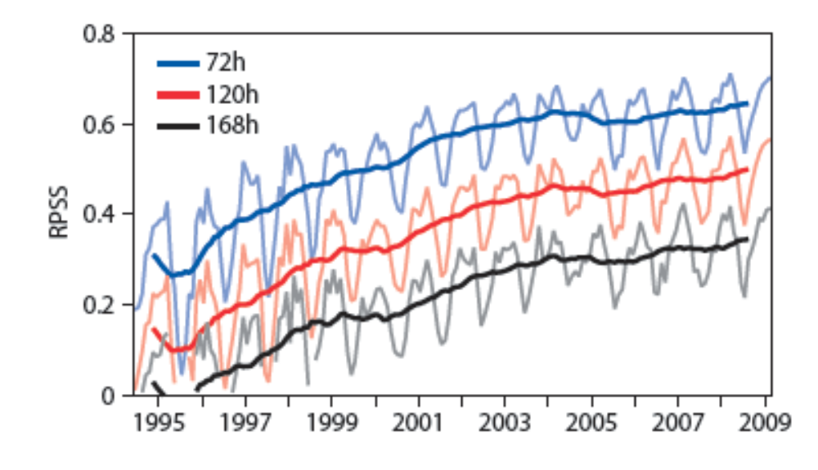
Numerical Weather Prediction
ECMWF EPS Forecast Accuracy
RPSS – Ranked Probability Skill Score.
7-day (168-hour) forecast in 2008 about as accurate as 3-day (72-hour) forecast in 1996.
Graph reproduced from http://www.ecmwf.int/about/information_leaflets/EPS.pdf

Slide 17
Numerical Weather Prediction
In practice, parallelism of several thousand-fold is being used in this production system. Parallelism is exploited across the data 'spaces' (independent vertical columns in the time-domain and independent frequency components in the frequency domain) – this is data parallelism; and across the different forecasts of the EPS (Ensemble Prediction System) – this is task parallelism.
Attention is increasingly focussed on additional pre-processing (to improve the computed initial states) and probabilistic algorithms for predicting the 'most likely' outcome based on ensemble forecasts.

Slide 18
Summary
Solving a computational problem using HPC involves design and development at several distinct Levels of Abstraction. The totality of issues to be considered well exceeds the capabilities of a normal human being.
At Application Level, the description of the problem to be solved is informal.
A primary task in developing a solution is to create a formal (mathematical) model, or specification. Although formal and abstract, an specification model implies computational work that must be done and so ultimately determines the performance that can be achieved in an implementation.
Algorithms are procedures, based on discrete data domains, for solving (approximations to) mathematical problems. An algorithm is also abstract, although it is more clearly related to the computer that will implement it than is the corresponding specification.

Slide 19
Summary
Concrete implementation of an algorithm is achieved through the medium of a program, which determines how the discrete data domains inherent in the algorithm will be laid out in the memory of the executing computer, and also defines the operations that will be performed on that data, and their relative execution order. Interest is currently focused on parallel execution using concurrent programming languages, based on multiple (active) processes (with message-passing) or multiple threads (with data-sharing).
Performance is ultimately dictated by the available parallel computer platform, via the efficiency of its support for processes or threads. Hardware architectures are still evolving, but a clear trend is emerging towards distributed memory structure, with various levels of support for sharing data at the Program Level.

