Slide 1
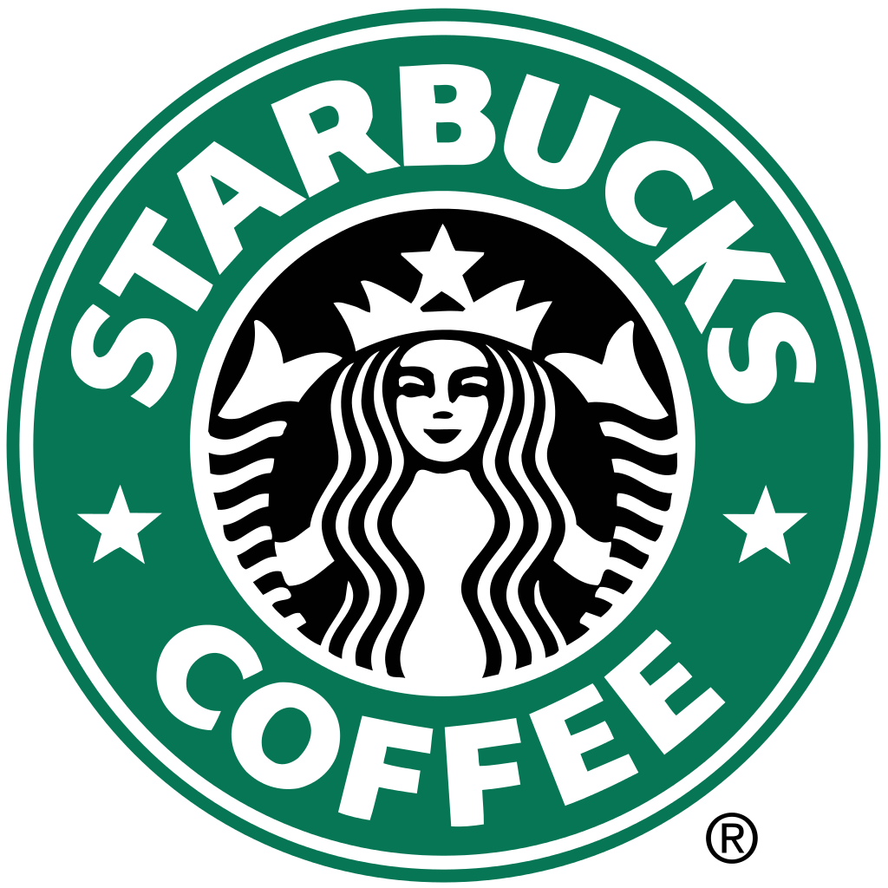

Slide 2
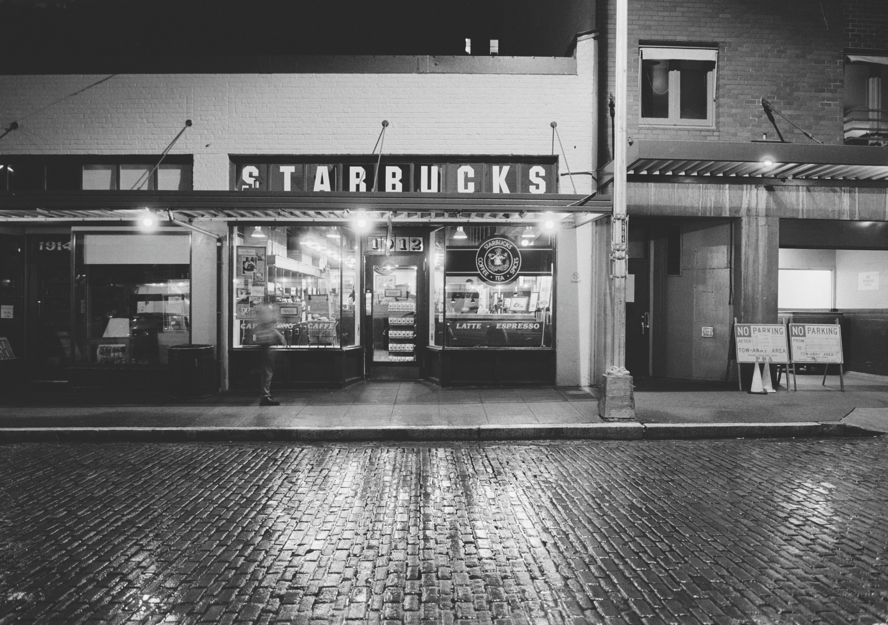
Story
Created in 1917 in Seattle

Slide 3
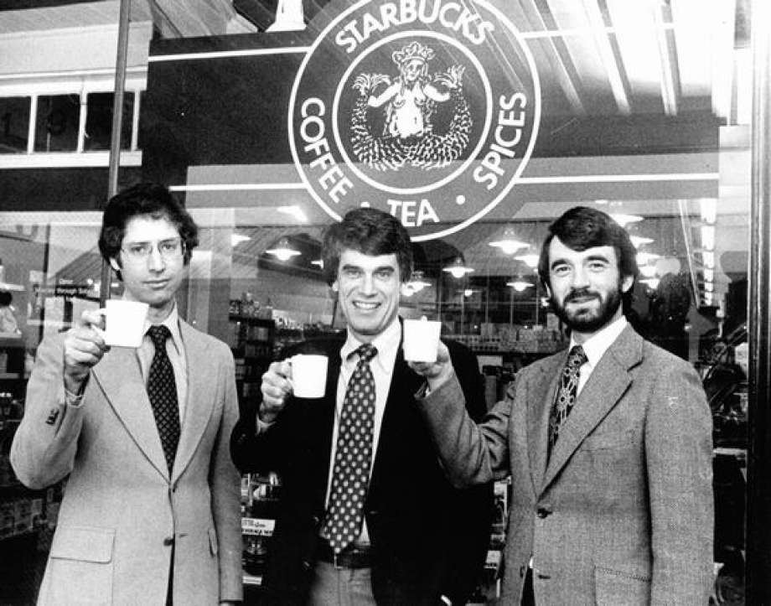
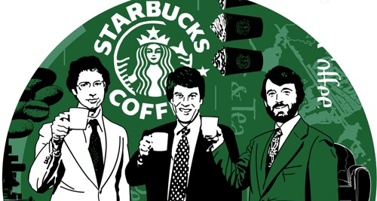
3 partners an English teacher Jerry Baldwin , an History teacher Zev Siegl and a Writer Gordon Bowker

Slide 4
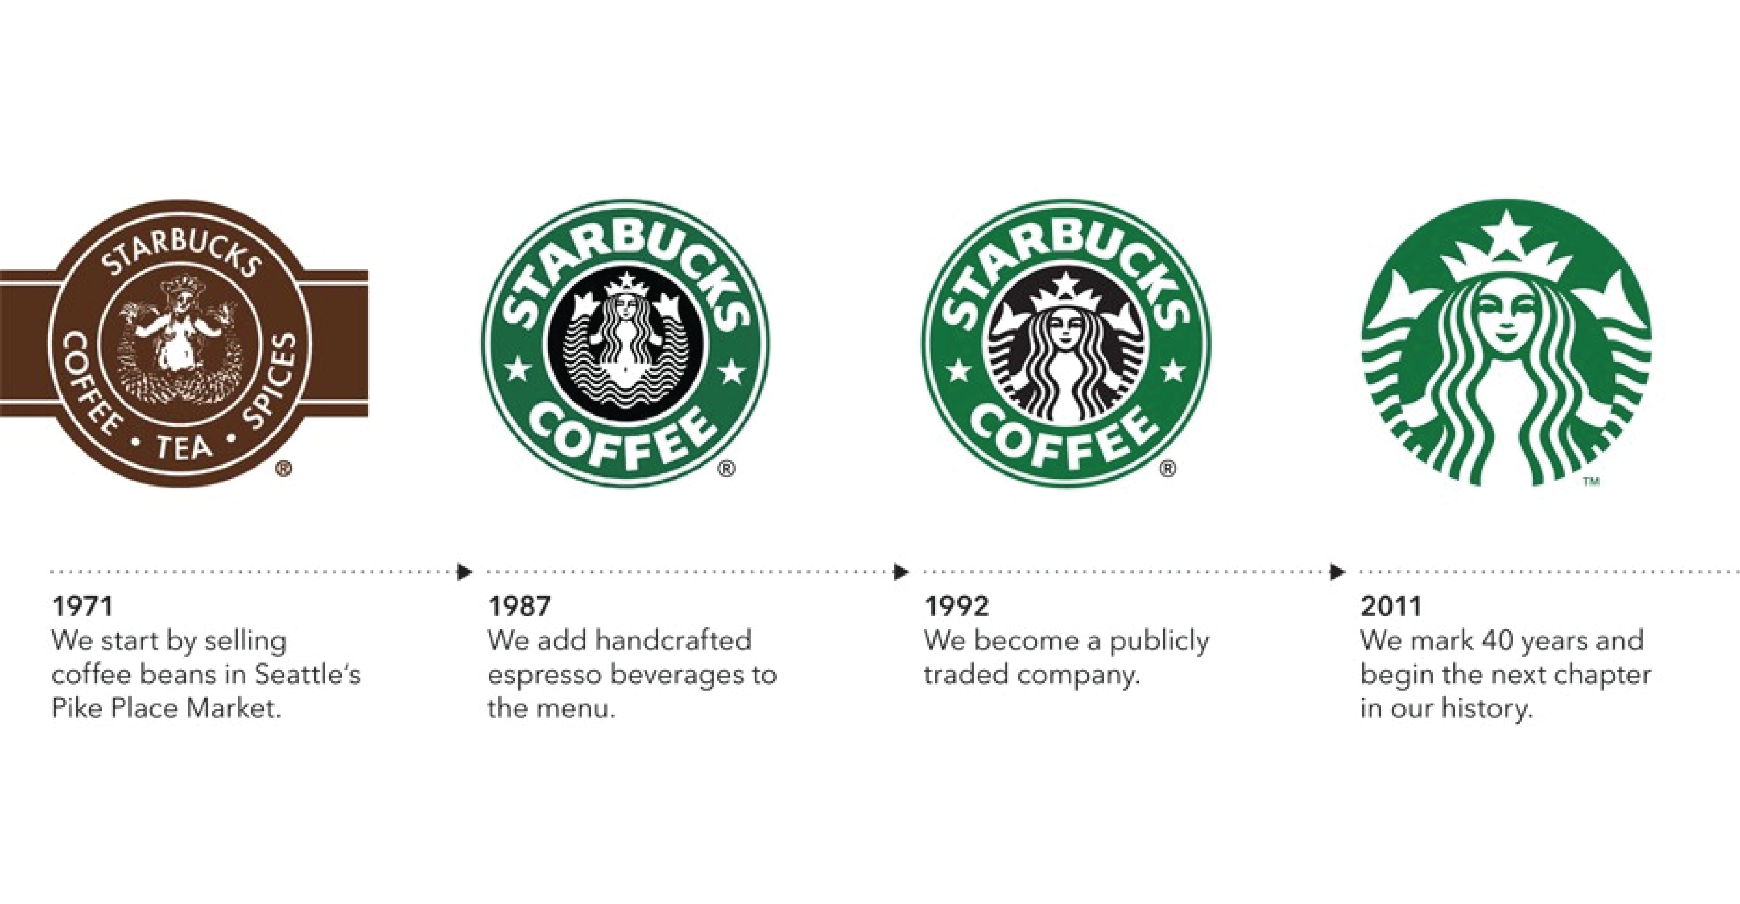
Logo

Slide 5
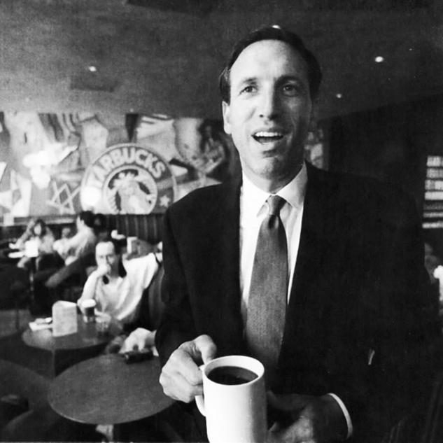
Howard Schultz takes his first coffe cup in a Stabucks cofee

Slide 6

In 1983, Howard Schultz transposed in the United States the tradition of Italian cafes

Slide 7
Competitor
Balzac Coffe, an German company
Mc Donald’s
Costa Cofee

Slide 8
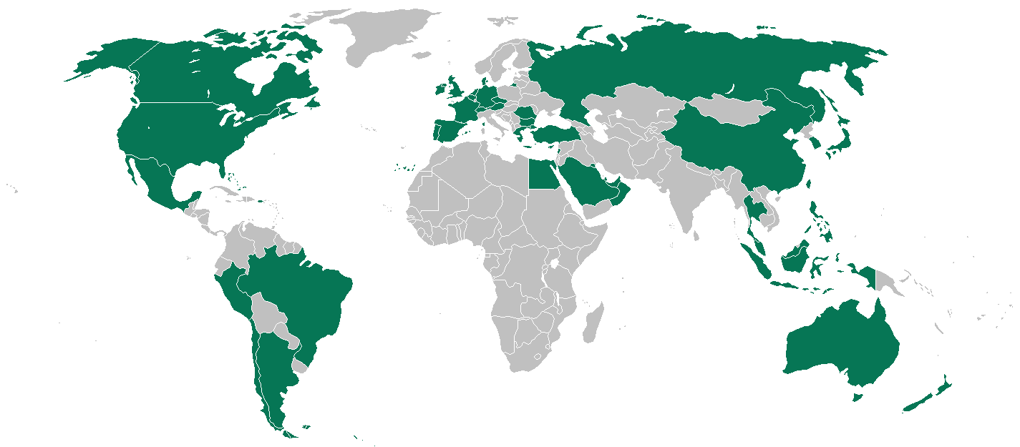
Where does its success come from ?

