Slide 1

A DATABASE CREATED BY KRISTA FORSYTHE AND COLBY LECLERC

Slide 2
WHAT IS THE PURPOSE OF KCGAMES?
KC Games is an online game store and review website. Its purpose is to allow people to share their own personal opinion on our select database of games, which could aid others in their decision of whether or not to buy a game. Our website also shows sales, development studio, and platform information, which collectively add to the data that can be displayed to our customers. The main goal of KC Games is to create a community of end-users who will end their session on our website, knowing which game they will purchase next.

Slide 3
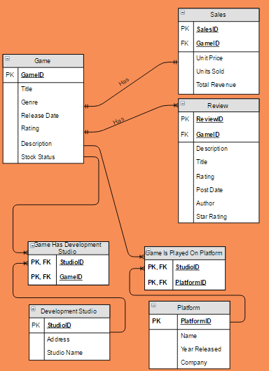
ERD DIAGRAM

Slide 4
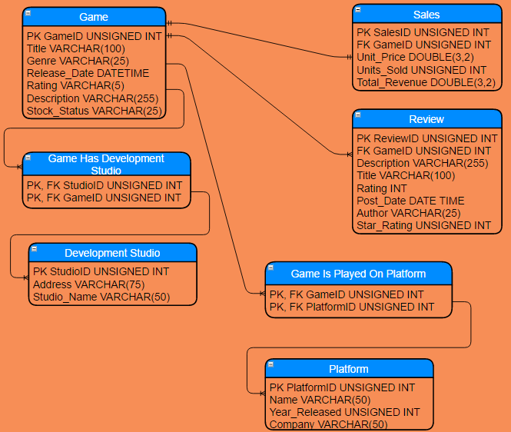
LOGICAL DESIGN

Slide 5
SOME SIMPLE BACK-END SQL ACCOMPLISHMENTS
“I would like to see all games with 10,000 units sold or above.” SELECT DISTINCT g.Title, s.Units_Sold FROM Game g, Sales s WHERE s.Units_Sold >= 10000 AND g.GameID = s.GameID;
“I would like to see the games that a development studio makes.” SELECT g.Title FROM Development_Studio ds, G_CreatedAt_DS gds, Game g WHERE ds.Studio_Name = “studioName” AND gds.GameID = g.GameID AND gds.StudioID = (SELECT StudioID FROM Development_Studio WHERE Studio_Name = “studioName”);

Slide 6
SOME SIMPLE BACK-END SQL ACCOMPLISHMENTS
"I would like to see the development studio's location." SELECT ds.Studio_Name, ds.Address FROM Development_Studio ds WHERE ds.Studio_Name = “studioName” AND ds.StudioID = (SELECT StudioID FROM Development_Studio WHERE Studio_Name = “studioName”);
"I would like to see the platforms that support this game." SELECT p.Name FROM Platform p, G_PlayedOn_P gp, Game g WHERE g.Title = “gameName” AND p.PlatformID = gp.PlatformID AND gp.GameID = (SELECT GameID FROM Game WHERE Title = “gameName”);

Slide 7
SOME COMPLEX BACK-END SQL ACCOMPLISHMENTS
“I would like to see the highest rated review for a game.” SELECT gm.Title, rv.Description, rv.Star_Rating, rv.Author FROM Game as gm, Review as rv WHERE gm.GameID = rv.GameID AND gm.GameID = 51 GROUP BY rv.Star_Rating, gm.Title, rv.Description, rv.Author ORDER BY rv.Star_Rating DESC LIMIT 1;
“I would like to see the highest rated game.” SELECT gm.Title as title, gm.Genre, gm.Description, MAX(rv.Star_Rating) as Rating FROM Game as gm, Review as rv WHERE rv.GameID = gm.GameID GROUP BY title, gm.Genre, gm.Description ORDER BY Rating DESC LIMIT 1;

Slide 8
SOME COMPLEX BACK-END SQL ACCOMPLISHMENTS
“I would like to see the following details of the game: platform, release date, sales, price, development studio.” SELECT DISTINCT g.Title, g.Release_Date, s.Total_Revenue, s.Unit_Price, ds.Studio_Name, (SELECT GROUP_CONCAT(p1.Name SEPARATOR ', ') FROM Platform p1, G_PlayedOn_P gp1, Game g1 WHERE g1.Title = ‘gameName’ AND p1.PlatformID = gp1.PlatformID AND gp1.GameID = (SELECT GameID FROM Game WHERE Title = ‘gameName’) GROUP BY g1.Title) AS Platforms FROM Game g, G_CreatedAt_DS gds, Development_Studio ds, G_PlayedOn_P gp, Platform p, Sales s WHERE g.Title = ‘gameName’ AND s.GameID = (SELECT GameID FROM Game WHERE Title = ‘gameName’) AND ds.StudioID = gds.StudioID AND gds.GameID = (SELECT GameID FROM Game WHERE Title = ‘gameName’);

Slide 9
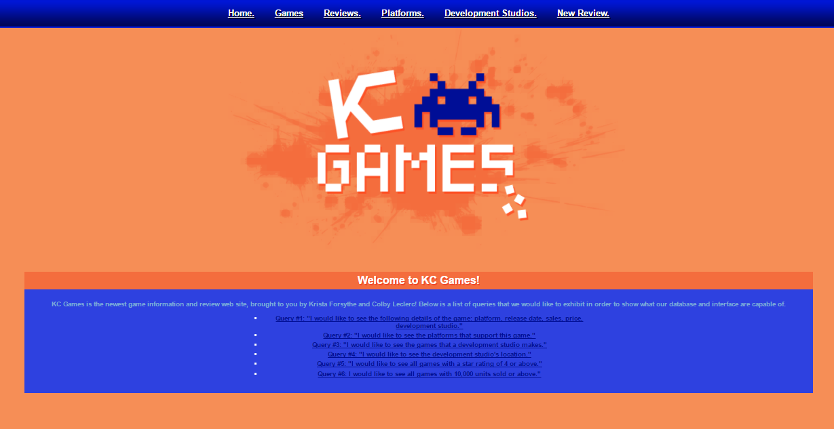
FRONT-END SYSTEM

Slide 10
FRONT-END SYSTEM ACCOMPLISHMENTS
You can easily navigate your way through the website to access the components that you would like to see.
You can post reviews for a specific game with your name, review title, star rating, and review.
You can view reviews that have already been posted for a specific game.
You can see game, development studio, sales, and platform information.

Slide 11
HOW DID WE INTEGRATE THE FRONT-END TO THE BACK-END?
We connected the front-end to the back-end with the use of PHP. The back-end was implemented with MySQL, while the front-end was implemented with the help of HTML, CSS, and PHP. PHP is a scripting language that can be embedded into HTML, which is mainly used for server-side scripting. It also allows us to execute queries within the front-end by connecting to the back-end. We were able to perform SELECT queries, as well as INSERT INTO queries.

Slide 12
WHO IS RESPONSIBLE FOR WHAT?
Krista: Created the interface, powerpoint, small parts of the project final report. Took part in creating the ERD diagram and logical diagram. Took part in adding data entries and table creation. Performed one half of the queries.
Colby: Did most of the project final report. Took part in creating the ERD diagram and the logical diagram. Took part in adding data entries and table creation. Performed one half of the queries.

Slide 13
CLICK HERE TO SEE OUR DEMONSTRATION!

