Slide 1
Customer Retention Analysis

Slide 2
Outline
Objectives
Data Exploration
Modeling

Slide 3
Objective
Determine if we can predict if a customer will return within 1 year of their first visit
Criteria
Customer has had to spend at least $100
Product group excludes surgeries

Slide 4
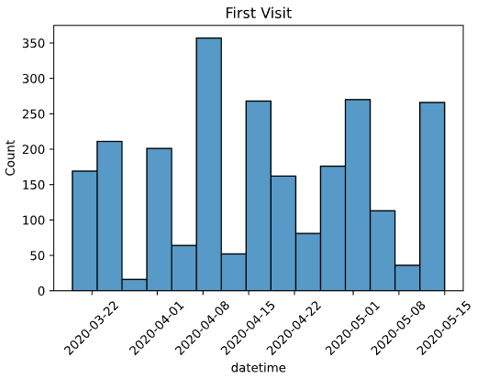
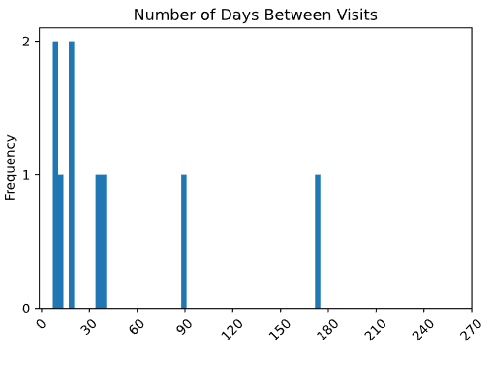
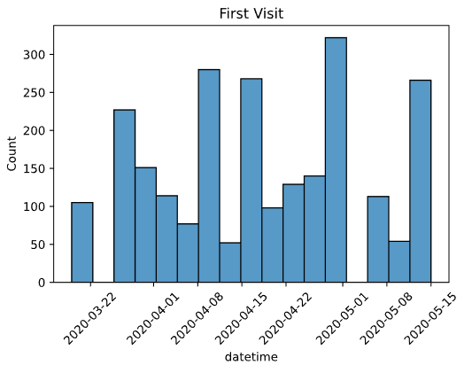
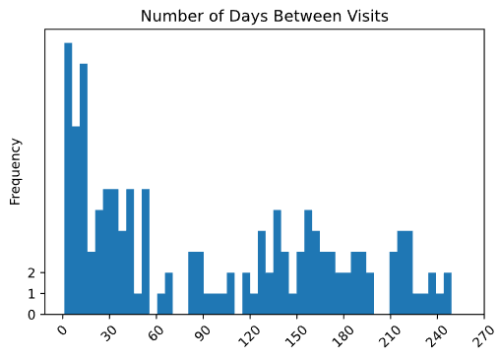
Data Exploration
Unique Animal IDs 65
Returned 15
Did Not Return 49
Ratio 23%
Unique Animal IDs 555
Returned 44
Did Not Return 511
Ratio 8%
1 Year Filter
6 Month Filter

Slide 5
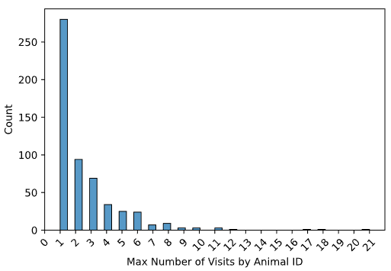
Data Exploration
Max # of Visits | Count
1 | 280
2 | 94
3 | 69
4 | 34
5 | 25
6 | 24
7 | 7
8 | 9
9 | 3
10 | 3
11 | 3
17 | 1
18 | 1
21 | 1

Slide 6
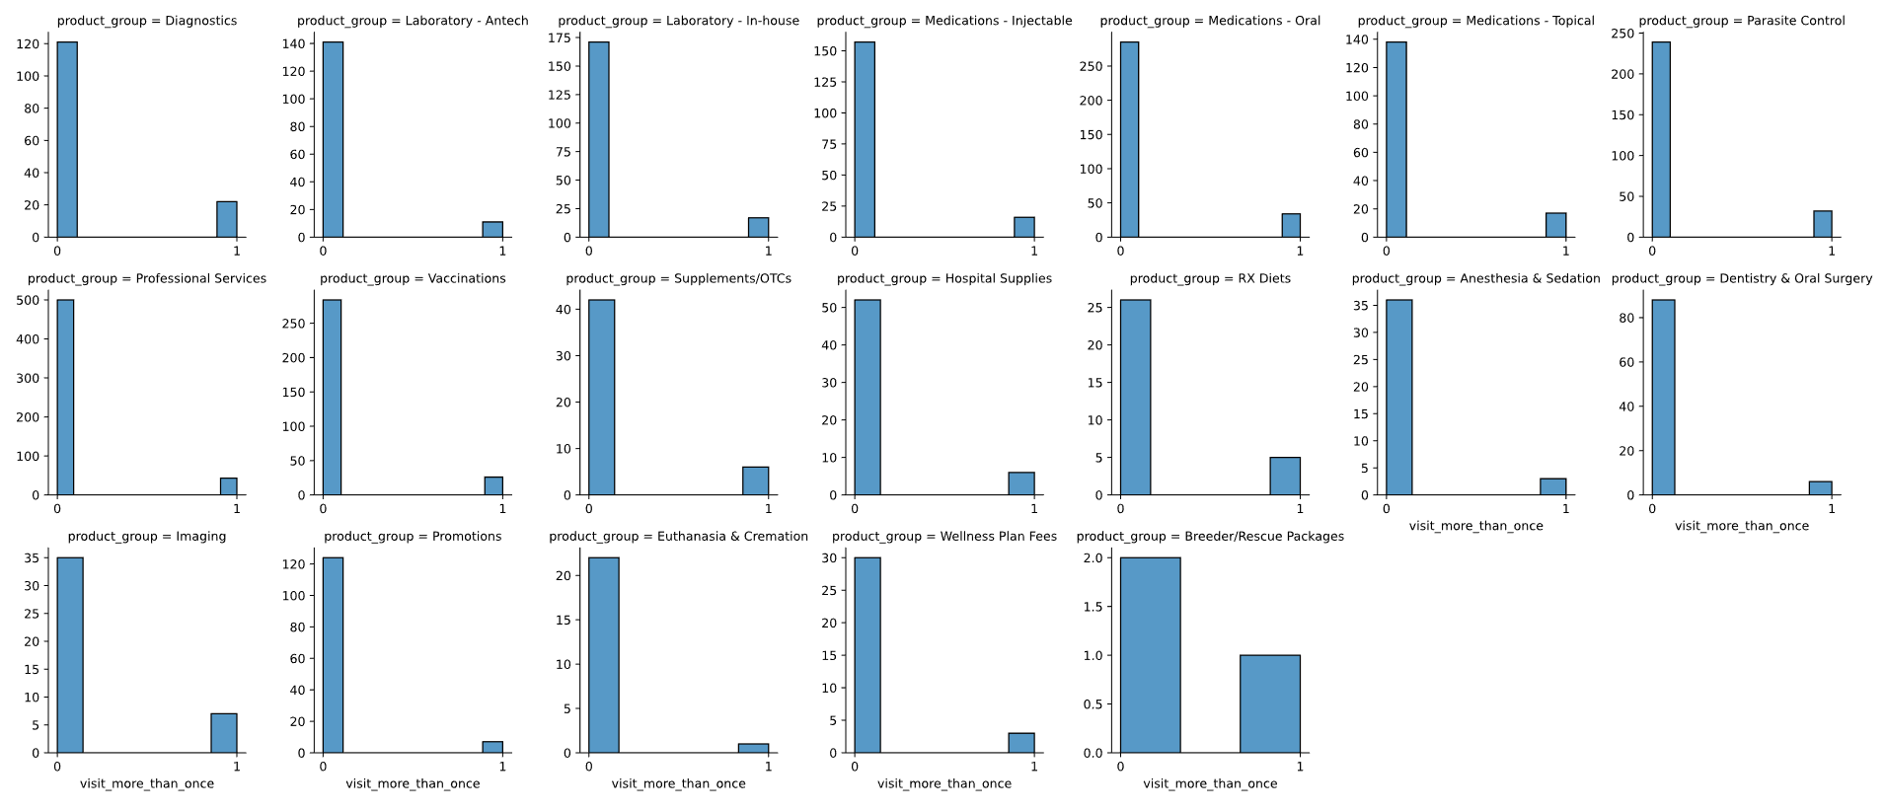
Data Exploration

Slide 7
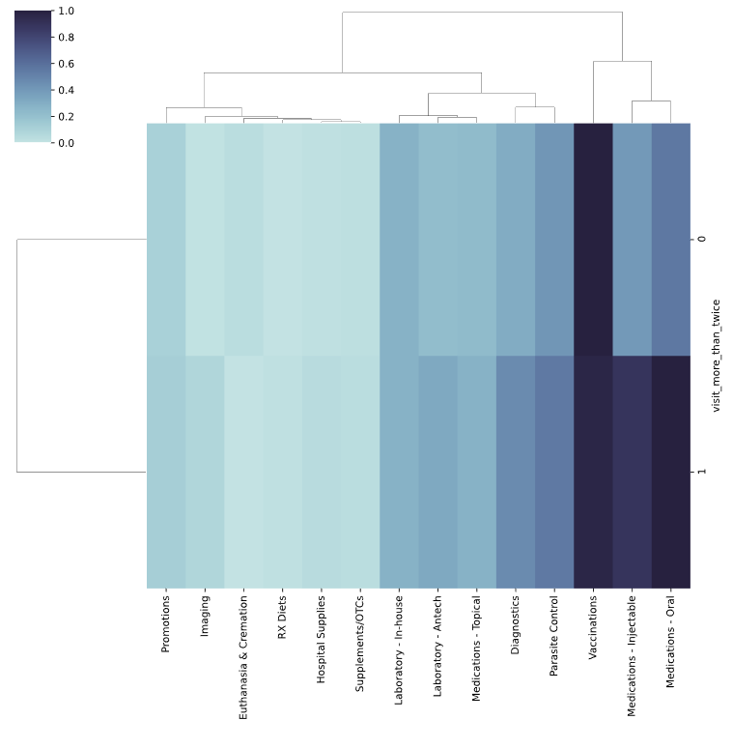
Data Exploration
More Than One Visit | Animal ID Count
No | 6,176
Yes | 2,309

Slide 8
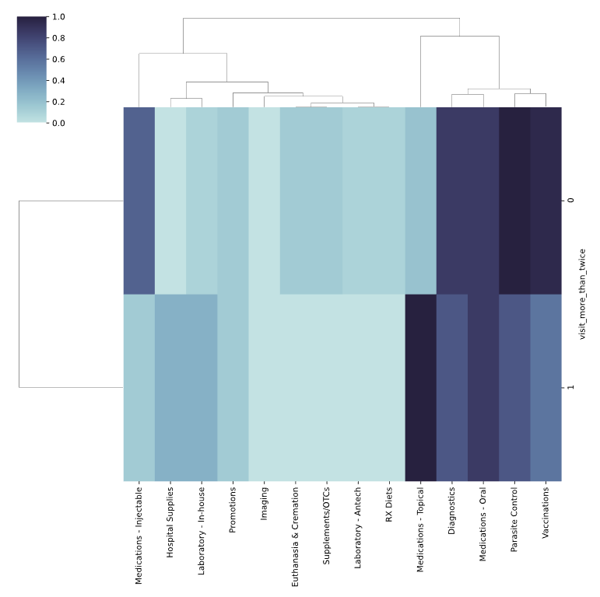
Data Exploration
More Than One Visit | Animal ID Count
No | 196
Yes | 43

Slide 9
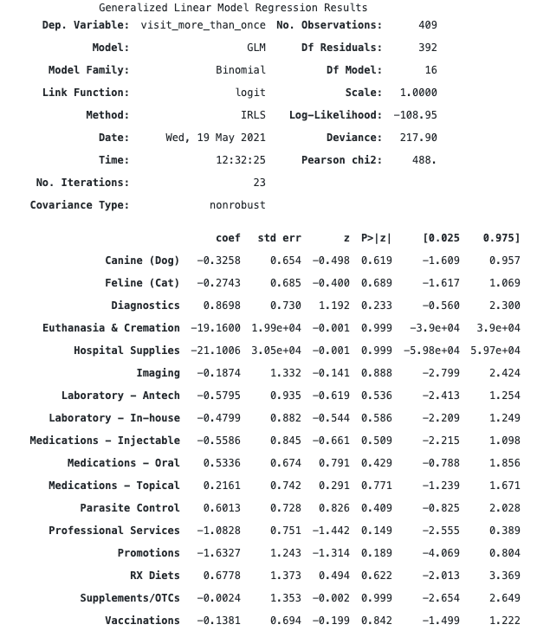
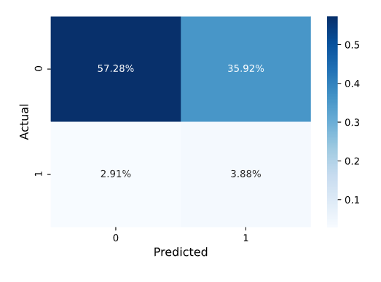
Model

