Slide 1
Customer Retention Analysis

Slide 2
Outline
Objectives
Data Exploration
Modeling

Slide 3
Objective
Determine if we can predict if a customer will return within 1 year of their first visit
Criteria
Customer has had to spend at least $100
Product group excludes surgeries

Slide 4
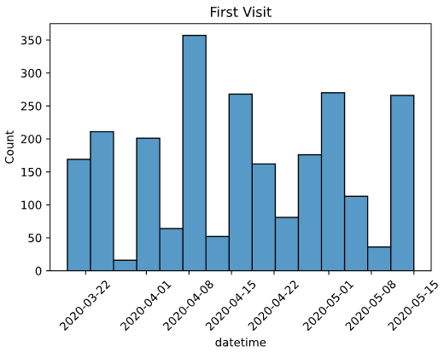
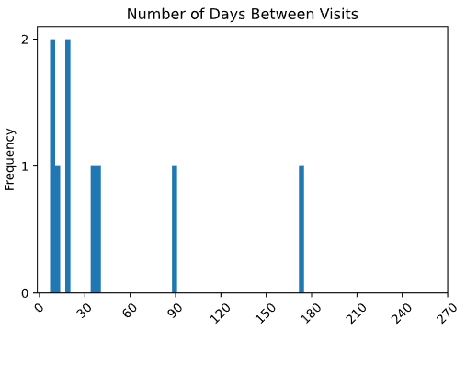
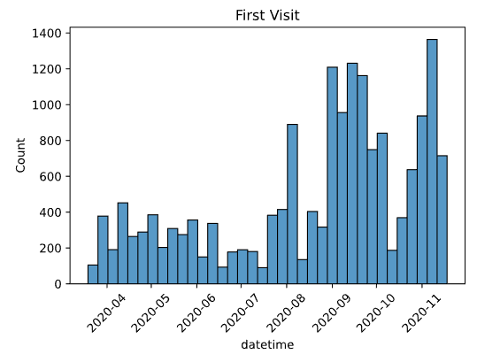
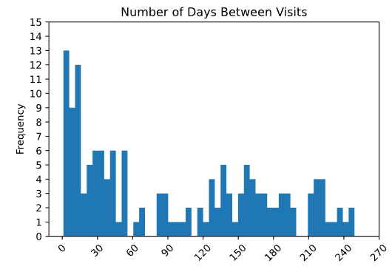
Data Exploration
Unique Animal IDs 65
Returned 15
Did Not Return 49
Ratio 23%
Unique Animal IDs 555
Returned 44
Did Not Return 511
Ratio 8%
1 Year Filter
6 Month Filter

Slide 5
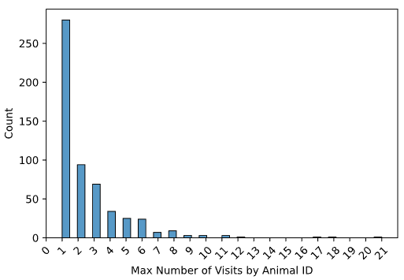
Data Exploration
Max # of Visits | Count
1 | 280
2 | 94
3 | 69
4 | 34
5 | 25
6 | 24
7 | 7
8 | 9
9 | 3
10 | 3
11 | 3
17 | 1
18 | 1
21 | 1

Slide 6
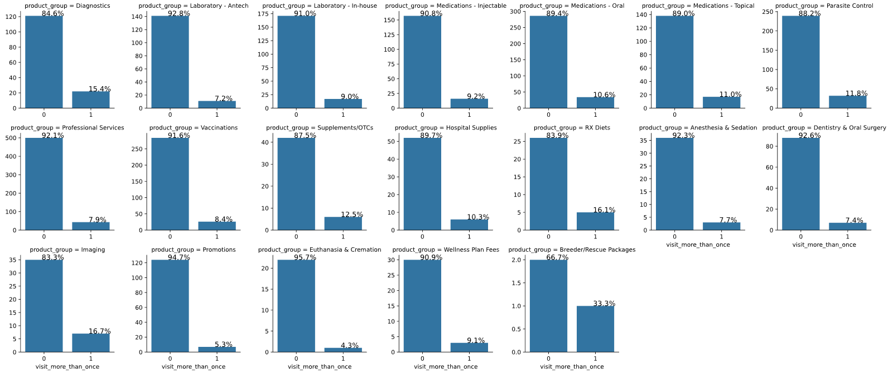
Data Exploration

Slide 7
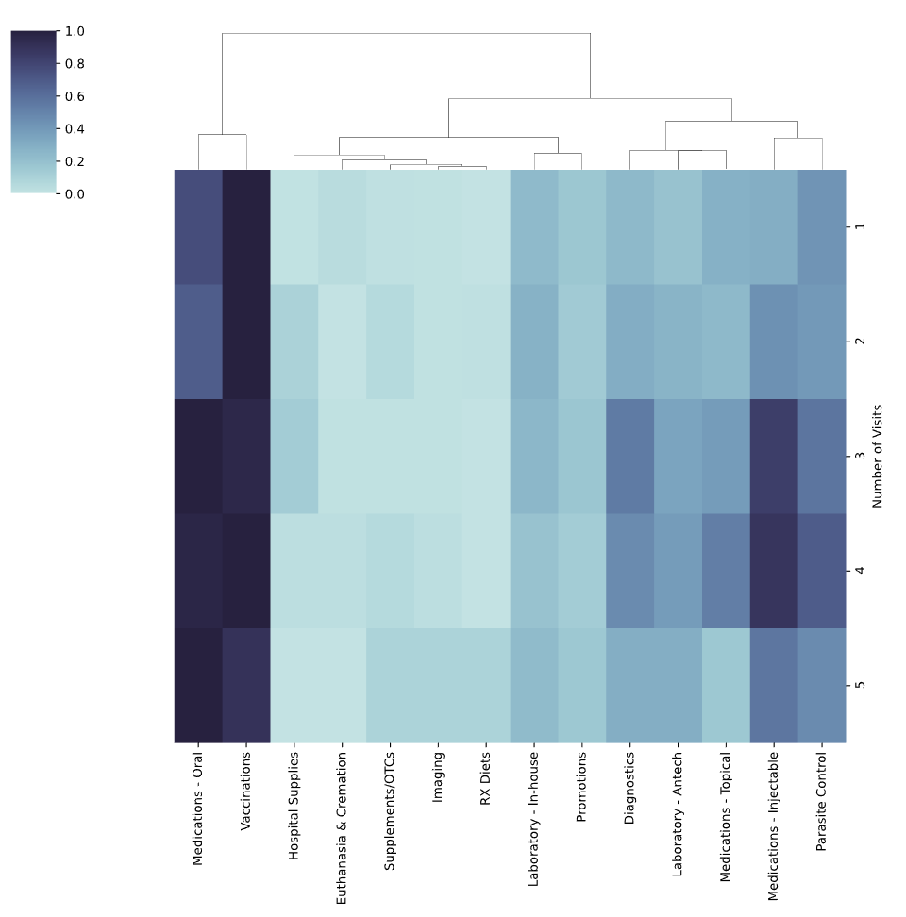
Data Exploration for Dogs
Number of Visits | Animal ID Count
1 | 484
2 | 177
3 | 114
4 | 67
5 | 44

Slide 8
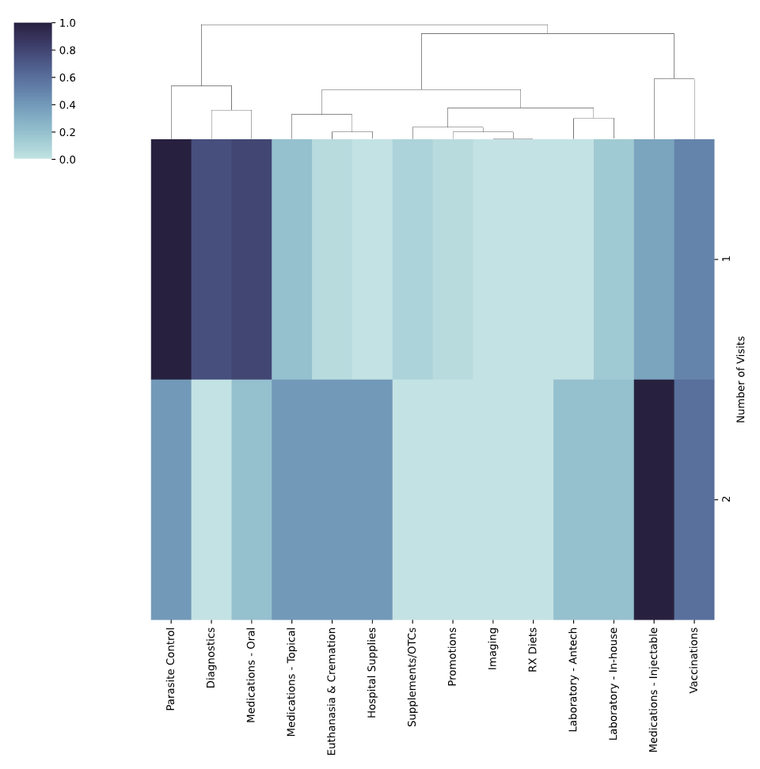
Data Exploration for Cats
Number of Visits | Animal ID Count
1 | 28
2 | 5
3 | 2
4 | 2
5 | 1

Slide 9
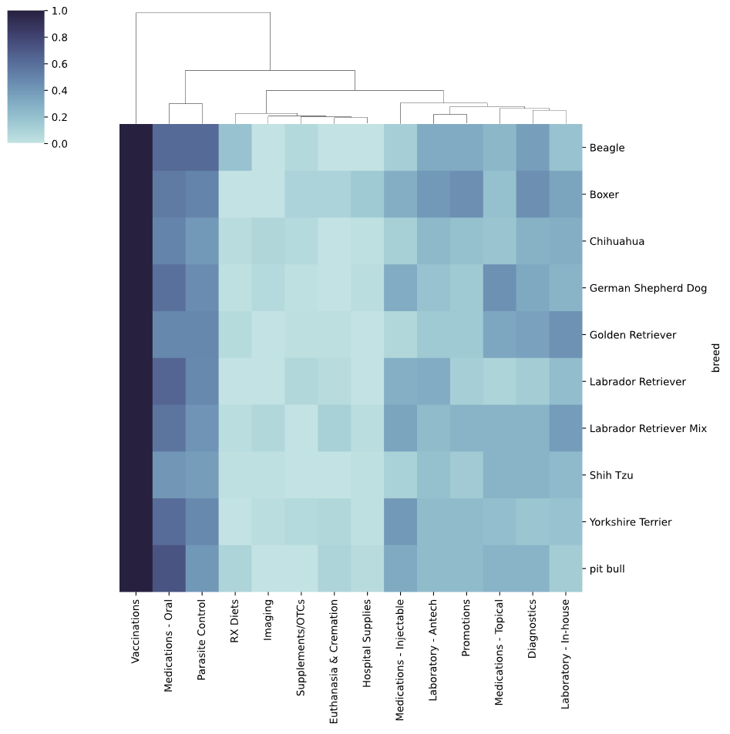
Dogs First Visit
Breed | Animal ID Count
Labrador Retriever | 73
German Sheperd | 61
Yorkshire Terrier | 59
Shih Tzu | 53
Chihuahua | 50
Golden Retriever | 44
Labrador Retriever Mix | 28
Pit Bull | 28
Boxer | 28
Beagle | 21

Slide 10
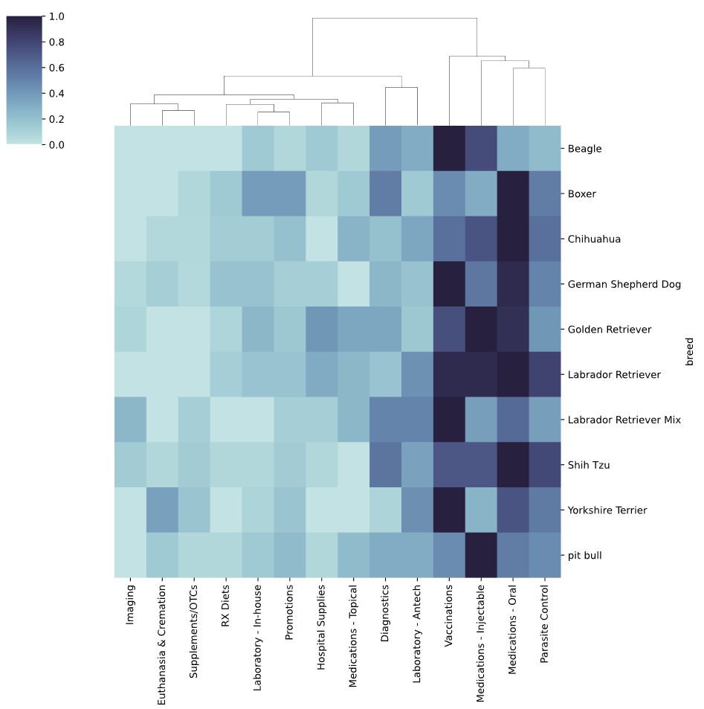
Dogs Second Visit
Breed | Animal ID Count
Labrador Retriever | 41
Shih Tzu | 31
German Sheperd | 31
Chihuahua | 25
Yorkshire Terrier | 24
Golden Retriever | 21
Boxer | 18
Pit Bull | 17
Labrador Retriever Mix | 14
Beagle | 12

Slide 11
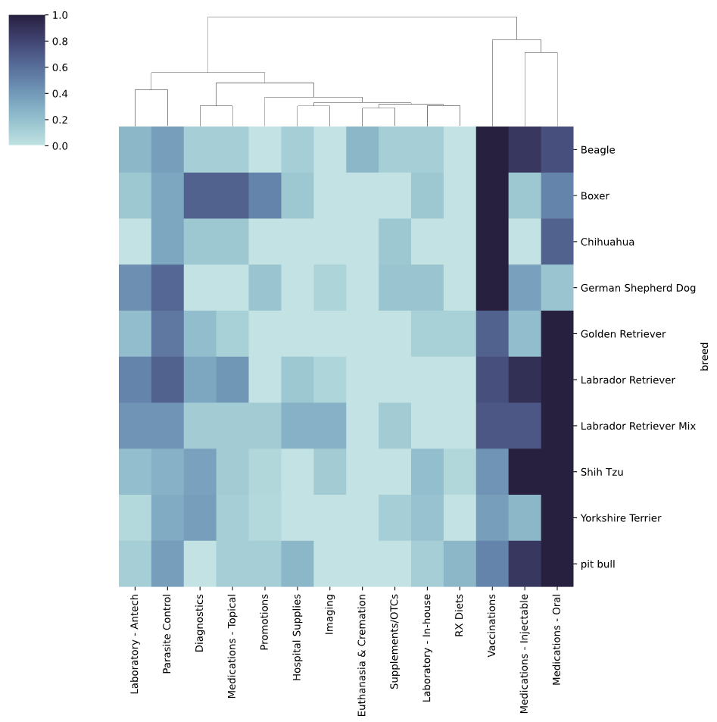
Dogs Third Visit
Breed | Animal ID Count
Labrador Retriever | 25
Shih Tzu | 17
German Sheperd | 17
Golden Retriever | 15
Yorkshire Terrier | 14
Pit Bull | 13
Boxer | 10
Labrador Retriever Mix | 10
Beagle | 9
Chihuahua | 8

Slide 12
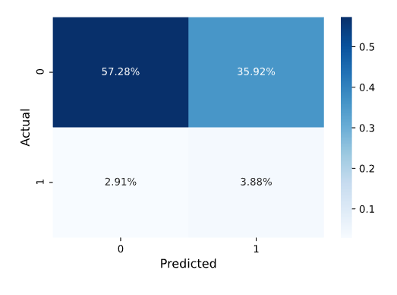
Model
Parameters Used:
Canine (Dog)
Feline (Cat)
Diagnostics
Euthanasia & Cremation
Hospital Supplies
Imaging
Laboratory - Antech
Laboratory - In-house
Medications - Injectable
Medications - Oral
Medications - Topical
Parasite Control
Professional Services
Promotions
RX Diets
Supplements/OTCs
Vaccinations
Caveats:
None of the parameters were significant
This is due to small data set consisting of 555 unique animals

