Slide 1
DMCplus
Features and Functions

Slide 2
DMCplus...AspenTech’s Advanced Control Technology
“New Generation” of control technology
Derived from both SMCA and [DMC]
Standard process control system interconnect layer
Basis for future AspenTech advanced control technology

Slide 3
Comparison of Technology
SMCA DMC
Multi-Move (v2.0*)
Change Gains
IRV
Explicit Ranks
QP-Based Steady State
N/A
CV Reference Time Based Tuning
Multi-Move
Change Gains (v5.3)
External Targets (v5.3)
Explicit Ranks (v5.3)
LP-Based Steady State
Composite LP
MV Move Suppression and Dynamic CV Weighting Tuning
Sub-Controllers
STD Transformation and Calculations
N/A
N/A
Notes:
25
22
22
18

Slide 4
Structure of DMCplus
OFF-LINE
ON-LINE
Build
VIEW
CONTROLLER
Manage
Definition
File
Simulate/
Tune
CONNECT
Model
Model
File
Collect
Data
File
PROCESS
Definition
File
Notes:
10
7
7
6
8

Slide 5
DMCplus Off-line Functions
Off-Line Tool Set Providing:
  Plant test data handling
  Dynamic model identification
  Controller definition and tag specification
  Controller simulation to establish and test initial tuning

Slide 6
DMCplus On-line Functions
On-Line Control System Consisting Of Two Layers Providing:
  DMCplus control calculations
  Interactive controller management
  Remote engineering window
    Client/server to present live controller data
  Network aware, multiple device interface
  Plant test data collection

Slide 7
Details of DMCplus
Off-line Tool
Model
Build
Simulate
View
Client
On-line Tool
Optional
Human
Interface
DAT
View
Server
MDL
CCF
Controller
Collect
Manage
Context
Control
Connect
CIM I/O
CIMIO SERVER
CIMIO SERVER
CIMIO SERVER

Slide 8
DMCplus Components
Collect
    Plant test data collection
Model
    Identify dynamic model
Build
    Define controller, specify tags
Simulate
    Simulate controller, establish tuning

Slide 9
DMCplus Components
Control
  DMCplus controller engine
Manage
  Online controller management tool
Context
  Shared memory controller data structure

Slide 10
DMCplus Components
Connect, CIMIO, CIMIO Server
    AspenTech I/O Subsystem
View Client/Server
    Display Live Controller Data

Slide 11
DMCplus-Control Structure
Economics
Costs on Manipulated Variables
Operator
Control Engineer
Limits and
Targets
Tuning
Constants
Dynamic Predictions
MV
Targets
Prediction
Module
Linear
Program
Module
Dynamic
Control
Module
Steady
State
Predictions
CV
Targets
Dependent
Variable
Values
Setpoint
Output
Values
Independent
Variable Values
Manipulated
Variable Values
DCS/Real-Time Database
Process

Slide 12
DMCplus Features
Dynamic Weighting
Future Moves
CV Limit Ranking
Standard Transforms
Input and Output Calculations
Composite Linear Program
Subcontrollers
External Optimizer Targets
Variable Gains

Slide 13
DMCplus Tuning
Equal Concern Error
  Relative importance of CV errors
  Steady-state constraints and CV dynamics
  Engineering unit scaling and prioritization
Move Suppression
  Balance MV movement and CV error
  Optimal distribution of variability

Slide 14
DMCPlus Peformance Issues
Higher Resolution in Model and Controller.
Between 30 and 360 Coefficients In Model
Up To 120 Coefficients in the Controller
Calculates Between 8 and 14 Future Moves in Each MV.
Integrators (levels)
Systems With Dead-time
Varied Process Dynamics
Normalized Move Distribution.
Optimal Path for MV Move Pattern Maintained For High Coefficient Models
=> More Model Coefficients Than Controller
Coefficients

Slide 15
Controller Prediction Routine Update
Step 1
Updated Prediction
Controlled
Variable 1
Prediction At t = 0
Controlled
Variable 2
Updated Prediction
t = 0
t = 1
t = SS
t=SS+1
Time Horizon (120 Minutes)

Slide 16
Controller Prediction Routine Update
Step 2
Partially Updated
Prediction
Controlled
Predicted Value
Variable 1
Actual Value
Fully Updated
Prediction
Actual Value
Controlled
Predicted Value
Variable 2
Partially Updated
Prediction
Prediction
Prediction Error Shift
Error
t = 0
t = SS
Time Horizon (120 Minutes)

Slide 17
Linear Program / Dynamic Control Routine
LP Target
Hi Limit
Controlled
Variable 1
Integrated Error
Low Limit
Controlled
Variable 2
LP Target
Low Limit
Manipulated
Hi Limit
Variable 1
Future Moves
LP Target
Current MV Value
Low Limit
Hi Limit
Manipulated
Future Moves
LP Target
Variable 2
Low Limit
t = 0
t = SS
)
Time Horizon (120 Minutes

Slide 18
DMCplus Controller Dynamic Weighting
WU
WM
WL
Operator
Operator
Specified
Specified
High Limit
Low Limit
Upper Transition
Lower Transition
Zone
Zone

Slide 19
Dynamic Weighting
Dynamic Weighting
  Controller Tuning is Automatically Adjusted As Dependent Variables Move Closer to Limit
  Controls Tightly Only Those Variables That Are Close To Their Respective Dependent Variable Limits
  User Specified
    Default Setting Is For A Flat Profile(Equal Weighting)

Slide 20
Dynamic Weighting (con’t.)
  On-Line Tuning
    Controller Tuning Constants Can Be Adjusted On-Line
    Move Suppression
    Equal Concern
    No Off-Line Work Is Required

Slide 21
Controller Linear Program With Dynamic Weighting
Upper
Transition Zone
LP Target
Controlled
Hi Limit
Variable 1
Integrated Error
Low Limit
Hi Limit
Controlled
2
LP Target
Variable
Low Limit
Lower transition Zone
Manipulated
Hi Limit
Variable 1
Future Moves
LP Target
Current MV Value
Low Limit
Hi Limit
Manipulated
Future Moves
LP Target
2
Variable
Low Limit
t = 0
t = SS
Time Horizon (120 Minutes)

Slide 22
CV Limit Ranking
Optional way of managing dependent variable steady-state constraints
“Sequential” dependent variable priority
Augments LP Equal Concern Errors

Slide 23
Transforms
Automatic transfomation of all controller input and output parameters
  Measurement, Hi/Lo Limits, ROC Limits, LP Target, Move, Future Prediction, etc.
Commonly used forms are available:
  Linear and Parabolic Valves
  Natural Logarithm
  Piecewise Linear
User Defined

Slide 24
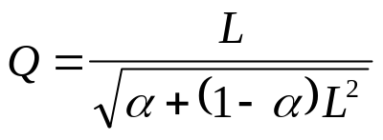
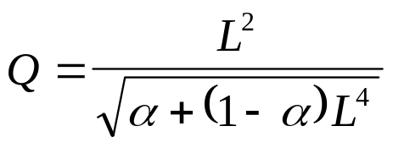
Standard Transform - Valves
Percent Maximum Flow
120
100
80
α
= 0.05
Linear
α
= 0.05
60
40
α
= 0.2
α
= 0.2
20
Equal %
0
0
10
20
30
40
50
60
70
80
90
100
Valve Position
* Taken from Perry's Chemical Engineer's Handbook - 6th Ed.

Slide 25
Standard Transform - Log
Reflux Ratio vs Overhead Product Impurity
Reflux Ratio vs Log (Overhead Product Impurity)
Overhead Product Impurity
Overhead Product Impurity
2.0
1
1.5
0
1.0
-1
0.5
-2
0.0
-3
3.75
3.8
3.85
3.9
3.95
4
4.05
4.1
3.75
3.8
3.85
3.9
3.95
4
4.05
4.1
Reflux Ratio
Reflux Ratio
Both natural and common logarithms

Slide 26
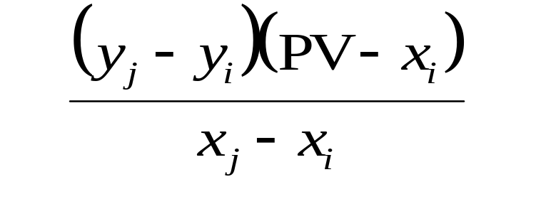
Standard Transform - Piecewise Linear
Defined by a series of line segments
Interpolation formula:
4
3
Transformed PV
Transformed Variable
2
1
0
PV
0
1
2
3
4
5
6
7
Measured Variable

Slide 27
Input/Output Calculations
Calculations involving any data in the DMCplus-Context
Can be done at two points
  After “GET” from process database
  Before “PUT” to process database
Standard arithmetic operations along with many special functions

Slide 28
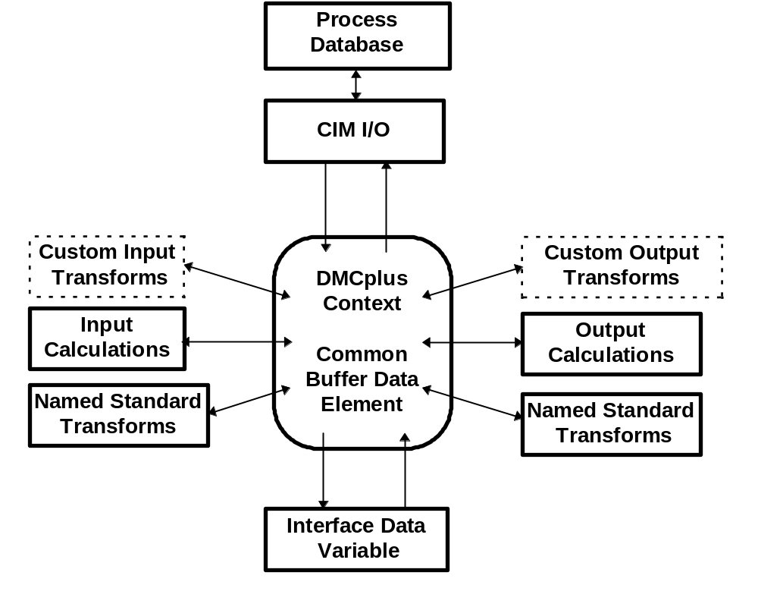
Calculation Sequence

Slide 29
Composite Linear Program
Multiple DMCplus controllers share a common LP solution
Primarily used for extremely large problems, or extreme fast/slow range
Not applicable to all processes

Slide 30
Composite Linear Program
Individual Controllers
Pred 1
Pred 2
Pred 3
LP 1
LP 2
LP 3
Move
Move
Move
Calc 1
Calc 2
Calc 3
Composite Linear Program System
Overall Prediction
Composite Linear Program
Move
Move
Move
Calc 1
Calc 2
Calc 3

Slide 31
Subcontrollers
Partitions a single large controller into logical process sections
Can improve service factors
Takes a group of related manipulated and controlled variables in and out of the controller simultaneously
No change to true controller structure

Slide 32
External Optimizer Targets
External optimizer sets “soft” targets for the DMCplus controller LP
Targets for both MV’s and CV’s
External Targets can be ranked the same way as normal limits
Overrides controller LP economics

Slide 33
Variable Gains
Extension of linearizing transformations
Steady-state gain of individual curves adjusted at each execution cycle
Gains calculated by external non-linear process model
Prediction update is based on current model gain

Slide 34
DMCplus - The Future
Objective-based control functionality
Dependent variable reference-time as an alternate basis for tuning
Major research consortium investigation into integration of control and optimization
Integration of inferential property estimation into controller

Slide 35
Long Term Plan for DMCplus
Longer Term (1 Year) Plan
  Update desktop tools (configuration, simulation, model identification): integrated package consistent with new corporate software standards
  Real-time software components: broader platform support, improved performance and integration with RT-OPT, ASPEN PLUS, etc.
  Large-scale applications
  Take product suite to new level of usability

