Slide 1
Cold Fries ARF
Davin - Programmer, Media Organizer, Facilitator
Khai- Programmer, Timekeeper
Kenny- Electrical, Team Lead
Kevin- Electrical, Treasurer, Project Manager
Michael- Programmer, Scribe
Notes:
From the Syllabus:
The presentation slides will be graded according to the following Rubric:
• Identifies Team Members, Team Structure, Disciplines, and Roles (10%)
• Content Clarity of Presentation Material (organized, summarizes findings) (20%)
• Participation Time of each Presenter (roughly equal) (10%)
The oral presentation will be graded according to the following Rubric:
• Presentation Clarity (simple language, easy to follow narrative) (20%)
• Personal Contributions Identified (and purpose of activity) (20%)
• Presentation Delivery (eye contact, gestures, practiced) (20%)

Slide 2
A.R.F.
Mission: To build an app based pet feeder that is user friendly and can care for your pets tummy while you’re gone or would like to free up daily feeding time!
Pros:
-Compatible with any type of dry food
-safe and secure (animal can’t access unportioned food)
-affordability
-slow feed mode
-Large storage capacity = less work
-Splitter to feed multiple animals
- custom voice messaging
-consistent and reliable
-easy removal of compartments for cleaning
-power cord is nice
Cons
-doesn’t portion for you
-amount of compartments being too little
-bowl hard to eat from
-only batteries
-just programs a time to give food. No app and bad user interface
-noisy operation
-confusing setup
-expense for extra functions (WOPET Feeder, smart feeder was 170$)
-unwieldy and too heavy

Slide 3
Kenny
When looking at ARF, we know that the basics that we must have on the hardware side would be a way for the feeder to work.
When designing, we want to have a way to dispense water without wasting water and using too much electricity and feed pets different foods
This can be done with an actuator, a solenoid, a motor, and some sort of device that will connect to the IoT.
We then want to have a way to dispense it in a certain way, working on the mechanicals such as a way to dispense just a cup

Slide 4
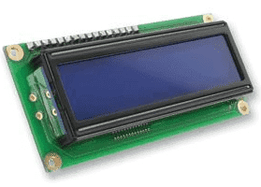
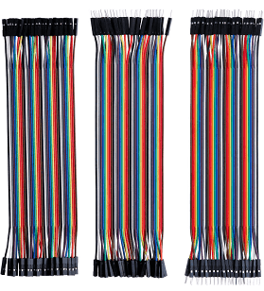
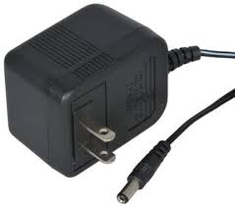
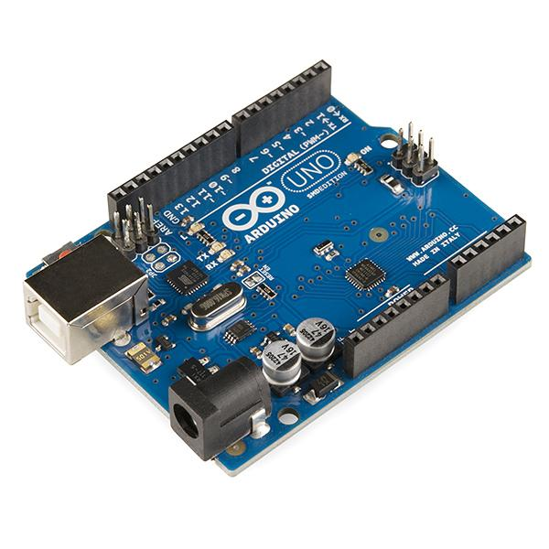
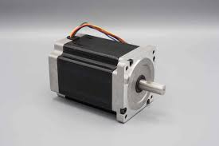
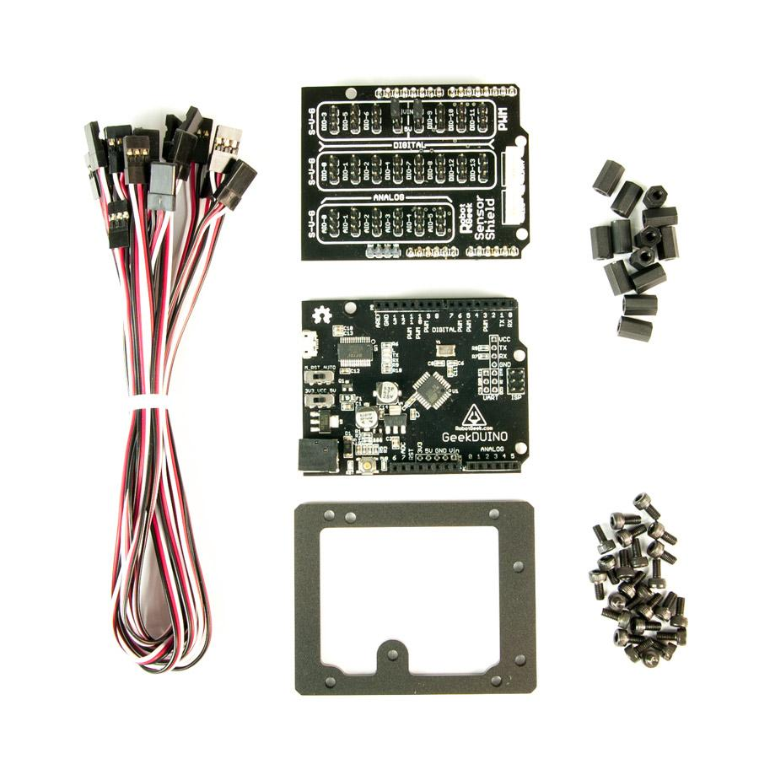
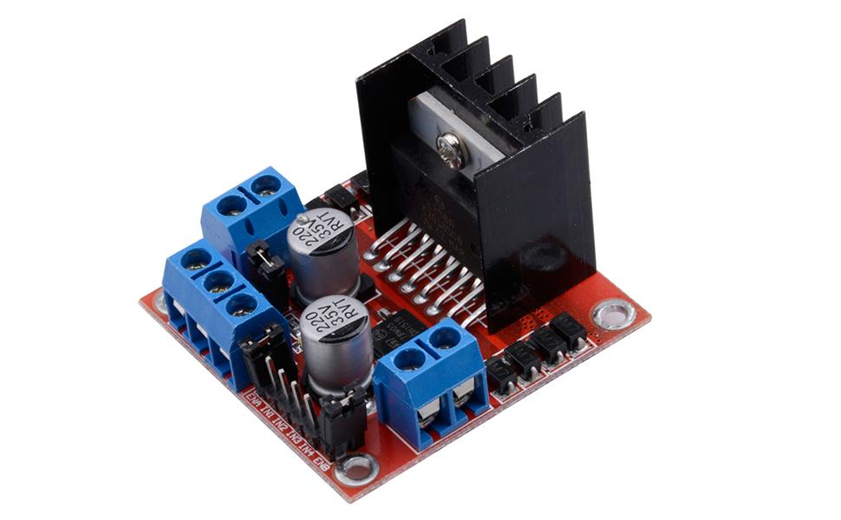
Kevin
Arduino; mega arduino? Need enough I/O to integrate all functions.
Power: 120VAC to 12VDC; Looking at motor drive controller board module or shield
Motors and components will use too many AMPS. Need to use a (Bridge, OP amp, BJT, transistor, IC) that output more amps to certain functions
Battery backup wanted
Stepper motor → auger dispensing from a hopper (as of now NEMA 14 motor that can hold 14oz/inch w/ 10VDC at 500mA = 5W
Linear actuator to shut a door
Water pump, 300 mA and 12VDC = 3.6W
LCD screen with programmable buttons for the feeder.
Notes:
AC120 to 12DC conversion- plugs into arduino (but see below) there are some issues with this. May need to find another way to connect still
Battery backup wanted
Stepper motor to run the auger that dispenses from a hopper (as of now NEMA 14 motor that can hold 14oz/inch w/ 10VDC at 500mA = 5W
This motor will probably use too many amps from arduino. Need to use a (Bridge, OP amp, BJT, transistor, IC) that output more amps. Idk which one yet. Also an issue with connecting straight to wall instead of going to that. Looking at motor drive controller board module.
For the water bowl. Thinking of adding a water pump. We need electrical systems used here and its useful to have water for the end-user… the animal needs water. The pump will keep the water ‘filtered’ could have addable filters later for the user to add.This will be probably 3.6W = 300 mA and 12VDC motor drive controller board would be nice here as well. We could also do a solenoid to release water into the bowl if preferred. This will require
Using linear actuator to shut a door at the end of the hopper or tube that goes to the hopper.
LCD screen with programmable buttons for the feeder. This will also connect to the app and can make the system dispense in person right when you want it to.

Slide 5
Davin
Different types of connections considered between the device and website
Settled on an internet connection since bluetooth has a limited range
Option to use
Once the device is connected to wifi, the website would need to be able to communicate with the device to send instructions to it
It is easy to connect to the device through the local network the device is on
Accessing the device outside of that local network would be difficult
Would need to be able to open a port that would allow the device to be found on the internet, possibly through IP address

Slide 6
Michael
Devices that work with arduino; ESP32, BeagleBone.
Suggested to do website application instead of mobile app
Choose to use a website versus app.
By doing it on a website, allows for cross-platform compatibility without the worry of recreating code on different environments
All of our CS majors have more experience using website based functions compared to mobile app development

Slide 7
Khai
-Building the structure in an offline domain using Djoin.exe. (Cut budget cost)
Active Directory state and computer state changes are completed without any network traffic to the computer
Each set of changes can be completed at a different time allowing multiple members to make active changes.
By doing it offline, it allows us to test it in an active environment before release
We will build a server to test on on the hardware spectrum and allow for remote access, then also store it on a cloud in order to allow for the backup of information
Wifi on an Arduino
The ESP8266 Wifi module is a complete Wi­Fi network where you can easily connect as a serving Wi- Fi adapter

Slide 8
