Slide 1

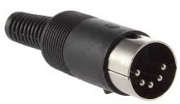
Sanyo Denki 103H5210-0440 Stepper Motor
Unipolar hybrid 0.37 nm, 24V dc, 1.2A, 6 wires
Excitation Sequence
2
1 | 2 | 3 | 4 | 5 | 6
+ | + | 0 | + | 0 | +
+ | + | 0 | 0 | + | +
+ | 0 | + | 0 | + | +
+ | 0 | + | + | 0 | +
Output Sequence
1
CW
A | B | C | D
0 | + | 0 | +
+ | 0 | 0 | +
+ | 0 | + | 0
0 | + | + | 0
3
5
6
4
Controller/Driver
shield
+V
+V
A
+V
B
A
C
B=!A
D
C
D=!C

