Slide 1

B.Tech - BCSE497J Project-I
Retrieval-Augmented Cold-Start Risk Prediction for Serverless Computing
Team members:
Parth Goyal (23BCE0411)
Saanvi Sharma (23BDS0064)
Guide: Dr. Narayanan Prashanth
Team ID: 15785UG03

Slide 2

Approval Mail From Guide
Paste the guide's approval mail here before the review.
Approval is required for: title, aim and objectives, the methodology used, and the results reported in this deck.
Due 01-09-2026.

Slide 3
Aim
• To design and evaluate RACRP - a memory-based approach to serverless keep-alive scheduling - which:
  – treats cold-start mitigation as estimation of an application's idle-gap distribution rather than as invocation-count forecasting, so that the warm window becomes a decision derived from that distribution instead of a number read off it;
  – measures, model-free, how much of that distribution is actually predictable from each context a scheduler can observe, and uses the measurement to choose the mechanism rather than assuming one;
  – derives the pre-warm offset and keep-alive length by minimising the expected cost of the warm window, replacing the platform's percentile heuristic with a knob an operator can actually price - the number of GB-minutes a cold start is worth;
  – conditions the estimate on the application's own recent state - an episodic memory of what followed similar states in its own past - with partial pooling so a thin conditional is never trusted before it is earned;
  – evaluates every arm at MATCHED memory cost against the policy actually deployed in Azure, and against a deliberately strengthened version of it that is allowed to tune both of its percentiles, since a policy that holds more containers warm always shows fewer cold starts.
• Success criterion: fewer cold starts per unit of memory-time on a real production trace, against the deployed policy rather than a straw man.
02-09-2026
SCOPE
3

Slide 4
Abstract
Serverless platforms scale to zero, so an idle application must be rebuilt before it can serve - the cold-start problem. The policy deployed in Azure Functions sets each application's warm window from two fixed percentiles of a histogram of its own idle times. We ask what that policy discards.
First, the histogram is MARGINAL: it pools every gap the application has shown and forgets the state each occurred in. A model-free information audit finds roughly 89% of the next gap's entropy irreducible - why the richer retrieval schemes we built first all failed - but localises the rest in one variable: the gap that just closed. Conditioning on it, with partial pooling towards the marginal, recovers 26.3% at matched memory cost, and recovers the deployed policy exactly as its limiting case.
Second, and larger, the WINDOW itself was never derived. A percentile is a heuristic, and not a quantity an operator can price. Minimising the window's expected cost instead - memory paid for the part of the gap it covers, against the risk of a cold start if the next invocation falls outside - replaces the percentile with K/m, the GB-minutes a cold start is worth. Optimising offset and length jointly cuts cold starts by 78.8% against the deployed policy, and 67.6% against a strengthened baseline allowed to tune both percentiles over 36 configurations. The same optimisation on another application's histogram removes the gain.
Evaluated on the Azure Functions 2019 trace over held-out days, only at matched memory spend, with a control for each claimed mechanism. We report that the two ideas do not compose, the budget at which the gain fades, and the negative results.
02-09-2026
SCOPE
4

Slide 5
Literature Review (1/2) - most recent first
# | Work (venue, year) | Approach and key result | Limitation this project acts on
[1] | Joosen et al., EuroSys 2025 | Month-long Huawei production trace: 85 billion requests and 11.9 million cold starts across five regions | Characterisation only; confirms cold starts persist at scale but provides no predictor
[2] | Han et al., ICML 2025 | RAFT: retrieval-augmented time-series forecasting conditioned on similar historical segments | Generic benchmarks; retrieval never coupled to serverless scheduling, and no measurement of whether the target series is predictable at all
[3] | Hu et al., Computing 2025 | An RNN forecasts future invocations and a pre-warming scheduler adapts idle-container lifetimes; about 49.5% more invocations served | Predicts invocation counts rather than the gap distribution the decision is actually a percentile of
[4] | Nguyen et al., arXiv 2025 | Model predictive control jointly optimises pre-warming and dispatch; up to 85% lower tail latency with 34% fewer resources | Hinges entirely on forecast accuracy; sensitive to hand-tuned horizons and cost weights
[5] | Golec et al., ACM CSUR 2024 | Systematic review and taxonomy of cold-start research | Survey only; flags prediction under sparse workloads as open but does not quantify how much is predictable
02-09-2026
SCOPE
5

Slide 6
Literature Review (2/2) - most recent first
# | Work (venue, year) | Approach and key result | Limitation this project acts on
[6] | Vahidinia et al., IEEE IoT J. 2023 | Two-layer scheme: reinforcement learning sets keep-alive duration, an LSTM forecasts invocation times to size the pre-warmed pool | Learns only from recent observations; keeps containers warm even when no cold start would have occurred
[7] | Roy et al., ASPLOS 2022 | IceBreaker predicts invocation patterns with a Fourier basis and warms functions across heterogeneous nodes; about 45% lower keep-alive cost | The Fourier basis presumes periodicity; our information audit finds time-of-day explains only 7.6% of gap entropy on this trace
[8] | Fuerst & Sharma, ASPLOS 2021 | FaasCache recasts keep-alive as object caching with greedy-dual eviction; up to about 50% more warm starts under memory pressure | Fully reactive eviction with no forecasting, so it cannot anticipate a surge after a long idle gap
[9] | Shahrad et al., USENIX ATC 2020 | Characterises the Azure Functions production workload; a hybrid histogram of inter-invocation idle times sets per-application pre-warm and keep-alive windows; deployed in Azure and the trace released publicly | The histogram is a MARGINAL distribution over an application's gaps - it discards the state each gap occurred in. This is the gap our method closes.
[10] | Xu et al., IEEE ICPADS 2019 | Adaptive Warm-Up: an LSTM predicts each function's next invocation time so containers are warmed just before it | A point forecast of a time; no notion of the uncertainty a keep-alive window is a percentile of; per-function, with no use of state
02-09-2026
SCOPE
6

Slide 7
Research Gap
• Every deployed and published method estimates one distribution per application from that application's pooled history. Histograms [9], LSTM/RNN forecasters [10][6][3], caching heuristics [8], Fourier [7] and MPC [4] all discard the state in which each observation occurred.
• That is a modelling error, not an estimation error: no amount of extra data fixes a marginal that is being asked to describe two regimes at once. An application's own history contains the answer, and the deployed policy throws it away.
• Retrieval-augmented prediction is proposed as the remedy [2], and the cold-start survey lists prediction under sparse workloads as open [5], but no published system applies retrieval to serverless scheduling - so the proposal has never been evaluated, and nobody has measured how much signal is there to retrieve in the first place.
• Second gap, and the larger one: the WINDOW itself has never been derived. Every method above, the deployed policy included, turns its estimated distribution into a warm window by taking a percentile of it. No published work argues for a particular percentile, and a percentile is not a quantity any platform operator can price. The decision is an optimal-stopping problem with an explicit cost, and treating it as one has not been tried.
• Gap addressed: we measure the predictable content of an application's idle gaps, we condition the deployed policy's own estimator on the state that measurement identifies, and we derive the warm window from the cost model instead of reading it off a quantile - using a system's own history to prepare it for its own future.
02-09-2026
SCOPE
7

Slide 8
Objectives
• O1 - Apparatus. Build a minute-tick serverless simulator validated against an independent reference implementation, and a faithful reimplementation of the ATC'20 hybrid histogram, so that every later claim rests on a trustworthy instrument.
• O2 - Information audit. Measure, model-free, how much of the next idle gap's entropy each observable context explains, and use the result to select the conditioning variable rather than assuming one.
• O3 - Conditional estimator. Condition the idle-gap distribution on the selected state, partially pooled towards the marginal so thin cells are not over-trusted, with the deployed policy recovered exactly in the limit.
• O4 - Honest evaluation. Compare every arm at matched memory cost, with a random-key control, ablations over the conditioning variable, and stratified reporting; report what the controls say even when it contradicts the headline.
• O5 - Derived decision rule. Replace the percentile heuristic that both the deployed policy and our own conditional estimator relied on with the window that minimises expected cost, optimised jointly over pre-warm offset and keep-alive length, so the operator's knob becomes a price rather than a quantile.
02-09-2026
SCOPE
8

Slide 9
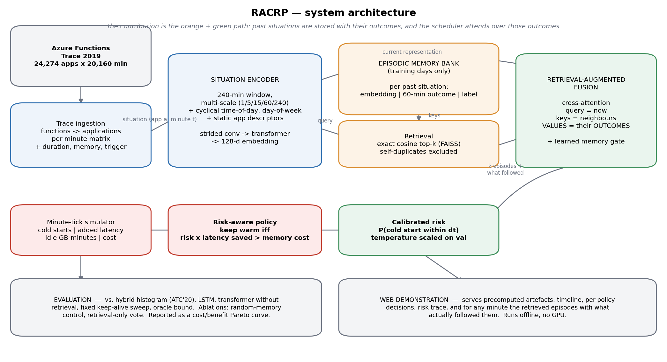
Framework / Architecture / Block Diagram
  – 1. Trace ingestion - Azure Functions 2019, 14 days, aggregated from function level to application level, since Azure allocates per app.
  – 2. Information audit - mutual information between each observable context and the next idle gap. This SELECTS the mechanism; it is not a diagnostic run afterwards.
  – 3. Episodic memory - per application, one idle-gap histogram per bucket of the gap that just closed, updated online from gaps that have already CLOSED, so no decision ever consults the future.
  – 4. Partially-pooled estimate - the conditional is blended with the application's marginal in quantile space, weighted by how much evidence supports the cell.
  – 5. Decision - the pre-warm offset and the keep-alive length are DERIVED, by minimising the expected cost of the warm window jointly over both, rather than read off the distribution as percentiles. The knob that is swept is K/m, the GB-minutes a cold start is worth.
  – 6. Simulation - every policy is replayed minute by minute and scored, and arms are compared only at equal idle GB-minutes.
• The blend weight kappa is measured in equivalent observed gaps; as it grows the estimate becomes the ATC'20 histogram exactly.
02-09-2026
SCOPE
9

Slide 10
Functional Requirements
• FR1 Trace ingestion: parse the 14-day trace, aggregate functions to applications, and build a per-minute invocation matrix with duration and memory attributes joined per application.
• FR2 Information audit: for any context and any application, quantify how much of the next idle gap's entropy that context explains.
• FR3 Episodic memory: maintain, per application, the marginal and per-state conditional idle-gap histograms, updated online and only from gaps that have already closed.
• FR4 Estimation: produce a partially-pooled idle-gap distribution for the current state, reducing exactly to the marginal when the state has no support.
• FR5 Scheduling decision: choose the pre-warm offset and keep-alive length by minimising the warm window's expected cost jointly over both, taking the price of a cold start in GB-minutes as the knob; the percentile rule is retained as the baseline it replaces.
• FR6 Simulation and measurement: replay any policy over any slice and report cold starts, added latency, warm and idle-warm minutes, memory-time and cost.
• FR7 Explanation and demonstration: expose, for any application, the marginal and conditional distributions and the different windows they imply.
02-09-2026
SCOPE
10

Slide 11
Modules
• M1 Data (racrp/data) - trace parsing, application aggregation, temporal and application-level splits, windowing, labelling, batched loading.
• M2 Simulator (racrp/sim) - minute-tick simulator and the policy family, verified against a reference implementation by randomised equivalence tests.
• M3 Baselines (racrp/baselines) - hybrid histogram (ATC'20) with the ARIMA-style fallback, fixed keep-alive sweep, scale-to-zero, oracle; plus the fleet estimator retained as a reported negative result.
• M4 Conditional estimator (racrp/baselines/conditional.py) - the method: per-state idle-gap histograms with quantile-space partial pooling, and the ablation keys including the random-key control.
• M5 Derived window (racrp/baselines/hazard.py) - the optimal-stopping rule: joint (offset, length) minimisation of the warm window's expected cost, O(range) per offset so it can be recomputed online, with the donor-application control the headline is reported against.
• M6 Evaluation (racrp/eval) - metrics with bootstrap confidence intervals, the policy harness, matched-cost interpolation, sparsity strata.
• M7 Web demonstration (racrp/web) - FastAPI over precomputed artefacts and an offline dashboard.
02-09-2026
SCOPE
11

Slide 12
Experiments and Results - the headline, at matched memory cost
Arm (all vs the deployed ATC'20 policy) | Median cold-start reduction | Range | Points
Window DERIVED from the cost model | +78.8% | +15.6% to +89.0% | 6
Derived window + conditioning | +68.6% | -20.7% to +89.3% | 6
Conditioning only (percentile window) | +26.3% | +19.0% to +30.7% | 5
CONTROL - same optimiser, a donor application's history | -427.5% | -1819.8% to -110.4% | 6
• Against a STRENGTHENED baseline - ATC'20 swept over both of its percentiles, 36 configurations, lower envelope taken, chosen with the test period in view - the derived window still wins by 67.6% median, positive at all 13 budgets.
• 1,999 applications, held-out test days 11-14, every arm swept over its own cost knob and compared only at equal idle GB-minutes.
02-09-2026
SCOPE
12

Slide 13
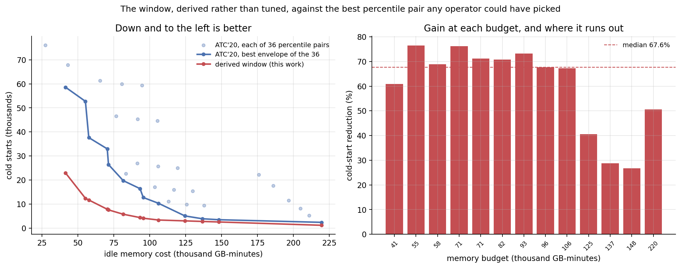
Experiments and Results - cost/benefit curves, not point claims
• Left: every one of the 36 tuned ATC'20 percentile pairs (dots), their best reachable frontier (blue), and the derived window (red).
• Right: the gain at each of the baseline's own operating points - and the budget at which it runs out. When memory is nearly free there is little left for an optimiser to recover.
02-09-2026
SCOPE
13

Slide 14
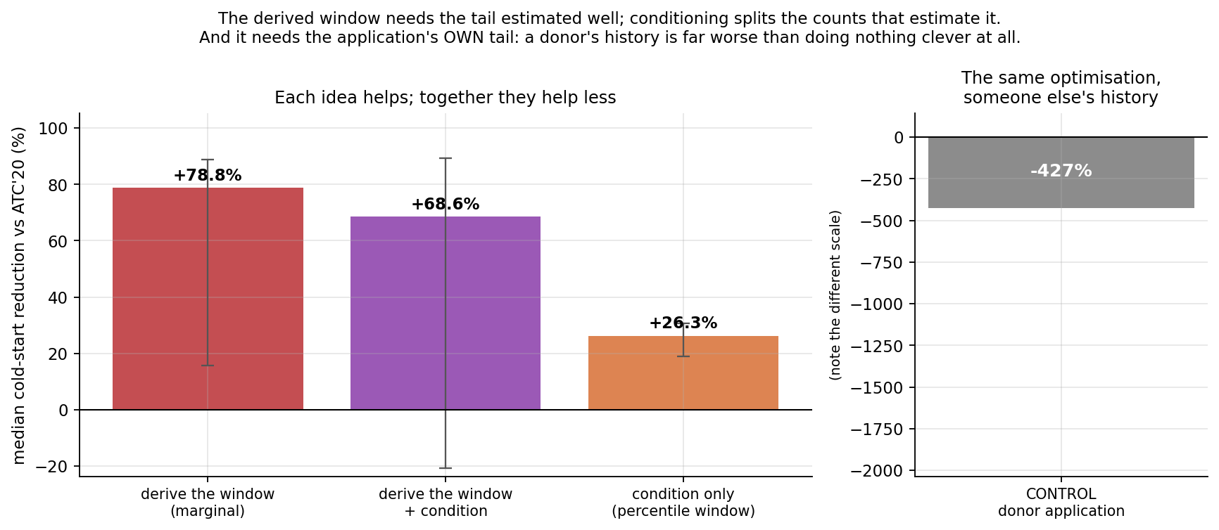
Why we believe it: the control, and a composition that fails
• The same optimiser, same price, same simulator - given ANOTHER application's gap histogram - lands at -427%, far worse than the baseline it was beating. The gain requires each application's own history.
• The two ideas do not compose: a percentile survives sparse counts, a cost-optimal window needs the tail estimated well, and conditioning fragments the counts that estimate it.
• The one hyper-parameter was chosen on VALIDATION (= 25). The setting that scores best on the test period ranks LAST on validation.
02-09-2026
SCOPE
14

Slide 15
Controls, Negative Results and Limitations
• Negative results, reported because we ran the controls
  – Retrieving situations across applications: null. Every application already had its own history in its features, so a shared memory was redundant by construction, and the random-memory control said so.
  – Borrowing idle-gap distributions across applications: loses at matched cost, and an ORACLE retriever that picks the applications whose true distribution is closest loses too. Applications are individuals.
  – Conditioning on a rich key (time of day, day of week, recent activity shape, k-nearest-neighbour lookup): loses. The information audit explains why - those contexts explain 4-9% of the gap's entropy, too little to pay for the variance of estimating a distribution from a few dozen neighbours.
• Threats to validity
  – Simulation, not deployment. Cold starts are counted in a minute-tick simulator because the trace records per-minute counts, not individual request timestamps. The cold-start latency model is taken from published measurements, so absolute latency figures are relative comparisons.
  – One instance per application. Concurrency within an application is aggregated, following the evaluation methodology of the works compared against.
  – A single trace. Results are established on the Azure 2019 trace; the Huawei trace released at EuroSys 2025 is the intended second test.
  – The information audit uses discretised contexts, so it lower-bounds what a continuous predictor could extract. The bound is loose in principle, but the measured margins are wide enough that the conclusion is robust to it.
02-09-2026
SCOPE
15

Slide 16
Conclusion
• RESULT. The deployed policy reads its warm window off two fixed percentiles. Deriving it instead - minimising the window's expected cost - cuts cold starts by 78.8% at matched memory cost, and by 67.6% against a baseline allowed to tune both percentiles. The knob becomes K/m - GB-minutes a cold start is worth - which an operator can quote.
• CONTROL FIRST. The identical optimiser on a donor application's history lands at -427%. The gain is not good window sizes on average; it needs each application's own past.
• SECOND RESULT. The same histogram is also a marginal - it forgets the state each gap occurred in. Conditioning on that state gives 26.3%, with the deployed policy recovered exactly as the limiting case. The two do not compose (68.6% together).
• WHY THIS METHOD. An information audit run before any policy found ~89% of the next idle gap's entropy irreducible, and localised the rest in the previous gap (11.0%). That one measurement explains three earlier negative results and selects the estimator.
• PROJECT-II. Non-stationarity rather than scarcity; multi-instance concurrency; carrying the derived rule to a second trace (Huawei, EuroSys'25); and the loose-budget regime where the gain fades, which we can describe but not yet fix.
02-09-2026
SCOPE
16

Slide 17
References (1/2)
[1] A. Joosen et al., "Serverless cold starts and where to find them," in Proc. EuroSys, 2025, pp. 938-953.
[2] S. Han, S. Lee, M. Cha, S. O. Arik, and J. Yoon, "Retrieval augmented time series forecasting," in Proc. ICML, 2025.
[3] Q. Hu, H. Li, and E. Nikougoftar, "Mitigating cold start problem in serverless computing using predictive pre-warming with machine learning," Computing, vol. 107, art. 27, 2025.
[4] C. Nguyen, M. Bhuyan, and E. Elmroth, "Taming cold starts: Proactive serverless scheduling with model predictive control," arXiv:2508.07640, 2025.
[5] M. Golec et al., "Cold start latency in serverless computing: A systematic review, taxonomy, and future directions," ACM Comput. Surv., vol. 57, no. 3, art. 65, 2024.
[6] P. Vahidinia, B. Farahani, and F. S. Aliee, "Mitigating cold start problem in serverless computing: A reinforcement learning approach," IEEE Internet Things J., vol. 10, no. 5, pp. 3917-3927, 2023.
[7] R. B. Roy, T. Patel, and D. Tiwari, "IceBreaker: Warming serverless functions better with heterogeneity," in Proc. ACM ASPLOS, 2022, pp. 753-767.
02-09-2026
SCOPE
17

Slide 18
References (2/2)
[8] A. Fuerst and P. Sharma, "FaasCache: Keeping serverless computing alive with greedy-dual caching," in Proc. ACM ASPLOS, 2021, pp. 386-400.
[9] M. Shahrad et al., "Serverless in the wild: Characterizing and optimizing the serverless workload at a large cloud provider," in Proc. USENIX ATC, 2020, pp. 205-218.
[10] Z. Xu, H. Zhang, X. Geng, Q. Wu, and H. Ma, "Adaptive function launching acceleration in serverless computing platforms," in Proc. IEEE ICPADS, 2019, pp. 9-16.
[11] T. M. Cover and J. A. Thomas, Elements of Information Theory, 2nd ed. Hoboken, NJ: Wiley-Interscience, 2006.
[12] C. Guo, G. Pleiss, Y. Sun, and K. Q. Weinberger, "On calibration of modern neural networks," in Proc. ICML, 2017, pp. 1321-1330.
[13] J. Johnson, M. Douze, and H. Jegou, "Billion-scale similarity search with GPUs," IEEE Trans. Big Data, vol. 7, no. 3, pp. 535-547, 2021.
[14] Microsoft Azure, "AzurePublicDataset: Azure Functions Trace 2019," https://github.com/Azure/AzurePublicDataset (CC-BY licence), accessed 2026.
02-09-2026
SCOPE
18

