Slide 1
POST-PROPOSAL REVIEW
RetinAI
Grading ROP from a single baby eye photo
What works, what broke, and the one idea we are testing next.
13,037
4
661
6
photos collected
hospitals
photos held back,
opened once
grades:
Normal, 1, 2, 3, 4/5, AP-ROP
Slides read top to bottom. Numbers come from the metric sheet at the end.
RetinAI · ROP staging

Slide 2
PART 1 · THE PROBLEM
A blindness we already know how to stop
The disease. Babies born too early can grow bad blood vessels in the retina. Left alone, the retina peels off and the child is blind for life.
Who this is for
NICU teams who need a quick second look at the cot side.
The good news. Caught in time, it is treatable.
Eye doctors who want a grade, not just a red flag.
The catch. Someone has to look. There are not enough trained eye doctors, and two doctors often give the same eye different grades.
Other researchers, who need our splits to check us.
The AI catch. Models that score 98% in a paper usually fall apart at a hospital they have not seen.
It is a research prototype. It is not a device, and it does not decide anything on its own.
Part 1 of 6
RetinAI · ROP staging

Slide 3
PART 2 · THE SYSTEM
One photo in, one grade out
photo
›
crop the circle
›
pad to a square
›
boost contrast
›
384 px
›
EfficientNetV2-S
›
grade
Three heads, one backbone
What it costs to run
What we would not bend
A stage head that knows 1 → 2 → 3 is an order, so being three stages off costs far more than being one off.
112 ms per photo on a laptop CPU. No GPU at the cot side.
A doctor signs every case. The score never files itself.
A separate yes/no head for AP-ROP, because AP-ROP is not a rung on that ladder.
70 minutes per fold on a free Kaggle P100.
Split by baby, never by photo.
A training-only branch that is meant to punish the model for recognising the hospital. See slide 8 — it did not work.
20.5 million weights. Small enough to ship, big enough to matter.
The fourth hospital stays sealed until the rules are written down.
Part 2 of 6
RetinAI · ROP staging

Slide 4
PART 3 · WHAT WE FOUND
Why published scores are so high
Most papers split their photos at random. That puts the same baby on both sides of the line.
The same model, scored three ways
Why that happens
98–100%
what papers report when they split by photo
One baby can contribute up to 470 photos. Split at random and the model sees that baby's eye in training, then gets marked on it again in the test.
78.6%
our model, split by baby, at the three hospitals it trained on
It stops being a test of the disease and becomes a memory test.
52.0%
the same model at a fourth hospital it had never seen
So every number we report is split by baby, and the confidence ranges resample babies, not photos.
The fourth hospital was opened once, on 18 Aug 2026, under rules committed to git beforehand.
Part 3 of 6 · finding 1
RetinAI · ROP staging

Slide 5
PART 3 · WHAT WE FOUND
The grade belongs to the eye. We stamped it on every photo.
This is the main finding of the project, and it is not about the network at all.
Same model. Same predictions. Only the thing being scored changes.
How often a diseased eye is called Normal, by where the camera pointed
0.52
0.80
Temporal
12.7%
looks straight at the ridge
agreement when you score
photo by photo
agreement when you pool
a whole eye first
Nasal
63.4%
looks to the nose side
A doctor grades the eye. That single grade is copied onto all four photos of it.
Posterior pole
71.7%
ROP grows at the outer edge. A photo of the middle of the eye cannot show it — but it still carries the label.
looks at the middle, away from it
The mistakes point somewhere. That is what tells you it is a labelling problem and not a blind model.
Part 3 of 6 · finding 2 · quadratic weighted kappa on the sealed hospital
RetinAI · ROP staging

Slide 6
PART 3 · WHAT WE FOUND
It is surest exactly when it is most wrong
Diseased eyes called “Normal”
What we are doing about it
186
141
Pool the eye. Grade every photo of an eye and take the worst. On the sealed hospital that alone cuts missed eyes to 17.8%.
missed cases
of them above
90% confidence
Fit the threshold on purpose. Pick the highest cut-off that still catches 90% of disease at both sites, not the one that looks best at home.
Average confidence on a miss: 0.93 — higher than when it is right.
Say what the score is. It is a ranking, not a probability. The app labels it that way until temperature scaling is fitted.
So “only act on confident answers” throws away almost nothing. You cannot threshold this away.
Part 3 of 6 · finding 3 · counts from the 6,700-photo training pool
RetinAI · ROP staging

Slide 7
PART 3 · WHAT WE FOUND
Two things we thought we had fixed, and had not
Both are reported as failures. They cost us weeks, so they belong on a slide.
The clever stage head
The anti-hospital branch
Our ordinal head and a plain softmax score the same: 0.8964 against 0.8962, p = 0.98.
A simple probe says the hospital fingerprint is gone. It looked like a win.
The plain one is better calibrated — 0.035 against our 0.109.
A fairer probe — one that holds the disease mix fixed — still reads the hospital at 0.87, against 0.85 with no defence at all.
Which one wins on F1 flips when you only change the random seed. That is noise, not a result.
Nothing was removed. The first probe was just measuring the disease.
We keep ours for one honest reason: it keeps AP-ROP off the stage ladder.
A weak test that agrees with you is worse than no test.
Part 3 of 6 · finding 4
RetinAI · ROP staging

Slide 8
PART 4 · THE NEXT TEST
The green-channel idea, and how we plan to kill it
The one new thing we are trying. We would rather it fail on our bench than in review.
The claim
We drop the idea if either of these happens
Blood vessels show up with the most contrast in the green channel of a fundus photo. Lots of papers say so. It may well be true.
It makes the hospital easier to guess, not harder.
Why the obvious version breaks
It loses to the contrast setup we already use, scored on temporal photos only — the ones that can actually see the disease.
Feeding one channel to a pretrained network throws away two thirds of its first layer and gives it colour statistics it has never seen.
What we will actually run
Written down before the run, so we cannot move the line afterwards. Three seeds, folds 1–4, one week of GPU.
Take green, boost its contrast, copy it into all three channels. Everything else — crop, padding, size, seed, folds — stays identical.
Part 4 of 6
RetinAI · ROP staging

Slide 9
PART 5 · THE BAR
What counts as done, decided in advance
≥ 0.85
≥ 0.80
≤ 0.05
agreement across our
own five folds
agreement per eye at a
hospital we never trained on
calibration error, after
temperature scaling
Rules we cannot bend later
What we are not claiming
No baby appears in two splits. No near-duplicate photos across them.
Stage 4/5 and AP-ROP at the new hospital: 4 and 12 photos. Too few to say anything.
The model must beat a cheat baseline that reads only file metadata by 2.5×.
Heatmaps are not evidence yet — attention lands on the retina barely more than chance would put it there.
The sealed hospital is opened once. It has been, and it is not reopening.
Eyes already treated, and non-ROP damage, are out of scope.
Part 5 of 6
RetinAI · ROP staging

Slide 10
PART 6 · WHO AND WHEN
Who owns what, and the next four weeks
Modelling
Data and audits
This week
laptop only
backbone, heads, calibration
splits, leakage checks, de-identification
· Scrub the last names out of the repo history.
· Fix the sampler in the structured config.
· Fit temperature scaling so the score stops lying.
Clinical analysis
App and deployment
Weeks 1–2
GPU
per-view breakdown, eye pooling, heatmaps
Flask inference, PDF reports, CI gates
· Run the green-channel test against what we use now.
· Three seeds, folds 1–4, nothing else changed.
Four lanes. Everyone can defend their own numbers.
Already banked
Weeks 3–4
clinic
13,037 photos filtered down to 8,024 usable ones across 4 hospitals.
· Ask Narayana Nethralaya to re-grade about 300 of our images.
· Compare their grades against ours, per eye.
Five backbones benchmarked; the sealed test opened once; 275 audit files in the repo.
Part 6 of 6 · target: ISBI 2027
RetinAI · ROP staging

Slide 11
THE EVIDENCE
Six figures, then every number on one page
Each one is drawn straight from a committed result file. Nothing here was redrawn by hand for the slide.
Figures 1–7
RetinAI · ROP staging

Slide 12
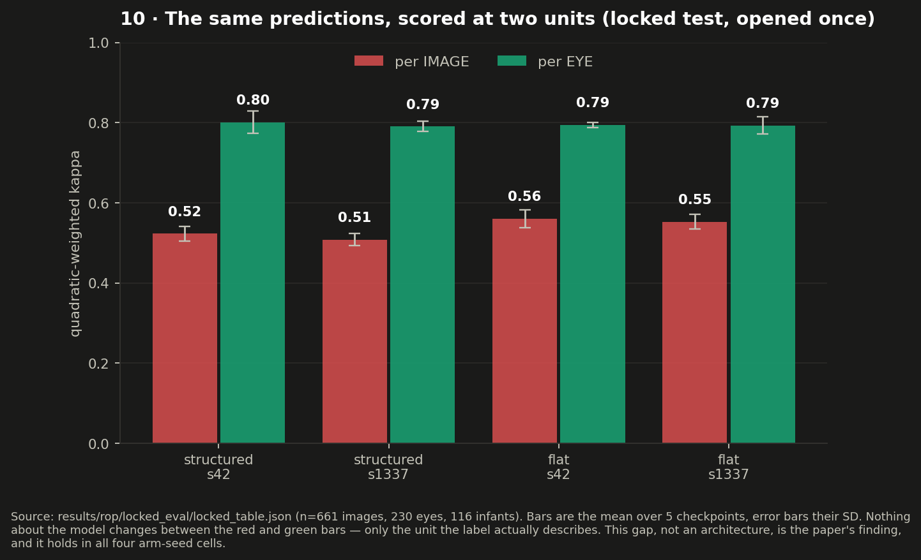
FIGURE 1
The same answers, scored two ways
Nothing about the model changes between the red and the green bar. Only what gets scored: a photo, or the eye it came from. The gap holds for both heads and both seeds, which is why we call it a measurement result and not a lucky run.

Slide 13
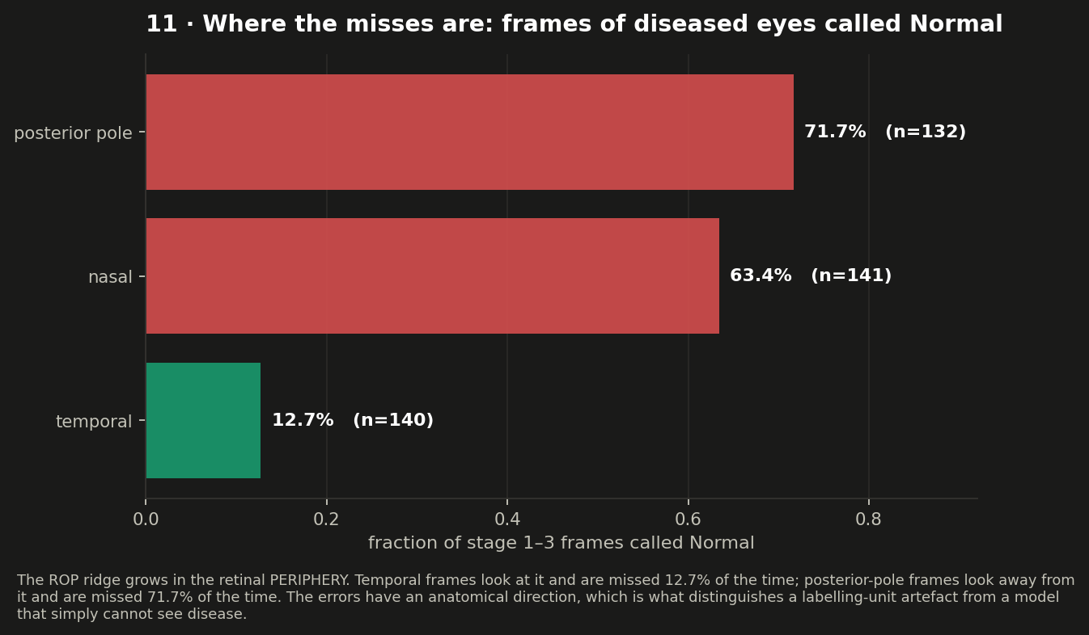
FIGURE 2
The misses have a direction
Photos pointed at the outer edge, where the ridge grows, are missed 13% of the time. Photos pointed at the middle of the eye are missed 72% of the time. A model that simply could not see disease would miss both equally.

Slide 14
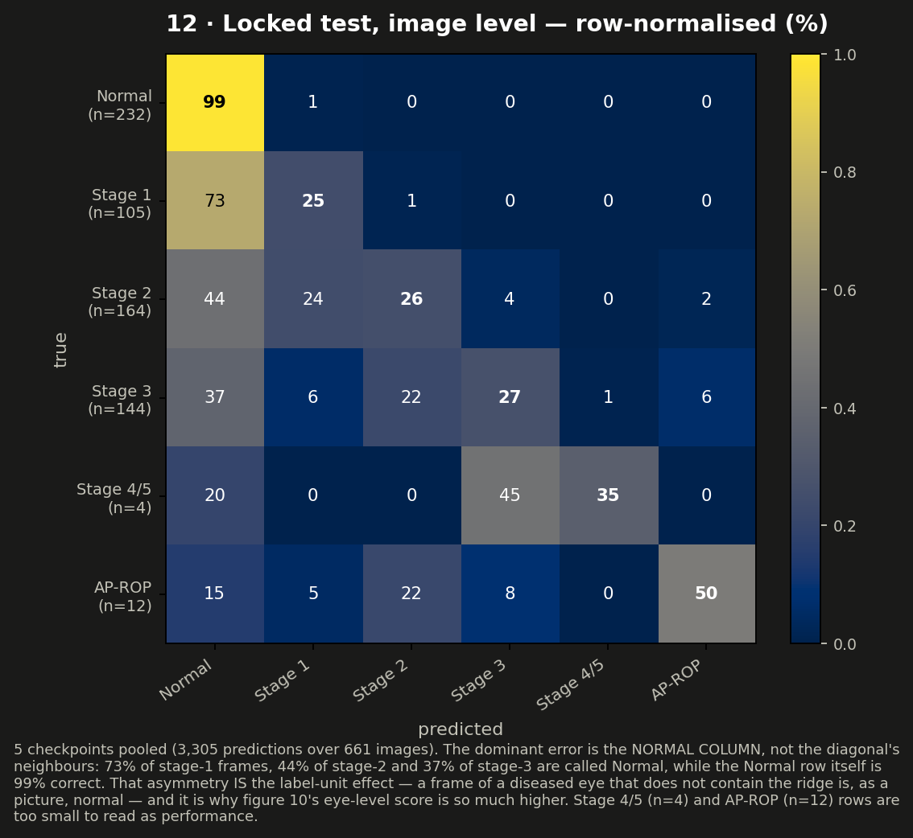
FIGURE 3
Where the mistakes land
The damage is in the Normal column, not around the diagonal. Most stage-1 frames get called Normal while the Normal row itself is 99% right — which is exactly what you would expect if some diseased frames do not contain the disease.

Slide 15
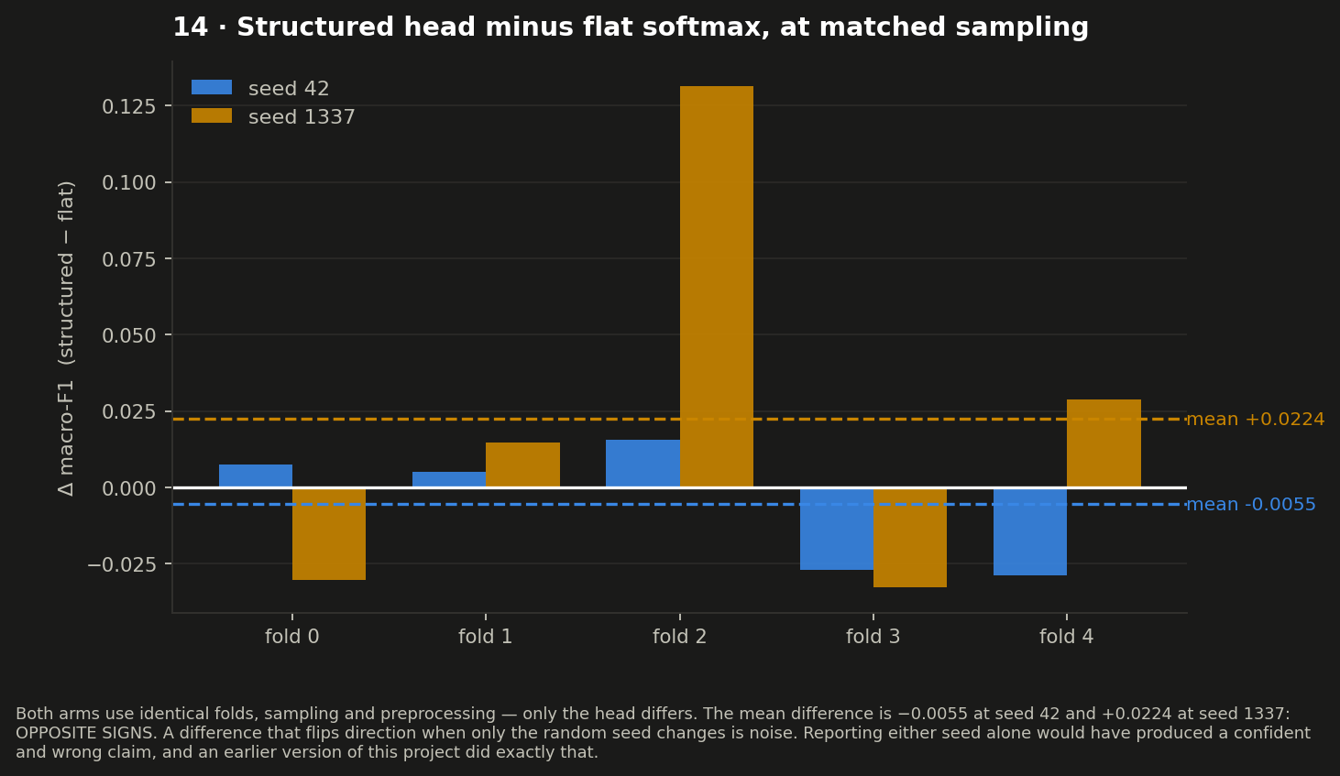
FIGURE 4
Our clever head does not beat a plain one
Identical folds, sampling and preprocessing; only the head differs. The difference changes sign when the seed changes. An earlier version of this project reported one seed and claimed a win.

Slide 16
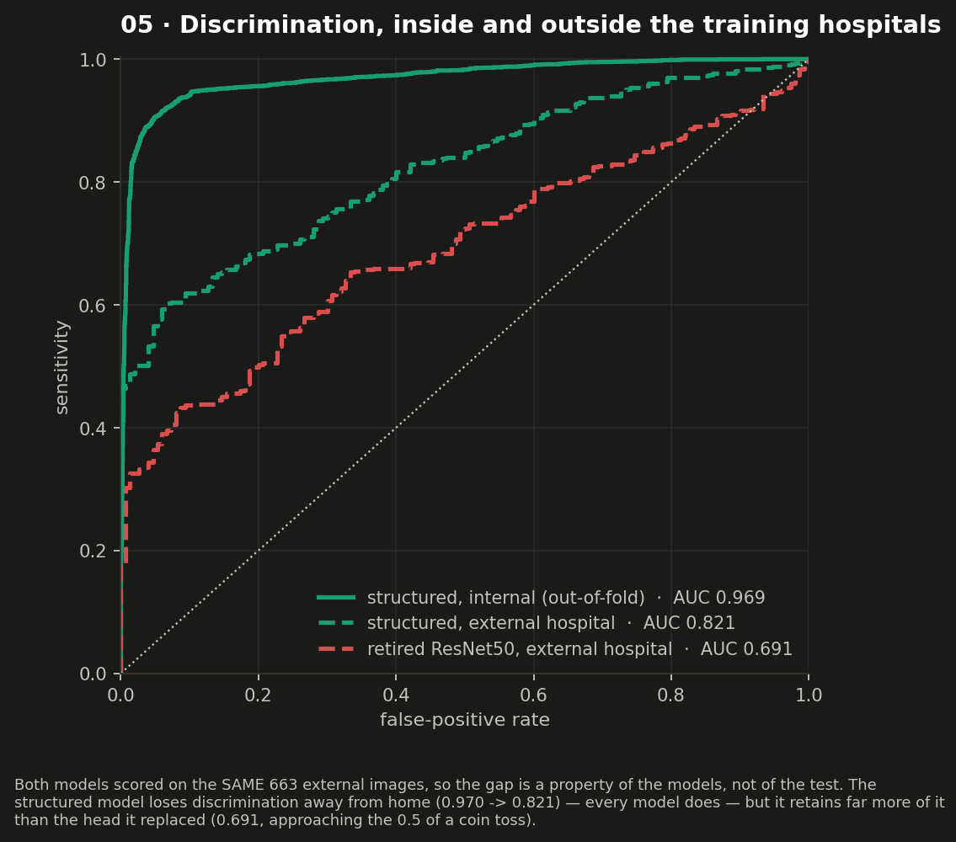
FIGURE 5
What survives the trip to a new hospital
Both models scored on the same 663 photos from a hospital neither had seen. Telling a sick eye from a healthy one travels reasonably well. The old head we retired lands near a coin toss.

Slide 17
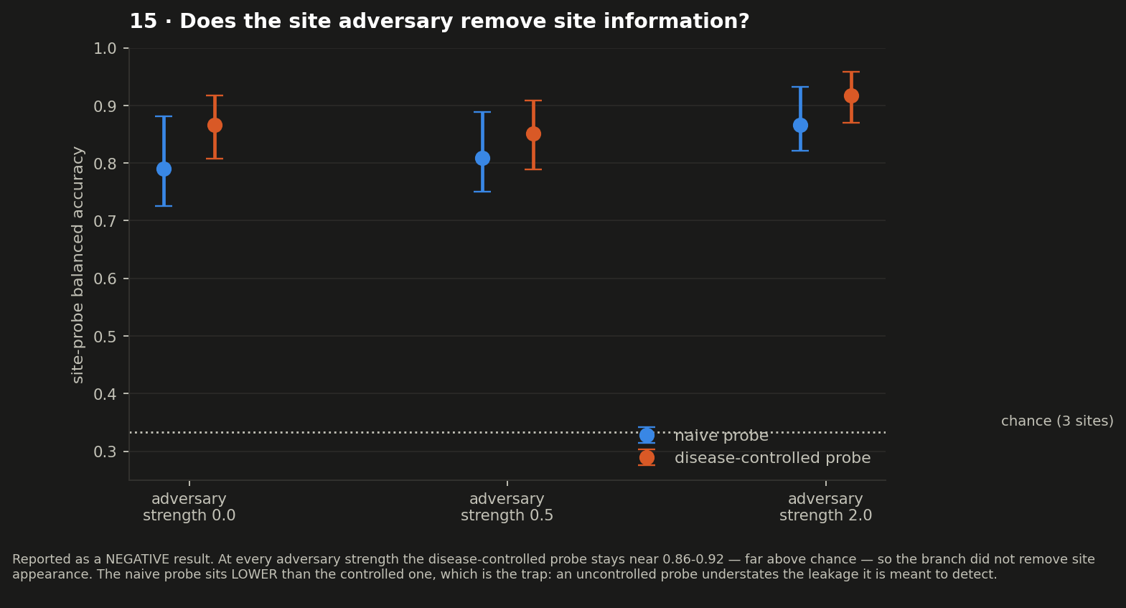
FIGURE 6
The hospital fingerprint is still there
A negative result, reported as one. At every strength of the anti-hospital branch, a probe that controls for disease still identifies the hospital. The naive probe scores lower — which is the trap: a weak test understates the leak.

Slide 18
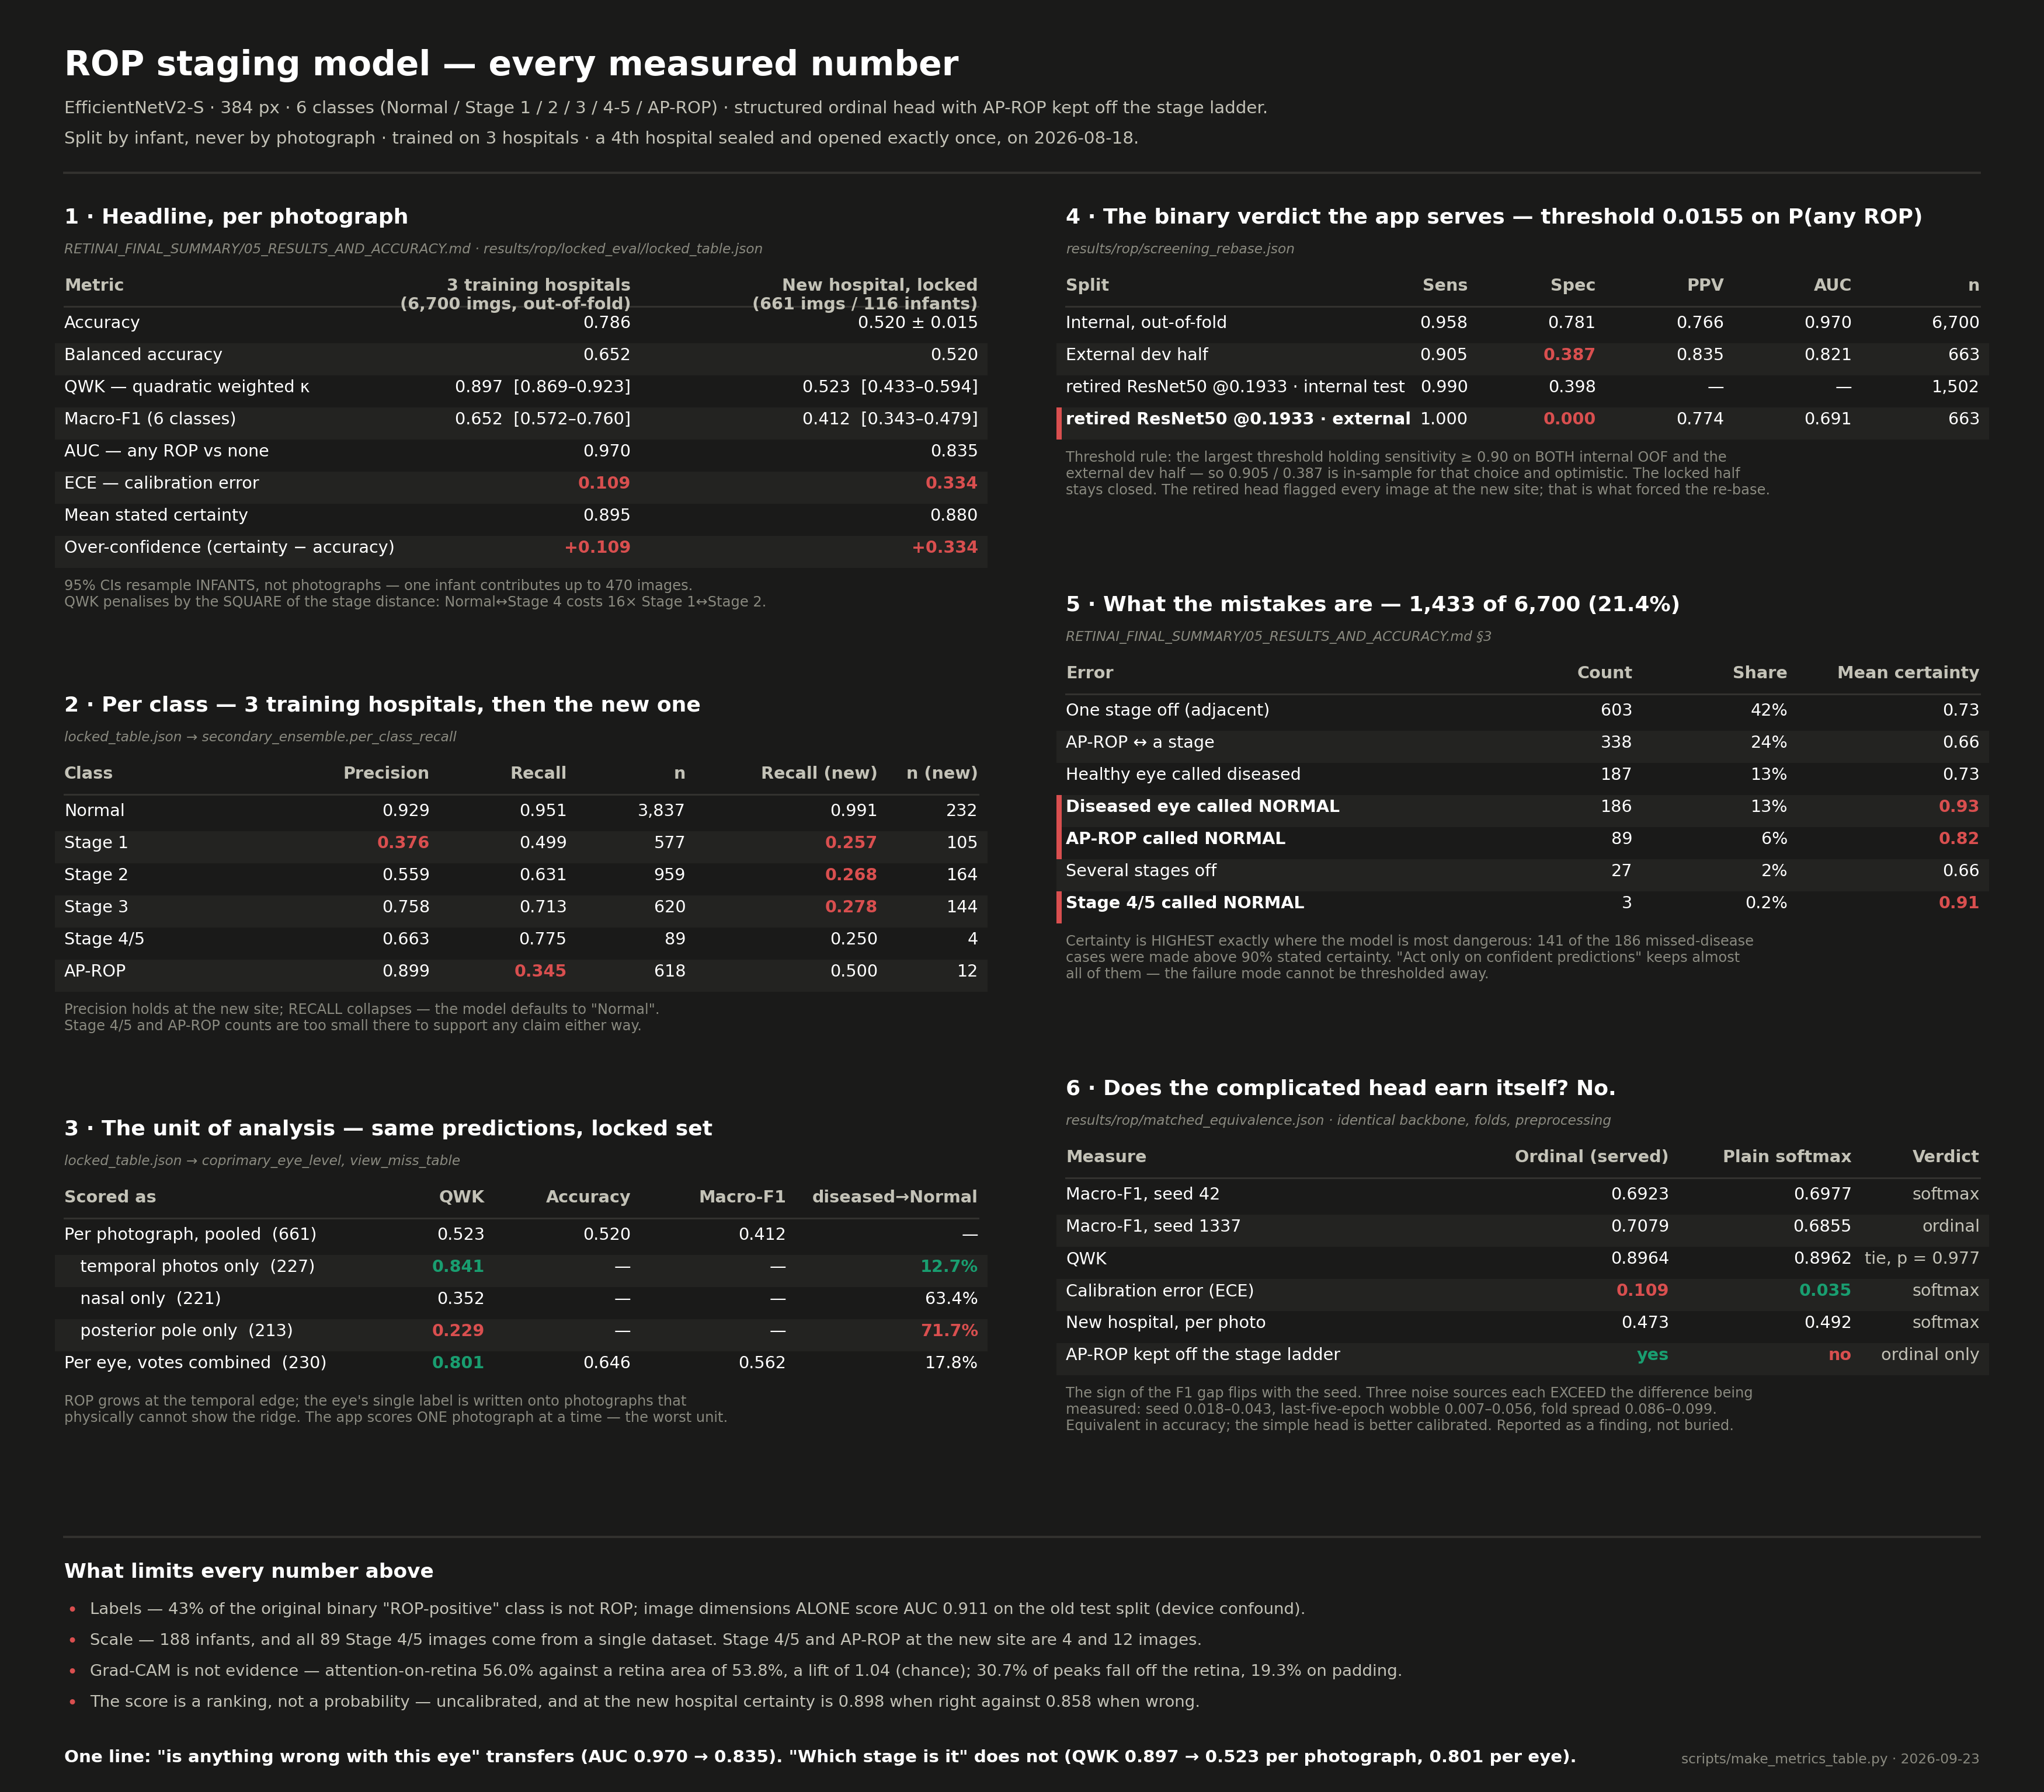
FIGURE 7
Every measured number, on one page
Each table names the file it was copied from. Red marks the rows that are dangerous rather than merely disappointing.

Slide 19
IN ONE LINE
“Is anything wrong with this eye?” travels to a new hospital.
“Which stage is it?” does not — yet.
0.970 → 0.835
0.897 → 0.523
0.523 → 0.801
any disease vs none, at home then away
which stage, scored photo by photo
the same photos, pooled per eye
The next four weeks are about closing the second line, and we know which experiment does it.
Thank you — questions welcome
RetinAI · ROP staging · Sept 2026

