Slide 1
Text

Slide 4
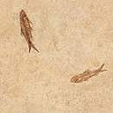


Slide 5
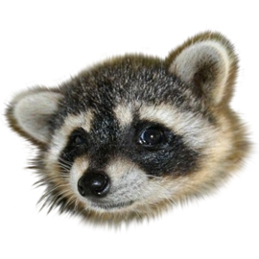

Slide 6


Slide 8


Slide 11



Slide 13


Slide 16
T€kśt☺➔
T€kśt☺➔
T€kśt☺➔
T€kśt☺➔
T€kśt☺➔
T€kśt☺➔
T€kśt☺➔
T€kśt☺➔
T€kśt☺➔
T€kśt☺➔
T€kśt☺➔
T€kśt☺➔
T€kśt☺➔
T€kśt☺➔
T€kśt☺➔
T€kśt☺➔
T€kśt☺➔
T€kśt☺➔
T€kśt☺➔
T€kśt☺➔
T€kśt☺➔
T€kśt☺➔
T€kśt☺➔
T€kśt☺➔
T€kśt☺➔
T€kśt☺➔
T€kśt☺➔
T€kśt☺➔
T€kśt☺➔
T€kśt☺➔

Slide 17
QWERTYUIOP{}
QWERTYUIOP{}
QWERTYUIOP{}
QWERTYUIOP{}
QWERTYUIOP{}
QWERTYUIOP{}
QWERTYUIOP{}
QWERTYUIOP{}
QWERTYUIOP{}
QWERTYUIOP{}

Slide 18
Click on them
Camera
Chimes (from file)
Calculator

Slide 19
Minefield
Enable rotor

Slide 20





You should hear XP startup sound…
← chord.wav
← a recorded sound
Stop sound
← 10 sec of CD audio track 1
← flourish.mid
← wave sound object

Slide 21
Entry animations
ABC
ABC
ABC
ABC
ABC
ABC
ABC
ABC
ABC
ABC
ABC
ABC
ABC
ABC
ABC
ABC
ABC
ABC
ABC
ABC
ABC

Slide 22
Emphasize animations
ABC
ABC
ABC
ABC
ABC
ABC
ABC
ABC
ABC
ABC
ABC
ABC
ABC
ABC
ABC
ABC
ABC
ABC

Slide 23
Exit animations
ABC
ABC
ABC
ABC
ABC
ABC
ABC
ABC
ABC
ABC
ABC
ABC
ABC
ABC
ABC
ABC
ABC
ABC
ABC
ABC
ABC

Slide 24
Path animations
ABC
ABC
ABC
ABC
ABC
ABC
ABC
ABC
ABC
ABC
ABC

Slide 25
Text animations
The quick brown fox jumps over the lazy dog.
The quick brown fox jumps over the lazy dog.
The quick brown fox jumps over the lazy dog.

Slide 26
A

Slide 27
B

Slide 28
A

Slide 29
B

Slide 30
A

Slide 31
B

Slide 32
A

Slide 33
B

Slide 34
A

Slide 35
B

Slide 36
A

Slide 37
B

