Slide 1
Numerical optimization 10 January 2022
Fitting hierarchical models with TMB
10-14 January, 2022
University of Concepción, Chile
Dr. Cole Monnahan

Slide 2
Maximum likelihood estimation
Fitting statistical models often uses a technique called maximum likelihood estimation
(Technically, we minimize the negative log-likelihood (NLL))
“x” is our parameter vector, “f(x)” is the NLL
Has good properties as data increases, e.g.:
Consistency
Asymptotic normality
But is not always unbiased!
It is widely used, including for our class here

Slide 3


Probabilities vs likelihoods
The difference can be confusing
$$N(μ=?,σ=?)$$
$$N(μ=2,σ=1)$$
Model
Likelihood
Probability
Data
$$x=\{2.1,3.9,−1.2\}$$
$$x=\{??\}$$

Slide 4
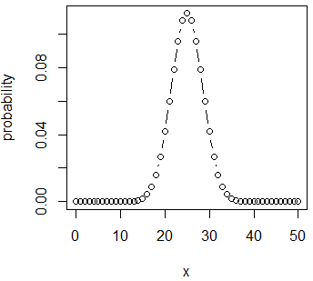
Probabilities vs likelihoods
Simple example:
We flip a fair coin 50 times
Pr(heads)=p=0.5
What is the probability of getting x=# heads={0,1,..50}?
probabilities=
choose(50,x)*0.5^x*(1-0.5)^(50-x)
sum(probabilities)=1
Why???
Important constant
x heads
50-x not heads (tails)

Slide 5
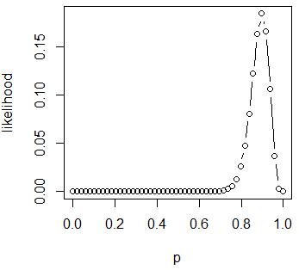
Probabilities vs likelihoods
Simple example:
We observe 50 coin flips: x=45 heads, 5 tails
[Do you think p=0.5)?]
Likelihood of p, given observed data
likelihoods=
choose(50,45) * p^45 * (1-p)^5
sum(likelihoods)!=1
Why???
Constant (ignore)
45 heads
5 not heads (tails)

Slide 6
Probabilities vs likelihoods
This distinction is incredibly important and we will minimize likelihoods all week
Probabilities:
Parameters/model known, data unknown
Sum over Pr(x)=1 by definition
Likelihoods:
Data known, parameters/model unknown
Sum over Pr(p) != 1 and is not meaningful
We care about relative likelihoods
Likelihood(p=.9|x=45)/likelihood(p=.5|x=45)
=98,268,134
It is extremely unlikely the coin is fair
What is the most likely value for p?

Slide 7
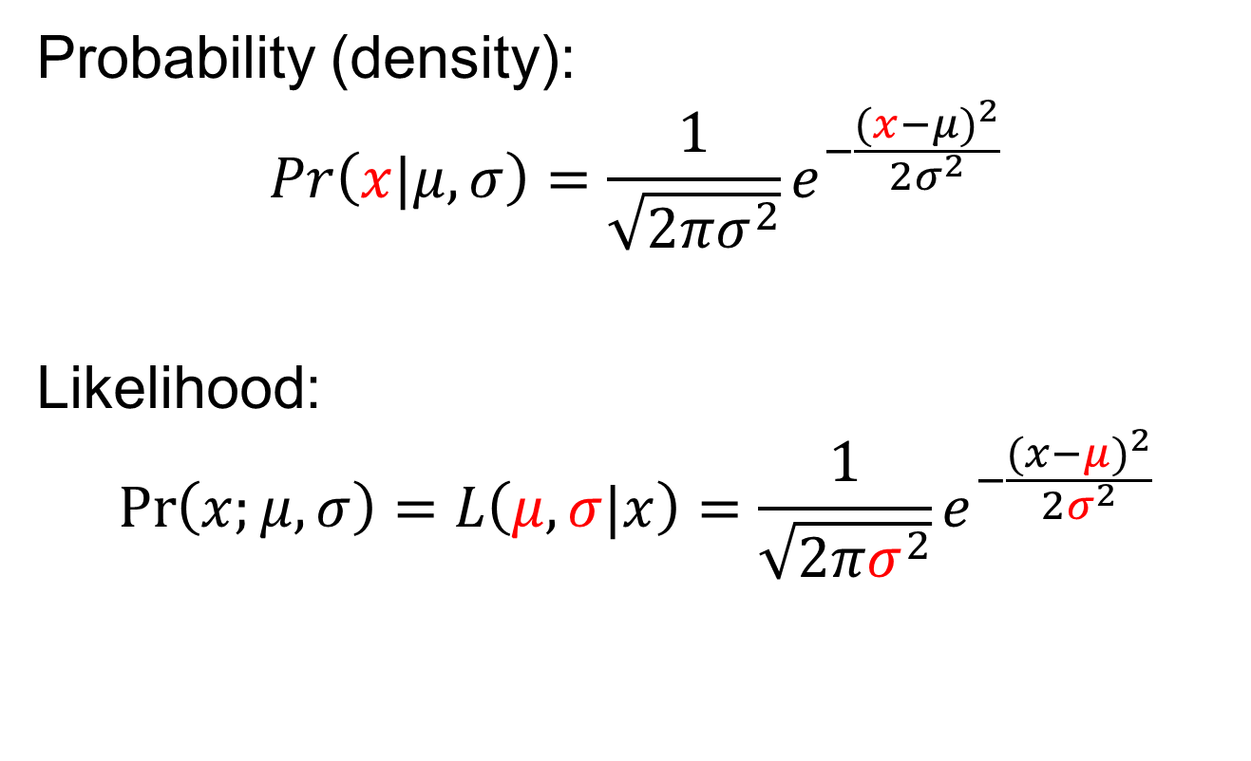
Example: Normal likelihood
Probability (density):
$$Pr\left(x|μ,σ\right)=\frac{1}{\sqrt{2πσ^{2}}}e^{−\frac{{(x−μ)}^{2}}{2σ^{2}}}$$
Likelihood:
$$\operatorname{Pr}\left(x;μ,σ\right)=L\left(μ,σ|x\right)=\frac{1}{\sqrt{2πσ^{2}}}e^{−\frac{{(x−μ)}^{2}}{2σ^{2}}}$$
But calculated the same in R!
dnorm(x=2, mean=3, sd=1)

Slide 8
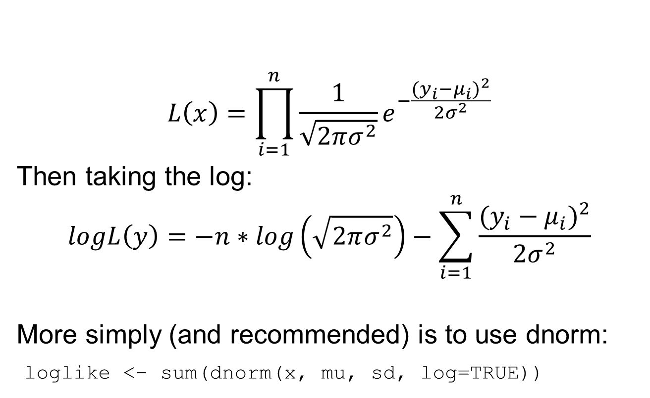
Example: Normal likelihood
$$L\left(x\right)=\prod_{i=1}^{n}{\frac{1}{\sqrt{2πσ^{2}}}e^{−\frac{{(y_{i}−μ_{i})}^{2}}{2σ^{2}}}}$$
Then taking the log:
$$logL\left(y\right)=−n∗log\left(\sqrt{2πσ^{2}}\right)−\sum_{i=1}^{n}{\frac{{(y_{i}−μ_{i})}^{2}}{2σ^{2}}}$$
More simply (and recommended) is to use dnorm:
loglike <- sum(dnorm(x, mu, sd, log=TRUE))
If independent, multiply data points together
Sum of squares

Slide 9
Example: Normal likelihood
μ is the expected value, a function of parameters
The “MLE” is the set of parameters which maximize the likelihood of the data
Constants have no effect on optimization, but often best to leave them in
Same ideas for other likelihoods (Poisson, binomial, etc.)

Slide 10
Exercise: Poisson likelihood
See the Poisson probability mass function (pmf)
Identify which terms are data and parameters
Take log by hand and write out R function to calculate -log-likelihood for single data point
[Hint: k!=factorial(k)]
Evaluate for k=4 and lambda=5.5
Check answer with -dpois(k, lambda, TRUE)
Plot NLL for lambda between 0 and 15
What is the minimum of this function?

Slide 11
Fitting MLE models: basics
Goal: find the MLE which is the parameters that minimize the NLL
Usually need to use numerical optimization
Need to specify starting value that is reasonable
Need to be careful to constrain parameters appropriately (e.g., σ>0; 0<p<1) with transformations
logsigma parameter, then use exp(logsigma)

Slide 12
Fitting MLE models: details
Algorithm approaches minimum but may never achieve it
Thus, “convergence” = sufficiently close to global minimum
Typically when maximum gradient is <0.0001
Warning: Can get “stuck” in local minima (bad!)
Test: multiple initializations arrive at same MLE
You are responsible for assuring convergence!

Slide 13
Example: Linear model
We will use a simple linear model to demonstrate maximum likelihood fitting
We will fit the model three ways:
Using the lm function in R
Using R optimizer with R NLL
Using R optimizer with TMB NLL
The goal is to introduce some key concepts and get practice with TMB

Slide 14
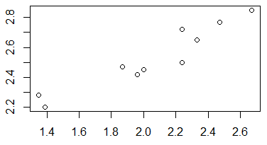

Linear model 1: with lm command
x <- c(1.87, 1.96, 1.39, 2.24, 2.33, 2.24, 2.67, 2.47,
1.35, 2.00)
y <- c(2.47, 2.42, 2.2, 2.72, 2.65, 2.5, 2.85, 2.77,
2.28, 2.45)
We assume model: $y=intercept+slope∗x$
lm(y~x)
Note: This way uses an analytical solution

Slide 15
Linear model 2: by hand in R
nll <- function(pars){
intercept <- pars[1]
slope <- pars[2]
sd <- exp(pars[3])
## Predict y given parameters
mu <- intercept + slope*x
## Calculate log-likelihood
nll <-
-sum(dnorm(y, mu, sd, log=T))
return(nll)
}
fit.R <-
nlminb(start=pars, objective=nll)
R function that
Inputs parameters
Returns NLL
Need to explicitly model variance term
Note the use of exp() to keep it positive
We don’t have a gradient function

Slide 16
Linear model 3: with TMB
TMB looks similar to R
We have a gradient function!
[Look through TMB code]
… TMB code:
<ignore other code for now>
vector<Type> mu(y.size());
mu=intercept+slope*x;
nll=-sum(dnorm(y, mu, sd, true));
return nll;
…
fit.tmb <- nlminb(start=pars,
objective=obj$fn,
gradient=obj$gr)

Slide 17
Linear model comparisons
> fit.R
$par
[1] 1.5774 0.4647 -2.735
$objective
[1] -13.16127
$convergence
[1] 0
$iterations
[1] 13
$evaluations
function gradient
22 48
nlminb returns a list with elements:
Optimal parameters (par)
Minimum NLL (objective)
Convergence status (0=converged)
How many steps it took (iterations)
# of times it used the function (evaluations)
Finite difference

Slide 18
Linear model comparisons
TMB prints the maximum gradient component (mgc) at each iteration (step)
Getting smaller and smaller
What happens if we evaluate the gradient function at the MLE?
Note: R has no idea it is using TMB!
fit.tmb <- nlminb(start=pars,
objective=obj$fn, gradient=obj$gr)
outer mgc: 99.40139
outer mgc: 5.990303
outer mgc: 132.3652
outer mgc: 108.0497
outer mgc: 4.673943
…
outer mgc: 0.1184033
outer mgc: 0.005721744
outer mgc: 0.0002056732
outer mgc: 1.404738e-05

Slide 19
What about the variance term?
R shows the variance estimate in the summary()
Residual standard error: 0.07255
Does this match our MLE?
> exp(fit.tmb$par[3]) [1] 0.06488976
No! lm does not use maximum likelihood to estimate the variance!!
It uses Restricted Maximum Likelihood (REML) which is better in this case (we will do this with TMB later)
Remember: MLEs can be biased (and are for variances)

Slide 20
Review of key concepts
Given data and a model expectation, can calculate likelihoods
To “fit” statistical models we numerically optimize the –log-likelihood to find the MLE
Same as maximizing the likelihood
Optimization is better with gradients, and TMB calculates those easily
We use exp() to keep parameters positive
The MLE variance is biased

Slide 21
Questions?

