Slide 1
More Complex Models in TMB
Fitting hierarchical models with TMB
15-19 January, 2018
University of Concepción, Chile
Dr. Cole Monnahan

Slide 2
Spatiotemporal models in TMB
Spatial/Geospatial/Spatiotemporal is a type of model where errors are correlated in space (and time).
We had spatial patterns in our residuals for CPUE analysis. That is, the residuals are correlated, so our IID assumption failed
Spatial models use correlated residuals: nearby sites are more similar than distant sites
This is Geostatistics/Spatiotemporal modeling, and is a huge literature. (see Thorson & Hendrix course materials)

Slide 3
Brief spatial model in TMB
Each site (row of data) has a random effect (n).
Then create an n x n matrix of pairwise differences all points are from all others = “dd”
Then specify a function which relates distance to correlation. From there we can build a covariance matrix:
// Exponentially decaying correlation
cov(i,j)=exp(-a*dd(i,j));
cov(j,i)=cov(i,j);

Slide 4
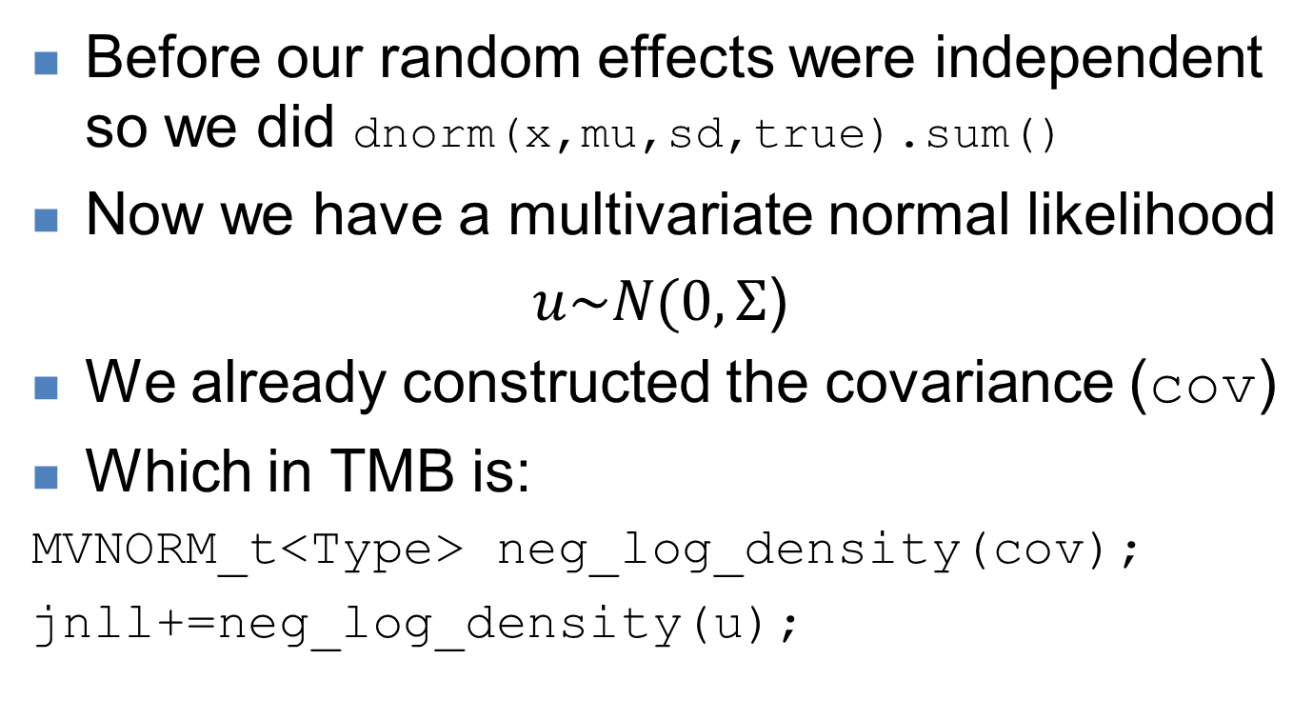
Brief spatial model in TMB
Before our random effects were independent so we did dnorm(x,mu,sd,true).sum()
Now we have a multivariate normal likelihood
$u\sim N(0,Σ$)
We already constructed the covariance (cov)
Which in TMB is:
MVNORM_t<Type> neg_log_density(cov);
jnll+=neg_log_density(u);

Slide 5
Brief spatial model in TMB
We have a few extra parameters associated with the spatial process:
A variance
A decay rate
A vector of random effects
Otherwise, we fit as normal.
[Demo]

Slide 6
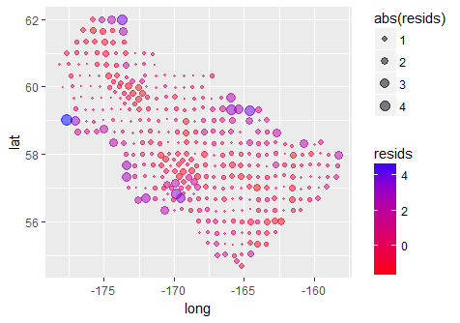
Not so good: clear spatial autocorrelation. We’ll fix that tomorrow!

Slide 7
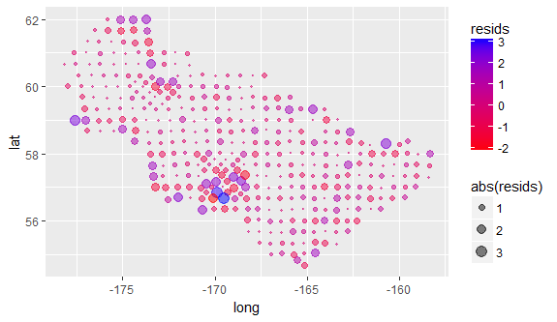
Much better: spatial correlation reduced… but still problems

Slide 8
SPDE approach with TMB
Notice that our model took some time to run
The cause is the covariance matrix is “dense” – meaning there are no 0 elements
In fact, as the # sites grows this will be a problem (we often have >10000 sites).
This is by design – all sites have a distance to all others
However, this dense matrix slows TMB down (or any other software)

Slide 9
SPDE approach with TMB
The solution is found in the geostatistics literature and is known as the “Stochastic Partial Differential Equation” (SPDE) approach
Basically, we make our dense cov matrix have 0’s (sparse) without losing much
The math is very complicated, and generally implemented in the INLA framework (Lindgren & Lindstrom 2011; Lindgren & Rue 2015)
But of course we can do it with TMB!

Slide 10
Creating the mesh
R-INLA has a tool to create a grid of cells called a “mesh”
Here is an R function that does what we need:
spde <- create.spde(dat=pollock[, c('long', 'lat')],
n_knots=100, make.plot=TRUE)
All observations within a cell will have the same random effect.
So our random effect vector can be *much* smaller
The number of cells is control by n_knots

Slide 11
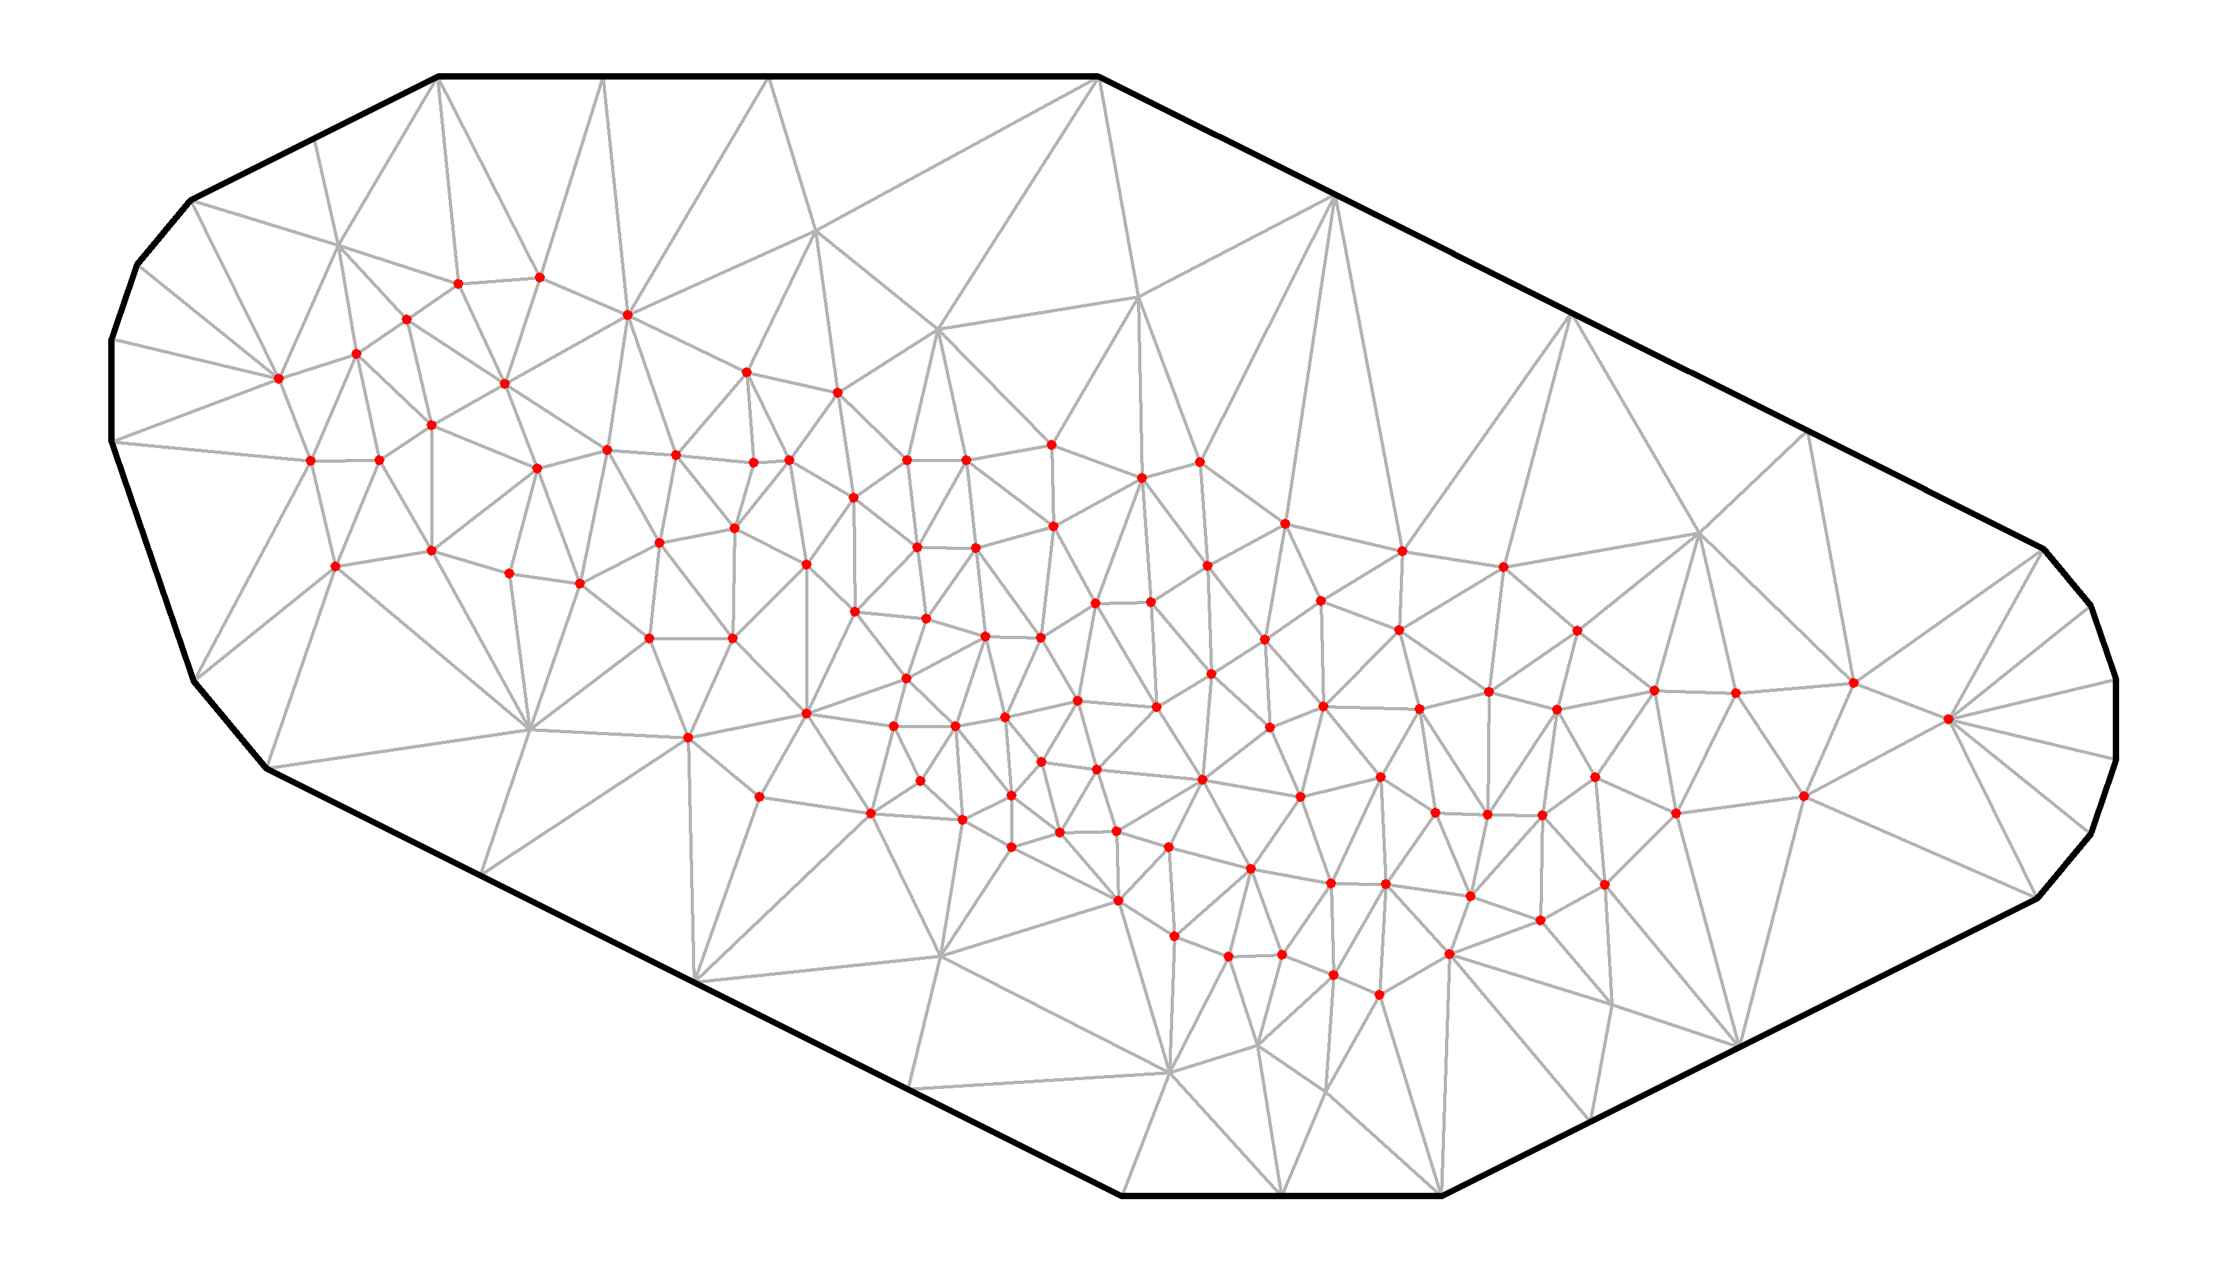
Mesh with 100 “knots”

Slide 12
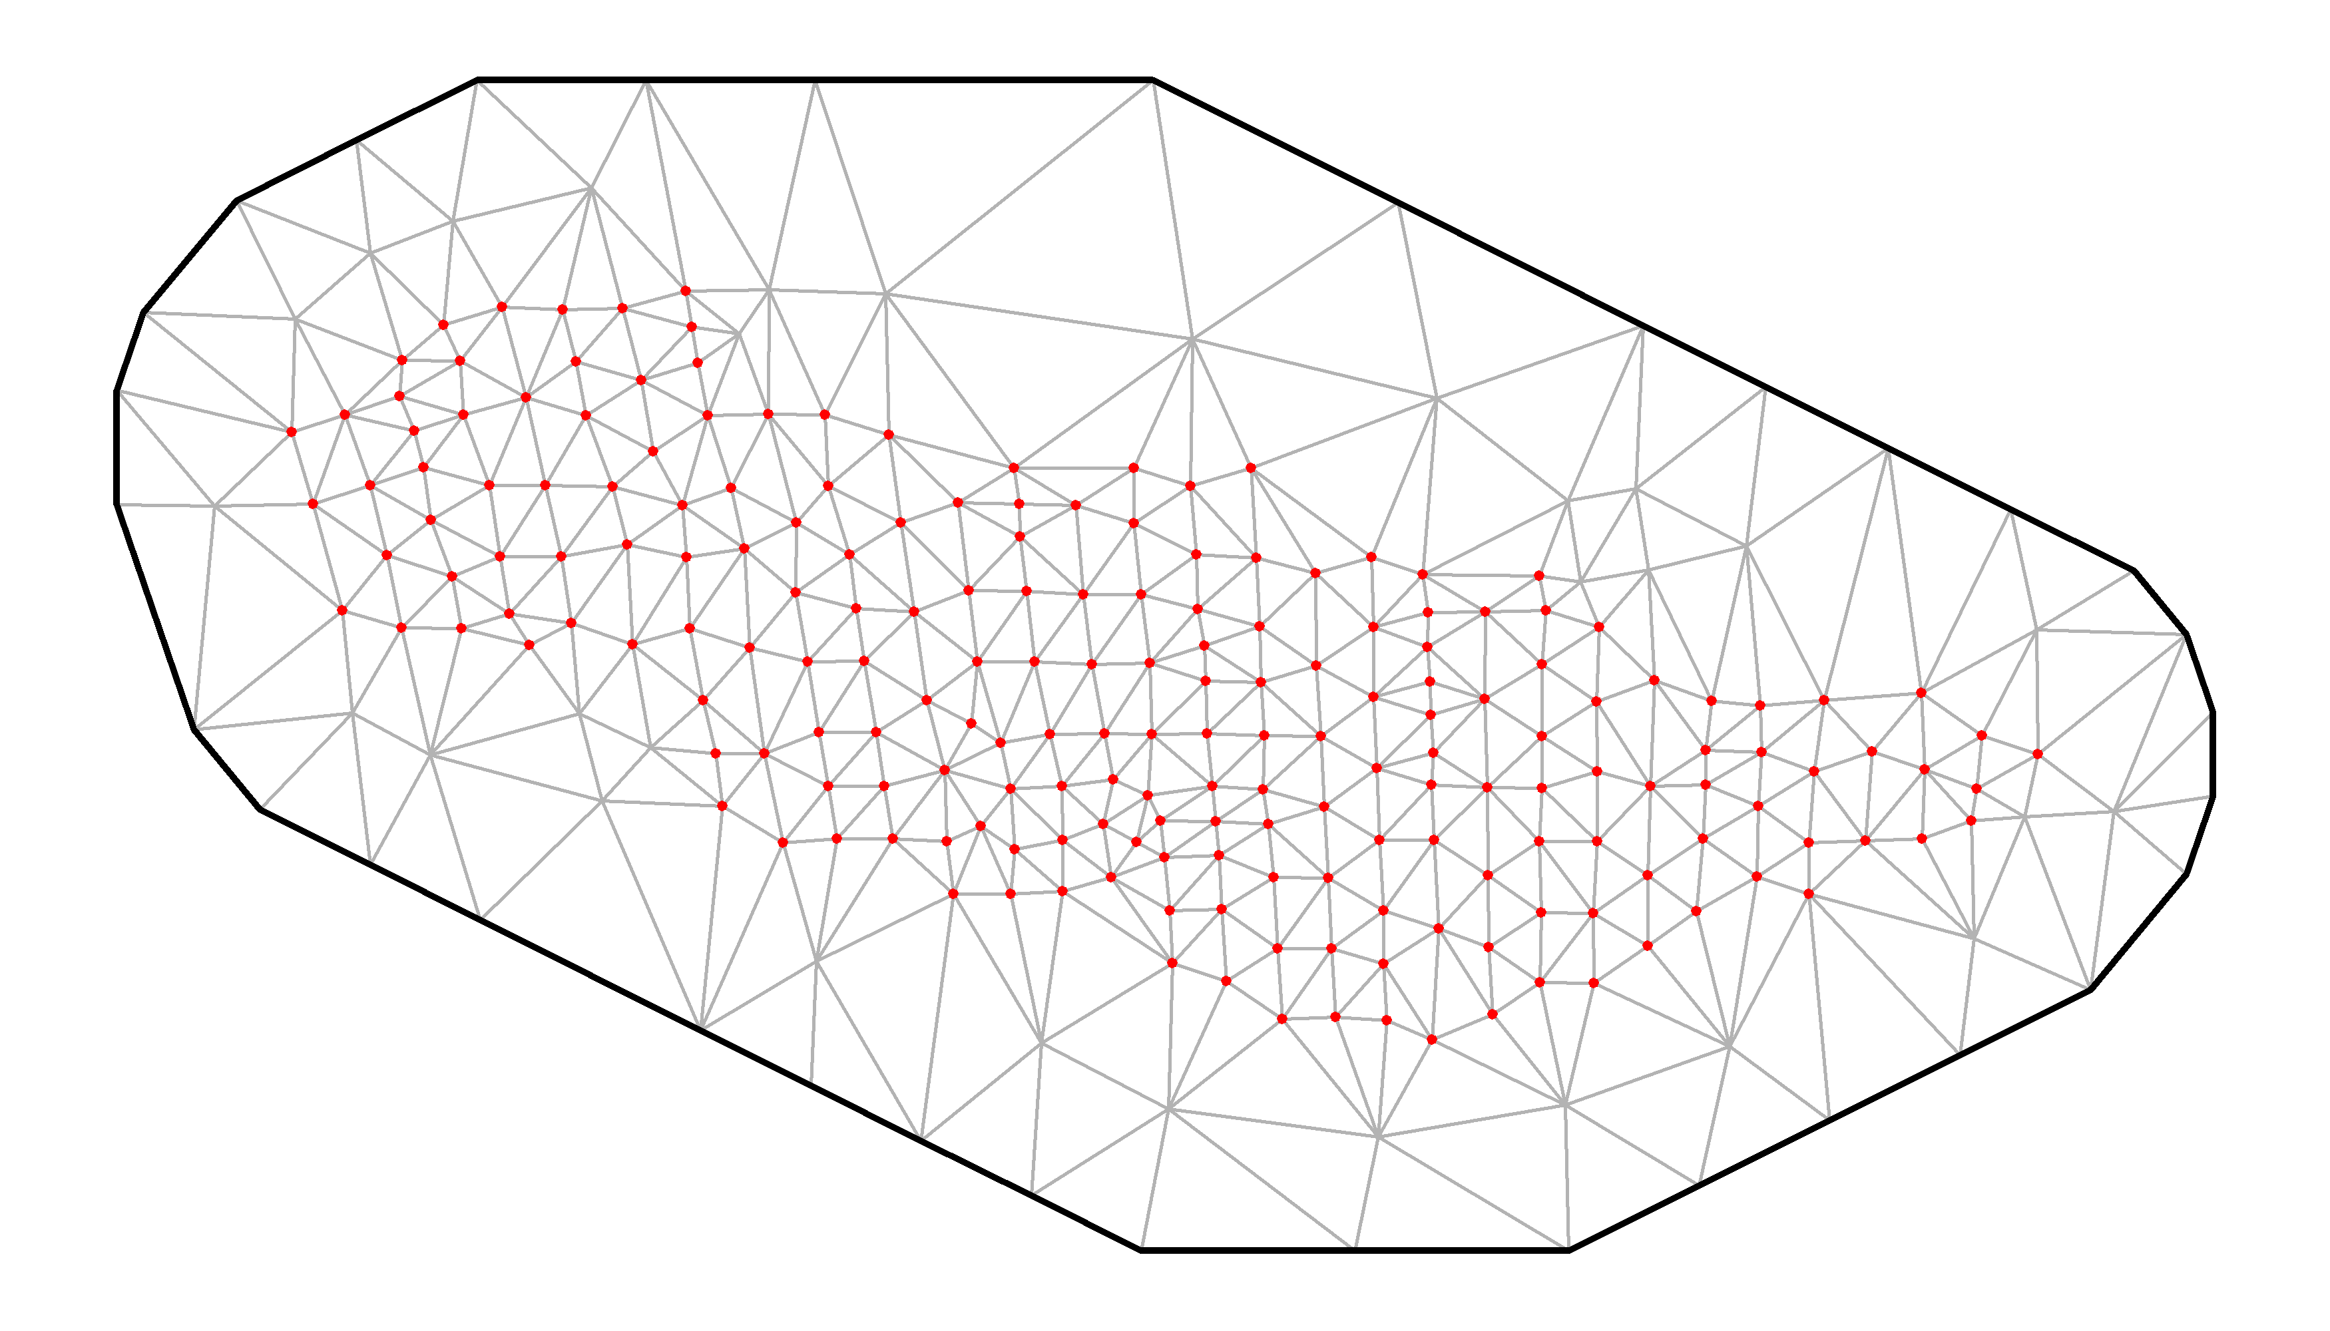
Mesh with 200 “knots”

Slide 13
Effect of cells
The more cells, the better the “resolution” of the mesh, and the better our fits
But the model will also take longer to run
So generally, we want n_knots to be as small as possible without affecting our results
Note: We can never have more cells than sites
Typically, we have thousands of cells, and maybe hundreds of thousands of observations (sites).
TMB will handle this no problem, SPDE works well

Slide 14
Exercise
Run the SPDE version of the model with different levels of knots
Try 100, 200, 300
Notice the difference in speed
Plot residuals and compare visually vs the first spatial model we did

Slide 15
TMB for spatiotemporal models
Spatiotemporal (ST) models are currently one of the most popular uses for TMB
Many data sets are inherently spatial, and with TMB we can add a spatial component to our analysis relatively easily.
It is a very complicated field, this was a very brief introduction to these methods.
Possible extensions:
Time (annual deviations): remember we only used 2014
Anisotropy: correlation strength depends on direction

Slide 16
Resources for ST TMB models
Jim Thorson (NOAA, USA) is leading the way on developing ST models with TMB
See software and list of papers here: https://github.com/James-Thorson/VAST
He has free lecture notes, code, and examples from a previous course online: https://github.com/James-Thorson/2016_Spatio-temporal_models
Expect an explosion of analyses with these techniques!
TMB is the most flexible, powerful tool for ST models.

Slide 17
Stock assessments with TMB
Fisheries stock assessments are population dynamics models used to provide management advice
Often age- or size-structured, typically use ADMB.
However, TMB is better than ADMB (yes really!)
So can we do assessments in TMB?
Of course!
(But, it will take a long time to recode models)

Slide 18
LIME: data limited assessment
Account for time-varying fishing mortality and recruitment
Estimate annual fishing mortality, selectivity, and recruitment variation
Derivation of random effects for time-varying recruitment
Fit to length composition data and/or catch and/or an abundance index time series, if available.
Estimate spawning potential ratio reference points or MSY-based reference points
Rudd and Thorson (2017)

Slide 19
LIME: data limited assessment
See code at https://github.com/merrillrudd/LIME
[Go through model code]
https://github.com/merrillrudd/LIME/blob/master/src/LIME.cpp
[Look at examples]:
https://github.com/merrillrudd/LIME/blob/master/LIME_examples/LIME_example.R
Rudd and Thorson (2017)

Slide 20
SAM: State-space assessment
See code here:
https://github.com/kaskr/adcomp/blob/master/tmb_examples/sam.cpp
See Nielsen and Berg (2014) for more information

Slide 21
Why TMB instead of ADMB?
ADMB cannot easily estimate random effects
It has the Laplace Approximation but it is difficult to use
Thus, hyper-variances are arbitrarily fixed (e..g, sigmaR=.5) instead of estimated
TMB is trivial (random=‘recevs’) to estimate them
TMB is faster than ADMB
Expect to see a lot of new TMB assessments in the future

Slide 22
Recap
Moving beyond GLMMs shows the real power of TMB
INLA works great for classes of spatial models
ADMB works great for fixed effects models
TMB is the best generic tool for complex hierarchical models
E.g., we could do a spatiotemporal CPUE standardization and a stock assessment in the same model

Slide 23
References
Lindgren, F., Rue, H., & Lindstrom, J. (2011). An explicit link between Gaussian fields and Gaussian Markov random fields: the stochastic partial differential equation approach. Journal of the Royal Statistical Society Series B-Statistical Methodology, 73(4), 423-498. doi: 10.1111/j.1467-9868.2011.00777.x
Lindgren, F., & Rue, H. (2015). Bayesian spatial modelling with R-INLA. Journal of Statistical Software, 63(19), 1-25.
Rudd, Merrill B., and James T. Thorson. "Accounting for variable recruitment and fishing mortality in length-based stock assessments for data-limited fisheries." Canadian Journal of Fisheries and Aquatic Sciences ja (2017).
Nielsen, Anders, and Casper W. Berg. "Estimation of time-varying selectivity in stock assessments using state-space models." Fisheries Research 158 (2014): 96-101.

