Slide 1
Advanced TMB topics
Fitting hierarchical models with TMB
10-14 January, 2022
University of Concepción, Chile
Dr. Cole Monnahan

Slide 2
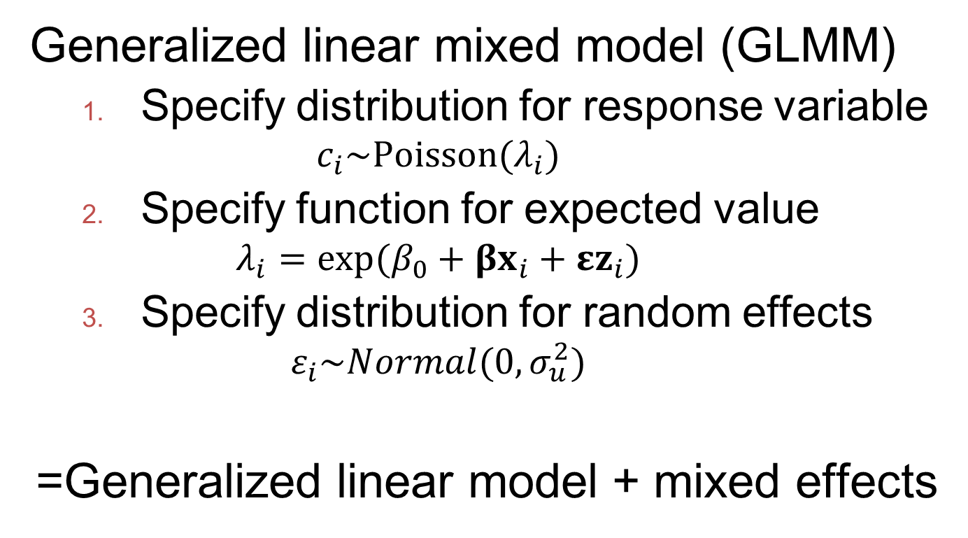
GLMM review
Generalized linear mixed model (GLMM)
Specify distribution for response variable
$$c_{i}\sim Poisson(λ_{i})$$
Specify function for expected value
$$λ_{i}=exp⁡(β_{0}+βx_{i}+εz_{i})$$
Specify distribution for random effects
$$ε_{i}\sim Normal(0,σ_{u}^{2})$$
=Generalized linear model + mixed effects

Slide 3
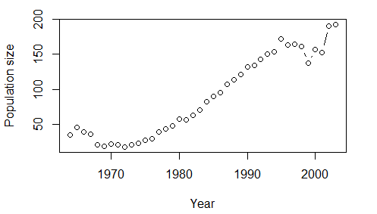
Motivating example
Counts of peregrine falcons over time
Comes from Kery and Schaub (2006)

Slide 4
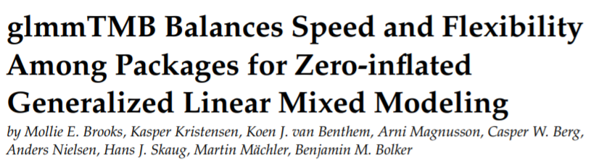
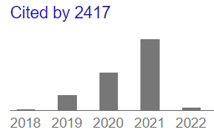
Fitting with glmmTMB
glmmTMB: R package for regressions w/ TMB
We fit it with lme4-like syntax:
glmmTMB(pairs ~ (1 | yr) + cov1 + cov2 + cov3,
family = poisson)
This is a really good option for hierarchical regressions in your work

Slide 5
Spatial models with TMB
sdmTMB fits spatial and spatiotemporal predictive-process GLMMs using TMB, R-INLA, and Gaussian Markov random fields. One common application is for species distribution models (SDMs).
VAST (Thorson and Barnett 2017) extends sdmTMB to include more options and control, including multivariate responses

Slide 6
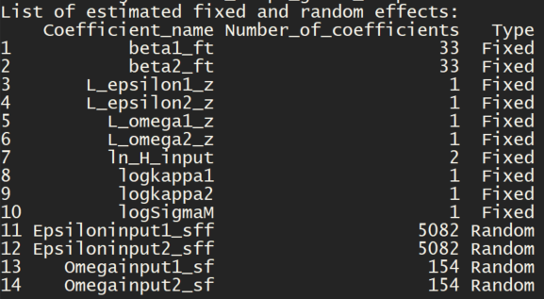

VAST example
10,472 random effects!!..
Integrated and differentiated easily!
www.vix.com

Slide 7
Model diagnostics, validation, selection
Checking model assumptions are met is a key part of an analysis, regardless of the software used
Checking residuals vs predicted, vs covariates, etc.
There are two options for residuals:
One Step Ahead (?TMB::oneStepPredict)
DHARMa R package:
I recommend OSA as a starting place

Slide 8
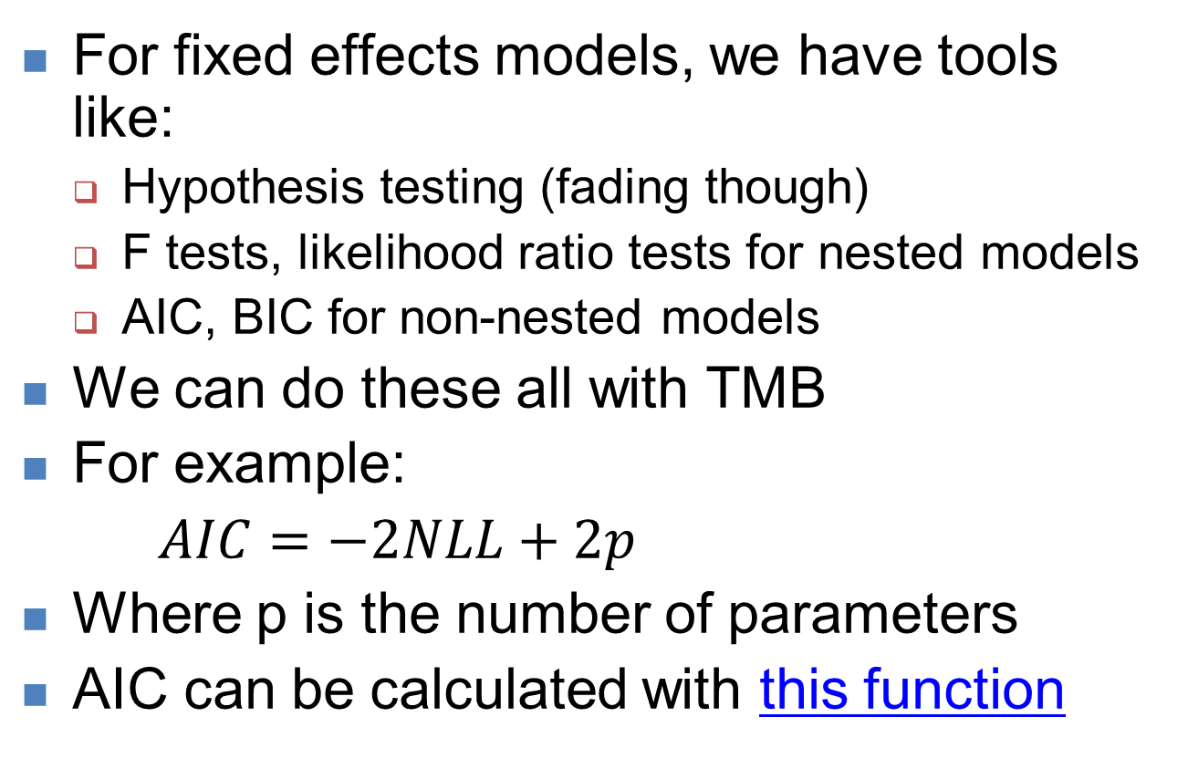
Model selection with TMB
For fixed effects models, we have tools like:
Hypothesis testing (fading though)
F tests, likelihood ratio tests for nested models
AIC, BIC for non-nested models
We can do these all with TMB
For example:
$AIC=−2NLL+2p$
Where p is the number of parameters
AIC can be calculated with this function

Slide 9
Selecting random effects
We used AIC for fixed effects model selection
For random effects structures, it is more complicated
(A whole course is necessary I think)
We alternate between ML and REML
REML=“restricted maximum likelihood”

Slide 10
Los pasos* de la estimación en modelos con efectos aleatorios en R
Ajuste un modelo lineal con todas las covariables independientes y sus interacciones con REML
Ajuste alternativas formas de los efectos aleatorias con REML y use AIC o BIC para evaluar los modelos
Identifique la estructura optima con respecto de los efectos aleatorios
Ajuste alternativas formas de las covariables independientes con ML y use F, t, AIC para evaluar los modelos
Identifique la estructura optima con respecto de las covariables independientes
Recorra el modelo en paso 5 con REML
Presente los resultados
*Similar de los pasos en p. 121 – 122 de Zuur et al. (2009)

Slide 11
REML – brief introduction
Remember that our LM variance was different (biased)
To fit a TMB model with REML, we simply declare random and fixed effects as “random” in MadeADFun
Only the variance terms are parameters
The estimates will be less biased (better)
This is available in lmer, but not glmer.
TMB can always do it [See this demo]

Slide 12
Cross validation
Another popular technique for model selection is cross validation
Leave random subset of the data out
Fit model to remaining data
Predict the out of sample data
Calculate a metric of fit
Repeat above steps for different versions of the model and see how well they predict

Slide 13
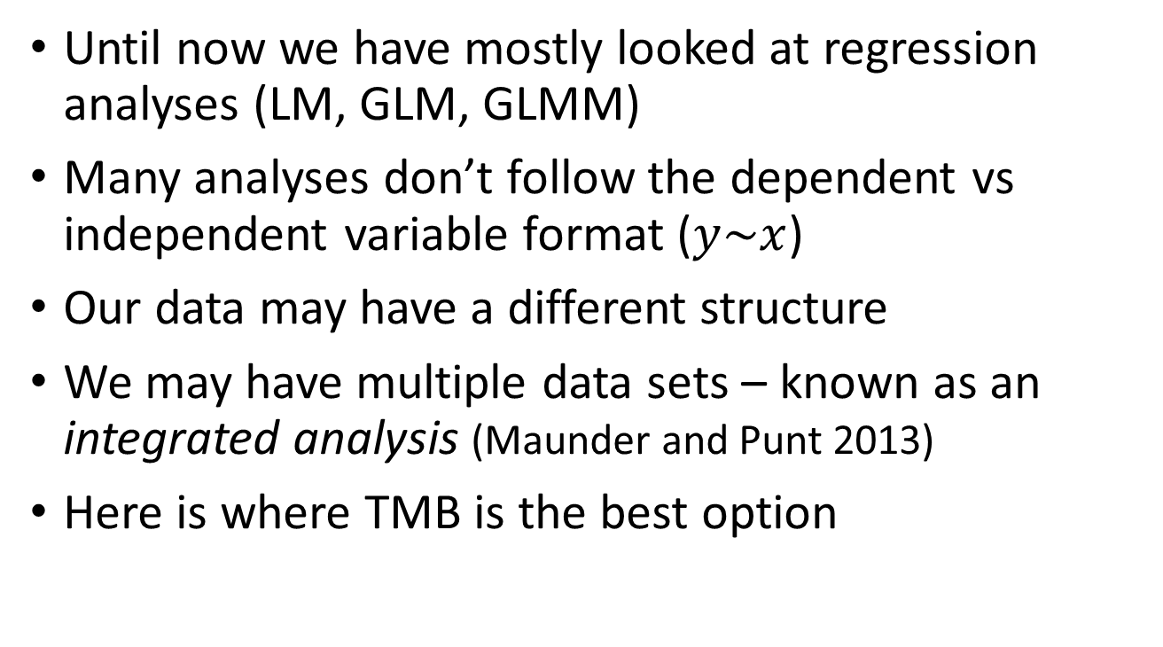
Moving beyond regressions
Until now we have mostly looked at regression analyses (LM, GLM, GLMM)
Many analyses don’t follow the dependent vs independent variable format ($y\sim x$)
Our data may have a different structure
We may have multiple data sets – known as an integrated analysis (Maunder and Punt 2013)
Here is where TMB is the best option

Slide 14
Bird mark-recapture model
State-space survival and detection with environmental covariates
Data is presence/absence over time
This is a complex model, too much to fully explore
Instead we will use it to motivate some additional capabilities of TMB
There is likely no other software that can fit this model in a maximum likelihood framework
Section 14.5 of Korner-Nievergelt et al (2015)

Slide 15
Bird mark-recapture model
3 sets of random effects
5 fixed effects, 172 random effects total
Probability of never being seen after last observation is difficult to write out analytically
But we can solve it recursively backwards
(This integrates out a Bernoulli dummy variable – why do we need to do this?)

Slide 16
Advanced control logic in TMB
for (int t=1; t<last(i); t++)
last is inputted as data, = the last year observed
Thus, this loop length varies by individual.
while (k > 1) {
chi(i,k-1) = <code>
k = k - 1;
}
This while loop calculates probability never being seen again, backwards!
(How would you do this in lme4?)

Slide 17
If() statements on data
if(CH(i,t)==1){
nll-= log(p(i,t));
} else {
nll-= log(1-p(i,t));
}
Here we apply a different NLL calculation based on the value in the data matrix CH.
We cannot use parameters in if statements, because that is not differentiable

Slide 18
Custom TMB functions
We can write our own C++ functions to use in the template
Put at top of file after #include<TMB>.hpp
For instance, a logistic transformation is needed to ensure a valid probability:
template<class Type>
Type inv_logit(Type x){
Type y= 1/(1+exp(-x));
return(y);
}
Note both input x and output y are Type variables

Slide 19
Likelihood functions
Can also write our own functions
Put them at top of template file (but after #include statement
// inverse gamma density
template<class Type>
Type dinvgauss(Type x, Type mean, Type shape, int give_log=0){
Type logres = 0.5*log(shape) –
0.5*log(2*M_PI*pow(x,3)) –
(shape * pow(x-mean,2) / (2*pow(mean,2)*x)); if(give_log) return logres; else return exp(logres); }

Slide 20
Fitting different model versions
Say we want to fit a model with and without a parameter (for model selection)
Do we need 2 templates & 2 parameter lists?
If so, that would be very annoying
Fortunately we can use the “map” feature to turn off estimation of parameters.
The map feature allows a wide range of behavior

Slide 21
Using the “map” feature
“map” is an argument to MakeADFun
It is a named list of factors:
Names and length match the parameter list
A level of NA means to turn off estimation (fix it)
Vectors elements with the same level are grouped together
“Turned off” = stays at initial value
list(beta=factor(NA)) – Fixed effect turned off
list(u=factor(c(NA, 1,1,2)) – Vector where first element is fixed, 2nd two are estimated the same, and last is estimated separately

Slide 22
Common uses for mapping
Turning off a parameter. Initialize it at 0, and turn off with factor(NA). It has no effect on the model, and does not show up at
Fixing a parameter. Initialize at desired value, then turn off. E.g. a likelihood ratio test, or when assuming a specific value (M=0.2)
For ?contrasts, where a model is confounded between a global mean and levels of a factor.
Typically we set the first one to 0.
This is the default behavior in R lm

Slide 23
Simulation
TMB has built-in simulation tools
http://kaskr.github.io/adcomp/_book/Simulation.html
SIMULATE{
y=rnorm(mu,sd);
REPORT(y);
}
Useful for simulating new data, simulation residuals, and Laplace accuracy checking
Very flexible and worth exploring when you build your model.

Slide 24
Bayesian additions
Any TMB model can be plugged into the software “Stan” to do Bayesian inference via MCMC
You will need to add priors manually
See details in Monnahan and Kristensen (2018)
[Demo]

Slide 25
References
Korner-Nievergelt, F., Roth, T., von Felten, S., Guélat, J., Almasi, B., & Korner-Nievergelt, P. (2015). Bayesian data analysis in ecology using linear models with R, BUGS, and Stan: including comparisons to frequentist statistics: Academic Press.
glmmTMB:
https://rjournal.github.io/archive/2017/RJ-2017-066/index.html
https://cran.r-project.org/web/packages/glmmTMB/index.html

