Slide 1
Hierarchical models in TMB
Fitting hierarchical models with TMB
10-14 January, 2022
University of Concepción, Chile
Dr. Cole Monnahan

Slide 2
Recap from yesterday
We pass data and parameters into the TMB object and it returns the NLL
From this, we can fit the model and calculate uncertainty estimates in several ways
Typically we use asymptotic approximations and the Delta method

Slide 3
Hierarchical model: overview
Class of model with a hierarchical structure
Known by other names:
Random effects (mixed effects) models
State-space models
Multi-level models
Hierarchies occur naturally: individuals within sites, subpopulations within populations, etc.
Many ways to think about this class of models, can be conceptually difficult and overwhelming
Royle and Dorazio 2008

Slide 4
What are hierarchical models (HM)?
Broad class of models that include random effects
Hierarchies occur naturally: individuals within sites, etc.
So what are random effects?
An additional source of variation
Typically structured by time, space, site, region, individual, etc.
Typically assumed to be normally distributed, but we estimate (hyper)mean and (hyper)variance

Slide 5
Exchangeability
Particularly important in the Bayesian literature (Gelman et al. 2004)
Exchangeability suggests:
random effects come from a common grouping
no expected differences in the stochastic process generating the effects
For example 2 wild populations and 1 captive population would NOT be exchangeable

Slide 6
Vocabulary related to random effects
Term | Definition
Random effect | Coefficient that is “exchangeable” with one or more other coefficients
Hyperdistribution | Distribution for random effects
Exchangeable | No information is available to distinguish between residual variability in random effects
Fixed effect | Coefficient that is not exchangeable with others, and which hence is estimated without a hyperdistribution
Mixed-effect model | Model with both fixed and random effects
Definitions
Notes:
Exchangability
Given value for stream 1, gives no info on stream 2, conditional on knowing true value.
The D values are random effects

Slide 7
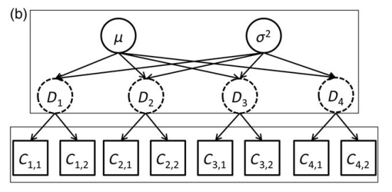
Motivating example
Average density and variability among sites
Density at 4 sites
Observed counts from 2 surveys at each site
The site densities are related (dependent)
The site densities are not directly observed (latent)
Thorson and Minto 2014

Slide 8
Reasons for HM
More closely match natural processes
Improved scope of inference – apply randomness to a new, unstudied population
Borrowing strength – effects not estimated independently but grouped so share information among group
Combining information – meta-analysis of repeated studies by grouping studies

Slide 9
Constructing model
Step 1 – Distribution for data C₁, .. C₄
Step 2 – Function for expected value
Step 3 - Distribution for random effects
Thorson and Minto 2014

Slide 10
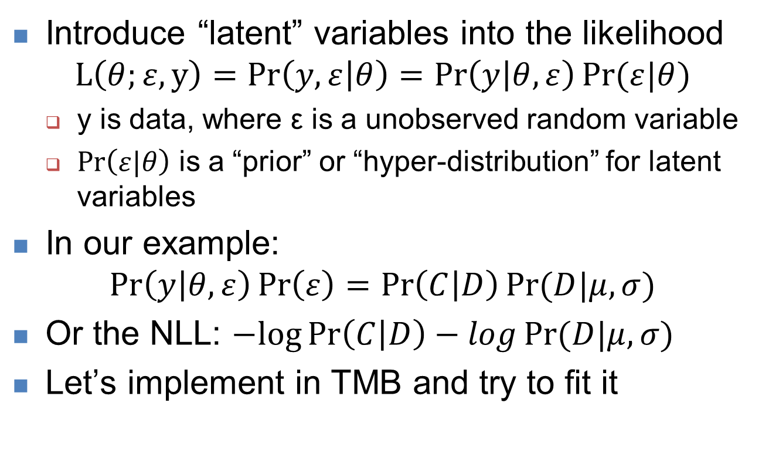
Hierarchical likelihoods
Introduce “latent” variables into the likelihood
$$L\left(θ;ε,y\right)=Pr\left(y,ε | θ\right)=\operatorname{Pr}\left(y | θ,ε\right)Pr⁡(ε|θ)$$
y is data, where ε is a unobserved random variable
$\operatorname{Pr}\left(ε|θ\right)$ is a “prior” or “hyper-distribution” for latent variables
In our example:
$$\operatorname{Pr}\left(y | θ,ε\right)\operatorname{Pr}\left(ε\right)=\operatorname{Pr}\left(C | D\right)Pr⁡(D|μ,σ)$$
Or the NLL: $−log\operatorname{Pr}\left(C | D\right)−logPr⁡(D|μ,σ)$
Let’s implement in TMB and try to fit it
Some slides borrowed from: https://github.com/James-Thorson/2016_Spatio-temporal_models

Slide 11
Demo: Hierarchical NLL
“poisson” model is missing NLL calculations
Add a Poisson (dpois) likelihood for the data (C)
Add a normal likelihood for the random effects (D)
C <- c(10, 11, 24, 21, 16, 13, 14, 10)
sites <- c(1, 1, 2, 2, 3, 3, 4, 4)
pars <- list(D=rep(20,4), mu=20, logsigma=1)
With these initial pars, NLL=37.47486
Will it fit?
Try a likelihood profile of logsigma

Slide 12
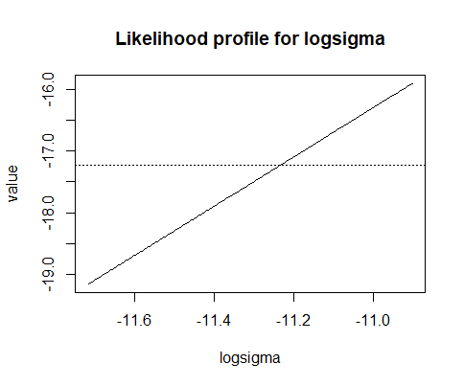
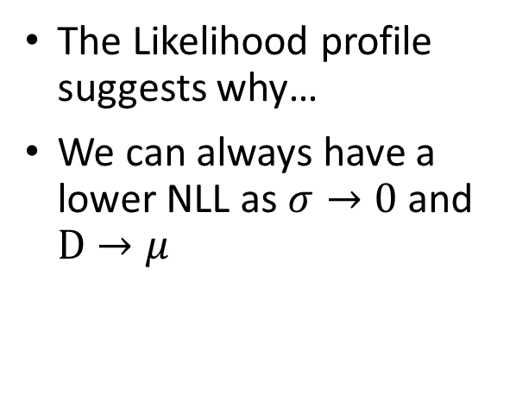
What happened?
We completely failed to fit this model. Why?
Because joint likelihoods in hierarchical models do not have a valid minimum!
The Likelihood profile suggests why…
We can always have a lower NLL as $σ→0$ and $D→μ$
-dnorm(0,0,1e-3,T) = -6
-dnorm(0,0,1e-6,T) = -13
-dnorm(0,0,1e-9,T) = -20

Slide 13
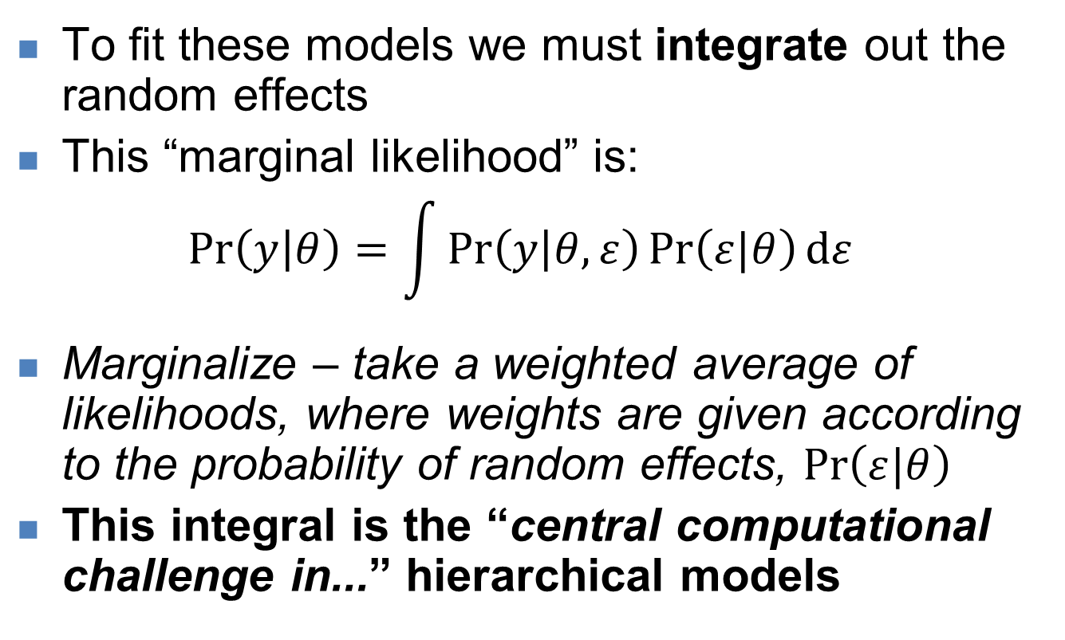
Solution: marginal likelihood
To fit these models we must integrate out the random effects
This “marginal likelihood” is:
$$\operatorname{Pr}\left(y | θ\right)=\int{\operatorname{Pr}\left(y | θ,ε\right)\operatorname{Pr}\left(ε|θ\right)dε}$$
Marginalize – take a weighted average of likelihoods, where weights are given according to the probability of random effects, $\operatorname{Pr}\left(ε|θ\right)$
This integral is the “central computational challenge in...” hierarchical models
Thorson and Minto (2014)

Slide 14
Estimating the marginal likelihood
Bayesian approach
Generally involves MCMC
Already integrating across parameters, so integrates across latent variables automatically
Frequentist approach:
Use “Laplace approximation” of marginal likelihood
Then maximize the marginal likelihood
Use alternating estimation of fixed and random effects
“Inner optimization” – random effects | fixed effects
“Outer optimization” – fixed effects | random effects
This is what TMB does (and other software)

Slide 15
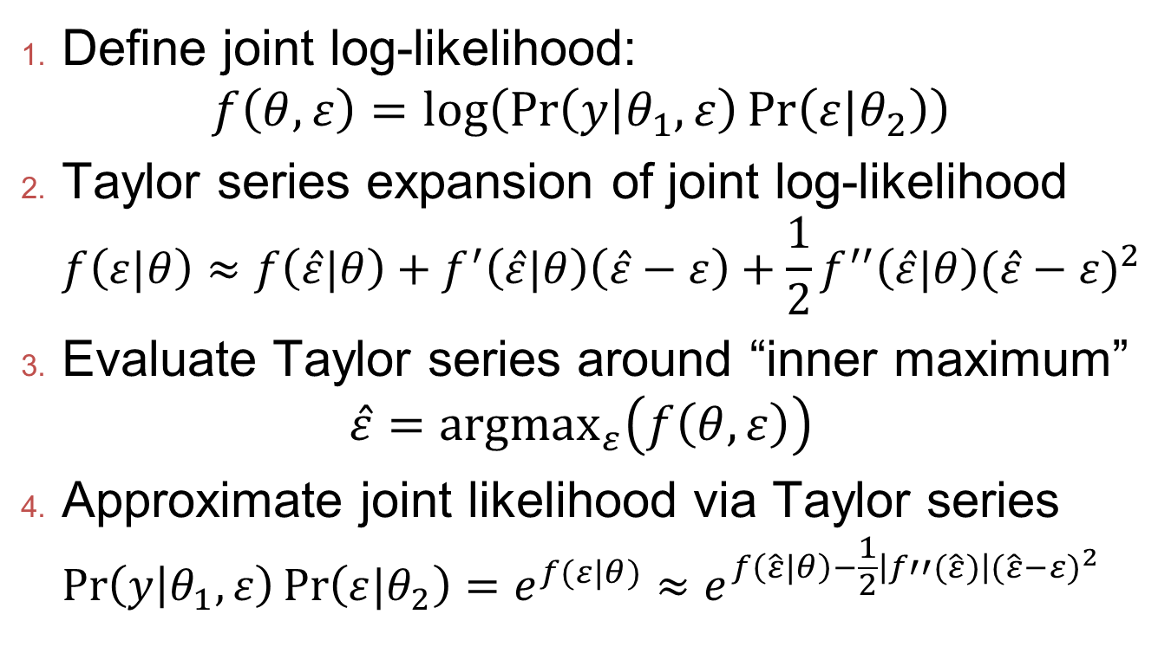
Laplace approximation details I
Define joint log-likelihood: $f\left(θ,ε\right)=log⁡\left(\operatorname{Pr}\left(y | θ_{1},ε\right)\operatorname{Pr}\left(ε|θ_{2}\right)\right)$
Taylor series expansion of joint log-likelihood $f\left(ε|θ\right)≈f\left(\hat{ε}|θ\right)+f^{′}\left(\hat{ε}|θ\right)\left(\hat{ε}−ε\right)+\frac{1}{2}f^{′′}\left(\hat{ε}|θ\right){(\hat{ε}−ε)}^{2}$
Evaluate Taylor series around “inner maximum” $\hat{ε}={argmax}_{ε}\left(f\left(θ,ε\right)\right)$
Approximate joint likelihood via Taylor series $\operatorname{Pr}\left(y | θ_{1},ε\right)\operatorname{Pr}\left(ε|θ_{2}\right)=e^{f(ε|θ)}≈e^{f\left(\hat{ε}|θ\right)−\frac{1}{2}\left|f′′(\hat{ε})\right|{(\hat{ε}−ε)}^{2}}$
https://github.com/James-Thorson/2016_Spatio-temporal_models.

Slide 16
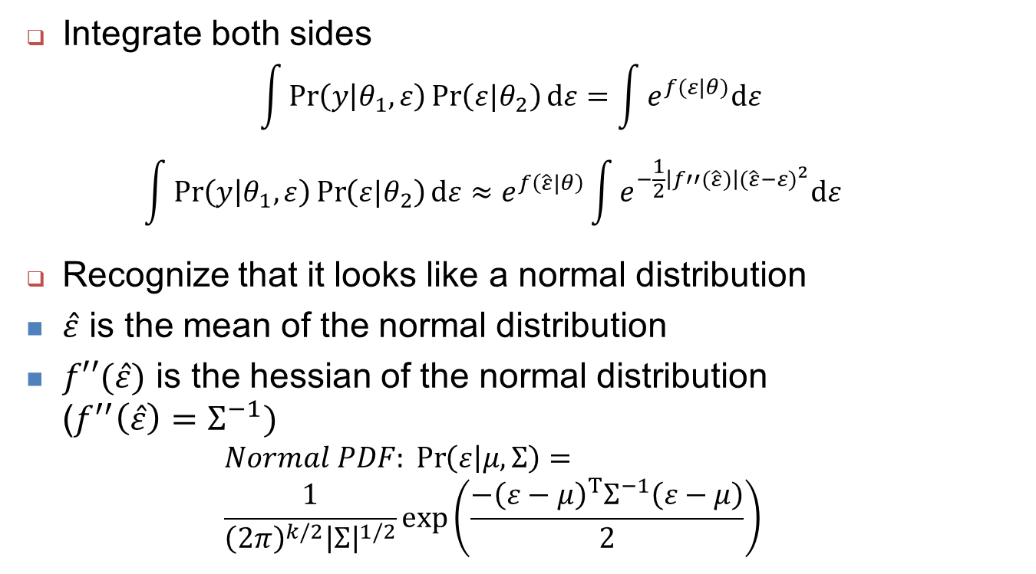
Laplace approximation details II
Integrate both sides
$$\int{\operatorname{Pr}\left(y | θ_{1},ε\right)\operatorname{Pr}\left(ε|θ_{2}\right)dε}=\int{e^{f(ε|θ)}dε}$$
$$\int{\operatorname{Pr}\left(y | θ_{1},ε\right)\operatorname{Pr}\left(ε|θ_{2}\right)dε}≈e^{f\left(\hat{ε}|θ\right)}\int{e^{−\frac{1}{2}\left|f′′(\hat{ε})\right|{(\hat{ε}−ε)}^{2}}dε}$$
Recognize that it looks like a normal distribution
$\hat{ε}$ is the mean of the normal distribution
$f′′(\hat{ε})$ is the hessian of the normal distribution ($f^{′′}\left(\hat{ε}\right)=Σ^{−1})$
$$Normal PDF: \operatorname{Pr}\left(ε | μ,Σ\right)= \\ \frac{1}{{\left(2π\right)}^{k/2}{\left|Σ\right|}^{1/2}}exp⁡\left(\frac{−{\left(ε−μ\right)}^{T}Σ^{−1}\left(ε−μ\right)}{2}\right)$$
https://github.com/James-Thorson/2016_Spatio-temporal_models.

Slide 17
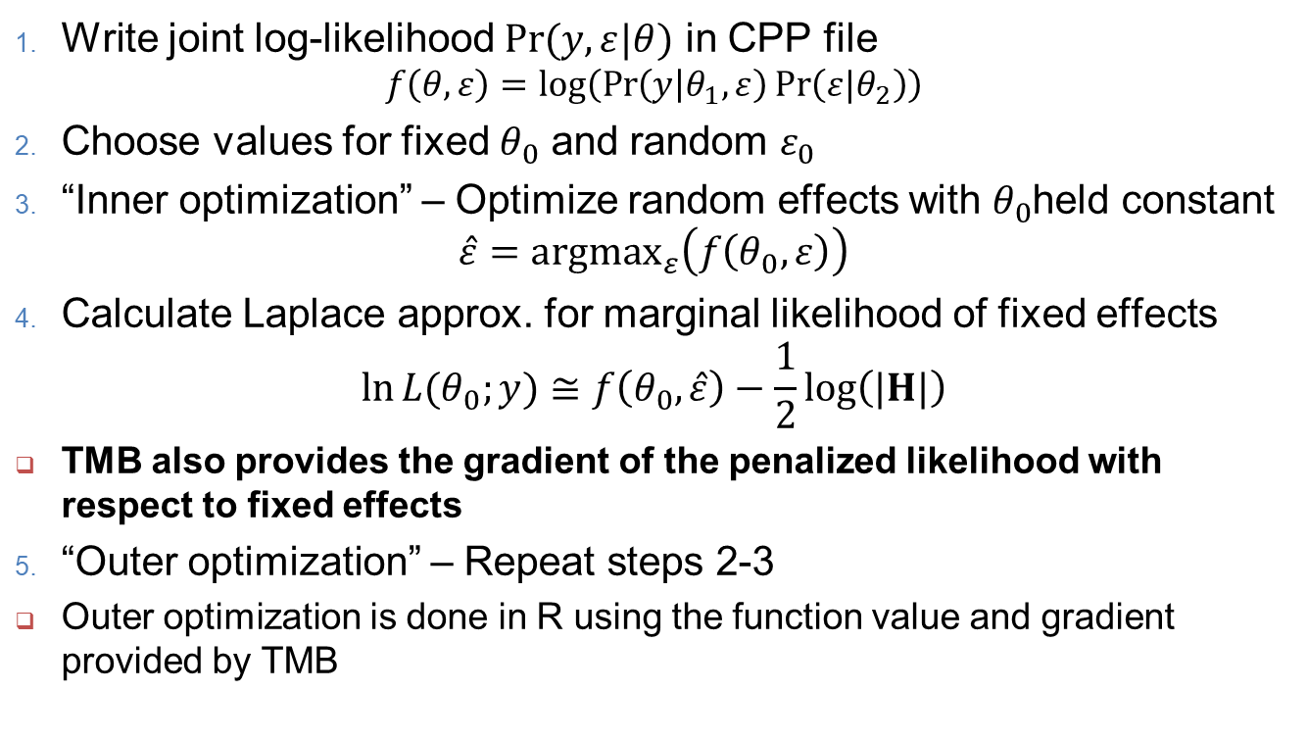
TMB Laplace approximation steps
Write joint log-likelihood $\operatorname{Pr}{(y,ε|θ)}$ in CPP file
$$f\left(θ,ε\right)=log⁡\left(\operatorname{Pr}\left(y | θ_{1},ε\right)\operatorname{Pr}\left(ε|θ_{2}\right)\right)$$
Choose values for fixed $θ_{0}$ and random $ε_{0}$
“Inner optimization” – Optimize random effects with $θ_{0}$held constant
$$\hat{ε}={argmax}_{ε}\left(f\left(θ_{0},ε\right)\right)$$
Calculate Laplace approx. for marginal likelihood of fixed effects
$$\ln{L{(θ_{0};y)}}≅f\left(θ_{0},\hat{ε}\right)−\frac{1}{2}\log\left(|H|\right)$$
TMB also provides the gradient of the penalized likelihood with respect to fixed effects
“Outer optimization” – Repeat steps 2-3
Outer optimization is done in R using the function value and gradient provided by TMB

Slide 18
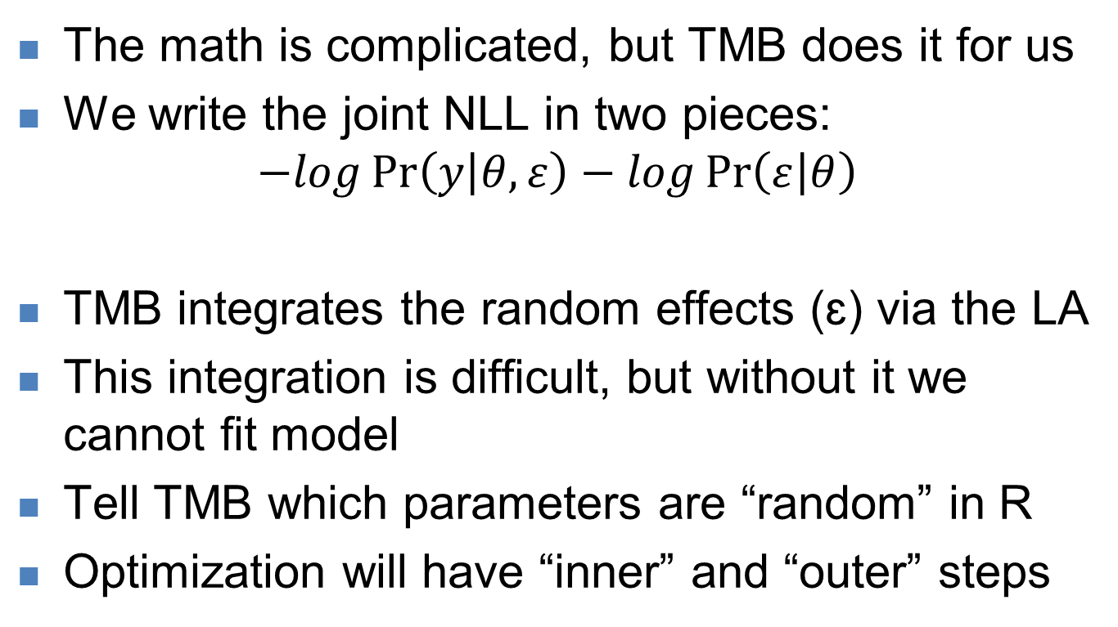
LA in TMB: what you need to know
The math is complicated, but TMB does it for us
We write the joint NLL in two pieces:
$$−log\operatorname{Pr}\left(y | θ,ε\right)−log\operatorname{Pr}\left(ε | θ\right)$$
TMB integrates the random effects (ɛ) via the LA
This integration is difficult, but without it we cannot fit model
Tell TMB which parameters are “random” in R
Optimization will have “inner” and “outer” steps
Likelihood of data
Probability of random effects

Slide 19
Revisiting the example
Previously we tried to minimize the joint likelihood.
How do we tell TMB to integrate out the random effects (D) and thus return the marginal NLL?
obj <- MakeADFun(data=data, parameters=pars, random="D")
obj$fn()
iter: 1 value: 29.34683 mgc: 0.95 ustep: 1
iter: 2 value: 29.34683 mgc: 4.305564e-05 ustep: 1
iter: 3 mgc: 8.970602e-14
[1] 29.6912
Here we see the “inner” loop optimization.
The result is the marginal NLL!

Slide 20


Revisiting the example
How about the gradient?
> obj$gr()
iter: 1 mgc: 8.970602e-14
outer mgc: 2.033172
[1] 2.0331719 -0.2137577
Again we see the inner loop mgc (small) and the outer mgc (big – we haven’t optimized yet)
Note: there are only two gradients. What about gradients for random effects? They are gone – integrated out!
TMB differentiated the marginal NLL (!!!!!)
www.vix.com
www.vix.com

Slide 21
Demo : Fit marginal likelihood
Integrate out the random effects
Re-fit… convergence?
Plot likelihood profile for logsigma (hint use parm.range=c(-2,3) in tmbprofile

Slide 22
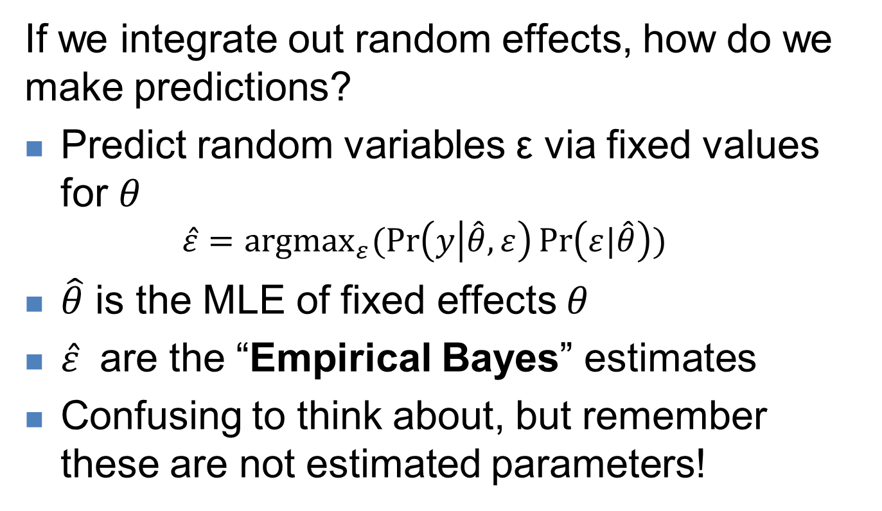
Predicting random variables
If we integrate out random effects, how do we make predictions?
Predict random variables ε via fixed values for $θ$
$$\hat{ε}={argmax}_{ε}(\operatorname{Pr}\left(y | \hat{θ},ε\right)\operatorname{Pr}\left(ε|\hat{θ}\right))$$
$\hat{θ}$ is the MLE of fixed effects $θ$
$\hat{ε}$ are the “Empirical Bayes” estimates
Confusing to think about, but remember these are not estimated parameters!

Slide 23
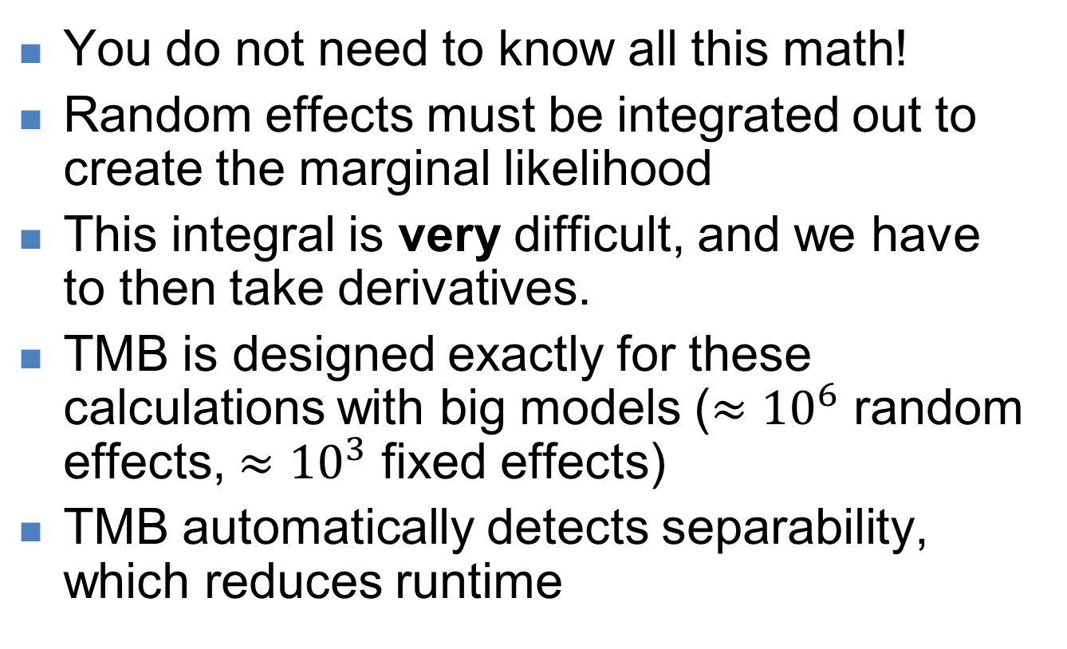
Important concepts 1
You do not need to know all this math!
Random effects must be integrated out to create the marginal likelihood
This integral is very difficult, and we have to then take derivatives.
TMB is designed exactly for these calculations with big models ($≈{10}^{6}$ random effects, $≈{10}^{3}$ fixed effects)
TMB automatically detects separability, which reduces runtime

Slide 24
Important concepts 2
You specify the joint likelihood in the template
Declare parameters as “random” when building R object (not in the template)
TMB does all the work for you; proceed with fitting and uncertainty estimates as before
TMB uses Empirical Bayes to predict the random effects given the fixed effects
The LA is an approximation that assumes normality – sometimes this won’t hold

Slide 25
References
Full details and math of the LA in
Skaug, H. J., & Fournier, D. A. (2006). Automatic approximation of the marginal likelihood in non-Gaussian hierarchical models. Computational Statistics & Data Analysis, 51(2), 699-709. doi: 10.1016/j.csda.2006.03.005
Kristensen, K., Nielsen, A., Berg, C. W., Skaug, H., & Bell, B. M. (2016). TMB: Automatic differentiation and Laplace approximation. [automatic differentiation; AD; random effects; latent variables; C++ templates; R]. Journal of Statistical Software, 70(5), 21. doi: 10.18637/jss.v070.i05
See this paper for working with Emprical Bayes estimates:
Thorson, J. T., & Kristensen, K. (2016). Implementing a generic method for bias correction in statistical models using random effects, with spatial and population dynamics examples. Fisheries Research, 175, 66-74. doi: 10.1016/j.fishres.2015.11.016

