Slide 1
Course introduction 10 January 2022
Fitting hierarchical models with TMB
10-14 January, 2022 (virtual)
University of Concepción, Chile
Dr. Cole Monnahan

Slide 2
Language approach
Noble and I speak intermediate Spanish, and have experience teaching in it
We will use a mixture of English and Spanish
Written lectures in Spanish, recorded in English
R and TMB code is in English
You can write/ask questions/make comments in either language
If you want to practice English, great!

Slide 3
Dr. Cole Monnahan
Formación Académica
University of Washington, M.S.& PhD
Quantitative Ecology
Actividades Laborales
Post-doc con Billy Ernst (UdeC & UW)
Conexión con Chile
Quería vivir en América Latina y aprender español.

Slide 4
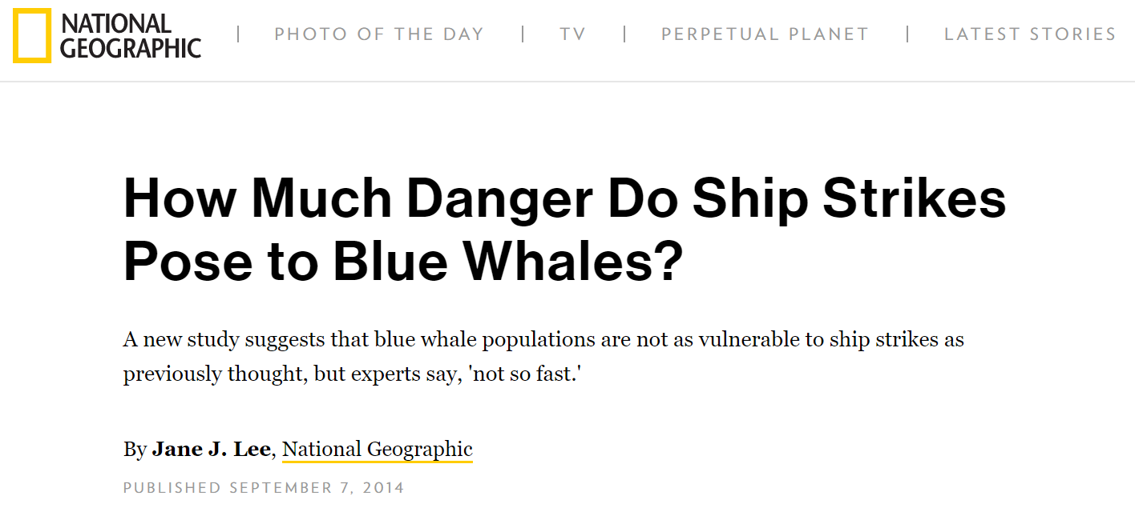
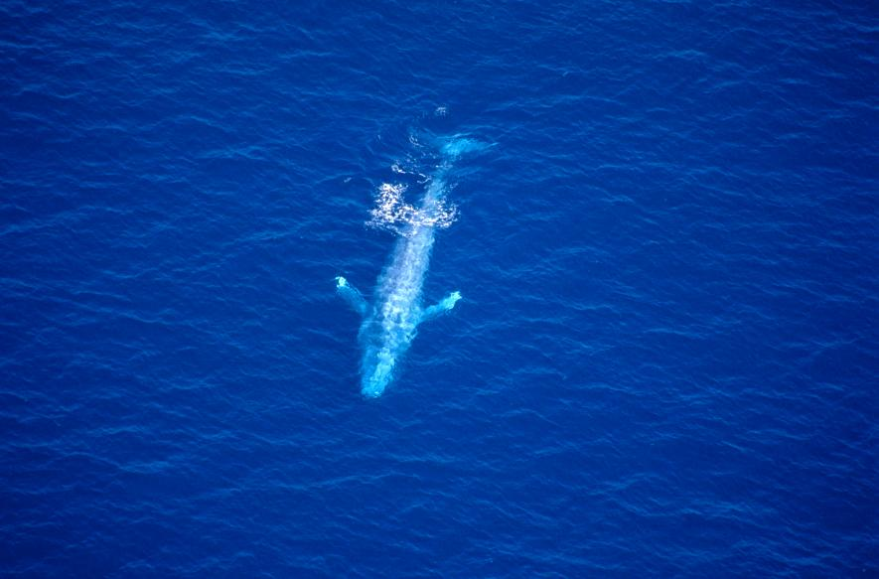
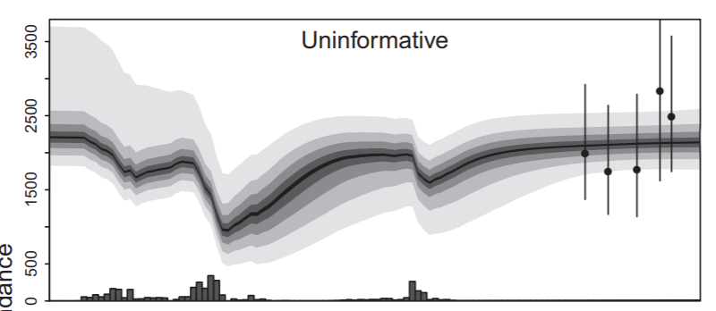
California blue whale recovery

Slide 5
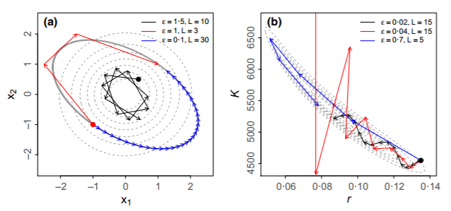
Bayesian fisheries stock assessments
Hamiltonian Monte Carlo MCMC for ADMB assessments

Slide 6
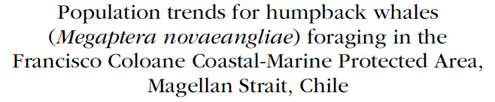
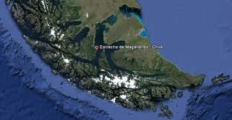
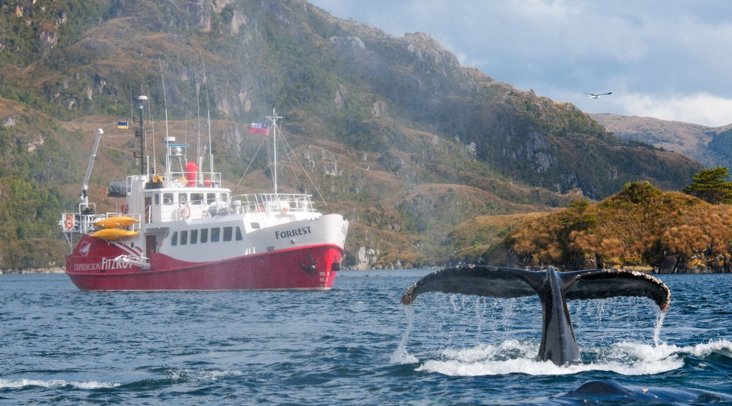
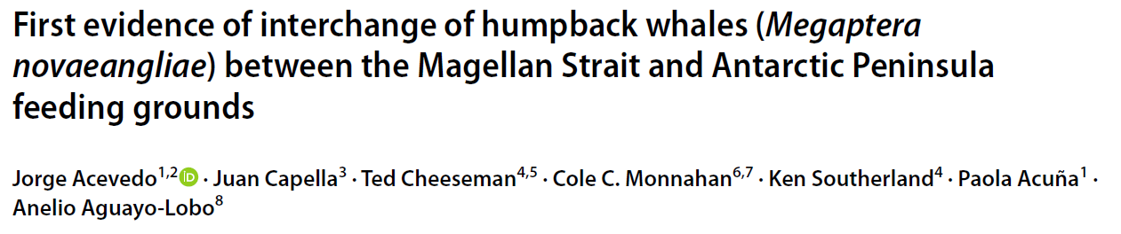
Postdoc:
Crédito: Luis Bertea

Slide 7
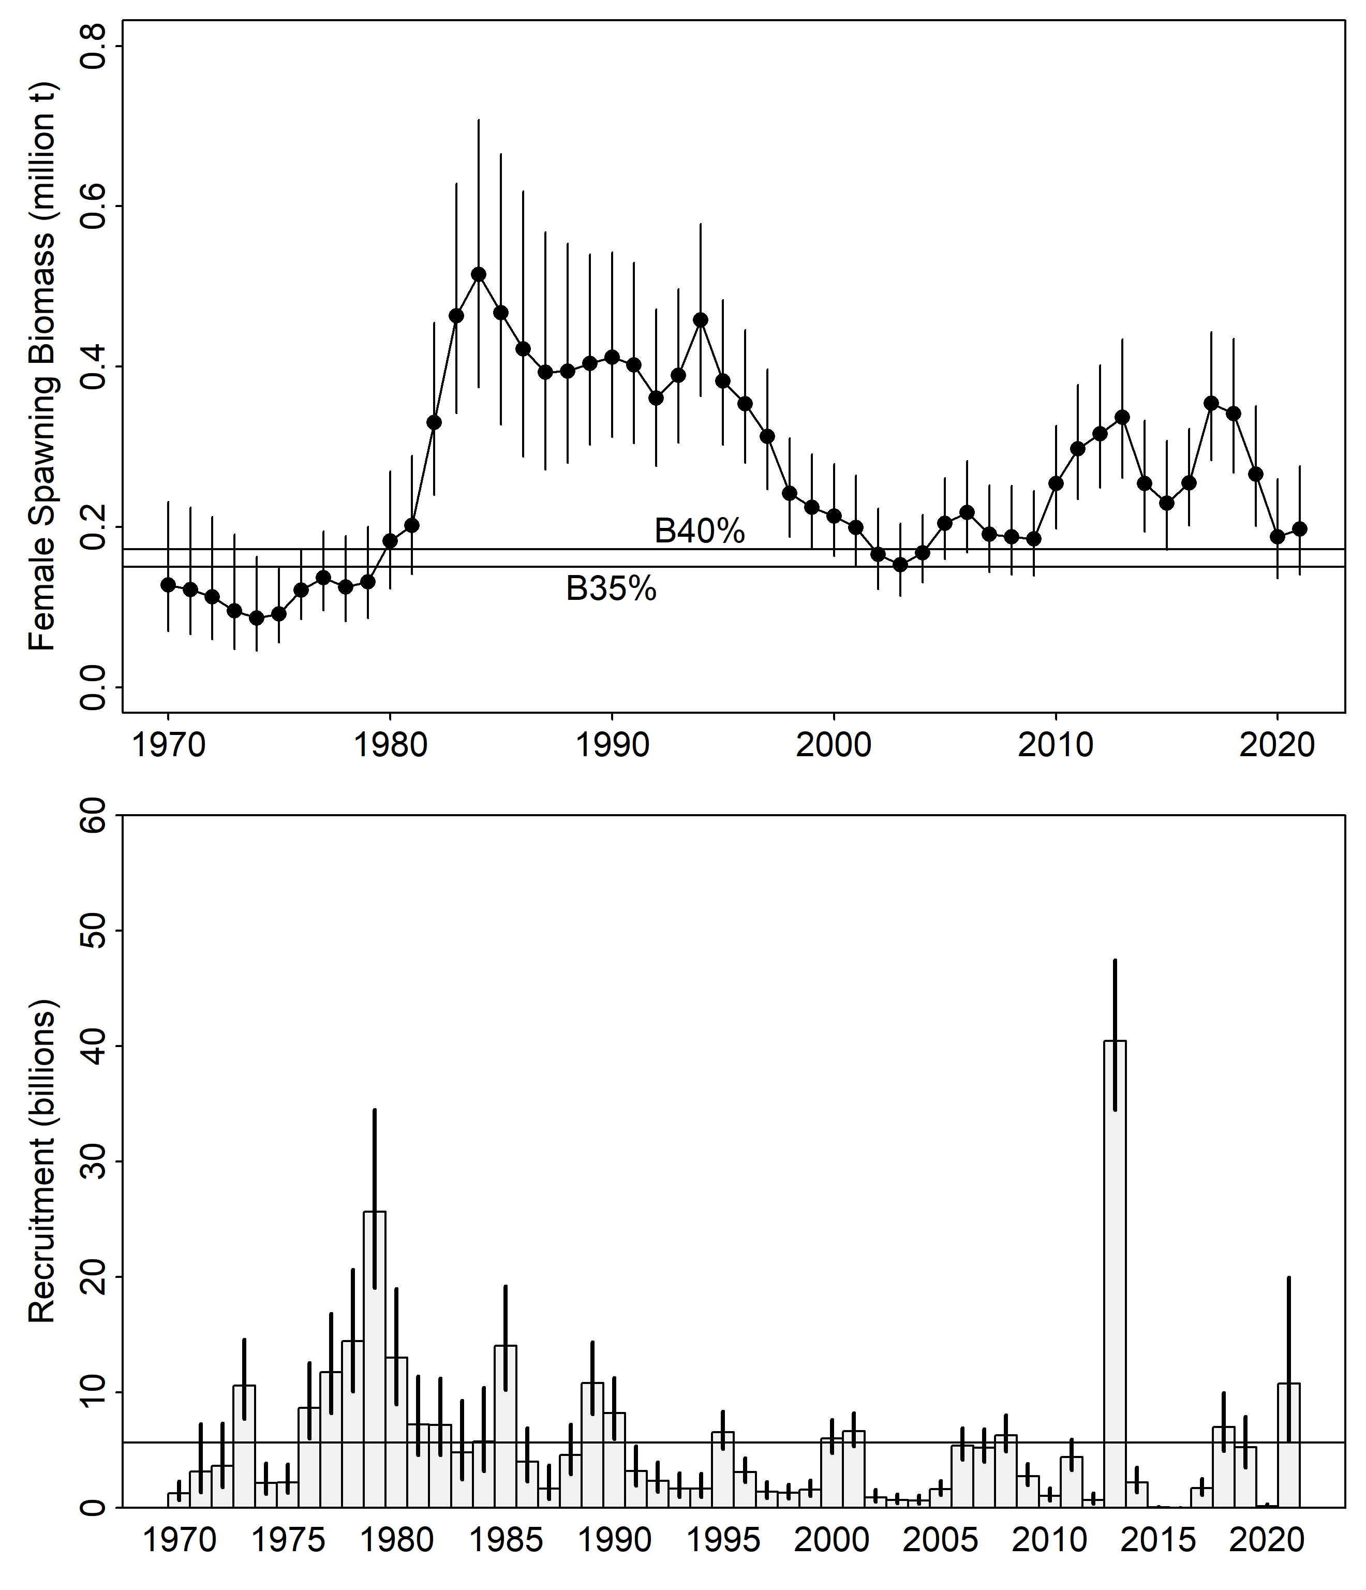
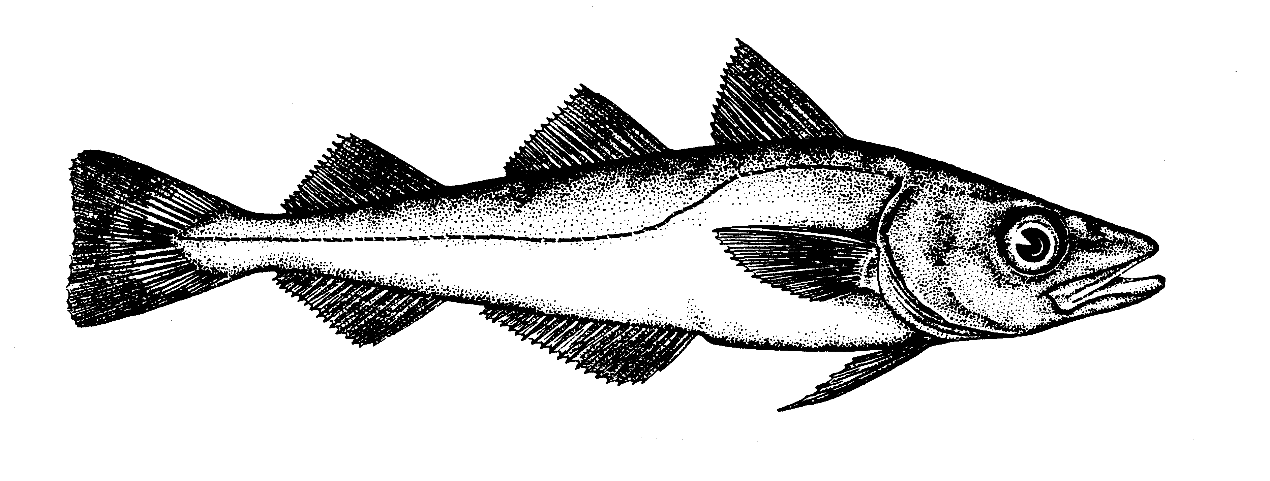
Current position at NOAA
Gulf of Alaska walleye pollock stock assessment
Fisheries stock assessments in Alaska, USA
Spatial models (VAST)
State-space stock assessments
Development of next-generation stock assessment software (FIMS)

Slide 8
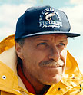
Dr. Noble Hendrix
Formación Académica
Duke University, MS Zoology
University of Washington, PhD Fisheries
Actividades Laborales
Consultor – QEDA Consulting, LLC
University of Washington – facultad afiliada
Conexión con Chile
Billy Ernst, UDEC tuvimos el mismo profesor,
Ray HIlborn
Ray Hilborn

Slide 9
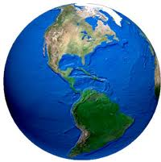
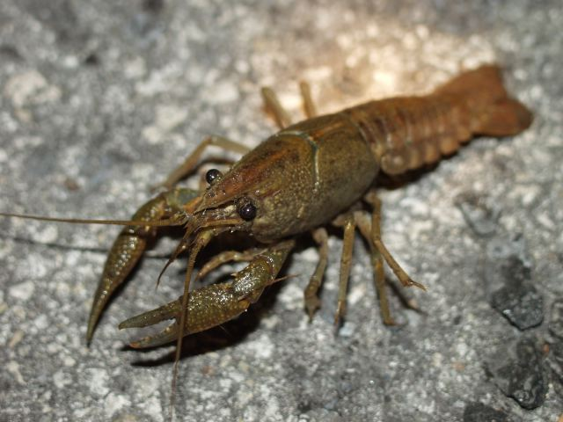
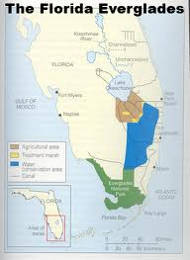
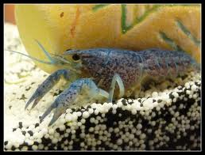
Florida Everglades

Slide 10
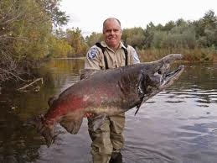
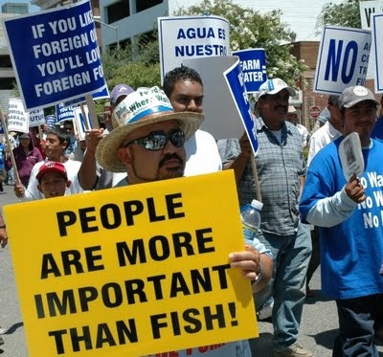
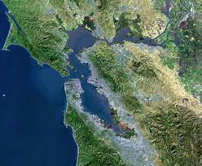
Salmón en la Bahia de San Francisco y San Joaquin Delta, California

Slide 11
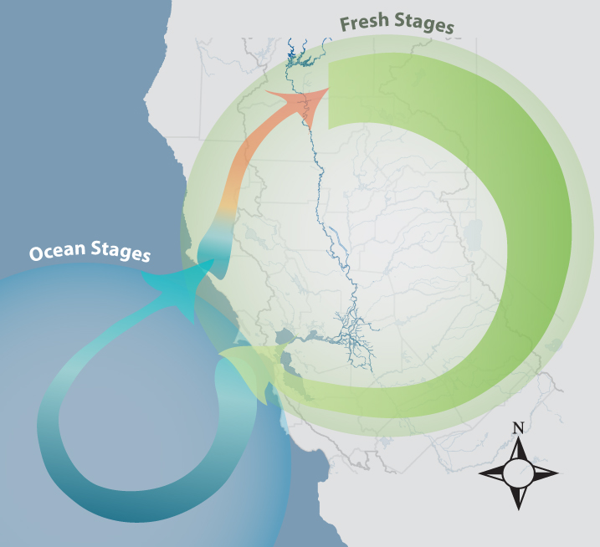
Hipótesis de los factores que afectan las poblaciones de Chinook salmón
Temperature
In river
Mortality
Min Ave Flow
Max Ave Flow
DCC % Open
Yolo flow >2K
Harvest
SLH
UPW
Bass CPUE
PDO
SST

Slide 12

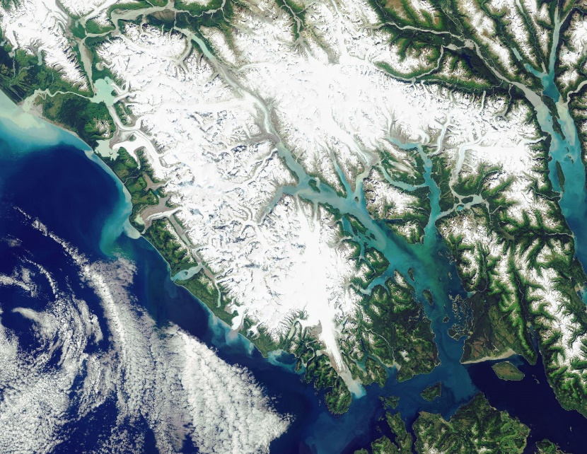
Ballenas jorobadas en Glacier Bay, Alaska
Credit: Scott Gende, NPS

Slide 13
Y ahora es su turno…
¿Experiencia & Interés?
¿Qué espera a realizar del curso?
¿Que es su experiencia con modelos jerarquicos?
¿Qué es su experiencia con el idioma R y ADMB?

Slide 14
Course goals
Gain comfort with numerical optimization of statistical models
Build, test, and use TMB models
Incorporate random effects into models
Start core of your own analysis (project)
Warning: This course covers complex math/stats concepts and programming in R and C++.. it will be hard!
Please be patient and kind to yourself and ask questions!

Slide 15
Hierarchical model: overview
Class of model with a hierarchical structure
Known by other names:
Random effects (mixed effects) models
State-space models
Multi-level models
Hierarchies occur naturally: individuals within sites, subpopulations within populations, etc.
Many ways to think about this class of models, can be conceptually difficult and overwhelming
Royle and Dorazio 2008

Slide 16
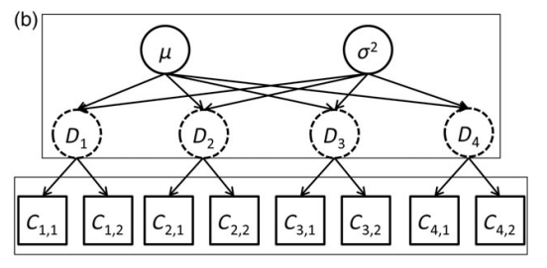
Hierarchical models: example
Average density and variability among sites
Density at 4 sites
Observed counts from 2 surveys at each site
The site densities are related (dependent)
The site densities are not directly observed (latent)
Thorson and Minto 2014

Slide 17
HM by Royle & Dorazio
Statistical models used widely in ecology
A “conceptual and philosophical approach to doing science” with distinct models:
Observation: How data are observed (with error), given the process.
Process: Describes the dynamics of the ecological process (e.g. animal abundance over time/space)
P(data|process, parameters)*P(process|parameters)
observation
process
Royle and Dorazio 2008

Slide 18
HM: Thorson and Minto
Many models estimate unobservable biological characteristics
These “latent states” lead to correlated residuals
E.g., densities sampled close together in space or time will be more similar than if far apart
This violates independence assumption of non-HM models (e.g., LM, GLM).
Hierarchical (mixed-effects) models are a generic solution in such situations
Random effects = “parameters assumed to arise from a shared stochastic process”
Thorson and Minto 2014

Slide 19
Fitting hierarchical models
Possible as either Bayesian or frequentist
Fitting requires integration of the random effects
High-dimensional integration is difficult, so historically not used
… until Bayesian packages like JAGS
Frequentist approaches integrate using the “Laplace Approximation”
We will use TMB to fit hierarchical models

Slide 20

What is TMB?
TMB is an R package and environment for fitting statistical models
It is the successor to AD Model Builder
Designed specifically for large, complex hierarchical models
Uses marginal maximum likelihood
Capable of Bayesian inference
TMB has a superpower: calculus!
Calculus!!
www.vix.com

Slide 21
TMB
Linear Hierarchical Models
[R + lme4]
Generalized Additive Models
[R mgcv/gam/gamlss]
Linear and Generalized Linear Models
[R]
Timeseries
[R + ??]
Fisheries stock assessment
[ADMB/Fortran]
Geospatial / Spatiotemporal
Models
[ArcGIS/INLA]
Mark-recapture
[JAGS/MARK]
Generic Bayesian
[JAGS/Stan]

Slide 22
TMB examples
Spatial (geospatial)
Thorson, James T., et al. "The importance of spatial models for estimating the strength of density dependence." Ecology 96.5 (2015): 1202-1212.
Osgood-Zimmerman, Aaron, and Jon Wakefield. "A Statistical Introduction to Template Model Builder: A Flexible Tool for Spatial Modeling." arXiv preprint arXiv:2103.09929 (2021).
Species shifts
Thorson, J. T., Pinsky, M. L. and Ward, E. J. (2016), Model-based inference for estimating shifts in species distribution, area occupied and centre of gravity. Methods Ecol Evol, 7: 990–1002. doi:10.1111/2041-210X.12567
Fisheries stock assessments
Berg, Casper W., and Anders Nielsen. "Accounting for correlated observations in an age-based state-space stock assessment model." ICES Journal of Marine Science 73.7 (2016): 1788-1797.
Stock, Brian C., and Timothy J. Miller. "The Woods Hole Assessment Model (WHAM): A general state-space assessment framework that incorporates time-and age-varying processes via random effects and links to environmental covariates." Fisheries Research 240 (2021): 105967.
Rudd, Merrill B., and James T. Thorson. "Accounting for variable recruitment and fishing mortality in length-based stock assessments for data-limited fisheries." Canadian Journal of Fisheries and Aquatic Sciences ja (2017).

Slide 23
TMB examples
Animal movement
Albertsen, Christoffer Moesgaard, et al. "Fast fitting of non‐Gaussian state‐space models to animal movement data via Template Model Builder." Ecology 96.10 (2015): 2598-2604.
Fisheries CPUE standardization
Monnahan, C.C., and I. J. Stewart. "The effect of hook spacing on longline catch rates: Implications for catch rate standardization." Fisheries Research 198 (2018): 150-158.
Cavieres, Joaquin, Cole C. Monnahan, and Aki Vehtari. "Accounting for spatial dependence improves relative abundance estimates in a benthic marine species structured as a metapopulation." Fisheries Research 240 (2021): 105960.
Evolution of fly wings
Houle, David, et al. "Mutation predicts 40 million years of fly wing evolution." Nature 548.7668 (2017): 447.
See more at: google scholar citations

Slide 24
TMB Workflow Overview
Postulate a statistical model
Write a C++ template file to calculate the negative log-likelihood given parameters
Compile the model and link to it in R
Declare which parameters are “random”
Fit model using R minimizer and the objective and gradient functions returned by TMB
Make inference from the maximum likelihood

Slide 25
Review of key concepts
Hierarchical models contain random effects
Occur widely and naturally in ecology
A useful way to model our data
Requires integration of random effects
TMB is integrated with R, but requires writing some C++ code
TMB can fit almost all statistical models, it is very powerful

Slide 26
Questions?

