Slide 1
Lab 4: Poisson GLMM
Fitting hierarchical models with TMB
10 -14 January, 2022
University of Concepción, Chile
Dr. Noble Hendrix & Dr. Cole Monnahan

Slide 2
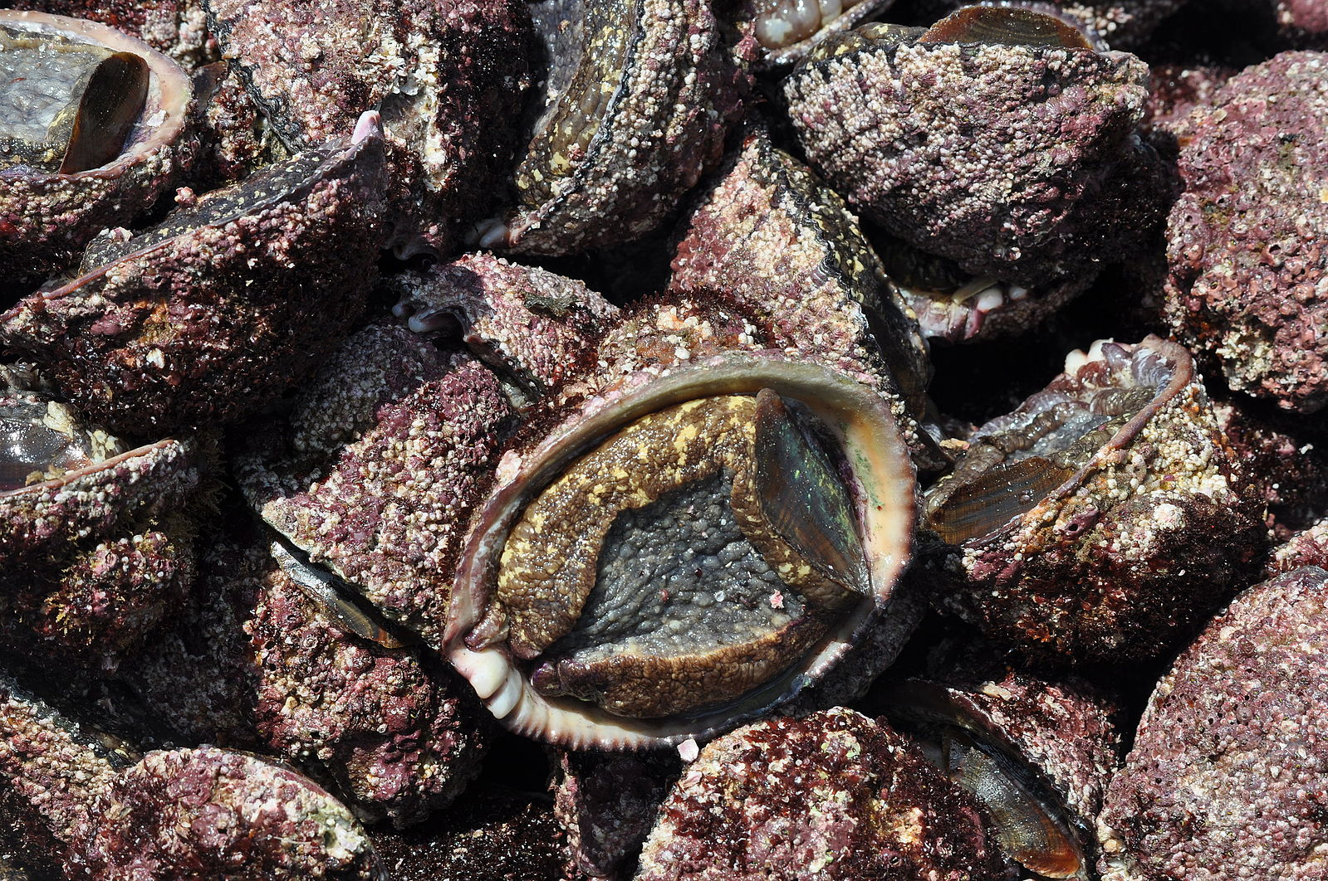
Simulate hypothetical data for Loco (Concholepas concholepas)
Photo from wikimedia commons
Manríquez et al. 2012

Slide 3
Simulated Data

Slide 4
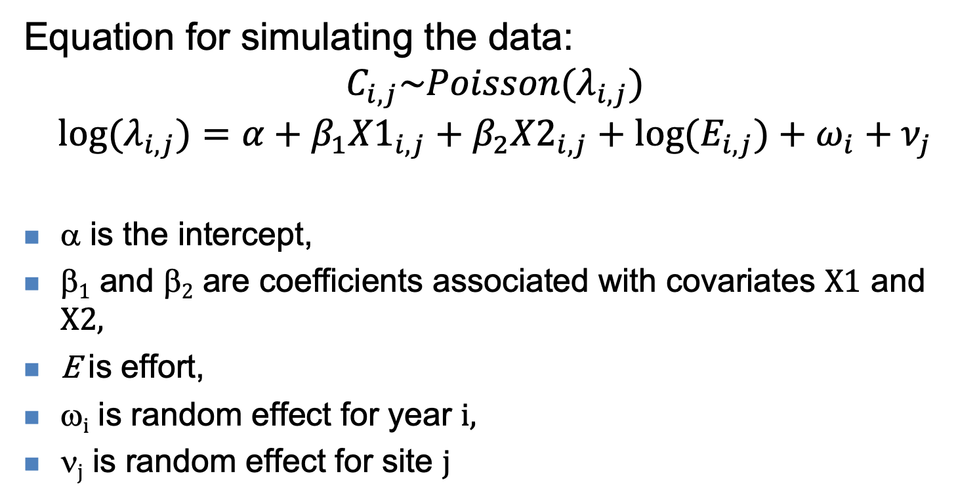
Model simulations
Equation for simulating the data:
$$C_{i,j}\sim Poisson(λ_{i,j})$$
$${log⁡(λ}_{i,j})=α+β_{1}{X1}_{i,j}+{β_{2}X2}_{i,j}+{log⁡(E}_{i,j})+ω_{i}+ν_{j}$$
α is the intercept,
β₁ and β₂ are coefficients associated with covariates X1 and X2,
E is effort,
ω_{i} is random effect for year i,
ν_{j} is random effect for site j

Slide 5
Lab steps
Together we will:
Simulate data
Fit a GLM to the simulated data
Fit a GLMM with year effects
Then you will:
Fit a GLMM with site effects
Fit a GLMM with both site and year effects

