Slide 1
Numerical optimization 10 January 2022
Fitting hierarchical models with TMB
10-14 January, 2022
University of Concepción, Chile
Dr. Cole Monnahan

Slide 2
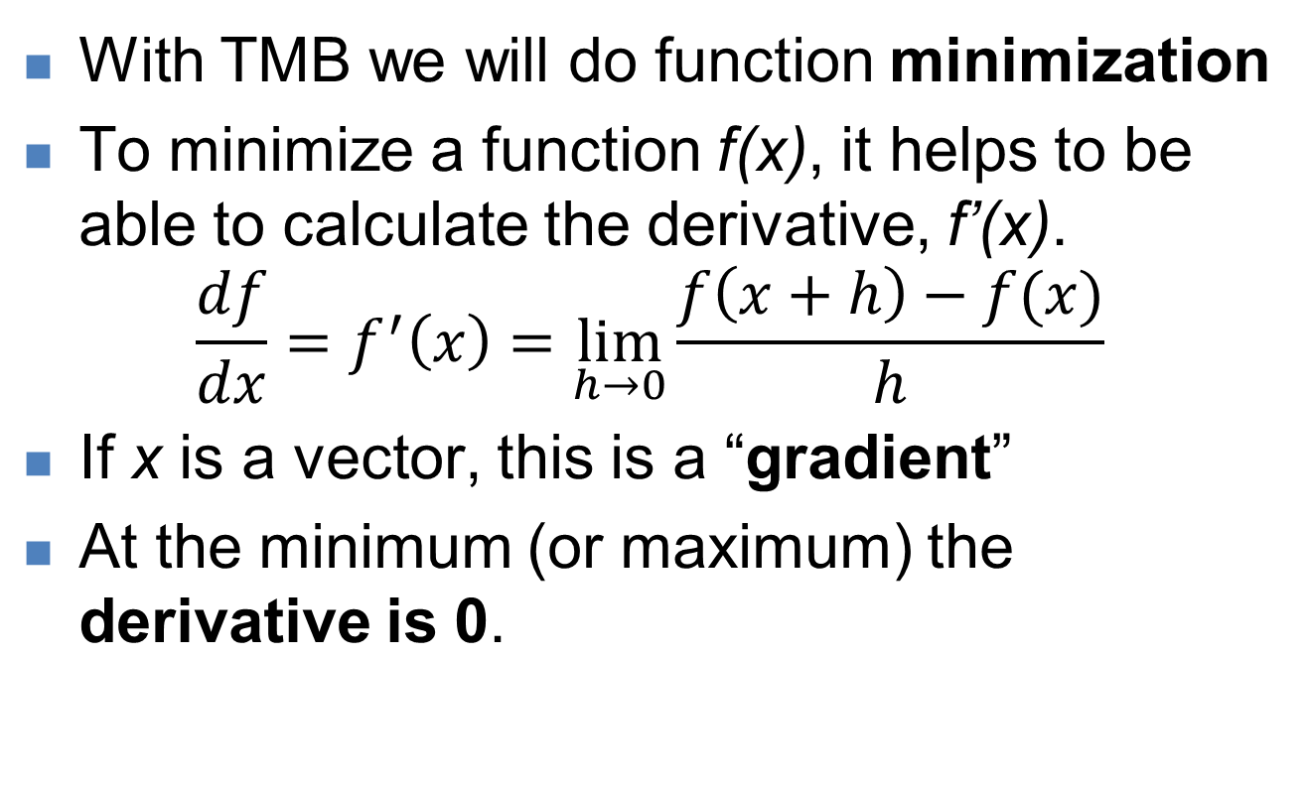
Function minimization
With TMB we will do function minimization
To minimize a function f(x), it helps to be able to calculate the derivative, f’(x).
$$\frac{df}{dx}=f^{′}\left(x\right)=\lim_{h→0}{\frac{f\left(x+h\right)−f(x)}{h}}$$
If x is a vector, this is a “gradient”
At the minimum (or maximum) the derivative is 0.

Slide 3
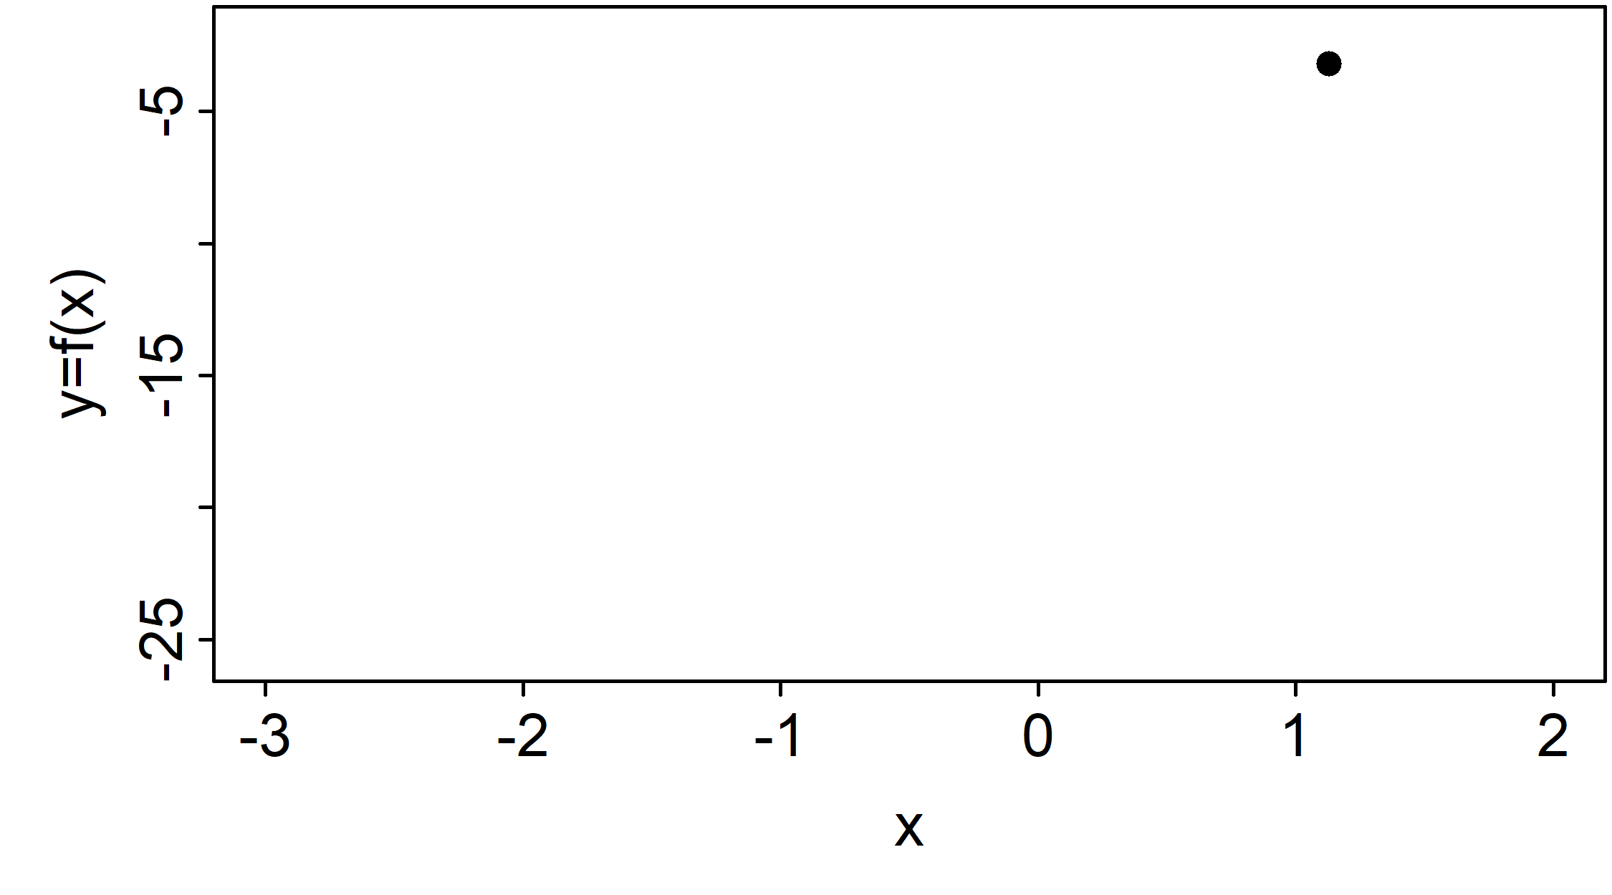
1D Function minimization
Derivatives tell us which way is down
Iterate toward minimum until derivative is 0
This is known as numerical optimization

Slide 4
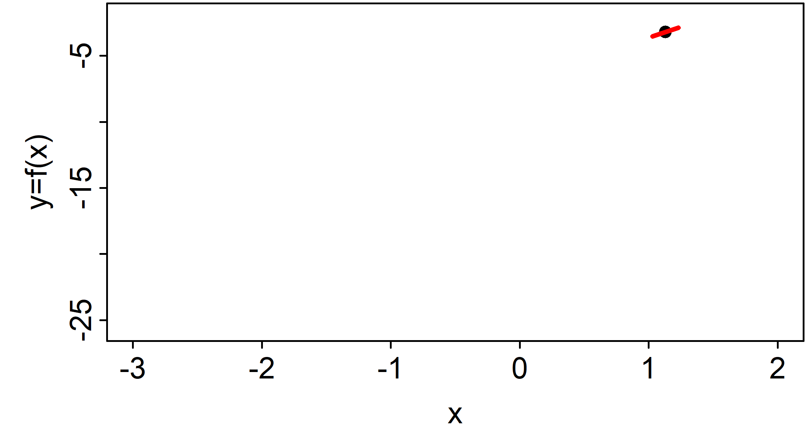
1D Function minimization
Derivatives tell us which way is down
Iterate toward minimum until derivative is 0
This is known as numerical optimization

Slide 5
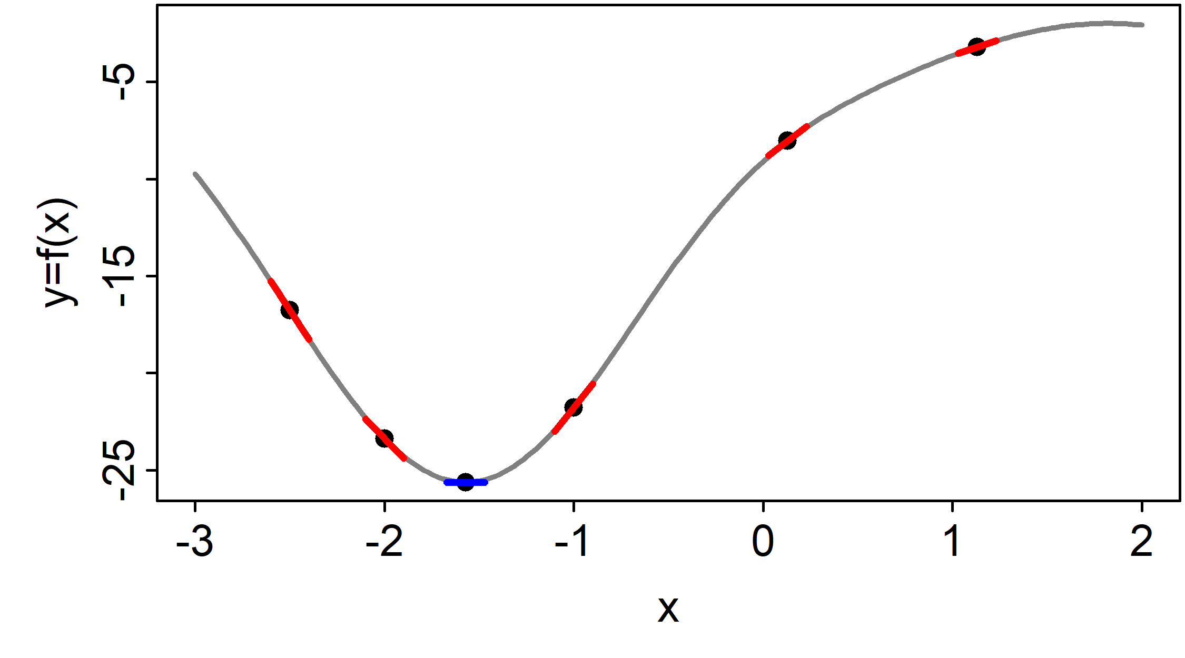
1D Function minimization
Derivatives tell us which way is down
Iterate toward minimum until derivative is 0
This is known as numerical optimization

Slide 6
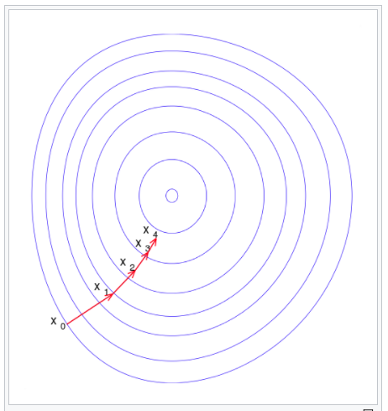
2D function minimization
Contours show level sets
(think of bowl)
Iterative steps toward minimum
Wikipedia.org

Slide 7
Calculating derivatives
Analytical derivatives (i.e., a formula) are ideal, but difficult to find
Numerical derivatives like “finite difference” (e.g., set h=0.0001 in formula) are unreliable
So, how do we calculate gradients of complex functions (e.g., statistical models)?
Solution = “automatic differentiation”
For us, a magic trick the computer does to calculate fast and accurate gradients

Slide 8
Function minimization
Finding the minimum of a function is “fitting” a statistical model
The function f(x) is related to the “likelihood”
The independent variable “x” is our model parameter(s)
We will discuss this concept in more depth tomorrow
For now, we can just consider f(x) a function

Slide 9
Function minimization in Excel
Let f(x)=(a-x)^2+(b-x)^2+(c-x)^2
a,b,c = {0.113, -0.240, 0.583} are constants
For any x we can calculate f(x) and f’(x)
[Excel demo]

Slide 10
Function minimization in R
Let f(x)=(a-x)^2+(b-x)^2+(c-x)^2
a,b,c = {0.113, -0.240, 0.583} are constants
For any x we can calculate f(x) and f’(x)
[Demo in R]
f <- function(x) sum((c(.113, -.24, .583)-x)^2)
fprime <- function(x, h=1e-5) (f(x+h)-f(x))/h

Slide 11
Function minimization in TMB
Let f(x)=(a-x)^2+(b-x)^2+(c-x)^2
a,b,c = {0.113, -0.240, 0.583} are constants
For any x we can calculate f(x) and f’(x)
[Demo in R]
#include <TMB.hpp>
template<class Type>
Type objective_function<Type>::operator() ()
{
PARAMETER(x);
Type f=pow(x-0.113,2)+pow(x- -0.240,2)+pow(x-0.583,2);
return f;
}

Slide 12
Function minimization in TMB
Let f(x)=(a-x)^2+(b-x)^2+(c-x)^2
a,b,c = {0.113, -0.240, 0.583} are constants
For any x we can calculate f(x) and f’(x)
[Demo in R]
compile("TMB_models/simple.cpp")
dyn.load(dynlib("TMB_models/simple"))
obj <- MakeADFun(data=list(), parameters=list(x=1), DLL='simple')
obj$fn(1) # f(x)
obj$gr(1) # f'(x)

Slide 13
Optimizers in R
R offers many numerical optimizers with different advantages/disadvantages
We will use nlminb but can also use optim
Allows use of box constraints (more later)
We pass it a function, it gives us the parameters that minimize it
Reminder: accurate gradients really improve optimizer performance

Slide 14
Optimizers in R
opt <- nlminb(start=1, objective=f, gradient=fprime)
opt$par
f(opt$par)
fprime(opt$par)
opt <- nlminb(obj$par, objective=obj$fn, gradient=obj$gr)
opt$par
obj$fn(opt$par)
obj$gr(opt$par)

Slide 15

Function minimization w/ TMB
How could we calculate derivative of this?
[Show cpp code, demo in R]
compile("tmb_models/polynomial.cpp")
dyn.load(dynlib("tmb_models/polynomial"))
obj <- MakeADFun(data=list(),
parameters=list(x=0))
obj$fn()
obj$gr()
www.vix.com

Slide 16
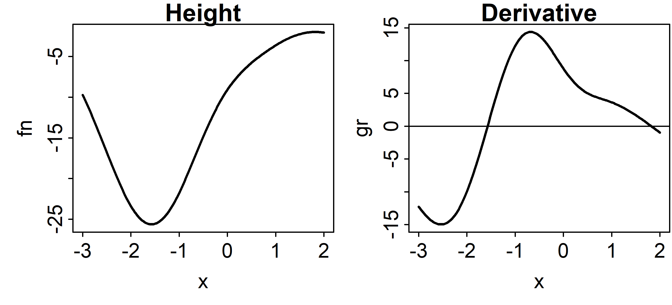
Demo 1
Use TMB to recreate this plot
We need to use a for loop over x in [-3,2]

Slide 17
Review of key concepts
Numerical optimization is finding the minimum of a function
Optimization is better with gradients, and TMB calculates those automatically:
For extremely complex functions
With thousands of parameters
Integrating parameters subsets (more later)
To “fit” statistical models we will minimize the –log-likelihood to find the MLE

Slide 18
Questions?

