Slide 1
Lab 1 10 January 2022
Fitting hierarchical models with TMB
10-14 January, 2022 (virtual)
University of Concepción, Chile
Dr. Cole Monnahan

Slide 2

Hands on exercise
I provide an Excel sheet with the function:
$f\left(x\right)=2x−4\log{x}−5\log{x}$
Build this function in R (check against Excel)
Use it to plot f(x) from 1 to 10

Slide 3
Hands on exercise step 2
Build a derivative function in R using h=0.001
Plot f’(x) from 1 to 10
Optimize it with nlminb and report the value that minimizes f, and the minimum
Confirm that the minimum has a derivative of 0

Slide 4
Hands on exercise
Make sure this code runs and matches your previous answer
Download file “lab1.cpp” from TEAMS and put into “tmb_models” folder, then run this code:
library(TMB)
compile('tmb_models/lab1.cpp')
dyn.load(dynlib('tmb_models/lab1'))
obj <- MakeADFun(data=list(), parameters=list(x=5), DLL='lab1')
opt <- nlminb(obj$par, obj$fn, obj$gr)
opt$par

Slide 5
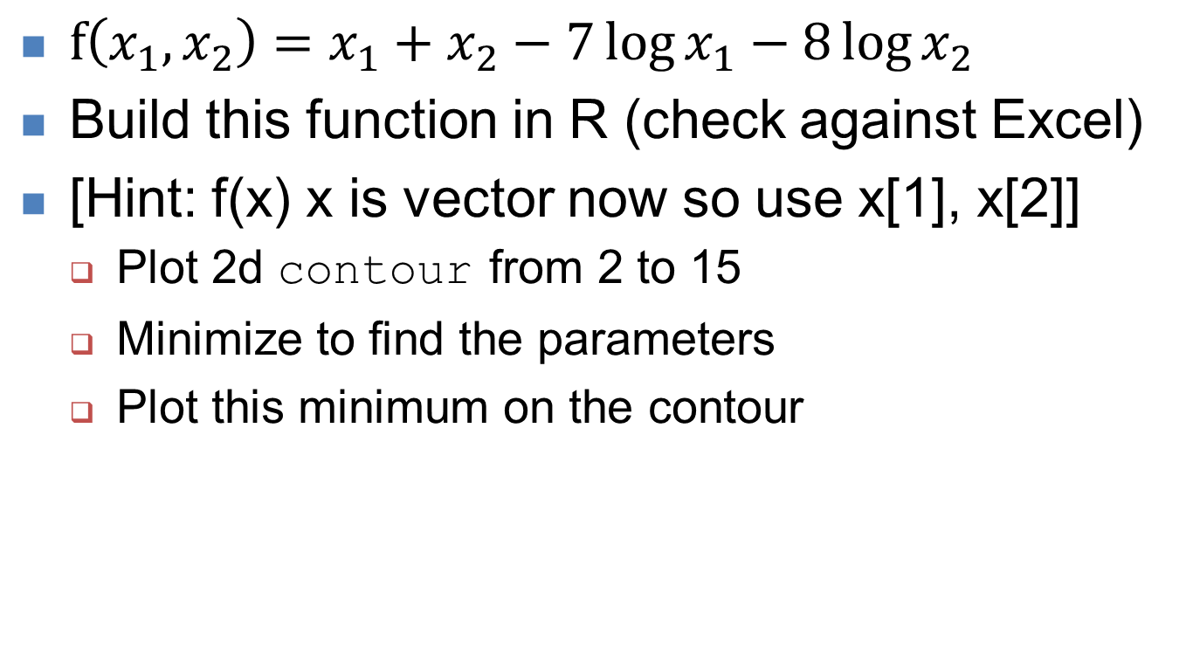
Hands on exercise: advanced
$f\left(x_{1},x_{2}\right)=x_{1}+x_{2}−7\log{x_{1}}−8\log{x_{2}}$
Build this function in R (check against Excel)
[Hint: f(x) x is vector now so use x[1], x[2]]
Plot 2d contour from 2 to 15
Minimize to find the parameters
Plot this minimum on the contour

Slide 6
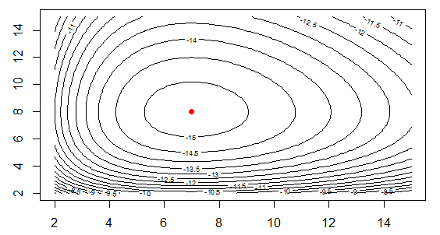
Answer

Slide 7
Recap
nlminb will find which inputs minimize a function
It helps to have a gradient function, which we can create for very simple functions like these
TMB will give us gradients for (almost) any function we can write down
What are these functions?.. -log-likelihoods of Poisson models! (GLM)
We will discuss in depth tomorrow

