Slide 1
Glacier Travel I
Aaron Yahr
1 November 2010

Slide 2
Reference Outline
Glacier definition
Zones and crevasses
Features and hazards
Snowbridges
Climates
Rope team set up
Roped Travel
Routefinding

Slide 3
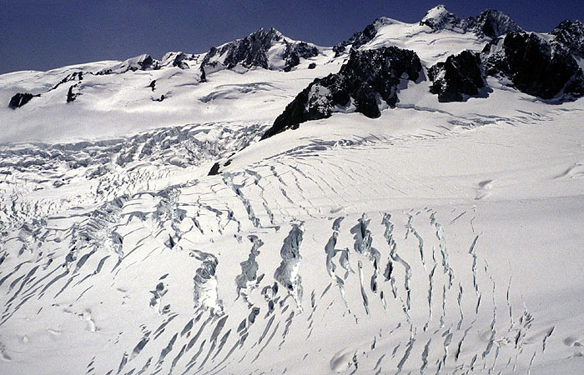
Glaciers

Slide 4
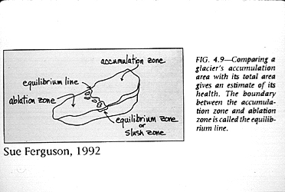
Glaciers
Form in areas that receive more snow than can melt in a given year
Snow compresses; turns to ice in several to 100 years depending on climate
Ice grows in size and moves – motion key to definition of glacier (vs snowfield)
Accumulation zone – new snow falls (upper glacier)
Abalation zone – where ice has moved down to (lower glacier)

Slide 5
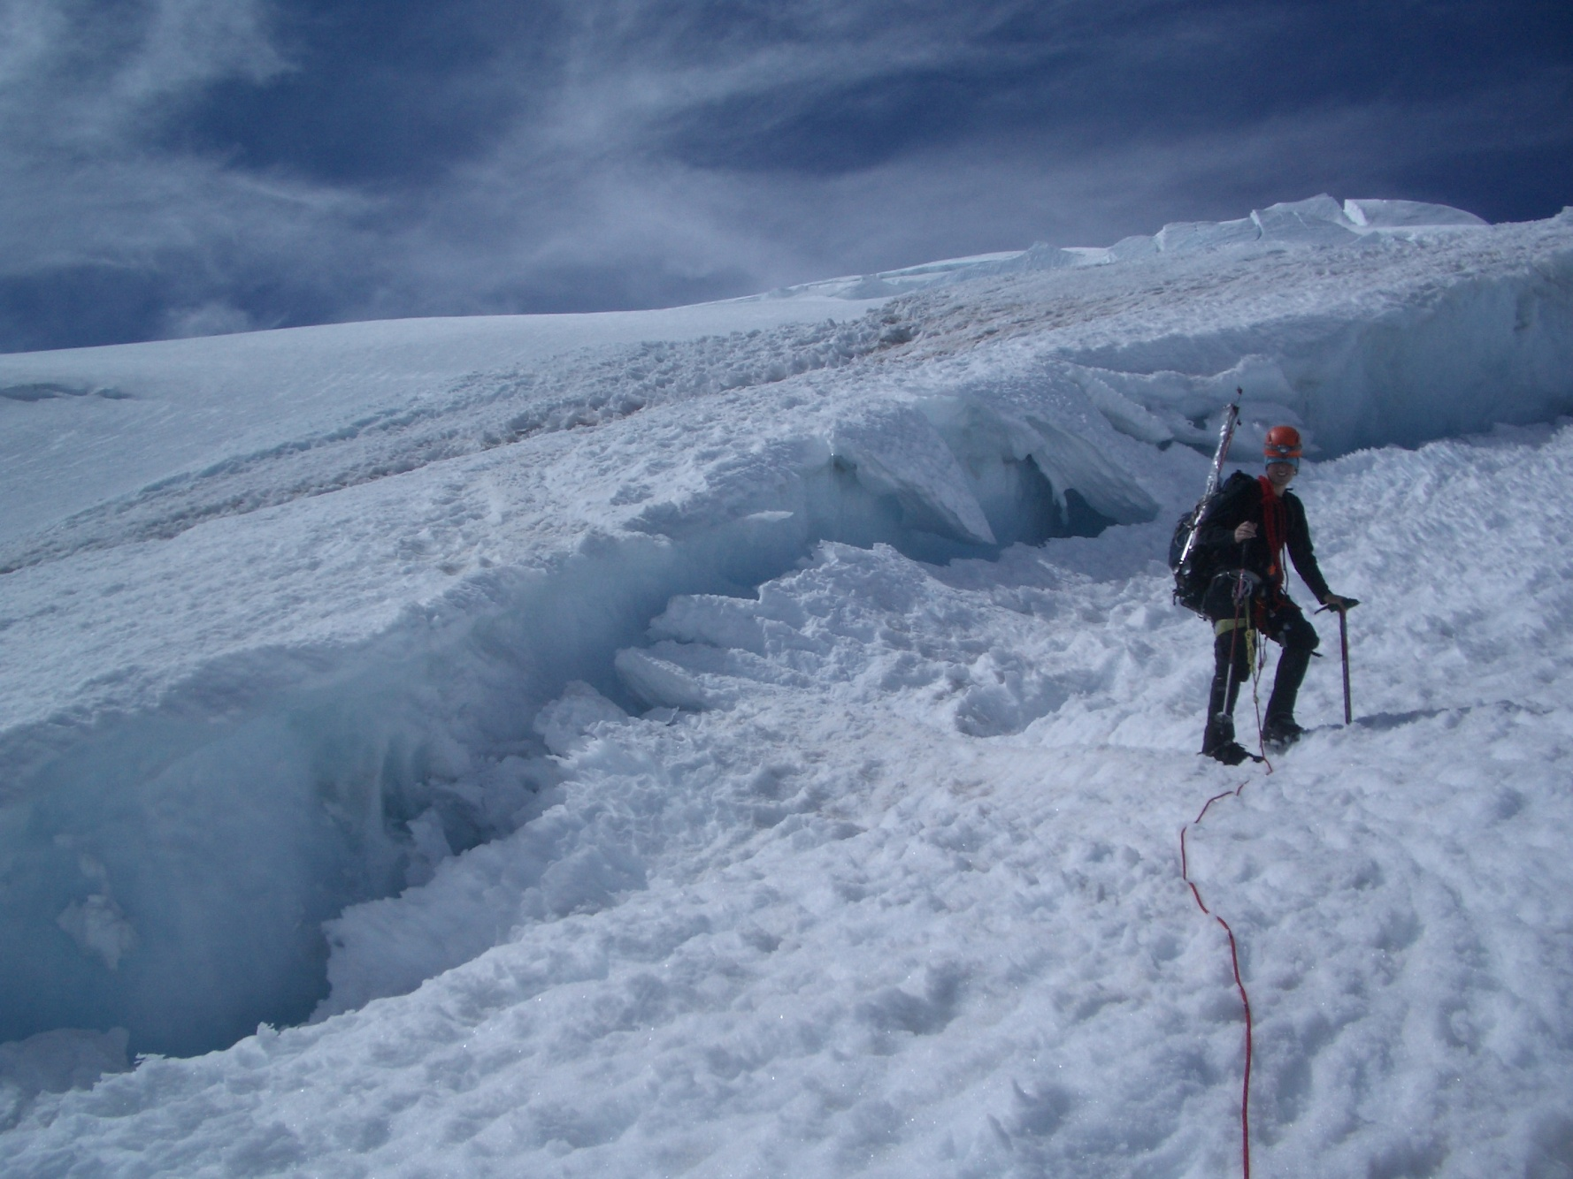
Zones and Crevasses

Slide 6
Zones and Crevasses
Crevasses form from the tension that occurs when some ice moves faster than other adjacent ice
Tension zone – e.g. sharp angled slope; surface ice must travel farther than ice at bedrock
Compression zone – e.g. base of slope; crevasses filled in by pooling
Transverse crevasses – perpendicular to glacier flow; on simple slope forms as series of parallel crevasses
Marginal crevasses – angle up glacier at 45; form on edge of rock wall and often widen toward center of glacier
Radial crevasses – form at turn or where glacier flows cross one another
Bergschrund – upper most crevasse; usually just below steep headwall and often wide and long

Slide 7
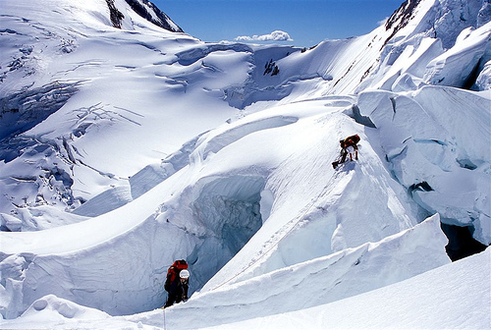
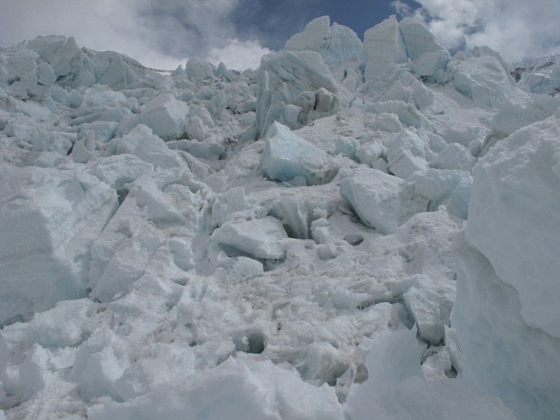
Features and hazards
Seracs
Icefall

Slide 8
Features and hazards
Icefall
chaotic structure resulting from glacier traversing rough terrain
generally refers to glacial region, “serac fall” usually used to indicate hazard of ice falling onto you (instead of “ice fall”)
Seracs
Large towers or blocks of ice
May fall onto the route or onto you
How to identify risk
Look for debris on ground
Guidebook!
Listen for crashing (also in the night)

Slide 9
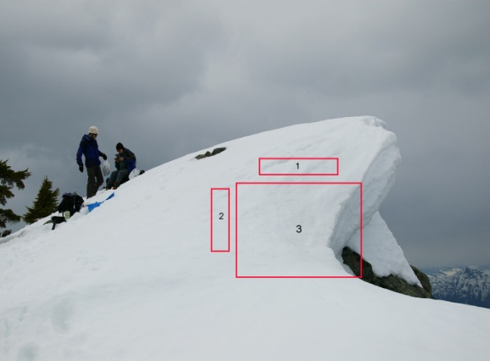
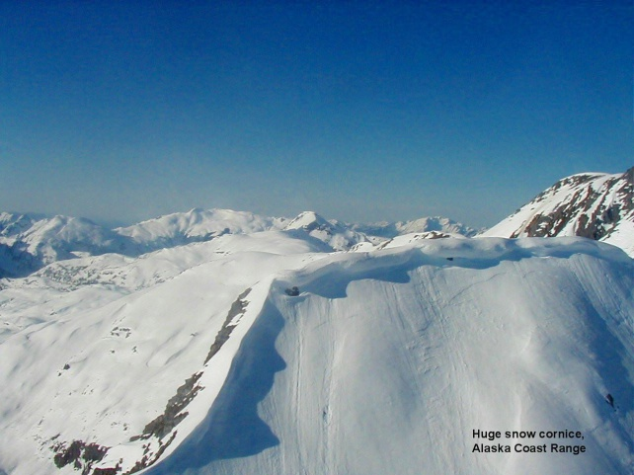
Features and hazards
Moats
Melt gaps between glacier and rock wall
May become dicer farther into summer
Can be deep and over hung with weak snow
Listen for flowing water
Cornice
When on crevasses will eventually form snowbridges
Build up of overhanging snow along on edge
Unstable - avoid travel on
Avalanches

Slide 10
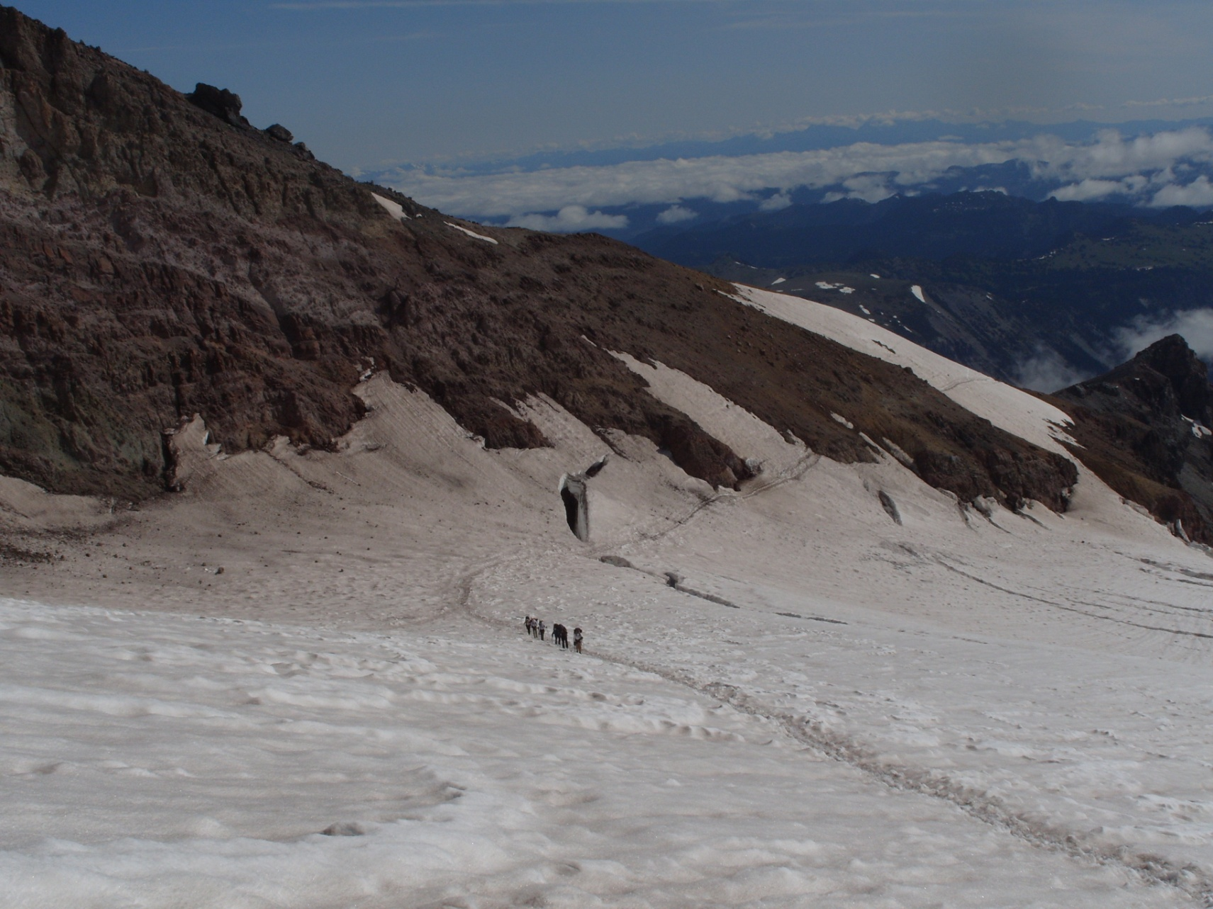
Snowbridges

Slide 11
Snowbridges
Formation
Blown snow crystals stick to lips (if not too cold) and form cornices, which link to form snowbridges
Flakes undergo age hardening to form stronger bonds over time
Generally reform during fall/winter and collapse during spring/summer
Strength
Many factors! Snow weight, solar radiation, temperature, humidity, wind, etc
Many melt-freeze cycles result in dense “snow-ice”

Slide 12
Temperate Climate
e.g. Cascades, European Alps
Glaciers: 1-10 miles long
Winter
wet with heavy snowfall (weather often poor for travel, most wands needed)
Crevasses are hidden, but snowbridges strengthen over the course of fall
Avalanches
Spring
Snowbridges begin to weaken and collapse
May be able to use skis/sled (function of glacier and slope)
Summer
Dry with long days
Crevasses begin to show; snowbridges continue to vanish
Toward later season more navigation (= guess and check) required to ascend glacier; glacier may become icy or slushy – travel better at night
Fall
Light snow dusts glacier and can mask crevasses
Snowbridges yet to form or are unrealiable

Slide 13
Other Climates
Subarctic – e.g. Alaska Range
Winter-wet / summer-dry
Snowbridges do not strengthen as much as on temperate glaciers due to less melt/freeze cycles (winter is too cold; less wet)
Glaciers: up to over 30 miles long
Meltwater on powdery snow causes more crevasse falls
Continental – e.g. Canadian Rockies, White Mtns
Precipitation any time of year – weather windows are variable
Subtropical and Tropical – e.g. Himalaya, Andes
Polar regions – e.g. Greenland, Ellesmere Is., Poles (prohibitively expensive places to access)

Slide 14
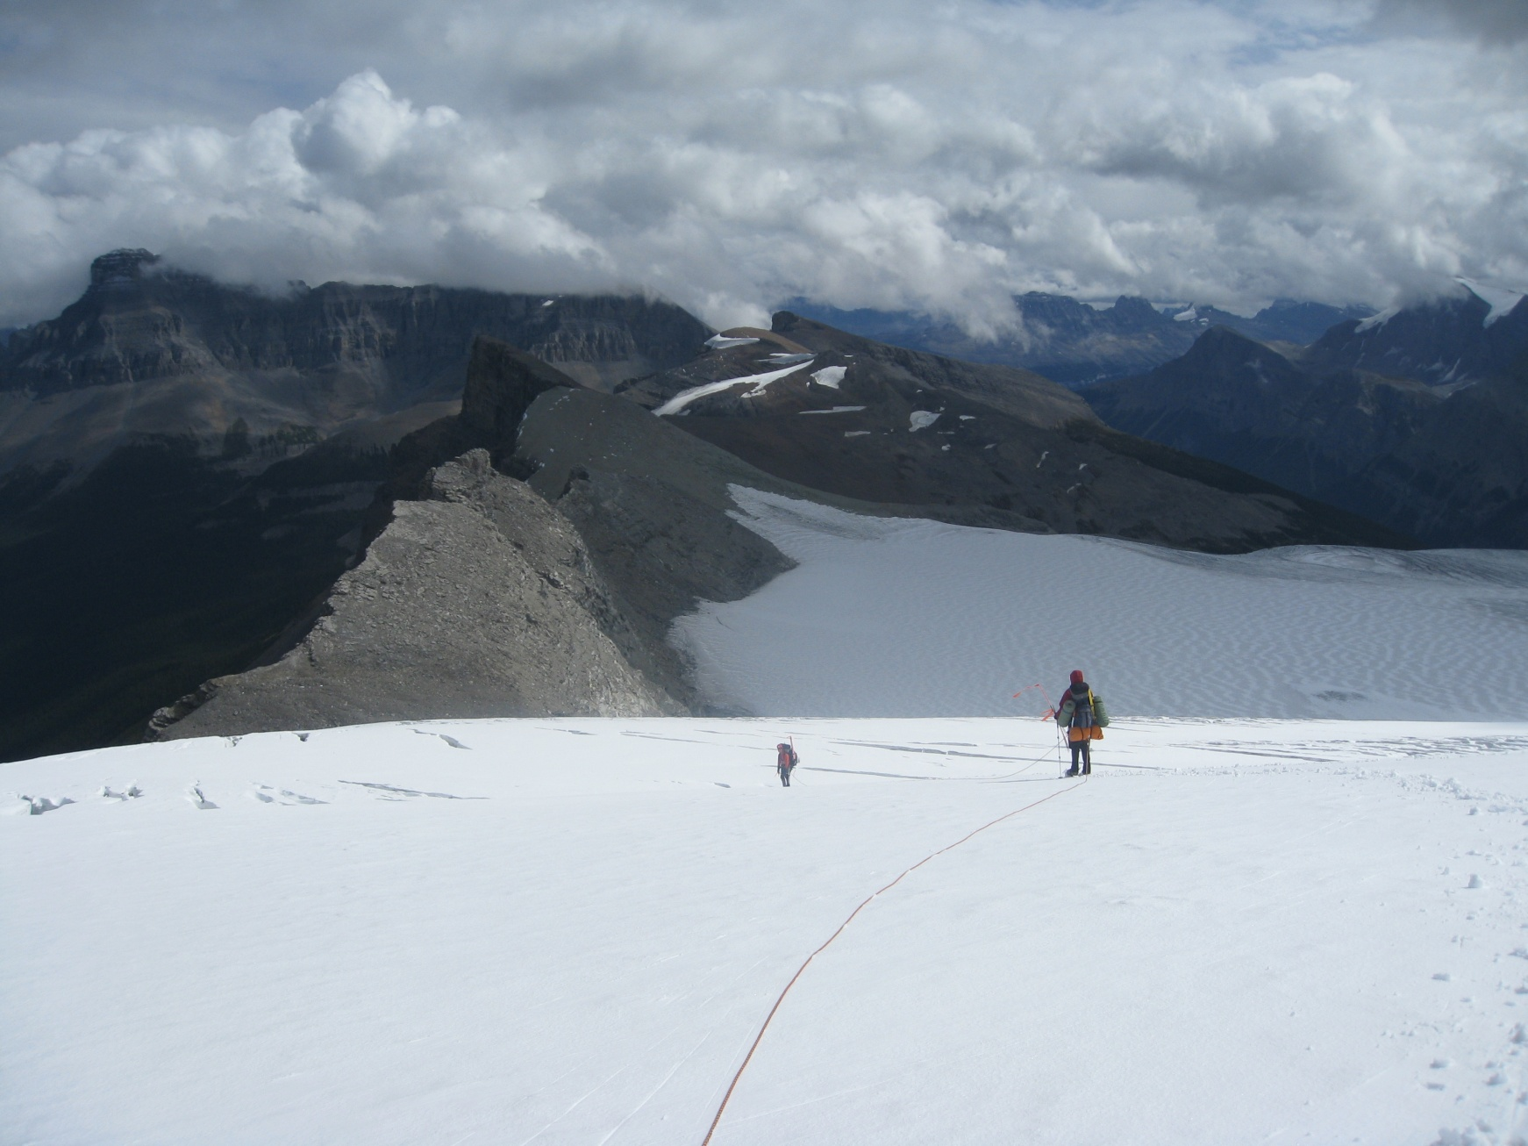
Roped Travel

Slide 15
Roped Travel
Roping up
When the benefit from arresting a partner’s fall outweighs the hazard of literally tying your fate to one another
Not helpful on icy slopes (can’t arrest)
Not helpful where low risk of fall (hinders travel)
Tying in:
Middles: eight on a bight
Ends: tie directly in with an eight
Chest harness
Pro: keeps you from flipping upside down in crevasse
Con: harder to arrest partner’s fall
Harness above hipbone
Keep slack out of the rope, but do not keep completely taut or will pull on partners

Slide 16
Roped Travel
How far apart
Longer span between people: bridge wider crevasses, more time to arrest, easier to make turns or other awkward motions
Shorter span: less slack (fallen climber doesn’t go as far), easier to stay perpendicular to crevasses
Also function of crevasse size: more slack for Alaska size glaciers in order to span hole
Estimates:
50m rope: 10m apart for 2-4 ppl, 12m for 5
60m rope: 12m apart for 2-4 ppl, 15m for 5
60m rope (Alaska): 18-20m apart for 2-4 ppl
Slack stays with end climbers for rescue
Arm span similar to height- pull rope to measure distance

Slide 17
Roped Travel
How many
Three people: classic balance between movement efficiency and ability to rescue fallen climber
Four or five: more power to hold falls, harder to maneuver. Can use two ropes- one party likely have to help group of two with anchor/haul if is fall
Two people: very demanding to arrest fall AND fix anchor alone. Practice the Z x C!
Solo: self-belay systems exist, also bridging systems. Unwise to say the least for novices

Slide 18
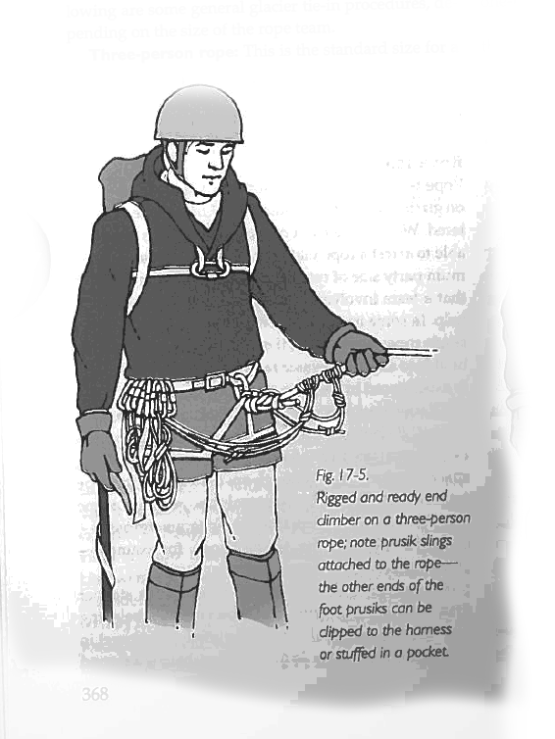
Tying In
Two options:
Tie in directly or use a carabiner to clip into a figure 8 knot
Tying in directly is sometimes recommended because it eliminates the extra link
Use double bowline or butterfly knot
Clip end to hardness so it cannot come untied - Leave some free rope at the ends for rescue use - Coil the free rope

Slide 19
Rope Management
No slack!
Makes it easier to arrest if someone falls in because they get less speed
Less chance you'll fall in the hole too
Person doesn't fall in as much
Hold rope with downhill hand behind you to feel progress of people behind you
Keep rope on downhill side of you so you avoid stepping on it
When switch backing up steep terrain
Cross the rope onto other side when switch backing
If turn is very tight, you may want to go outside of the original tracks, though this carries some risks
Switch ice axe hands too.
If you want to be lazy, don't use a leash.

Slide 20
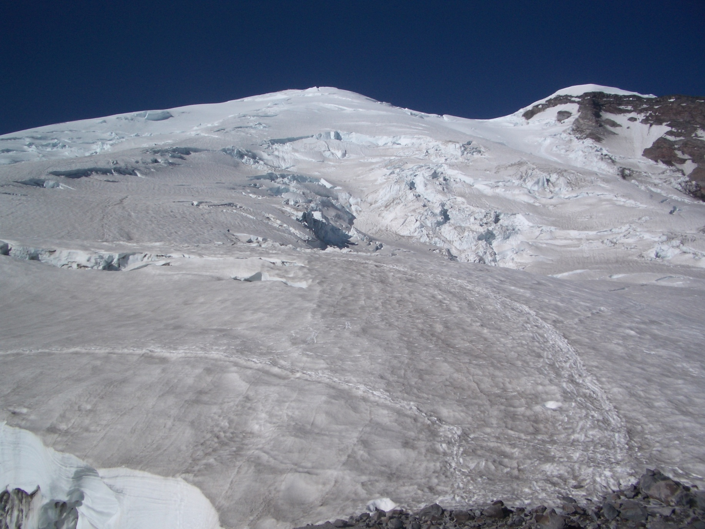
Routefinding

Slide 21
Routefinding
No trail, no cairns
Use wands – colored duct tape on garden stakes from hardware store
Crevasse maze
Different every season/year – requires trial and error
Travel farther in late season
Perspective of route changes with ascension – plan and readjust
Rope leader (person in front) often makes smaller scale decisions alone (i.e. route through dense crevasse field)
Can probe snowbridges on route with hiking pole to test sturdiness
Covered crevasses may look like old trails
Boottrack becomes less reliable over time
Altimeters, maps, compasses, gps
Whiteouts

Slide 22
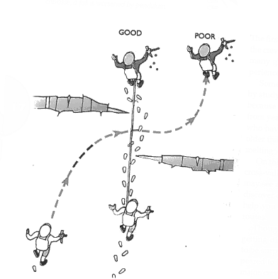
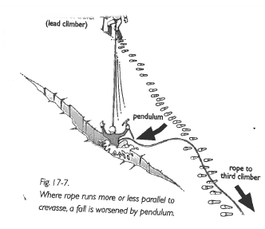
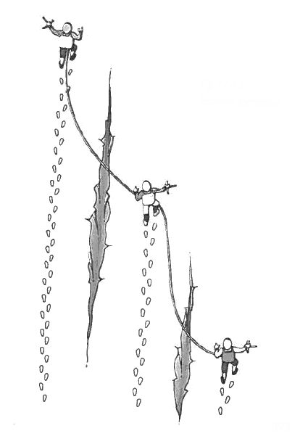
Travel
Keep rope at right angle to crevasse when possible
Reduces a lengthy pendulum fall
If you have to walk parallel to crevasses, use echelon formation

Slide 23
Travel
Play find the crevasse!
Just because you can't see it, doesn't mean it's not there
Send scout party to search for crevasses in daylight the day
Snow probing (while walking):
Use ice axe, or better a hiking pole without the basket
Thrust into snow to test if the resistance to the thrust is uniform - If not, you may have broken into a hole - Once found, establish the extent of the hole

Slide 24
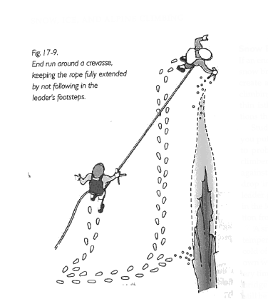
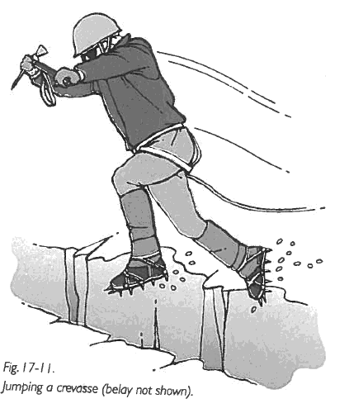
Crossing a crevasse
Walk around it
If impractical, use a snow bridge
Study it carefully
Get side view
Get close-up view while second climber braces or belays you
Follow leader's footsteps exactly
Jumping
Last resort
Spool out rope
Have ice axe out to self arrest on other side
Keep feet far apart
Going inside (if shallow)

Slide 25
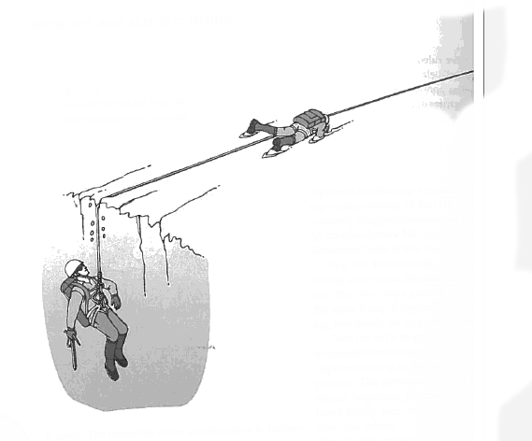
When Falling
Yell "falling" - Others self arrest
Rescue
Next class ☺

Slide 26
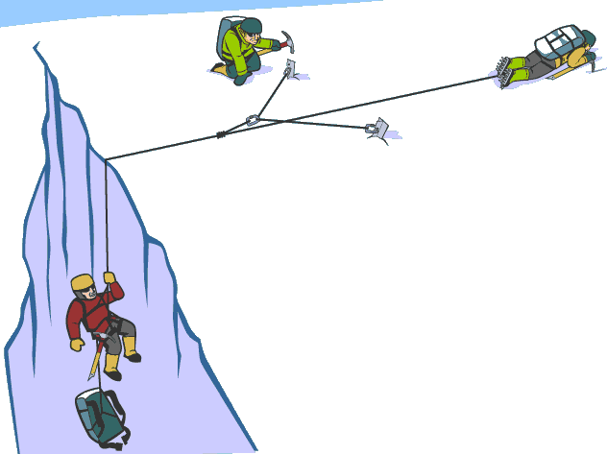
Coming Soon (now?)
More on when to rope up
Ascending the rope
Rescue and hauling systems
Protection and equipment required

Slide 27
Reference

Slide 28
Trip Planning
What to bring
Gear list w/ personal gear, group gear, maybe weight
Beta
Internet helpful but inadequate; need guide, guidebook or (a lot of) experience
Logistics
Are roads open; passable with intended vehicle?
Is a plane/helicopter required?
Will my gear fit / is it allowed in my checked luggage?
Emergency plans
WIMP: local contact info
Radio, GPS, sat phone

Slide 29
Other topics
Travel at night
Remoteness
Where to camp
Rock fall
Sleds

