Slide 1
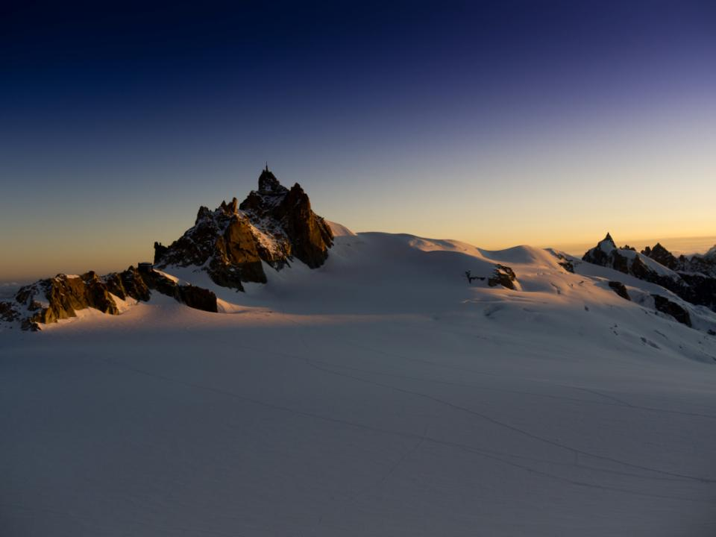
Mountaineering Refresher
Brian Hendrickson
MITOC Technical Review Session
February 27th, 2012

Slide 2
A Few Essentials*
Crampon Techniques
Self-Arrest
Roping Up
Moving as a Team
*A very incomplete list

Slide 3
More Essentials for Another Time*
Knots and Multi-Point Gear Anchors
Transitions Management (simul-climbing, pitched climbing, rapping)
Protection (deadman, pickets, bollards, screws, v-threads, natural)
Navigation (compass, resistance assessment based on terrain and maps)
Down-Climbing Techniques (facing in vs out, footwork, balling prevention)
Alternative Belay and Rappel Techniques (Dulfersitz, single-strand, simul-rapping)
Hazard Assessment (rock/ice fall, crevasse, avy, weather, team condition)
Bivouacs (gear, safety, eating, sleeping)
Camp Management (fortifying, kitchen-building, latrines)
Trip Planning (route selection, expedition vs alpine, timing, pacing, logistics)
Nutrition (mountain physiology, cooking, hydrating)
Weather (evaluating clouds, typical cycles, local patterns)
Training (cardiovascular, strength endurance vs power, periodization)
Rescue (escaping belay, line ascension, hauling systems)
Wilderness Medicine (patient assessment, long-term treatment, evacuation)
*A still incomplete list

Slide 4

Requisite Disclaimer
Mountaineering requires improvisation and real-time assessment of trade-offs. It demands both conceptual knowledge and deep first-hand experience. This review is not the definitive guide to mountaineering. Respect its limits and yours.

Slide 5
Crampon Techniques
Several main options based on:
Terrain steepness
Surface hardness
Direction of travel relative to slope
Personal fatigue

Slide 6
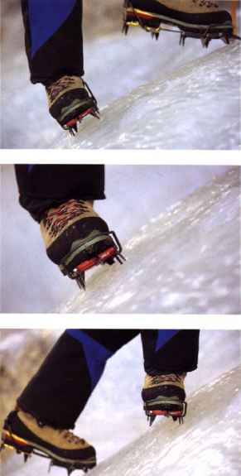
Flat-Footing (French Technique)
AVOID
PROS
CONS
All crampon points engaged
Minimal calf strain
Simple
Uncomfortable on ankles as slope angle increases
Rigid boots may prevent it on steeper terrain

Slide 7
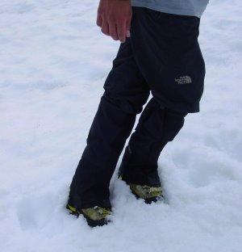
Cross Stepping
PROS
CONS
Engages major muscle groups
Minimal ankle and calf strain
Easy to rest (straighten downhill leg)
Momentarily out of balance
Easy to snag crampons!
PRACTICE

Slide 8
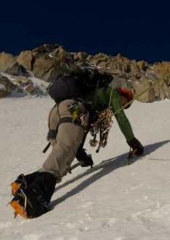
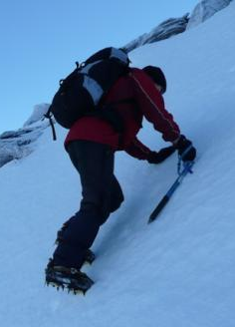
Front-Pointing (German Technique)
Easy on the Calves
Not-So-Easy on the Calves
PROS
CONS
Easy on ankles
Ascend quickly
Drains calf muscles
Only 2-4 points in contact with surface

Slide 9
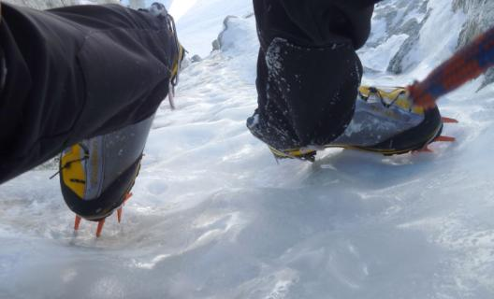
Hybrid (American Technique)
PROS
CONS
Can rest a calf/ankle
Many points in surface
Must periodically alternate
Doesn’t work on steep stuff

Slide 10
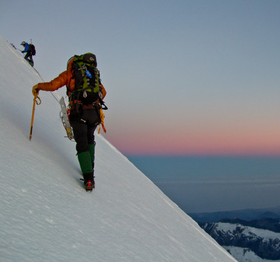
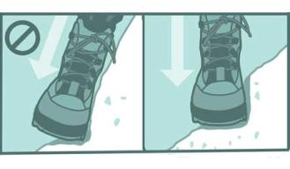
Traversing
Firm Surface
PROS
Soft Surface

Slide 11
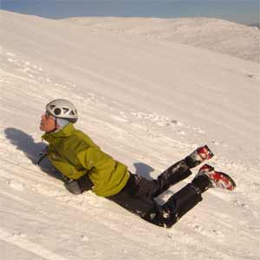
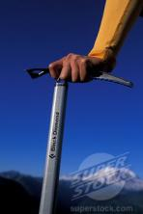
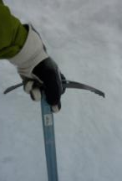
Self-Arrest
Hold like this guy
…not this guy
Reading how to do it ≠ Having it hardwired (should be practiced regularly– from multiple orientations)
Arm holding axe head must be locked off tight to shoulder (avoid having arm pop straight and lose control of axe/dislocate shoulder)
Climb with axe pointing behind you

Slide 12
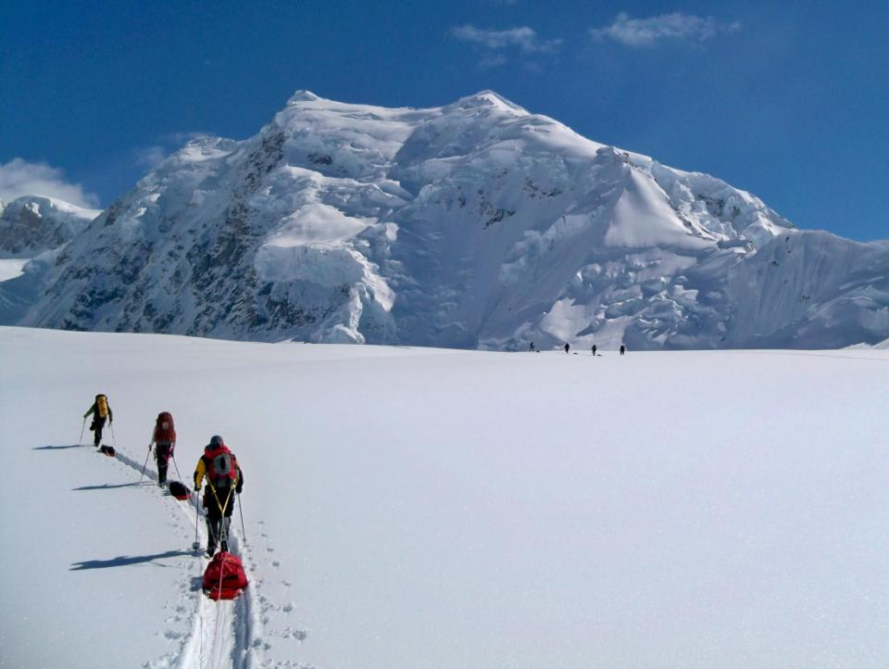
Roping Up

Slide 13
Roping Up
Chance of Partner Pulling You Off
Chance of Axe Arresting a Fall
Chance of Snagging Rope
Ability to Place Protection
Time Pressure
Do It
Don’t Do It
Roping up does not always ≠ Added safety

Slide 14
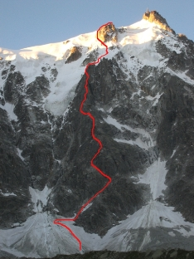
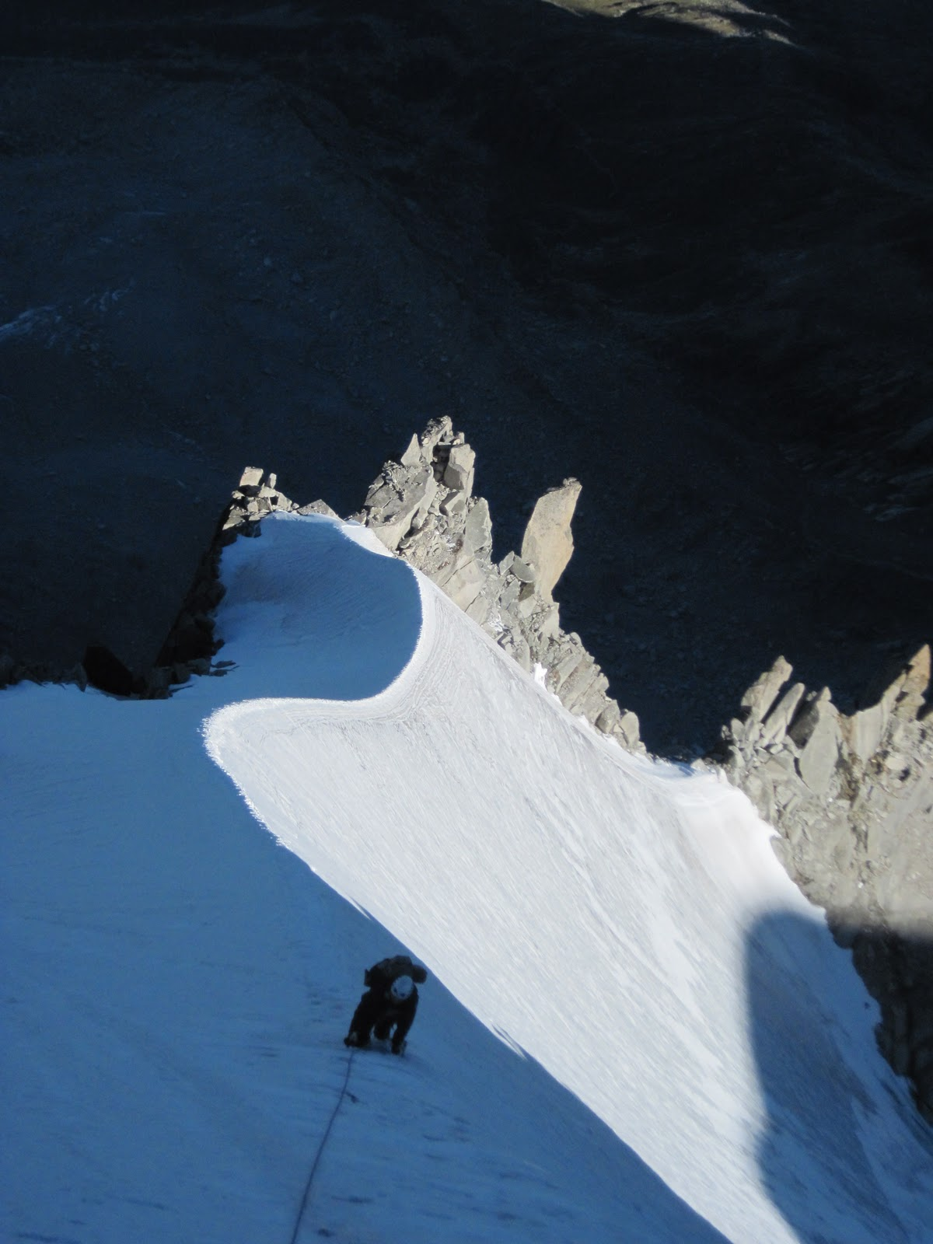

Slide 15
Tying In
Space tie-in points ~30-36 feet (more if larger crevasses) (use armspan nearly equals own height as a measuring stick)
Excess rope length coiled at ends of rope team (avoid having arm pop straight and lose control of axe/dislocate shoulder)
End People: Tie in directly (follow-through knot) or clip locking carabiner into figure-8 on a bight
Middle People: Locking ‘biner clipped into figure-8 on a bight or a butterfly

Slide 16
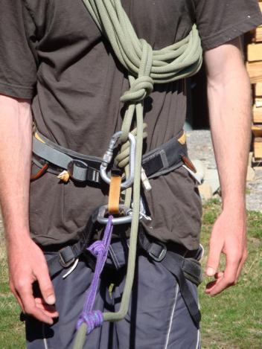
Coiling at Ends
Minimize this distance to keep potential fall forces on waist
Prussic should not be load bearing like this guy’s….
Several alternatives. We’ll practice….

Slide 17
Moving as a Team
Keep slack to a minimum
Keep rope perpendicular to crevasses
Keep rope downhill to avoid stepping on it
Remember that just because you have reached an easy/fast section, your partner(s) may still be in a slow section!

Slide 18
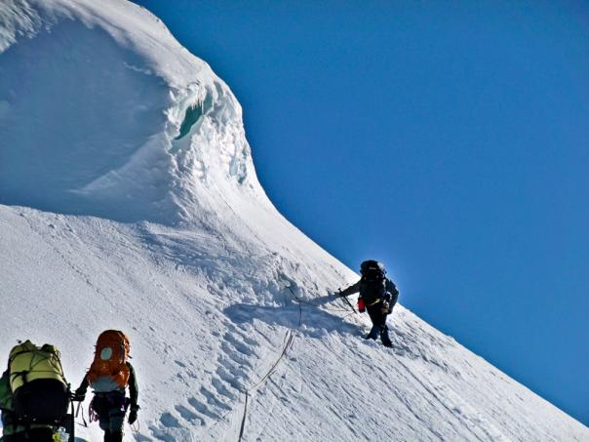
Traveling Together
Identify “islands of safety”– places where a person has minimal chance of falling (down or in crevasse) and minimal chance of stuff falling on them (rocks, ice, fellow climber)
Avoid more than one person outside of zones of safety at a time- and safeguard against people being pulled out of safety

Slide 19
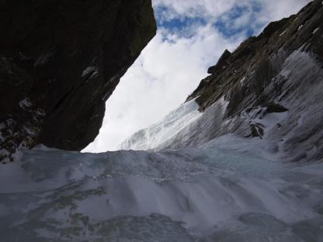
Communication
Leader should communicate planned moves for next section and the signal for follower to start up/down
Anticipate that audible communication may not be possible (nor rope tugs)

Slide 20
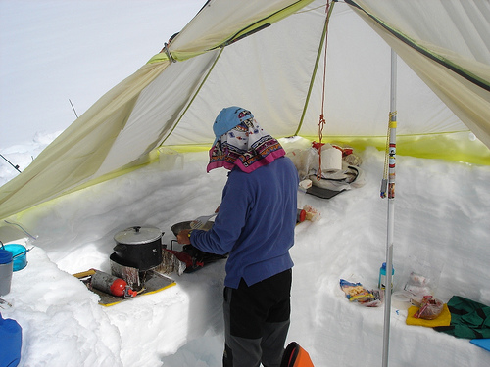
Questions?

