Slide 1
Glacier Travel II
Marek Olszewski
Aaron Yahr
1 November 2010

Slide 2
Reference Outline
Gear
Prussiks
Anchors
Belay Systems
Ascending the rope

Slide 3
What to bring
Ropes:
Dry treated ropes absorb less water so are lighter, and handle better when frozen
8.5 - 9mm generally thick enough for falls into crevasses with packs
But, the glacier is usually only one part of the climb, if you're doing any technical climbing higher up, you'll need a standard 10-11mm rope or two smaller ropes for double or twin climbing.
Harness:
Adjustable leg loops are useful since you may have more insulation
Loops that can be completely undone are also nice
If you have a heavy pack, a chest harness is also useful, can be made from a piece of 1 inch webbing

Slide 4
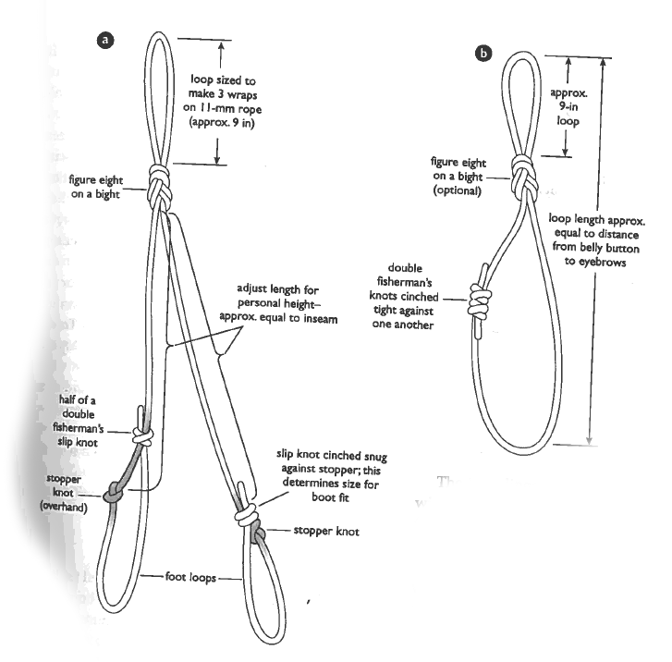
What to bring…
Prusiks
5 to 7mm perlon accessory cord
Attach to climbing rope with friction knot
Moves freely when loose
Grips firmly when weighed
Usually use prusik knot
Also like Bachmann friction knot because it uses a carabiner which makes a good handle.
Used for ascending the rope after a crevasse fall, or for self belaying yourself along a rope.
May also use an Etrier (aka Aider), and/or mechanical ascenders

Slide 5
What to bring…
Pulleys
For building rescue hauling systems.
Carabiner can be used too, but adds friction
Anchor
Snow or Ice anchors depending on conditions
Runners
Bring at least 2 single-length and one double-length runner for attaching to anchors
Tied runners are better than sewn runners because you can more easily adjust their length
Belay device
Carabiners
Recommend at least one locking, and 4 non-locking

Slide 6
Chest Harness
Chest Harness:
Helps you stay upright if you fall into a crevasse with a heavy pack - But makes it harder to self arrest - Good rule of thumb: - Clip rope into chest harness when crossing snow bridge, and keep unclipped otherwise

Slide 7
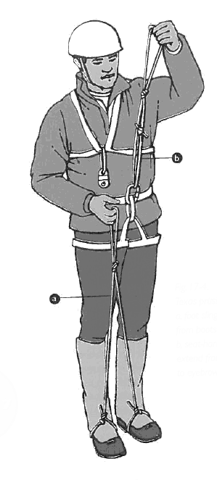
Prusik Slings
Attach slings to rope when roping up
A set consists of a short and long sling (possibly with foot loops) - Tie other end of short sling to harness - Stuff other end of long sling in pockets
When in the middle, you should attach one set to each rope direction
Some people only attach only one prusik in each direction and tie the second one only after they fall

Slide 8
Belay Systems
Common reasons to use (when higher risk of fall):
Fragile snowbridge on wide crevasse, or when traveling perpendicular to crevasse
When climbing
When on steep/icy ground above a crevasse
Boot-ax
Fast to set up- weaves rope around boot and buried ax of belayer
Generally backed up by third party ready to arrest
Only for moderate falls
Harness-ax
More reliable than boot-ax, longer to set up
Adds harness/belay device into equation

Slide 9
Belay Systems
Anchored
Similar to what is used in ice/rock climbing
Belayer is seated and attached to anchor
Anchor set to hold in direction of fall (more on anchors/pro later)
Takes longest to rig up, but is strongest
Running belay
Useful on icy slopes where arrest is of little use
Rope is clipped to protection (e.g. screw, picket) placed by the leader
Climbers clip past protection when they reach it
Last climber removes gear

