Slide 1




Is there energy loss in small systems?
Coleridge Faraday
frdcol002@myuct.ac.za
University of Cape Town, South Africa
UCT Energy Loss Group Talk
Based on CF and W. A. Horowitz, arXiv:2505.14568 [hep-ph] (2025); and CF and W. A. Horowitz, Phys. Lett. B 864, 139437 (2025).

Slide 2
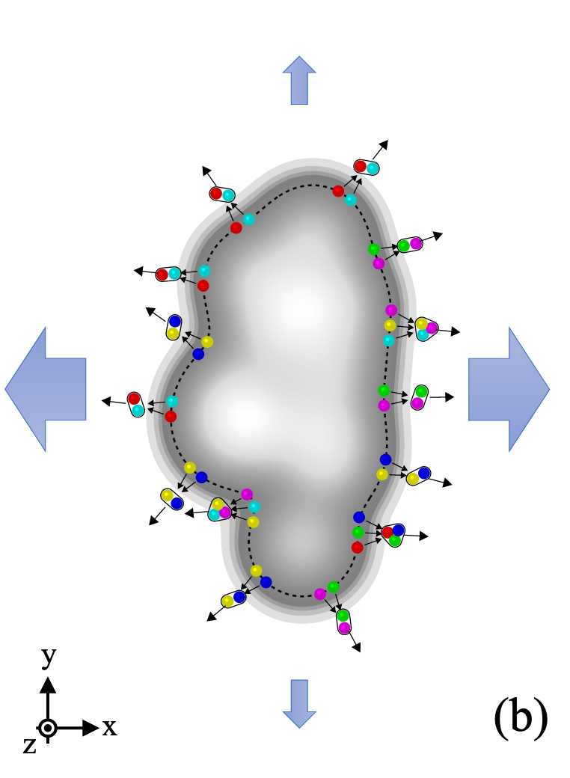
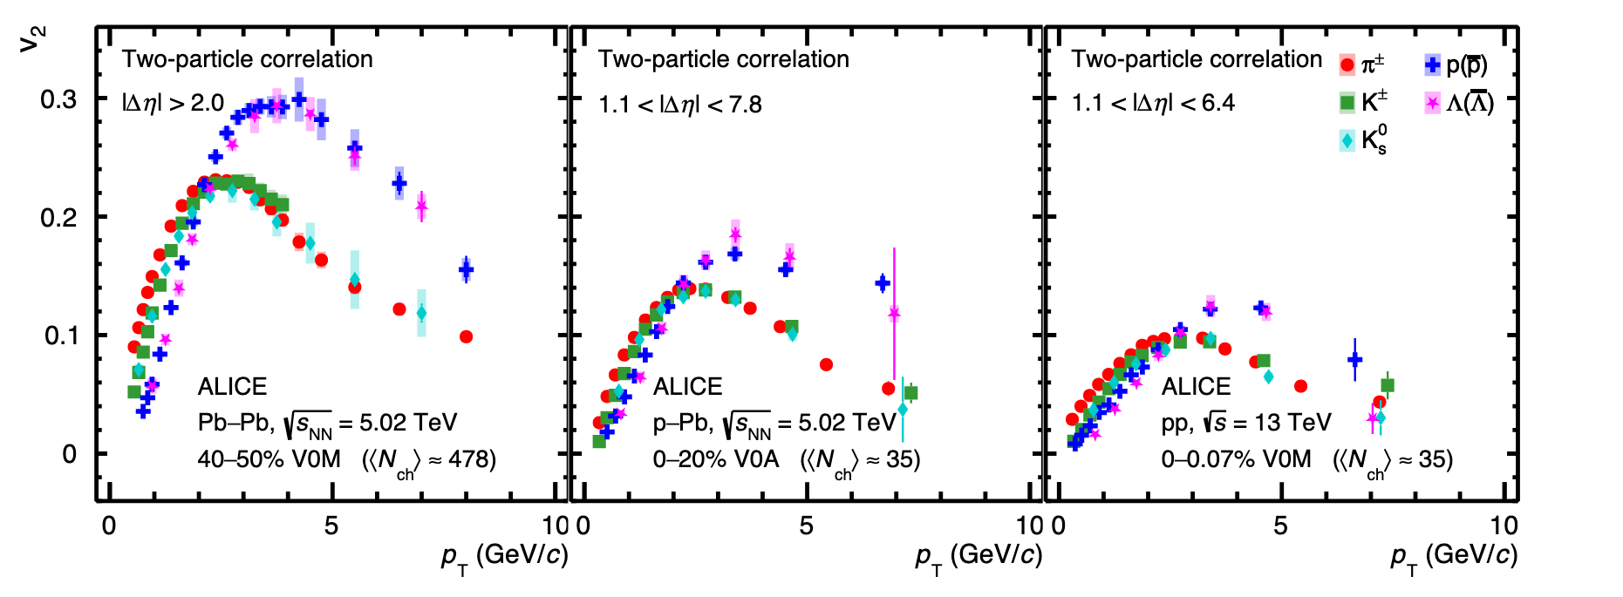
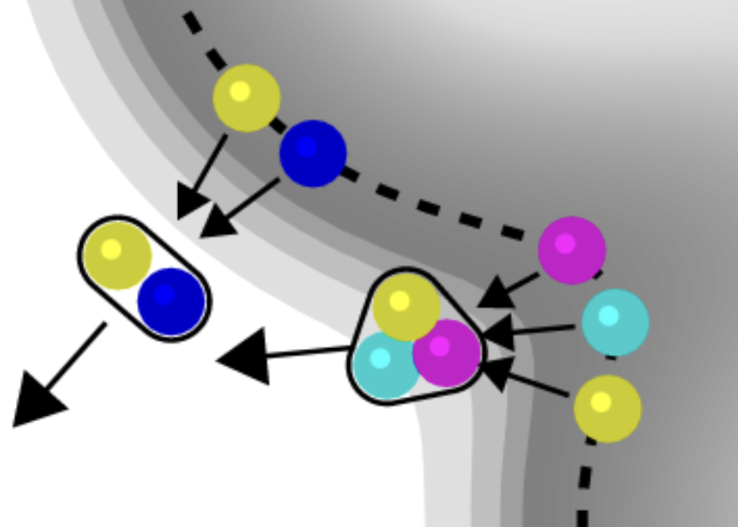
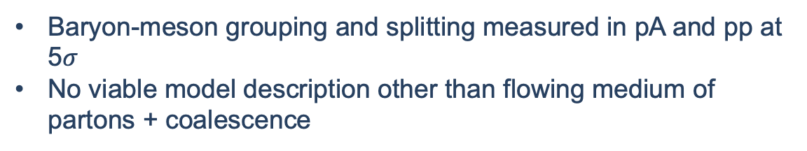
QGP Formation in Small Systems?
Pb + Pb
p + Pb
p + p
Baryon-meson grouping and splitting measured in pA and pp at 5$σ$
No viable model description other than flowing medium of partons + coalescence
ALICE, arXiv:2411.09323 [nucl-ex] (2024).

Slide 3
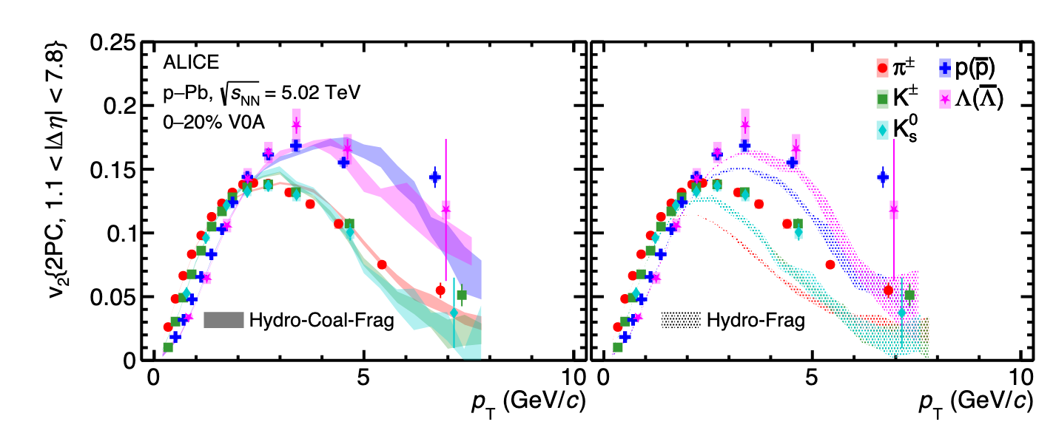
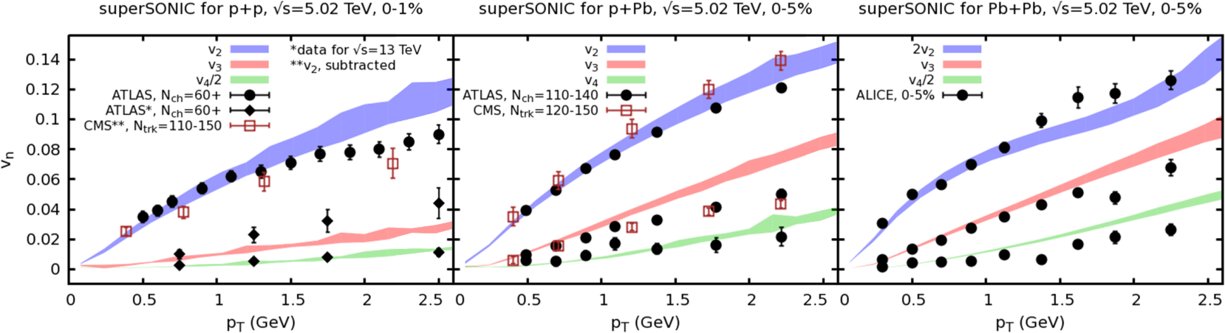
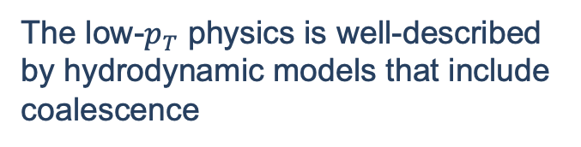

Theory describes low-$p_{T}$ in small sys.
The low-$p_{T}$ physics is well-described by hydrodynamic models that include coalescence
ALICE, arXiv:2411.09323 [nucl-ex] (2024).
Weller et al., PLB 774 (2017) 351-356

Slide 4
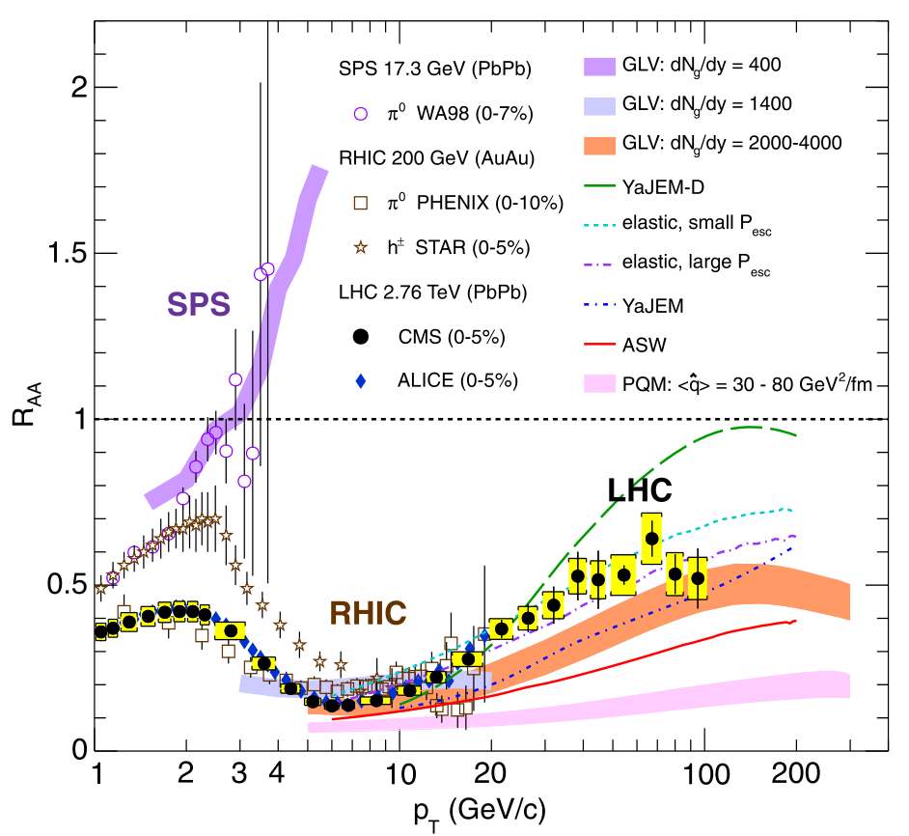
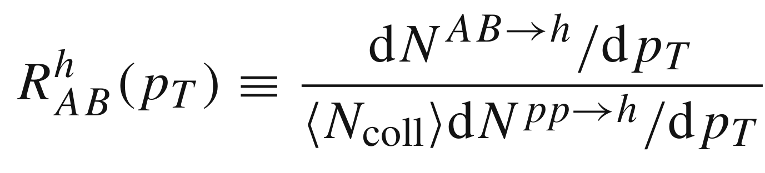
Nuclear Modification Factor
Qualitative success of pQCD energy loss models in large systems
If QGP forms in small systems, then we should also see suppression

Slide 5
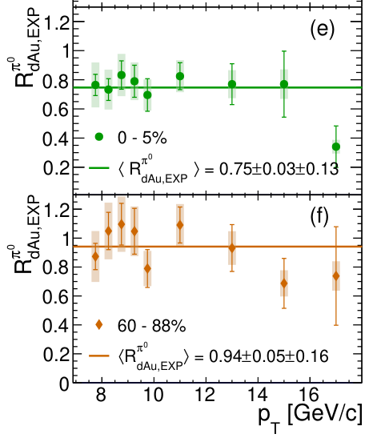
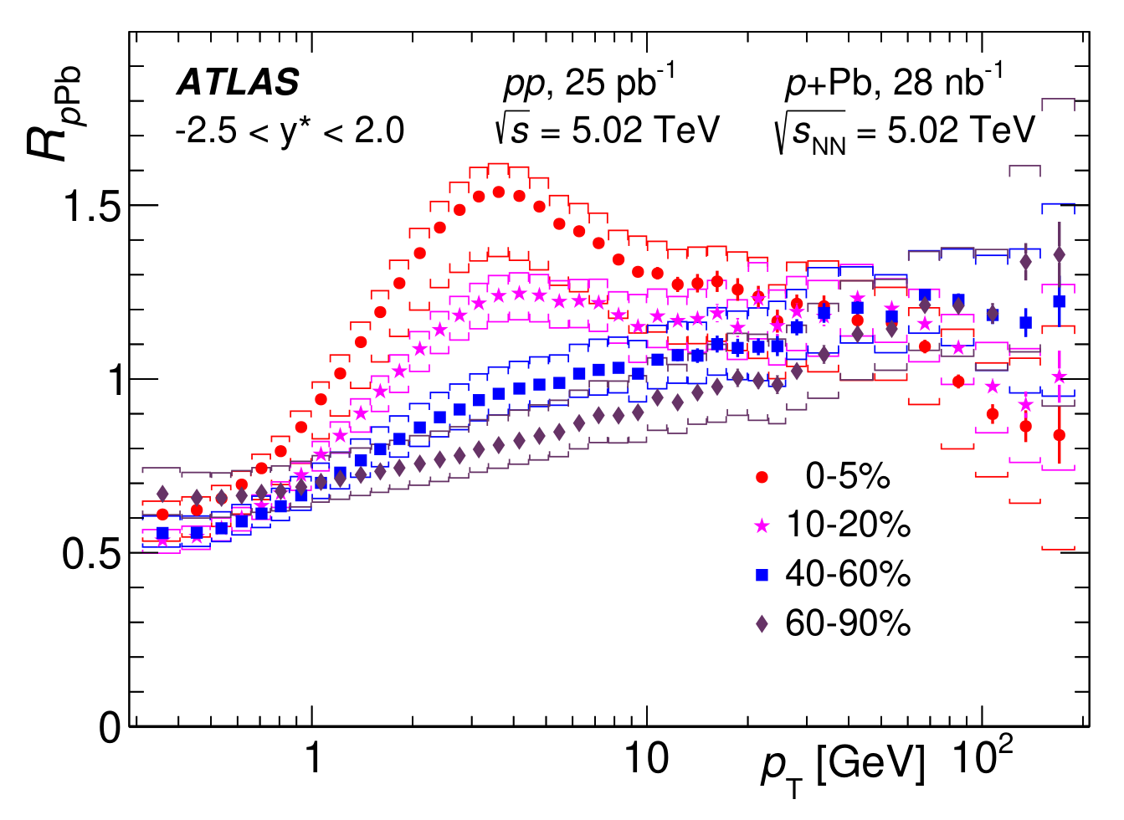

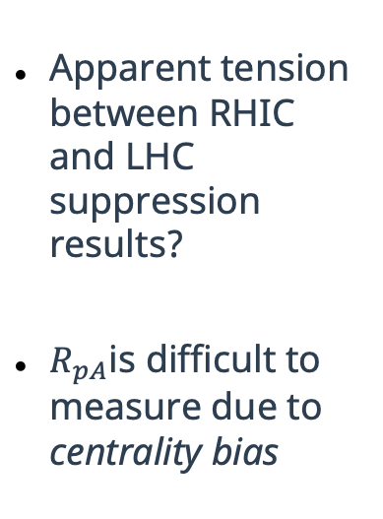
Nuclear Modification in Small Systems
Small system suppression pattern not clear
Direct $γ$
Apparent tension between RHIC and LHC suppression results?
$R_{pA}$is difficult to measure due to centrality bias
No suppression!
Glauber
Suppression ~0.75!
→ Theoretical input needed
ATLAS, JHEP 07 (2023) 074
PHENIX, Phys. Rev. Lett. 134, 022302 (2025).

Slide 6
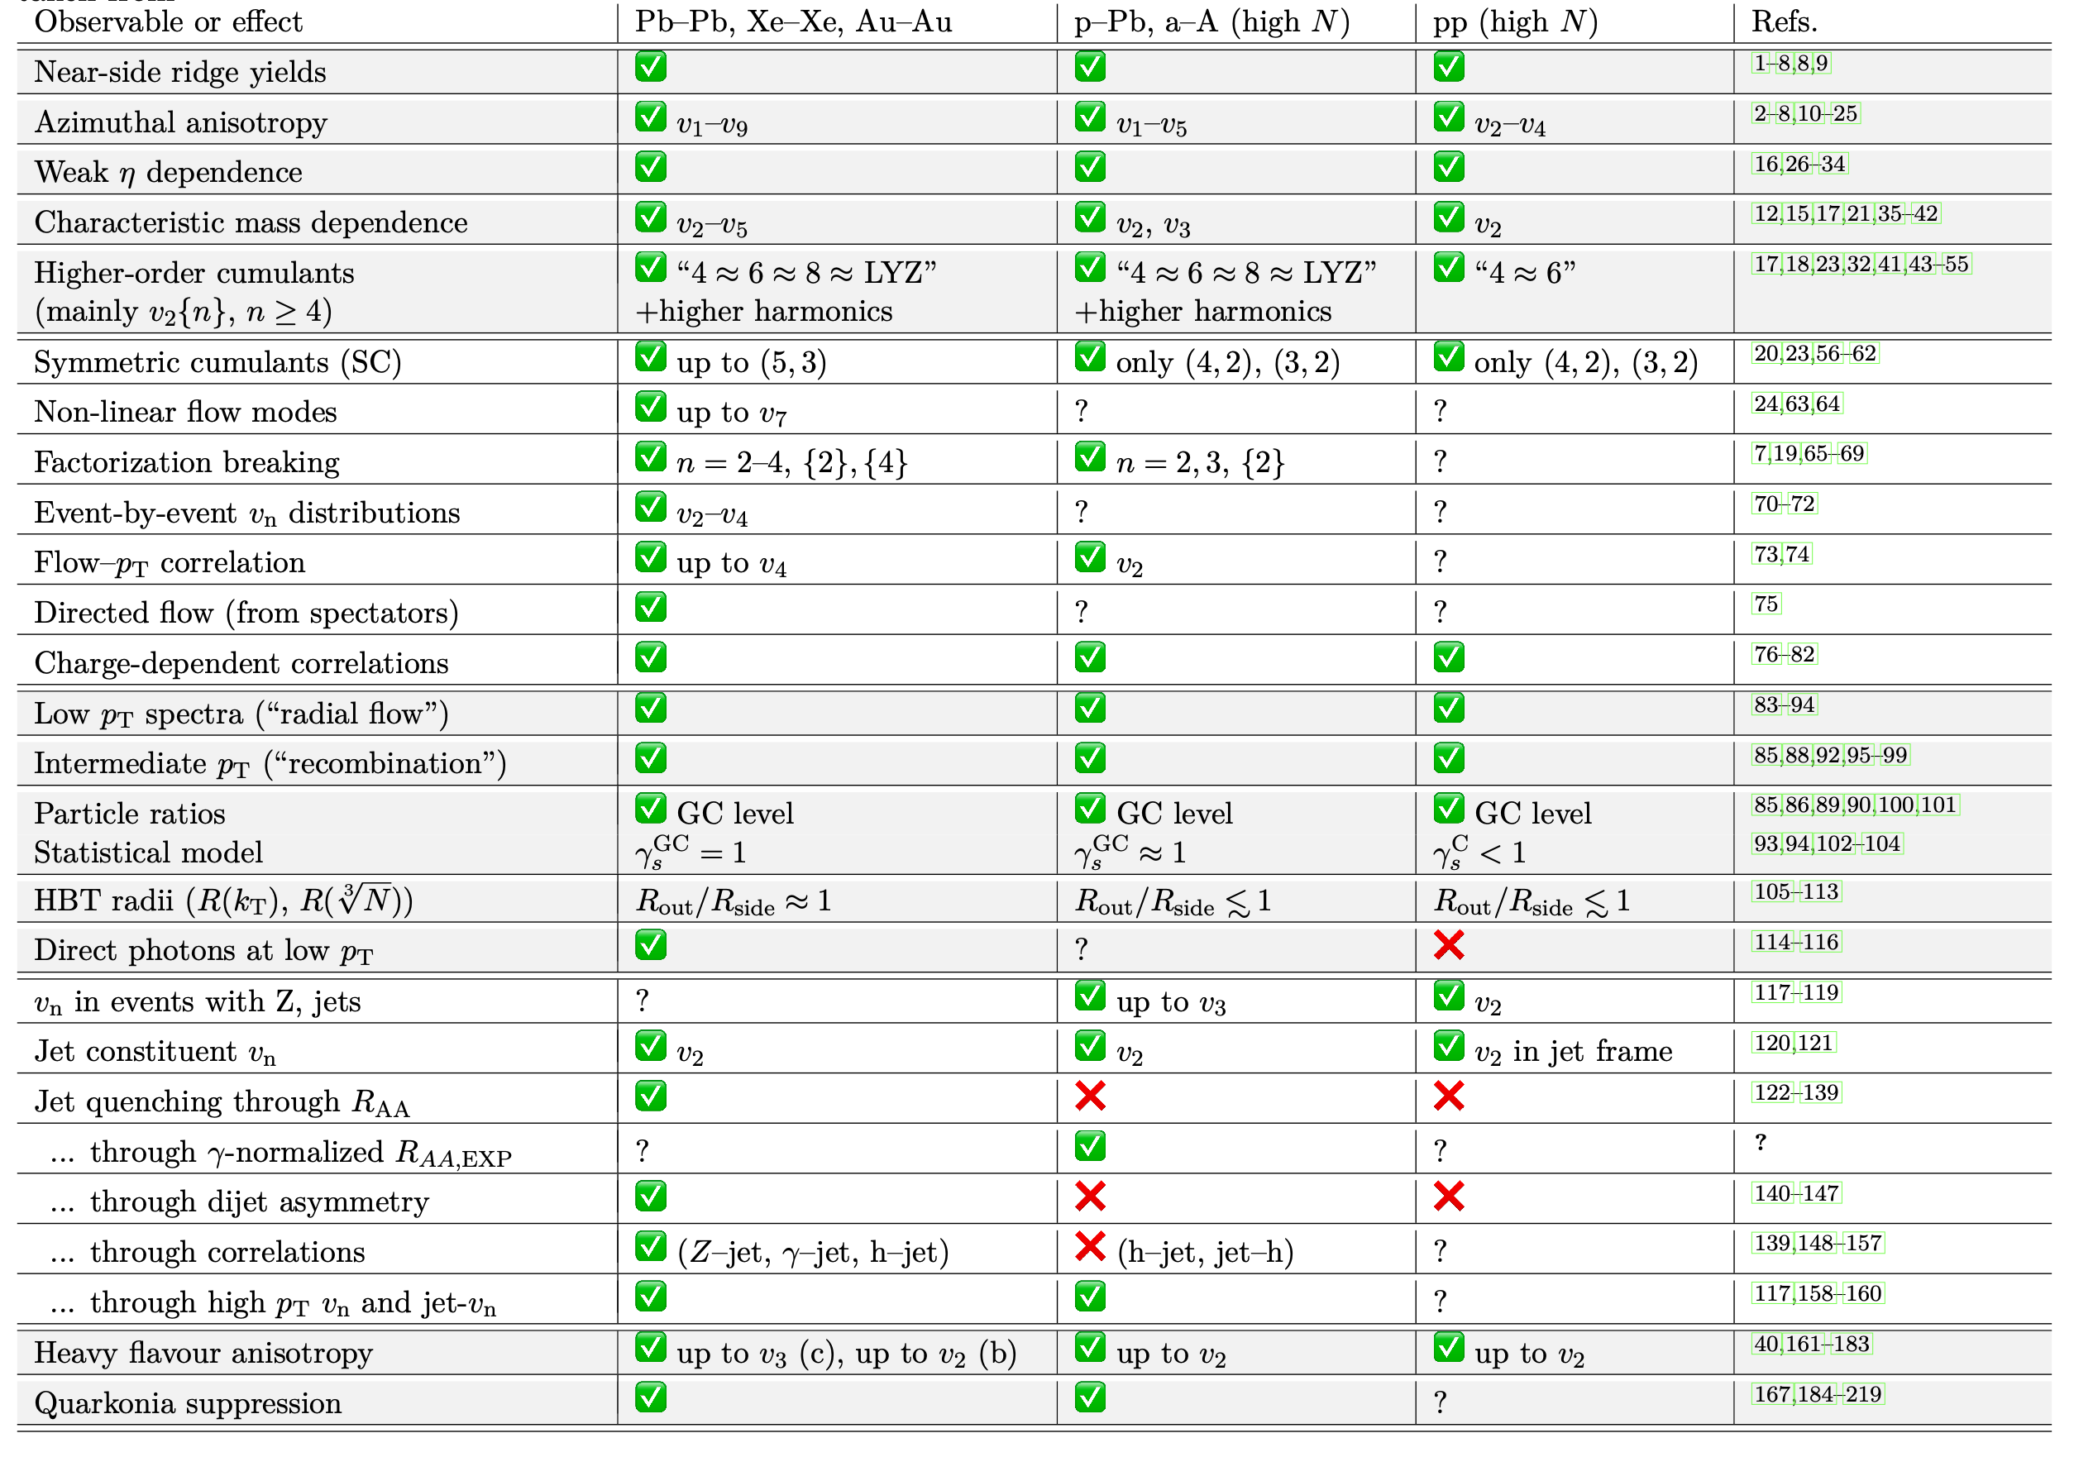



$$A + A$$
$$p + A$$
$$p +p$$
✅ = observed
❌ = not observed
? = not measured
Many, many measurements have been done in both large and small systems (220 references!)
Adapted from J. F. Grosse-Oetringhaus and U. A. Wiedemann, arXiv:2407.07484 [hep-ex] (2024). See backup slides for references

Slide 7
$$A + A$$
$$p + A$$
$$p +p$$
Flow
✅ = observed
❌ = not observed
? = not measured
Correlations
Mixed messages?
Hard probes are the missing piece of the puzzle!
Freezeout
properties
Hard probes
Adapted from J. F. Grosse-Oetringhaus and U. A. Wiedemann, arXiv:2407.07484 [hep-ex] (2024). See backup slides for references
Heavy-flavor

Slide 8
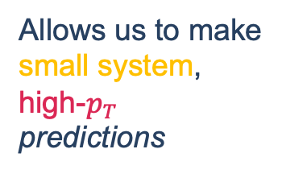
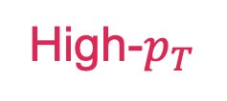
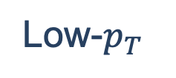
Large
Small
Constrains the small-system background
Low-$p_{T}$
Allows us to make
small system, high-$p_{T}$ predictions
High-$p_{T}$
Adapted from J. F. Grosse-Oetringhaus and U. A. Wiedemann, arXiv:2407.07484 [hep-ex] (2024). See backup slides for references
Constrains the energy loss

Slide 9
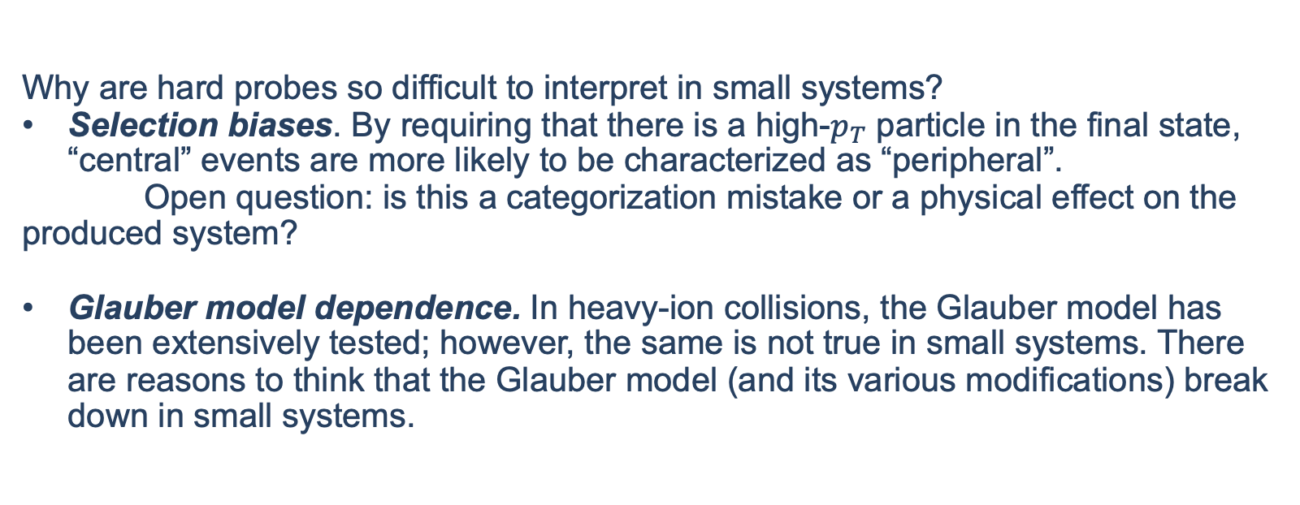
Hard probes and selection biases
Why are hard probes so difficult to interpret in small systems?
Selection biases. By requiring that there is a high-$p_{T}$ particle in the final state, “central” events are more likely to be characterized as “peripheral”.
Open question: is this a categorization mistake or a physical effect on the produced system?
Glauber model dependence. In heavy-ion collisions, the Glauber model has been extensively tested; however, the same is not true in small systems. There are reasons to think that the Glauber model (and its various modifications) break down in small systems.
ALICE, Phys. Rev. C 91, 064905 (2015).
ATLAS, Phys. Lett. B 763, 313 (2016).
ATLAS, arXiv:2504.02638 [nucl-ex] (2025).
JETSCAPE, arXiv:2407.17443 [hep-ph] (2024).
D. V. Perepelitsa, Phys. Rev. C 110, L011901 (2024).
Perhaps these difficulties mean that it is unsurprising that small system suppression is so inconclusive?

Slide 10
Problem statement
Is there a QGP formed in small systems?
If there is (as collective data points to), then should we expect energy loss?
If we do expect energy loss, then how do we understand the inconclusive and null measurements of suppression?

Slide 11
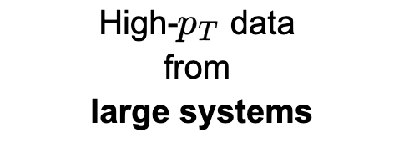


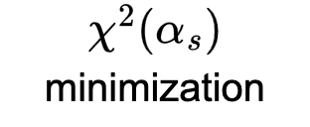
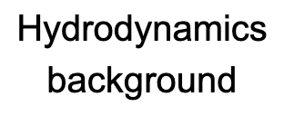



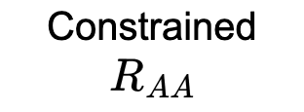
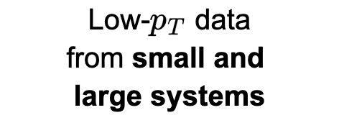

Physics model

Slide 12
Geometry

Slide 13

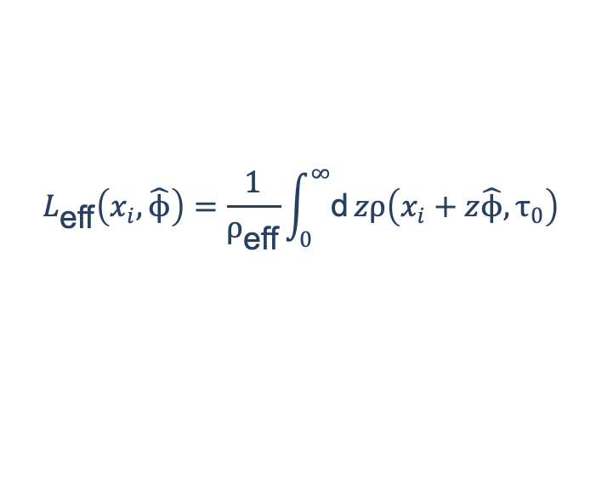
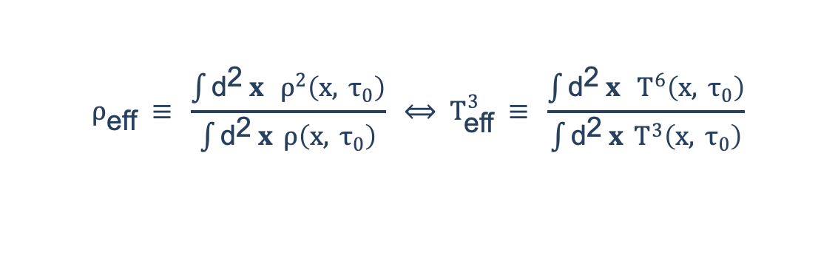
Geometry
We assume longitudinal Bjorken expansion $$T_{\text{eff}}\left(τ\right)≈T_{\text{eff}}\left(τ_{0}\right){\left(\frac{τ_{0}}{τ}\right)}^{1/3}≈T_{\text{eff}}\left(τ_{0}\right){\left(\frac{2τ_{0}}{L_{\text{eff}}}\right)}^{1/3}$$
And use the initial collision geometry to generate effective temperatures and lengths (but energy loss with full event-by-event hydrodynamic evolution is in the works!)
$$L_{\text{eff}}\left(x_{i},\hat{ϕ}\right)=\frac{1}{ρ_{\text{eff}}}\int_{0}^{∞}{\text{d}}zρ\left(x_{i}+z\hat{ϕ},τ_{0}\right)$$
$$ρ_{\text{eff}} ≡ \frac{\int{{\text{d}}^{\text{2}} x } ρ^{2}\left(x, τ_{0}\right)}{\int{{\text{d}}^{\text{2}} x }ρ\left(x, τ_{0}\right)} ⟺ T_{\text{eff}}^{3} ≡ \frac{\int{{\text{d}}^{\text{2}} x } T^{6}\left(x, τ_{0}\right)}{\int{{\text{d}}^{\text{2}} x }T^{3}\left(x, τ_{0}\right)}$$

Slide 14
Energy loss theoretical uncertainties

Slide 15
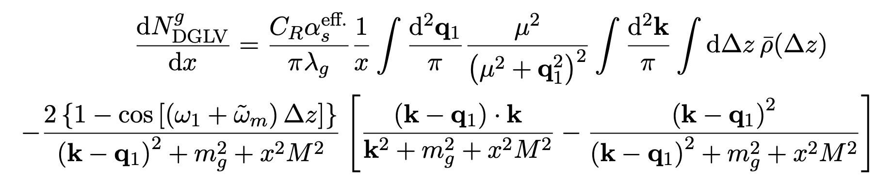
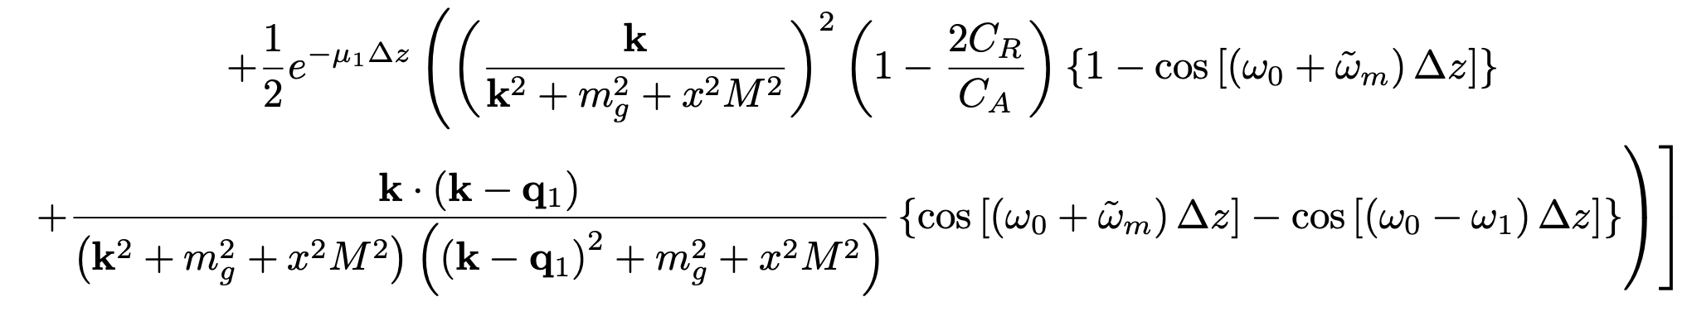
Radiative energy loss
We use Djordjevic-Gyulassy-Levai-Vitev (DGLV) radiative energy loss to first order in opacity:
M. Djordjevic and M. Gyulassy, Nucl. Phys. A 733, 265 (2004).
+ the short pathlength correction (SPLC)
I. Kolbé and W. A. Horowitz, Phys. Rev. C 100, 024913 (2019). CF, A. Grindrod, and W. A. Horowitz, Eur. Phys. J. C 83, 1060 (2023).

Slide 16
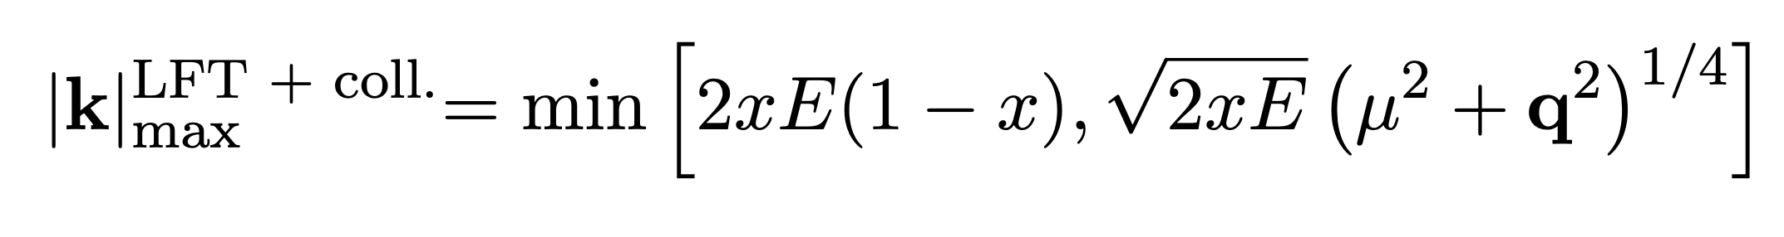
Large formation time approximation
The large formation time approximation is used in both DGLV and DGLV + SPLC, but it has a much larger impact for SPLC
We previously showed that this assumption is not self-consistently satisfied in either DGLV or DGLV + SPLC, but can be tamed by restricting the phase space of the radiative gluon emission.
In this work, we vary this bound up and down by factors of two to estimate the sensitivity to this constrain.
CF, A. Grindrod, and W. A. Horowitz, Eur. Phys. J. C 83, 1060 (2023).

Slide 17
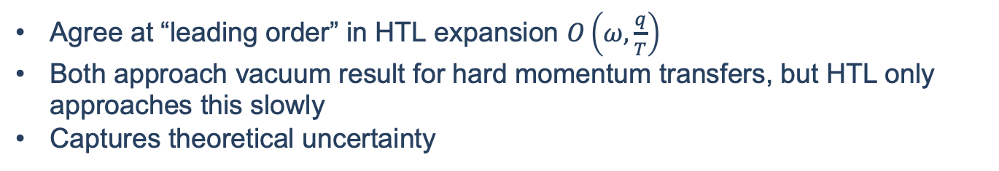
Collisional energy loss
We implement two limiting assumptions for the collisional energy loss
Braaten and Thoma (BT)
Hard Thermal Loop only (HTL only)
Uses HTL propagators for all interactions
However, keeps the full kinematics even for hard interactions, where HTL is not rigorously valid
Uses HTL propagators for soft interactions
Uses vacuum propagators for hard interactions
Agree at “leading order” in HTL expansion $O\left(ω,\frac{q}{T}\right)$
Both approach vacuum result for hard momentum transfers, but HTL only approaches this slowly
Captures theoretical uncertainty
E. Braaten and M. H. Thoma, Phys. Rev. D 44, R2625 (1991).
S. Wicks, PhD thesis, 2008.
CF and W. A. Horowitz, Phys. Rev. C 111, 054911 (2025).

Slide 18
Statistical analysis

Slide 19


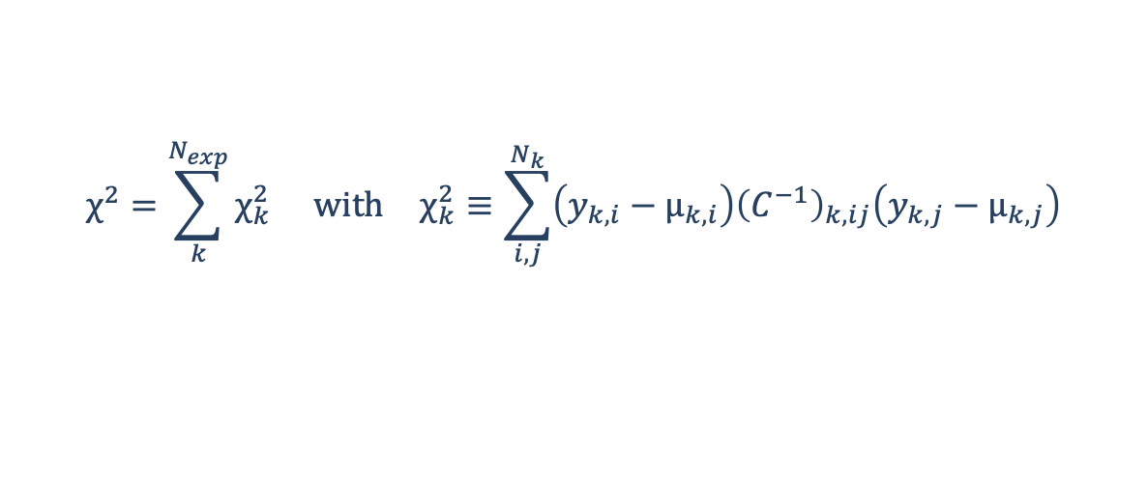
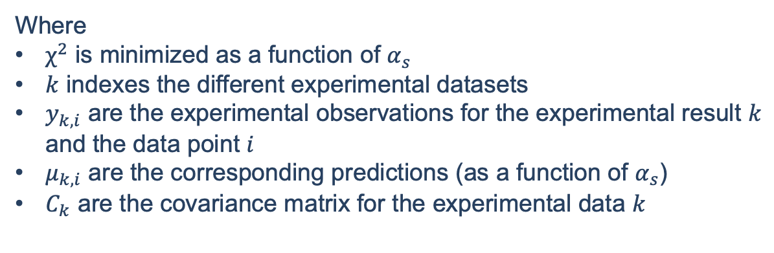
Statistical extraction of $α_{s}$
$$χ^{2}=\sum_{k}^{N_{exp}}{χ_{k}^{2}} \text{with} χ_{k}^{2}≡\sum_{i,j}^{N_{k}}{\left(y_{k,i}−μ_{k,i}\right){\left(C^{−1}\right)}_{k,ij}\left(y_{k,j}−μ_{k,j}\right)}$$
$$χ^{2}=\sum_{k}^{N_{exp. }}{χ_{k}^{2}} \text{with} χ_{k}^{2}≡\sum_{i,j}^{N_{k}}{\left(y_{k,i}−μ_{k,i}\right){\left(C^{−1}\right)}_{k,ij}\left(y_{k,j}−μ_{k,j}\right)}$$
Where
$χ^{2}$ is minimized as a function of $α_{s}$
$k$ indexes the different experimental datasets
$y_{k,i}$ are the experimental observations for the experimental result $k$ and the data point $i$
$μ_{k,i}$ are the corresponding predictions (as a function of $α_{s}$)
$C_{k}$ are the covariance matrix for the experimental data $k$
CF and W. A. Horowitz, arXiv:2505.14568 [hep-ph] (2025).

Slide 20

The covariance matrix $C$
Captures the correlations between uncertainties
Fully uncorrelated uncertainties contribute only to the diagonal (statistical & uncorrelated systematics)
Fully correlated uncertainties contribute only to the off-diagonal (correlated & globally correlated systematics)
In principle, there are
correlations between experiments, centrality classes, particle species, but the form is not known.
Contributions from theoretical uncertainties
JETSCAPE, Phys. Rev. C 109, 064903 (2024).
R. A. Soltz, D. A. Hangal, and A. Angerami, Phys. Rev. C 111, 034911 (2025).
CF and W. A. Horowitz, arXiv:2505.14568 [hep-ph] (2025).

Slide 21

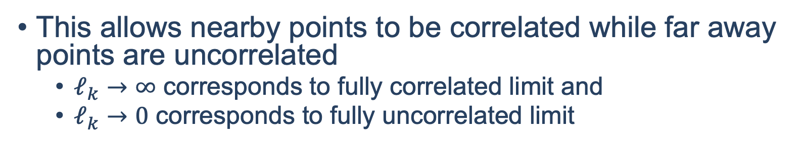

Length-correlated model for $C$
We assume that systematics with unknown correlation contribute to the covariance matrix as
$$C_{ij}^{B}=\exp\left[−{\left|\frac{p_{i}−p_{j}}{ℓ_{k}}\right|}^{2}\right]σ_{i}σ_{j}$$
This allows nearby points to be correlated while far away points are uncorrelated
$ℓ_{k}→∞$ corresponds to fully correlated limit and
$ℓ_{k}→0$ corresponds to fully uncorrelated limit
JETSCAPE, Phys. Rev. C 109, 064903 (2024).

Slide 22
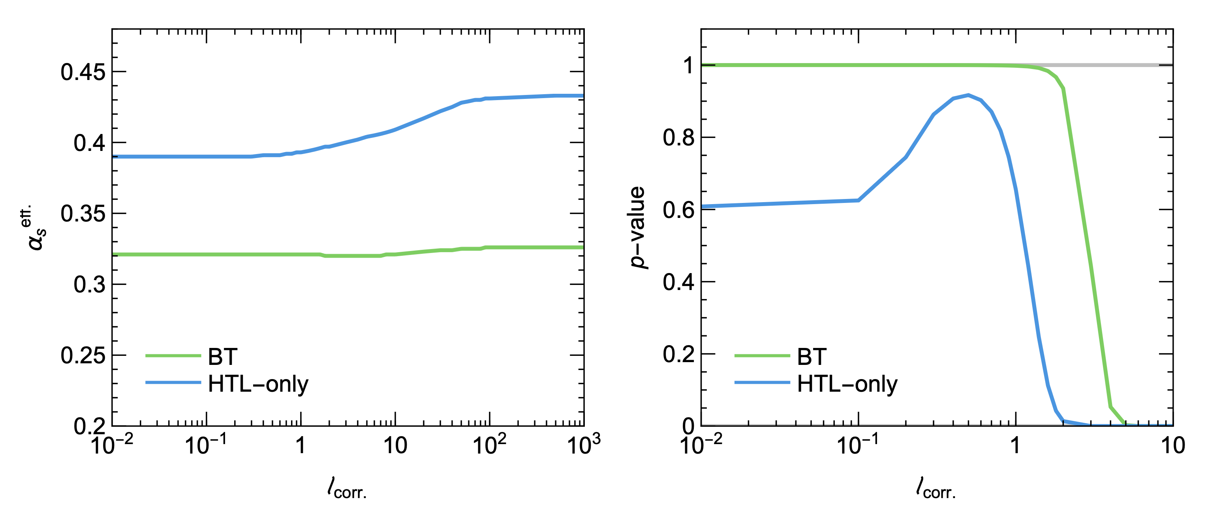
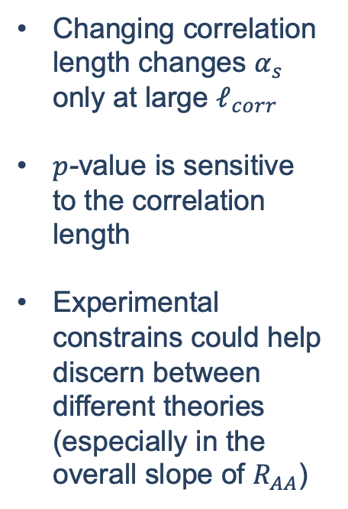
Sensitivity to correlation length
Changing correlation length changes $α_{s}$ only at large $ℓ_{corr}$
$p$-value is sensitive to the correlation length
Experimental constrains could help discern between different theories (especially in the overall slope of $R_{AA}$)

Slide 23
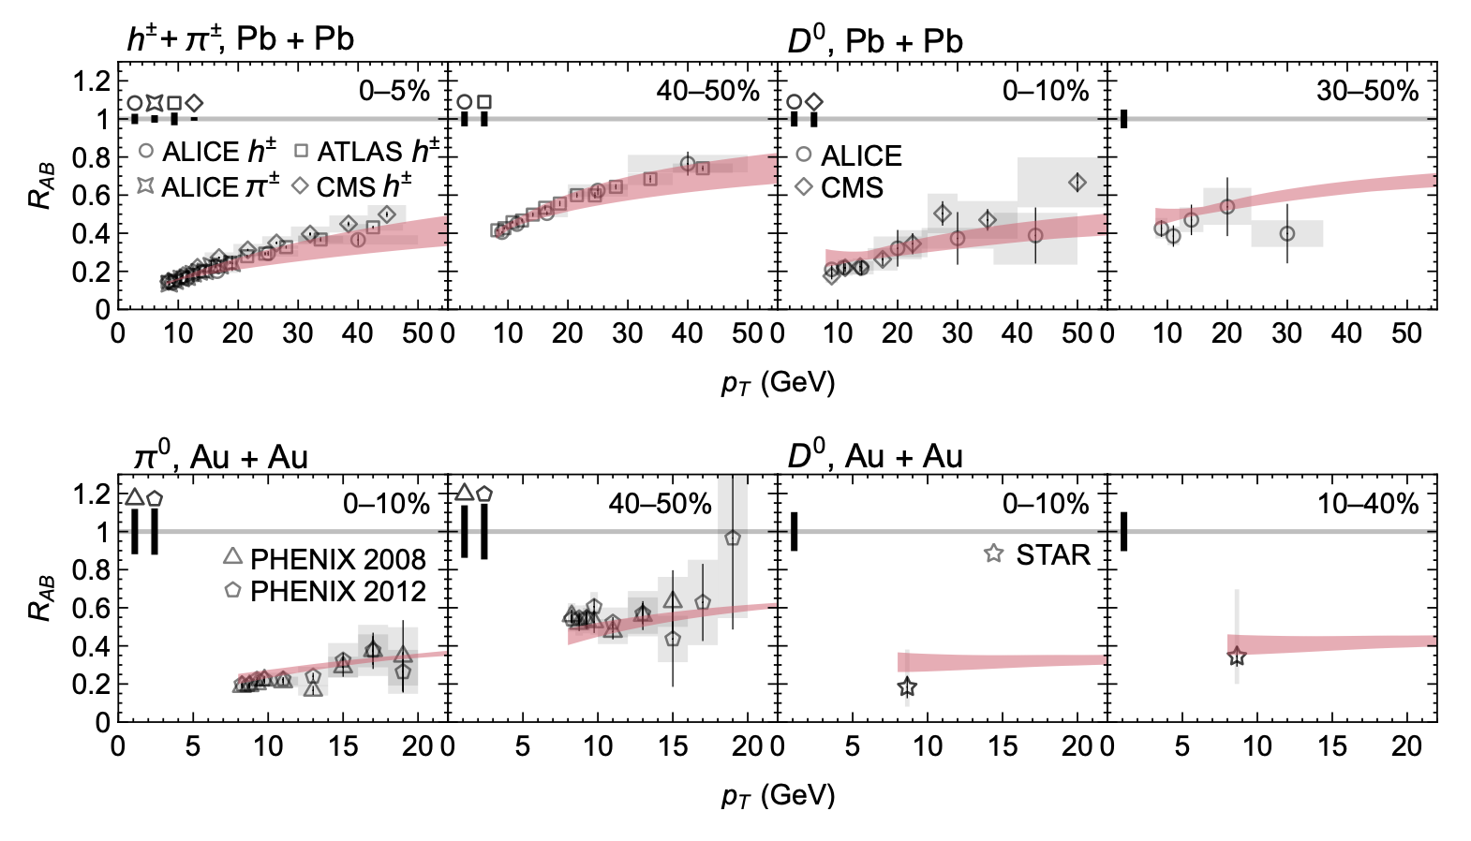

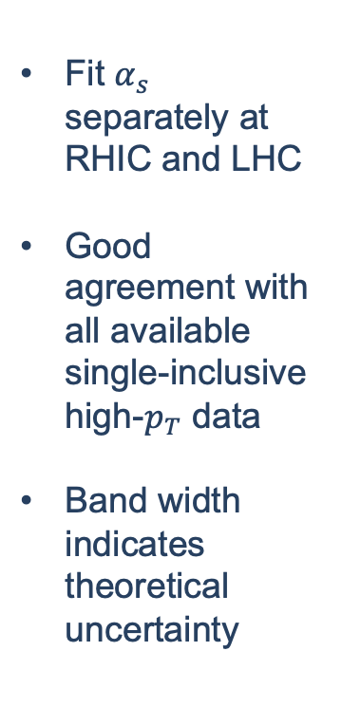
Results from global extraction of $α_{s}$
Fit $α_{s}$ separately at RHIC and LHC
Good agreement with all available single-inclusive high-$p_{T}$ data
Band width indicates theoretical uncertainty

Slide 24
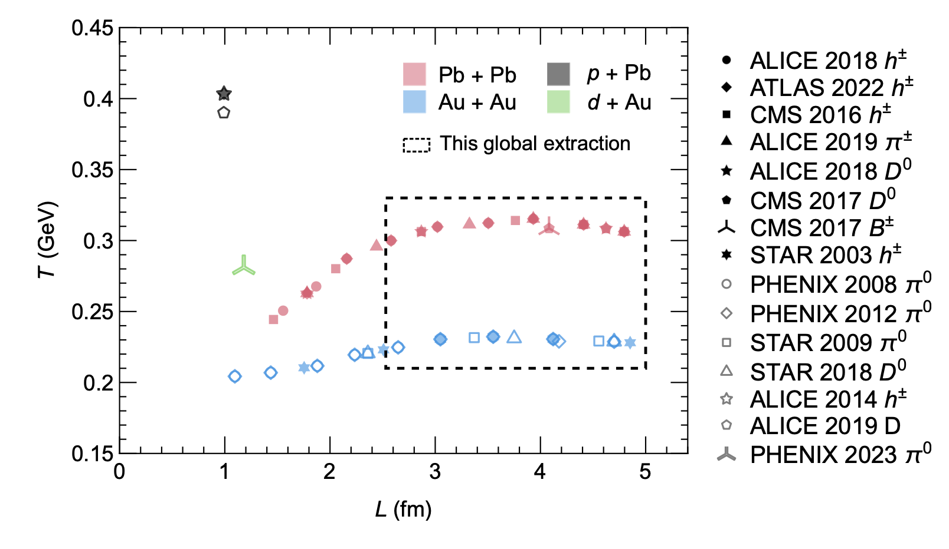
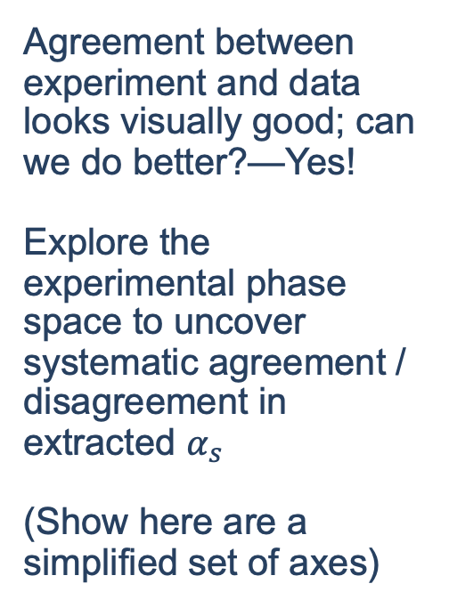
Can we do better?
Agreement between experiment and data looks visually good; can we do better?—Yes!
Explore the experimental phase space to uncover systematic agreement / disagreement in extracted $α_{s}$
(Show here are a simplified set of axes)
More peripheral

Slide 25
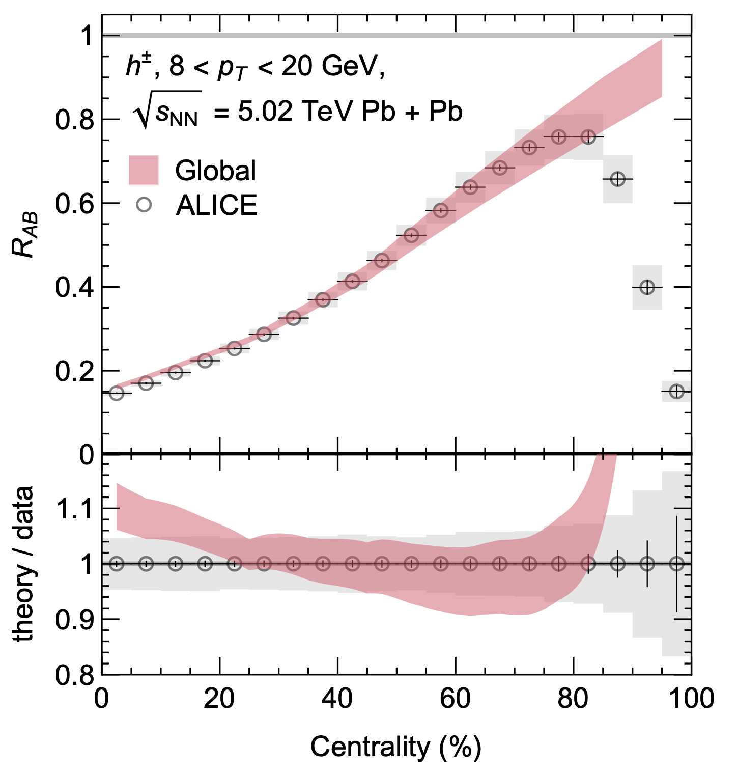
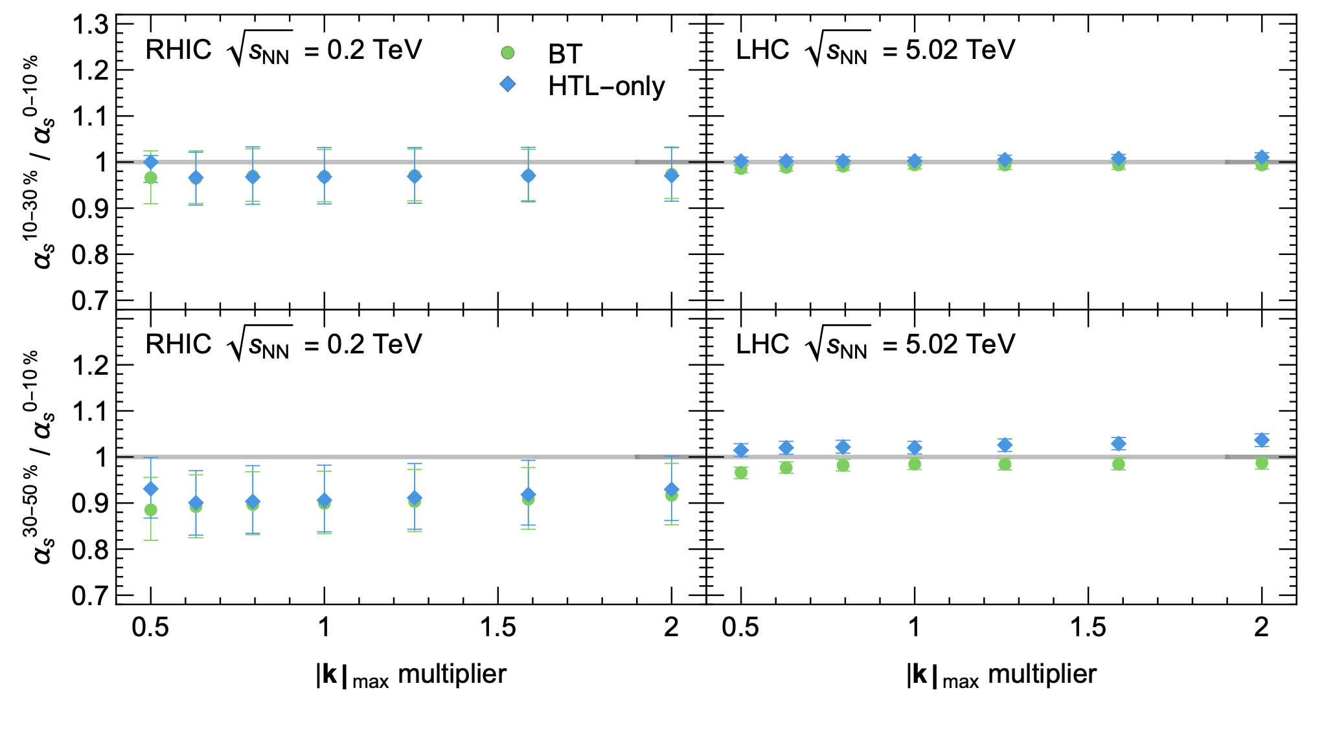

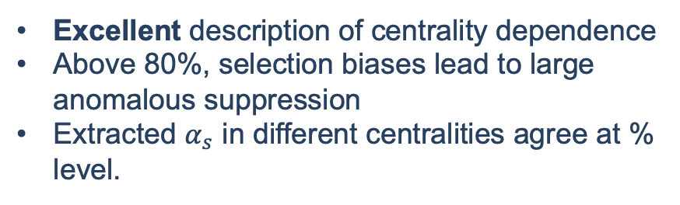
Centrality dependence of $α_{s}$
Excellent description of centrality dependence
Above 80%, selection biases lead to large anomalous suppression
Extracted $α_{s}$ in different centralities agree at % level.

Slide 26
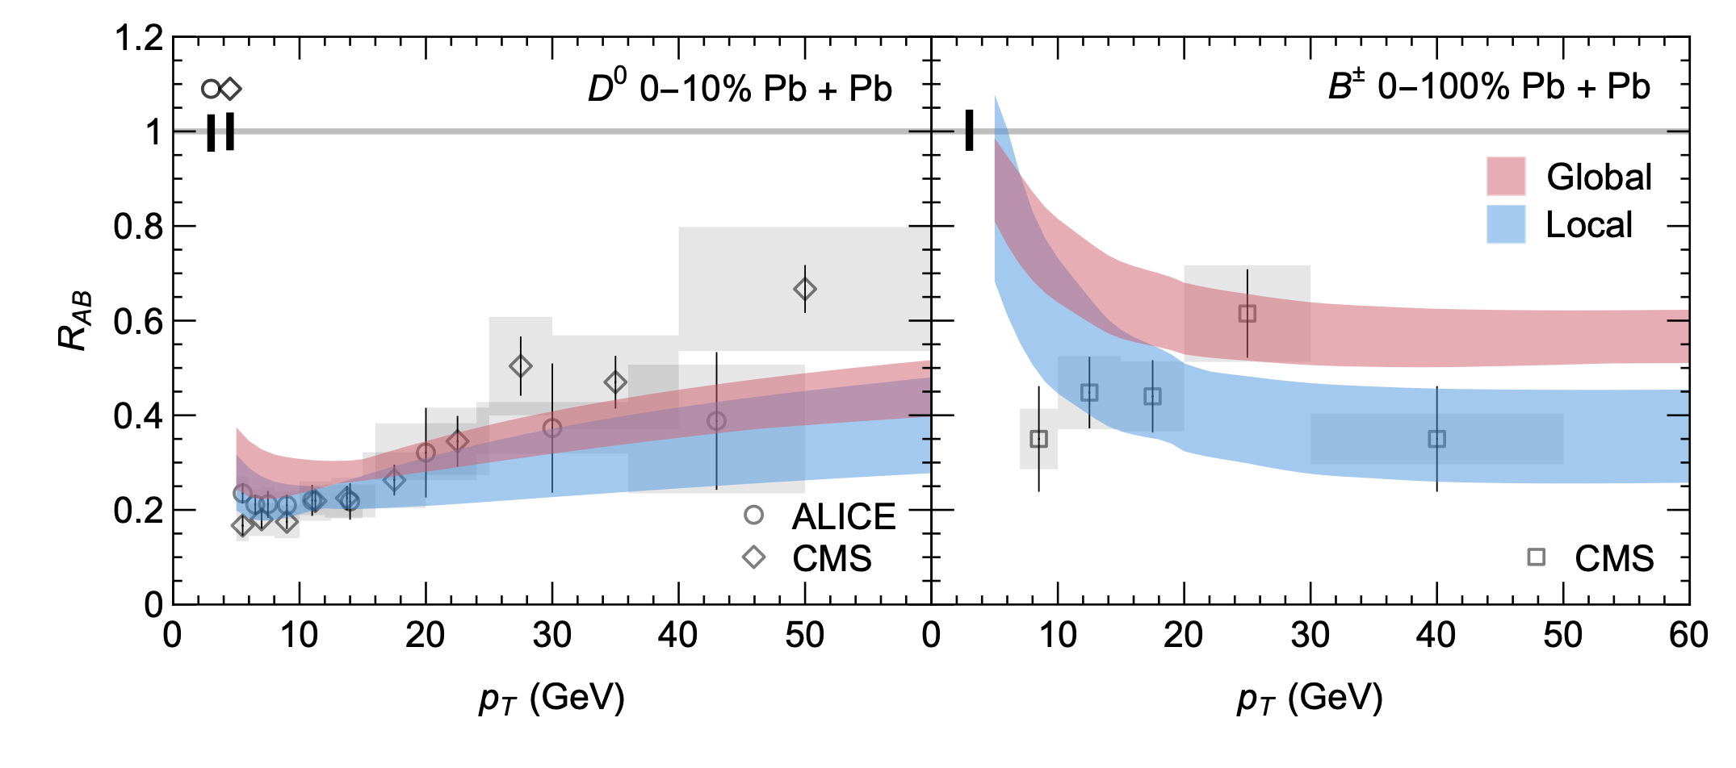

Flavor dependence of $α_{s}$
Heavy-flavors are undersuppressed compared to data
May point to missing flavor-dependent physics (heavy-flavor dissociation, flavor-dependent medium modifications to hadronization, incorrect partonic masses?)
Still within reasonable agreement within uncertainties (but B agreement is much worse than D)

Slide 27
Small system suppression
The good description of the centrality (~length) dependence of the experimental data justifies our extrapolation to small systems

Slide 28
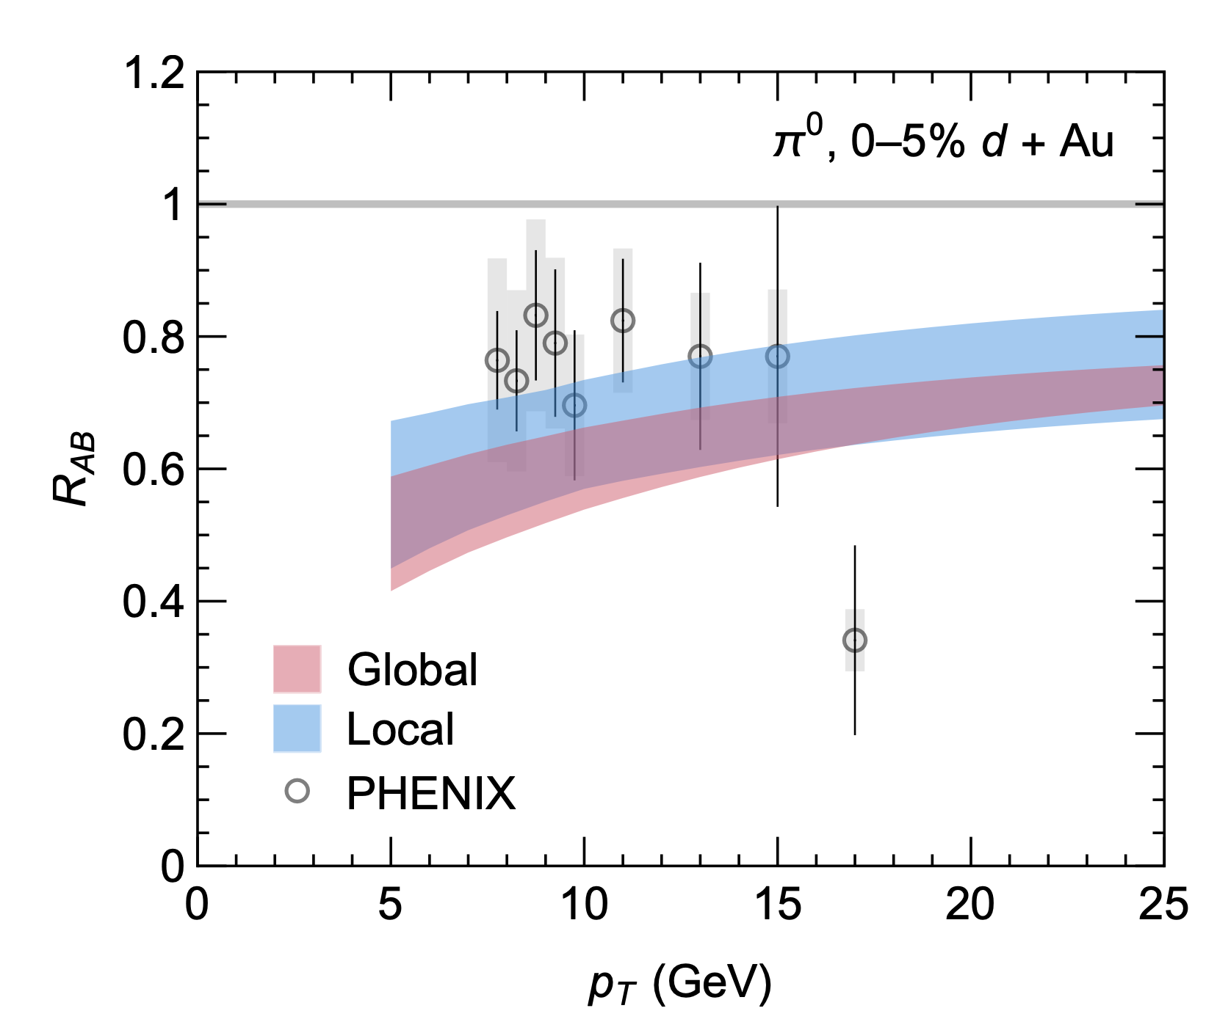
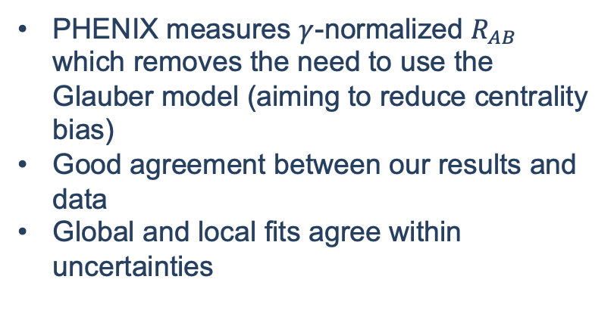
Small system suppression at RHIC
PHENIX measures $γ$-normalized $R_{AB}$ which removes the need to use the Glauber model (aiming to reduce centrality bias)
Good agreement between our results and data
Global and local fits agree within uncertainties
PHENIX, Phys. Rev. Lett. 134, 022302 (2025).

Slide 29
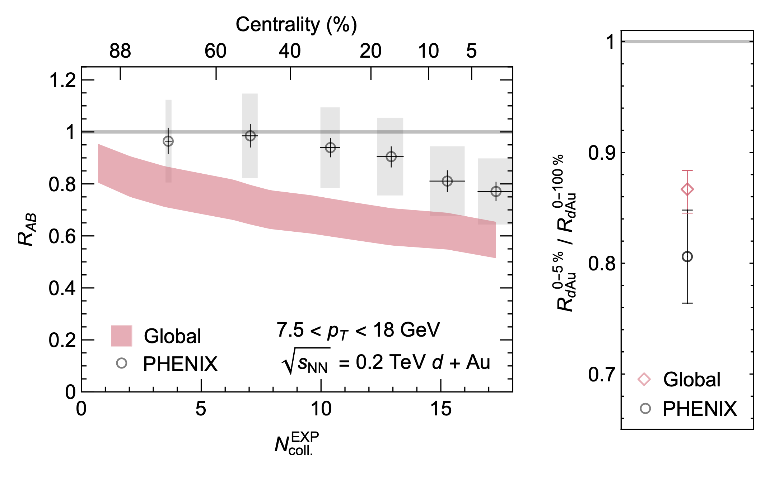
Small system suppression at RHIC
Agree within one-sigma with PHENIX centrality dependence
Note: all grey boxes are fully correlated systematic uncertainties
Moderately oversuppressed: no energy loss in the initial stage, soft / hard correlations, QGP formation turns off at some event-activity?
PHENIX, Phys. Rev. Lett. 134, 022302 (2025).

Slide 30
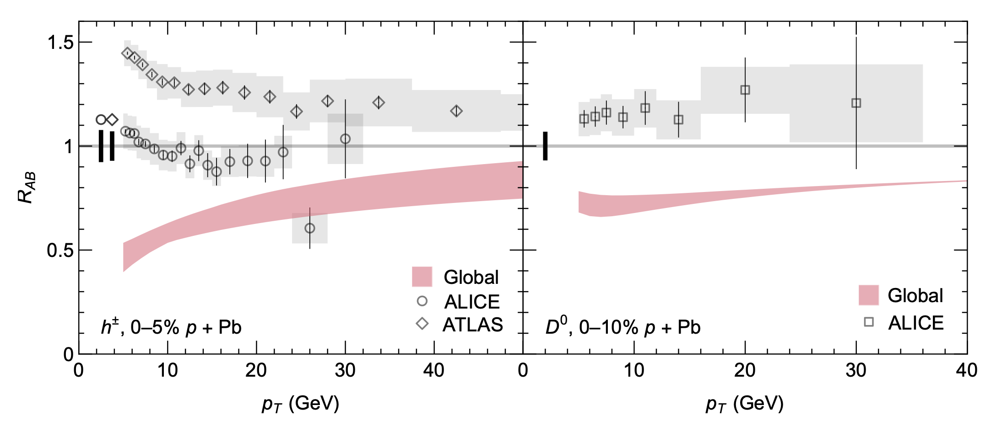
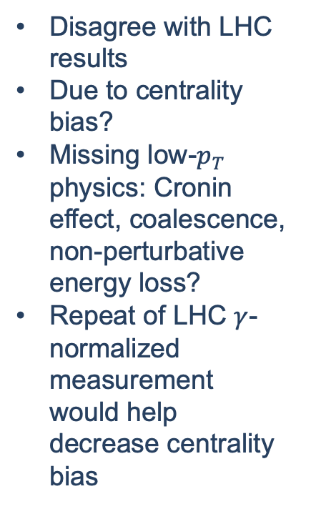
Small system suppression at LHC
Disagree with LHC results
Due to centrality bias?
Missing low-$p_{T}$ physics: Cronin effect, coalescence, non-perturbative energy loss?
Repeat of LHC $γ$-normalized measurement would help decrease centrality bias
ALICE, Phys. Rev. C 91, 064905 (2015).
ATLAS, JHEP 07, 074 (2023).
ALICE, JHEP 12, 092 (2019).

Slide 31
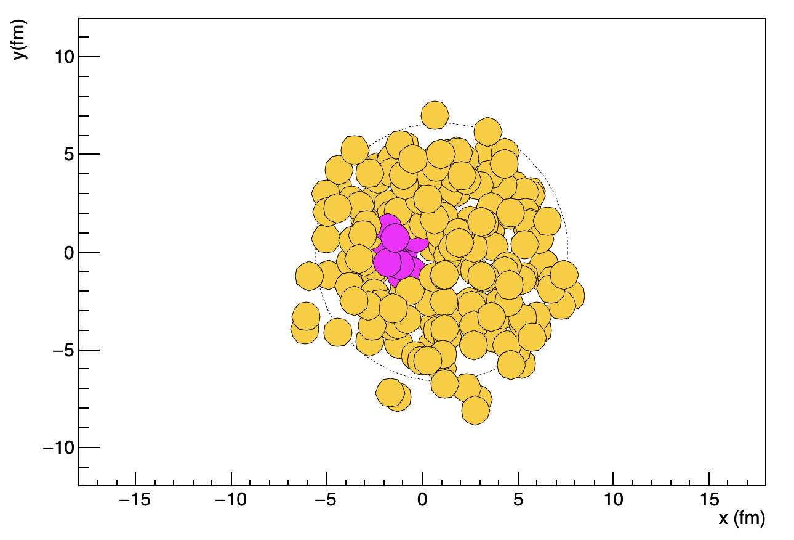
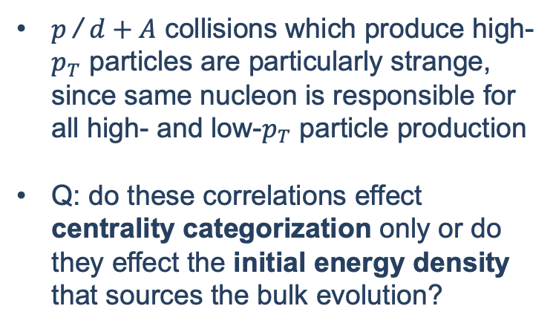

Selection biases?
Sample $p+\text{Pb}$
$p$/ $d+A$ collisions which produce high-$p_{T}$ particles are particularly strange, since same nucleon is responsible for all high- and low-$p_{T}$ particle production
Q: do these correlations effect centrality categorization only or do they effect the initial energy density that sources the bulk evolution?
Produced using code from D. d’Enterria and C. Loizides, Ann. Rev. Nucl. Part. Sci. 71, 315 (2021).

Slide 32
Confronting selection biases
There are a few options for dealing with these selection biases
Consider systems that are less (not at all?) sensitive to selection biases (minimum bias small systems)
Consider observables that are less (not at all?) sensitive to selection biases (hadron-hadron, jet-hadron, jet-jet, jet-photon, jet-Z correlations)
Model the selection biases and their physical effects

Slide 33
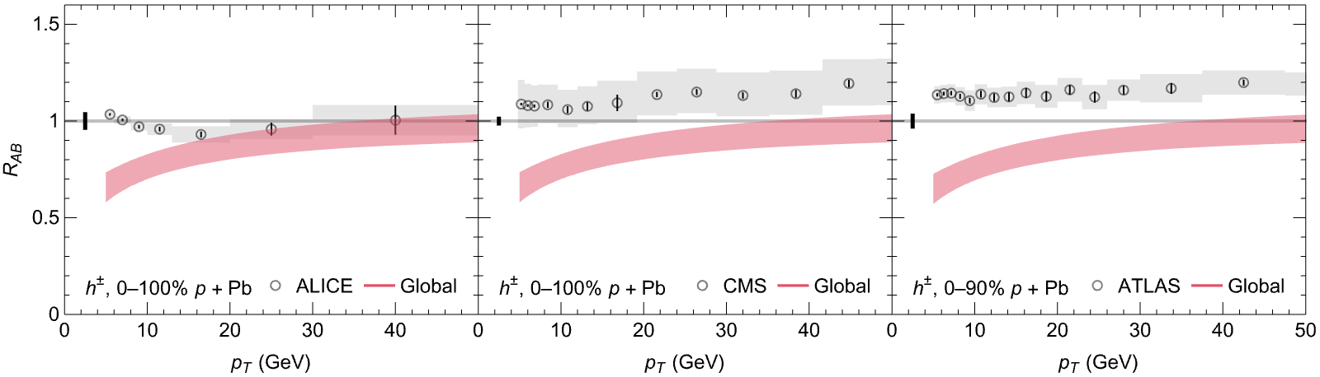
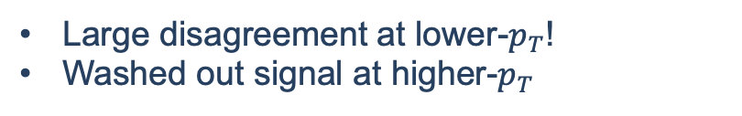
1. Minimum bias suppression
Minimum bias p + Pb
Fairly significant differences in the experimental measurements
Future: minimum bias O + O
Large disagreement at lower-$p_{T}$!
Washed out signal at higher-$p_{T}$

Slide 34

1. Minimum bias suppression cont.
What low-$p_{T}$ ($≤15$ GeV) physics are we missing?
Cronin effect
Nuclear PDF’s
Does QGP form in less-central systems?
Pre-thermalization time energy loss
Faster fall-off of pA temperature with time compared to Bjorken expansion
Coalescence
Correlations between hard and soft modes
All of these would move the $R_{pA}$ up at low-$p_{T}$!
W. Ke and I. Vitev, Phys. Rev. C 107, 064903 (2023).
Huss, A. Kurkela, A. Mazeliauskas, R. Paatelainen, W. van der Schee, and U. A. Wiedemann, Phys. Rev. Lett. 126, 192301 (2021).
J. Gebhard, A. Mazeliauskas, and A. Takacs, JHEP 04, 034 (2025).
CF, A. Grindrod, and W. A. Horowitz, Eur. Phys. J. C 83, 1060 (2023).
C. Zhang, L. Zheng, S. Shi, and Z.-W. Lin, Phys. Lett. B 846, 138219 (2023).
JETSCAPE, arXiv:2407.17443 [hep-ph] (2024).

Slide 35



2. Self-normalized observables
Back-to-back correlations are another useful self-normalized probe of energy loss in small systems
$I_{pA}$ consistent with no energy loss, although quantitative theoretical predictions are needed to make strong conclusions (work in progress!)
PHENIX, Phys. Rev. Lett. 134, 022302 (2025).
ATLAS, Phys. Rev. Lett. 131, 072301 (2023)

Slide 36



2. Self-normalized observables cont.
Use the number of direct, high-$p_{T}$ photons as a measure of the number of binary collisions
Finds 4.5$σ$ suppression, but interpretation may also be due to initial state effects (esp. color fluctuation model)
Selection biases may still be present in self-normalized observables.
For instance, different $⟨x⟩$ may lead to $R_{dA,EXP}<1$
PHENIX, Phys. Rev. Lett. 134, 022302 (2025); M. Alvioli and M. Strikman, Phys. Lett. B 722, 347 (2013).; D. V. Perepelitsa, Phys. Rev. C 110, L011901 (2024).

Slide 37

3. Modelling the selection biases
Take the viewpoint that these correlations result in physical effects on the formed plasma
i.e., hard particles produce smaller plasmas, resulting in less energy loss
Could be measured through low-$p_{T}$observables in the presence of a hard probe?
This scenario implies that all energy loss observables in small systems are sensitive to the selection biases—quantitative theoretical studies including correlations are unavoidable!
JETSCAPE, arXiv:2407.17443 [hep-ph] (2024)

Slide 38

3. Modelling the selection biases cont.
In a standard Glauber model picture, there is no knowledge of the high momentum production processes
$⇒$no correlations between high and low-$p_{T}$ particles
Some phenomenological approaches in the literature:
Subtract energy of the formed jet from the hydrodynamic bulk, then evolve as normal JETSCAPE, arXiv:2407.17443 [hep-ph] (2024)
Use a modified PDF for partons in all nucleons M. Kordell and A. Majumder, Phys. Rev. C 97, 054904 (2018).
Assume fluctuations in the nucleon-nucleon inelastic cross section (color fluctuation model) M. Alvioli and M. Strikman, Phys. Lett. B 722, 347 (2013).

Slide 39

Modified PDF
If a jet is formed by a binary collision, the x is “depleted” from the PDF for subsequent collisions
This leaves less x in the incoming nucleon, resulting in a similarly depleted effective $σ_{NN}^{inel}$ as the color fluctuation model.
But this comes with more modelling and caveats
M. Kordell and A. Majumder, Phys. Rev. C 97, 054904 (2018).

Slide 40




Color fluctuations
Fluctuations of the inelastic nucleon-nucleon cross section (used as an input to Glauber)
Most hydrodynamic models have some form of fluctuating subnucleonic structure in order to fit $v_{3}$ data
$⇒$ This should say something about the size of the fluctuations?
M. Alvioli and M. Strikman, Phys. Lett. B 722, 347 (2013); M. Alvioli, L. Frankfurt, D. Perepelitsa, and M. Strikman, Phys. Rev. D 98, 071502 (2018).; D. V. Perepelitsa, Phys. Rev. C 110, L011901 (2024).
Small $σ_{NN}^{inel}$
Large $σ_{NN}^{inel}$

Slide 41



Color fluctuations cont.
Currently, lots of fitting in the models M. Alvioli, L. Frankfurt, D. Perepelitsa, and M. Strikman, Phys. Rev. D 98, 071502 (2018).
$λ\left(x_{p}\right)={\left\langle σ_{NN}^{MB}\left(x_{p}\right)\right\rangle }/{σ_{NN}^{MB}}$ fit at each $x_{p}$
Makes it difficult to evaluate success of predictions and whether this masks actual physical effects
Can the fluctuations in hydro models determine the size of color fluctuations?
$$T_{q}\left(b_{⊥}\right)=\frac{1}{2πB_{q}}e^{−{b_{⊥}^{2}}/2B_{q}}$$
$$T_{p}\left(b_{⊥}\right)=\sum_{i=1}^{3}{T_{q}\left(b_{⊥}−b_{⊥}^{i}\right)}$$
B. Schenke, C. Shen, and P. Tribedy, Phys. Rev. C 102, 044905 (2020). H. Mäntysaari and B. Schenke, Phys. Rev. Lett. 117, 052301 (2016).

Slide 42
Physical effects of selection biases
These scenarios all generally imply that selecting on high multiplicity and a high momentum particle may result in a decreased size in the formed QGP
Could explain inconclusive energy loss measurements?
Effects all events with high momentum particles; self-normalized observables are not safe
Path forward:
Quantitative theoretical understanding of correlations between hard and soft particle production (and resulting bulk)
Event selections which have large QGP and a jet?
Larger (but still small) systems

Slide 43



















A path to an answer
Tests and constraints on each section of the model are invaluable
However, their implications must also be evaluated within the context of the complete partonic evolution
Observables

Slide 44
Things I had to leave out
Extraction of the scales at which the coupling runs
Extraction of the scales at which non-perturbative effects become important
Predictions for the RHIC system-size scan that includes ³He, d, and p + A. collisions.
CF and W. A. Horowitz, arXiv:2505.14568 [hep-ph] (2025).

Slide 45

Outlook
Understanding whether there is energy loss in small systems is the missing puzzle piece in understanding QGP formation in small systems
Selection biases and model dependences plague centrality-selected events with high-$p_{T}$ particles. We need:
Theoretical input: what is quantitatively expected in small systems? Need models that describe both the production of high- and low-$p_{T}$particles within a single framework?
Self-normalized observables: observables that are insensitive (to the extent that this is possible) to these effects; high-$p_{T}$ $v_{n}$, $I_{AA}$, $γ$-normalized $R_{AA}$.
More data: to understand the system-size dependence, data from collisions of more varied sizes would be useful; i.e., upcoming O + O run at LHC

Slide 46
Bonus Slides

Slide 47

Short pathlength (SPL) Corr. to DGLV
DGLV 1st order in opacity
Suppressed for large L
Djordjevic and Gyulassy, Nucl. Phys. A 733 (2004) 265-298
SPL corr.
Kolbe & Horowitz, PRC 100 (2019) 024913
Breaking of colour triviality
→ we’ll see this can lead to excessively large corr. for gluons!

Slide 48

Numerics of the Short Pathlength Corr.
We see the SPL correction:
Decreases as a function of L
much larger for gluons cf quarks
Can lead to negative energy loss
Grows as a function of

Slide 49


Central Limit Theorem in Elastic E-loss
How important is central limit theorem in the elastic energy loss?
We compare:
1) HTL result with Poisson distribution (Poisson HTL)
2) HTL result with Gaussian distribution (Gaussian HTL)
(Fluctuation Dissipation Thrm)

Slide 50

Elastic Energy Loss
Uncertainty in the elastic energy loss relating to applying HTL vs Gaussian propagators
We compare two extremes to capture this uncertainty:
Gaussian BT – combination of vacuum and HTL propagators Braaten and Thoma, Phys. Rev. D 44 (1991) R2625
Poisson HTL – HTL only propagators Wicks, PhD thesis (2008)
Generically in HIC radiative E-loss > elastic E-loss

Slide 51

What do Small QGP’s Look Like?
Small system ⟨L⟩ ~ 1 fm comparable to peripheral AA
Small systems have L/λ ∼ 1
Central limit theorem inapplicable (elastic)
Multiple soft scatter approaches inapplicable
Large systems have L/λ ∼ 5
Central limit theorem still dubious?

Slide 52

$$χ^{2}$$

Slide 53


Running coupling extraction ($√s$)

Slide 54


Running coupling extraction ($p_{T})$

Slide 55


Running coupling extraction ($p_{T})$ cont

Slide 56

Onset of non-perturbative effects

Slide 57

Predictions for RHIC system-size scan

Slide 58

ZDC and ET centrality selection

Slide 59


ATLAS: x-dependent dijets

Slide 60


Equal supp. in peripheral and small
CF and W. A. Horowitz, Phys. Lett. B 864, 139437 (2025).

Slide 61

All data
Lots of data!

Slide 62


Gaussian ~ Poisson?
Opposite ordering than expected according to CLT?
Strong
Gaussian distribution not a good fit for either small or large systems
→ Why is Gaussian RAA ~ Poisson

Slide 63

Why is Gaussian ~ Poisson?
One can show that:
1) In small systems: small energy loss ⇒ RAA depends mostly on average energy loss
2) In large systems: elastic energy loss small fraction compared to radiative energy loss

Slide 64
Elastic vs Radiative E-Loss Importance
Elastic ∆ E / E ≃ α² T² log (ET)/E Radiative ∆ E / E ≃ αs ³ L² T log E / E
Strong dependence on elastic E-loss used
Small systems elastic is ~1-3x more important than radiative

Slide 65


Large Formation Time Assumption
Large contributions to SPL corr. at high energies from regions of phase space not allowed according to Large Formation Time assumption
Also impacts DGLV
Future work should include a full rederivation of DGLV with LFT assumption relaxed
Can implement a phenomenological cut in the phase space as well to limit assumption-violating contributions

Slide 66


Turning Off Elastic E-Loss

Slide 67


Gluon to Light Quark Crossover

Slide 68

Reproducion of pp spectra

Slide 69


Controlling the LFT approximation

Slide 70




Example contribution to SPL corr.
Pole at

Slide 71
References for small sys. E-loss table
[1] V. Khachatryan et al. (CMS), JHEP 09, 091 (2010), arXiv:1009.4122 [hep-ex].
[2] S. Chatrchyan et al. (CMS), JHEP 07, 076 (2011), arXiv:1105.2438 [nucl-ex].
[3] G. Aad et al. (ATLAS), Phys. Rev. Lett. 110, 182302 (2013), arXiv:1212.5198 [hep-ex].
[4] B. Abelev et al. (ALICE), Phys. Lett. B 719, 29 (2013), arXiv:1212.2001 [nucl-ex].
[5] S. Chatrchyan et al. (CMS), Phys. Lett. B 718, 795 (2013), arXiv:1210.5482 [nucl-ex].
[6] S. Chatrchyan et al. (CMS), Eur. Phys. J. C 72, 2012 (2012), arXiv:1201.3158 [nucl-ex].
[7] G. Aad et al. (ATLAS), Phys. Rev. C 90, 044906 (2014), arXiv:1409.1792 [hep-ex].
[8] V. Khachatryan et al. (CMS), Phys. Rev. Lett. 116, 172302 (2016), arXiv:1510.03068 [nucl-ex].
[9] S. Acharya et al. (ALICE), Phys. Rev. Lett. 132, 172302 (2024), arXiv:2311.14357 [nucl-ex].
[10] K. Aamodt et al. (ALICE), Phys. Lett. B 708, 249 (2012), arXiv:1109.2501 [nucl-ex].
[11] G. Aad et al. (ATLAS), Phys. Rev. C 86, 014907 (2012), arXiv:1203.3087 [hep-ex].
[12] A. Adare et al. (PHENIX), Phys. Rev. Lett. 114, 192301 (2015), arXiv:1404.7461 [nucl-ex].
[13] G. Aad et al. (ATLAS), Phys. Rev. Lett. 116, 172301 (2016), arXiv:1509.04776 [hep-ex].
[14] L. Adamczyk et al. (STAR), Phys. Lett. B 747, 265 (2015), arXiv:1502.07652 [nucl-ex].
[15] J. Adam et al. (ALICE), JHEP 09, 164 (2016), arXiv:1606.06057 [nucl-ex].
[16] J. Adam et al. (ALICE), Phys. Lett. B 762, 376 (2016), arXiv:1605.02035 [nucl-ex].
[17] V. Khachatryan et al. (CMS), Phys. Lett. B 765, 193 (2017), arXiv:1606.06198 [nucl-ex].
[18] M. Aaboud et al. (ATLAS), Eur. Phys. J. C 77, 428 (2017), arXiv:1705.04176 [hep-ex].
[19] S. Acharya et al. (ALICE), JHEP 09, 032 (2017), arXiv:1707.05690 [nucl-ex].
[20] A. M. Sirunyan et al. (CMS), Phys. Rev. Lett. 120, 092301 (2018), arXiv:1709.09189 [nucl-ex].
[21] S. Acharya et al. (ALICE), JHEP 09, 006 (2018), arXiv:1805.04390 [nucl-ex].
[22] C. Aidala et al. (PHENIX), Nature Phys. 15, 214 (2019), arXiv:1805.02973 [nucl-ex].
[23] S. Acharya et al. (ALICE), Phys. Rev. Lett. 123, 142301 (2019), arXiv:1903.01790 [nucl-ex].
[24] S. Acharya et al. (ALICE), JHEP 05, 085 (2020), arXiv:2002.00633 [nucl-ex].
[25] M. I. Abdulhamid et al. (STAR), Phys. Rev. Lett. 130, 242301 (2023), arXiv:2210.11352 [nucl-ex].
[26] G. Aad et al. (ATLAS), Phys. Lett. B 707, 330 (2012), arXiv:1108.6018 [hep-ex].
[27] G. Aad et al. (ATLAS), Eur. Phys. J. C 74, 2982 (2014), arXiv:1405.3936 [hep-ex].
[28] R. Aaij et al. (LHCb), Phys. Lett. B 762, 473 (2016), arXiv:1512.00439 [nucl-ex].
[29] J. Adam et al. (ALICE), Phys. Lett. B 753, 126 (2016), arXiv:1506.08032 [nucl-ex].
[30] M. Aaboud et al. (ATLAS), Phys. Rev. C 95, 064914 (2017), arXiv:1606.08170 [hep-ex].
[31] V. Khachatryan et al. (CMS), Phys. Rev. C 96, 014915 (2017), arXiv:1604.05347 [nucl-ex].
[32] A. M. Sirunyan et al. (CMS), Phys. Rev. C 98, 044902 (2018), arXiv:1710.07864 [nucl-ex].[33] G. Aad et al. (ATLAS), (2023), arXiv:2308.16745 [nucl-ex].
[34] S. Acharya et al. (ALICE), JHEP 01, 199 (2024), arXiv:2308.16590 [nucl-ex].
[35] B. Abelev et al. (ALICE), Phys. Lett. B 719, 18 (2013), arXiv:1205.5761 [nucl-ex].
[36] B. B. Abelev et al. (ALICE), Phys. Lett. B 726, 164 (2013), arXiv:1307.3237 [nucl-ex].
[37] B. B. Abelev et al. (ALICE), JHEP 06, 190 (2015), arXiv:1405.4632 [nucl-ex].
[38] V. Khachatryan et al. (CMS), Phys. Lett. B 742, 200 (2015), arXiv:1409.3392 [nucl-ex].
[39] A. Adare et al. (PHENIX), Phys. Rev. C 97, 064904 (2018), arXiv:1710.09736 [nucl-ex].
[40] A. M. Sirunyan et al. (CMS), Phys. Rev. Lett. 121, 082301 (2018), arXiv:1804.09767 [hep-ex].
[41] S. Acharya et al. (ALICE), JHEP 05, 243 (2023), arXiv:2206.04587 [nucl-ex].
[42] A. Tumasyan et al. (CMS), JHEP 05, 007 (2023), arXiv:2205.00080 [nucl-ex].
[43] K. Aamodt et al. (ALICE), Phys. Rev. Lett. 105, 252302 (2010), arXiv:1011.3914 [nucl-ex].
[44] K. Aamodt et al. (ALICE), Phys. Rev. Lett. 107, 032301 (2011), arXiv:1105.3865 [nucl-ex].
[45] S. Chatrchyan et al. (CMS), Phys. Rev. C 87, 014902 (2013), arXiv:1204.1409 [nucl-ex].
[46] G. Aad et al. (ATLAS), Phys. Lett. B 725, 60 (2013), arXiv:1303.2084 [hep-ex].
[47] S. Chatrchyan et al. (CMS), Phys. Rev. C 89, 044906 (2014), arXiv:1310.8651 [nucl-ex].
[48] S. Chatrchyan et al. (CMS), Phys. Lett. B 724, 213 (2013), arXiv:1305.0609 [nucl-ex].
[49] G. Aad et al. (ATLAS), Eur. Phys. J. C 74, 3157 (2014), arXiv:1408.4342 [hep-ex].
[50] B. B. Abelev et al. (ALICE), Phys. Rev. C 90, 054901 (2014), arXiv:1406.2474 [nucl-ex].
[51] V. Khachatryan et al. (CMS), Phys. Rev. Lett. 115, 012301 (2015), arXiv:1502.05382 [nucl-ex].
[52] J. Adam et al. (ALICE), Phys. Rev. Lett. 116, 132302 (2016), arXiv:1602.01119 [nucl-ex].
[53] M. Aaboud et al. (ATLAS), Phys. Rev. C 97, 024904 (2018), arXiv:1708.03559 [hep-ex].
[54] A. M. Sirunyan et al. (CMS), Phys. Lett. B 776, 195 (2018), arXiv:1702.00630 [hep-ex].
[55] A. M. Sirunyan et al. (CMS), Phys. Rev. C 101, 014912 (2020), arXiv:1904.11519 [hep-ex].
[56] G. Aad et al. (ATLAS), Phys. Rev. C 90, 024905 (2014), arXiv:1403.0489 [hep-ex].
[57] G. Aad et al. (ATLAS), Phys. Rev. C 92, 034903 (2015), arXiv:1504.01289 [hep-ex].
[58] J. Adam et al. (ALICE), Phys. Rev. Lett. 117, 182301 (2016), arXiv:1604.07663 [nucl-ex].
[59] S. Acharya et al. (ALICE), Phys. Rev. C 97, 024906 (2018), arXiv:1709.01127 [nucl-ex].
[60] M. Aaboud et al. (ATLAS), Phys. Lett. B 789, 444 (2019), arXiv:1807.02012 [nucl-ex].
[61] A. M. Sirunyan et al. (CMS), Phys. Rev. C 103, 014902 (2021), arXiv:1905.09935 [hep-ex].
[62] B. Aboona et al. (STAR), Phys. Lett. B 839, 137755 (2023), arXiv:2211.11637 [nucl-ex].
[63] S. Acharya et al. (ALICE), Phys. Lett. B 773, 68 (2017), arXiv:1705.04377 [nucl-ex].
[64] A. M. Sirunyan et al. (CMS), Eur. Phys. J. C 80, 534 (2020), arXiv:1910.08789 [hep-ex].

Slide 72
References for small sys. E-loss table
[65] V. Khachatryan et al. (CMS), Phys. Rev. C 92, 034911 (2015), arXiv:1503.01692 [nucl-ex].[66] M. Aaboud et al. (ATLAS), Eur. Phys. J. C 78, 142 (2018), arXiv:1709.02301 [nucl-ex].
[67] A. M. Sirunyan et al. (CMS), Phys. Rev. C 96, 064902 (2017), arXiv:1708.07113 [nucl-ex].
[68] G. Aad et al. (ATLAS), Phys. Rev. Lett. 126, 122301 (2021), arXiv:2001.04201 [nucl-ex].
[69] S. Acharya et al. (ALICE), Phys. Rev. C 107, L051901 (2023), arXiv:2206.04574 [nucl-ex].
[70] G. Aad et al. (ATLAS), JHEP 11, 183 (2013), arXiv:1305.2942 [hep-ex].
[71] A. M. Sirunyan et al. (CMS), Phys. Lett. B 789, 643 (2019), arXiv:1711.05594 [nucl-ex].
[72] S. Acharya et al. (ALICE), JHEP 07, 103 (2018), arXiv:1804.02944 [nucl-ex].
[73] G. Aad et al. (ATLAS), Eur. Phys. J. C 79, 985 (2019), arXiv:1907.05176 [nucl-ex].
[74] S. Acharya et al. (ALICE), Phys. Lett. B 834, 137393 (2022), arXiv:2111.06106 [nucl-ex].
[75] B. Abelev et al. (ALICE), Phys. Rev. Lett. 111, 232302 (2013), arXiv:1306.4145 [nucl-ex].
[76] B. Abelev et al. (ALICE), Phys. Lett. B 723, 267 (2013), arXiv:1301.3756 [nucl-ex].
[77] J. Adam et al. (ALICE), Eur. Phys. J. C 76, 86 (2016), arXiv:1509.07255 [nucl-ex].
[78] J. Adam et al. (ALICE), Phys. Rev. C 93, 044903 (2016), arXiv:1512.05739 [nucl-ex].
[79] V. Khachatryan et al. (CMS), Phys. Rev. Lett. 118, 122301 (2017), arXiv:1610.00263 [nucl-ex].
[80] S. Acharya et al. (ALICE), Phys. Lett. B 777, 151 (2018), arXiv:1709.04723 [nucl-ex].
[81] A. M. Sirunyan et al. (CMS), Phys. Rev. C 100, 064908 (2019), arXiv:1708.08901 [nucl-ex].
[82] A. M. Sirunyan et al. (CMS), Phys. Rev. C 97, 044912 (2018), arXiv:1708.01602 [nucl-ex].
[83] B. Abelev et al. (ALICE), Phys. Rev. Lett. 109, 252301 (2012), arXiv:1208.1974 [hep-ex].
[84] S. Chatrchyan et al. (CMS), Eur. Phys. J. C 72, 2164 (2012), arXiv:1207.4724 [hep-ex].
[85] B. B. Abelev et al. (ALICE), Phys. Lett. B 728, 25 (2014), arXiv:1307.6796 [nucl-ex].
[86] B. Abelev et al. (ALICE), Phys. Rev. C 88, 044910 (2013), arXiv:1303.0737 [hep-ex].
[87] S. Chatrchyan et al. (CMS), Eur. Phys. J. C 74, 2847 (2014), arXiv:1307.3442 [hep-ex].
[88] C. Andrei (ALICE), Nucl. Phys. A 931, 888 (2014), arXiv:1408.0093 [hep-ex].
[89] J. Adam et al. (ALICE), Phys. Lett. B 758, 389 (2016), arXiv:1512.07227 [nucl-ex].
[90] J. Adam et al. (ALICE), Eur. Phys. J. C 76, 245 (2016), arXiv:1601.07868 [nucl-ex].
[91] S. Acharya et al. (ALICE), Eur. Phys. J. C 77, 658 (2017), arXiv:1707.07304 [nucl-ex].
[92] J. Adam et al. (ALICE), Phys. Rev. C 95, 064606 (2017), arXiv:1702.00555 [nucl-ex].
[93] S. Acharya et al. (ALICE), Phys. Rev. C 99, 024906 (2019), arXiv:1807.11321 [nucl-ex].
[94] S. Acharya et al. (ALICE), Phys. Rev. C 101, 044907 (2020), arXiv:1910.07678 [nucl-ex].
[95] B. B. Abelev et al. (ALICE), Phys. Rev. Lett. 111, 222301 (2013), arXiv:1307.5530 [nucl-ex].
[96] B. B. Abelev et al. (ALICE), Phys. Rev. C 91, 024609 (2015), arXiv:1404.0495 [nucl-ex].
[97] J. Adam et al. (ALICE), Phys. Lett. B 768, 203 (2017), arXiv:1506.09206 [nucl-ex].
[98] J. Adam et al. (ALICE), Phys. Lett. B 760, 720 (2016), arXiv:1601.03658 [nucl-ex].[99] V. Khachatryan et al. (CMS), Phys. Lett. B 768, 103 (2017), arXiv:1605.06699 [nucl-ex].
[100] B. B. Abelev et al. (ALICE), Phys. Lett. B 728, 216 (2014), [Erratum: Phys.Lett.B 734, 409–410
(2014)], arXiv:1307.5543 [nucl-ex].
[101] J. Adam et al. (ALICE), Nature Phys. 13, 535 (2017), arXiv:1606.07424 [nucl-ex].
[102] S. Acharya et al. (ALICE), Eur. Phys. J. C 80, 693 (2020), arXiv:2003.02394 [nucl-ex].
[103] S. Acharya et al. (ALICE), Eur. Phys. J. C 81, 584 (2021), arXiv:2101.03100 [nucl-ex].
[104] S. Acharya et al. (ALICE), Eur. Phys. J. C 84, 813 (2024), arXiv:2211.04384 [nucl-ex].
[105] K. Aamodt et al. (ALICE), Phys. Rev. D 84, 112004 (2011), arXiv:1101.3665 [hep-ex].
[106] B. B. Abelev et al. (ALICE), Phys. Lett. B 739, 139 (2014), arXiv:1404.1194 [nucl-ex].
[107] J. Adam et al. (ALICE), Phys. Rev. C 91, 034906 (2015), arXiv:1502.00559 [nucl-ex].
[108] J. Adam et al. (ALICE), Phys. Rev. C 92, 054908 (2015), arXiv:1506.07884 [nucl-ex].
[109] J. Adam et al. (ALICE), Phys. Rev. C 93, 024905 (2016), arXiv:1507.06842 [nucl-ex].
[110] M. Aaboud et al. (ATLAS), Phys. Rev. C 96, 064908 (2017), arXiv:1704.01621 [hep-ex].
[111] S. Acharya et al. (ALICE), Phys. Rev. C 96, 064613 (2017), arXiv:1709.01731 [nucl-ex].
[112] A. Tumasyan et al. (CMS), Phys. Lett. B 857, 138936 (2024), arXiv:2301.05290 [nucl-ex].
[113] A. Tumasyan et al. (CMS), Phys. Rev. C 109, 024914 (2024), arXiv:2306.11574 [nucl-ex].
[114] J. Adam et al. (ALICE), Phys. Lett. B 754, 235 (2016), arXiv:1509.07324 [nucl-ex].
[115] S. Acharya et al. (ALICE), Phys. Rev. C 99, 024912 (2019), arXiv:1803.09857 [nucl-ex].
[116] S. Acharya et al. (ALICE), (2023), arXiv:2308.16704 [nucl-ex].
[117] G. Aad et al. (ATLAS), Eur. Phys. J. C 80, 73 (2020), arXiv:1910.13978 [nucl-ex].
[118] M. Aaboud et al. (ATLAS), Eur. Phys. J. C 80, 64 (2020), arXiv:1906.08290 [nucl-ex].
[119] G. Aad et al. (ATLAS), Phys. Rev. Lett. 131, 162301 (2023), arXiv:2303.17357 [nucl-ex].
[120] S. Acharya et al. (ALICE), JHEP 08, 234 (2024), arXiv:2212.12609 [nucl-ex].
[121] A. Hayrapetyan et al. (CMS), Phys. Rev. Lett. 133, 142301 (2024), arXiv:2312.17103 [hep-ex].
[122] K. Aamodt et al. (ALICE), Phys. Lett. B 696, 30 (2011), arXiv:1012.1004 [nucl-ex].
[123] B. Abelev et al. (ALICE), JHEP 09, 112 (2012), arXiv:1203.2160 [nucl-ex].
[124] B. Abelev et al. (ALICE), Phys. Lett. B 720, 52 (2013), arXiv:1208.2711 [hep-ex].
[125] S. Chatrchyan et al. (CMS), Eur. Phys. J. C 72, 1945 (2012), arXiv:1202.2554 [nucl-ex].
[126] G. Aad et al. (ATLAS), Phys. Lett. B 748, 392 (2015), arXiv:1412.4092 [hep-ex].
[127] G. Aad et al. (ATLAS), Phys. Rev. Lett. 114, 072302 (2015), arXiv:1411.2357 [hep-ex].
[128] G. Aad et al. (ATLAS), JHEP 09, 050 (2015), arXiv:1504.04337 [hep-ex].

Slide 73
References for small sys. E-loss table
[158] S. Chatrchyan et al. (CMS), Phys. Rev. Lett. 109, 022301 (2012), arXiv:1204.1850 [nucl-ex].
[159] G. Aad et al. (ATLAS), Phys. Rev. C 105, 064903 (2022), arXiv:2111.06606 [nucl-ex].
[160] A. Tumasyan et al. (CMS), JHEP 07, 139 (2023), arXiv:2210.08325 [hep-ex].
[161] E. Abbas et al. (ALICE), Phys. Rev. Lett. 111, 162301 (2013), arXiv:1303.5880 [nucl-ex].
[162] B. Abelev et al. (ALICE), Phys. Rev. Lett. 111, 102301 (2013), arXiv:1305.2707 [nucl-ex].[163] B. B. Abelev et al. (ALICE), Phys. Rev. C 90, 034904 (2014), arXiv:1405.2001 [nucl-ex].
[164] J. Adam et al. (ALICE), Phys. Lett. B 753, 41 (2016), arXiv:1507.03134 [nucl-ex].
[165] J. Adam et al. (ALICE), Eur. Phys. J. C 77, 245 (2017), arXiv:1605.06963 [nucl-ex].
[166] J. Adam et al. (ALICE), JHEP 09, 028 (2016), arXiv:1606.00321 [nucl-ex].
[167] V. Khachatryan et al. (CMS), Eur. Phys. J. C 77, 252 (2017), arXiv:1610.00613 [nucl-ex].
[168] S. Acharya et al. (ALICE), Phys. Rev. Lett. 120, 102301 (2018), arXiv:1707.01005 [nucl-ex].
[169] S. Acharya et al. (ALICE), Phys. Lett. B 780, 7 (2018), arXiv:1709.06807 [nucl-ex].
[170] S. Acharya et al. (ALICE), Phys. Rev. Lett. 119, 242301 (2017), arXiv:1709.05260 [nucl-ex].
[171] A. M. Sirunyan et al. (CMS), Phys. Rev. Lett. 120, 202301 (2018), arXiv:1708.03497 [nucl-ex].
[172] S. Acharya et al. (ALICE), Phys. Rev. Lett. 122, 072301 (2019), arXiv:1805.04367 [nucl-ex].
[173] S. Acharya et al. (ALICE), JHEP 10, 141 (2020), arXiv:2005.14518 [nucl-ex].
[174] G. Aad et al. (ATLAS), Phys. Lett. B 807, 135595 (2020), arXiv:2003.03565 [nucl-ex].
[175] A. M. Sirunyan et al. (CMS), Phys. Lett. B 813, 136036 (2021), arXiv:2009.07065 [hep-ex].
[176] A. Tumasyan et al. (CMS), Phys. Rev. Lett. 129, 022001 (2022), arXiv:2112.12236 [hep-ex].
[177] S. Acharya et al. (ALICE), Phys. Lett. B 846, 137782 (2023), arXiv:2210.08980 [nucl-ex].
[178] A. Tumasyan et al. (CMS), Phys. Lett. B 850, 138389 (2024), arXiv:2212.01636 [nucl-ex].
[179] A. Tumasyan et al. (CMS), JHEP 10, 115 (2023), arXiv:2305.16928 [hep-ex].
[180] A. Tumasyan et al. (CMS), Phys. Lett. B 850, 138518 (2024), arXiv:2310.03233 [hep-ex].
[181] S. Acharya et al. (ALICE), Phys. Rev. Lett. 123, 192301 (2019), arXiv:1907.03169 [nucl-ex].
[182] G. Aad et al. (ATLAS), Phys. Rev. Lett. 124, 082301 (2020), arXiv:1909.01650 [nucl-ex].
[183] A. M. Sirunyan et al. (CMS), Phys. Lett. B 819, 136385 (2021), arXiv:2006.07707 [hep-ex].
[184] B. Abelev et al. (ALICE), Phys. Rev. Lett. 109, 072301 (2012), arXiv:1202.1383 [hep-ex].
[185] S. Chatrchyan et al. (CMS), JHEP 05, 063 (2012), arXiv:1201.5069 [nucl-ex].
[186] S. Chatrchyan et al. (CMS), Phys. Rev. Lett. 109, 222301 (2012), [Erratum: Phys.Rev.Lett. 120,
199903 (2018)], arXiv:1208.2826 [nucl-ex].
[187] B. B. Abelev et al. (ALICE), JHEP 02, 073 (2014), arXiv:1308.6726 [nucl-ex].
[188] S. Chatrchyan et al. (CMS), JHEP 04, 103 (2014), arXiv:1312.6300 [nucl-ex].
[129] J. Adam et al. (ALICE), Phys. Lett. B 746, 1 (2015), arXiv:1502.01689 [nucl-ex].
[130] V. Khachatryan et al. (CMS), Eur. Phys. J. C 75, 237 (2015), arXiv:1502.05387 [nucl-ex].[131] J. Adam et al. (ALICE), (2016), 10.1140/epjc/s10052-016-4107-8, arXiv:1603.03402 [nucl-ex].
[132] V. Khachatryan et al. (CMS), JHEP 04, 039 (2017), arXiv:1611.01664 [nucl-ex].
[133] A. M. Sirunyan et al. (CMS), Phys. Lett. B 772, 306 (2017), arXiv:1612.08972 [nucl-ex].
[134] S. Acharya et al. (ALICE), Phys. Lett. B 793, 420 (2019), arXiv:1805.05212 [nucl-ex].
[135] S. Acharya et al. (ALICE), Phys. Lett. B 788, 166 (2019), arXiv:1805.04399 [nucl-ex].
[136] S. Acharya et al. (ALICE), JHEP 11, 013 (2018), arXiv:1802.09145 [nucl-ex].
[137] A. M. Sirunyan et al. (CMS), JHEP 10, 138 (2018), arXiv:1809.00201 [hep-ex].
[138] G. Aad et al. (ATLAS), JHEP 07, 074 (2023), arXiv:2211.15257 [hep-ex].
[139] G. Aad et al. (ATLAS), Phys. Lett. B 846, 138154 (2023), arXiv:2303.10090 [nucl-ex].
[140] G. Aad et al. (ATLAS), Phys. Rev. Lett. 105, 252303 (2010), arXiv:1011.6182 [hep-ex].
[141] S. Chatrchyan et al. (CMS), Phys. Rev. C 84, 024906 (2011), arXiv:1102.1957 [nucl-ex].
[142] S. Chatrchyan et al. (CMS), Eur. Phys. J. C 74, 2951 (2014), arXiv:1401.4433 [nucl-ex].
[143] V. Khachatryan et al. (CMS), JHEP 11, 055 (2016), arXiv:1609.02466 [nucl-ex].
[144] A. M. Sirunyan et al. (CMS), Phys. Rev. Lett. 120, 142302 (2018), arXiv:1708.09429 [nucl-ex].
[145] A. M. Sirunyan et al. (CMS), JHEP 03, 181 (2018), arXiv:1802.00707 [hep-ex].
[146] A. M. Sirunyan et al. (CMS), JHEP 05, 116 (2021), arXiv:2101.04720 [hep-ex].
[147] G. Aad et al. (ATLAS), Phys. Rev. C 108, 024906 (2023), arXiv:2302.03967 [nucl-ex].
[148] J. Adam et al. (ALICE), JHEP 09, 170 (2015), arXiv:1506.03984 [nucl-ex].
[149] J. Adam et al. (ALICE), Phys. Lett. B 763, 238 (2016), arXiv:1608.07201 [nucl-ex].
[150] M. Aaboud et al. (ATLAS), Phys. Lett. B 774, 379 (2017), arXiv:1706.09363 [hep-ex].
[151] S. Acharya et al. (ALICE), Phys. Lett. B 783, 95 (2018), arXiv:1712.05603 [nucl-ex].
[152] A. M. Sirunyan et al. (CMS), Phys. Lett. B 785, 14 (2018), arXiv:1711.09738 [nucl-ex].
[153] A. M. Sirunyan et al. (CMS), Phys. Rev. Lett. 119, 082301 (2017), arXiv:1702.01060 [nucl-ex].
[154] A. M. Sirunyan et al. (CMS), JHEP 05, 006 (2018), arXiv:1803.00042 [nucl-ex].
[155] A. M. Sirunyan et al. (CMS), Phys. Rev. Lett. 121, 242301 (2018), arXiv:1801.04895 [hep-ex].
[156] G. Aad et al. (ATLAS), Phys. Rev. Lett. 131, 072301 (2023), arXiv:2206.01138 [nucl-ex].
[157] G. Aad et al. (ATLAS), Phys. Rev. C 107, 054908 (2023), [Erratum: Phys.Rev.C 109, 029901
(2024)], arXiv:2205.00682 [nucl-ex].

Slide 74
References for small sys. E-loss table
[189] B. B. Abelev et al. (ALICE), Phys. Lett. B 740, 105 (2015), arXiv:1410.2234 [nucl-ex].
[190] B. B. Abelev et al. (ALICE), JHEP 12, 073 (2014), arXiv:1405.3796 [nucl-ex].
[191] J. Adam et al. (ALICE), JHEP 06, 055 (2015), arXiv:1503.07179 [nucl-ex].
[192] J. Adam et al. (ALICE), JHEP 05, 179 (2016), arXiv:1506.08804 [nucl-ex].
[193] J. Adam et al. (ALICE), JHEP 11, 127 (2015), arXiv:1506.08808 [nucl-ex].
[194] J. Adam et al. (ALICE), JHEP 07, 051 (2015), arXiv:1504.07151 [nucl-ex].[195] J. Adam et al. (ALICE), JHEP 06, 050 (2016), arXiv:1603.02816 [nucl-ex].
[196] J. Adam et al. (ALICE), Phys. Lett. B 766, 212 (2017), arXiv:1606.08197 [nucl-ex].
[197] V. Khachatryan et al. (CMS), Phys. Lett. B 770, 357 (2017), arXiv:1611.01510 [nucl-ex].
[198] A. M. Sirunyan et al. (CMS), Phys. Rev. Lett. 118, 162301 (2017), arXiv:1611.01438 [nucl-ex].
[199] M. Aaboud et al. (ATLAS), Eur. Phys. J. C 78, 171 (2018), arXiv:1709.03089 [nucl-ex].
[200] R. Aaij et al. (LHCb), Phys. Lett. B 774, 159 (2017), arXiv:1706.07122 [hep-ex].
[201] D. Adamová et al. (ALICE), Phys. Lett. B 776, 91 (2018), arXiv:1704.00274 [nucl-ex].
[202] A. M. Sirunyan et al. (CMS), Eur. Phys. J. C 78, 509 (2018), [Erratum: Eur.Phys.J.C 83, 145
(2023)], arXiv:1712.08959 [nucl-ex].
[203] A. M. Sirunyan et al. (CMS), Phys. Rev. Lett. 120, 142301 (2018), arXiv:1706.05984 [hep-ex].
[204] A. M. Sirunyan et al. (CMS), Eur. Phys. J. C 77, 269 (2017), arXiv:1702.01462 [nucl-ex].
[205] S. Acharya et al. (ALICE), JHEP 07, 160 (2018), arXiv:1805.04381 [nucl-ex].
[206] S. Acharya et al. (ALICE), Eur. Phys. J. C 78, 466 (2018), arXiv:1802.00765 [nucl-ex].
[207] S. Acharya et al. (ALICE), Phys. Lett. B 790, 89 (2019), arXiv:1805.04387 [nucl-ex].
[208] M. Aaboud et al. (ATLAS), Eur. Phys. J. C 78, 762 (2018), arXiv:1805.04077 [nucl-ex].
[209] A. M. Sirunyan et al. (CMS), Phys. Lett. B 790, 270 (2019), arXiv:1805.09215 [hep-ex].
[210] S. Acharya et al. (ALICE), Phys. Lett. B 806, 135486 (2020), arXiv:1910.14405 [nucl-ex].
[211] J. Adam et al. (STAR), Phys. Lett. B 797, 134917 (2019), arXiv:1905.13669 [nucl-ex].
[212] S. Acharya et al. (ALICE), Phys. Lett. B 822, 136579 (2021), arXiv:2011.05758 [nucl-ex].
[213] S. Acharya et al. (ALICE), Phys. Rev. Lett. 132, 042301 (2024), arXiv:2210.08893 [nucl-ex].
[214] S. Acharya et al. (ALICE), JHEP 07, 137 (2023), arXiv:2211.14153 [nucl-ex].
[215] G. Aad et al. (ATLAS), Phys. Rev. C 107, 054912 (2023), arXiv:2205.03042 [nucl-ex].
[216] A. Tumasyan et al. (CMS), Phys. Lett. B 835, 137397 (2022), arXiv:2202.11807 [hep-ex].
[217] S. Acharya et al. (ALICE), Phys. Lett. B 849, 138451 (2024), arXiv:2303.13361 [nucl-ex].
[218] S. Acharya et al. (ALICE), JHEP 02, 066 (2024), arXiv:2308.16125 [nucl-ex].
[219] A. Tumasyan et al. (CMS), Phys. Rev. Lett. 133, 022302 (2024), arXiv:2303.17026 [hep-ex].

