Slide 1
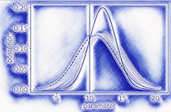




Statistical Analysis of Energy Loss Across System Size
Coleridge Faraday
University of Cape Town, South Africa
Precision Frontier of QCD Matter: Inference and Uncertainty Quantification
Based on CF and W. A. Horowitz, arXiv:2505.14568 [hep-ph] (2025); and CF and W. A. Horowitz, Phys. Lett. B 864, 139437 (2025).

Slide 2
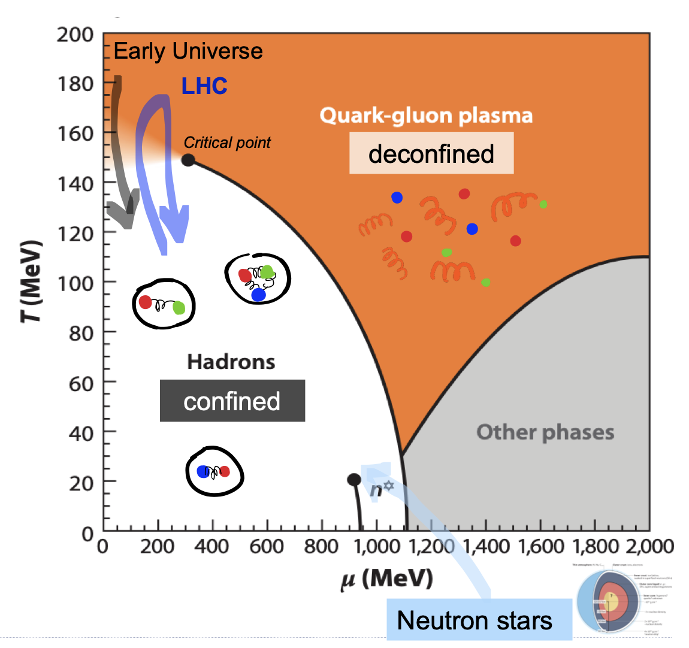
QCD Matter at the Extreme
High energy collisions of heavy-ions probe the high temperature regime of the QCD phase diagram
QGP formation established in collision of large nuclei
New frontier: how small can a collision be and still form QGP?
System size
Image: https://opendata.atlas.cern/docs/documentation/introduction/heavy_ions

Slide 3
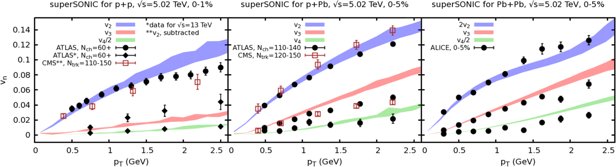
Collective phenomena in small systems
Collective phenomena is (qualitatively) well-described by hydrodynamic models across all collision systems (at high multiplicity)
Weller et al., PLB 774 (2017) 351-356

Slide 4
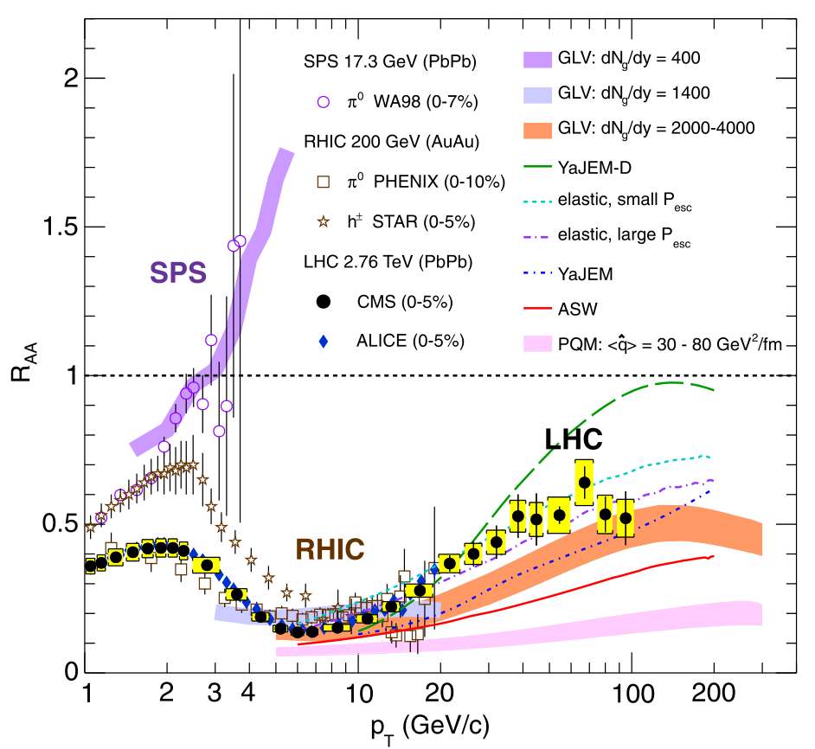
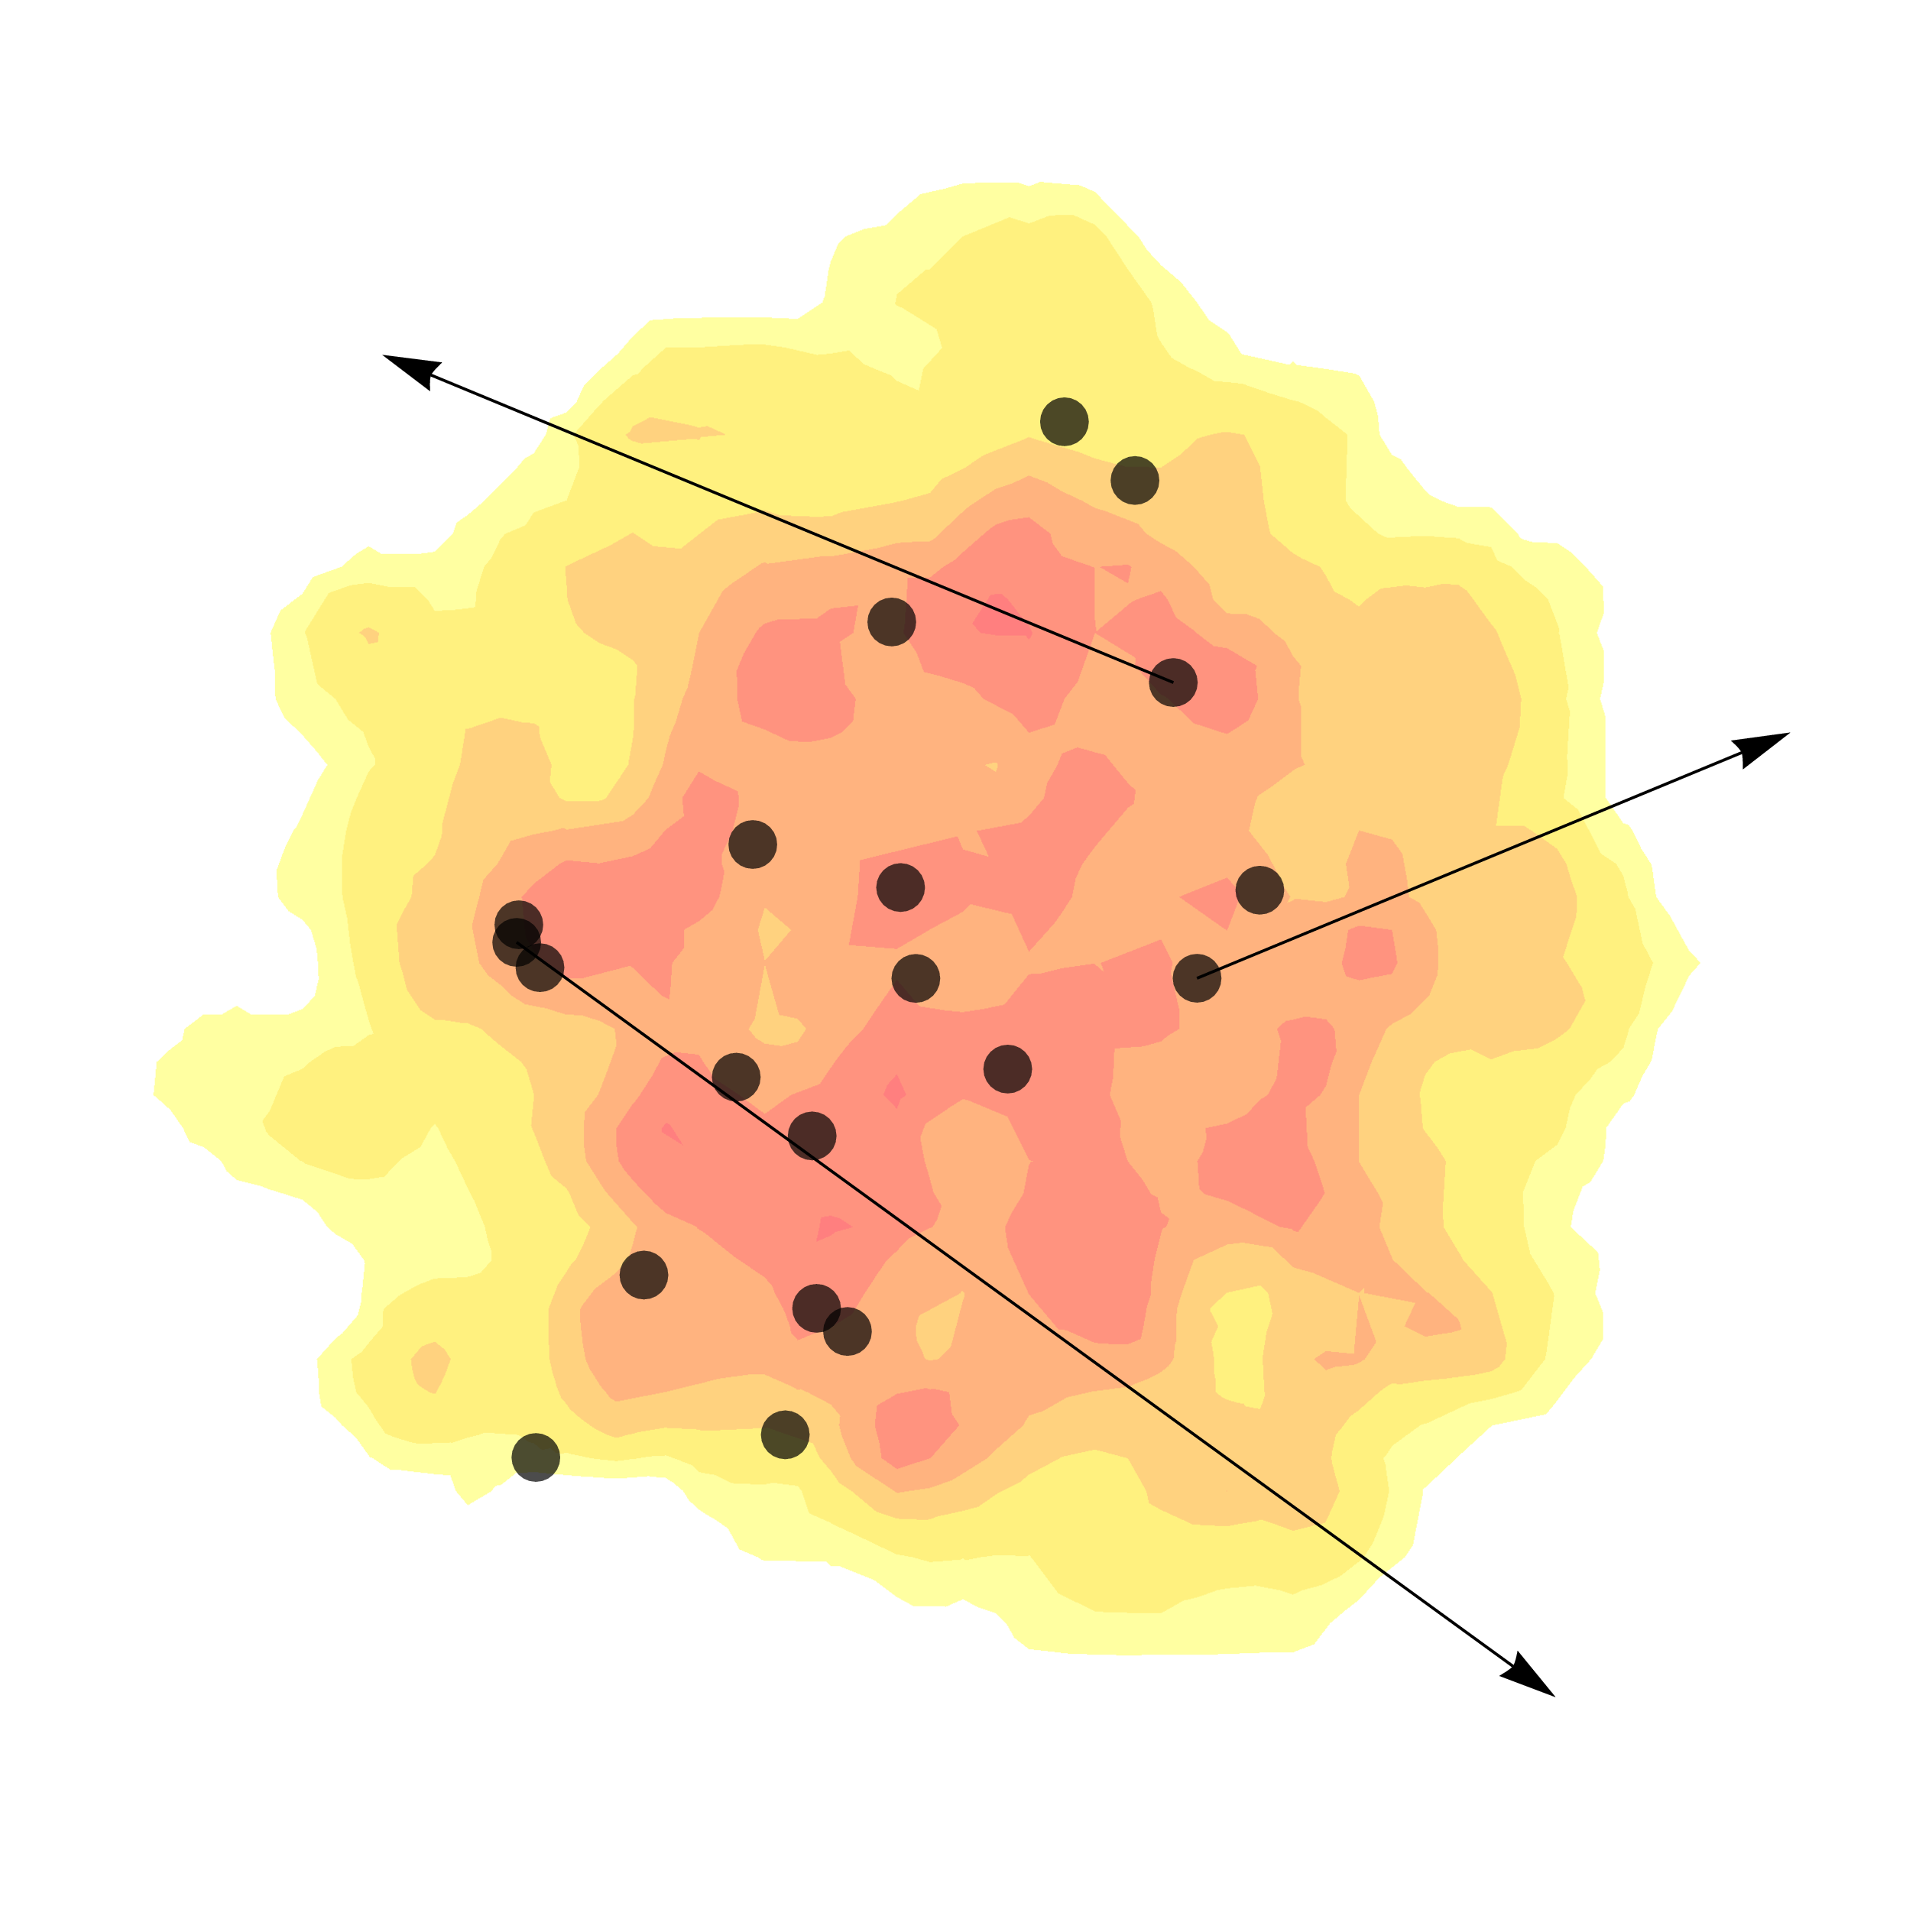
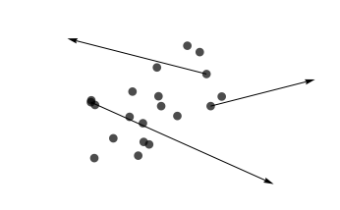
Hard probes of the QGP
=
Quantifies how much energy is lost by high momentum particles

Slide 5
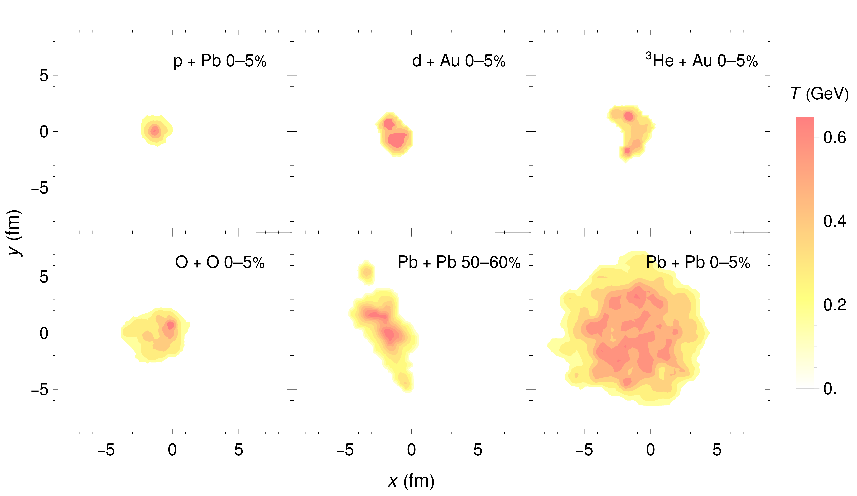
What do Small QGP’s Look Like?
p + Pb much smaller than Pb + Pb, but with similarly large temperatures
Are p + Pb plasmas large enough for energy loss?
B. Schenke, C. Shen, P. Tribedy, Phys.Rev.C 102 (2020) 044905 (adapted)

Slide 6
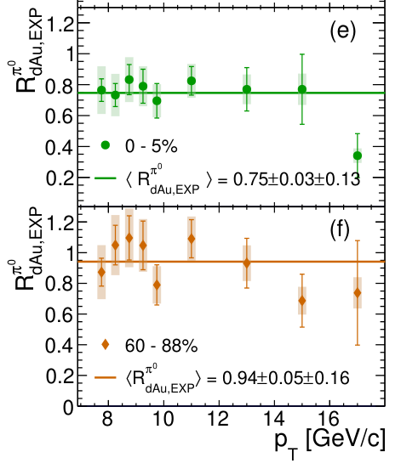
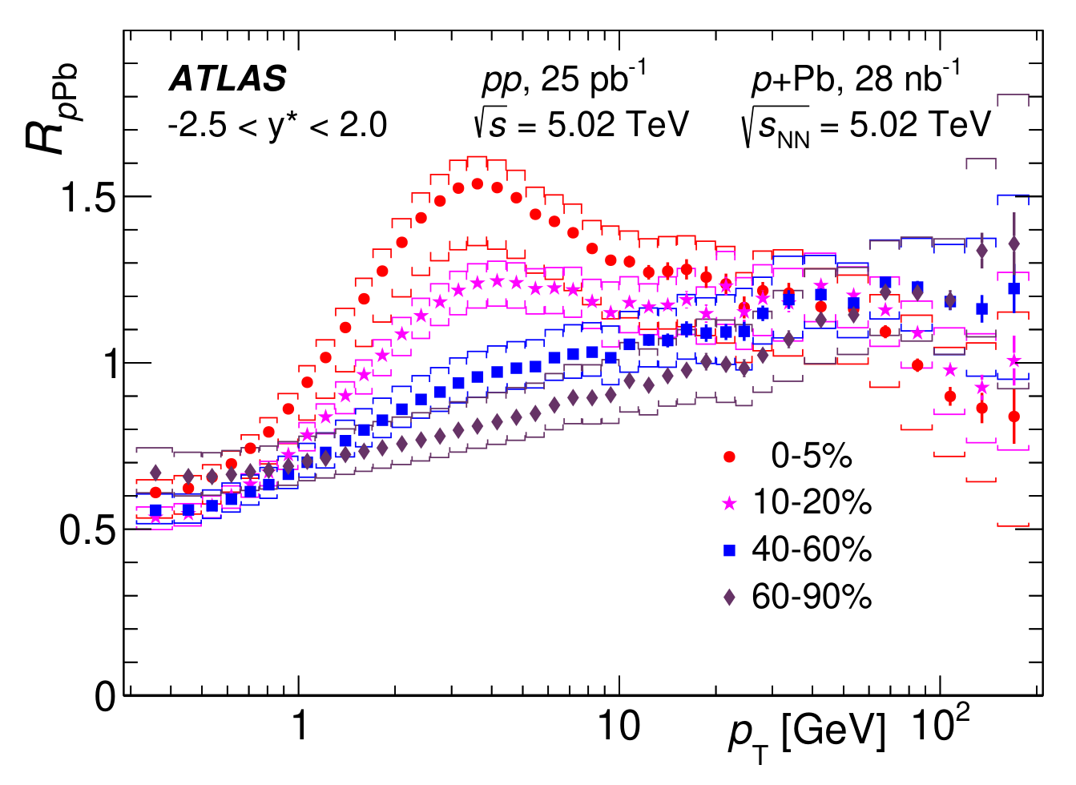

Nuclear Modification in Small Systems
Small system suppression pattern not clear
Direct $γ$
Apparent tension between RHIC and LHC suppression results?
No suppression!
→ Theoretical input
needed
Glauber
Suppression ~0.75!
ATLAS, JHEP 07 (2023) 074
PHENIX, Phys. Rev. Lett. 134, 022302 (2025).

Slide 7
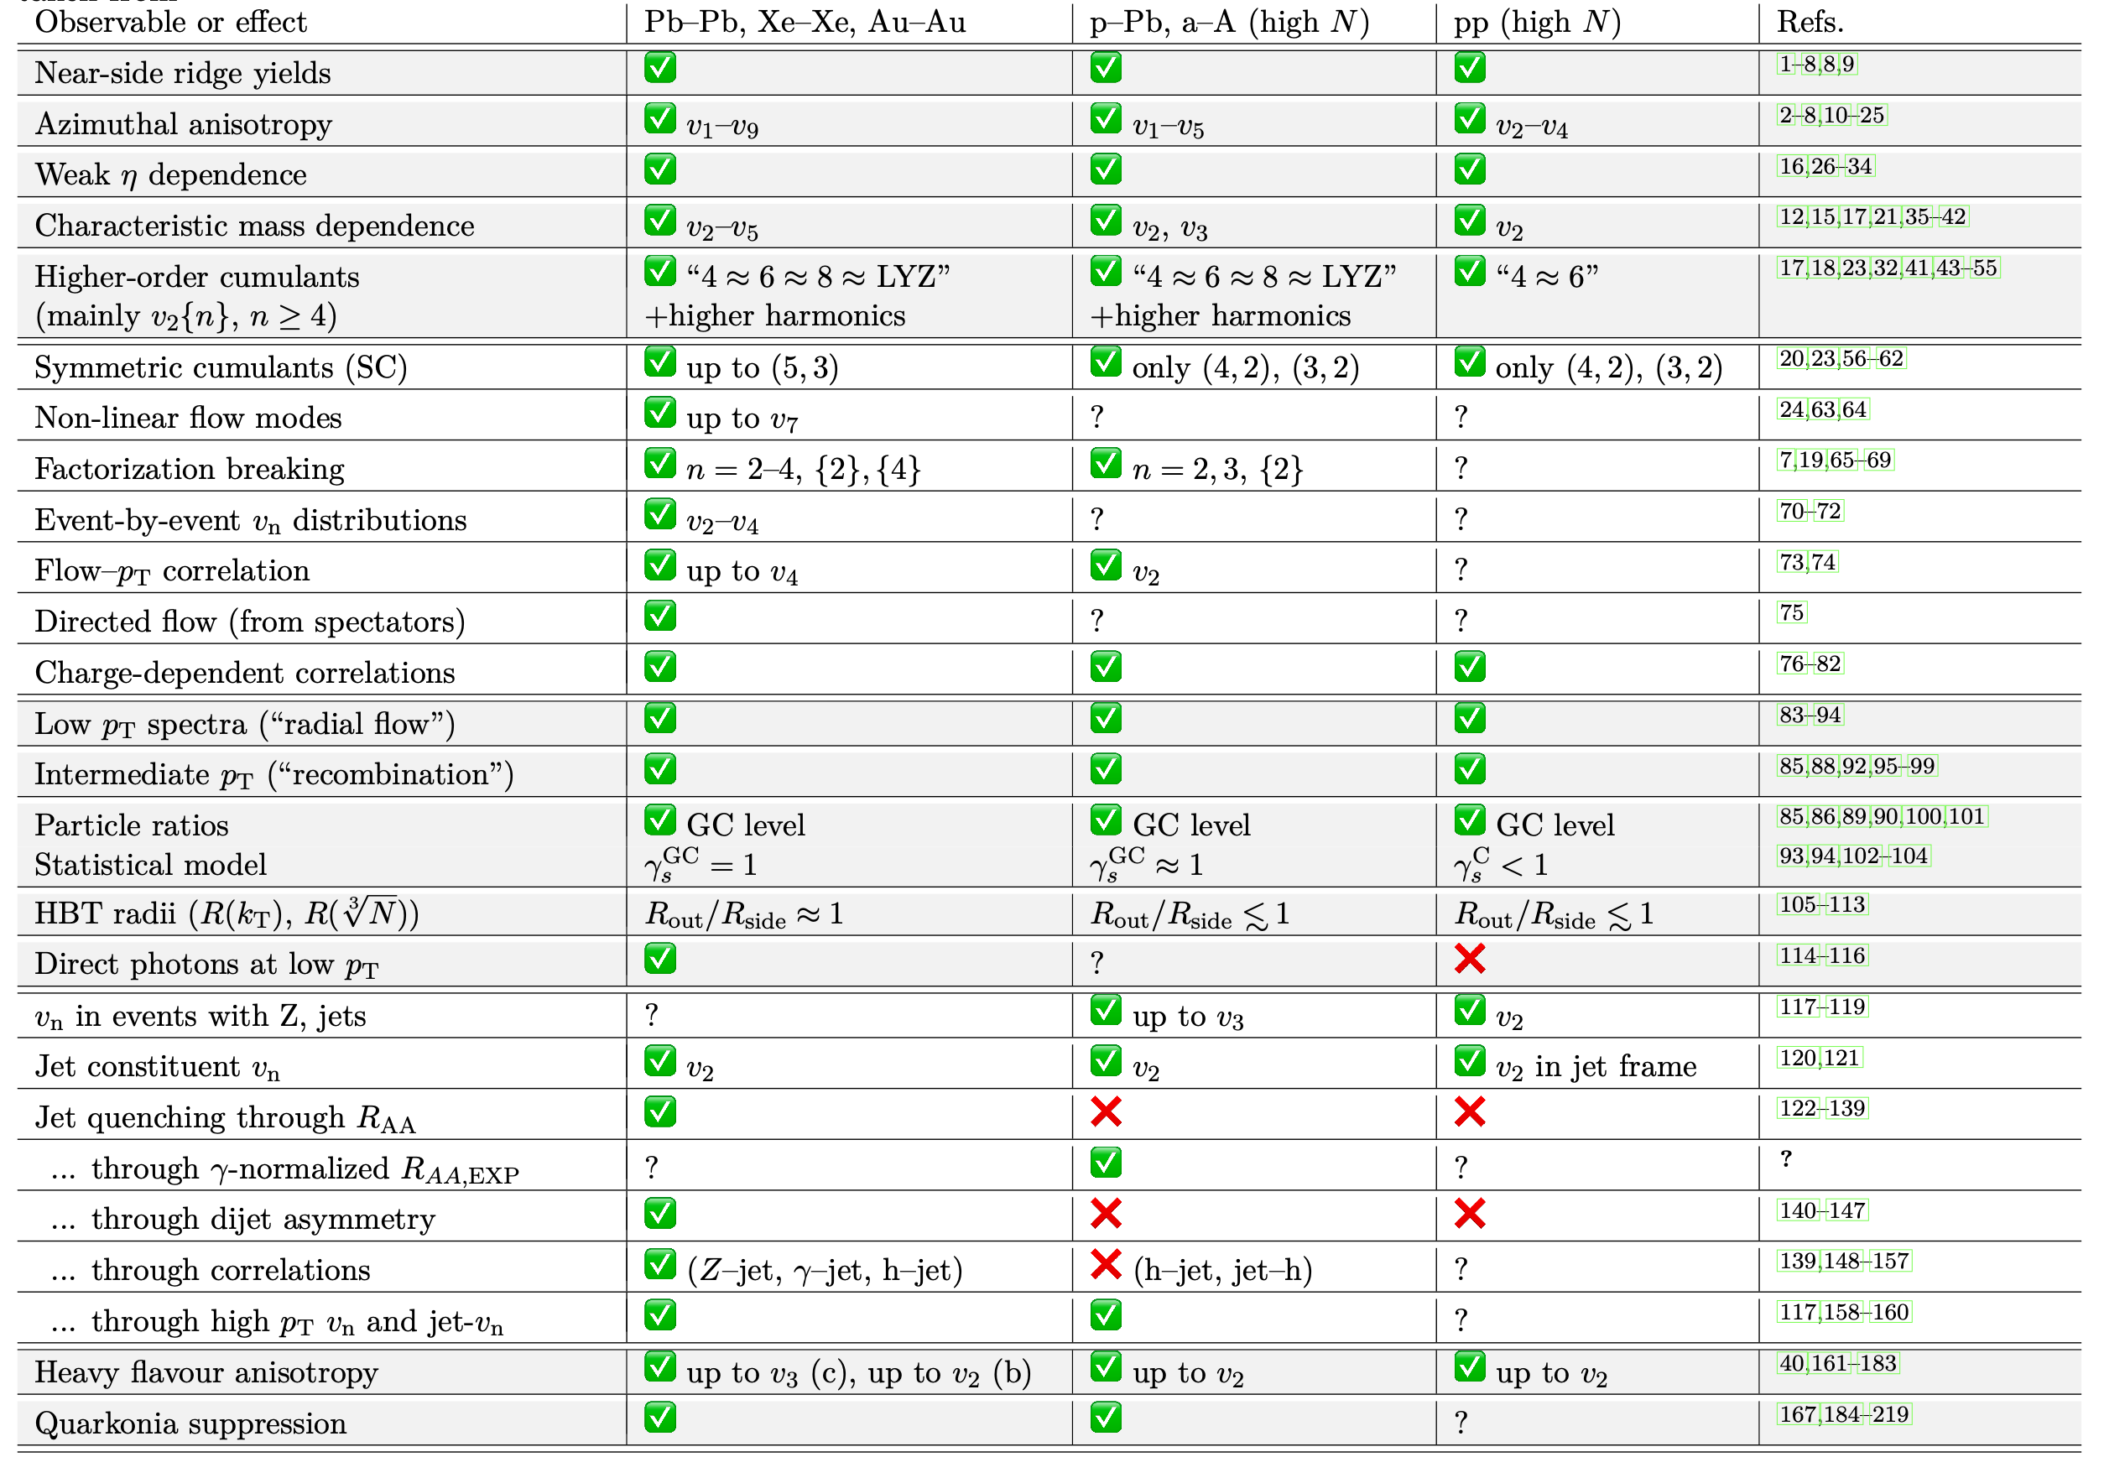



$$A + A$$
$$p + A$$
$$p +p$$
✅ = observed
❌ = not observed
? = not measured
Many, many measurements have been done in both large and small systems (220 references!)
Adapted from J. F. Grosse-Oetringhaus and U. A. Wiedemann, arXiv:2407.07484 [hep-ex] (2024). See backup slides for references

Slide 8
$$A + A$$
$$p + A$$
$$p +p$$
Flow
✅ = observed
❌ = not observed
? = not measured
Correlations
Mixed messages?
Hard probes are the missing piece of the puzzle!
Freezeout
properties
Hard probes
Adapted from J. F. Grosse-Oetringhaus and U. A. Wiedemann, arXiv:2407.07484 [hep-ex] (2024). See backup slides for references
Heavy-flavor

Slide 9
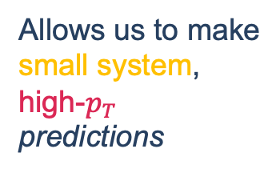
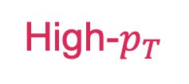
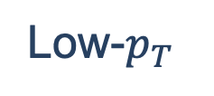
Large
Small
Constrains the small-system background
Low-$p_{T}$
Allows us to make
small system, high-$p_{T}$ predictions
High-$p_{T}$
Adapted from J. F. Grosse-Oetringhaus and U. A. Wiedemann, arXiv:2407.07484 [hep-ex] (2024). See backup slides for references
Constrains the energy loss

Slide 10
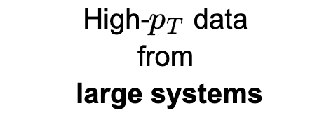


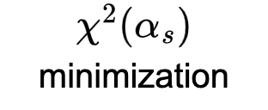
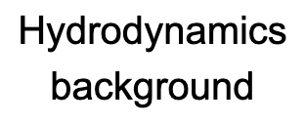



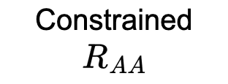
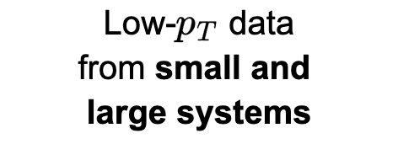

Physics model

Slide 11
Theoretical uncertainties

Slide 12
Theoretical uncertainties
We implement two limiting assumptions for the collisional energy loss:
Braaten and Thoma (BT) and Hard Thermal Loop only (HTL only)
Related to the transition between HTL and vacuum propagators
We vary cutoff on the transverse radiated gluon momentum
Each “model implementation” is separately fit to the data
Future work might include these uncertainties in the covariance matrix
E. Braaten and M. H. Thoma, Phys. Rev. D 44, R2625 (1991).
S. Wicks, PhD thesis, 2008.
CF and W. A. Horowitz, Phys. Rev. C 111, 054911 (2025).
CF, A. Grindrod, and W. A. Horowitz, Eur. Phys. J. C 83, 1060 (2023)

Slide 13
Statistical analysis

Slide 14


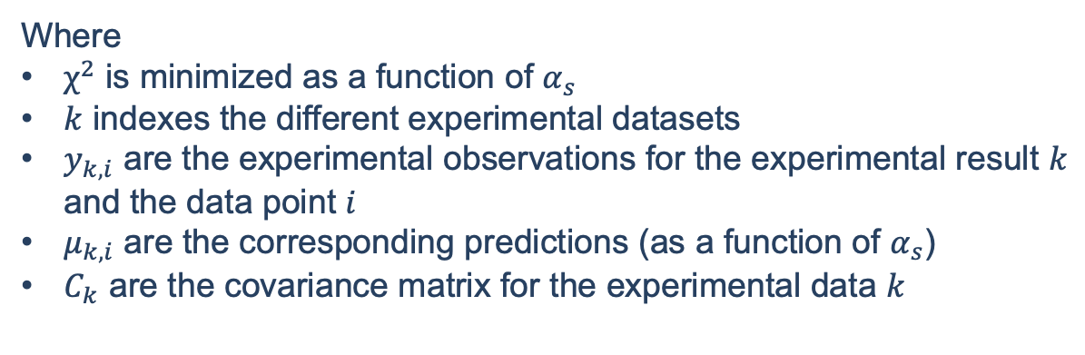
Statistical extraction of $α_{s}$
$$χ^{2}=\sum_{k}^{N_{exp. }}{χ_{k}^{2}} \text{with} χ_{k}^{2}≡\sum_{i,j}^{N_{k}}{\left(y_{k,i}−μ_{k,i}\right){\left(C^{−1}\right)}_{k,ij}\left(y_{k,j}−μ_{k,j}\right)}$$
Where
$χ^{2}$ is minimized as a function of $α_{s}$
$k$ indexes the different experimental datasets
$y_{k,i}$ are the experimental observations for the experimental result $k$ and the data point $i$
$μ_{k,i}$ are the corresponding predictions (as a function of $α_{s}$)
$C_{k}$ are the covariance matrix for the experimental data $k$
CF and W. A. Horowitz, arXiv:2505.14568 [hep-ph] (2025).

Slide 15
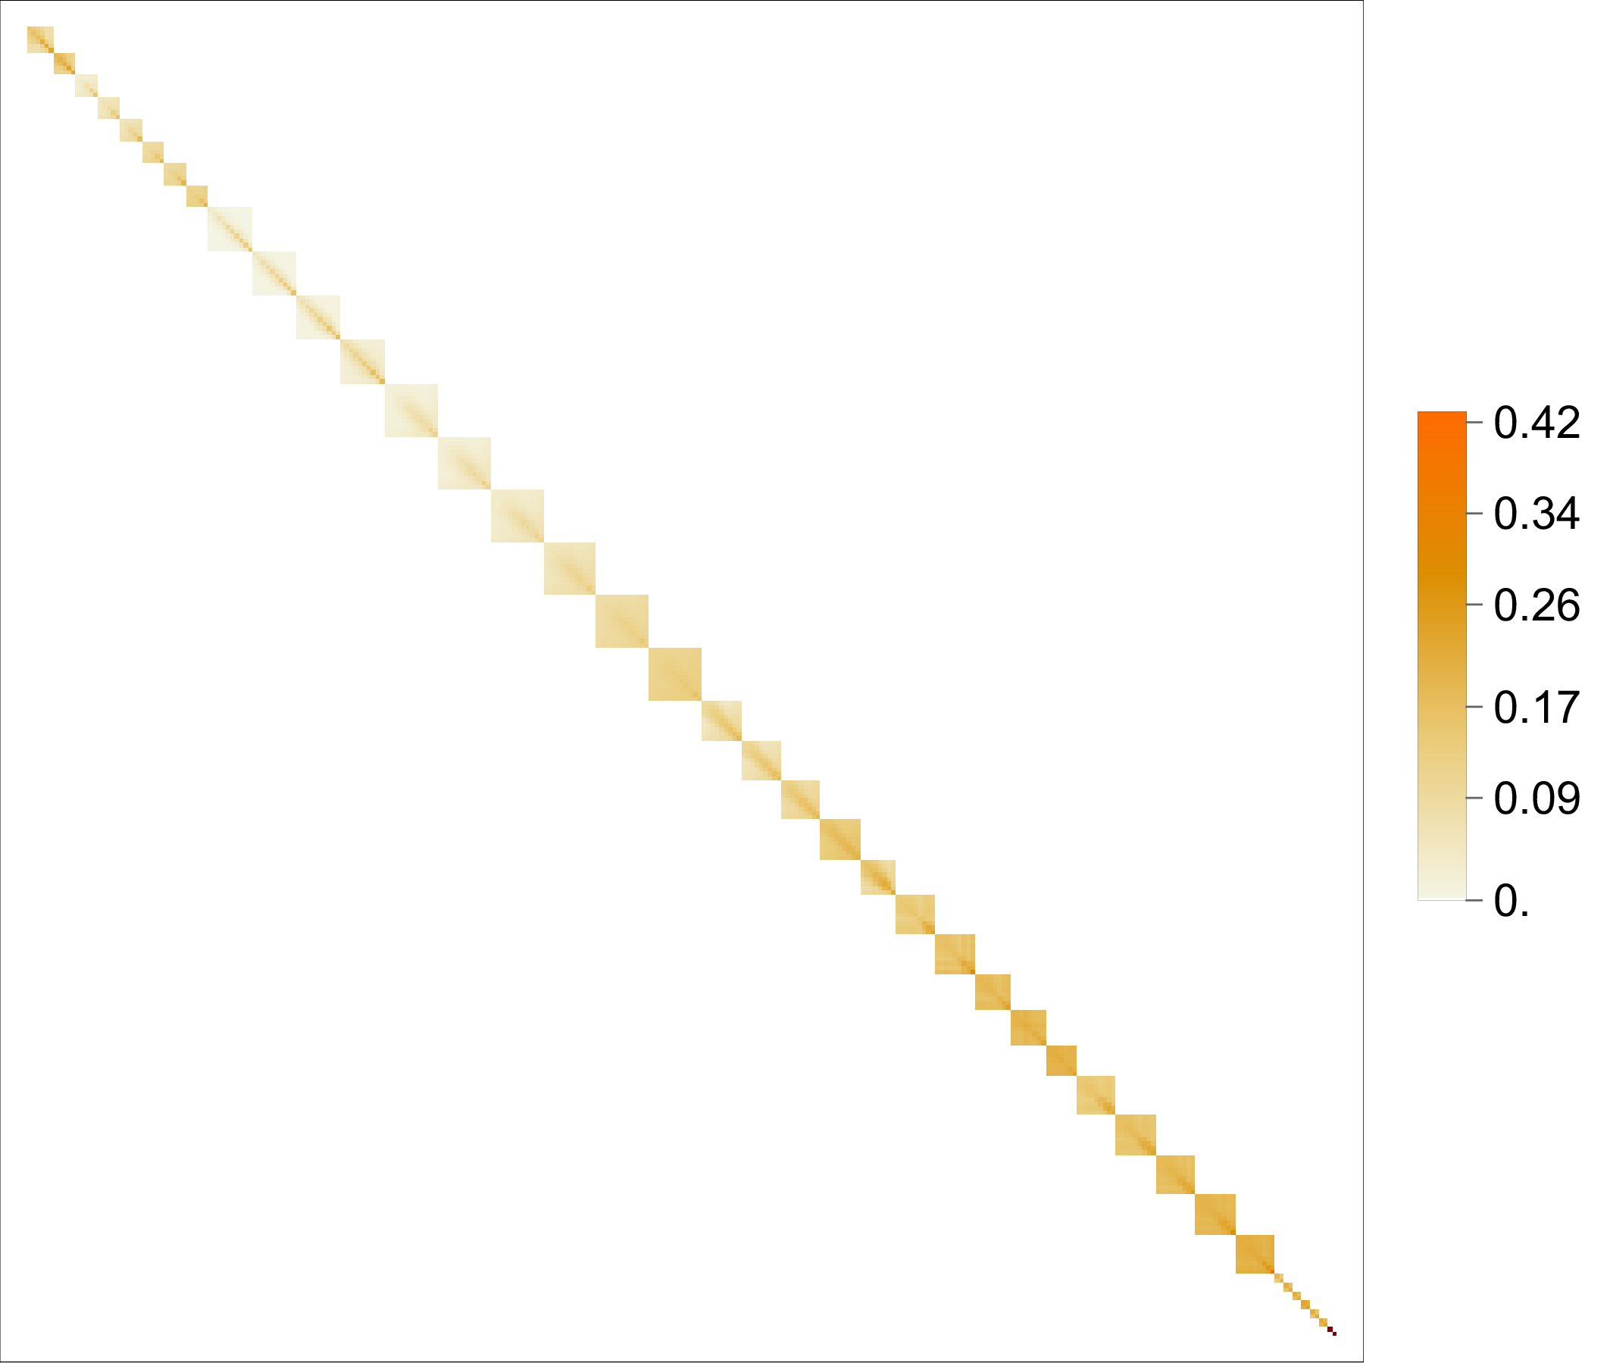

The covariance matrix $C$
Captures the correlations between uncertainties
Fully uncorrelated uncertainties contribute only to the diagonal (statistical & uncorrelated systematics)
Fully correlated uncertainties contribute only to the off-diagonal (correlated & globally correlated systematics)
In principle, there are
correlations between experiments, centrality classes, particle species, but the form is not known.
Contributions from theoretical uncertainties
JETSCAPE, Phys. Rev. C 109, 064903 (2024).
R. A. Soltz, D. A. Hangal, and A. Angerami, Phys. Rev. C 111, 034911 (2025).
CF and W. A. Horowitz, arXiv:2505.14568 [hep-ph] (2025).

Slide 16

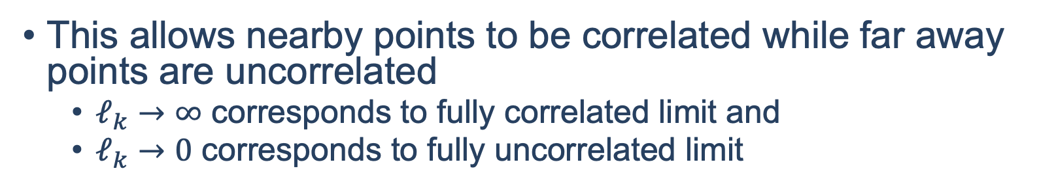

Length-correlated model for $C$
We assume that systematics with unknown correlation contribute to the covariance matrix as
$$C_{ij}^{B}=\exp\left[−{\left|\frac{p_{i}−p_{j}}{ℓ_{k}}\right|}^{2}\right]σ_{i}σ_{j}$$
This allows nearby points to be correlated while far away points are uncorrelated
$ℓ_{k}→∞$ corresponds to fully correlated limit and
$ℓ_{k}→0$ corresponds to fully uncorrelated limit
JETSCAPE, Phys. Rev. C 109, 064903 (2024).

Slide 17
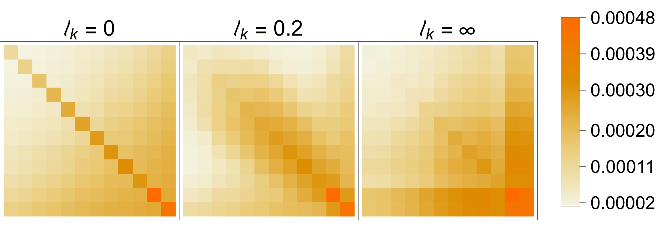
Effect of correlations
For example, here is the covariance matrix for Pions produced in 0-5% Pb + Pb collisions as measured by ATLAS
ATLAS, JHEP 07, 074 (2023)

Slide 18
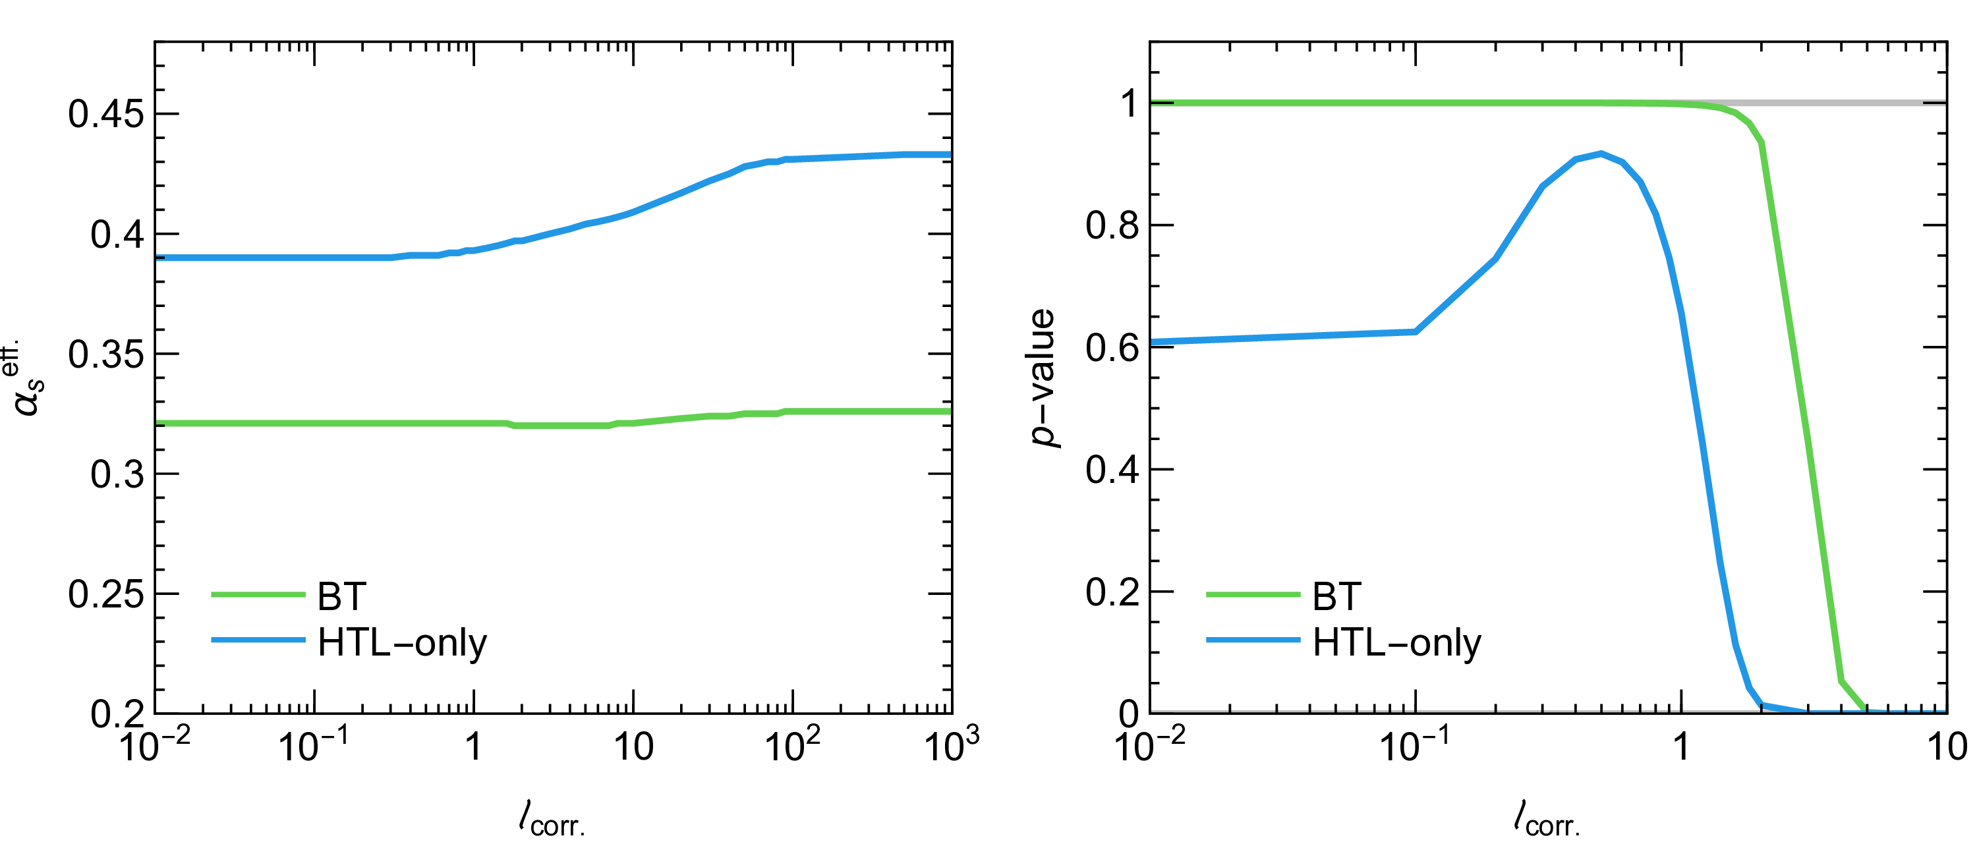
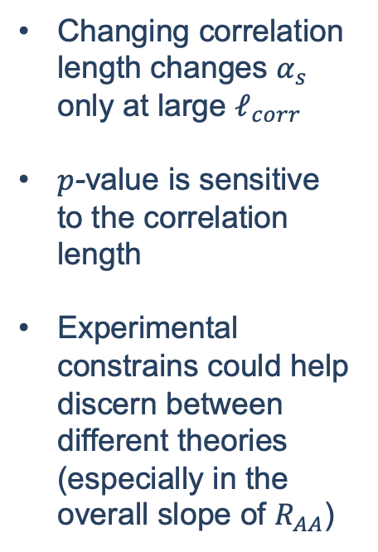
Sensitivity to correlation length
Changing correlation length changes $α_{s}$ only at large $ℓ_{corr}$
$p$-value is sensitive to the correlation length
Experimental constrains could help discern between different theories (especially in the overall slope of $R_{AA}$)

Slide 19
All results post-fitting, 295 data points

Slide 20
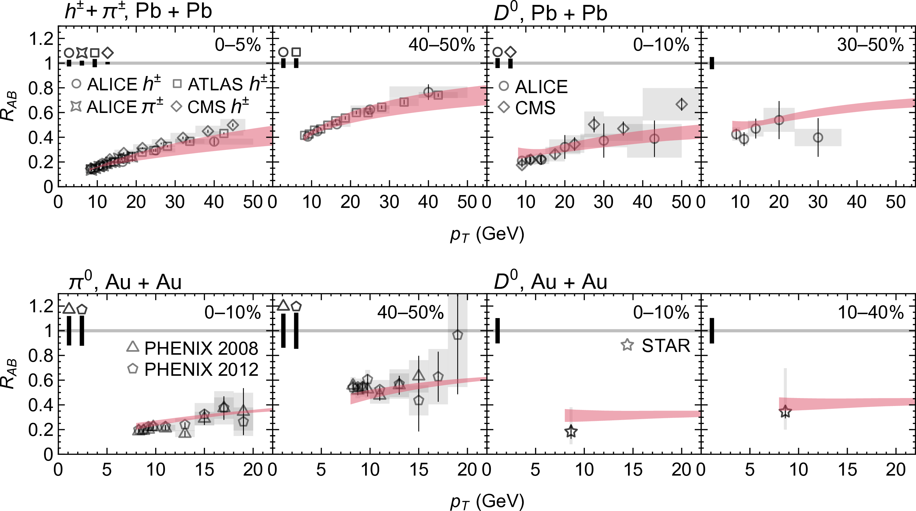
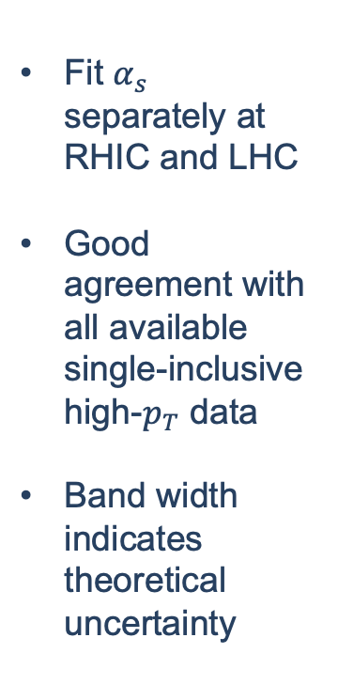
Sample of results post-fitting
Fit $α_{s}$ separately at RHIC and LHC
Good agreement with all available single-inclusive high-$p_{T}$ data
Band width indicates theoretical uncertainty

Slide 21

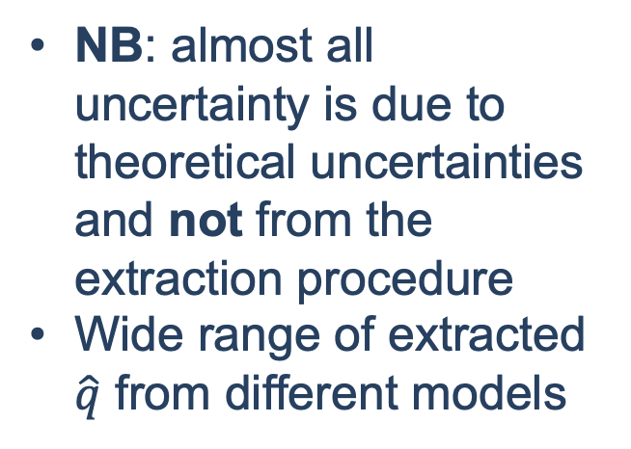
Extraction of $\hat{q}$
NB: almost all uncertainty is due to theoretical uncertainties and not from the extraction procedure
Wide range of extracted $\hat{q}$ from different models

Slide 22
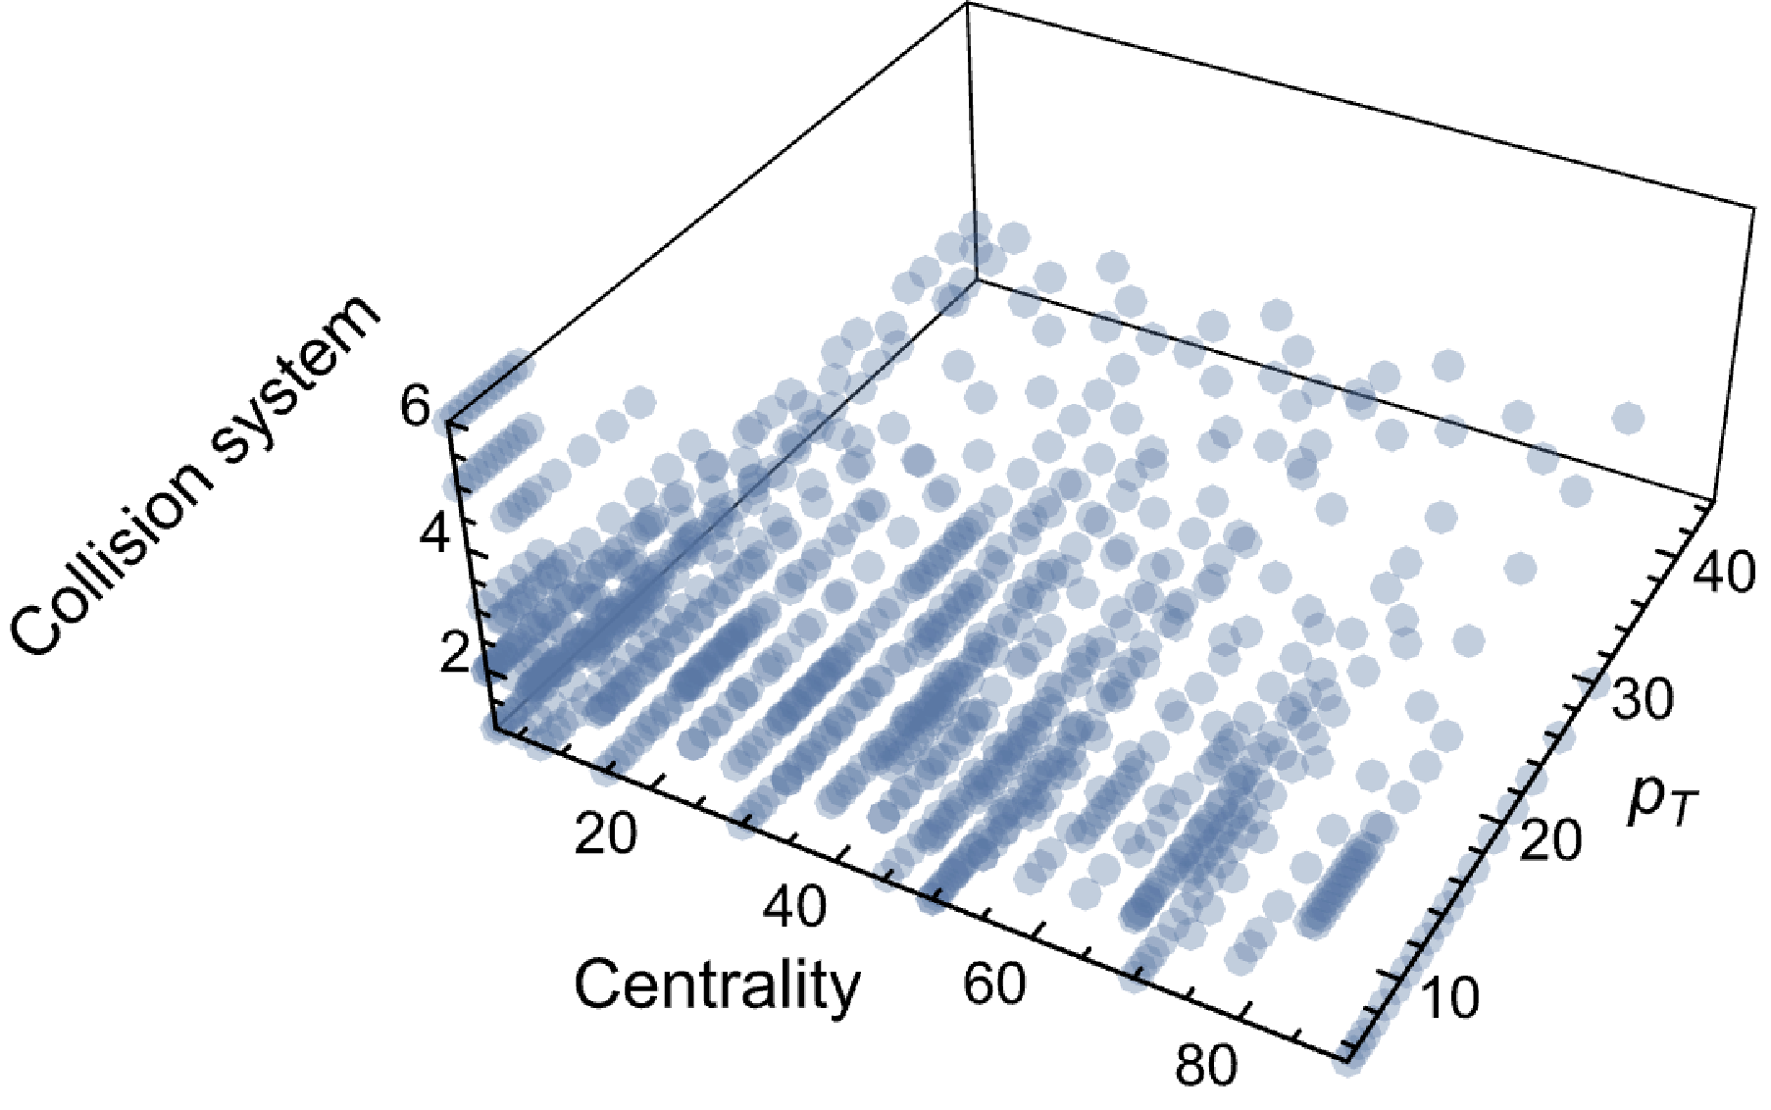
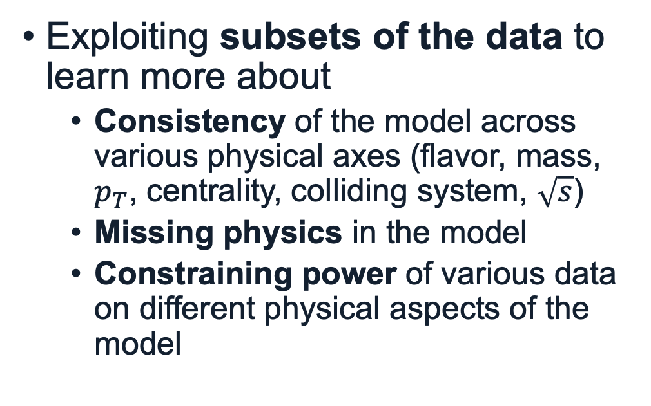
Can we do better?
Exploiting subsets of the data to learn more about
Consistency of the model across various physical axes (flavor, mass, $p_{T}$, centrality, colliding system, $\sqrt{s}$)
Missing physics in the model
Constraining power of various data on different physical aspects of the model

Slide 23
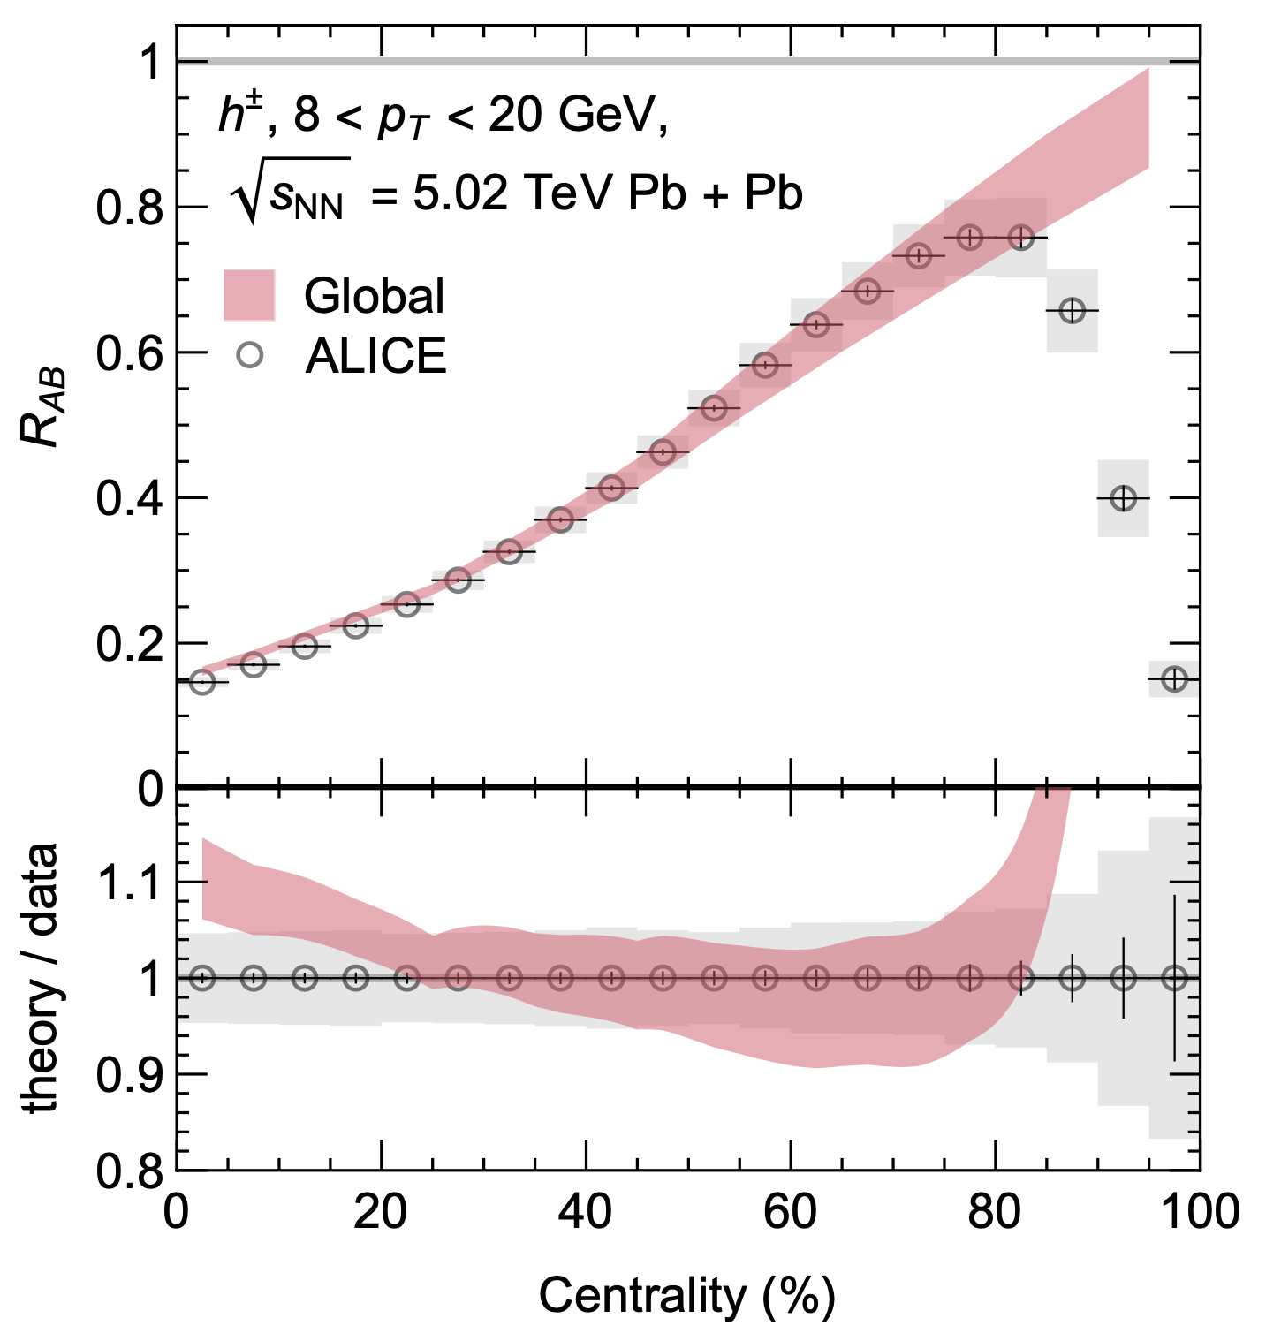

Centrality dependence of $α_{s}$
Excellent description of centrality dependence
Above 80%, selection biases lead to large anomalous suppression

Slide 24
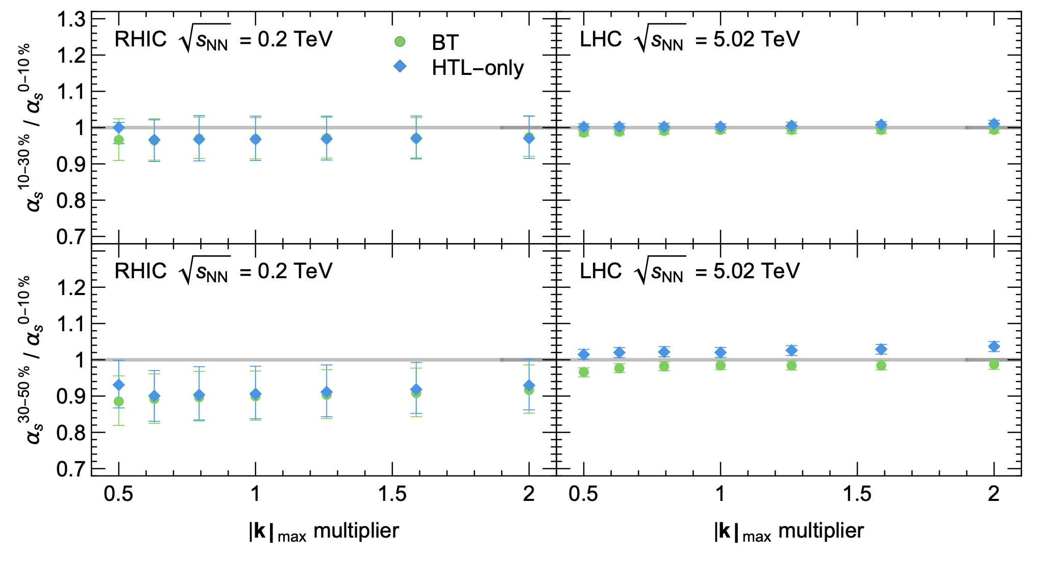
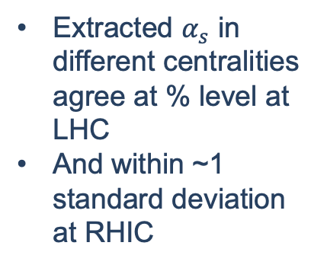
Centrality dependence of $α_{s}$
Extracted $α_{s}$ in different centralities agree at % level at LHC
And within ~1 standard deviation at RHIC

Slide 25
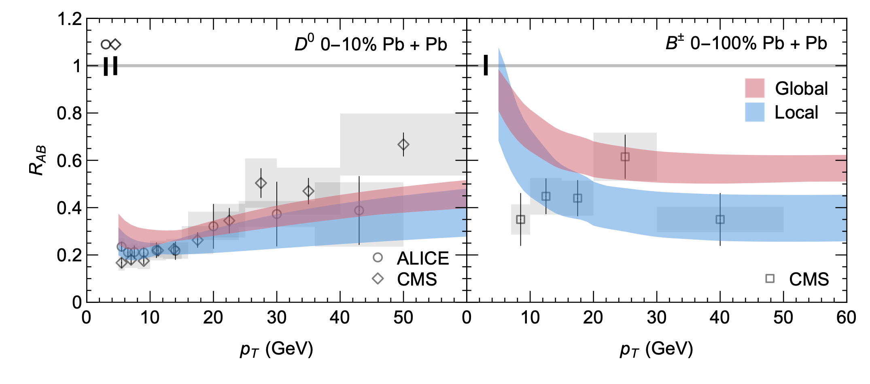

Flavor dependence of $α_{s}$
Heavy-flavors are undersuppressed compared to data
Points to missing flavor-dependent physics (heavy-flavor dissociation, flavor-dependent medium modifications to hadronization, incorrect partonic masses?)
Still within reasonable agreement within uncertainties (but B agreement is much worse than D)

Slide 26
Theoretical uncertainty of flavor dep.
1-2 standard deviation disagreement between D meson and light flavor extractions.
Many standard deviations disagreement between B meson and light-flavor extractions

Slide 27
Small system suppression
The good description of the centrality (~length) dependence of the experimental data justifies our extrapolation to small systems

Slide 28
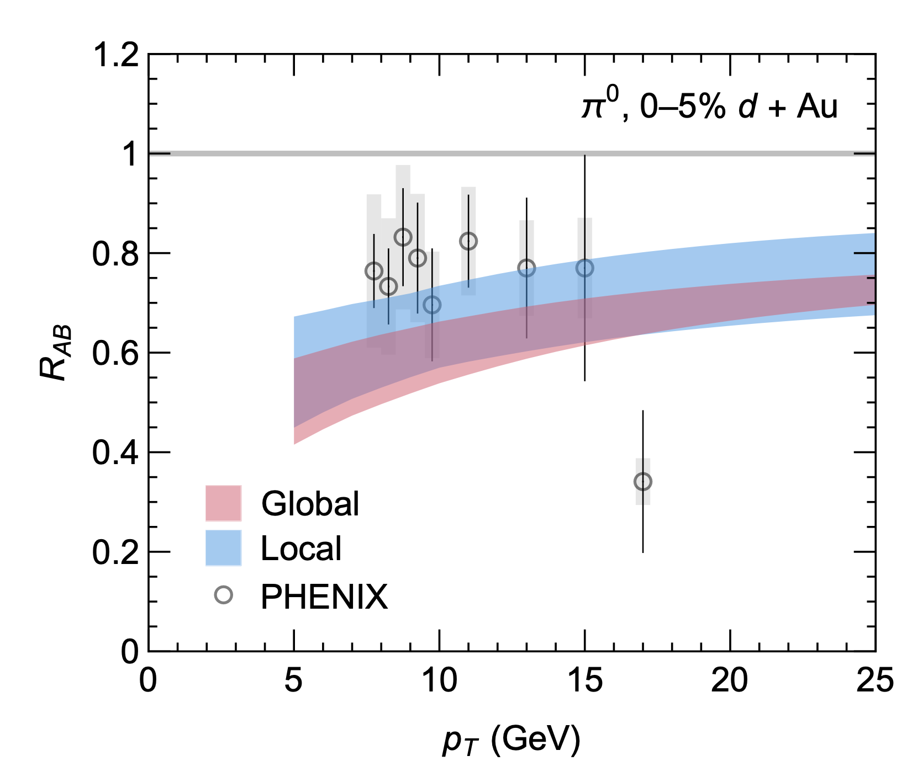
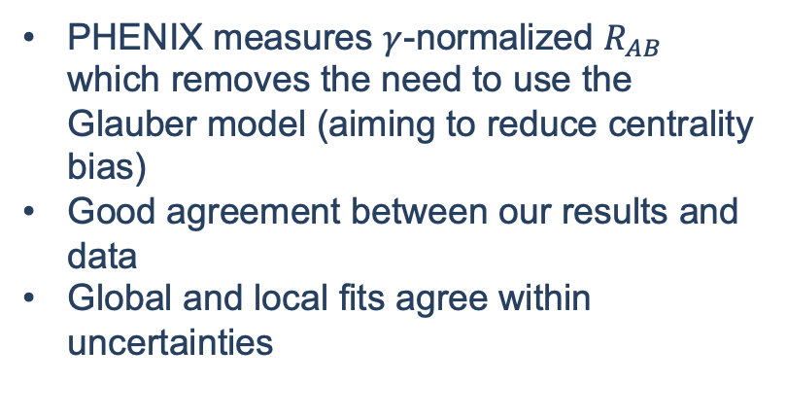
Small system suppression at RHIC
PHENIX measures $γ$-normalized $R_{AB}$ which removes the need to use the Glauber model (aiming to reduce centrality bias)
Good agreement between our results and data
Global and local fits agree within uncertainties
PHENIX, Phys. Rev. Lett. 134, 022302 (2025).

Slide 29
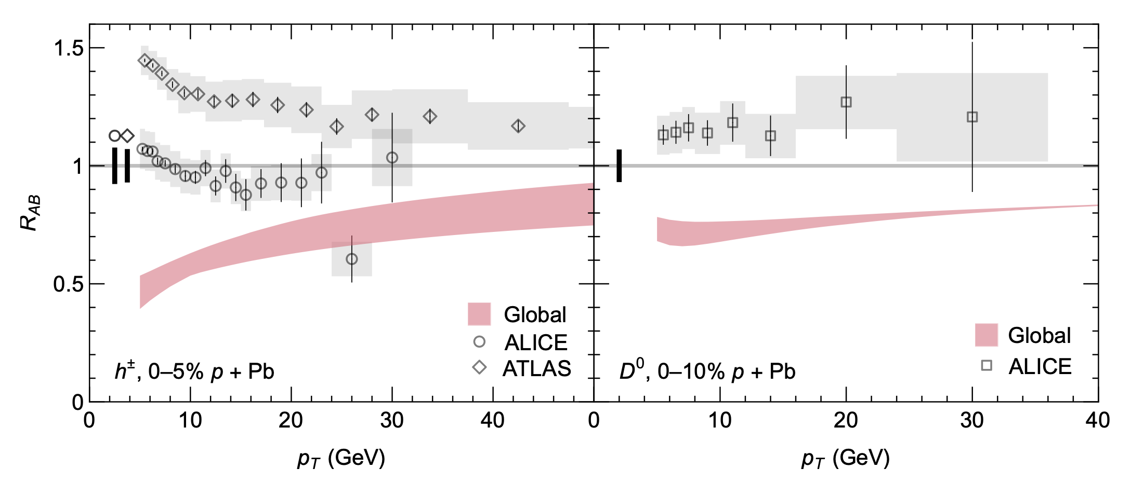
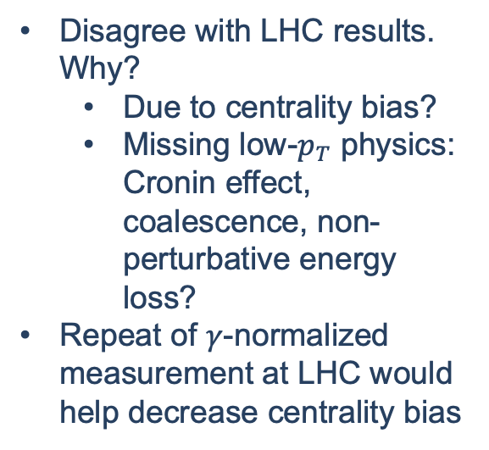
Small system suppression at LHC
Disagree with LHC results. Why?
Due to centrality bias?
Missing low-$p_{T}$ physics: Cronin effect, coalescence, non-perturbative energy loss?
Repeat of $γ$-normalized measurement at LHC would help decrease centrality bias
ALICE, Phys. Rev. C 91, 064905 (2015).
ATLAS, JHEP 07, 074 (2023).
ALICE, JHEP 12, 092 (2019).

Slide 30
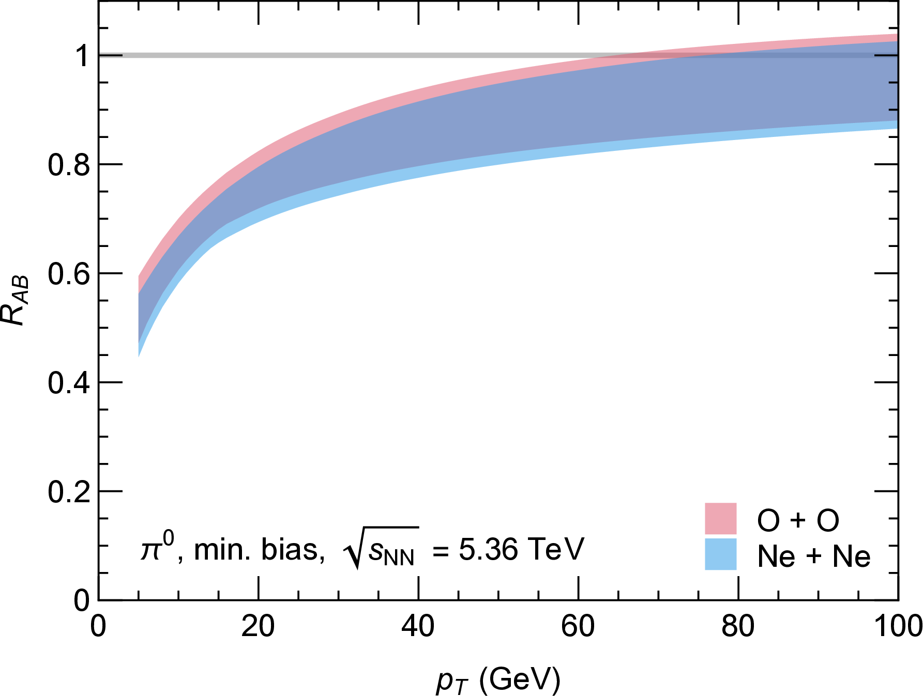
Predictions for light-ions
Light ions will serve as a useful test for energy loss models
Less centrality bias
Larger signal
“Stepping stone” to understanding smaller systems
We predict significant suppression that should be measurable
Future:
Constrain path length dependence of energy loss
Disentangle initial and final state effects

Slide 31
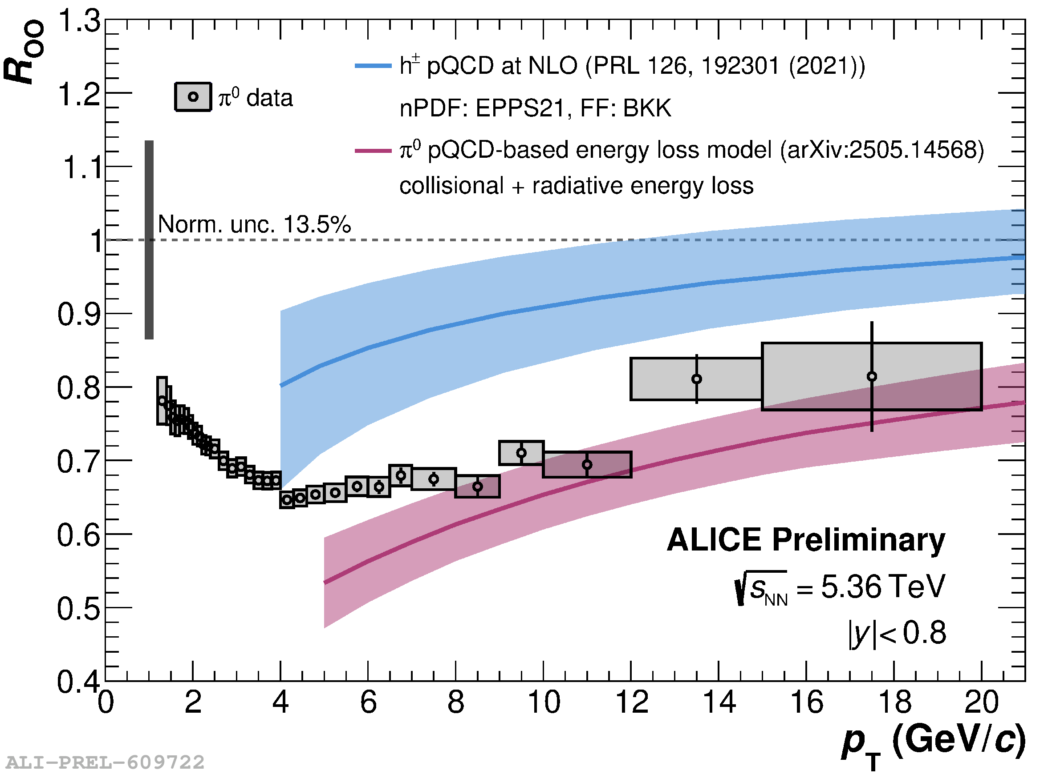
Predictions for light ions
R_{OO} vs. p_{T}
Just presented this morning at initial stages! (taken from Jan-Fiete’s slides)
will go down (expectation: 5%)
Our model

Slide 32
Can we do better?
Exploiting subsets of the data to learn more about
Consistency of the model across various physical axes (flavor, mass, $p_{T}$, centrality, colliding system, $\sqrt{s}$)
Missing physics in the model
Constraining power of various data on different physical aspects of the model

Slide 33
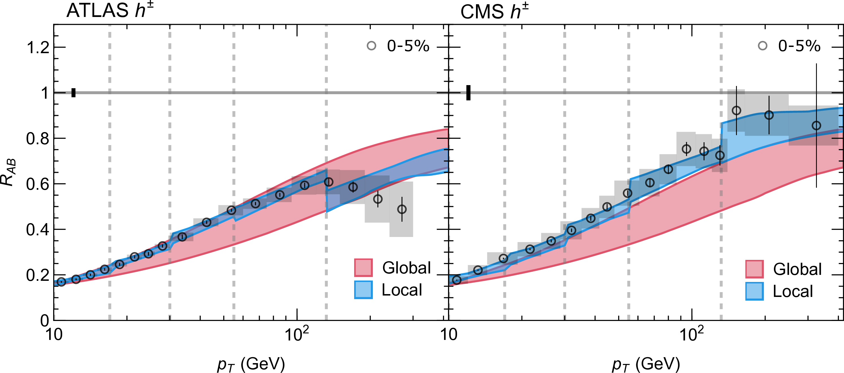

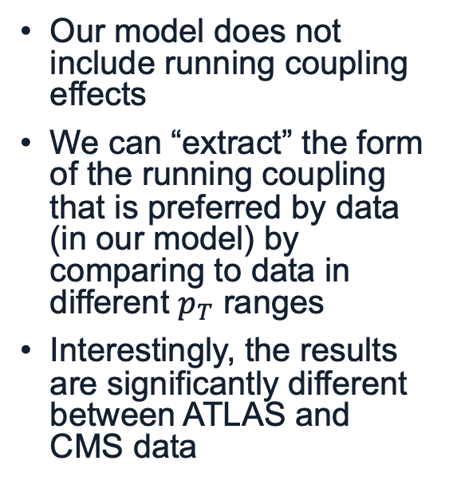
Running coupling in $p_{T}$
Our model does not include running coupling effects
We can “extract” the form of the running coupling that is preferred by data (in our model) by comparing to data in different $p_{T}$ ranges
Interestingly, the results are significantly different between ATLAS and CMS data

Slide 34
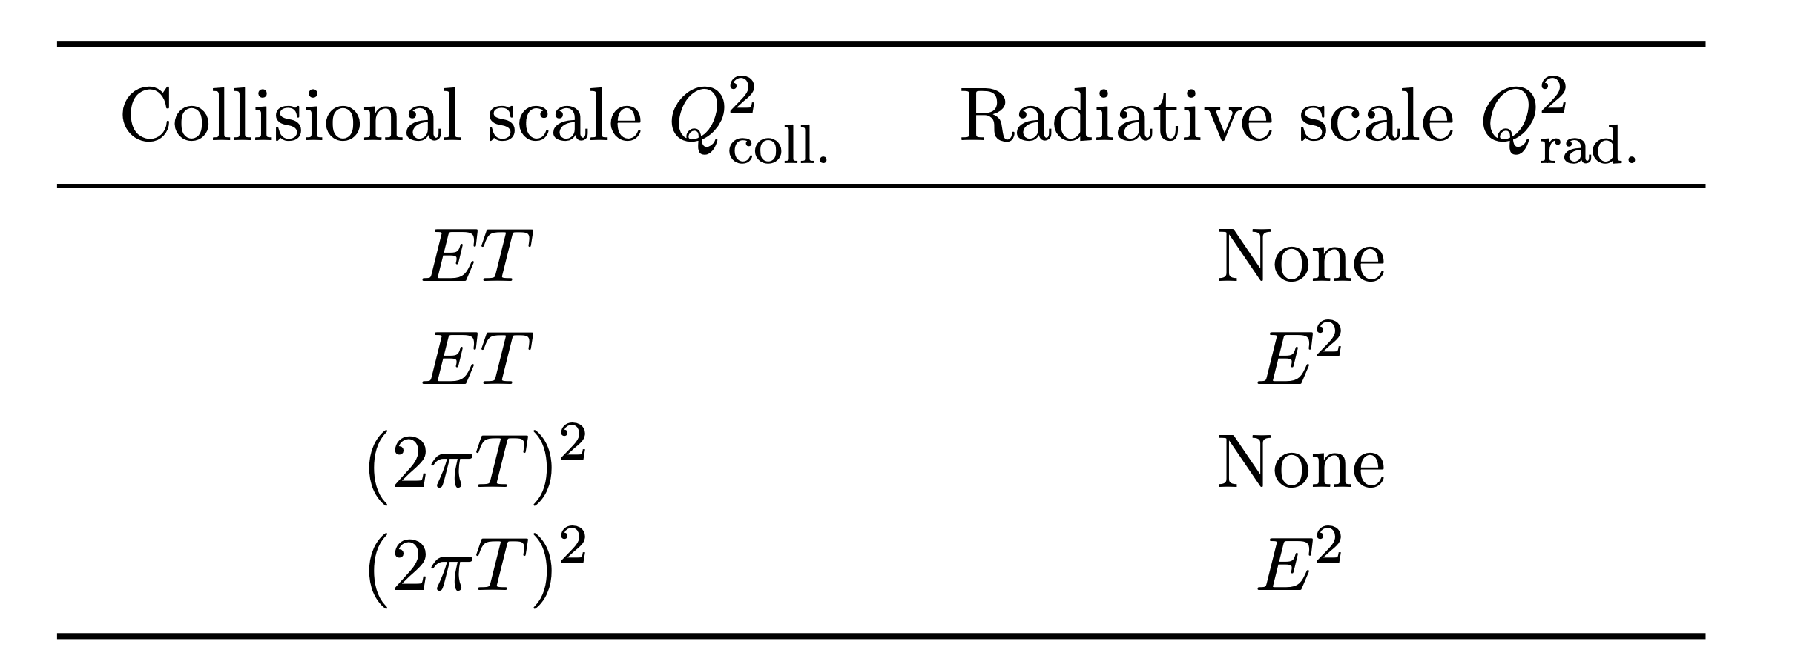

Parametric forms of running coupling
The coupling is typically taken to run as $α_{s}\left(Q\right)=2π/\left[9\ln\left(Q/Λ_{\text{QCD}}\right)\right]$
But the scales 𝑄 which are used differ between different model implementations
We’ll consider a few popular combination for the collisional and radiative scales

Slide 35
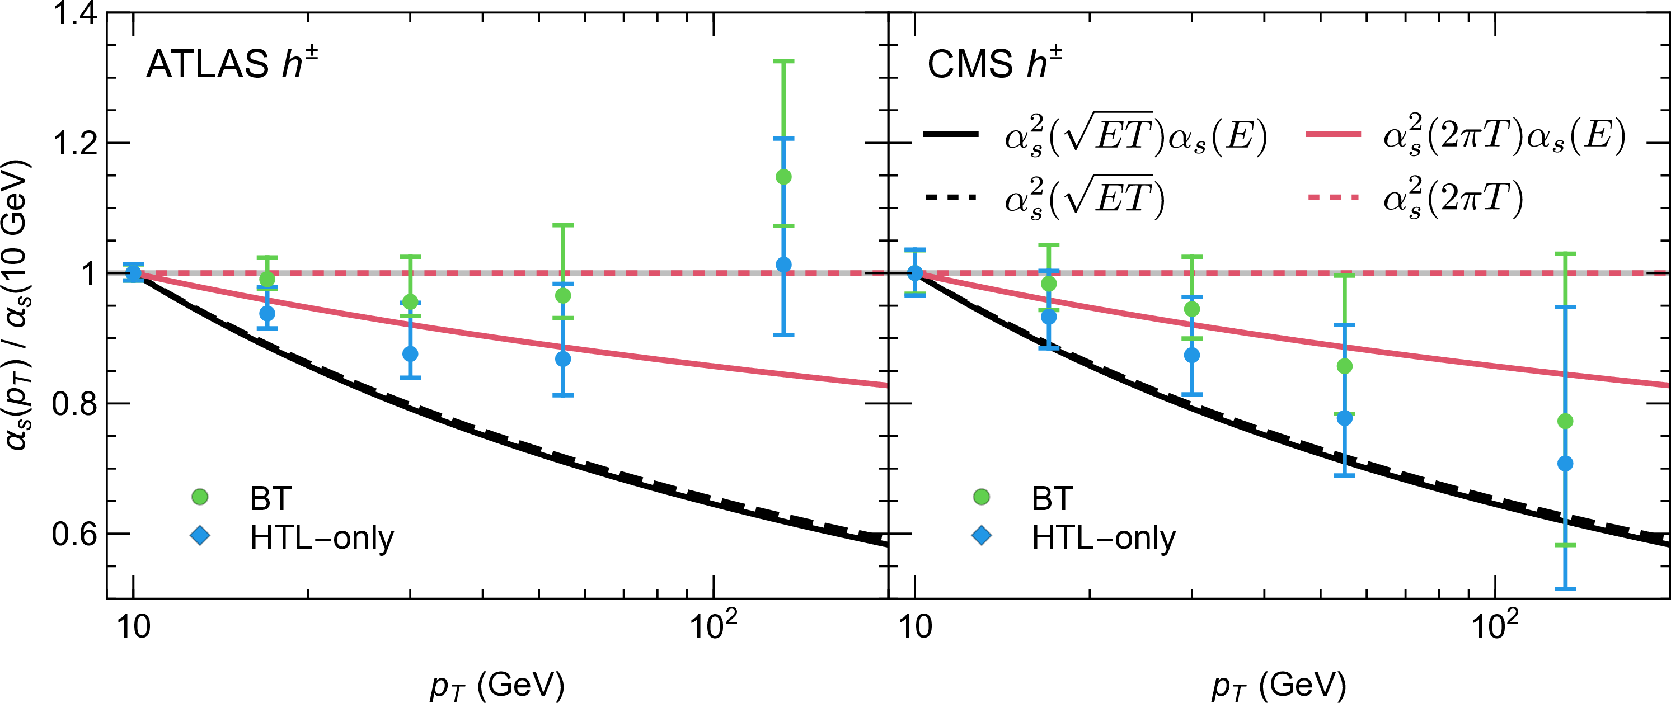

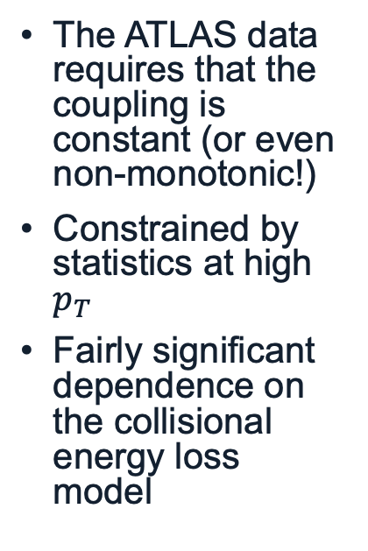
Data-extracted vs analytic forms of $α_{s}$
The ATLAS data requires that the coupling is constant (or even non-monotonic!)
Constrained by statistics at high $p_{T}$
Fairly significant dependence on the collisional energy loss model

Slide 36
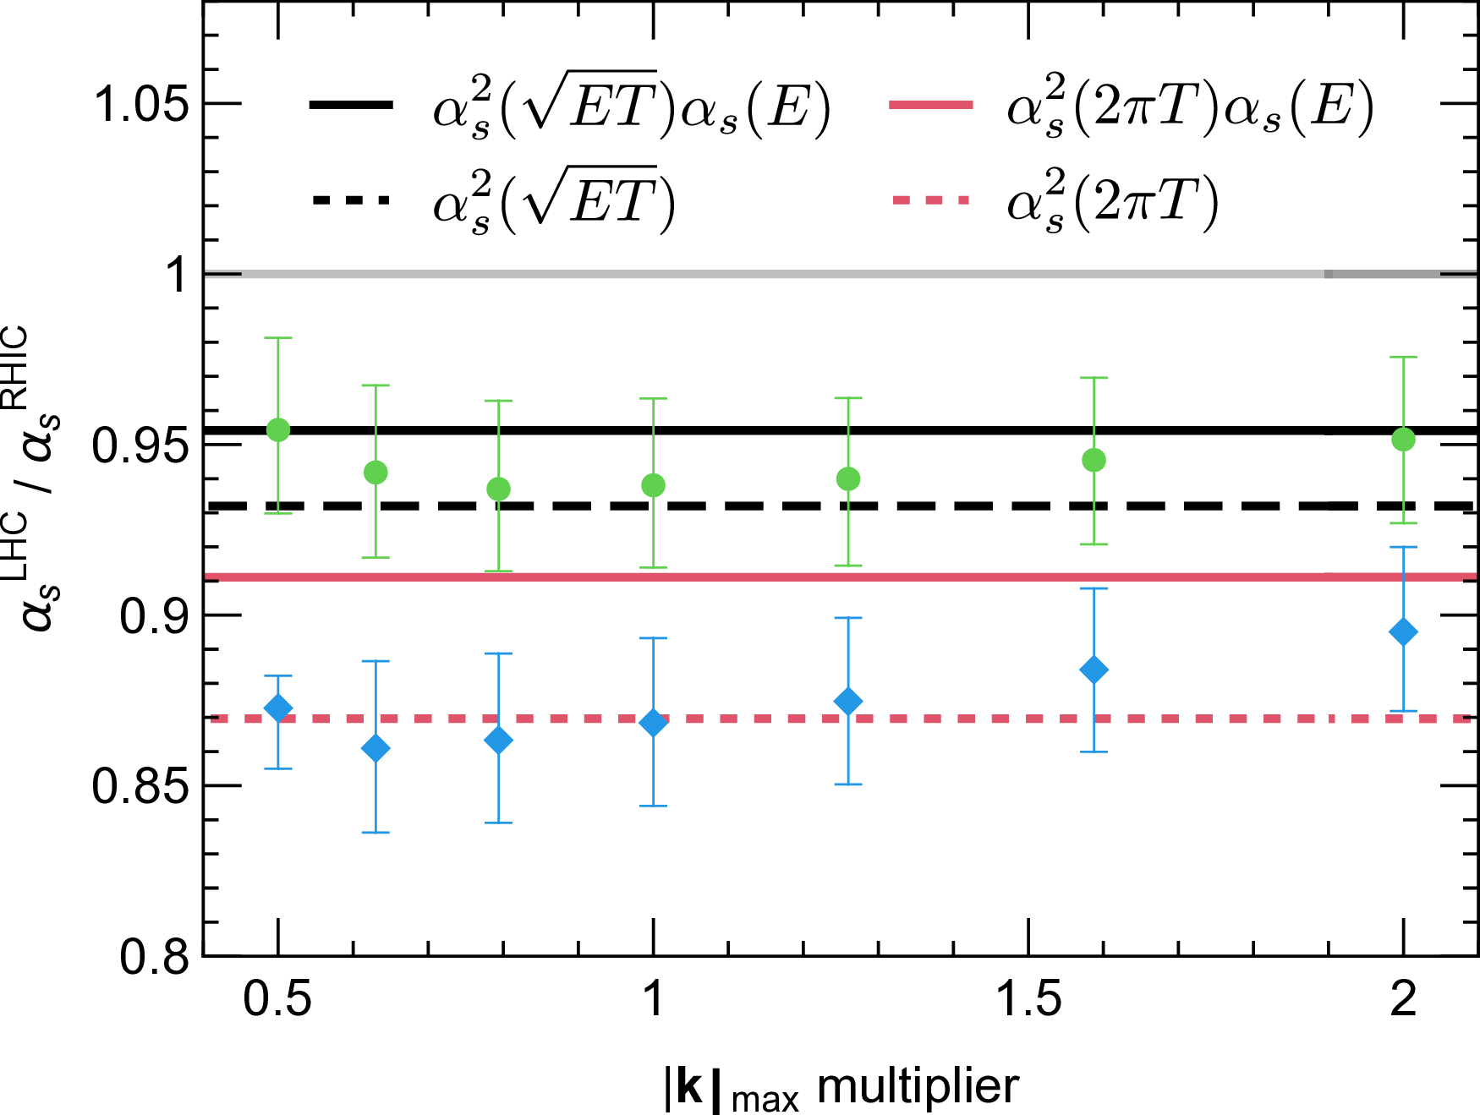

Running coupling in $\sqrt{s}$
We can similarly compare our extracted values at RHIC and LHC to constrain the temperature dependence of the running coupling
Strong sensitivity to collisional energy loss mechanism

Slide 37

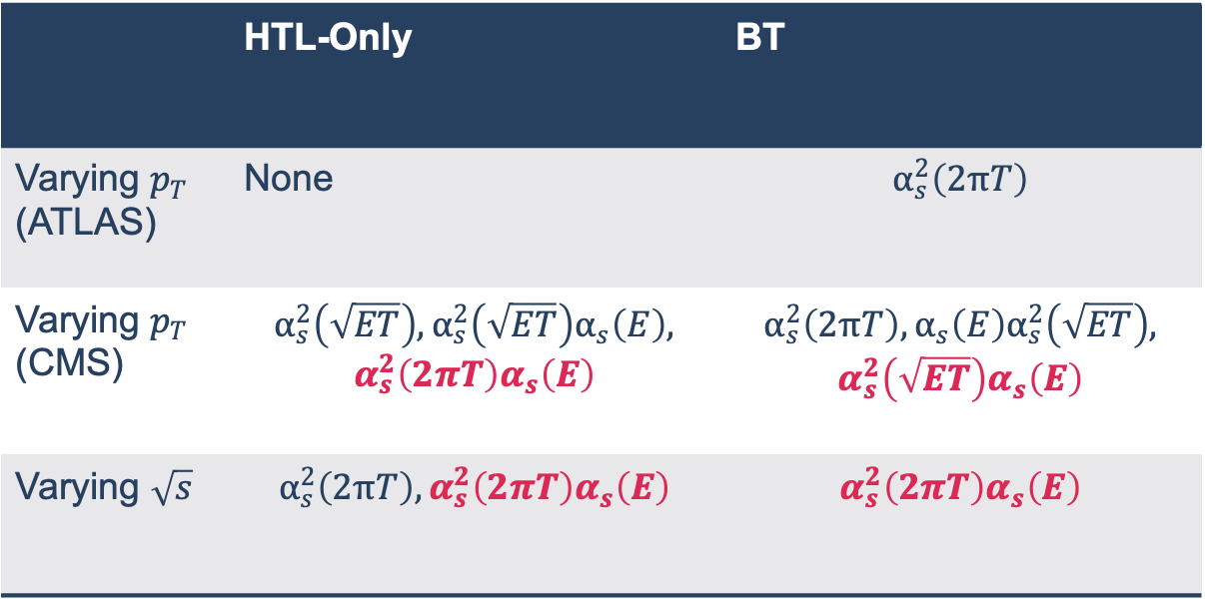
Combined $\sqrt{s}$ and $p_{T}$ constraints
Shows that this joint analysis has the potential to constrain both collisional energy loss mechanism and running coupling mechanism
Future work is required to make stronger conclusions on the scale that the coupling runs at
 | HTL-Only | BT
Varying $p_{T}$ (ATLAS) | None | $$α_{s}^{2}\left(2πT\right)$$
Varying $p_{T}$ (CMS) | $$α_{s}^{2}\left(\sqrt{ET}\right),α_{s}^{2}\left(\sqrt{ET}\right)α_{s}\left(E\right),$$ $$α_{s}^{2}\left(2πT\right)α_{s}\left(E\right)$$ | $$α_{s}^{2}\left(2πT\right), α_{s}\left(E\right)α_{s}^{2}\left(\sqrt{ET}\right),$$ $$α_{s}^{2}\left(\sqrt{ET}\right)α_{s}\left(E\right)$$
Varying $\sqrt{s}$ | $$α_{s}^{2}\left(2πT\right),α_{s}^{2}\left(2πT\right)α_{s}\left(E\right)$$ | $$α_{s}^{2}\left(2πT\right)α_{s}\left(E\right)$$

Slide 38
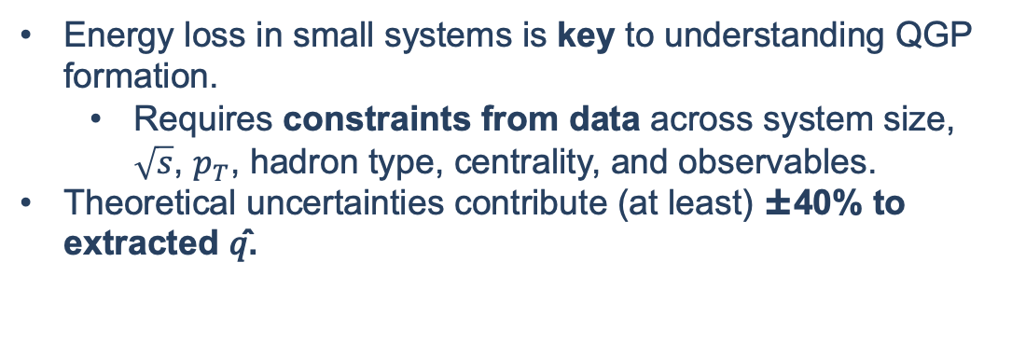
Summary
Energy loss in small systems is key to understanding QGP formation.
Requires constraints from data across system size, $\sqrt{s}$, $p_{T}$, hadron type, centrality, and observables.
Theoretical uncertainties contribute (at least) ±40% to extracted 𝑞̂.
Data subsets can test model consistency and highlight missing physics.
Provides a quick way to identify sensitive observables and potential gaps in the model.
Notes:
Data subsets can test model consistency and highlight missing physics.
Provides a quick way to identify sensitive observables and potential gaps in the model.

Slide 39
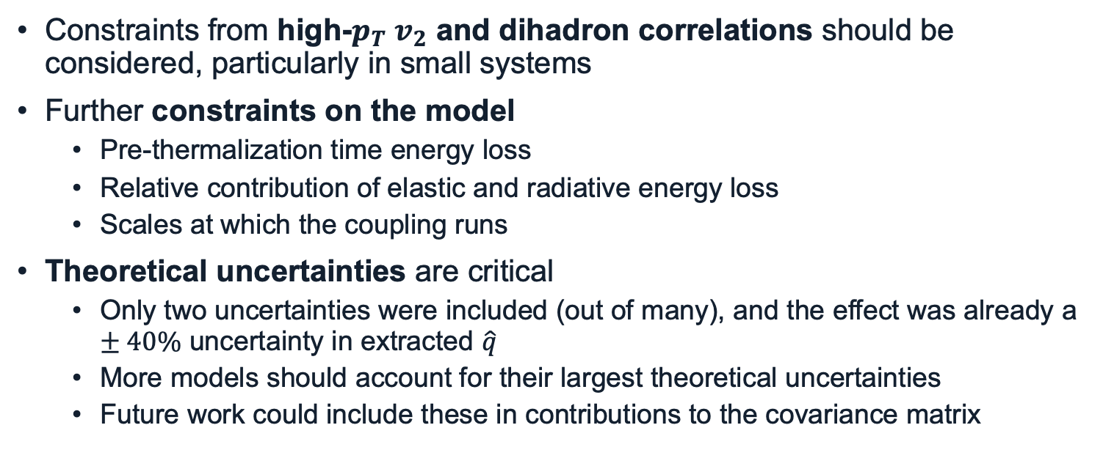
Outlook
Constraints from high-$p_{T}$ $v_{2}$ and dihadron correlations should be considered, particularly in small systems
Further constraints on the model
Pre-thermalization time energy loss
Relative contribution of elastic and radiative energy loss
Scales at which the coupling runs
Theoretical uncertainties are critical
Only two uncertainties were included (out of many), and the effect was already a $±40\%$ uncertainty in extracted $\hat{q}$
More models should account for their largest theoretical uncertainties
Future work could include these in contributions to the covariance matrix

Slide 40
Backup

Slide 41

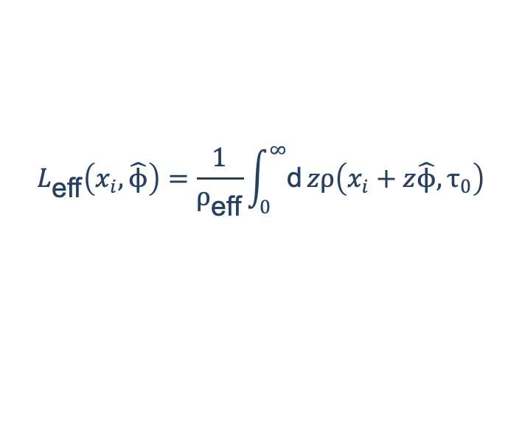

Geometry
We assume longitudinal Bjorken expansion $$T_{\text{eff}}\left(τ\right)≈T_{\text{eff}}\left(τ_{0}\right){\left(\frac{τ_{0}}{τ}\right)}^{1/3}≈T_{\text{eff}}\left(τ_{0}\right){\left(\frac{2τ_{0}}{L_{\text{eff}}}\right)}^{1/3}$$
And use the initial collision geometry to generate effective temperatures and lengths (but energy loss with full event-by-event hydrodynamic evolution is in the works!)
$$L_{\text{eff}}\left(x_{i},\hat{ϕ}\right)=\frac{1}{ρ_{\text{eff}}}\int_{0}^{∞}{\text{d}}zρ\left(x_{i}+z\hat{ϕ},τ_{0}\right)$$
$$ρ_{\text{eff}} ≡ \frac{\int{{\text{d}}^{\text{2}} x } ρ^{2}\left(x, τ_{0}\right)}{\int{{\text{d}}^{\text{2}} x }ρ\left(x, τ_{0}\right)} ⟺ T_{\text{eff}}^{3} ≡ \frac{\int{{\text{d}}^{\text{2}} x } T^{6}\left(x, τ_{0}\right)}{\int{{\text{d}}^{\text{2}} x }T^{3}\left(x, τ_{0}\right)}$$

Slide 42
Results of extraction

Slide 43

Small system suppression at RHIC
Agree within one-sigma with PHENIX centrality dependence
Note: all grey boxes are fully correlated systematic uncertainties
Moderately oversuppressed: no energy loss in the initial stage, soft / hard correlations, QGP formation turns off at some event-activity?
PHENIX, Phys. Rev. Lett. 134, 022302 (2025).

Slide 44

Predictions for RHIC system-size scan

Slide 45


Equal supp. in peripheral and small
CF and W. A. Horowitz, Phys. Lett. B 864, 139437 (2025).

Slide 46

Medium modifications to hadronization
Our model does not include medium modifications to hadronization
These effects are expected to be important at lower-$p_{T}$
Idea: vary the minimum $p_{T}$ of the data that is included in the best fit to find the $p_{T}$ at which medium effects become important

Slide 47
Medium modifications to hadronization

Slide 48

$$χ^{2}$$

Slide 49
Energy loss theoretical uncertainties

Slide 50


Radiative energy loss
We use Djordjevic-Gyulassy-Levai-Vitev (DGLV) radiative energy loss to first order in opacity:
M. Djordjevic and M. Gyulassy, Nucl. Phys. A 733, 265 (2004).
+ the short pathlength correction (SPLC)
I. Kolbé and W. A. Horowitz, Phys. Rev. C 100, 024913 (2019). CF, A. Grindrod, and W. A. Horowitz, Eur. Phys. J. C 83, 1060 (2023).

Slide 51

Large formation time approximation
The large formation time approximation is used in both DGLV and DGLV + SPLC, but it has a much larger impact for SPLC
We previously showed that this assumption is not self-consistently satisfied in either DGLV or DGLV + SPLC, but can be tamed by restricting the phase space of the radiative gluon emission.
In this work, we vary this bound up and down by factors of two to estimate the sensitivity to this constrain.
CF, A. Grindrod, and W. A. Horowitz, Eur. Phys. J. C 83, 1060 (2023).

Slide 52


Large Formation Time Assumption
Large contributions to SPL corr. at high energies from regions of phase space not allowed according to Large Formation Time assumption
Also impacts DGLV
Future work should include a full rederivation of DGLV with LFT assumption relaxed
Can implement a phenomenological cut in the phase space as well to limit assumption-violating contributions

Slide 53


Controlling the LFT approximation

Slide 54

Elastic vs Radiative E-Loss Importance
Elastic ∆ E / E ≃ α² T² log (ET)/E Radiative ∆ E / E ≃ αs ³ L² T log E / E
Strong dependence on elastic E-loss used
Small systems: elastic is ~1-3x more important than radiative

Slide 55
References for small sys. E-loss table
[1] V. Khachatryan et al. (CMS), JHEP 09, 091 (2010), arXiv:1009.4122 [hep-ex].
[2] S. Chatrchyan et al. (CMS), JHEP 07, 076 (2011), arXiv:1105.2438 [nucl-ex].
[3] G. Aad et al. (ATLAS), Phys. Rev. Lett. 110, 182302 (2013), arXiv:1212.5198 [hep-ex].
[4] B. Abelev et al. (ALICE), Phys. Lett. B 719, 29 (2013), arXiv:1212.2001 [nucl-ex].
[5] S. Chatrchyan et al. (CMS), Phys. Lett. B 718, 795 (2013), arXiv:1210.5482 [nucl-ex].
[6] S. Chatrchyan et al. (CMS), Eur. Phys. J. C 72, 2012 (2012), arXiv:1201.3158 [nucl-ex].
[7] G. Aad et al. (ATLAS), Phys. Rev. C 90, 044906 (2014), arXiv:1409.1792 [hep-ex].
[8] V. Khachatryan et al. (CMS), Phys. Rev. Lett. 116, 172302 (2016), arXiv:1510.03068 [nucl-ex].
[9] S. Acharya et al. (ALICE), Phys. Rev. Lett. 132, 172302 (2024), arXiv:2311.14357 [nucl-ex].
[10] K. Aamodt et al. (ALICE), Phys. Lett. B 708, 249 (2012), arXiv:1109.2501 [nucl-ex].
[11] G. Aad et al. (ATLAS), Phys. Rev. C 86, 014907 (2012), arXiv:1203.3087 [hep-ex].
[12] A. Adare et al. (PHENIX), Phys. Rev. Lett. 114, 192301 (2015), arXiv:1404.7461 [nucl-ex].
[13] G. Aad et al. (ATLAS), Phys. Rev. Lett. 116, 172301 (2016), arXiv:1509.04776 [hep-ex].
[14] L. Adamczyk et al. (STAR), Phys. Lett. B 747, 265 (2015), arXiv:1502.07652 [nucl-ex].
[15] J. Adam et al. (ALICE), JHEP 09, 164 (2016), arXiv:1606.06057 [nucl-ex].
[16] J. Adam et al. (ALICE), Phys. Lett. B 762, 376 (2016), arXiv:1605.02035 [nucl-ex].
[17] V. Khachatryan et al. (CMS), Phys. Lett. B 765, 193 (2017), arXiv:1606.06198 [nucl-ex].
[18] M. Aaboud et al. (ATLAS), Eur. Phys. J. C 77, 428 (2017), arXiv:1705.04176 [hep-ex].
[19] S. Acharya et al. (ALICE), JHEP 09, 032 (2017), arXiv:1707.05690 [nucl-ex].
[20] A. M. Sirunyan et al. (CMS), Phys. Rev. Lett. 120, 092301 (2018), arXiv:1709.09189 [nucl-ex].
[21] S. Acharya et al. (ALICE), JHEP 09, 006 (2018), arXiv:1805.04390 [nucl-ex].
[22] C. Aidala et al. (PHENIX), Nature Phys. 15, 214 (2019), arXiv:1805.02973 [nucl-ex].
[23] S. Acharya et al. (ALICE), Phys. Rev. Lett. 123, 142301 (2019), arXiv:1903.01790 [nucl-ex].
[24] S. Acharya et al. (ALICE), JHEP 05, 085 (2020), arXiv:2002.00633 [nucl-ex].
[25] M. I. Abdulhamid et al. (STAR), Phys. Rev. Lett. 130, 242301 (2023), arXiv:2210.11352 [nucl-ex].
[26] G. Aad et al. (ATLAS), Phys. Lett. B 707, 330 (2012), arXiv:1108.6018 [hep-ex].
[27] G. Aad et al. (ATLAS), Eur. Phys. J. C 74, 2982 (2014), arXiv:1405.3936 [hep-ex].
[28] R. Aaij et al. (LHCb), Phys. Lett. B 762, 473 (2016), arXiv:1512.00439 [nucl-ex].
[29] J. Adam et al. (ALICE), Phys. Lett. B 753, 126 (2016), arXiv:1506.08032 [nucl-ex].
[30] M. Aaboud et al. (ATLAS), Phys. Rev. C 95, 064914 (2017), arXiv:1606.08170 [hep-ex].
[31] V. Khachatryan et al. (CMS), Phys. Rev. C 96, 014915 (2017), arXiv:1604.05347 [nucl-ex].
[32] A. M. Sirunyan et al. (CMS), Phys. Rev. C 98, 044902 (2018), arXiv:1710.07864 [nucl-ex].[33] G. Aad et al. (ATLAS), (2023), arXiv:2308.16745 [nucl-ex].
[34] S. Acharya et al. (ALICE), JHEP 01, 199 (2024), arXiv:2308.16590 [nucl-ex].
[35] B. Abelev et al. (ALICE), Phys. Lett. B 719, 18 (2013), arXiv:1205.5761 [nucl-ex].
[36] B. B. Abelev et al. (ALICE), Phys. Lett. B 726, 164 (2013), arXiv:1307.3237 [nucl-ex].
[37] B. B. Abelev et al. (ALICE), JHEP 06, 190 (2015), arXiv:1405.4632 [nucl-ex].
[38] V. Khachatryan et al. (CMS), Phys. Lett. B 742, 200 (2015), arXiv:1409.3392 [nucl-ex].
[39] A. Adare et al. (PHENIX), Phys. Rev. C 97, 064904 (2018), arXiv:1710.09736 [nucl-ex].
[40] A. M. Sirunyan et al. (CMS), Phys. Rev. Lett. 121, 082301 (2018), arXiv:1804.09767 [hep-ex].
[41] S. Acharya et al. (ALICE), JHEP 05, 243 (2023), arXiv:2206.04587 [nucl-ex].
[42] A. Tumasyan et al. (CMS), JHEP 05, 007 (2023), arXiv:2205.00080 [nucl-ex].
[43] K. Aamodt et al. (ALICE), Phys. Rev. Lett. 105, 252302 (2010), arXiv:1011.3914 [nucl-ex].
[44] K. Aamodt et al. (ALICE), Phys. Rev. Lett. 107, 032301 (2011), arXiv:1105.3865 [nucl-ex].
[45] S. Chatrchyan et al. (CMS), Phys. Rev. C 87, 014902 (2013), arXiv:1204.1409 [nucl-ex].
[46] G. Aad et al. (ATLAS), Phys. Lett. B 725, 60 (2013), arXiv:1303.2084 [hep-ex].
[47] S. Chatrchyan et al. (CMS), Phys. Rev. C 89, 044906 (2014), arXiv:1310.8651 [nucl-ex].
[48] S. Chatrchyan et al. (CMS), Phys. Lett. B 724, 213 (2013), arXiv:1305.0609 [nucl-ex].
[49] G. Aad et al. (ATLAS), Eur. Phys. J. C 74, 3157 (2014), arXiv:1408.4342 [hep-ex].
[50] B. B. Abelev et al. (ALICE), Phys. Rev. C 90, 054901 (2014), arXiv:1406.2474 [nucl-ex].
[51] V. Khachatryan et al. (CMS), Phys. Rev. Lett. 115, 012301 (2015), arXiv:1502.05382 [nucl-ex].
[52] J. Adam et al. (ALICE), Phys. Rev. Lett. 116, 132302 (2016), arXiv:1602.01119 [nucl-ex].
[53] M. Aaboud et al. (ATLAS), Phys. Rev. C 97, 024904 (2018), arXiv:1708.03559 [hep-ex].
[54] A. M. Sirunyan et al. (CMS), Phys. Lett. B 776, 195 (2018), arXiv:1702.00630 [hep-ex].
[55] A. M. Sirunyan et al. (CMS), Phys. Rev. C 101, 014912 (2020), arXiv:1904.11519 [hep-ex].
[56] G. Aad et al. (ATLAS), Phys. Rev. C 90, 024905 (2014), arXiv:1403.0489 [hep-ex].
[57] G. Aad et al. (ATLAS), Phys. Rev. C 92, 034903 (2015), arXiv:1504.01289 [hep-ex].
[58] J. Adam et al. (ALICE), Phys. Rev. Lett. 117, 182301 (2016), arXiv:1604.07663 [nucl-ex].
[59] S. Acharya et al. (ALICE), Phys. Rev. C 97, 024906 (2018), arXiv:1709.01127 [nucl-ex].
[60] M. Aaboud et al. (ATLAS), Phys. Lett. B 789, 444 (2019), arXiv:1807.02012 [nucl-ex].
[61] A. M. Sirunyan et al. (CMS), Phys. Rev. C 103, 014902 (2021), arXiv:1905.09935 [hep-ex].
[62] B. Aboona et al. (STAR), Phys. Lett. B 839, 137755 (2023), arXiv:2211.11637 [nucl-ex].
[63] S. Acharya et al. (ALICE), Phys. Lett. B 773, 68 (2017), arXiv:1705.04377 [nucl-ex].
[64] A. M. Sirunyan et al. (CMS), Eur. Phys. J. C 80, 534 (2020), arXiv:1910.08789 [hep-ex].

Slide 56
References for small sys. E-loss table
[65] V. Khachatryan et al. (CMS), Phys. Rev. C 92, 034911 (2015), arXiv:1503.01692 [nucl-ex].[66] M. Aaboud et al. (ATLAS), Eur. Phys. J. C 78, 142 (2018), arXiv:1709.02301 [nucl-ex].
[67] A. M. Sirunyan et al. (CMS), Phys. Rev. C 96, 064902 (2017), arXiv:1708.07113 [nucl-ex].
[68] G. Aad et al. (ATLAS), Phys. Rev. Lett. 126, 122301 (2021), arXiv:2001.04201 [nucl-ex].
[69] S. Acharya et al. (ALICE), Phys. Rev. C 107, L051901 (2023), arXiv:2206.04574 [nucl-ex].
[70] G. Aad et al. (ATLAS), JHEP 11, 183 (2013), arXiv:1305.2942 [hep-ex].
[71] A. M. Sirunyan et al. (CMS), Phys. Lett. B 789, 643 (2019), arXiv:1711.05594 [nucl-ex].
[72] S. Acharya et al. (ALICE), JHEP 07, 103 (2018), arXiv:1804.02944 [nucl-ex].
[73] G. Aad et al. (ATLAS), Eur. Phys. J. C 79, 985 (2019), arXiv:1907.05176 [nucl-ex].
[74] S. Acharya et al. (ALICE), Phys. Lett. B 834, 137393 (2022), arXiv:2111.06106 [nucl-ex].
[75] B. Abelev et al. (ALICE), Phys. Rev. Lett. 111, 232302 (2013), arXiv:1306.4145 [nucl-ex].
[76] B. Abelev et al. (ALICE), Phys. Lett. B 723, 267 (2013), arXiv:1301.3756 [nucl-ex].
[77] J. Adam et al. (ALICE), Eur. Phys. J. C 76, 86 (2016), arXiv:1509.07255 [nucl-ex].
[78] J. Adam et al. (ALICE), Phys. Rev. C 93, 044903 (2016), arXiv:1512.05739 [nucl-ex].
[79] V. Khachatryan et al. (CMS), Phys. Rev. Lett. 118, 122301 (2017), arXiv:1610.00263 [nucl-ex].
[80] S. Acharya et al. (ALICE), Phys. Lett. B 777, 151 (2018), arXiv:1709.04723 [nucl-ex].
[81] A. M. Sirunyan et al. (CMS), Phys. Rev. C 100, 064908 (2019), arXiv:1708.08901 [nucl-ex].
[82] A. M. Sirunyan et al. (CMS), Phys. Rev. C 97, 044912 (2018), arXiv:1708.01602 [nucl-ex].
[83] B. Abelev et al. (ALICE), Phys. Rev. Lett. 109, 252301 (2012), arXiv:1208.1974 [hep-ex].
[84] S. Chatrchyan et al. (CMS), Eur. Phys. J. C 72, 2164 (2012), arXiv:1207.4724 [hep-ex].
[85] B. B. Abelev et al. (ALICE), Phys. Lett. B 728, 25 (2014), arXiv:1307.6796 [nucl-ex].
[86] B. Abelev et al. (ALICE), Phys. Rev. C 88, 044910 (2013), arXiv:1303.0737 [hep-ex].
[87] S. Chatrchyan et al. (CMS), Eur. Phys. J. C 74, 2847 (2014), arXiv:1307.3442 [hep-ex].
[88] C. Andrei (ALICE), Nucl. Phys. A 931, 888 (2014), arXiv:1408.0093 [hep-ex].
[89] J. Adam et al. (ALICE), Phys. Lett. B 758, 389 (2016), arXiv:1512.07227 [nucl-ex].
[90] J. Adam et al. (ALICE), Eur. Phys. J. C 76, 245 (2016), arXiv:1601.07868 [nucl-ex].
[91] S. Acharya et al. (ALICE), Eur. Phys. J. C 77, 658 (2017), arXiv:1707.07304 [nucl-ex].
[92] J. Adam et al. (ALICE), Phys. Rev. C 95, 064606 (2017), arXiv:1702.00555 [nucl-ex].
[93] S. Acharya et al. (ALICE), Phys. Rev. C 99, 024906 (2019), arXiv:1807.11321 [nucl-ex].
[94] S. Acharya et al. (ALICE), Phys. Rev. C 101, 044907 (2020), arXiv:1910.07678 [nucl-ex].
[95] B. B. Abelev et al. (ALICE), Phys. Rev. Lett. 111, 222301 (2013), arXiv:1307.5530 [nucl-ex].
[96] B. B. Abelev et al. (ALICE), Phys. Rev. C 91, 024609 (2015), arXiv:1404.0495 [nucl-ex].
[97] J. Adam et al. (ALICE), Phys. Lett. B 768, 203 (2017), arXiv:1506.09206 [nucl-ex].
[98] J. Adam et al. (ALICE), Phys. Lett. B 760, 720 (2016), arXiv:1601.03658 [nucl-ex].[99] V. Khachatryan et al. (CMS), Phys. Lett. B 768, 103 (2017), arXiv:1605.06699 [nucl-ex].
[100] B. B. Abelev et al. (ALICE), Phys. Lett. B 728, 216 (2014), [Erratum: Phys.Lett.B 734, 409–410
(2014)], arXiv:1307.5543 [nucl-ex].
[101] J. Adam et al. (ALICE), Nature Phys. 13, 535 (2017), arXiv:1606.07424 [nucl-ex].
[102] S. Acharya et al. (ALICE), Eur. Phys. J. C 80, 693 (2020), arXiv:2003.02394 [nucl-ex].
[103] S. Acharya et al. (ALICE), Eur. Phys. J. C 81, 584 (2021), arXiv:2101.03100 [nucl-ex].
[104] S. Acharya et al. (ALICE), Eur. Phys. J. C 84, 813 (2024), arXiv:2211.04384 [nucl-ex].
[105] K. Aamodt et al. (ALICE), Phys. Rev. D 84, 112004 (2011), arXiv:1101.3665 [hep-ex].
[106] B. B. Abelev et al. (ALICE), Phys. Lett. B 739, 139 (2014), arXiv:1404.1194 [nucl-ex].
[107] J. Adam et al. (ALICE), Phys. Rev. C 91, 034906 (2015), arXiv:1502.00559 [nucl-ex].
[108] J. Adam et al. (ALICE), Phys. Rev. C 92, 054908 (2015), arXiv:1506.07884 [nucl-ex].
[109] J. Adam et al. (ALICE), Phys. Rev. C 93, 024905 (2016), arXiv:1507.06842 [nucl-ex].
[110] M. Aaboud et al. (ATLAS), Phys. Rev. C 96, 064908 (2017), arXiv:1704.01621 [hep-ex].
[111] S. Acharya et al. (ALICE), Phys. Rev. C 96, 064613 (2017), arXiv:1709.01731 [nucl-ex].
[112] A. Tumasyan et al. (CMS), Phys. Lett. B 857, 138936 (2024), arXiv:2301.05290 [nucl-ex].
[113] A. Tumasyan et al. (CMS), Phys. Rev. C 109, 024914 (2024), arXiv:2306.11574 [nucl-ex].
[114] J. Adam et al. (ALICE), Phys. Lett. B 754, 235 (2016), arXiv:1509.07324 [nucl-ex].
[115] S. Acharya et al. (ALICE), Phys. Rev. C 99, 024912 (2019), arXiv:1803.09857 [nucl-ex].
[116] S. Acharya et al. (ALICE), (2023), arXiv:2308.16704 [nucl-ex].
[117] G. Aad et al. (ATLAS), Eur. Phys. J. C 80, 73 (2020), arXiv:1910.13978 [nucl-ex].
[118] M. Aaboud et al. (ATLAS), Eur. Phys. J. C 80, 64 (2020), arXiv:1906.08290 [nucl-ex].
[119] G. Aad et al. (ATLAS), Phys. Rev. Lett. 131, 162301 (2023), arXiv:2303.17357 [nucl-ex].
[120] S. Acharya et al. (ALICE), JHEP 08, 234 (2024), arXiv:2212.12609 [nucl-ex].
[121] A. Hayrapetyan et al. (CMS), Phys. Rev. Lett. 133, 142301 (2024), arXiv:2312.17103 [hep-ex].
[122] K. Aamodt et al. (ALICE), Phys. Lett. B 696, 30 (2011), arXiv:1012.1004 [nucl-ex].
[123] B. Abelev et al. (ALICE), JHEP 09, 112 (2012), arXiv:1203.2160 [nucl-ex].
[124] B. Abelev et al. (ALICE), Phys. Lett. B 720, 52 (2013), arXiv:1208.2711 [hep-ex].
[125] S. Chatrchyan et al. (CMS), Eur. Phys. J. C 72, 1945 (2012), arXiv:1202.2554 [nucl-ex].
[126] G. Aad et al. (ATLAS), Phys. Lett. B 748, 392 (2015), arXiv:1412.4092 [hep-ex].
[127] G. Aad et al. (ATLAS), Phys. Rev. Lett. 114, 072302 (2015), arXiv:1411.2357 [hep-ex].
[128] G. Aad et al. (ATLAS), JHEP 09, 050 (2015), arXiv:1504.04337 [hep-ex].

Slide 57
References for small sys. E-loss table
[158] S. Chatrchyan et al. (CMS), Phys. Rev. Lett. 109, 022301 (2012), arXiv:1204.1850 [nucl-ex].
[159] G. Aad et al. (ATLAS), Phys. Rev. C 105, 064903 (2022), arXiv:2111.06606 [nucl-ex].
[160] A. Tumasyan et al. (CMS), JHEP 07, 139 (2023), arXiv:2210.08325 [hep-ex].
[161] E. Abbas et al. (ALICE), Phys. Rev. Lett. 111, 162301 (2013), arXiv:1303.5880 [nucl-ex].
[162] B. Abelev et al. (ALICE), Phys. Rev. Lett. 111, 102301 (2013), arXiv:1305.2707 [nucl-ex].[163] B. B. Abelev et al. (ALICE), Phys. Rev. C 90, 034904 (2014), arXiv:1405.2001 [nucl-ex].
[164] J. Adam et al. (ALICE), Phys. Lett. B 753, 41 (2016), arXiv:1507.03134 [nucl-ex].
[165] J. Adam et al. (ALICE), Eur. Phys. J. C 77, 245 (2017), arXiv:1605.06963 [nucl-ex].
[166] J. Adam et al. (ALICE), JHEP 09, 028 (2016), arXiv:1606.00321 [nucl-ex].
[167] V. Khachatryan et al. (CMS), Eur. Phys. J. C 77, 252 (2017), arXiv:1610.00613 [nucl-ex].
[168] S. Acharya et al. (ALICE), Phys. Rev. Lett. 120, 102301 (2018), arXiv:1707.01005 [nucl-ex].
[169] S. Acharya et al. (ALICE), Phys. Lett. B 780, 7 (2018), arXiv:1709.06807 [nucl-ex].
[170] S. Acharya et al. (ALICE), Phys. Rev. Lett. 119, 242301 (2017), arXiv:1709.05260 [nucl-ex].
[171] A. M. Sirunyan et al. (CMS), Phys. Rev. Lett. 120, 202301 (2018), arXiv:1708.03497 [nucl-ex].
[172] S. Acharya et al. (ALICE), Phys. Rev. Lett. 122, 072301 (2019), arXiv:1805.04367 [nucl-ex].
[173] S. Acharya et al. (ALICE), JHEP 10, 141 (2020), arXiv:2005.14518 [nucl-ex].
[174] G. Aad et al. (ATLAS), Phys. Lett. B 807, 135595 (2020), arXiv:2003.03565 [nucl-ex].
[175] A. M. Sirunyan et al. (CMS), Phys. Lett. B 813, 136036 (2021), arXiv:2009.07065 [hep-ex].
[176] A. Tumasyan et al. (CMS), Phys. Rev. Lett. 129, 022001 (2022), arXiv:2112.12236 [hep-ex].
[177] S. Acharya et al. (ALICE), Phys. Lett. B 846, 137782 (2023), arXiv:2210.08980 [nucl-ex].
[178] A. Tumasyan et al. (CMS), Phys. Lett. B 850, 138389 (2024), arXiv:2212.01636 [nucl-ex].
[179] A. Tumasyan et al. (CMS), JHEP 10, 115 (2023), arXiv:2305.16928 [hep-ex].
[180] A. Tumasyan et al. (CMS), Phys. Lett. B 850, 138518 (2024), arXiv:2310.03233 [hep-ex].
[181] S. Acharya et al. (ALICE), Phys. Rev. Lett. 123, 192301 (2019), arXiv:1907.03169 [nucl-ex].
[182] G. Aad et al. (ATLAS), Phys. Rev. Lett. 124, 082301 (2020), arXiv:1909.01650 [nucl-ex].
[183] A. M. Sirunyan et al. (CMS), Phys. Lett. B 819, 136385 (2021), arXiv:2006.07707 [hep-ex].
[184] B. Abelev et al. (ALICE), Phys. Rev. Lett. 109, 072301 (2012), arXiv:1202.1383 [hep-ex].
[185] S. Chatrchyan et al. (CMS), JHEP 05, 063 (2012), arXiv:1201.5069 [nucl-ex].
[186] S. Chatrchyan et al. (CMS), Phys. Rev. Lett. 109, 222301 (2012), [Erratum: Phys.Rev.Lett. 120,
199903 (2018)], arXiv:1208.2826 [nucl-ex].
[187] B. B. Abelev et al. (ALICE), JHEP 02, 073 (2014), arXiv:1308.6726 [nucl-ex].
[188] S. Chatrchyan et al. (CMS), JHEP 04, 103 (2014), arXiv:1312.6300 [nucl-ex].
[129] J. Adam et al. (ALICE), Phys. Lett. B 746, 1 (2015), arXiv:1502.01689 [nucl-ex].
[130] V. Khachatryan et al. (CMS), Eur. Phys. J. C 75, 237 (2015), arXiv:1502.05387 [nucl-ex].[131] J. Adam et al. (ALICE), (2016), 10.1140/epjc/s10052-016-4107-8, arXiv:1603.03402 [nucl-ex].
[132] V. Khachatryan et al. (CMS), JHEP 04, 039 (2017), arXiv:1611.01664 [nucl-ex].
[133] A. M. Sirunyan et al. (CMS), Phys. Lett. B 772, 306 (2017), arXiv:1612.08972 [nucl-ex].
[134] S. Acharya et al. (ALICE), Phys. Lett. B 793, 420 (2019), arXiv:1805.05212 [nucl-ex].
[135] S. Acharya et al. (ALICE), Phys. Lett. B 788, 166 (2019), arXiv:1805.04399 [nucl-ex].
[136] S. Acharya et al. (ALICE), JHEP 11, 013 (2018), arXiv:1802.09145 [nucl-ex].
[137] A. M. Sirunyan et al. (CMS), JHEP 10, 138 (2018), arXiv:1809.00201 [hep-ex].
[138] G. Aad et al. (ATLAS), JHEP 07, 074 (2023), arXiv:2211.15257 [hep-ex].
[139] G. Aad et al. (ATLAS), Phys. Lett. B 846, 138154 (2023), arXiv:2303.10090 [nucl-ex].
[140] G. Aad et al. (ATLAS), Phys. Rev. Lett. 105, 252303 (2010), arXiv:1011.6182 [hep-ex].
[141] S. Chatrchyan et al. (CMS), Phys. Rev. C 84, 024906 (2011), arXiv:1102.1957 [nucl-ex].
[142] S. Chatrchyan et al. (CMS), Eur. Phys. J. C 74, 2951 (2014), arXiv:1401.4433 [nucl-ex].
[143] V. Khachatryan et al. (CMS), JHEP 11, 055 (2016), arXiv:1609.02466 [nucl-ex].
[144] A. M. Sirunyan et al. (CMS), Phys. Rev. Lett. 120, 142302 (2018), arXiv:1708.09429 [nucl-ex].
[145] A. M. Sirunyan et al. (CMS), JHEP 03, 181 (2018), arXiv:1802.00707 [hep-ex].
[146] A. M. Sirunyan et al. (CMS), JHEP 05, 116 (2021), arXiv:2101.04720 [hep-ex].
[147] G. Aad et al. (ATLAS), Phys. Rev. C 108, 024906 (2023), arXiv:2302.03967 [nucl-ex].
[148] J. Adam et al. (ALICE), JHEP 09, 170 (2015), arXiv:1506.03984 [nucl-ex].
[149] J. Adam et al. (ALICE), Phys. Lett. B 763, 238 (2016), arXiv:1608.07201 [nucl-ex].
[150] M. Aaboud et al. (ATLAS), Phys. Lett. B 774, 379 (2017), arXiv:1706.09363 [hep-ex].
[151] S. Acharya et al. (ALICE), Phys. Lett. B 783, 95 (2018), arXiv:1712.05603 [nucl-ex].
[152] A. M. Sirunyan et al. (CMS), Phys. Lett. B 785, 14 (2018), arXiv:1711.09738 [nucl-ex].
[153] A. M. Sirunyan et al. (CMS), Phys. Rev. Lett. 119, 082301 (2017), arXiv:1702.01060 [nucl-ex].
[154] A. M. Sirunyan et al. (CMS), JHEP 05, 006 (2018), arXiv:1803.00042 [nucl-ex].
[155] A. M. Sirunyan et al. (CMS), Phys. Rev. Lett. 121, 242301 (2018), arXiv:1801.04895 [hep-ex].
[156] G. Aad et al. (ATLAS), Phys. Rev. Lett. 131, 072301 (2023), arXiv:2206.01138 [nucl-ex].
[157] G. Aad et al. (ATLAS), Phys. Rev. C 107, 054908 (2023), [Erratum: Phys.Rev.C 109, 029901
(2024)], arXiv:2205.00682 [nucl-ex].

Slide 58
References for small sys. E-loss table
[189] B. B. Abelev et al. (ALICE), Phys. Lett. B 740, 105 (2015), arXiv:1410.2234 [nucl-ex].
[190] B. B. Abelev et al. (ALICE), JHEP 12, 073 (2014), arXiv:1405.3796 [nucl-ex].
[191] J. Adam et al. (ALICE), JHEP 06, 055 (2015), arXiv:1503.07179 [nucl-ex].
[192] J. Adam et al. (ALICE), JHEP 05, 179 (2016), arXiv:1506.08804 [nucl-ex].
[193] J. Adam et al. (ALICE), JHEP 11, 127 (2015), arXiv:1506.08808 [nucl-ex].
[194] J. Adam et al. (ALICE), JHEP 07, 051 (2015), arXiv:1504.07151 [nucl-ex].[195] J. Adam et al. (ALICE), JHEP 06, 050 (2016), arXiv:1603.02816 [nucl-ex].
[196] J. Adam et al. (ALICE), Phys. Lett. B 766, 212 (2017), arXiv:1606.08197 [nucl-ex].
[197] V. Khachatryan et al. (CMS), Phys. Lett. B 770, 357 (2017), arXiv:1611.01510 [nucl-ex].
[198] A. M. Sirunyan et al. (CMS), Phys. Rev. Lett. 118, 162301 (2017), arXiv:1611.01438 [nucl-ex].
[199] M. Aaboud et al. (ATLAS), Eur. Phys. J. C 78, 171 (2018), arXiv:1709.03089 [nucl-ex].
[200] R. Aaij et al. (LHCb), Phys. Lett. B 774, 159 (2017), arXiv:1706.07122 [hep-ex].
[201] D. Adamová et al. (ALICE), Phys. Lett. B 776, 91 (2018), arXiv:1704.00274 [nucl-ex].
[202] A. M. Sirunyan et al. (CMS), Eur. Phys. J. C 78, 509 (2018), [Erratum: Eur.Phys.J.C 83, 145
(2023)], arXiv:1712.08959 [nucl-ex].
[203] A. M. Sirunyan et al. (CMS), Phys. Rev. Lett. 120, 142301 (2018), arXiv:1706.05984 [hep-ex].
[204] A. M. Sirunyan et al. (CMS), Eur. Phys. J. C 77, 269 (2017), arXiv:1702.01462 [nucl-ex].
[205] S. Acharya et al. (ALICE), JHEP 07, 160 (2018), arXiv:1805.04381 [nucl-ex].
[206] S. Acharya et al. (ALICE), Eur. Phys. J. C 78, 466 (2018), arXiv:1802.00765 [nucl-ex].
[207] S. Acharya et al. (ALICE), Phys. Lett. B 790, 89 (2019), arXiv:1805.04387 [nucl-ex].
[208] M. Aaboud et al. (ATLAS), Eur. Phys. J. C 78, 762 (2018), arXiv:1805.04077 [nucl-ex].
[209] A. M. Sirunyan et al. (CMS), Phys. Lett. B 790, 270 (2019), arXiv:1805.09215 [hep-ex].
[210] S. Acharya et al. (ALICE), Phys. Lett. B 806, 135486 (2020), arXiv:1910.14405 [nucl-ex].
[211] J. Adam et al. (STAR), Phys. Lett. B 797, 134917 (2019), arXiv:1905.13669 [nucl-ex].
[212] S. Acharya et al. (ALICE), Phys. Lett. B 822, 136579 (2021), arXiv:2011.05758 [nucl-ex].
[213] S. Acharya et al. (ALICE), Phys. Rev. Lett. 132, 042301 (2024), arXiv:2210.08893 [nucl-ex].
[214] S. Acharya et al. (ALICE), JHEP 07, 137 (2023), arXiv:2211.14153 [nucl-ex].
[215] G. Aad et al. (ATLAS), Phys. Rev. C 107, 054912 (2023), arXiv:2205.03042 [nucl-ex].
[216] A. Tumasyan et al. (CMS), Phys. Lett. B 835, 137397 (2022), arXiv:2202.11807 [hep-ex].
[217] S. Acharya et al. (ALICE), Phys. Lett. B 849, 138451 (2024), arXiv:2303.13361 [nucl-ex].
[218] S. Acharya et al. (ALICE), JHEP 02, 066 (2024), arXiv:2308.16125 [nucl-ex].
[219] A. Tumasyan et al. (CMS), Phys. Rev. Lett. 133, 022302 (2024), arXiv:2303.17026 [hep-ex].

