Slide 1




Heavy Flavour Energy Loss in Small and Large Systems
Coleridge Faraday
University of Cape Town, South Africa
frdcol002@myuct.ac.za
Strangeness in Quark Matter - 4th of June 2024
Based on CF, A. Grindrod, W. A. Horowitz arXiv:2305.13182;
CF, W. A. Horowitz in prep.

Slide 2
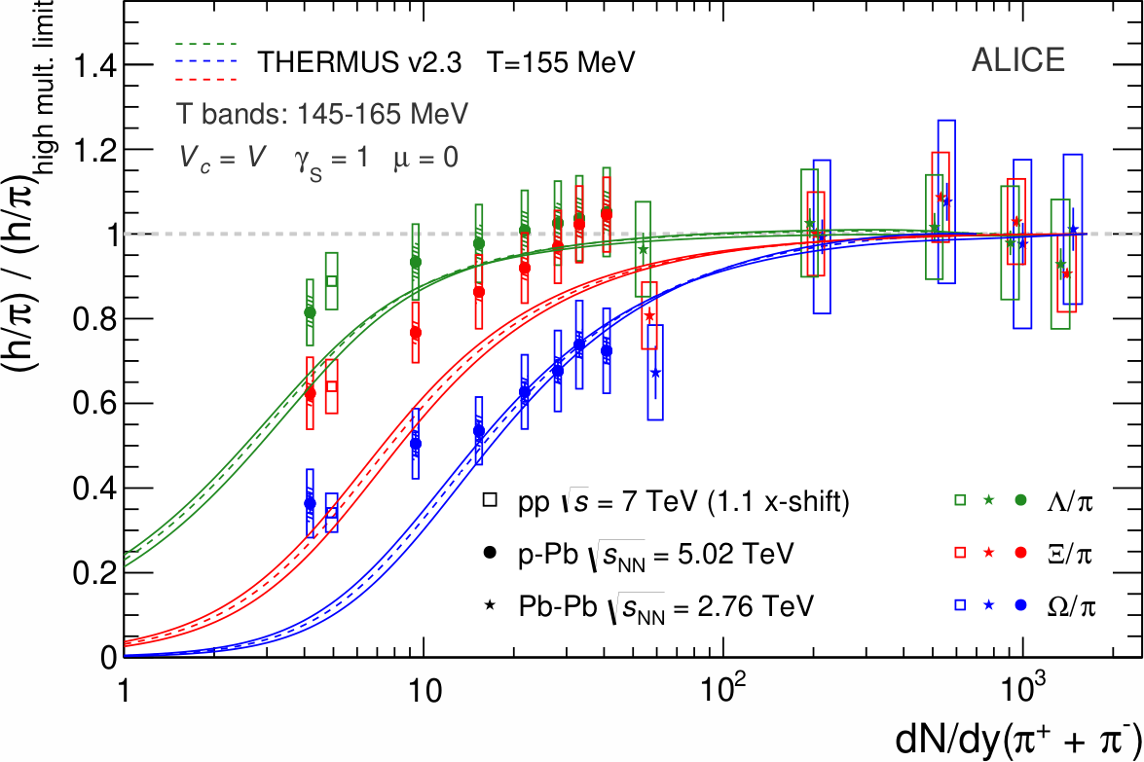
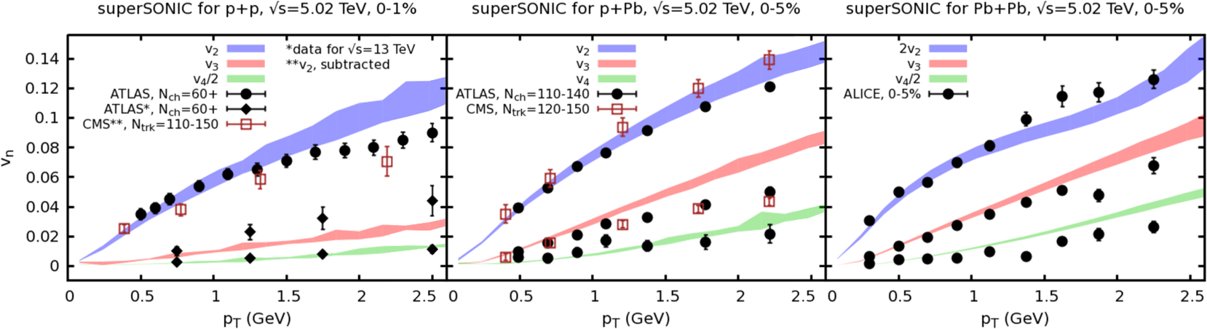
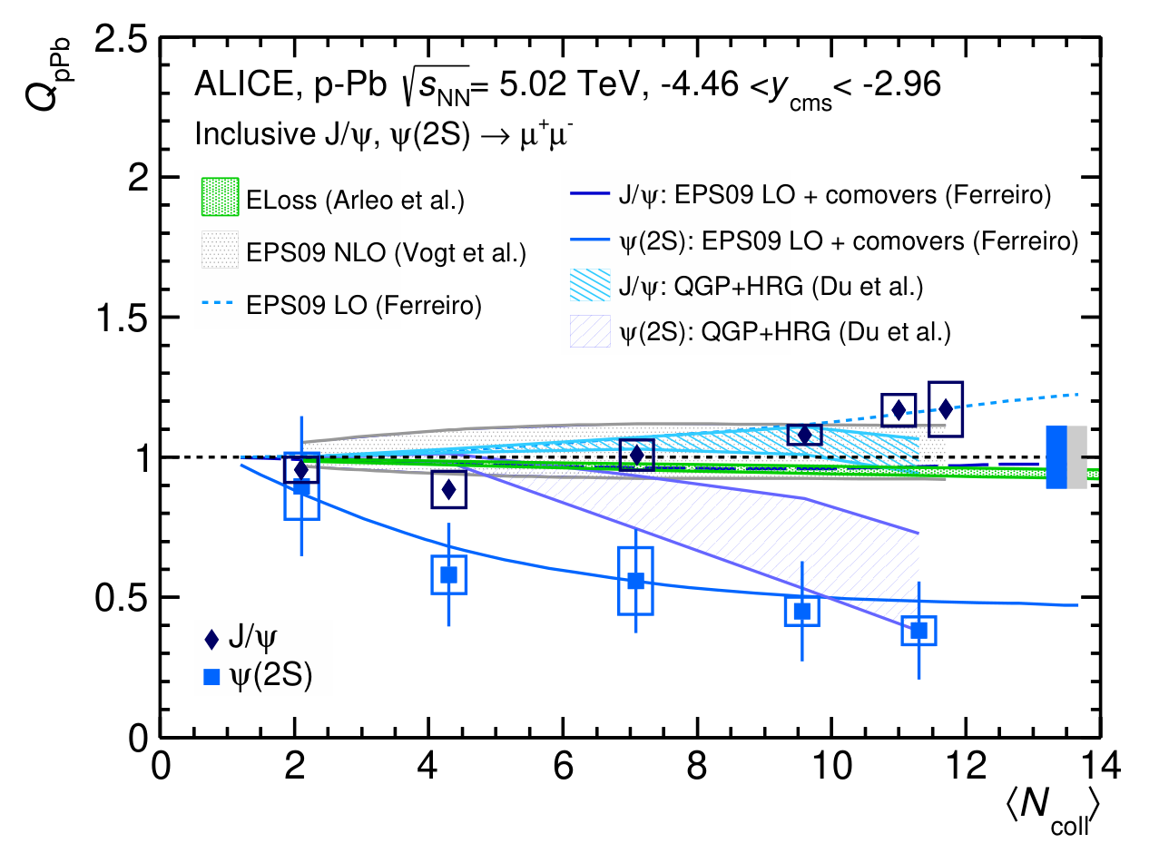
QGP Formation in Small Systems?
Signatures of QGP formation in high multiplicity pp, p / d / ³He + A
Strangeness enhancement
ALICE, PLB 758 (2016) 389-401
Quarkonium suppression
Elliptic flow
Weller et al., PLB 774 (2017) 351-356
ALICE, JHEP 06 (2016) 050

Slide 3
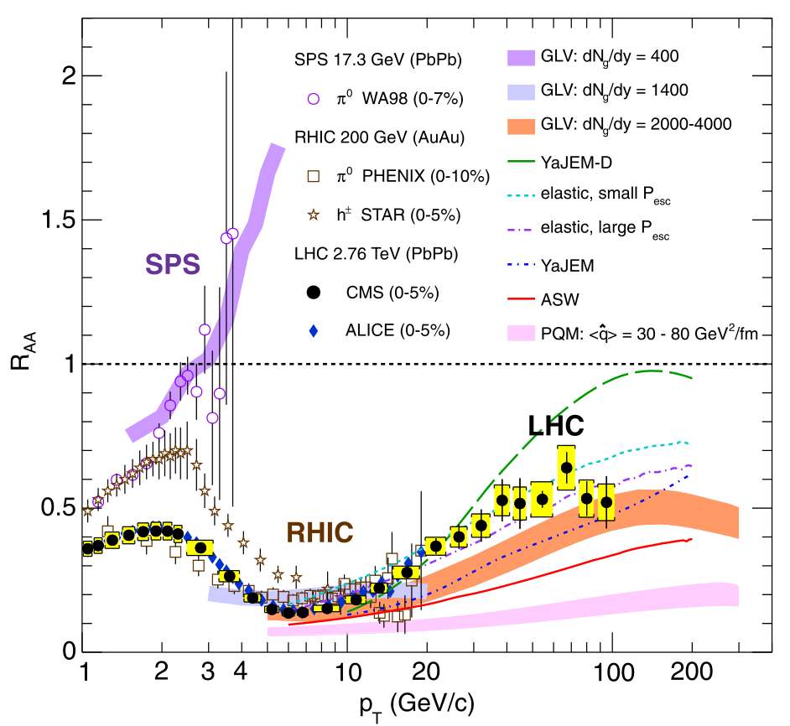
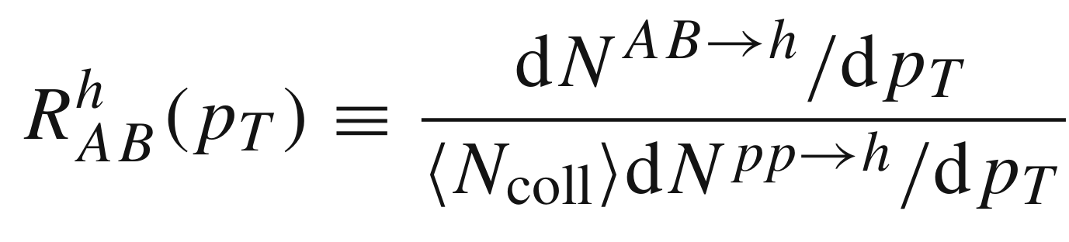
Nuclear Modification Factor
Qualitative success of pQCD energy loss models in large systems
If QGP forms in small systems, then we should also see suppression?

Slide 4
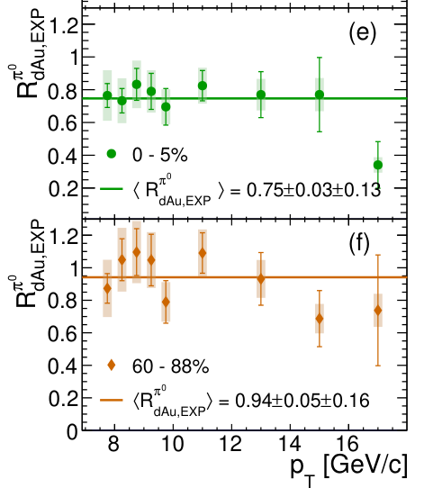
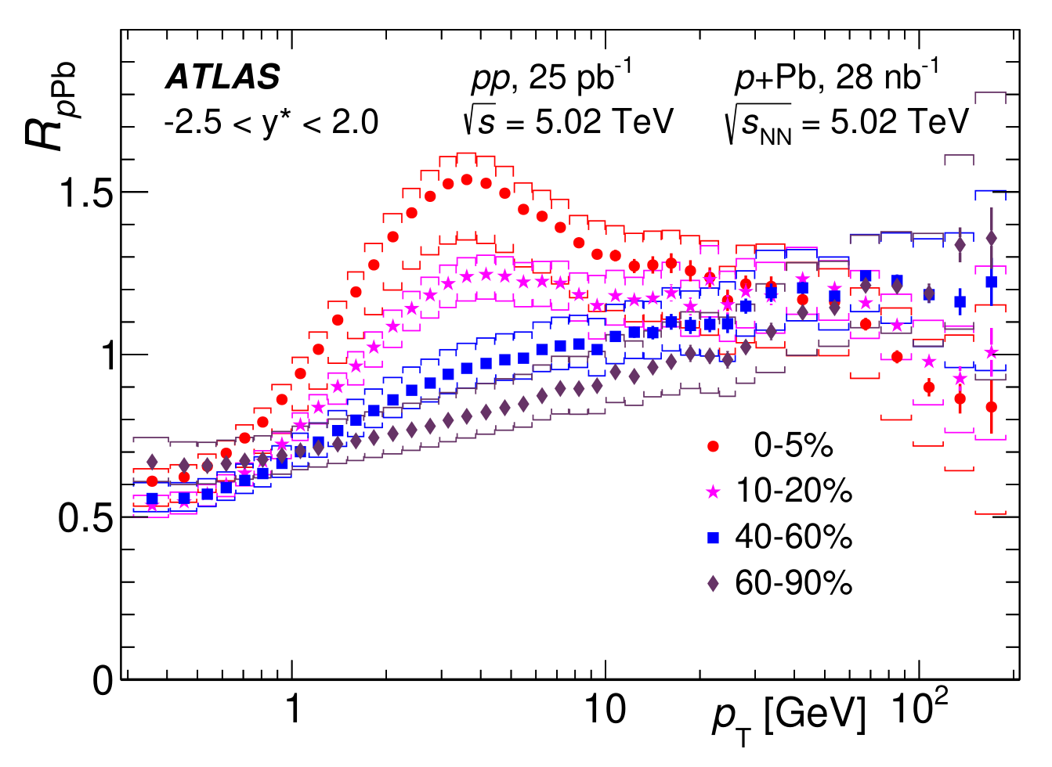
Nuclear Modification in Small Systems
Small system suppression pattern not as clear
Direct γ
Apparent tension between RHIC and LHC suppression results?
RpA is difficult to measure due to centrality bias
No suppression!
Glauber
Suppression ~0.75!
→ Theoretical input needed
ATLAS, JHEP 07 (2023) 074
PHENIX, arXiv:2303.12899 (2023)

Slide 5
Energy Loss Models in Small Systems
HTL, Braaten + Thoma
Theory RpA is difficult too!
Central limit theorem
Elastic
E-loss
Braaten and Thoma, PRD 44 (1991) R2625
Prethermalization E-loss is uncertain
Collision
Geometry
Bricks
of (L, T)
Total
E-Loss
RAA
IP-Glasma
+ Bjorken expansion
Djordjevic and Gyulassy, Nucl. Phys. A 733 (2004) 265-298
Schenke et al., PRC 102 (2020) 044905
Radiative
E-loss
DGLV, 1st order in opacity
Neglected terms ~ e^{− μ L}

Slide 6
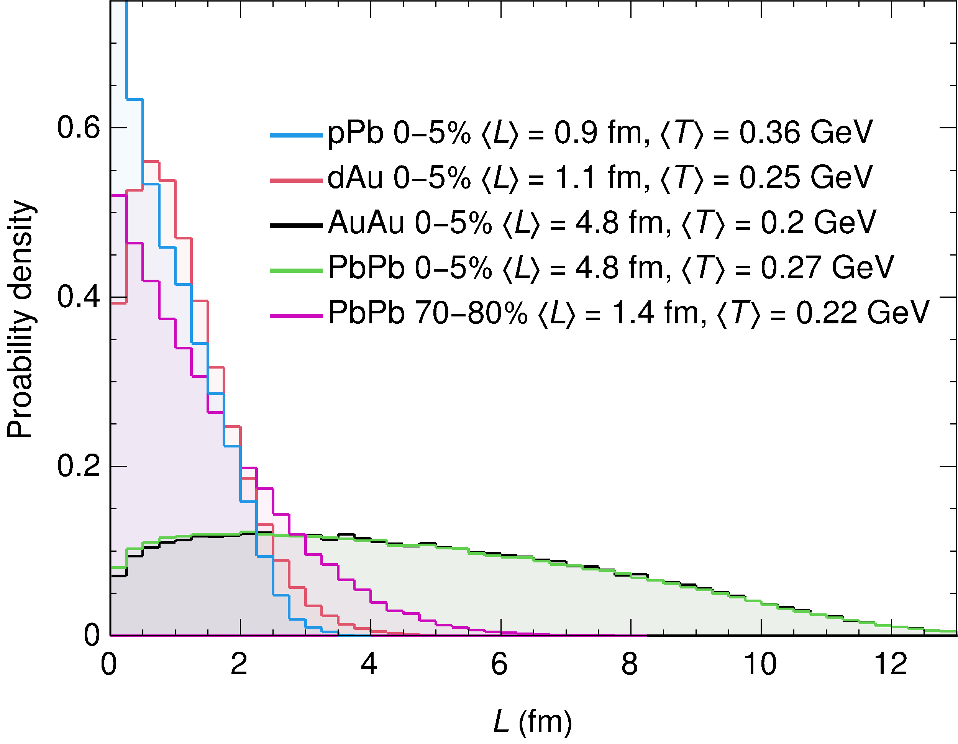
What do Small QGP’s Look Like?
Small system ⟨L⟩ ~ 1 fm comparable to peripheral AA
Small systems have L/λ ∼ 1
Central limit theorem inapplicable (elastic)
Multiple soft scatter approaches inapplicable
Large systems have L/λ ∼ 5
Central limit theorem still dubious?

Slide 7
Energy Loss Models in Small Systems
Central limit theorem
Elastic
E-loss
HTL, Braaten + Thoma
Prethermalization E-loss uncertain
Collision
Geometry
Bricks
of (L, T)
Total
E-Loss
RAA
IP-Glasma
+ Bjorken expansion
Radiative
E-loss
DGLV, 1st order in opacity
Neglected terms ~ e^{− μ L}

Slide 8
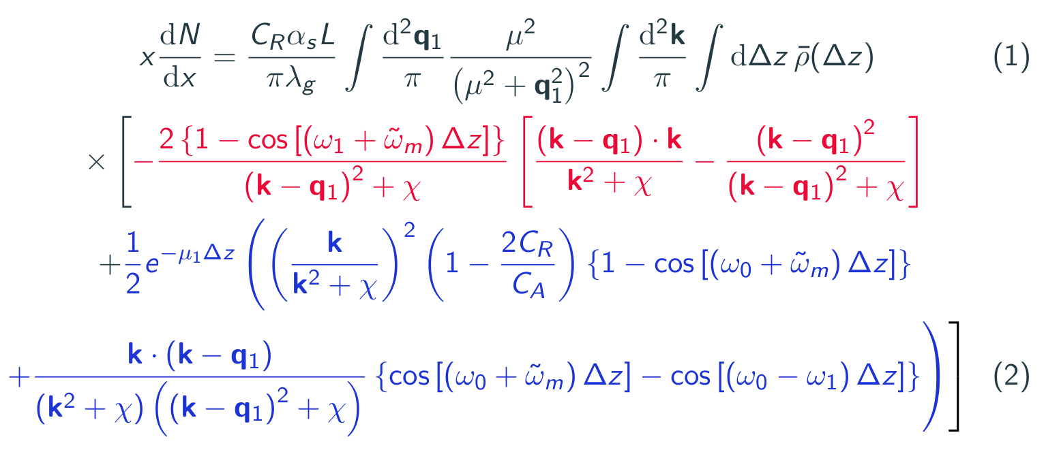
Short pathlength (SPL) Corr. to DGLV
DGLV 1st order in opacity
Suppressed for large L
Djordjevic and Gyulassy, Nucl. Phys. A 733 (2004) 265-298
SPL corr.
Kolbe & Horowitz, PRC 100 (2019) 024913
Breaking of colour triviality
→ we’ll see this can lead to excessively large corr. for gluons!

Slide 9
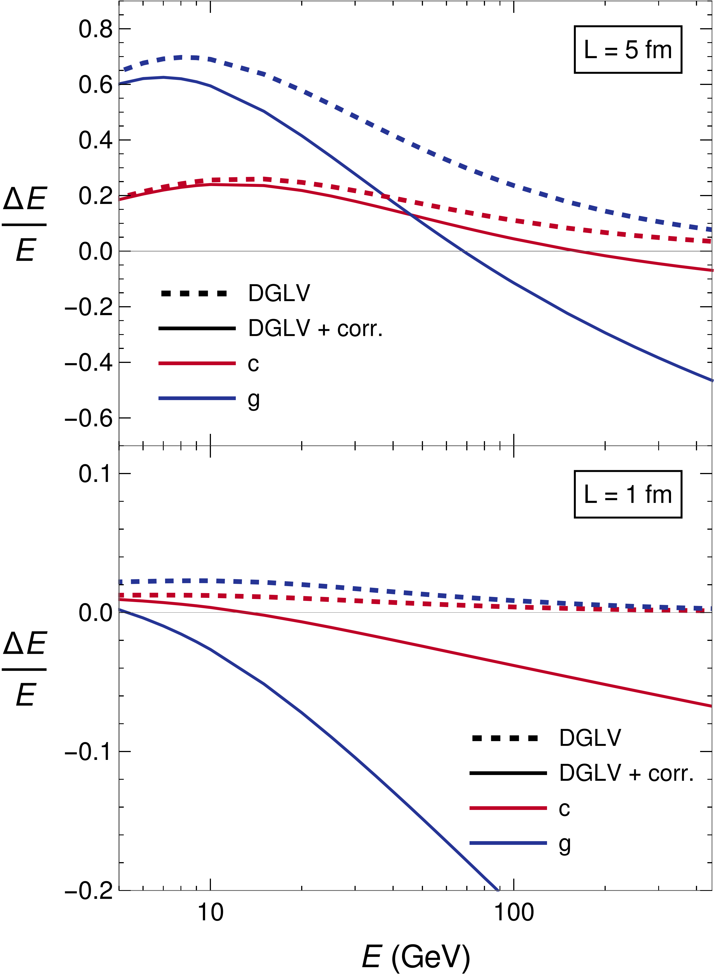
Numerics of the Short Pathlength Corr.
We see the SPL correction:
Decreases as a function of L
much larger for gluons cf quarks
Can lead to negative energy loss
Grows as a function of

Slide 10
Energy Loss Models in Small Systems
Central limit theorem
Elastic
E-loss
HTL, Braaten + Thoma
Prethermalization E-loss uncertain
Collision
Geometry
Bricks
of (L, T)
Total
E-Loss
RAA
IP-Glasma
+ Bjorken expansion
Radiative
E-loss
DGLV, 1st order in opacity
Neglected terms ~ e^{− μ L}

Slide 11

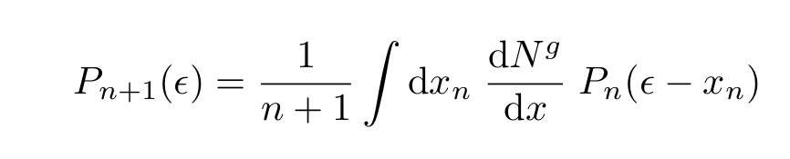
Central Limit Theorem in Elastic E-loss
How important is central limit theorem in the elastic energy loss?
We compare:
1) HTL result with Poisson distribution (Poisson HTL)
2) HTL result with Gaussian distribution (Gaussian HTL)
(Fluctuation Dissipation Thrm)

Slide 12
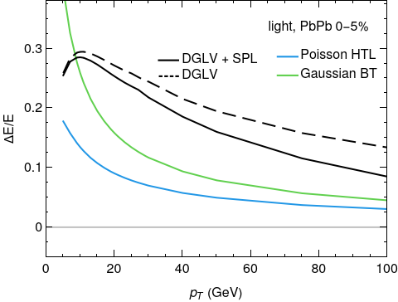
Elastic Energy Loss
Uncertainty in the elastic energy loss relating to applying HTL vs Gaussian propagators
We compare two extremes to capture this uncertainty:
Gaussian BT – combination of vacuum and HTL propagators Braaten and Thoma, Phys. Rev. D 44 (1991) R2625
Poisson HTL – HTL only propagators Wicks, PhD thesis (2008)
Generically in HIC radiative E-loss > elastic E-loss

Slide 13
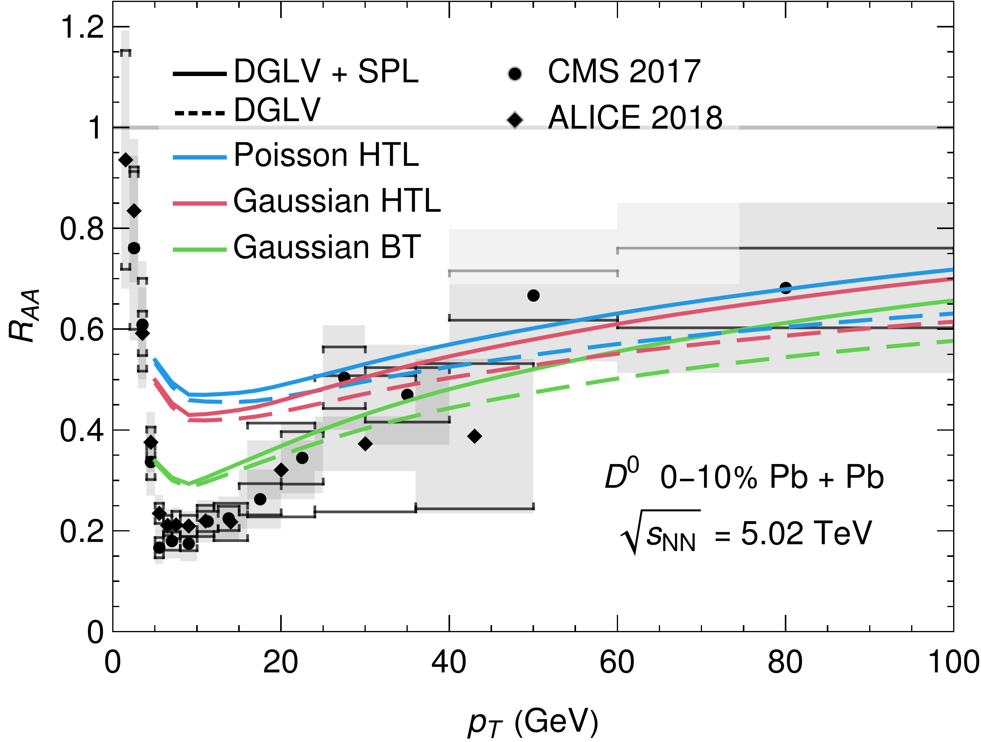
Heavy Flavour Suppression in PbPb
Low pt is sensitive to choice of elastic energy loss (HTL vs vacuum propagators)
Gaussian approximation ~ full Poisson result for all pt (blue vs red)
Short pathlength correction to radiative E-loss is small

Slide 14
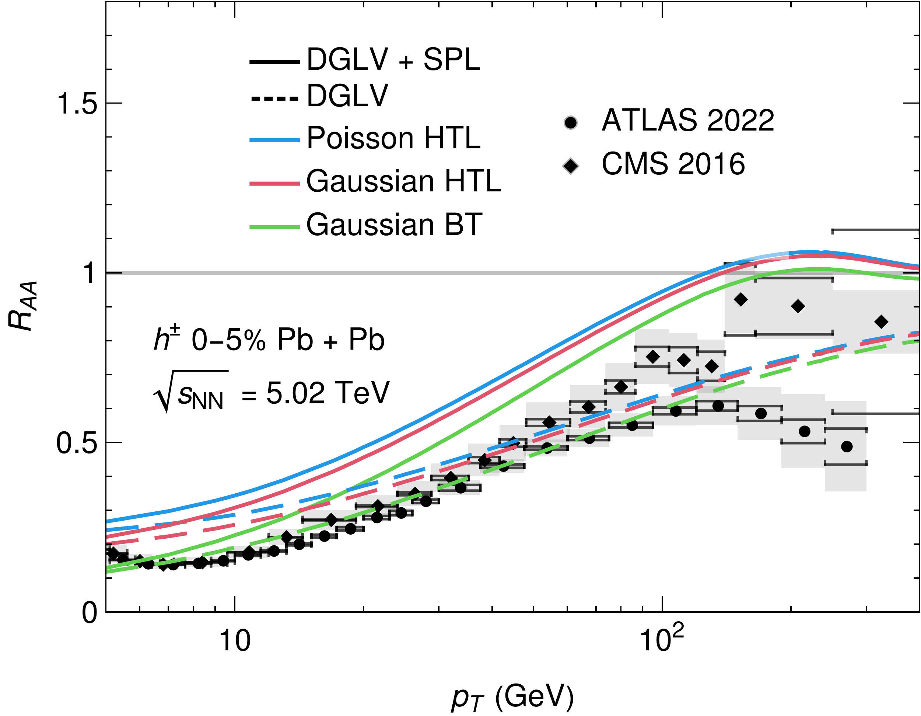
Light Flavour Suppression in PbPb
Gaussian ~ Poisson for all pt
Low-mid pt results sensitive to choice of elastic E-loss kernel
SPL corr. has a large effect, which may contribute to fast pion RAA rise in pT
Turnover can be understood as crossover from gluons to light quark dominated spectra

Slide 15
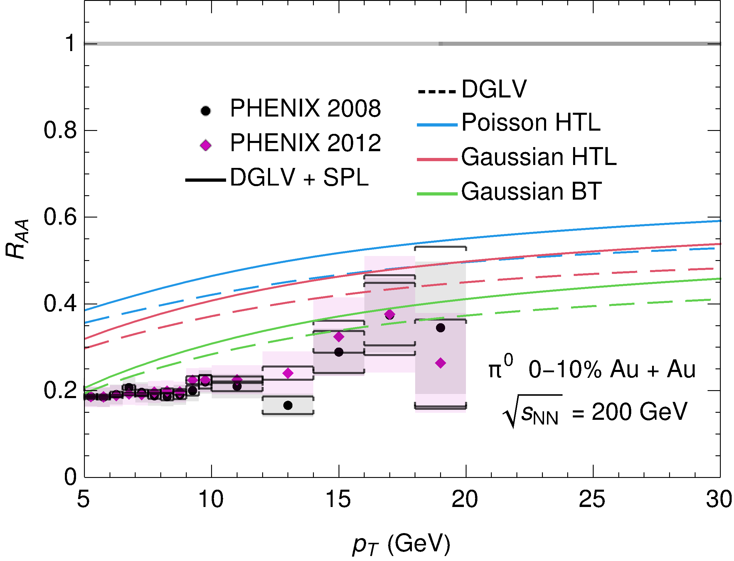
Light Flavour Suppression in AuAu
More sensitive to HTL vs BT elastic energy loss than PbPb, ~100% effect!
Poisson vs Gaussian is O(10-25%) effect size

Slide 16
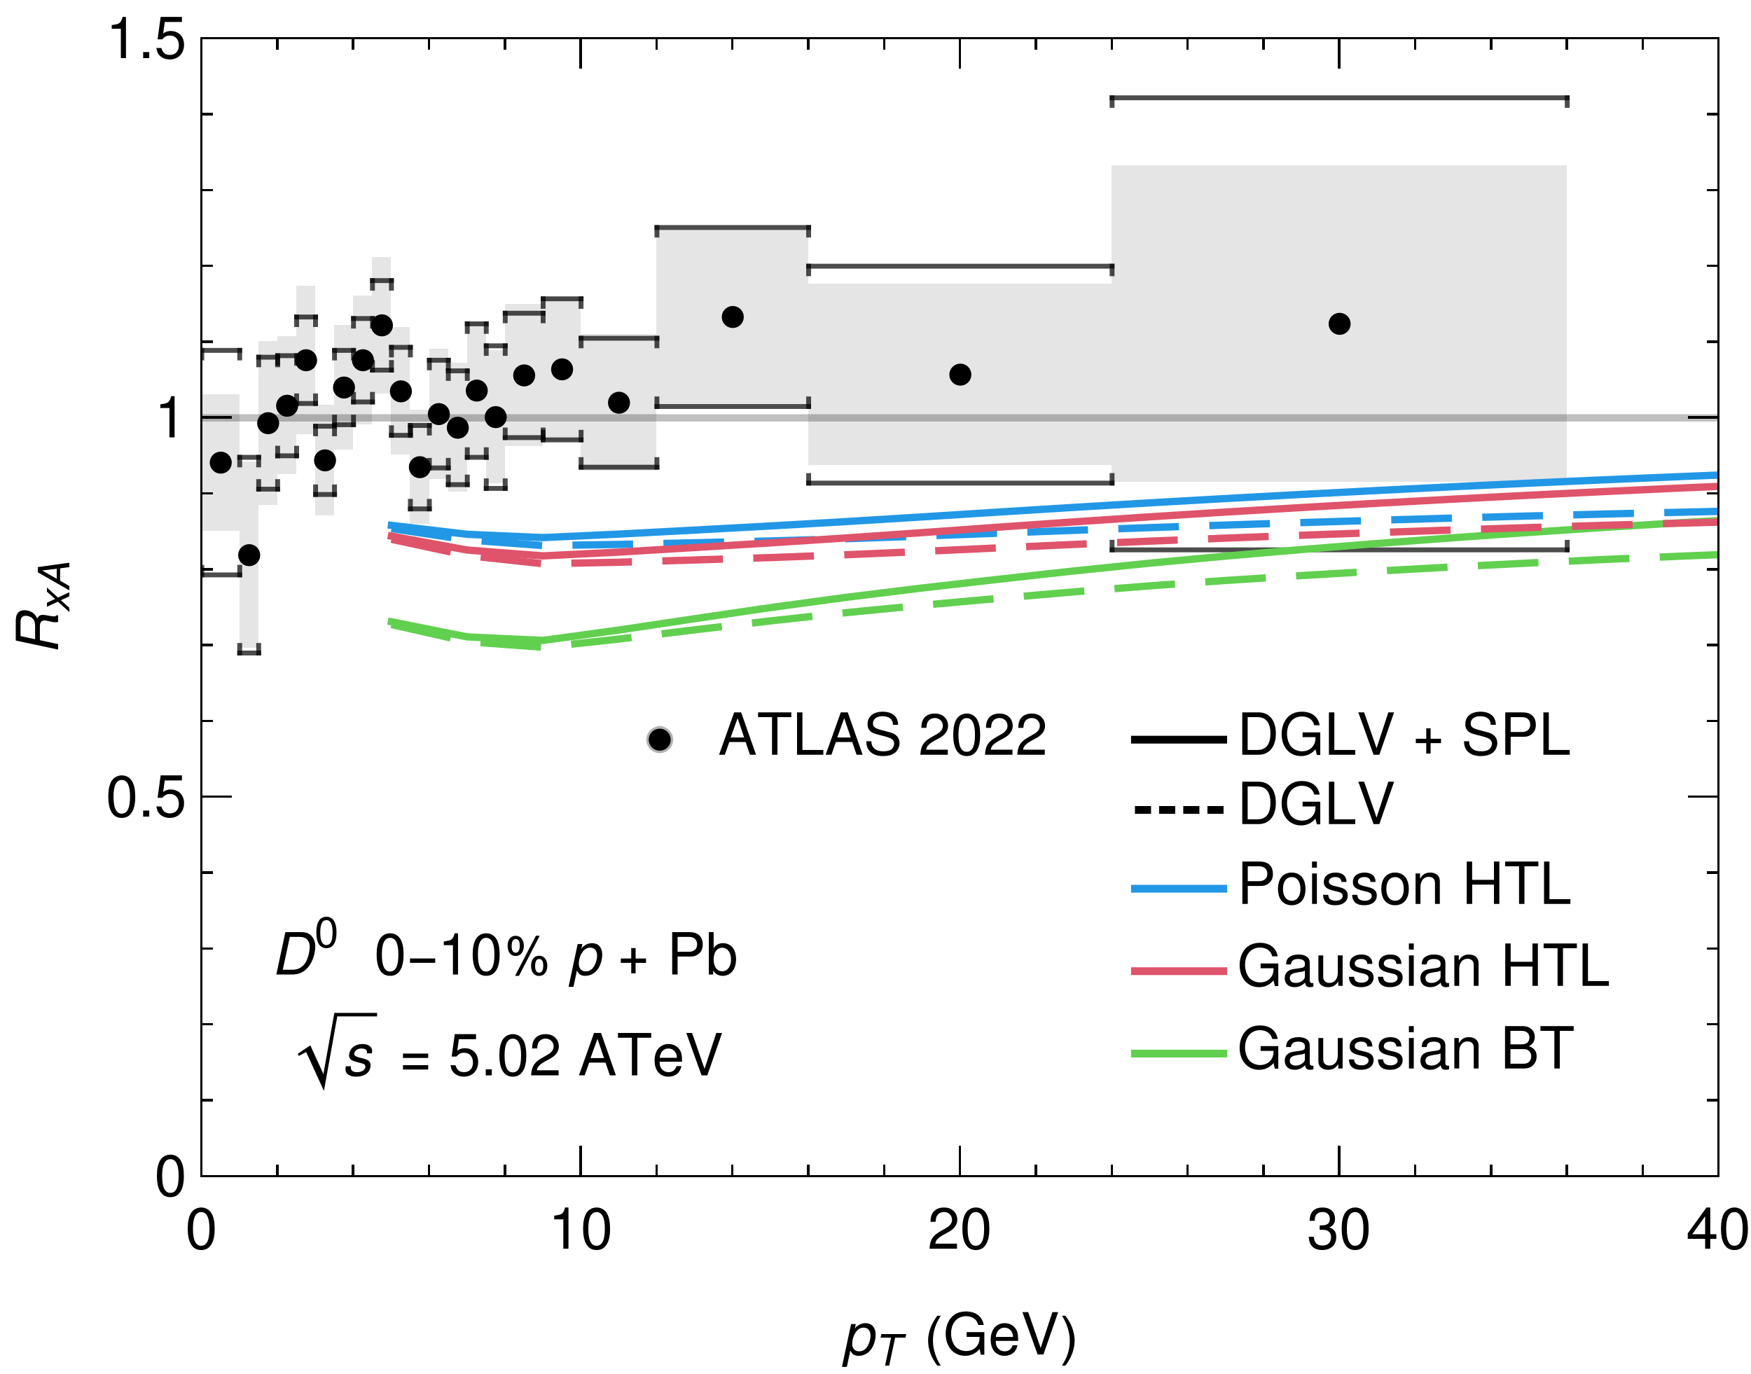
Heavy Flavour Suppression in pPb
Gaussian RAA ~ Poisson RAA ; Surprising since CLT should not be valid
Extremely sensitive to elastic energy loss model (x2 suppression)

Slide 17
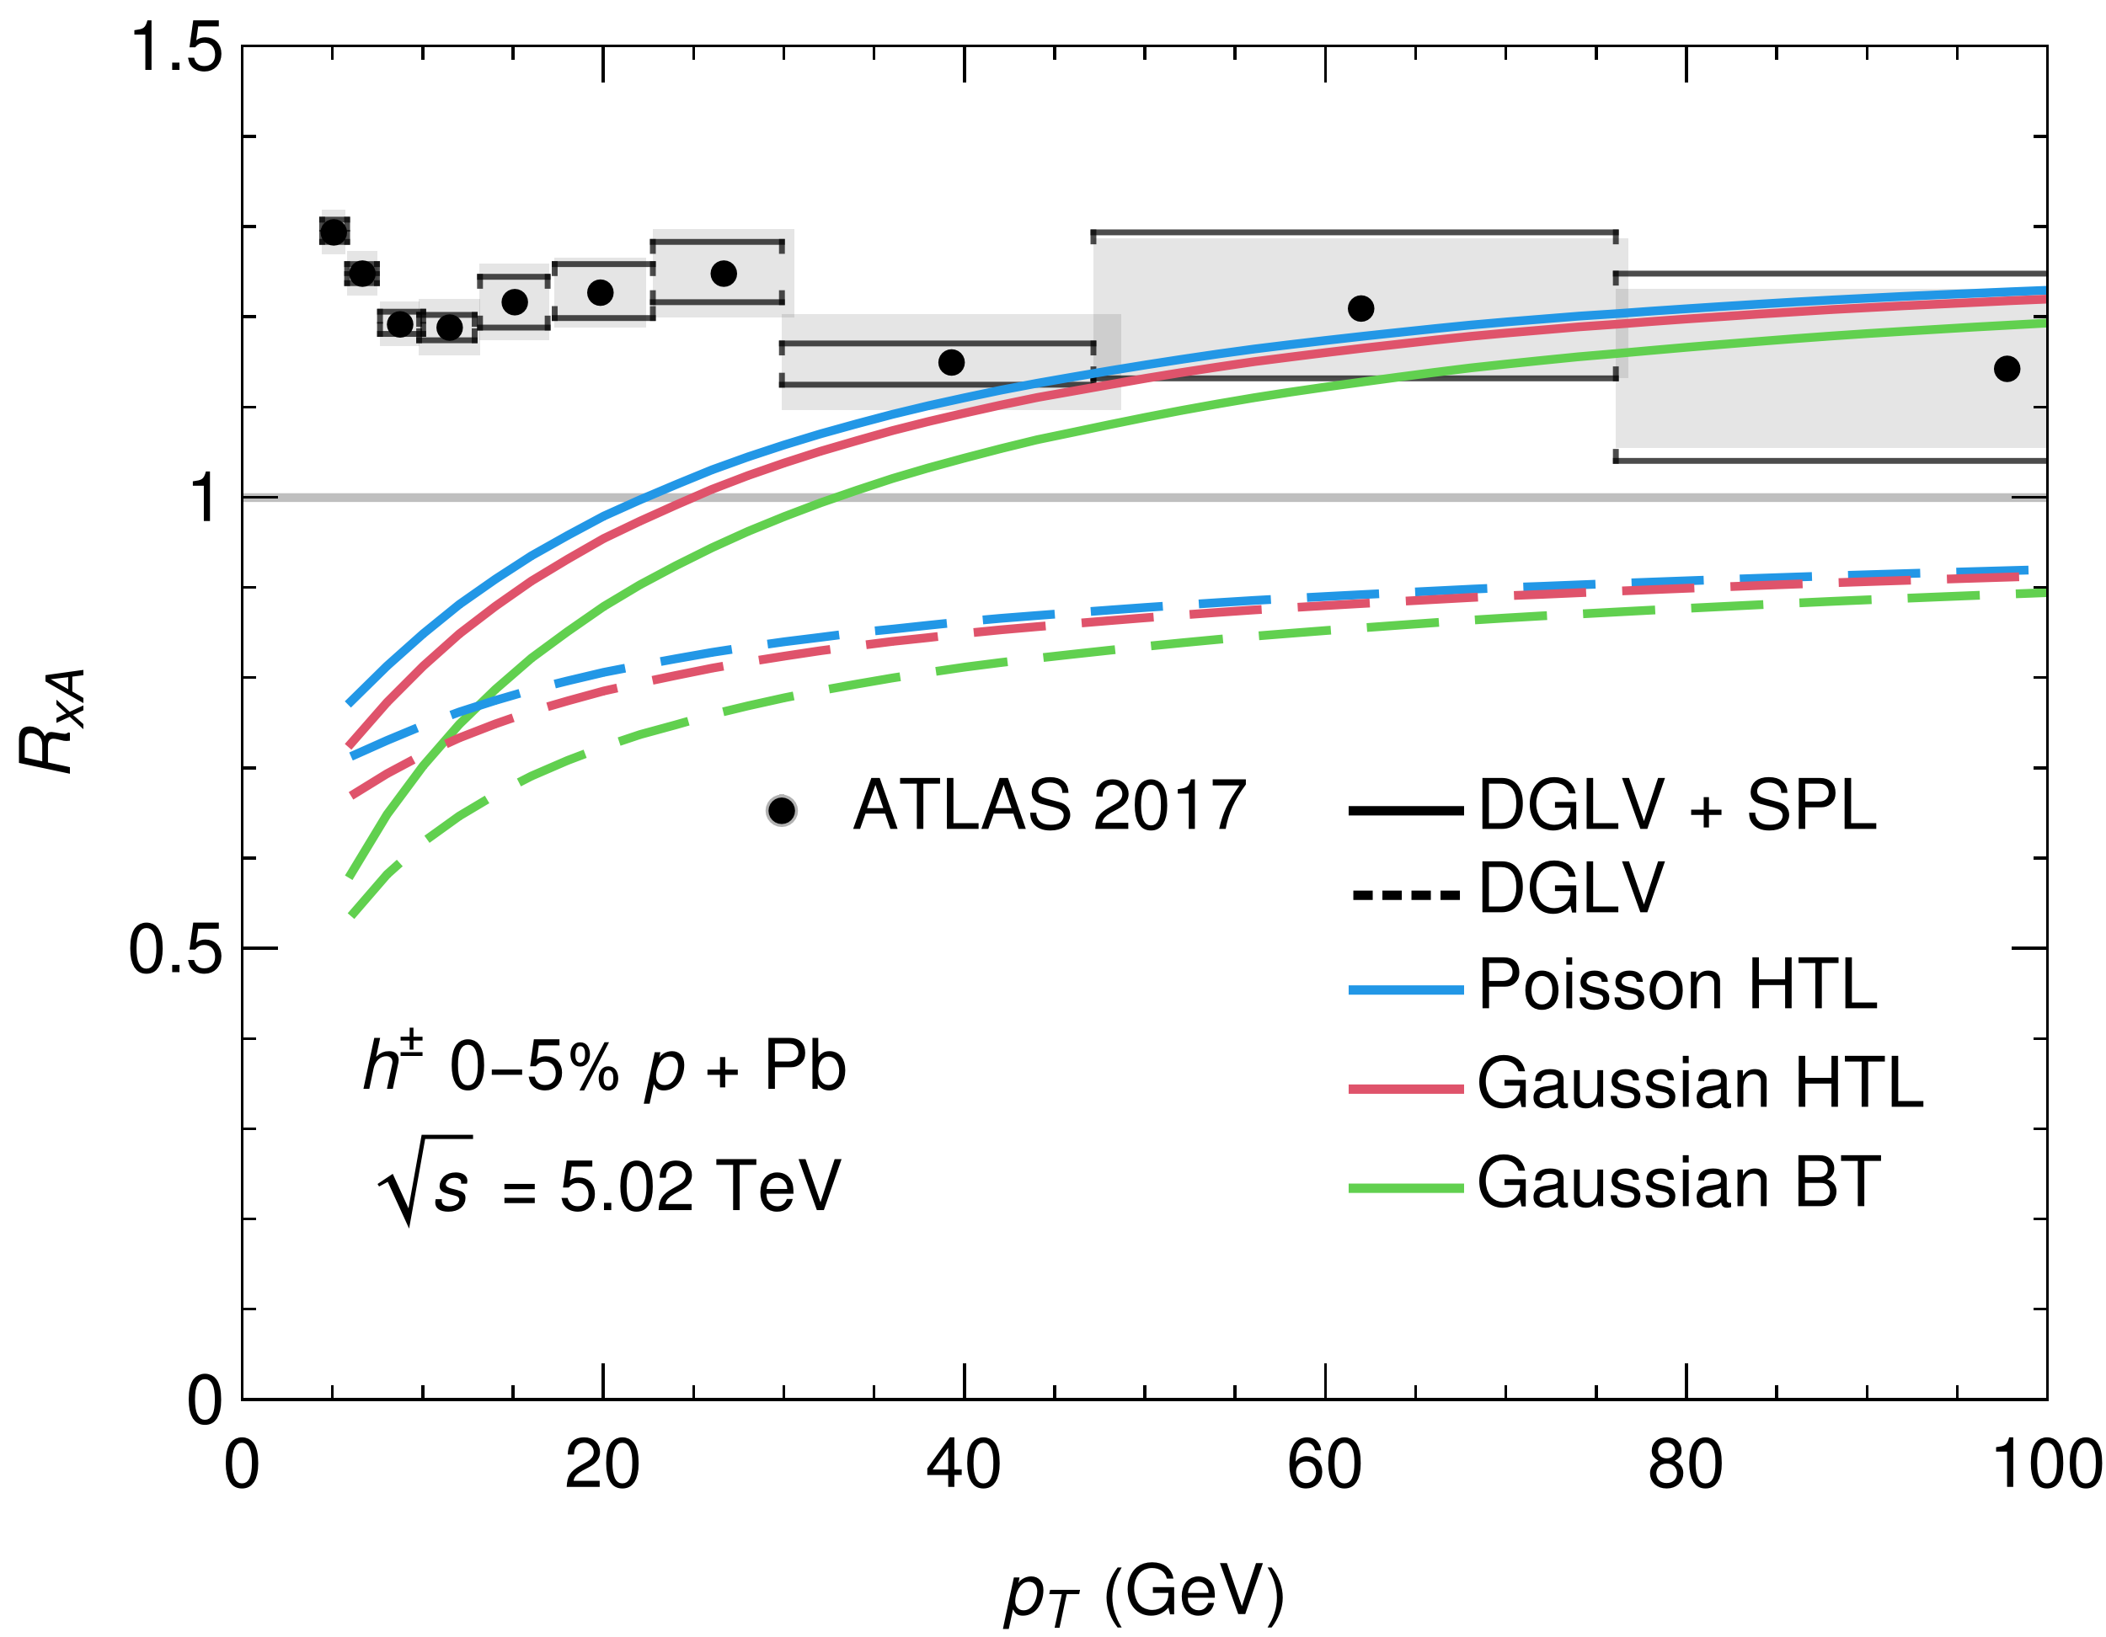
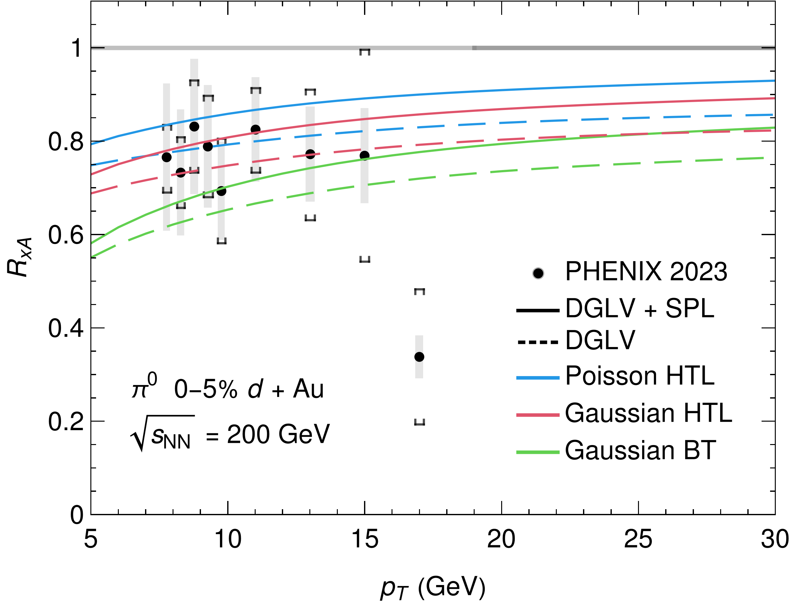
Light Flavour Suppression in pPb and dAu
pPb
dAu
High pT RAA qualitatively consistent with SPL result, but low pT dramatically inconsistent
Models qualitatively consistent with data in dAu

Slide 18
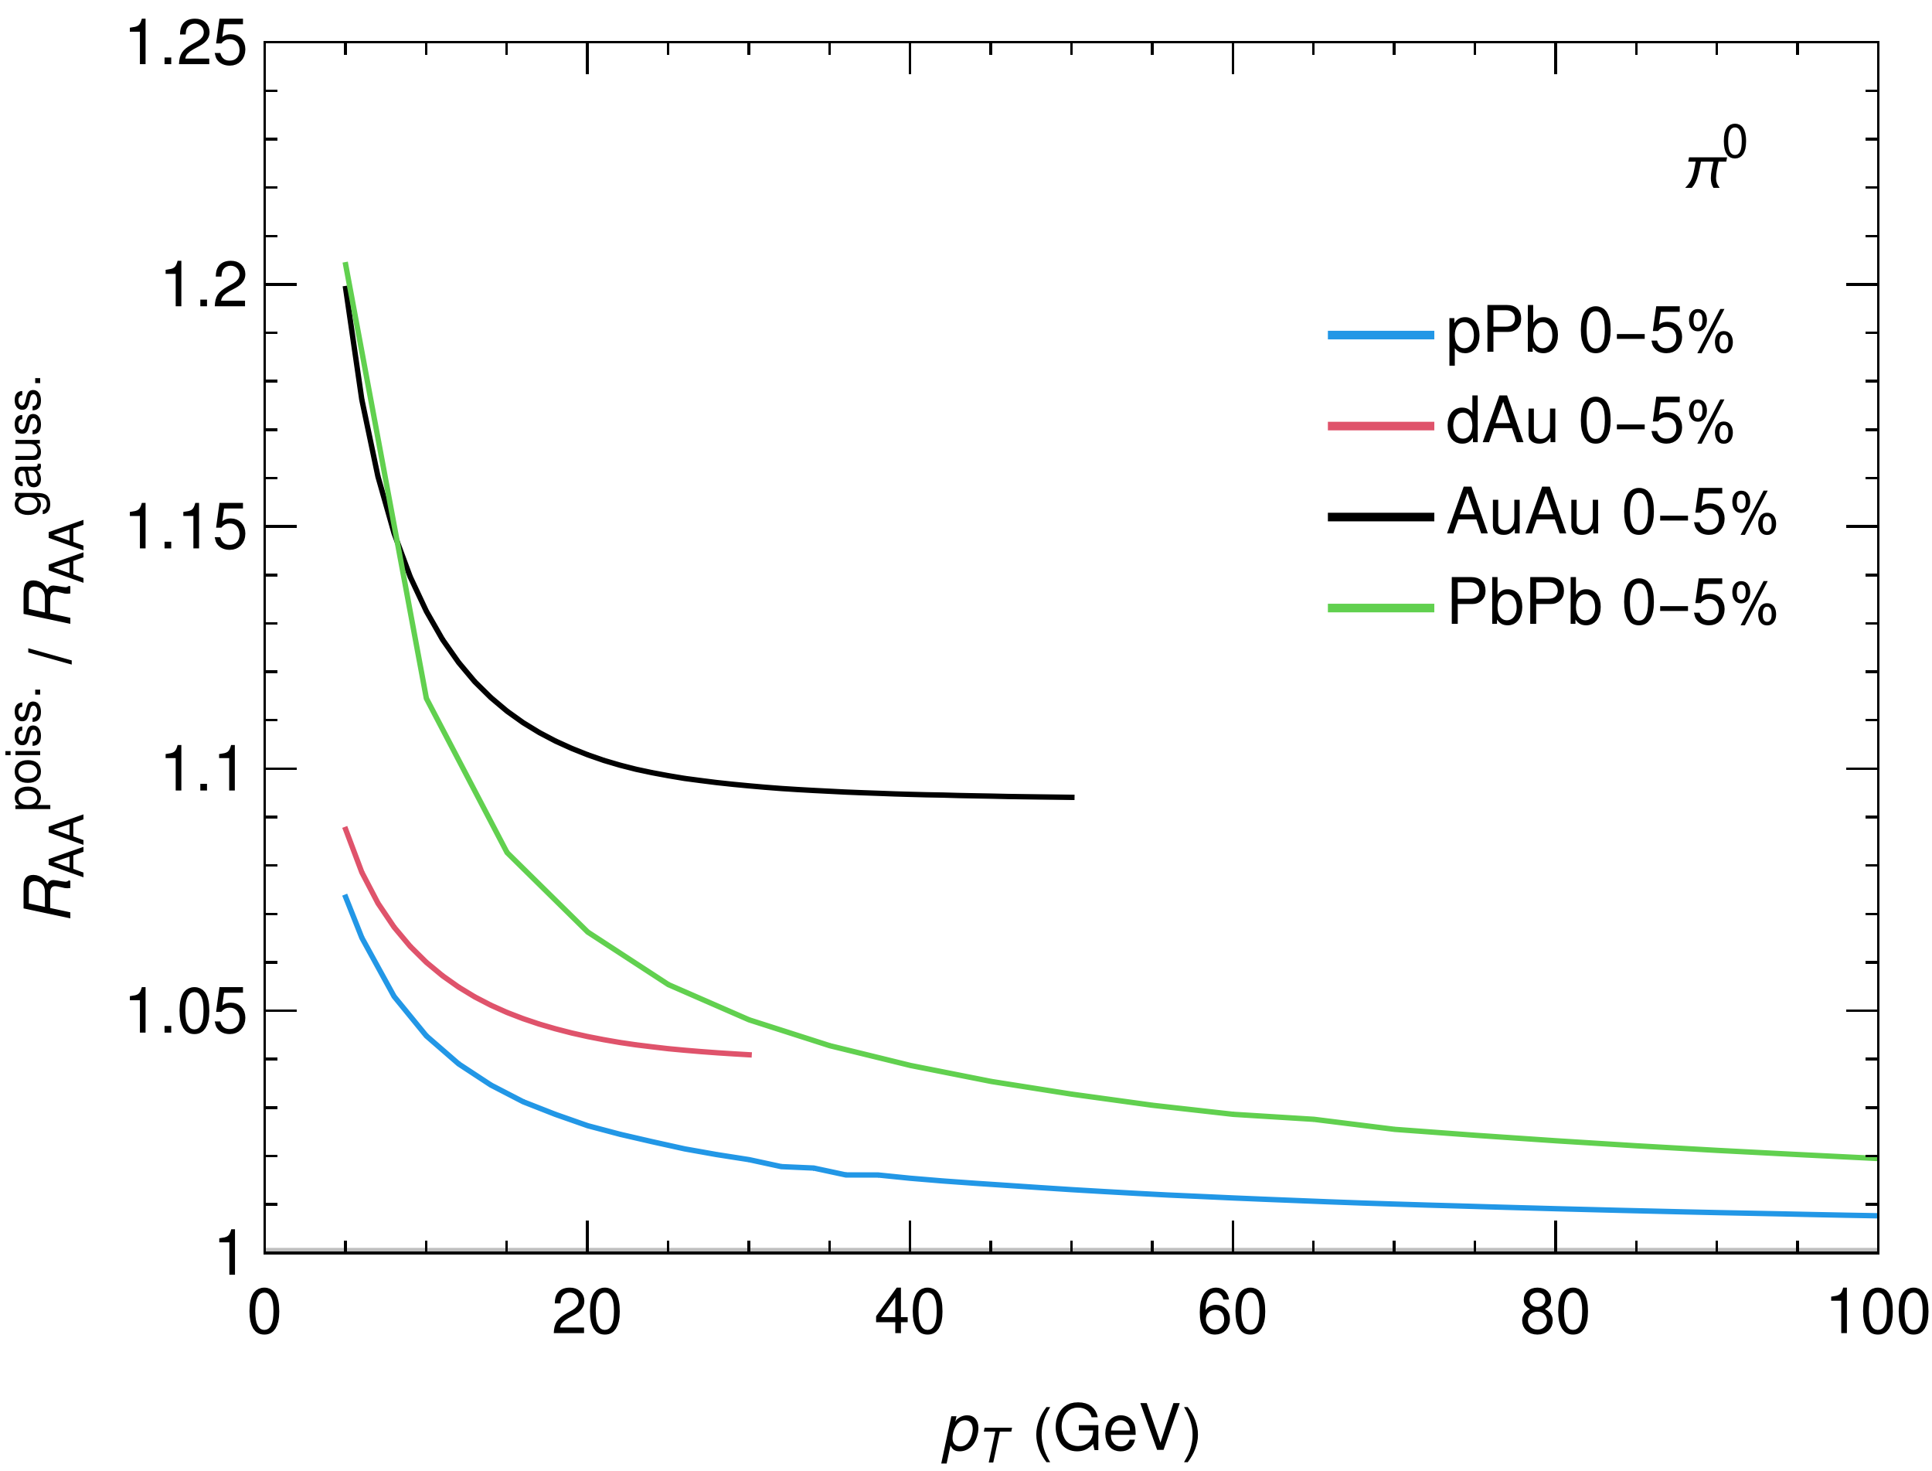
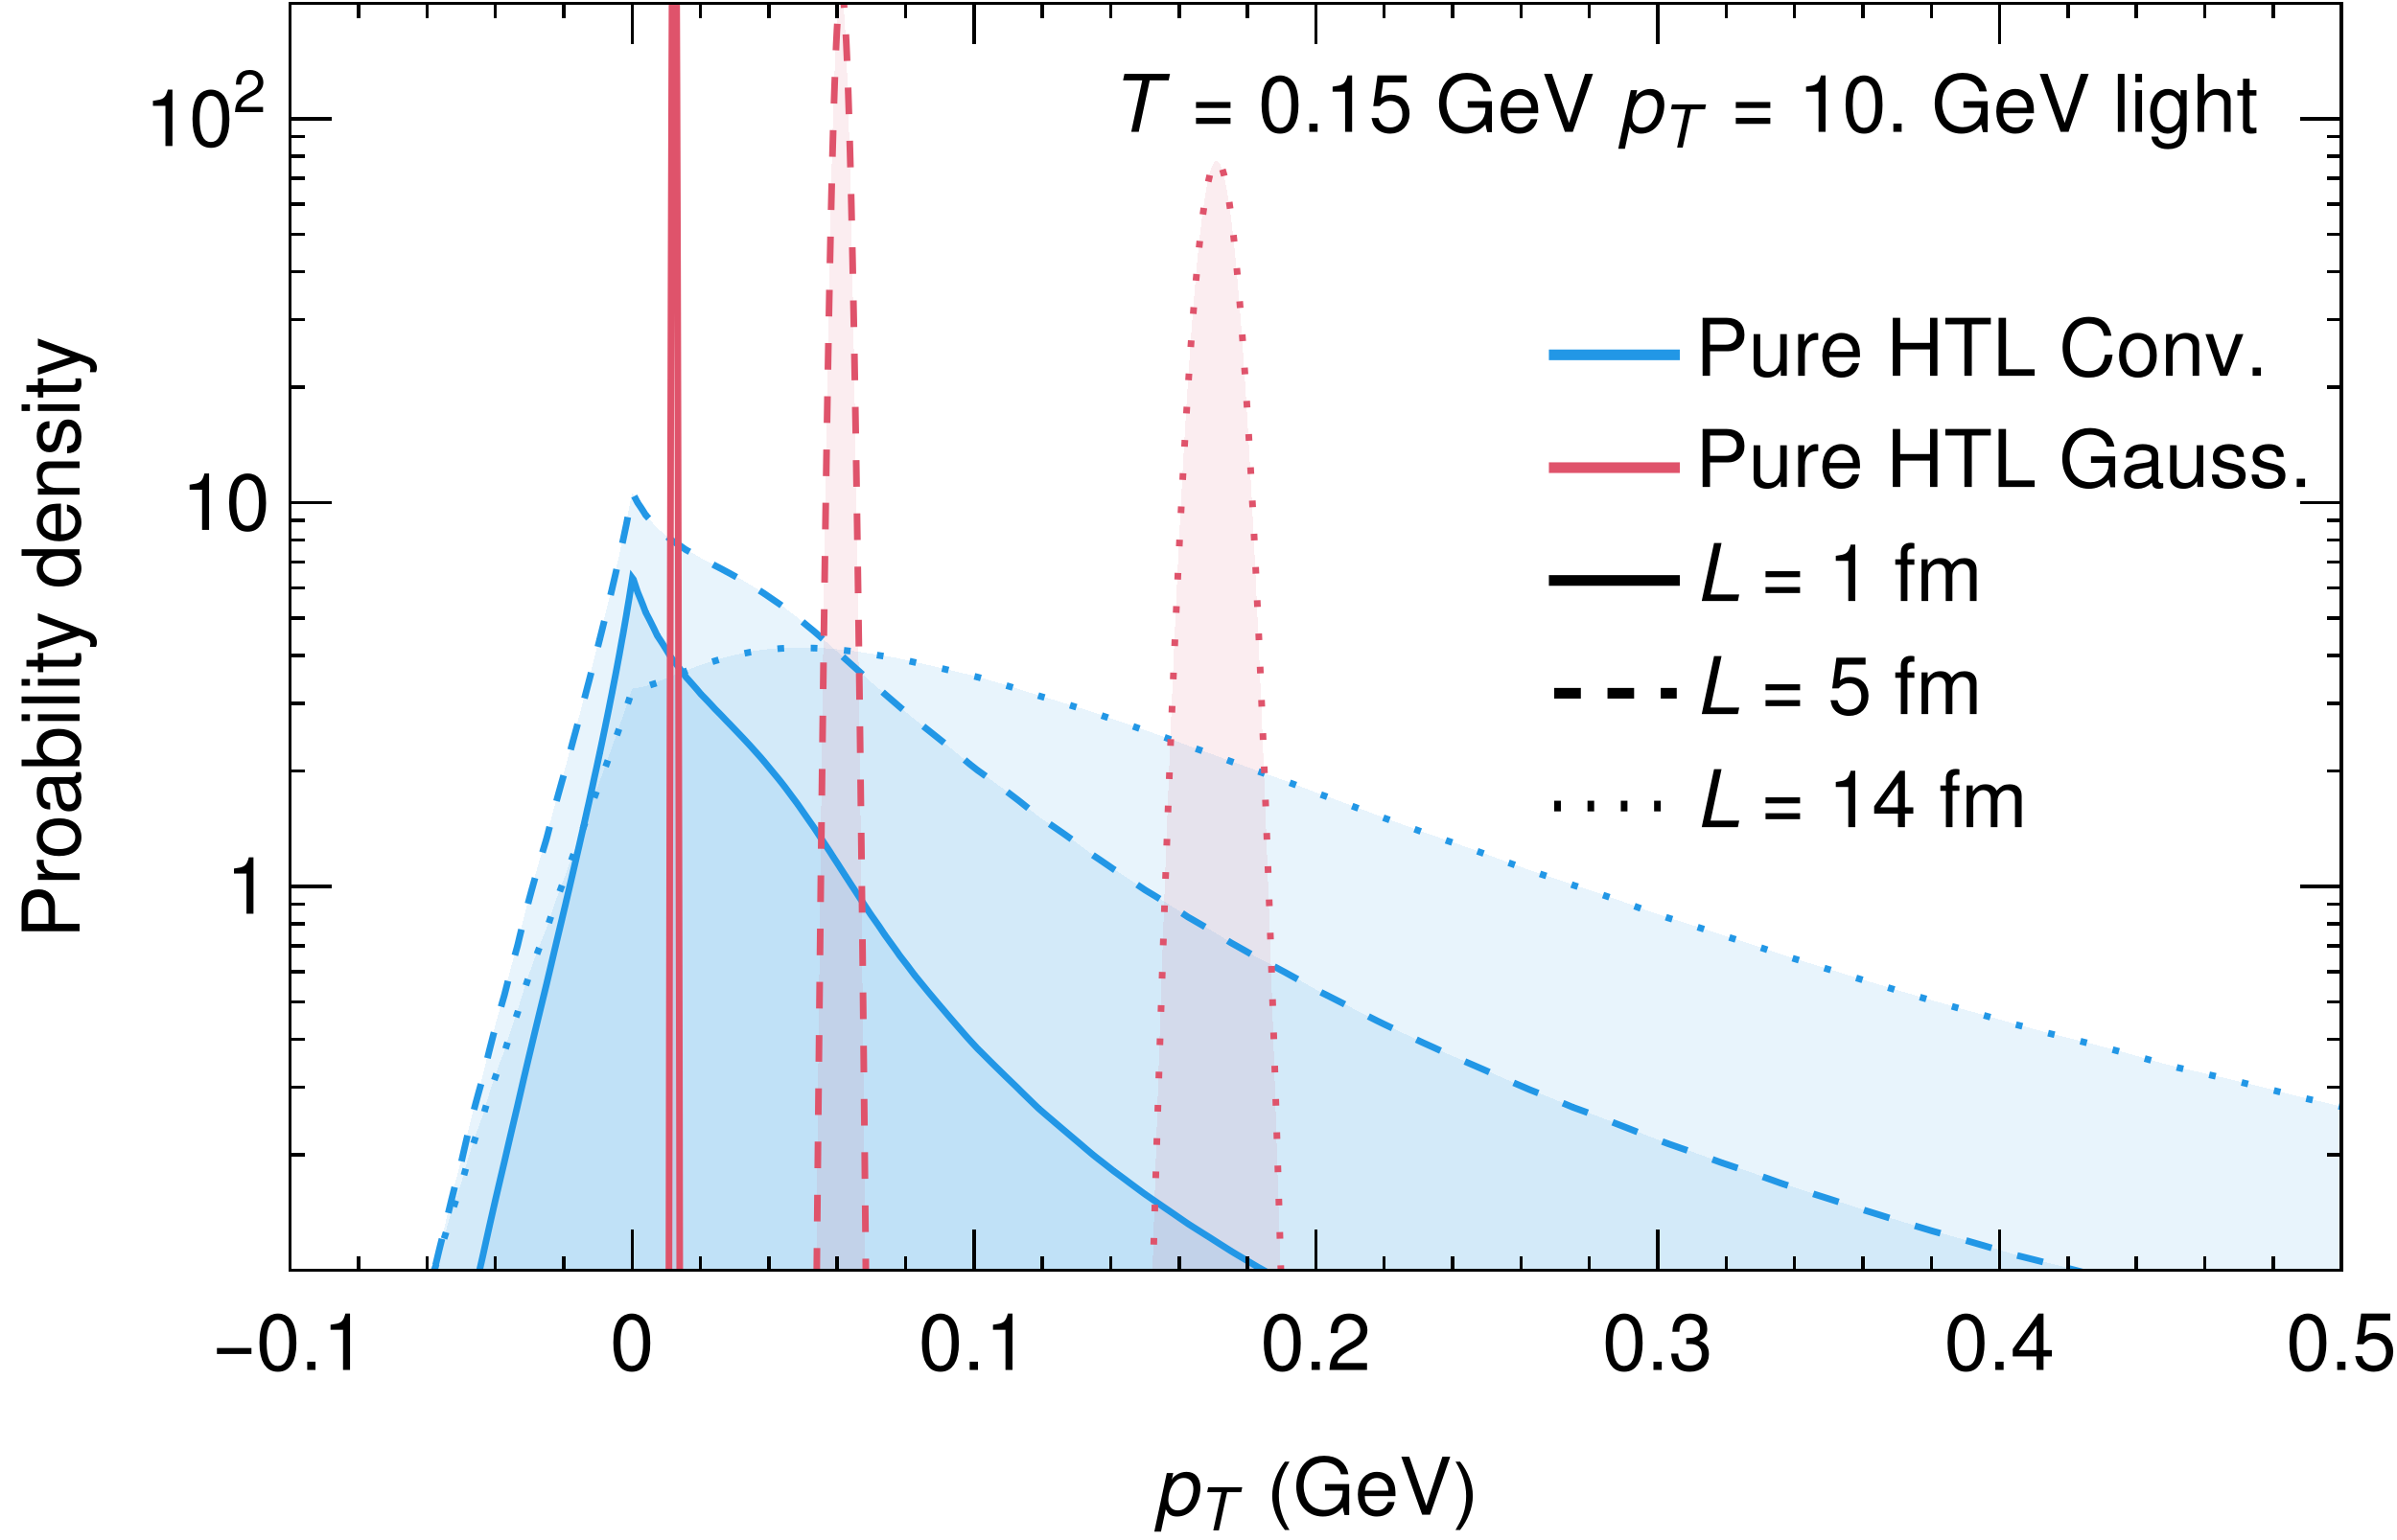
Gaussian ~ Poisson?
Opposite ordering than expected according to CLT?
Strong
Gaussian distribution not a good fit for either small or large systems
→ Why is Gaussian RAA ~ Poisson

Slide 19
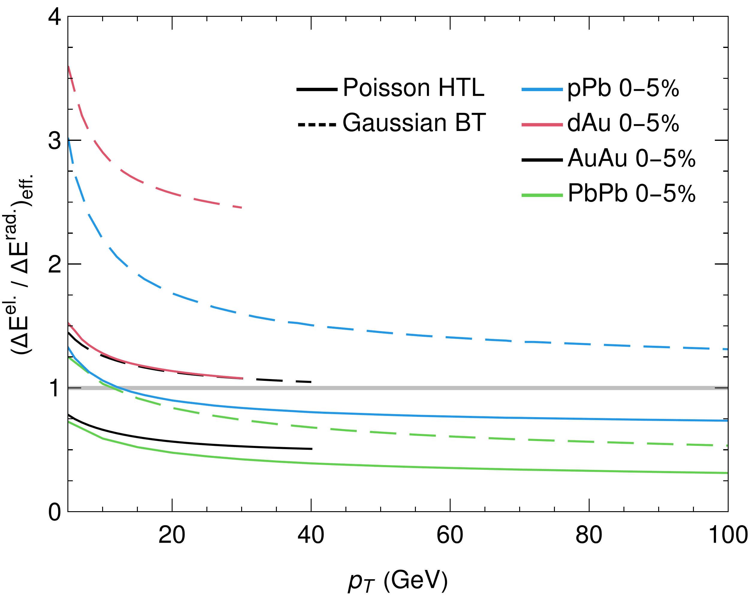
Why is Gaussian ~ Poisson?
One can show that:
1) In small systems: small energy loss ⇒ RAA depends mostly on average energy loss
2) In large systems: elastic energy loss small fraction compared to radiative energy loss

Slide 20
Preliminary results!
We want to understand:
Do different elastic/radiative energy loss models → different signatures in energy loss?
Can one simultaneously describe suppression (or lack thereof) in small and large systems?
→ Fit αs on a per model basis

Slide 21
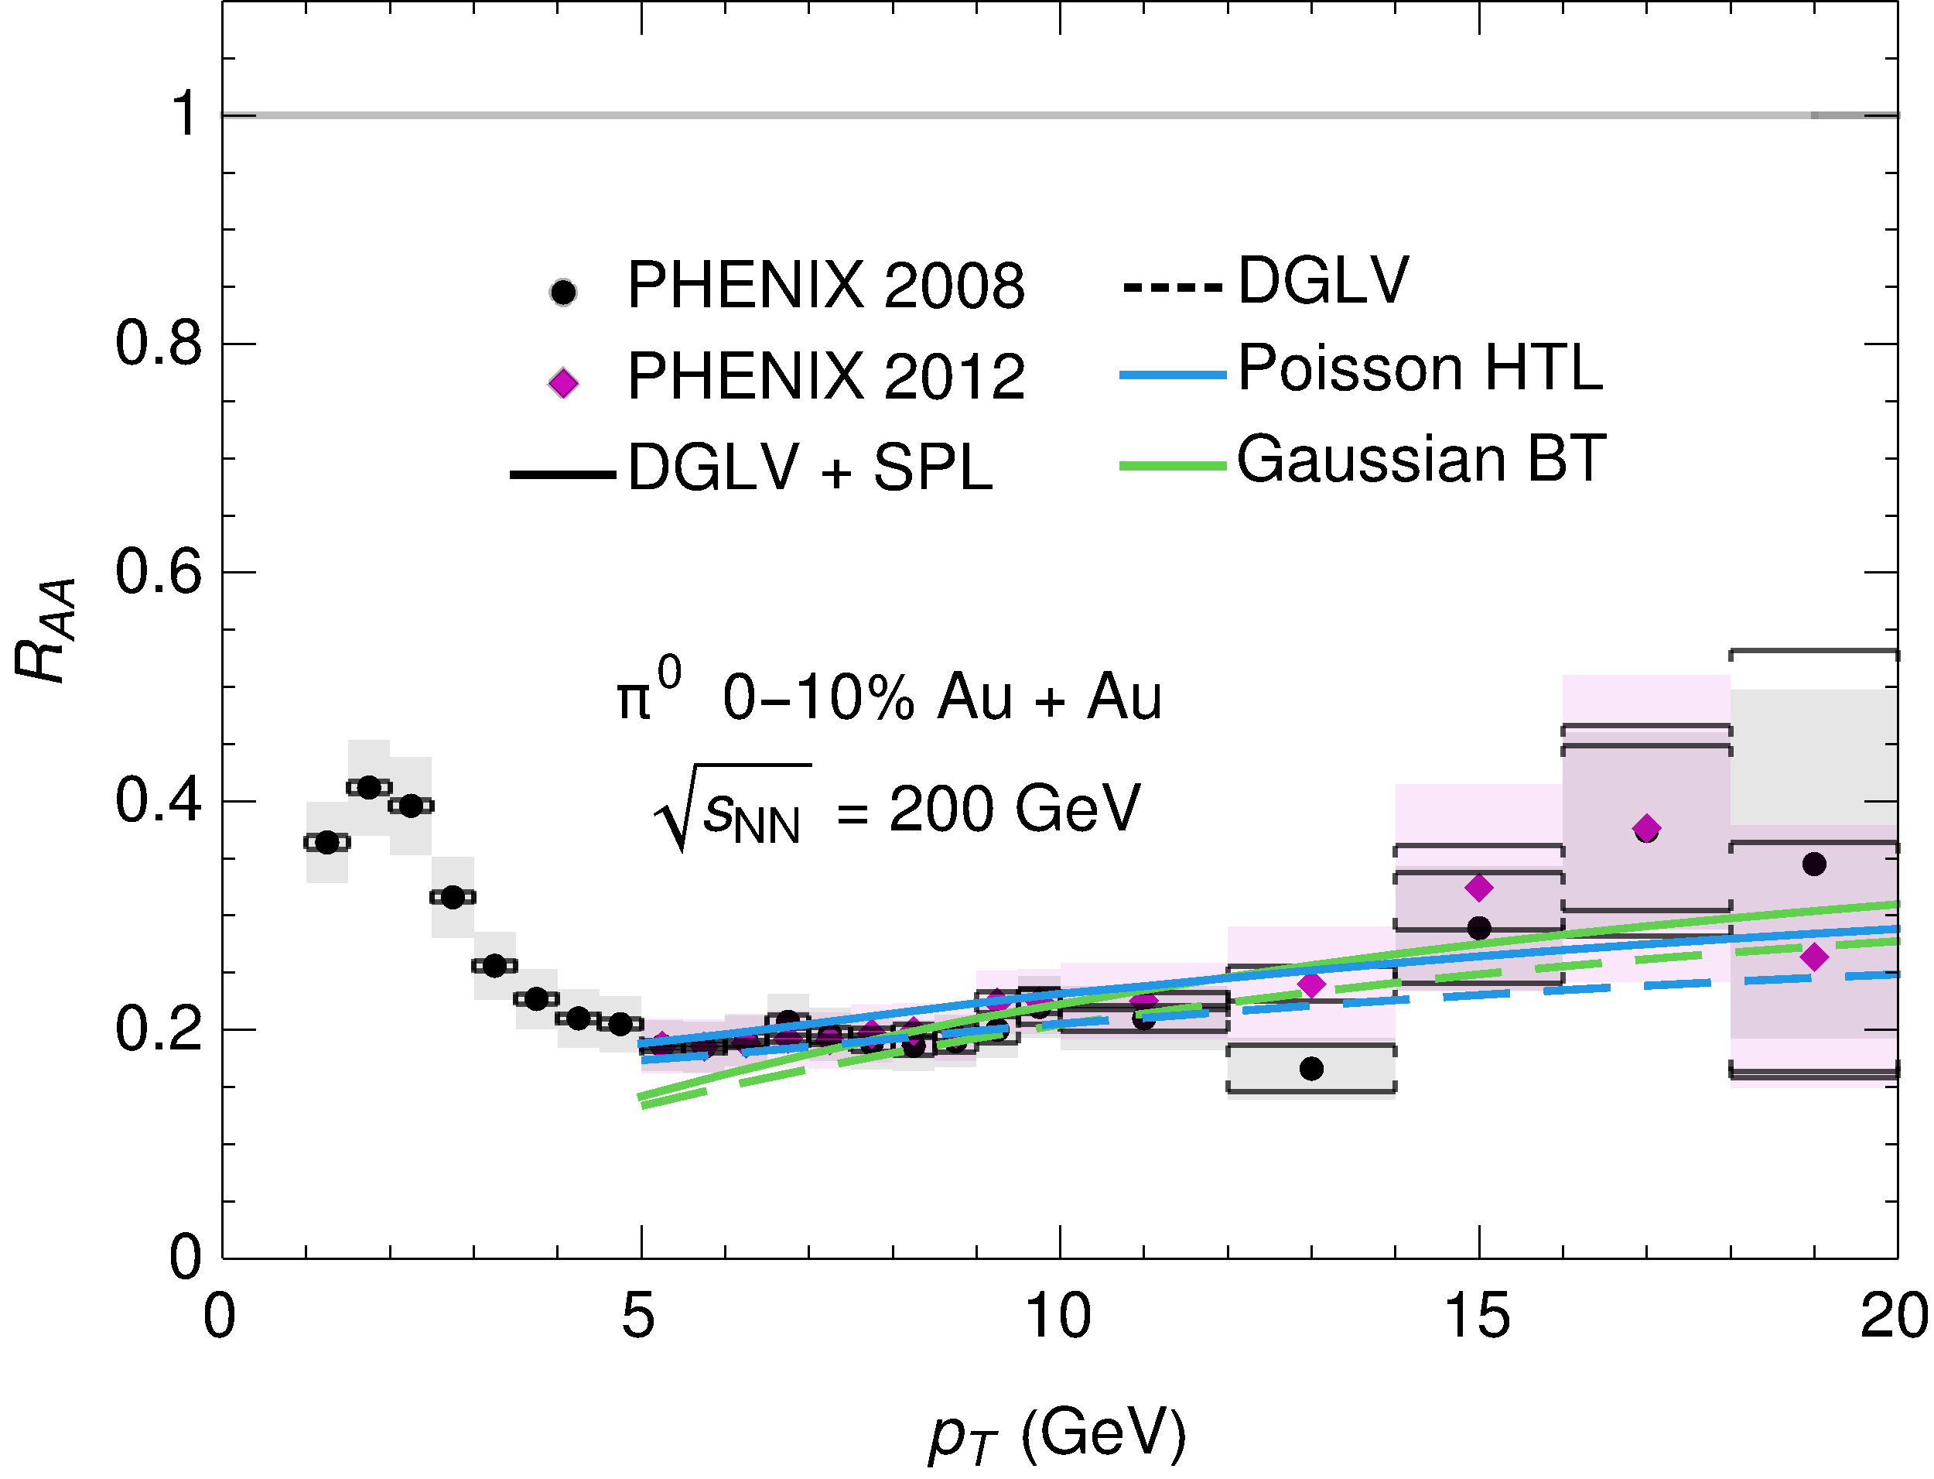
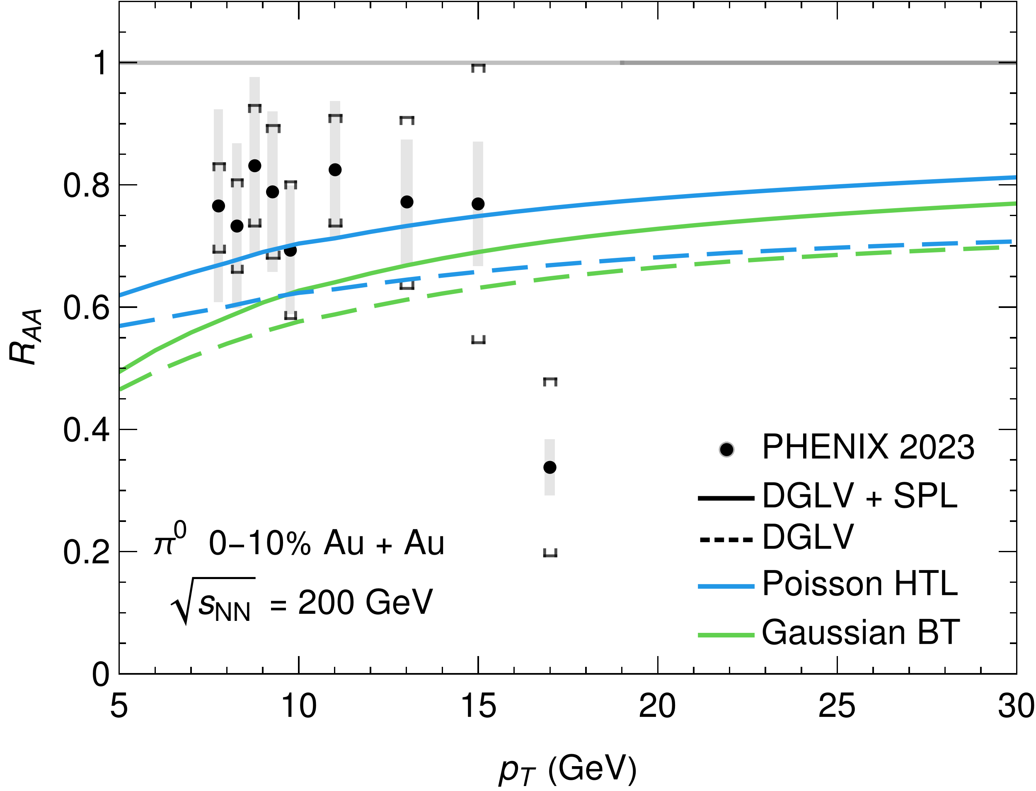
Global α-Fitted Results at RHIC
All models can fit both small and large systems, but HTL closer to data
Very different αs required for different models

Slide 22
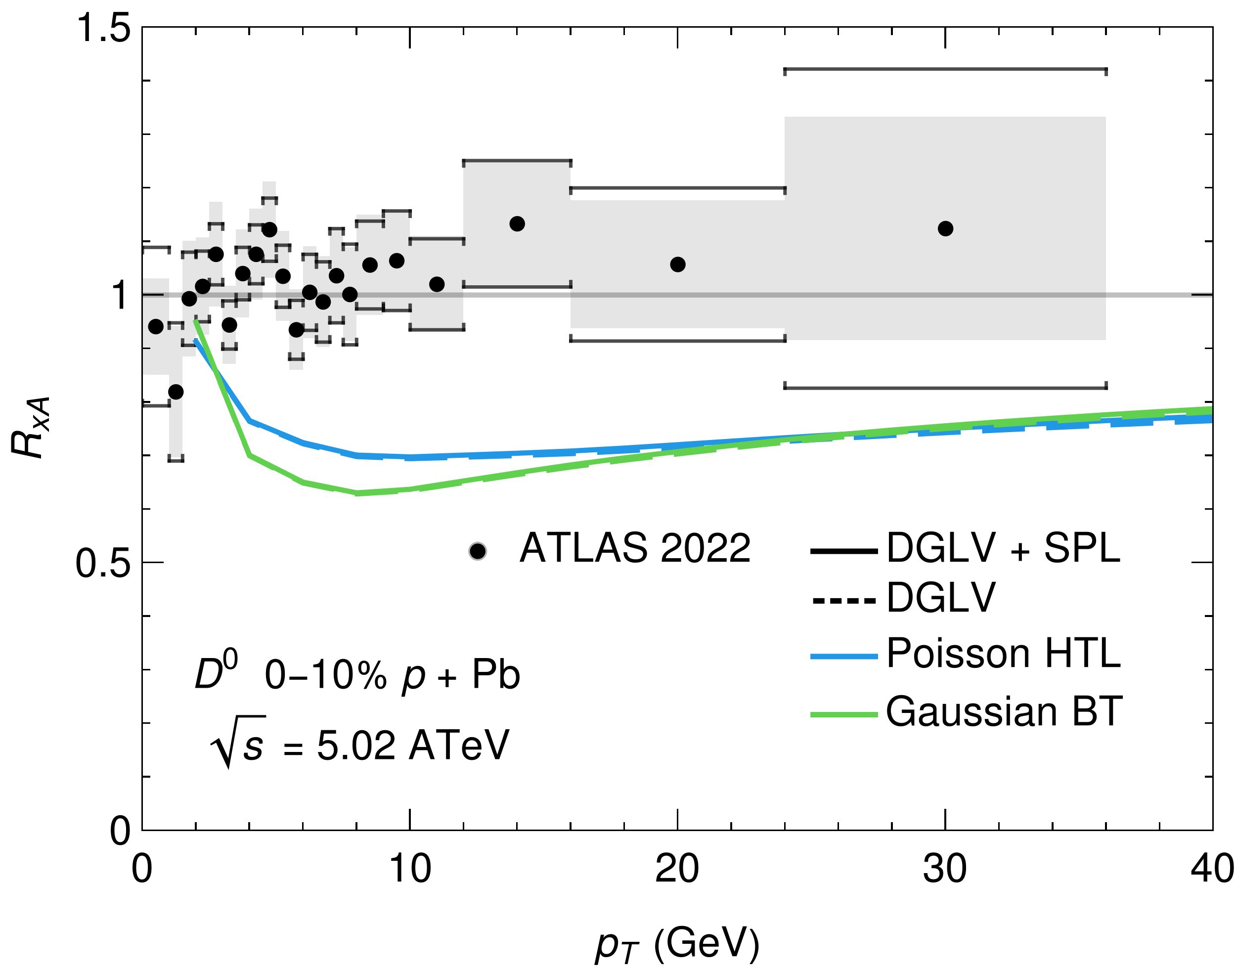
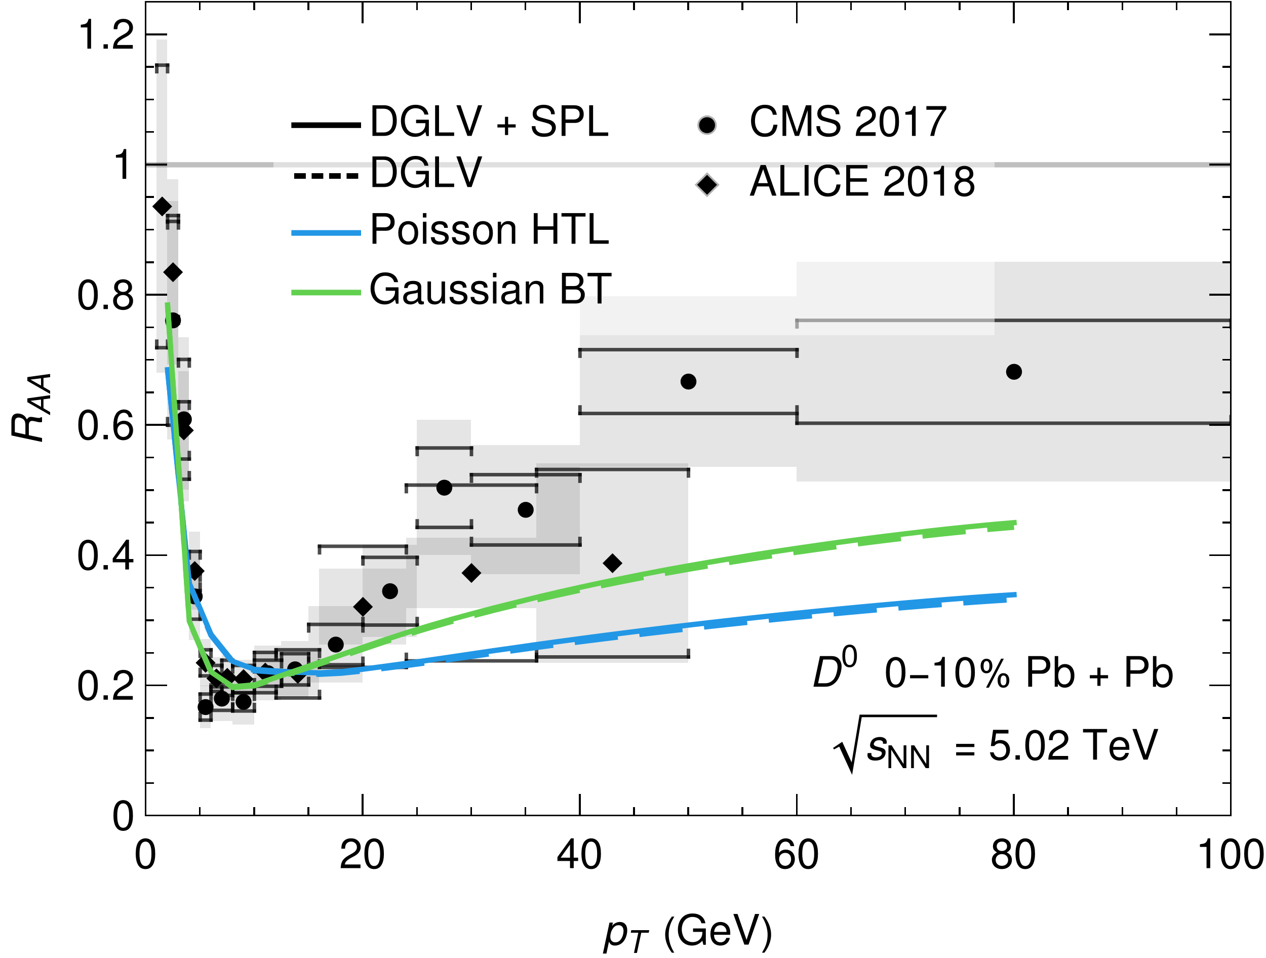
Global α-Fitted Results at the LHC (heavy)
Preliminary
Preliminary
All data over suppressed, especially small systems
Heavy flavour RAA is especially sensitive to elastic energy loss choice

Slide 23
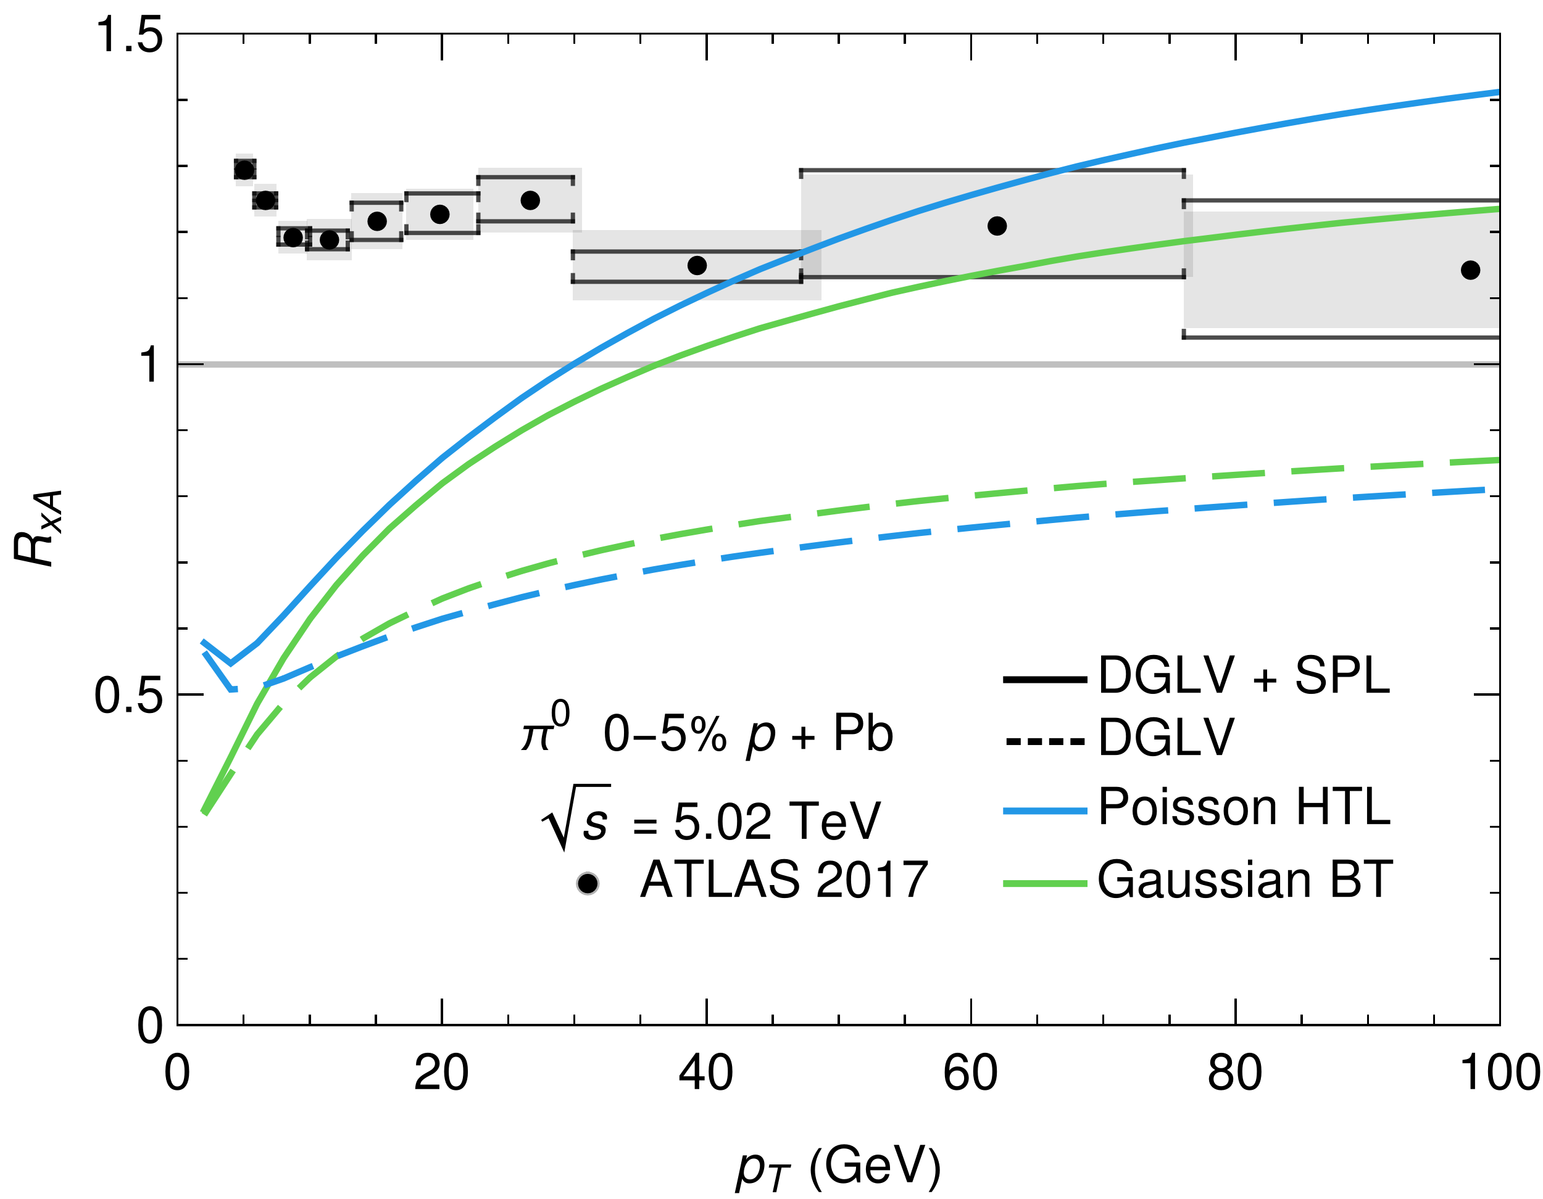
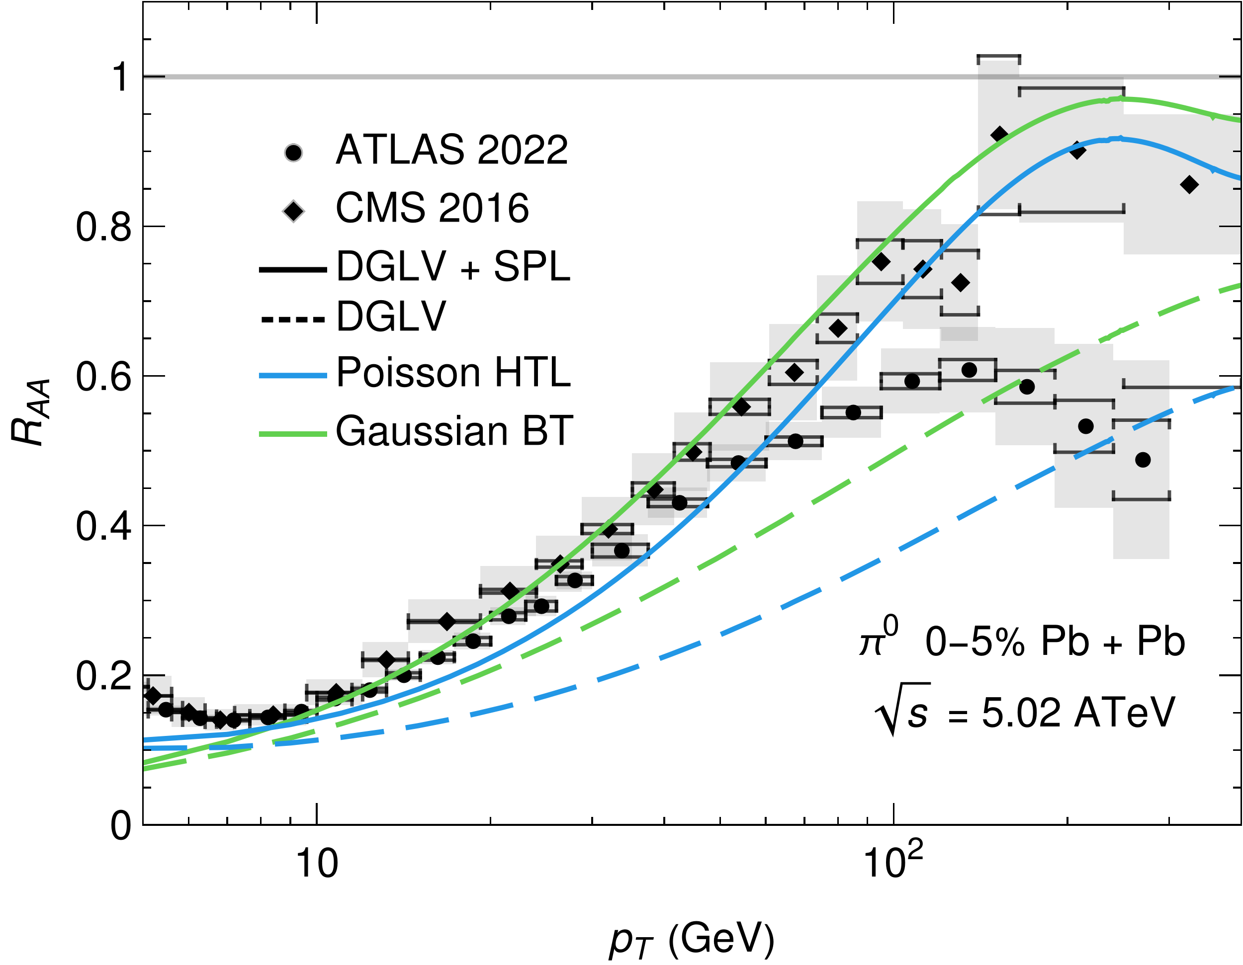
Global α-Fitted Results at the LHC (light)
Preliminary
Preliminary
Too good to be true? No space for running coupling effects
Over-suppressed in pPb with DGLV, qualitative agreement at high pt with SPL

Slide 24
Summary
dAu
RAA largely independent of distribution used for elastic energy loss
More sensitive at low √s, low pT and large systems
Small systems are almost entirely elastic energy loss
System size scan in RAA could disentangle radiation vs elastic energy loss mechanisms
Model is qualitatively consistent with data in both dAu and AuAu
Future work:
System size scan with global fitted αs
HTL vs vacuum propagators
Detailed uncertainty analysis

Slide 25
Bonus Slides

Slide 26
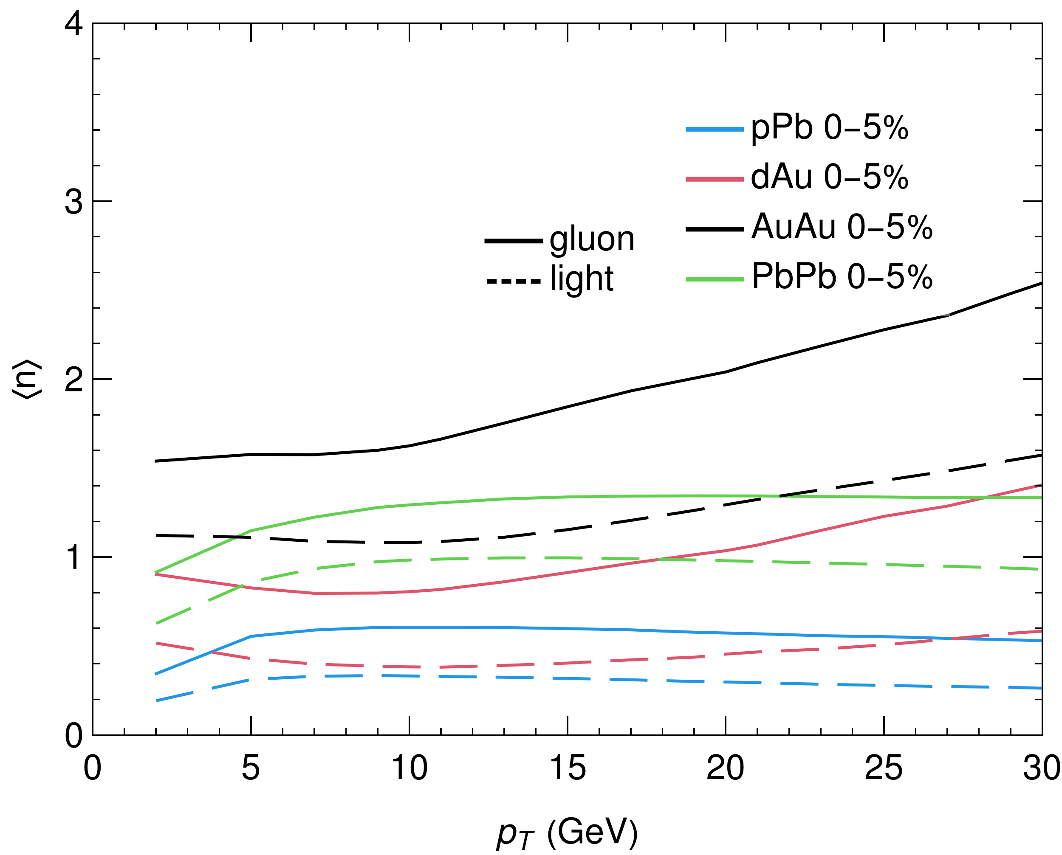
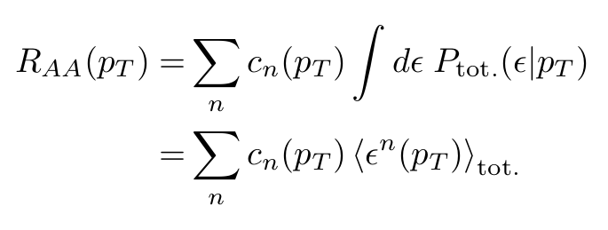
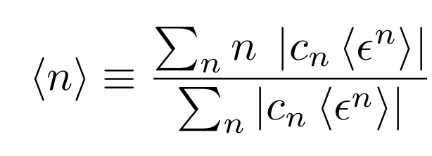
Why is Gaussian ~ Poisson?
Consider moment expansion of RAA
Small <n> => Gaussian RAA ~ Poisson RAA since zeroth and first moments are identical

Slide 27
Elastic vs Radiative E-Loss Importance
Elastic ∆ E / E ≃ α² T² log (ET)/E Radiative ∆ E / E ≃ αs ³ L² T log E / E
Strong dependence on elastic E-loss used
Small systems elastic is ~1-3x more important than radiative

Slide 28
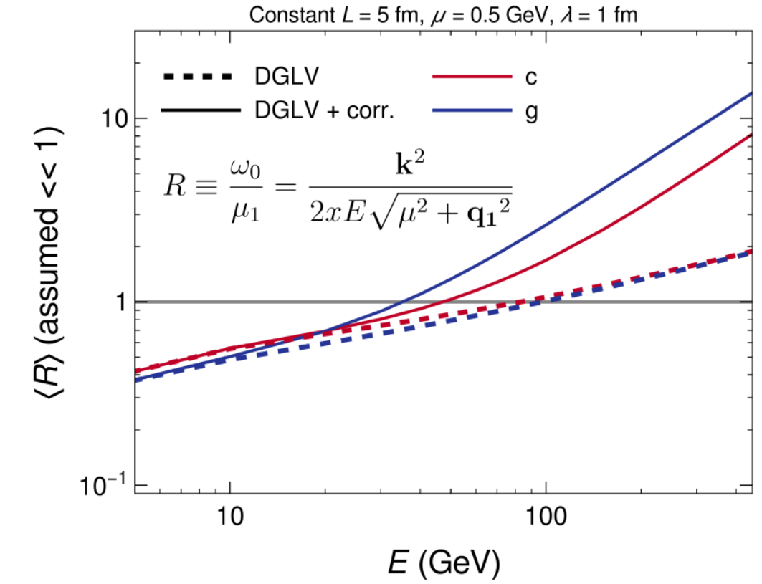
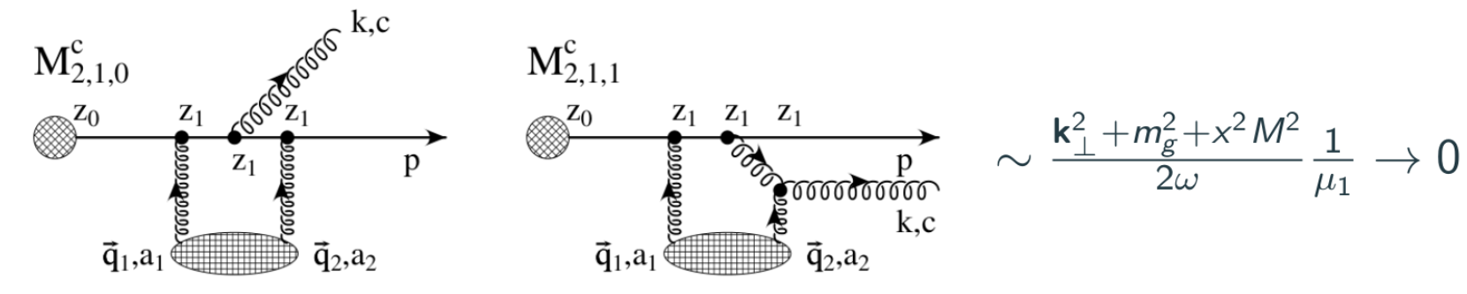
Large Formation Time Assumption
Large contributions to SPL corr. at high energies from regions of phase space not allowed according to Large Formation Time assumption
Also impacts DGLV
Future work should include a full rederivation of DGLV with LFT assumption relaxed
Can implement a phenomenological cut in the phase space as well to limit assumption-violating contributions

Slide 29
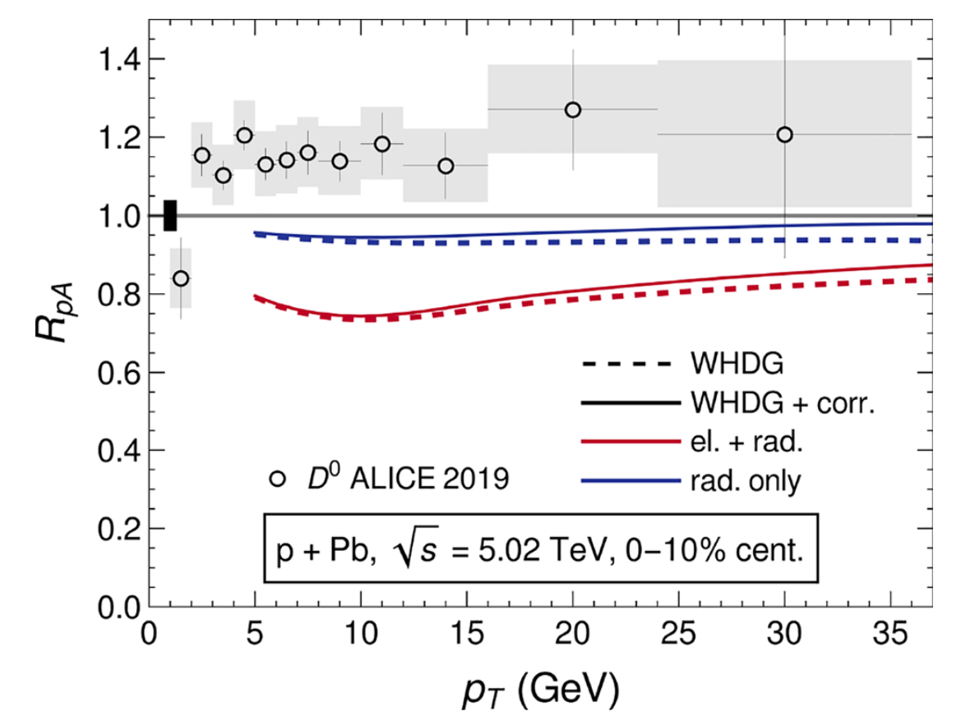
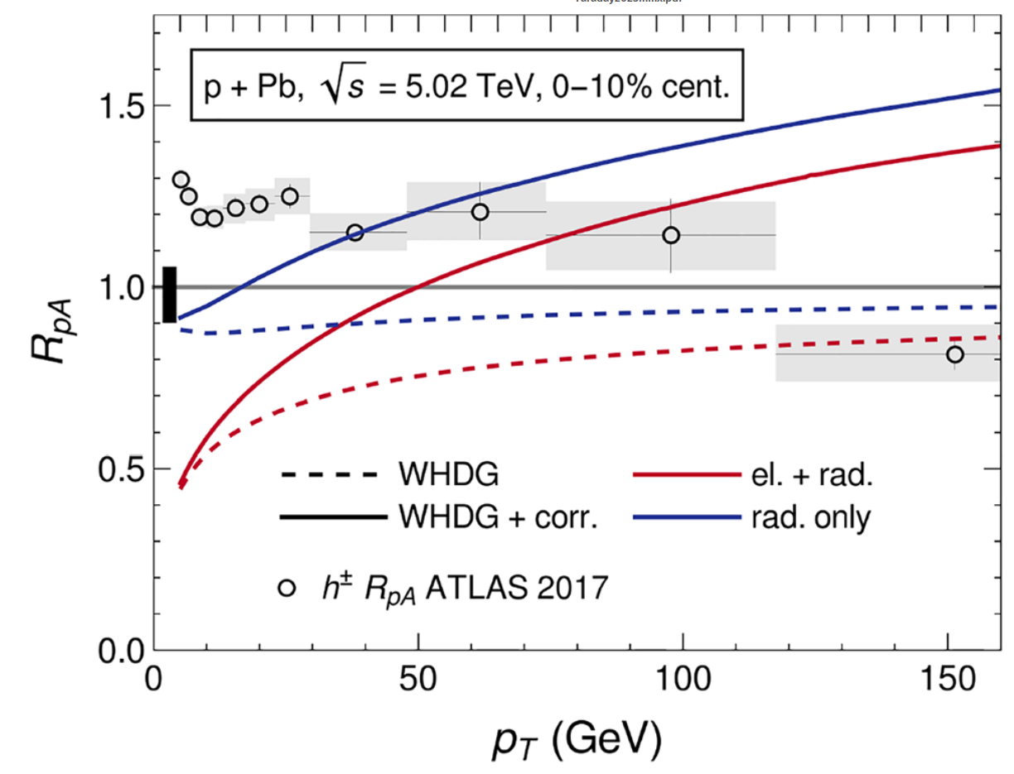
Turning Off Elastic E-Loss

Slide 30
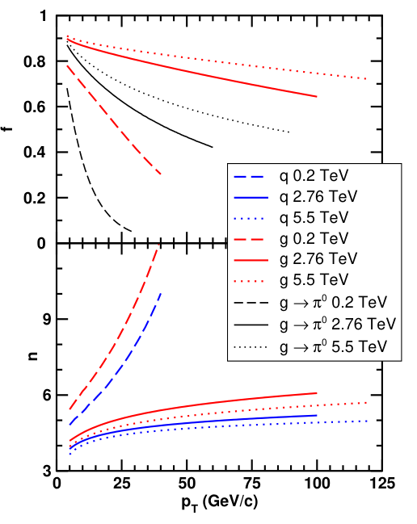
Gluon to Light Quark Crossover

Slide 31
HTL vs Vacuum propagators
HTL expands in momentum transfer: q / T ≃ gs
For large momentum transfer, vacuum propagators should be the correct theory
The way in which you cross between the two, changes the longitudinal and transverse components
Makes a large difference in energy loss

Slide 32
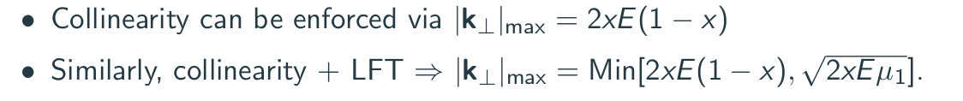
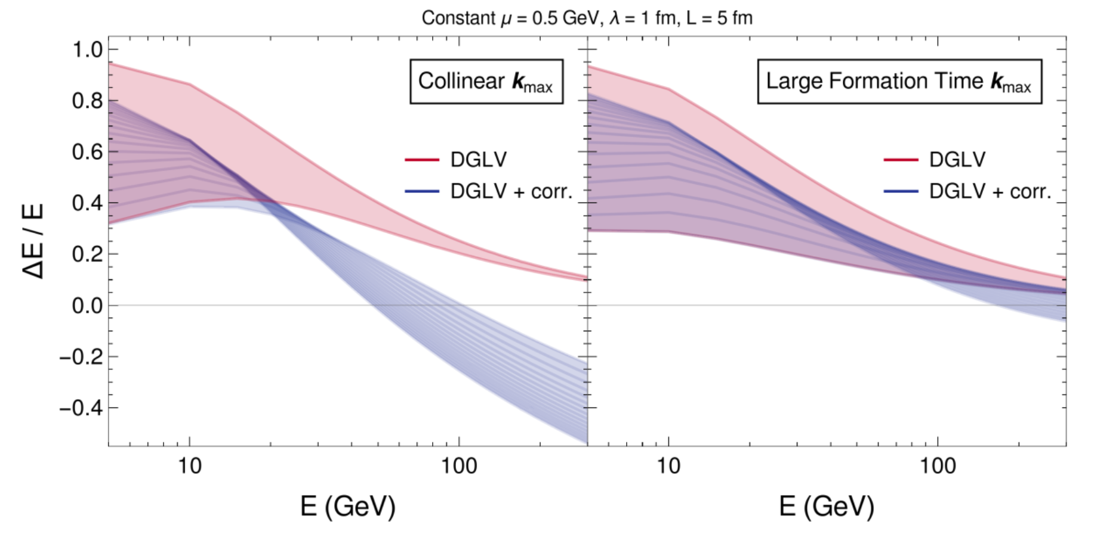
Controlling the LFT approximation

Slide 33
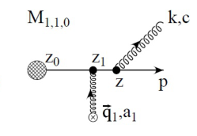
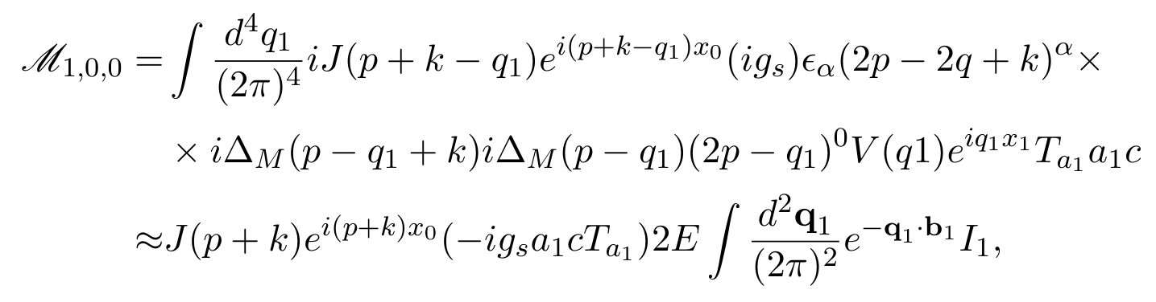
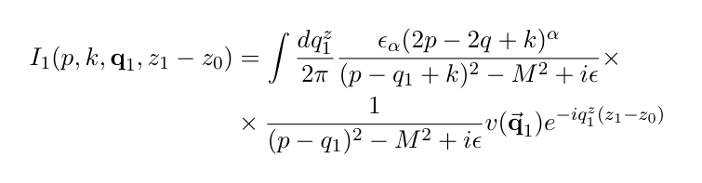

Example contribution to SPL corr.
Pole at

