Slide 1





First exploration of hard-soft
correlations from IP-Glasma
Coleridge Faraday
University of Cape Town, South Africa
23rd June 2026, Hard Probes
Based on CF, W. A. Horowitz, B. Schenke arXiv:2606.xxxxx

Slide 2
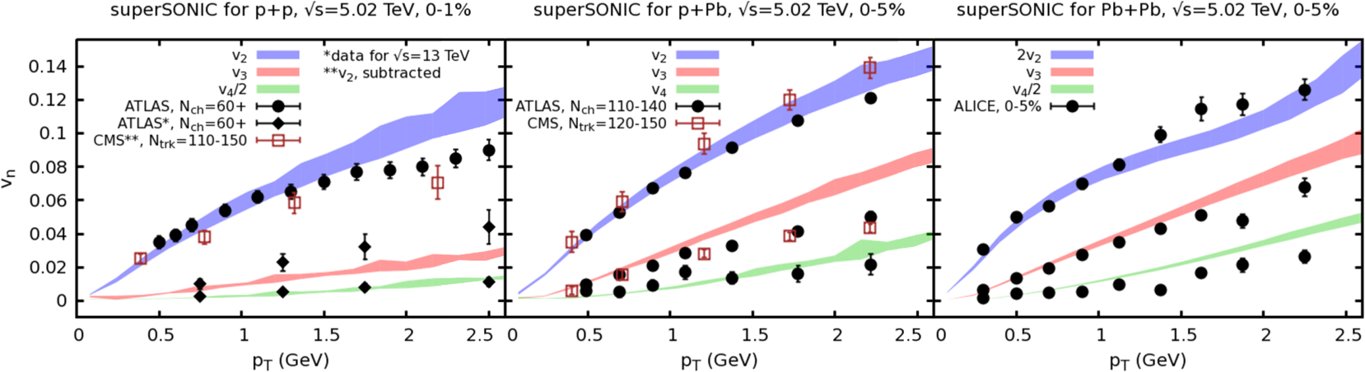



Quark-gluon plasma in small systems?
High-multiplicity events in all collision systems show collective phenomena that hydrodynamics can describe qualitatively.
pp, $𝒪\left(50\right)$ particles
pPb , $𝒪\left(100\right)$ particles
PbPb, ${𝒪(10}^{4})$ particles
Weller et al., PLB 774 (2017) 351-356

Slide 3
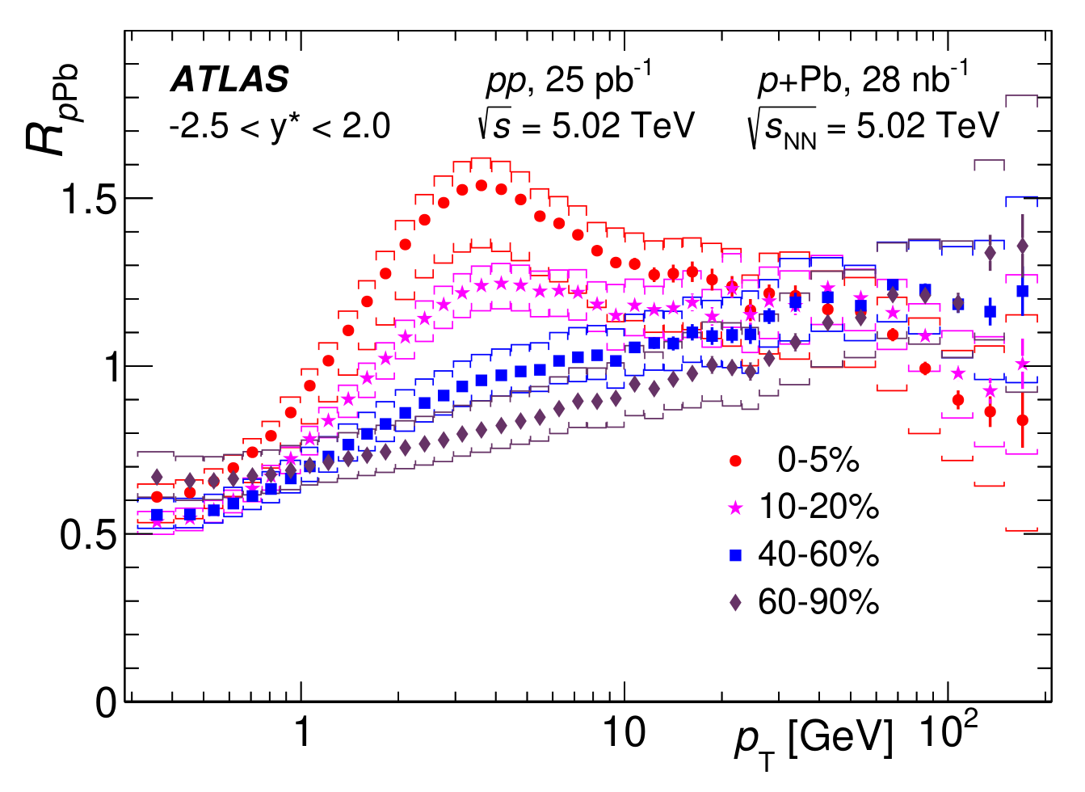
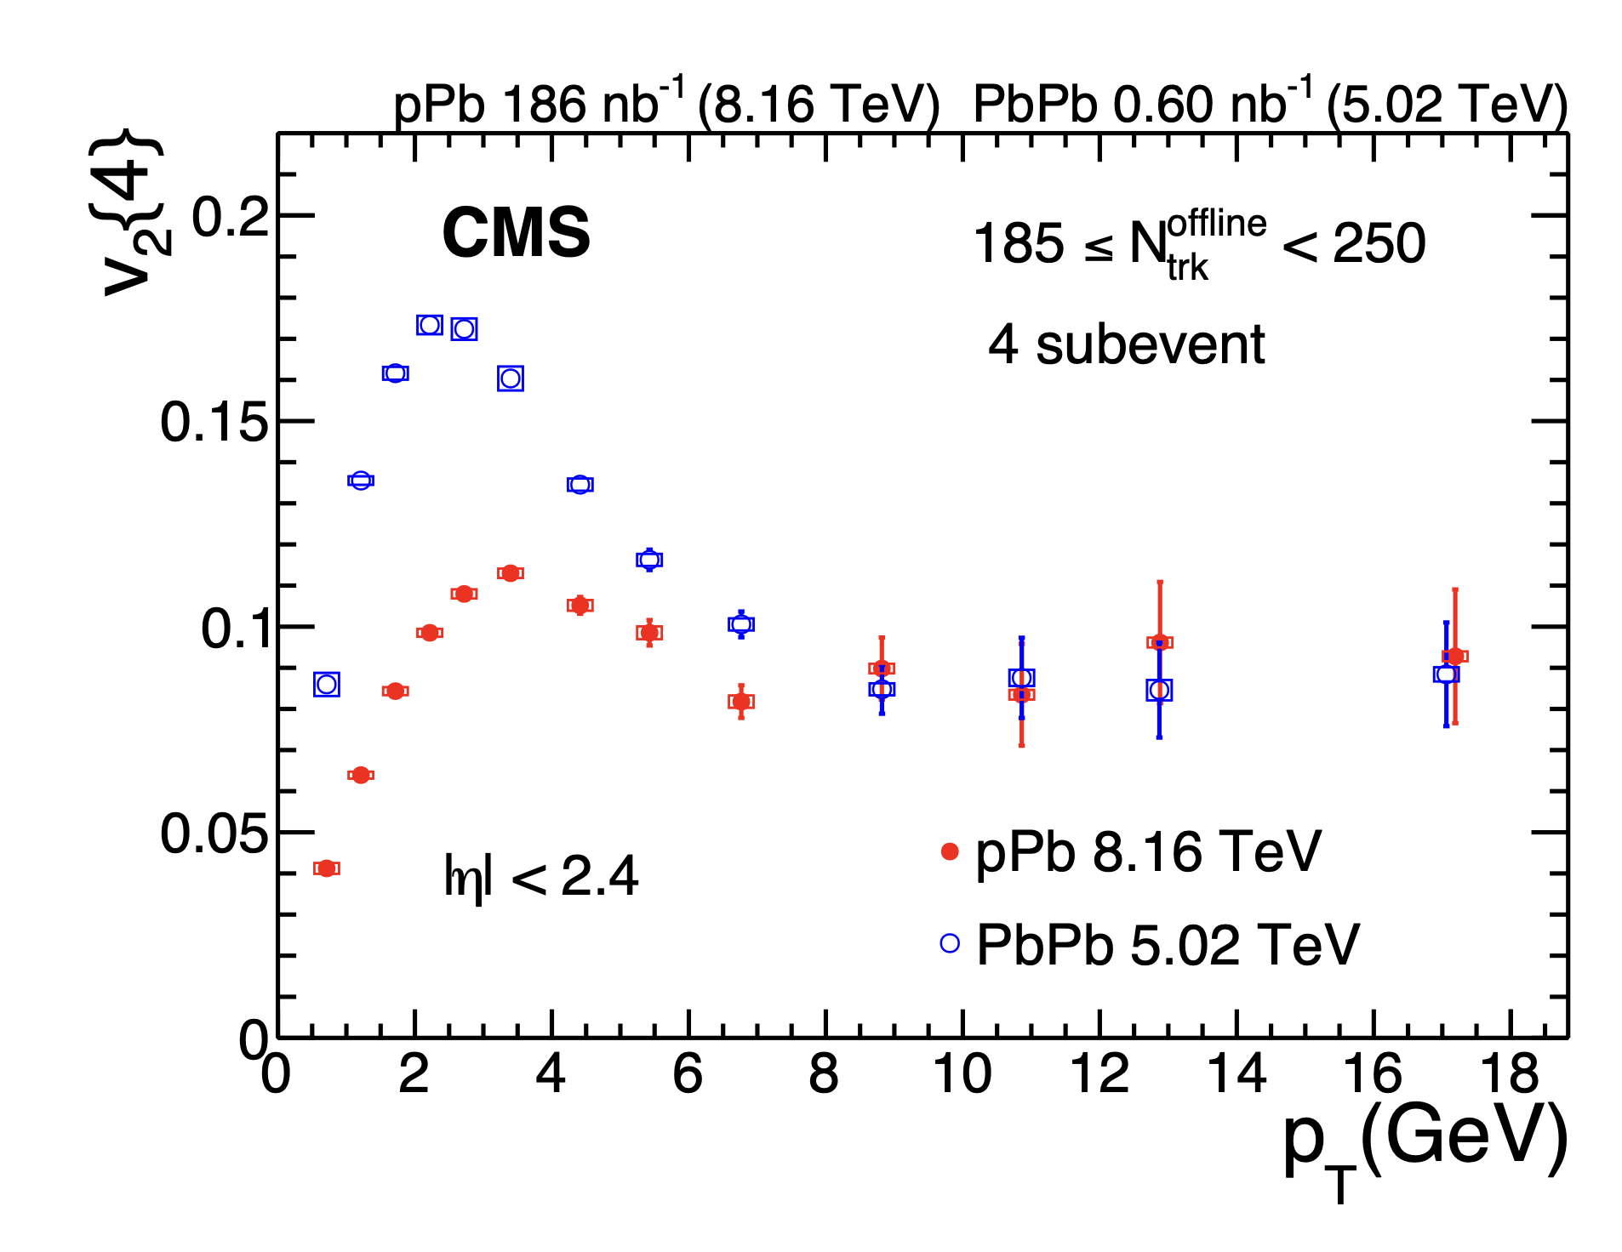
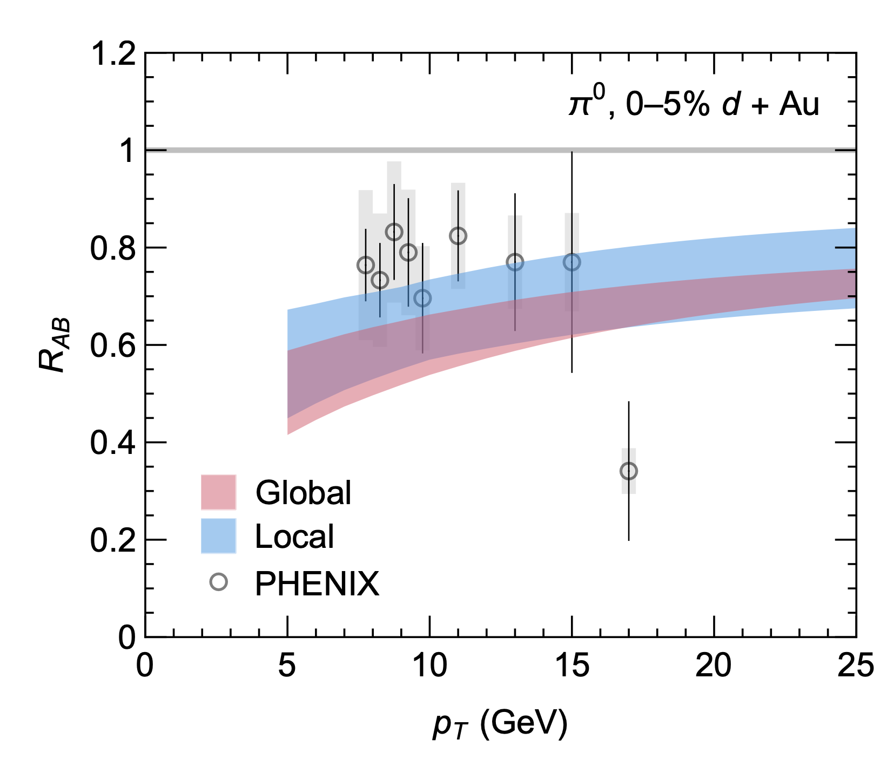
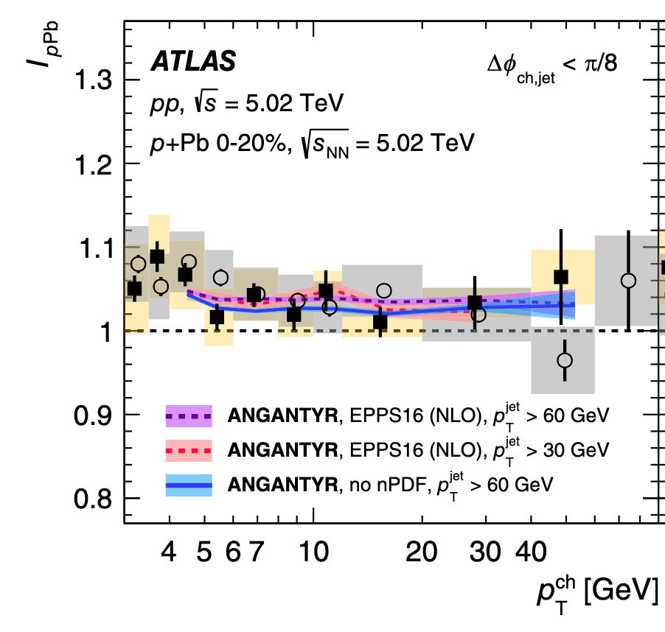

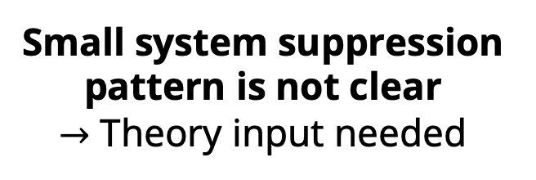
Hard probes in small systems
No energy loss?
No energy loss?
Energy loss?
Energy loss?
$$R_{dAu}^{π}/R_{dAu}^{γ}$$
No energy loss?
Small system suppression pattern is not clear
$→$ Theory input needed
PHENIX, Phys. Rev. Lett. 134, 022302 (2025).
CF and W. A. Horowitz, JHEP 11, 019 (2025).
ATLAS, JHEP 07 (2023) 074
CMS Phys. Rev. Lett. 135, 071903 (2025)
CMS Phys. Rev. Lett. 131, 072301 (2023)

Slide 4
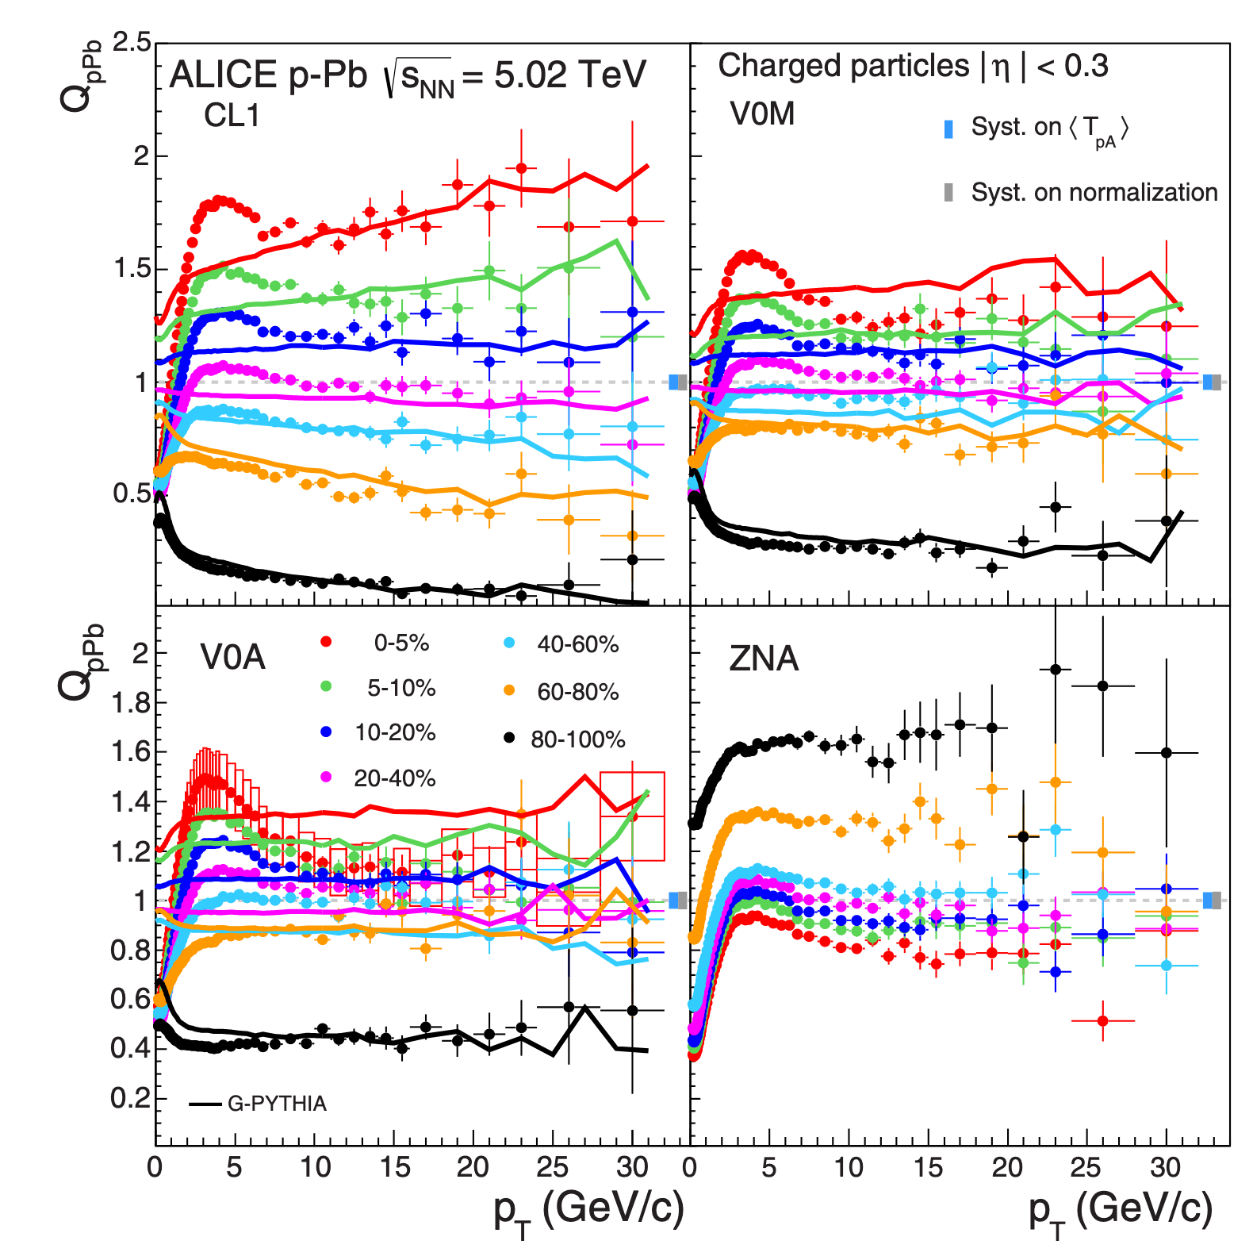
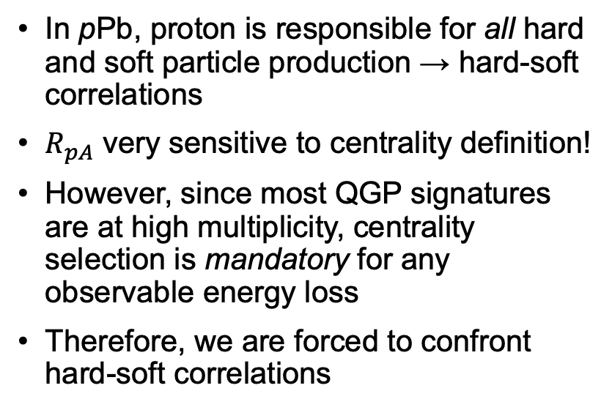
Why are centrality-selected hard probes difficult?
In pPb, proton is responsible for all hard and soft particle production → hard-soft correlations
$R_{pA}$ very sensitive to centrality definition!
However, since most QGP signatures are at high multiplicity, centrality selection is mandatory for any observable energy loss
Therefore, we are forced to confront hard-soft correlations
ALICE, Phys. Rev. C 91, 064905 (2015).

Slide 5
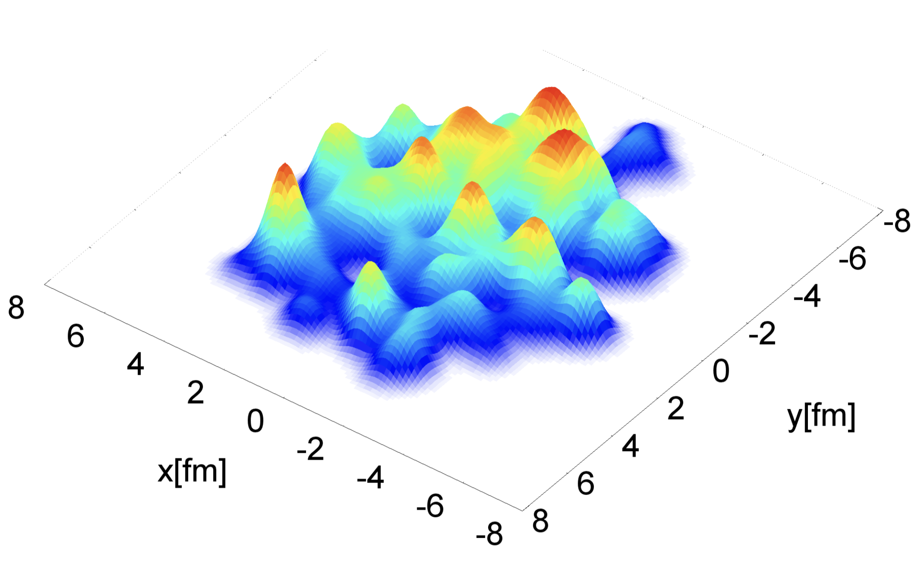
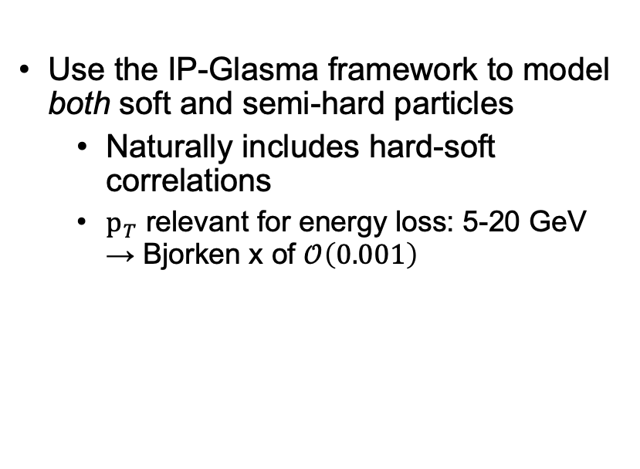
Tackling hard-soft correlations
IP-Glasma is built on the color glass condensate (CGC), valid at small Bjorken x
Solves classical Yang-Mills equations event-by-event, including geometric, subnucleonic color-charge, and saturation-scale fluctuations
Use the IP-Glasma framework to model both soft and semi-hard particles
Naturally includes hard-soft correlations
$p_{T}$ relevant for energy loss: 5-20 GeV → Bjorken x of $𝒪\left(0.001\right)$
Figure from B. Schenke, P. Tribedy, and R. Venugopalan, PRL 108, 252301 (2012).
CF, W. A. Horowitz, B. Schenke arXiv:2606.xxxxx

Slide 6
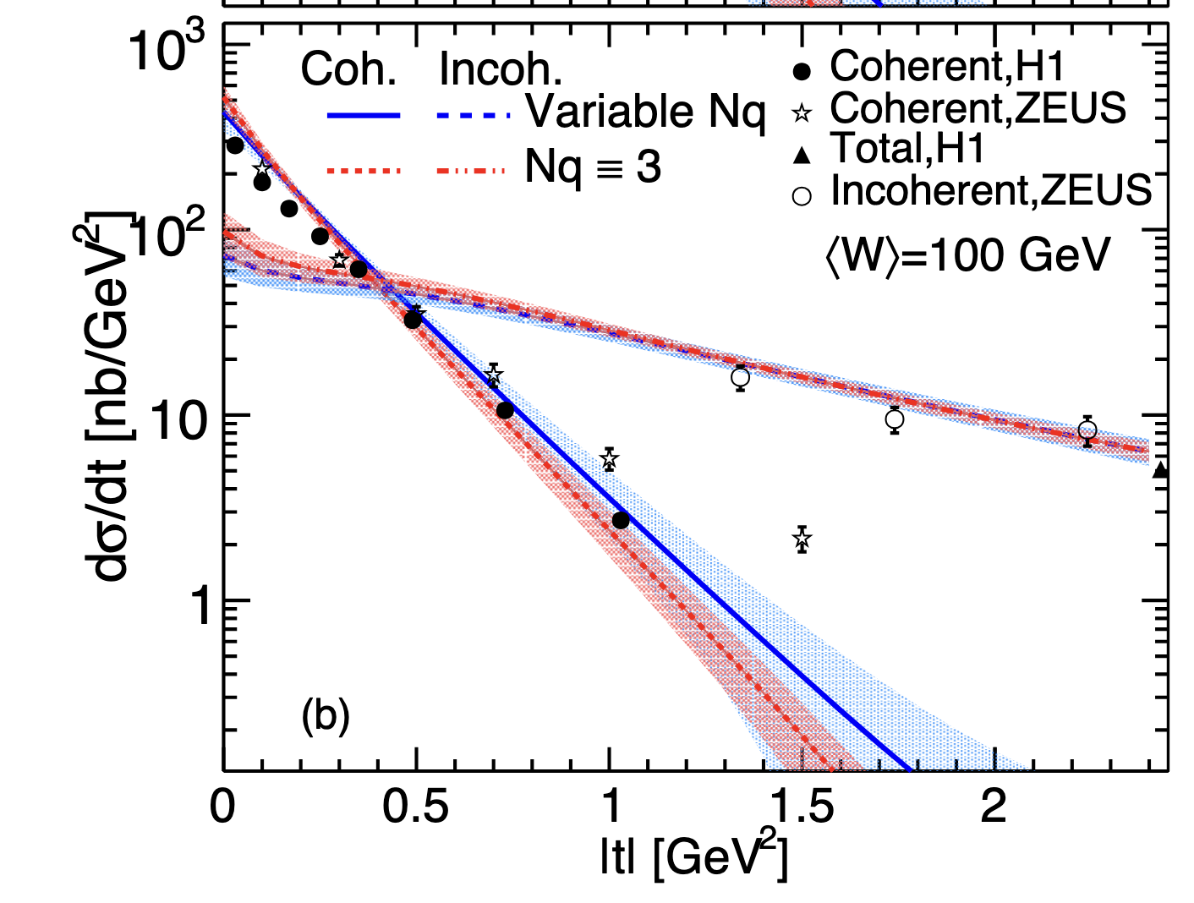
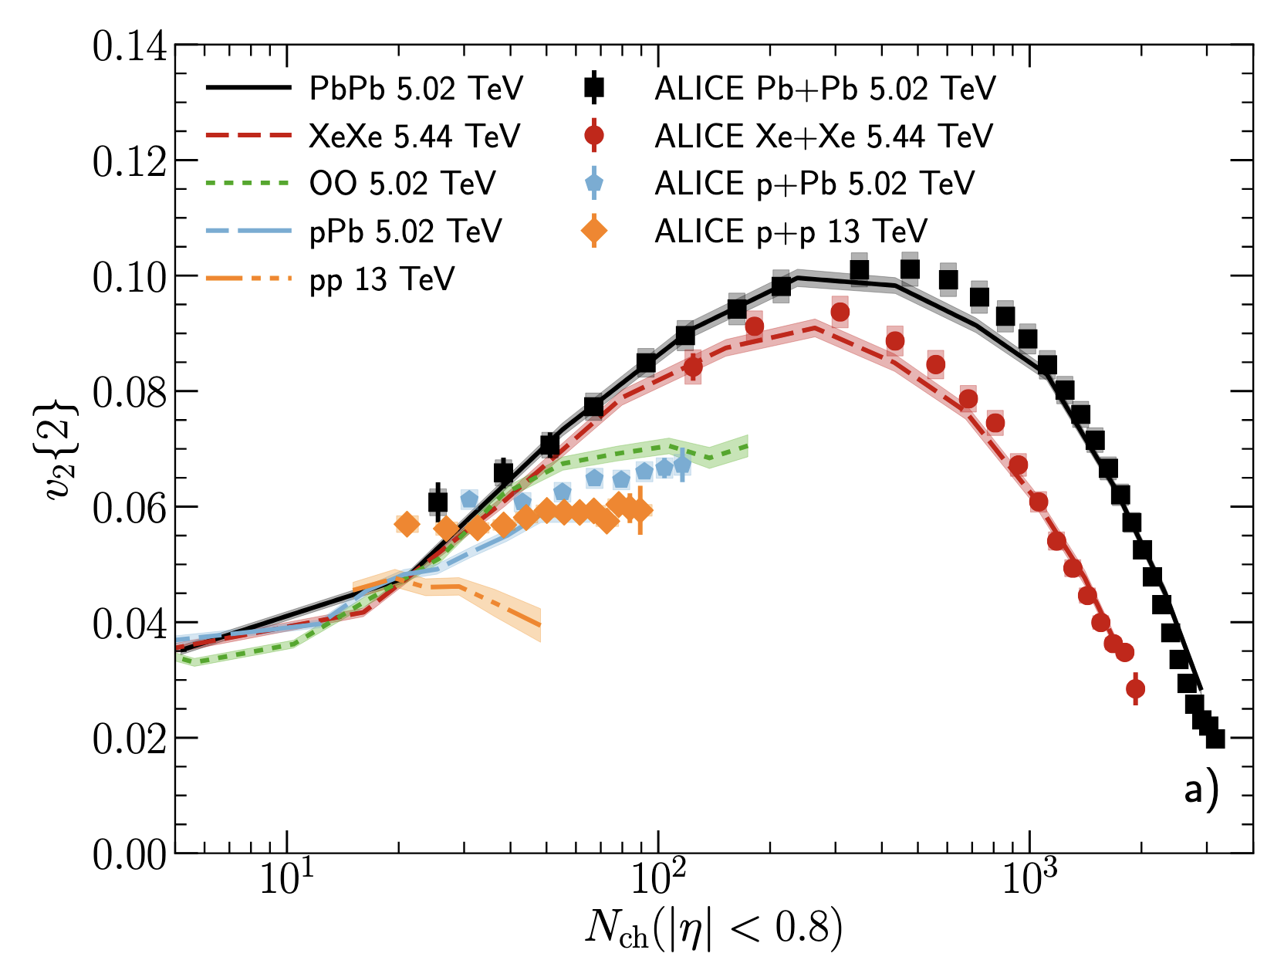
IP-Glasma as an initial-state
All parameters are sampled from a prior Bayesian posterior on HERA data [H. Mäntysaari, B. Schenke, C. Shen, and W. Zhao, Phys. Lett. B 833, 137348 (2022).]
After hydrodynamics, provides good description of soft observables (not yet included in this work)
B. Schenke, C. Shen, and P. Tribedy, Phys. Rev. C 102, 044905 (2020).

Slide 7
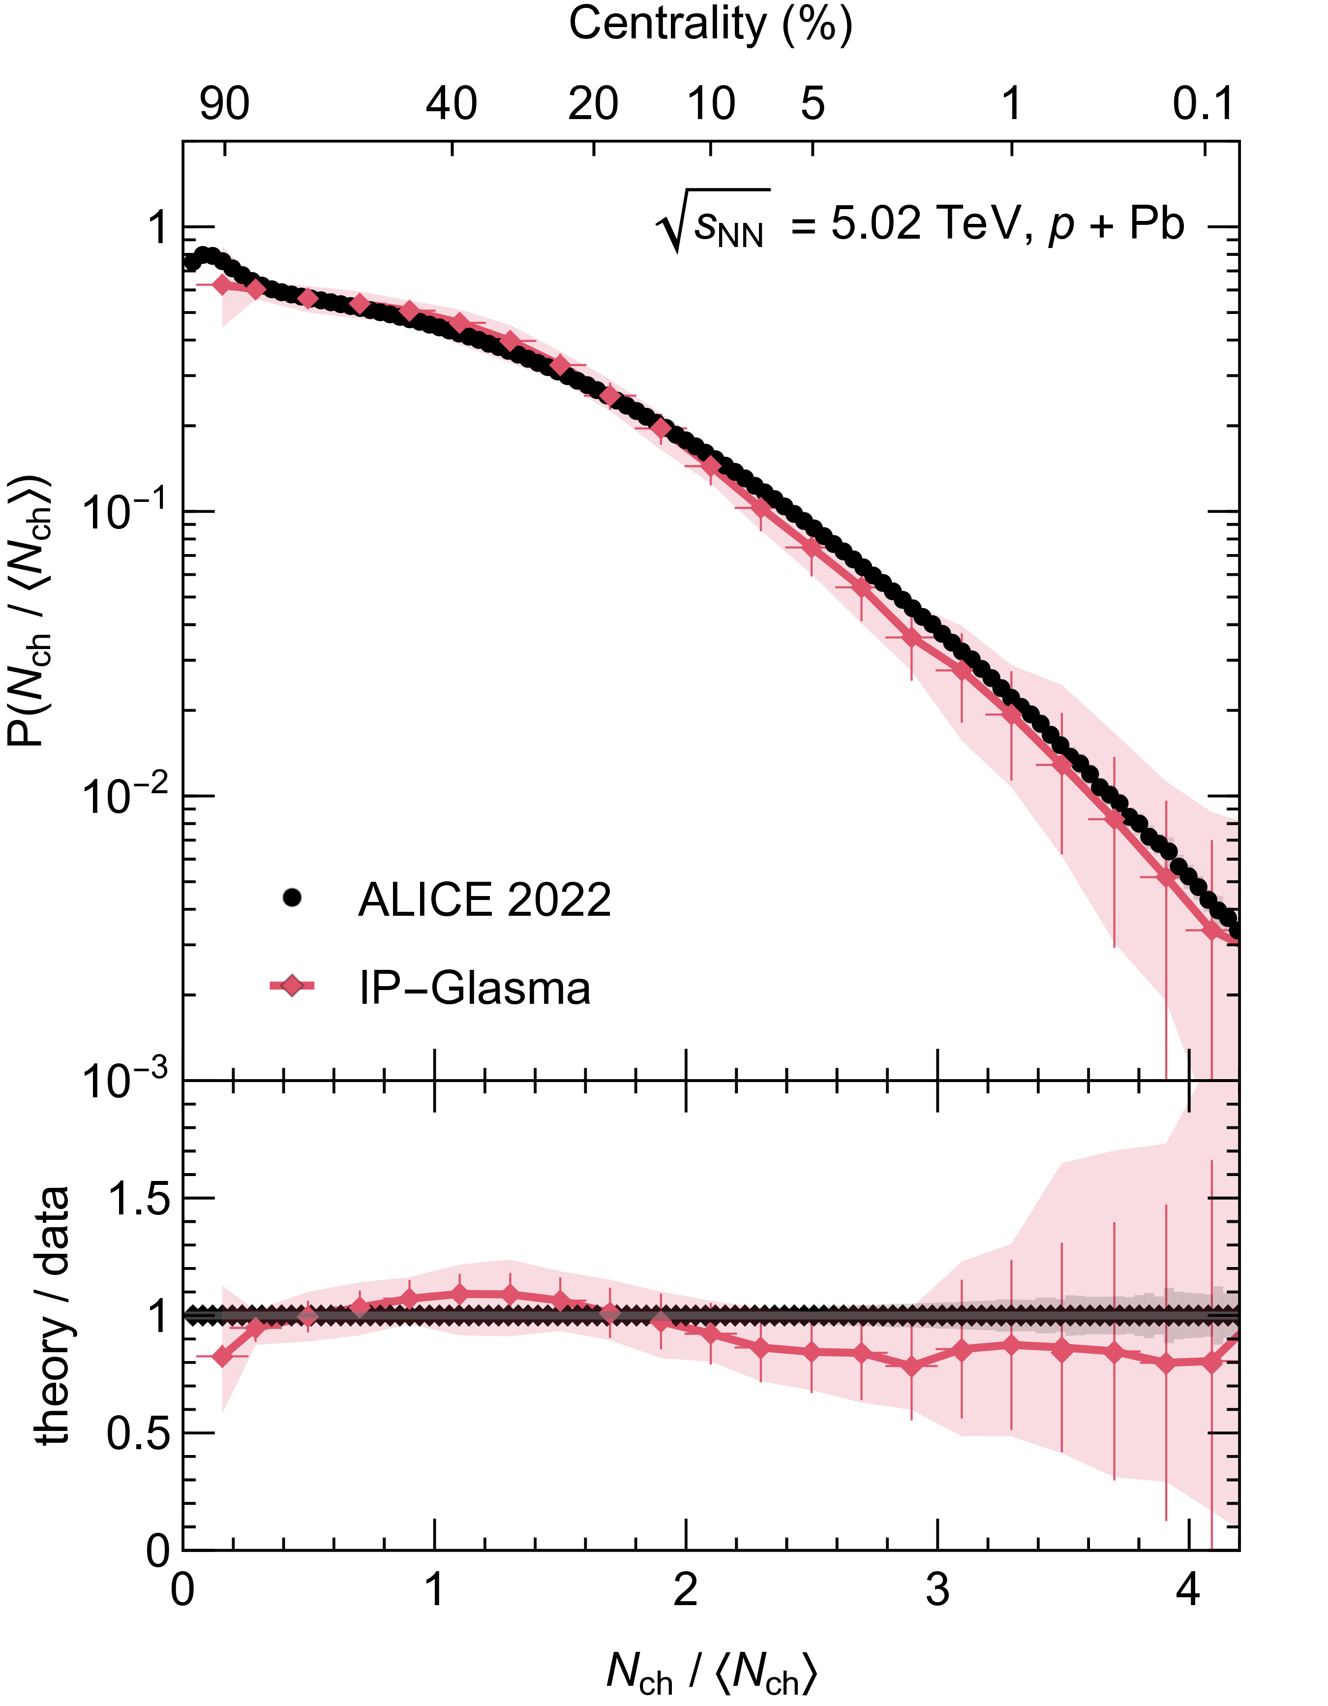
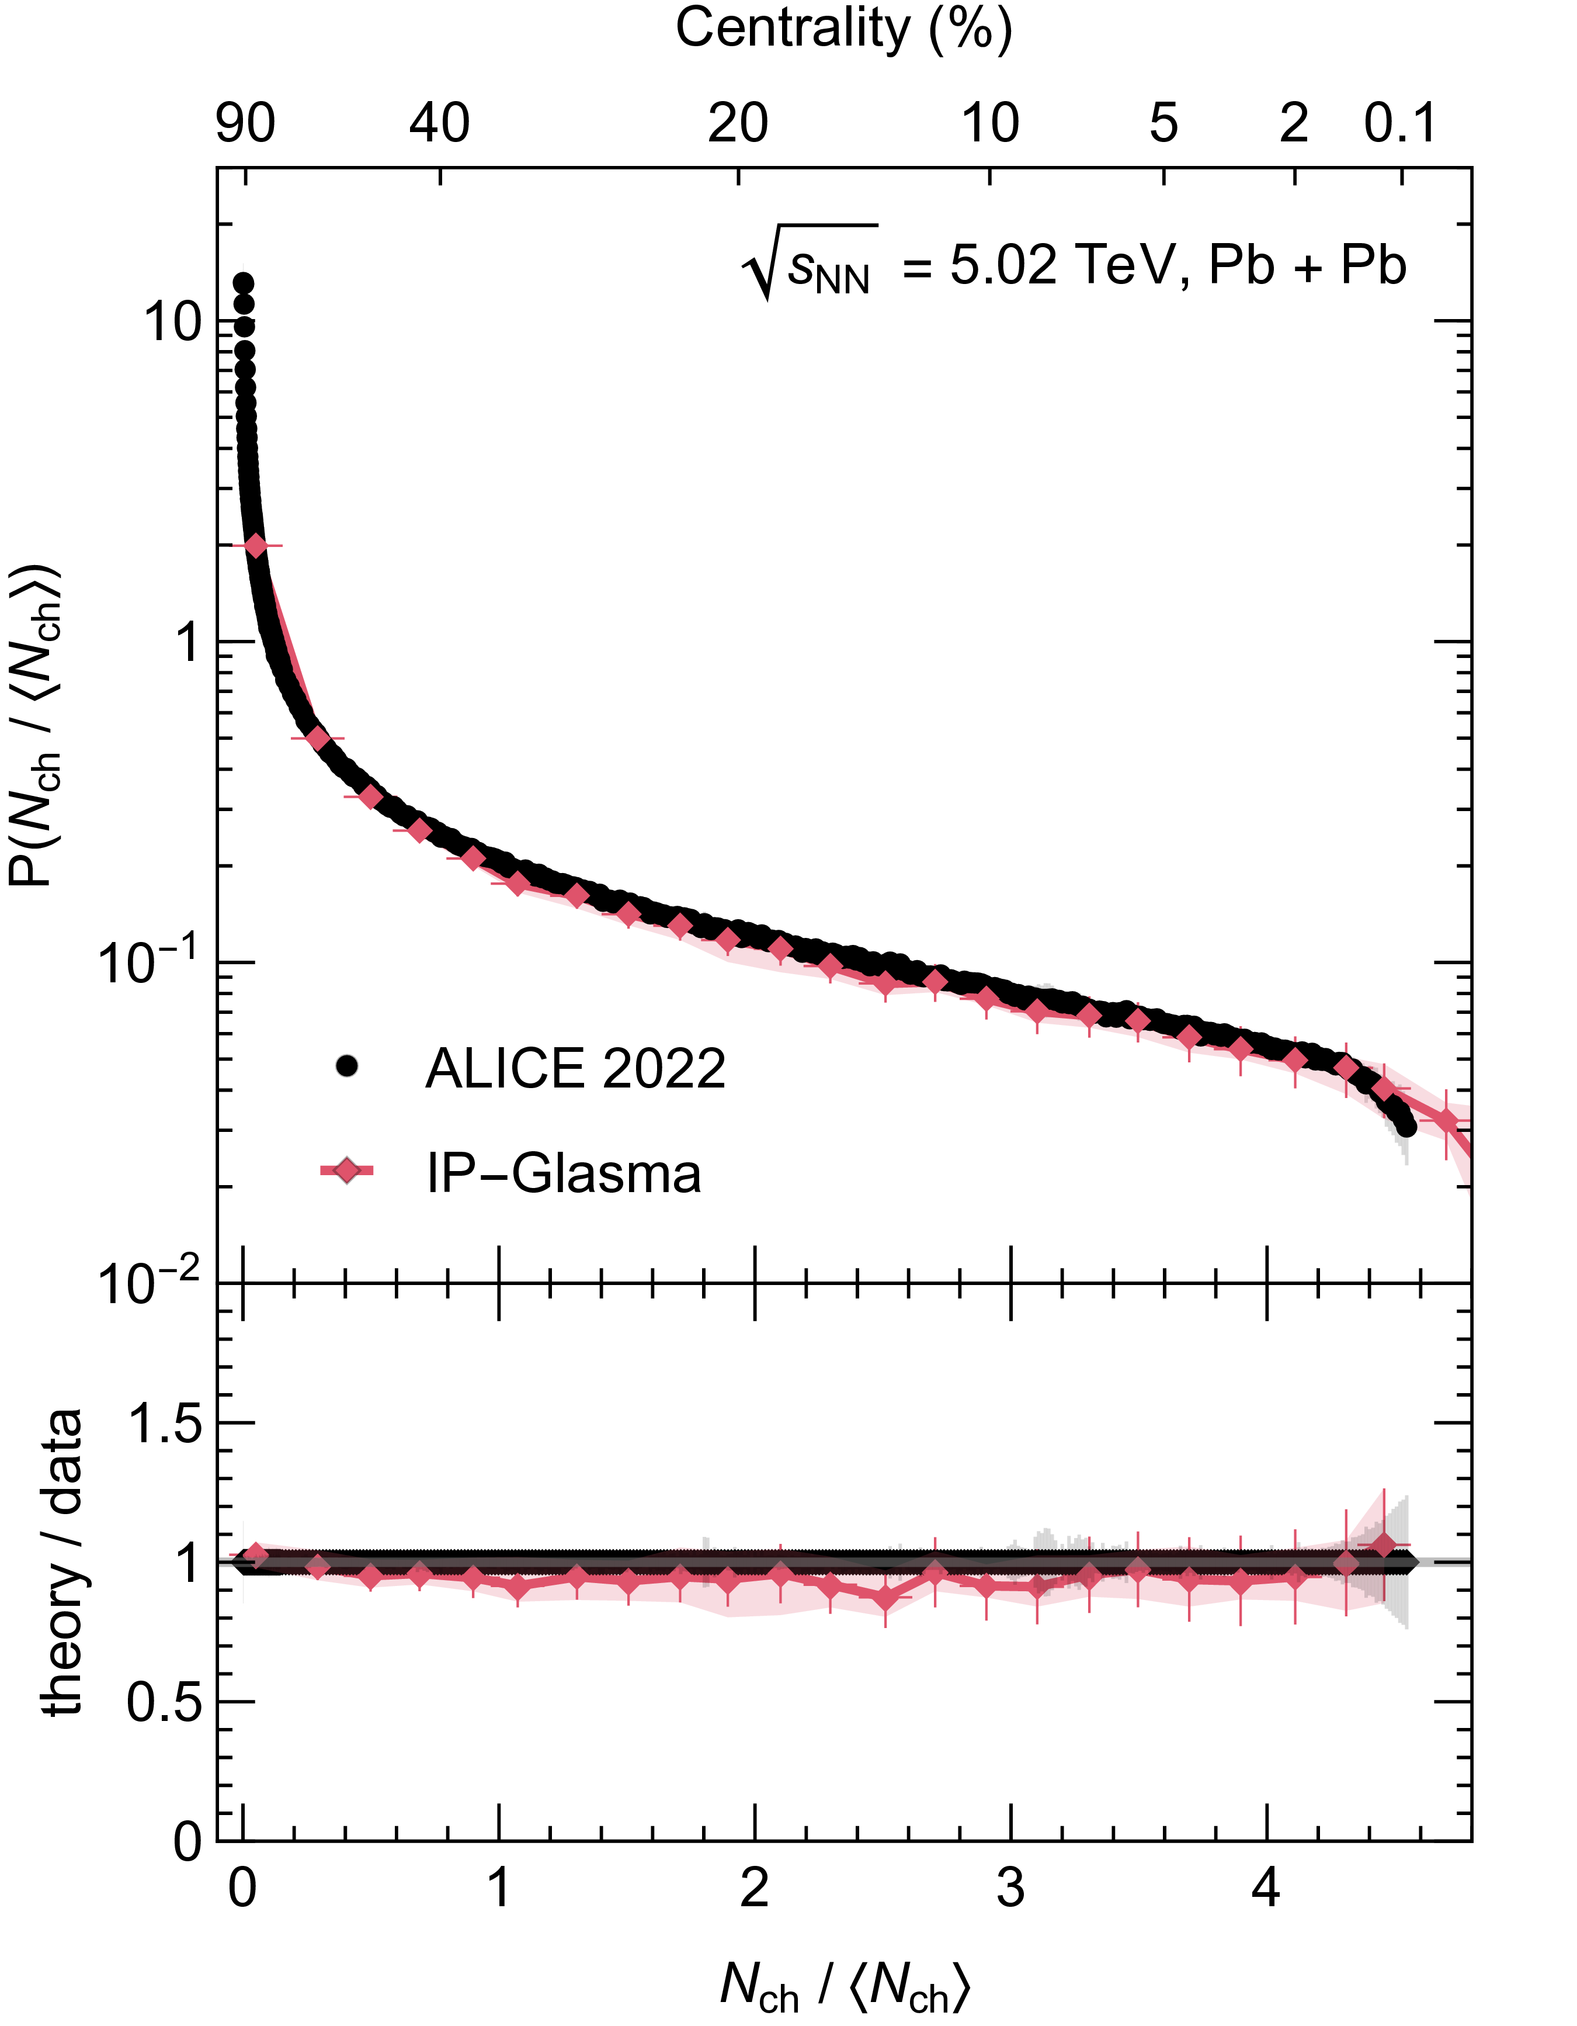


Multiplicity distributions
$$p + Pb$$
Multiplicity distributions are largely unchanged by the (missing) hydro evolution
Excellent agreement with multiplicity distributions from 0.1 – 100% centrality
→ centrality classification is reliable
$$Pb + Pb$$
Notes:
t

Slide 8
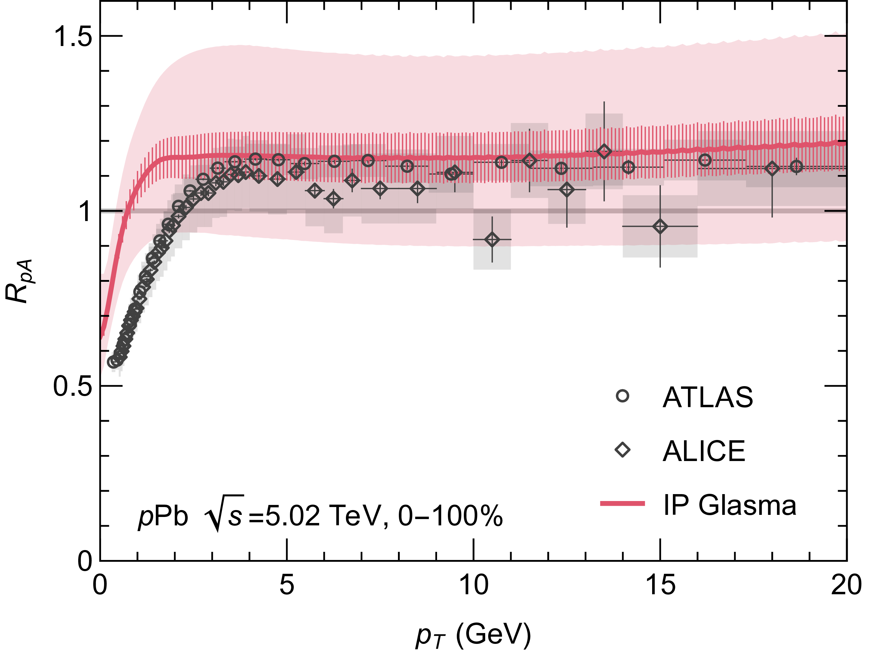

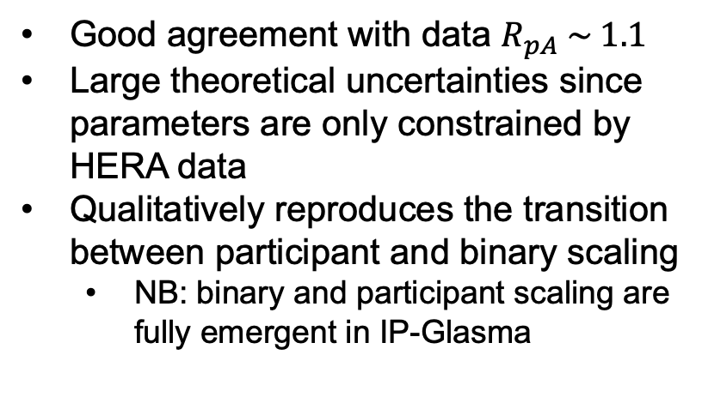
Minimum bias $R_{pA}$
From IP-Glasma
Experimentally reported
Good agreement with data $R_{pA} \sim 1.1$
Large theoretical uncertainties since parameters are only constrained by HERA data
Qualitatively reproduces the transition between participant and binary scaling
NB: binary and participant scaling are fully emergent in IP-Glasma
CF, W. A. Horowitz, B. Schenke arXiv:2606.xxxxx

Slide 9
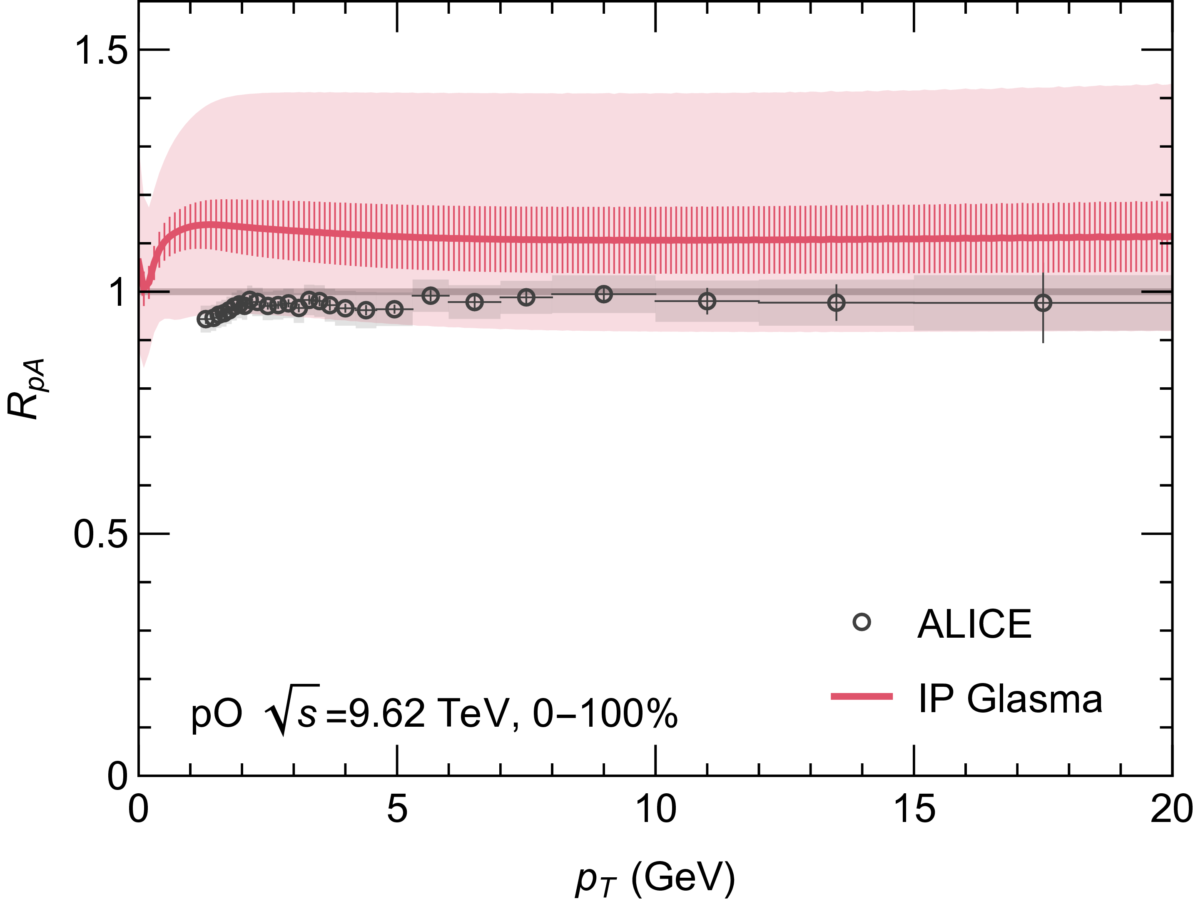
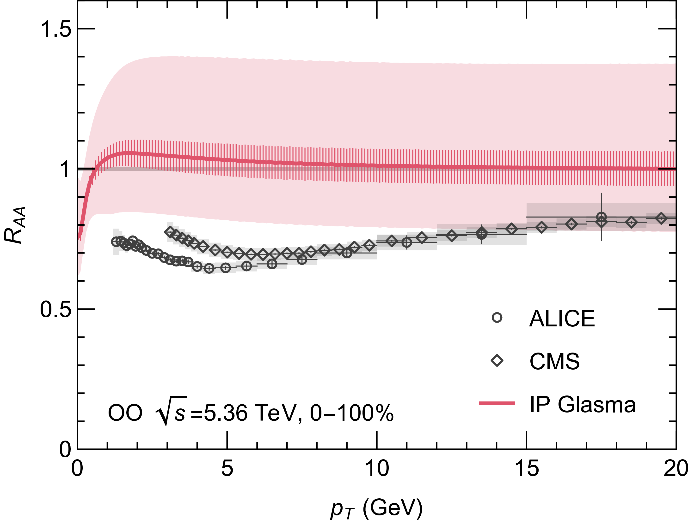
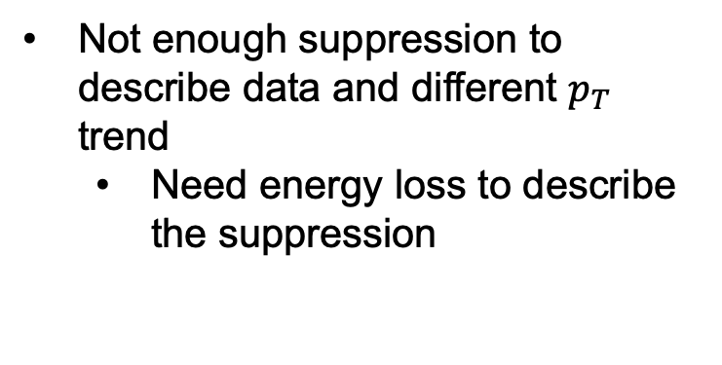
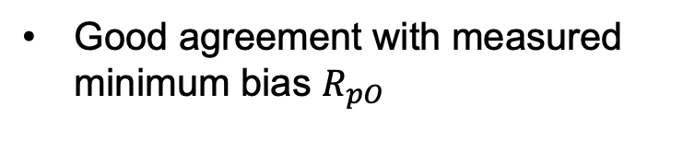
Oxygen?
Good agreement with measured minimum bias $R_{pO}$
Not enough suppression to describe data and different $p_{T}$ trend
Need energy loss to describe the suppression

Slide 10
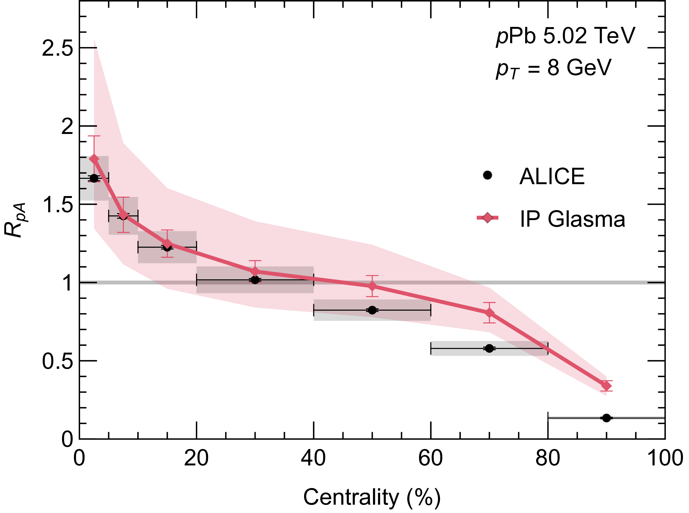
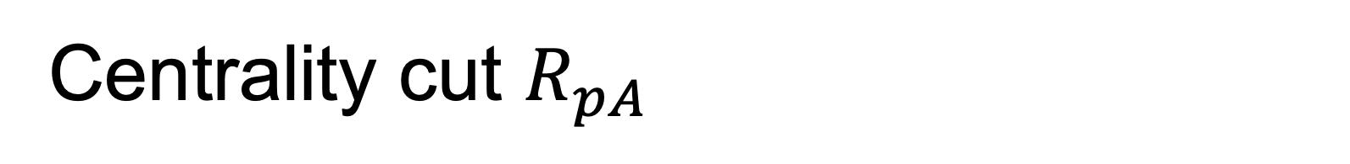
Centrality cut $R_{pA}$
Centrality determined by soft particles at midrapidity
IP-Glasma reproduces the data very well!
In most peripheral collisions, we miss jet-veto bias.
CF, W. A. Horowitz, B. Schenke arXiv:2606.xxxxx

Slide 11
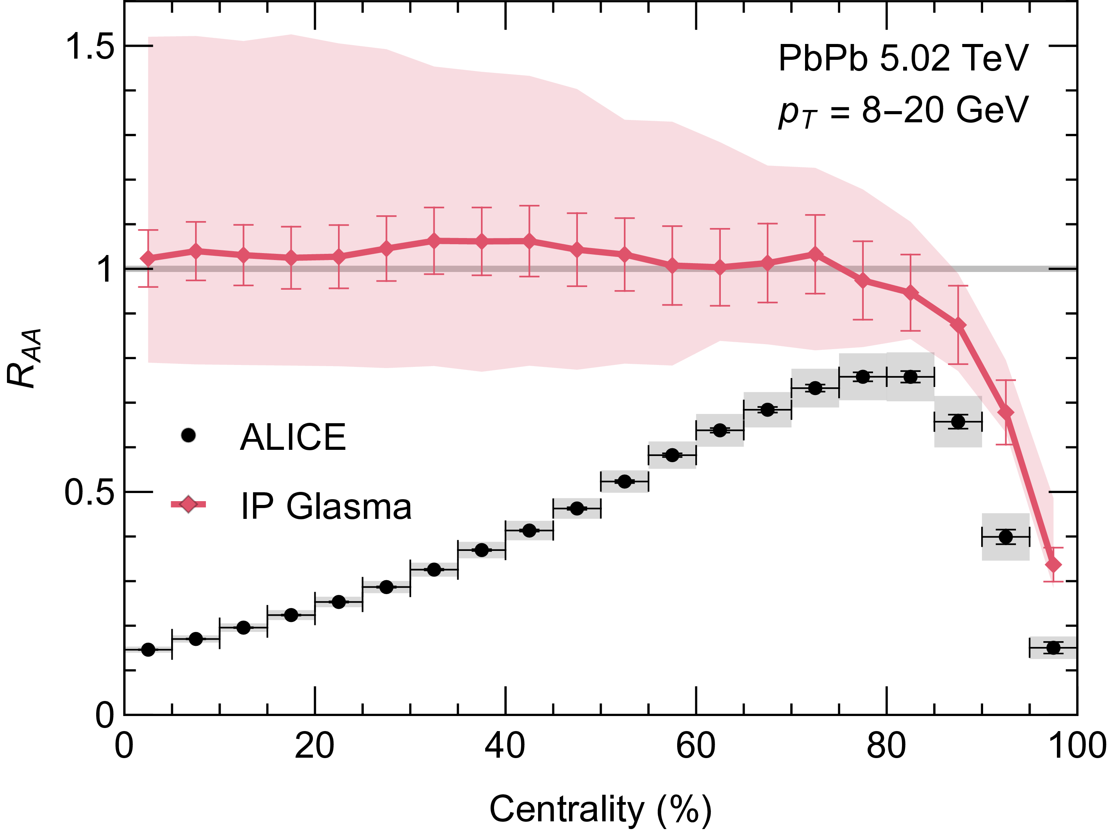
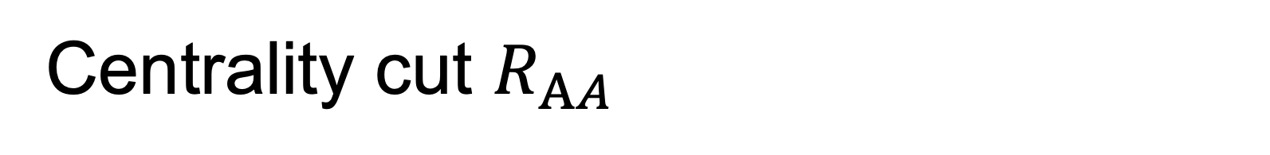
Centrality cut $R_{AA}$
In central collisions, we’re missing energy loss
IP-Glasma reproduces the most peripheral data qualitatively very well!
Quantitative disagreement in peripheral classes likely due to missing jet veto bias or residual energy loss
CF, W. A. Horowitz, B. Schenke arXiv:2606.xxxxx

Slide 12
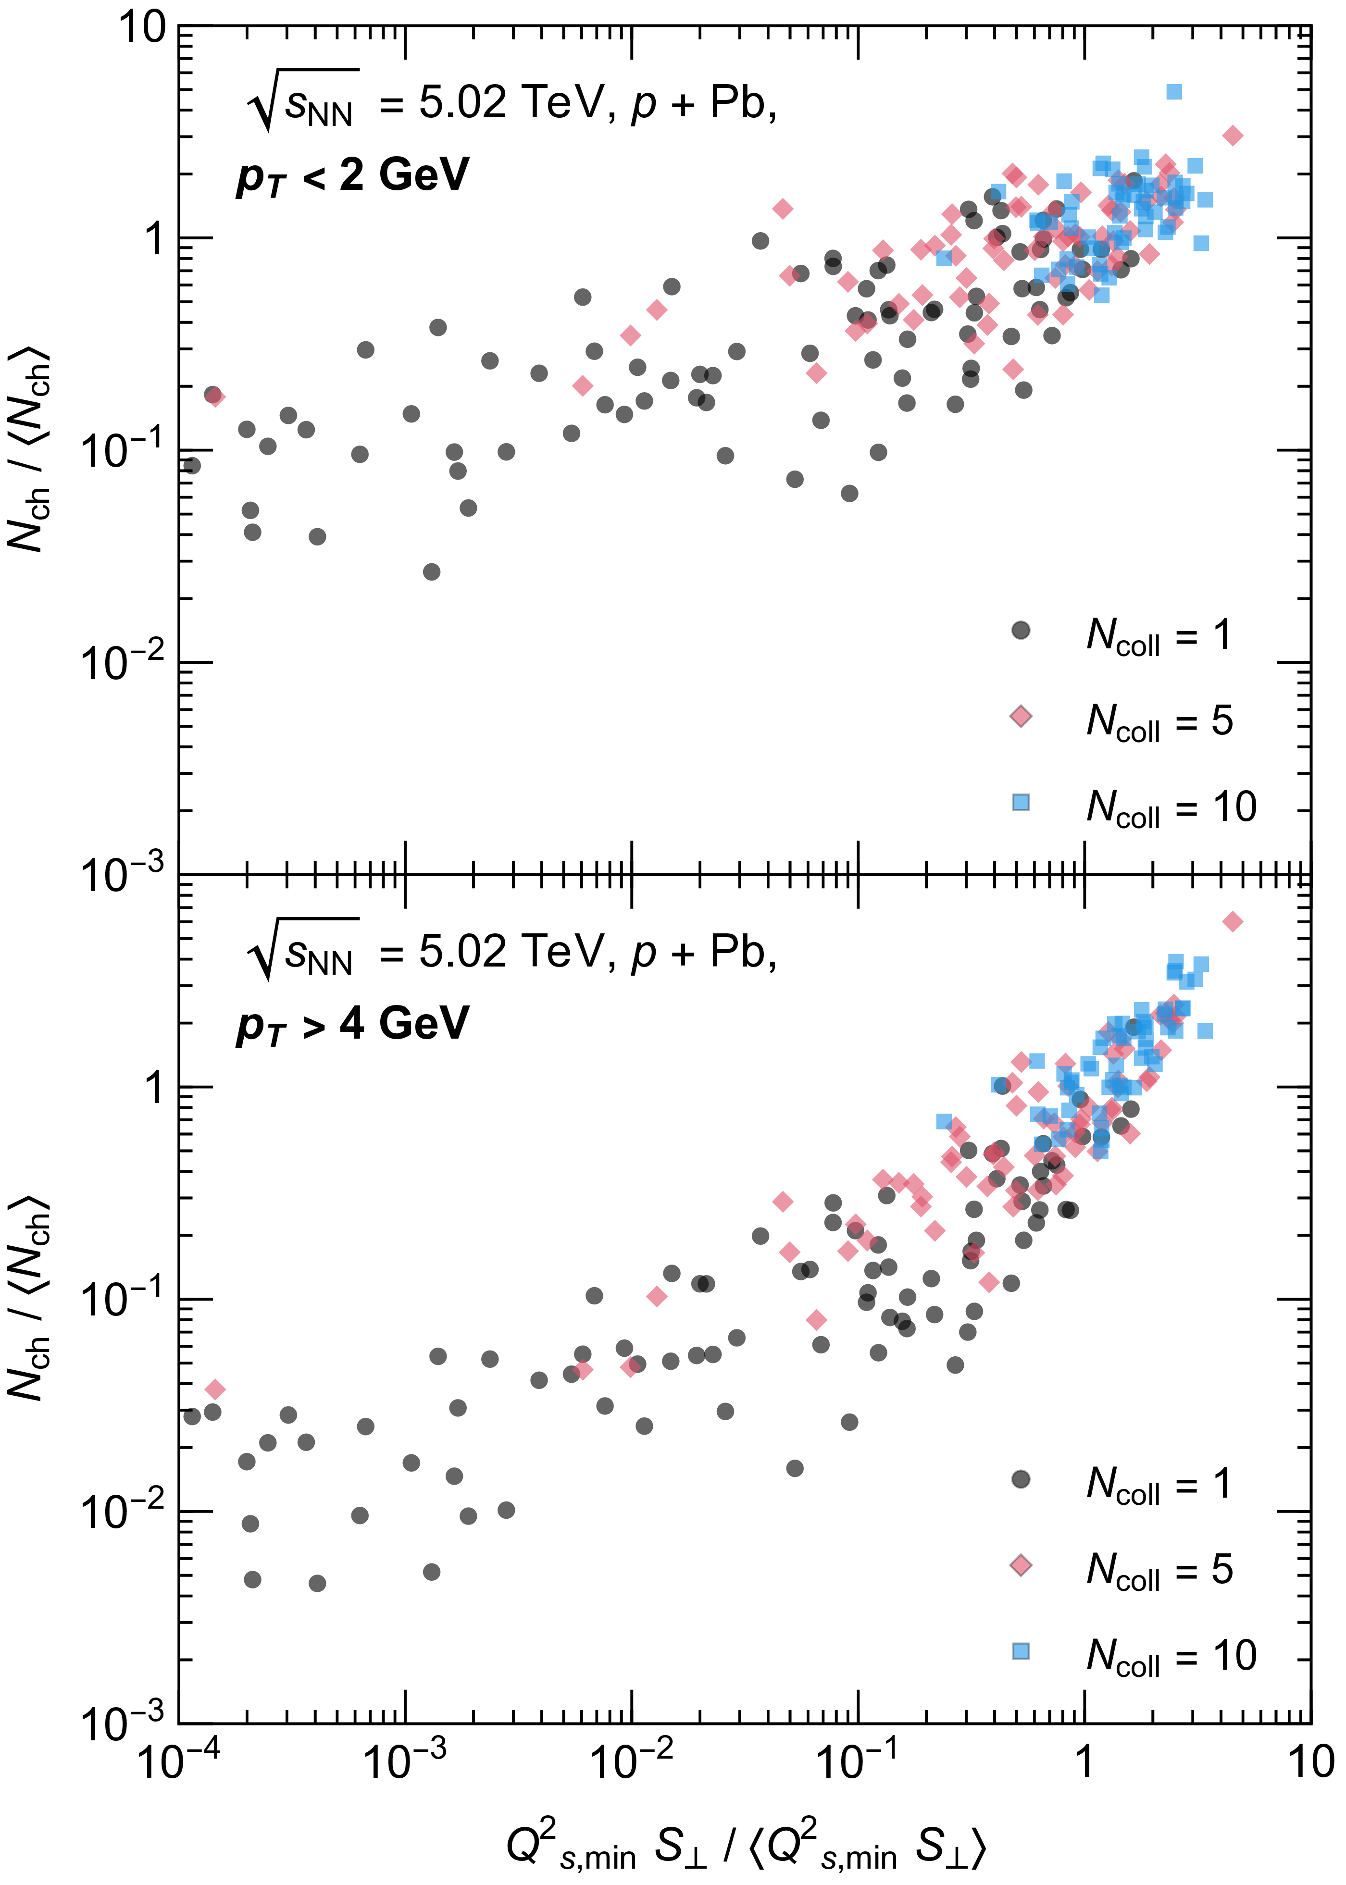

What causes hard-soft correlations?
Nucleon-by-nucleon fluctuations in the local saturation scale $Q_{s}(x)$ are correlated with both hard- and soft-multiplicity
Creates excess high-$p_{T}$ gluons in central events and depletion of high-$p_{T}$ gluons in peripheral events
CF, W. A. Horowitz, B. Schenke arXiv:2606.xxxxx

Slide 13
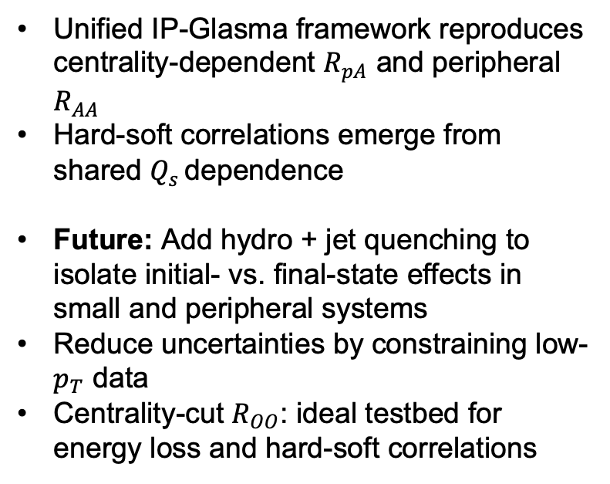
Summary and outlook
Unified IP-Glasma framework reproduces centrality-dependent $R_{pA}$ and peripheral $R_{AA}$
Hard-soft correlations emerge from shared $Q_{s }$dependence
Future: Add hydro + jet quenching to isolate initial- vs. final-state effects in small and peripheral systems
Reduce uncertainties by constraining low-$p_{T}$ data
Centrality-cut $R_{OO}$: ideal testbed for energy loss and hard-soft correlations
Notes:
Data subsets can test model consistency and highlight missing physics.
Provides a quick way to identify sensitive observables and potential gaps in the model.

Slide 14
Backup

Slide 15
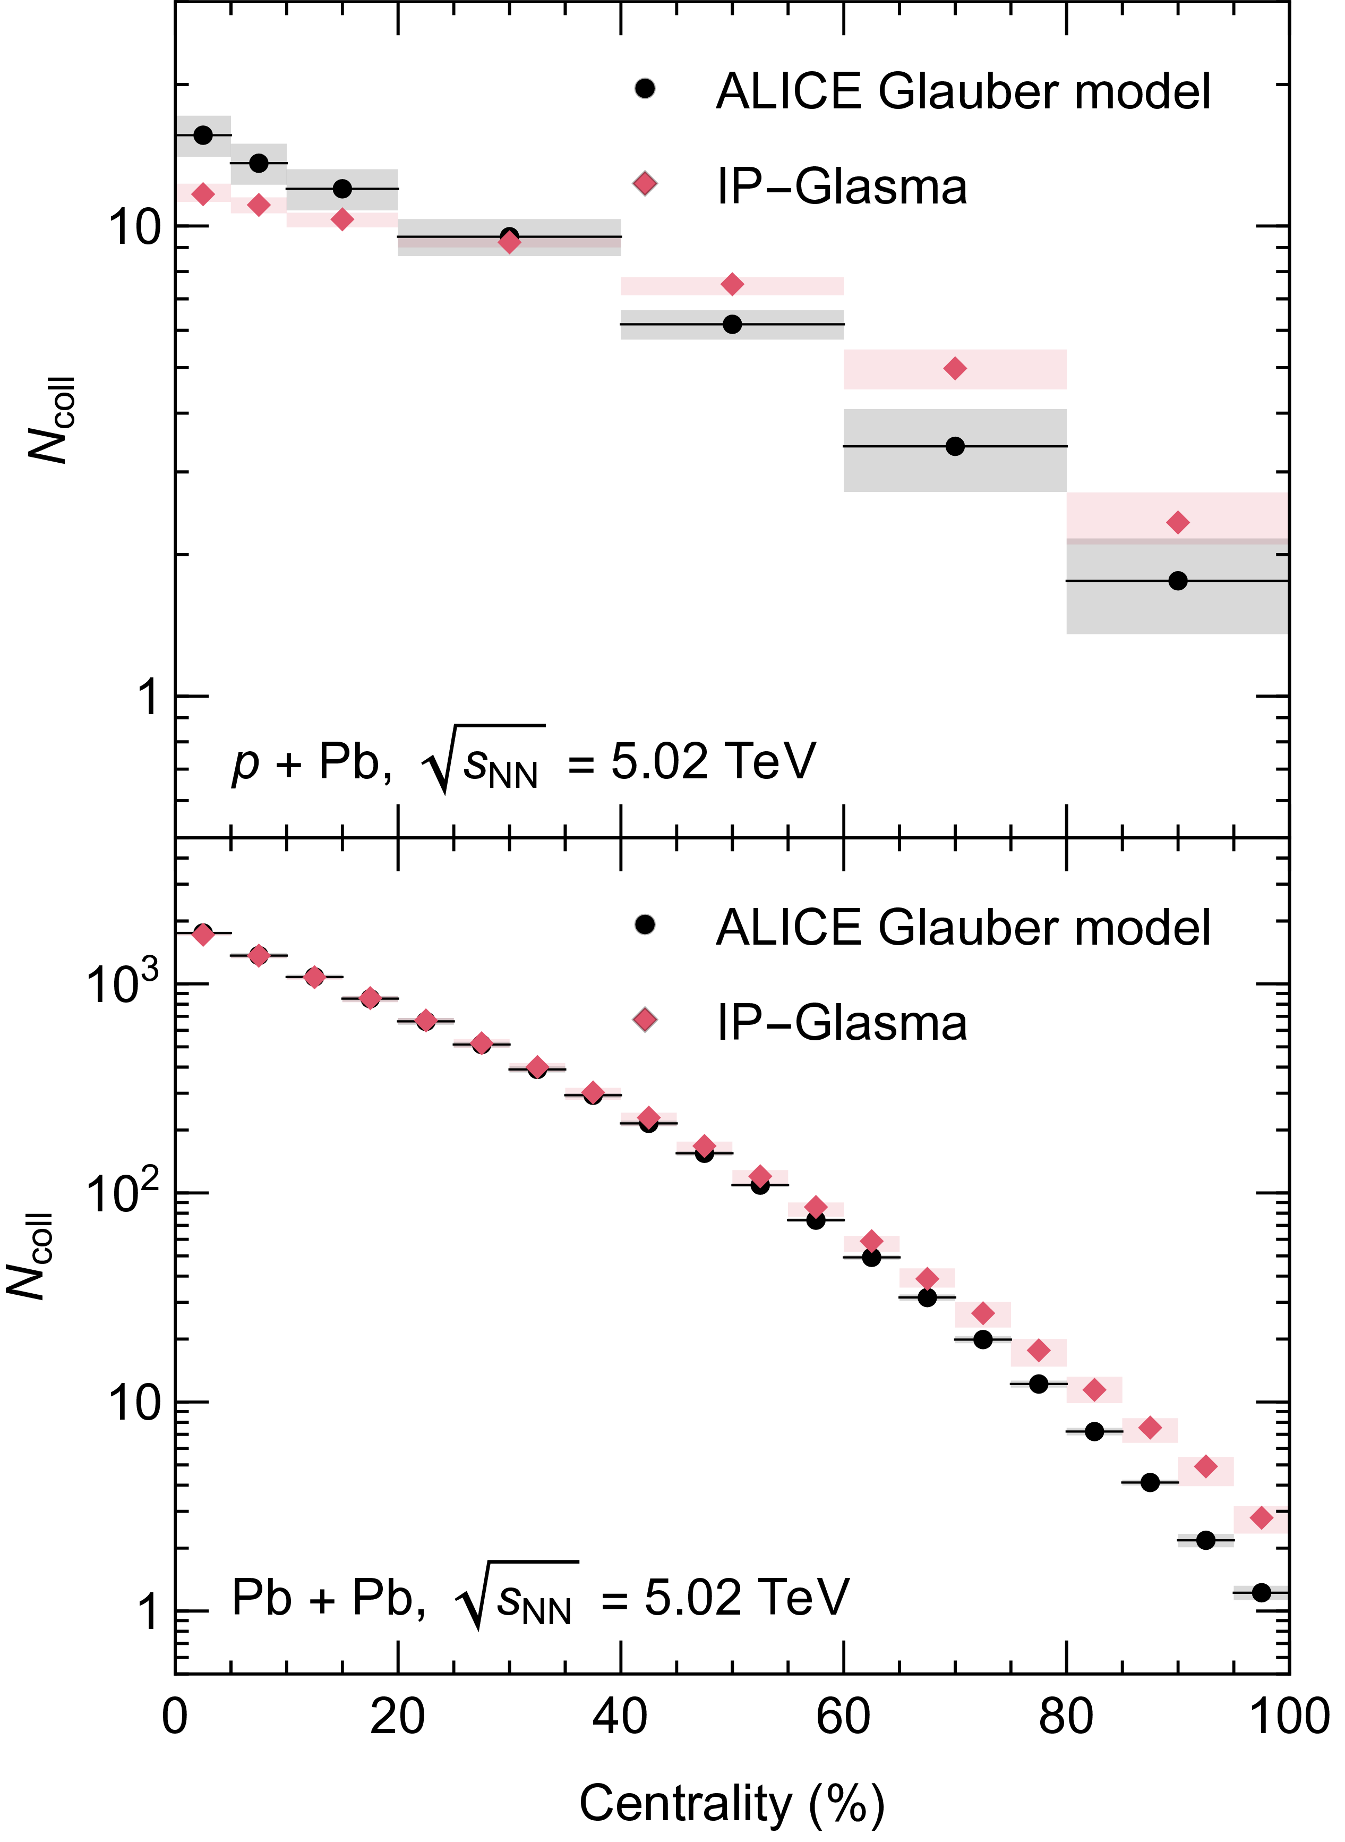
Ncoll
Deviations of IP-Glasma and ALICE reported Ncoll underscore importance of using experimental Ncoll when comparing

Slide 16
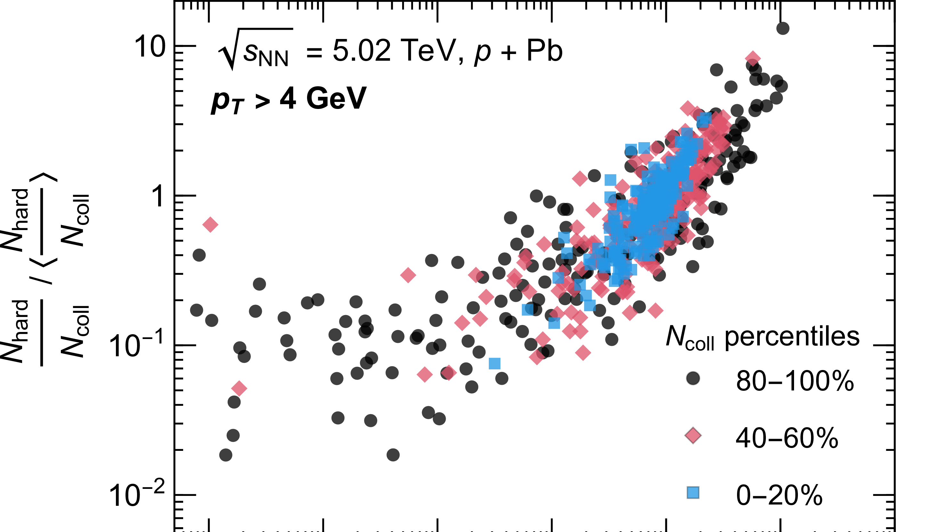
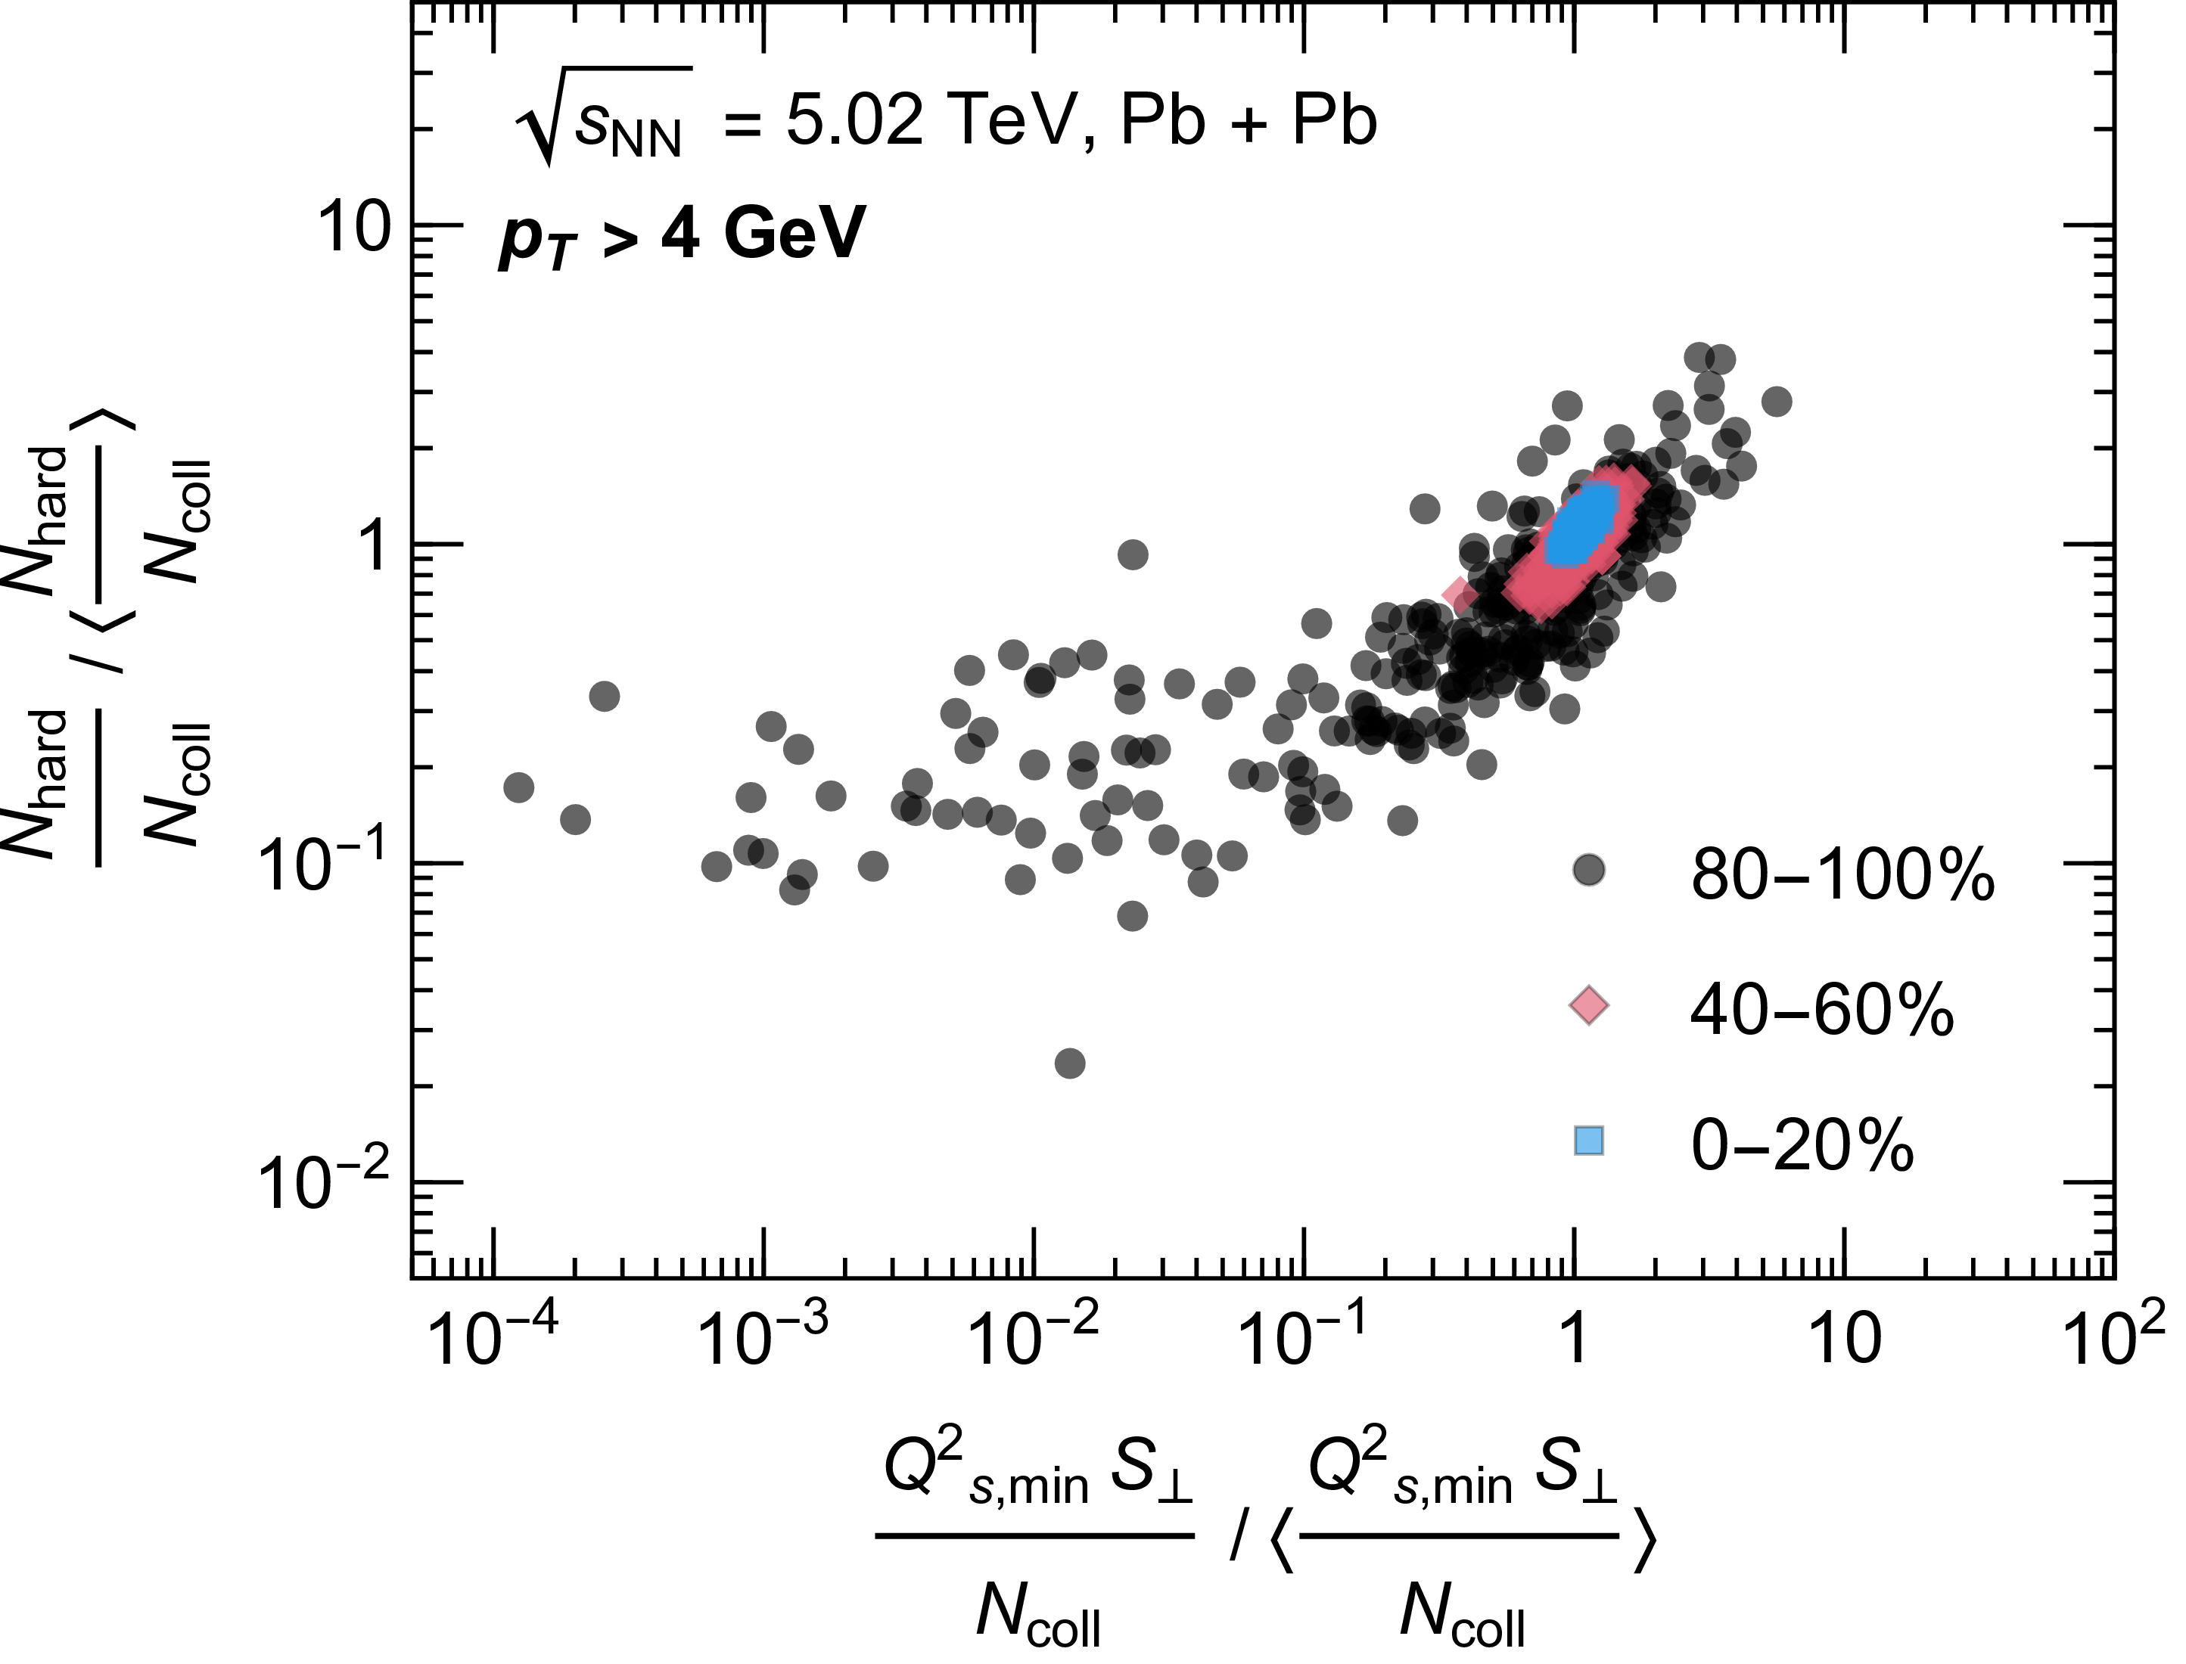
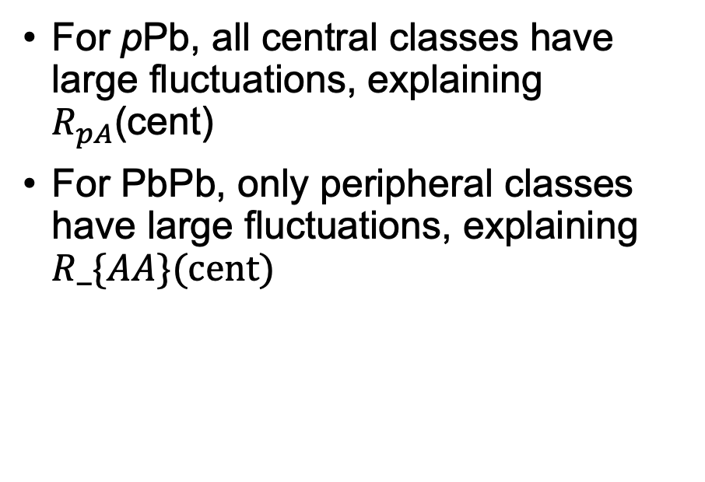
What causes hard-soft correlations? (2)
For pPb, all central classes have large fluctuations, explaining $R_{pA}$(cent)
For PbPb, only peripheral classes have large fluctuations, explaining $R_\{AA\}(cent)$
CF, W. A. Horowitz, B. Schenke arXiv:2606.xxxxx

Slide 17
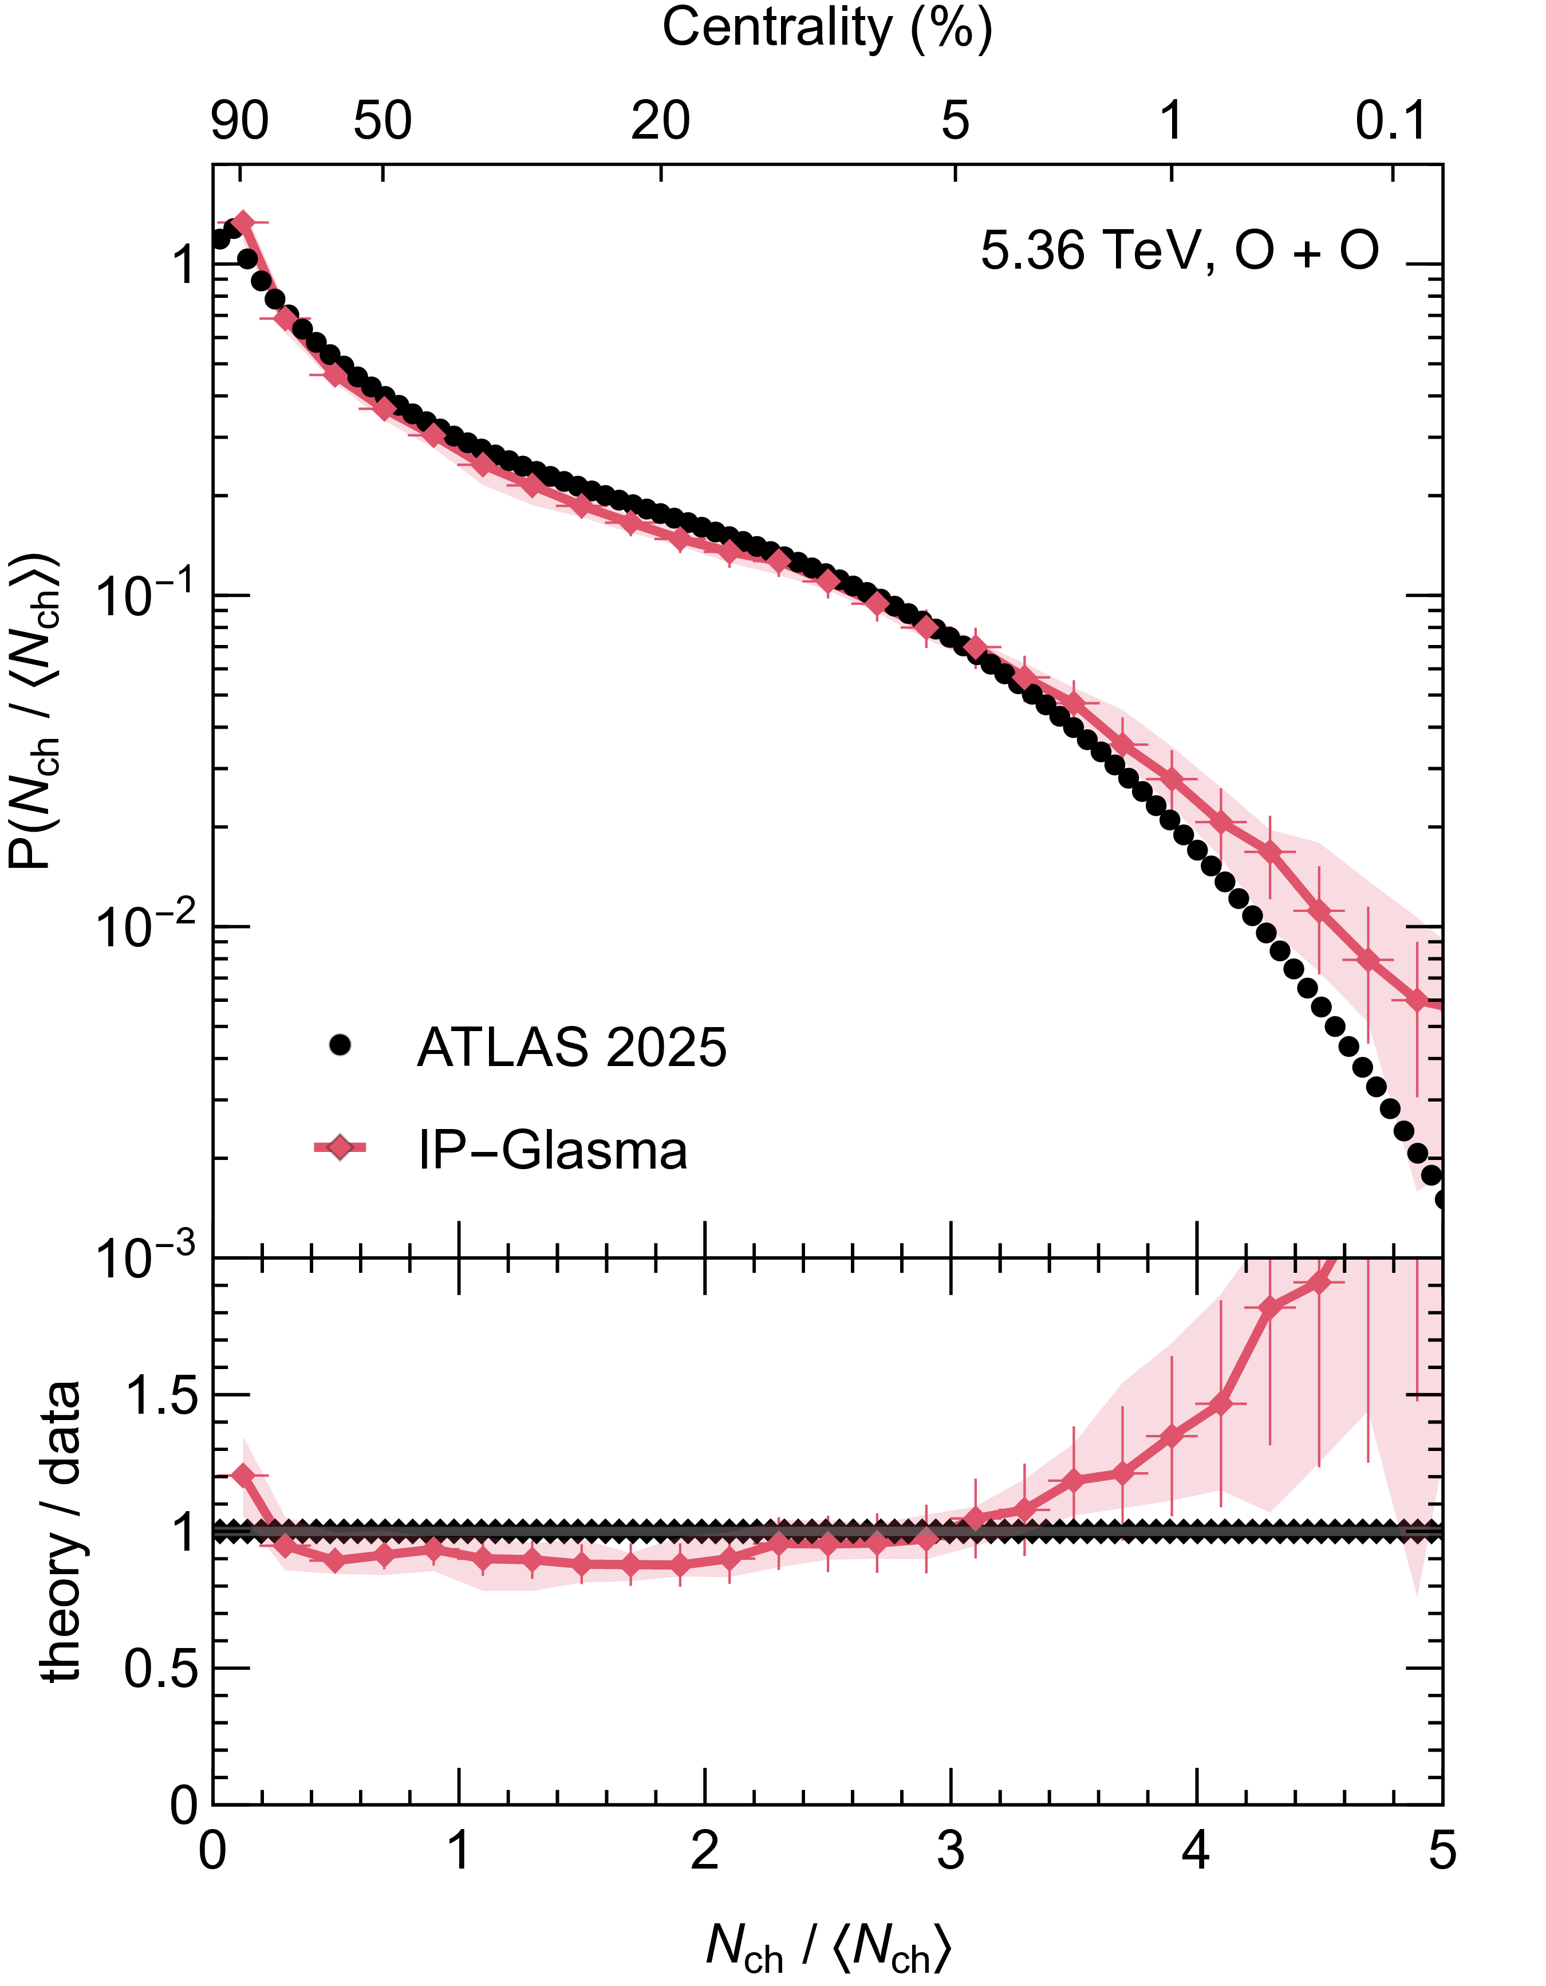
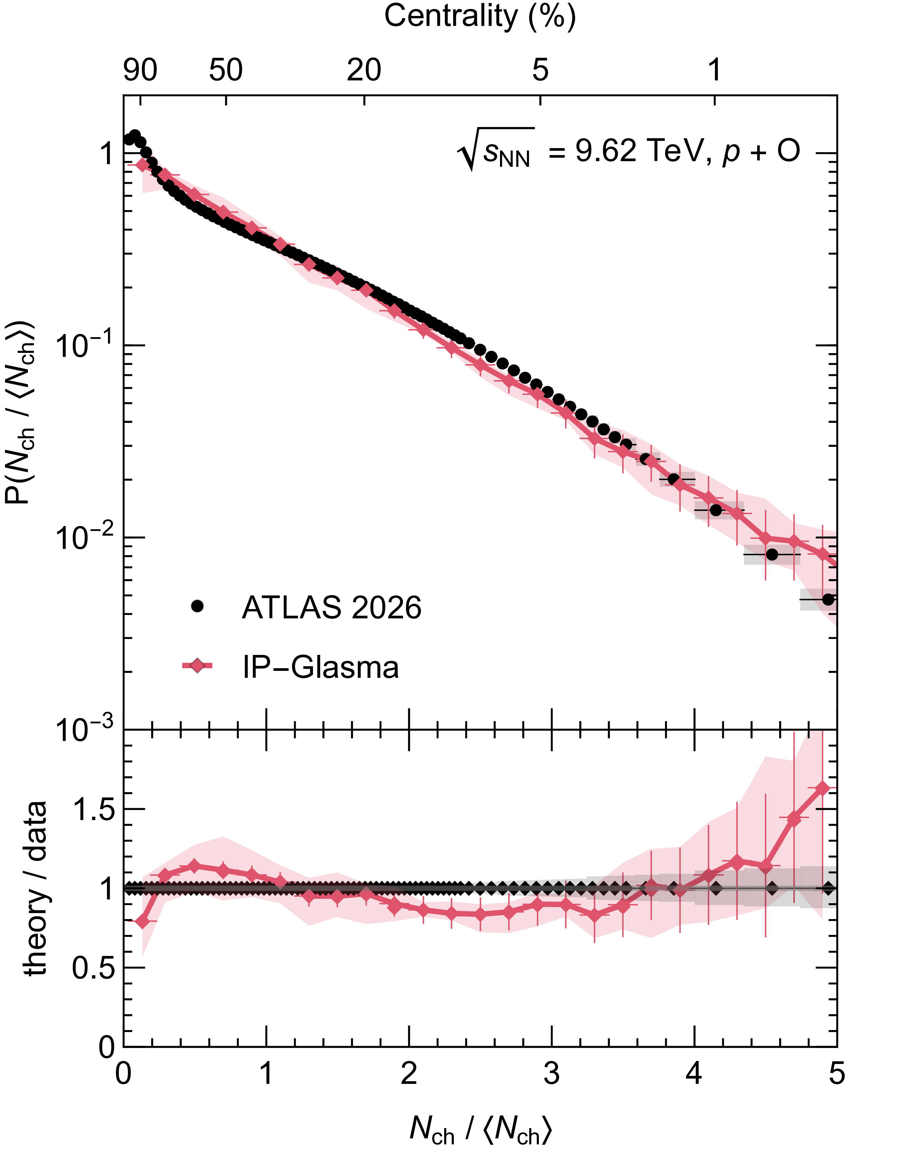
Oxygen?
Very good description of multiplicity distribution in pO and OO

Slide 18
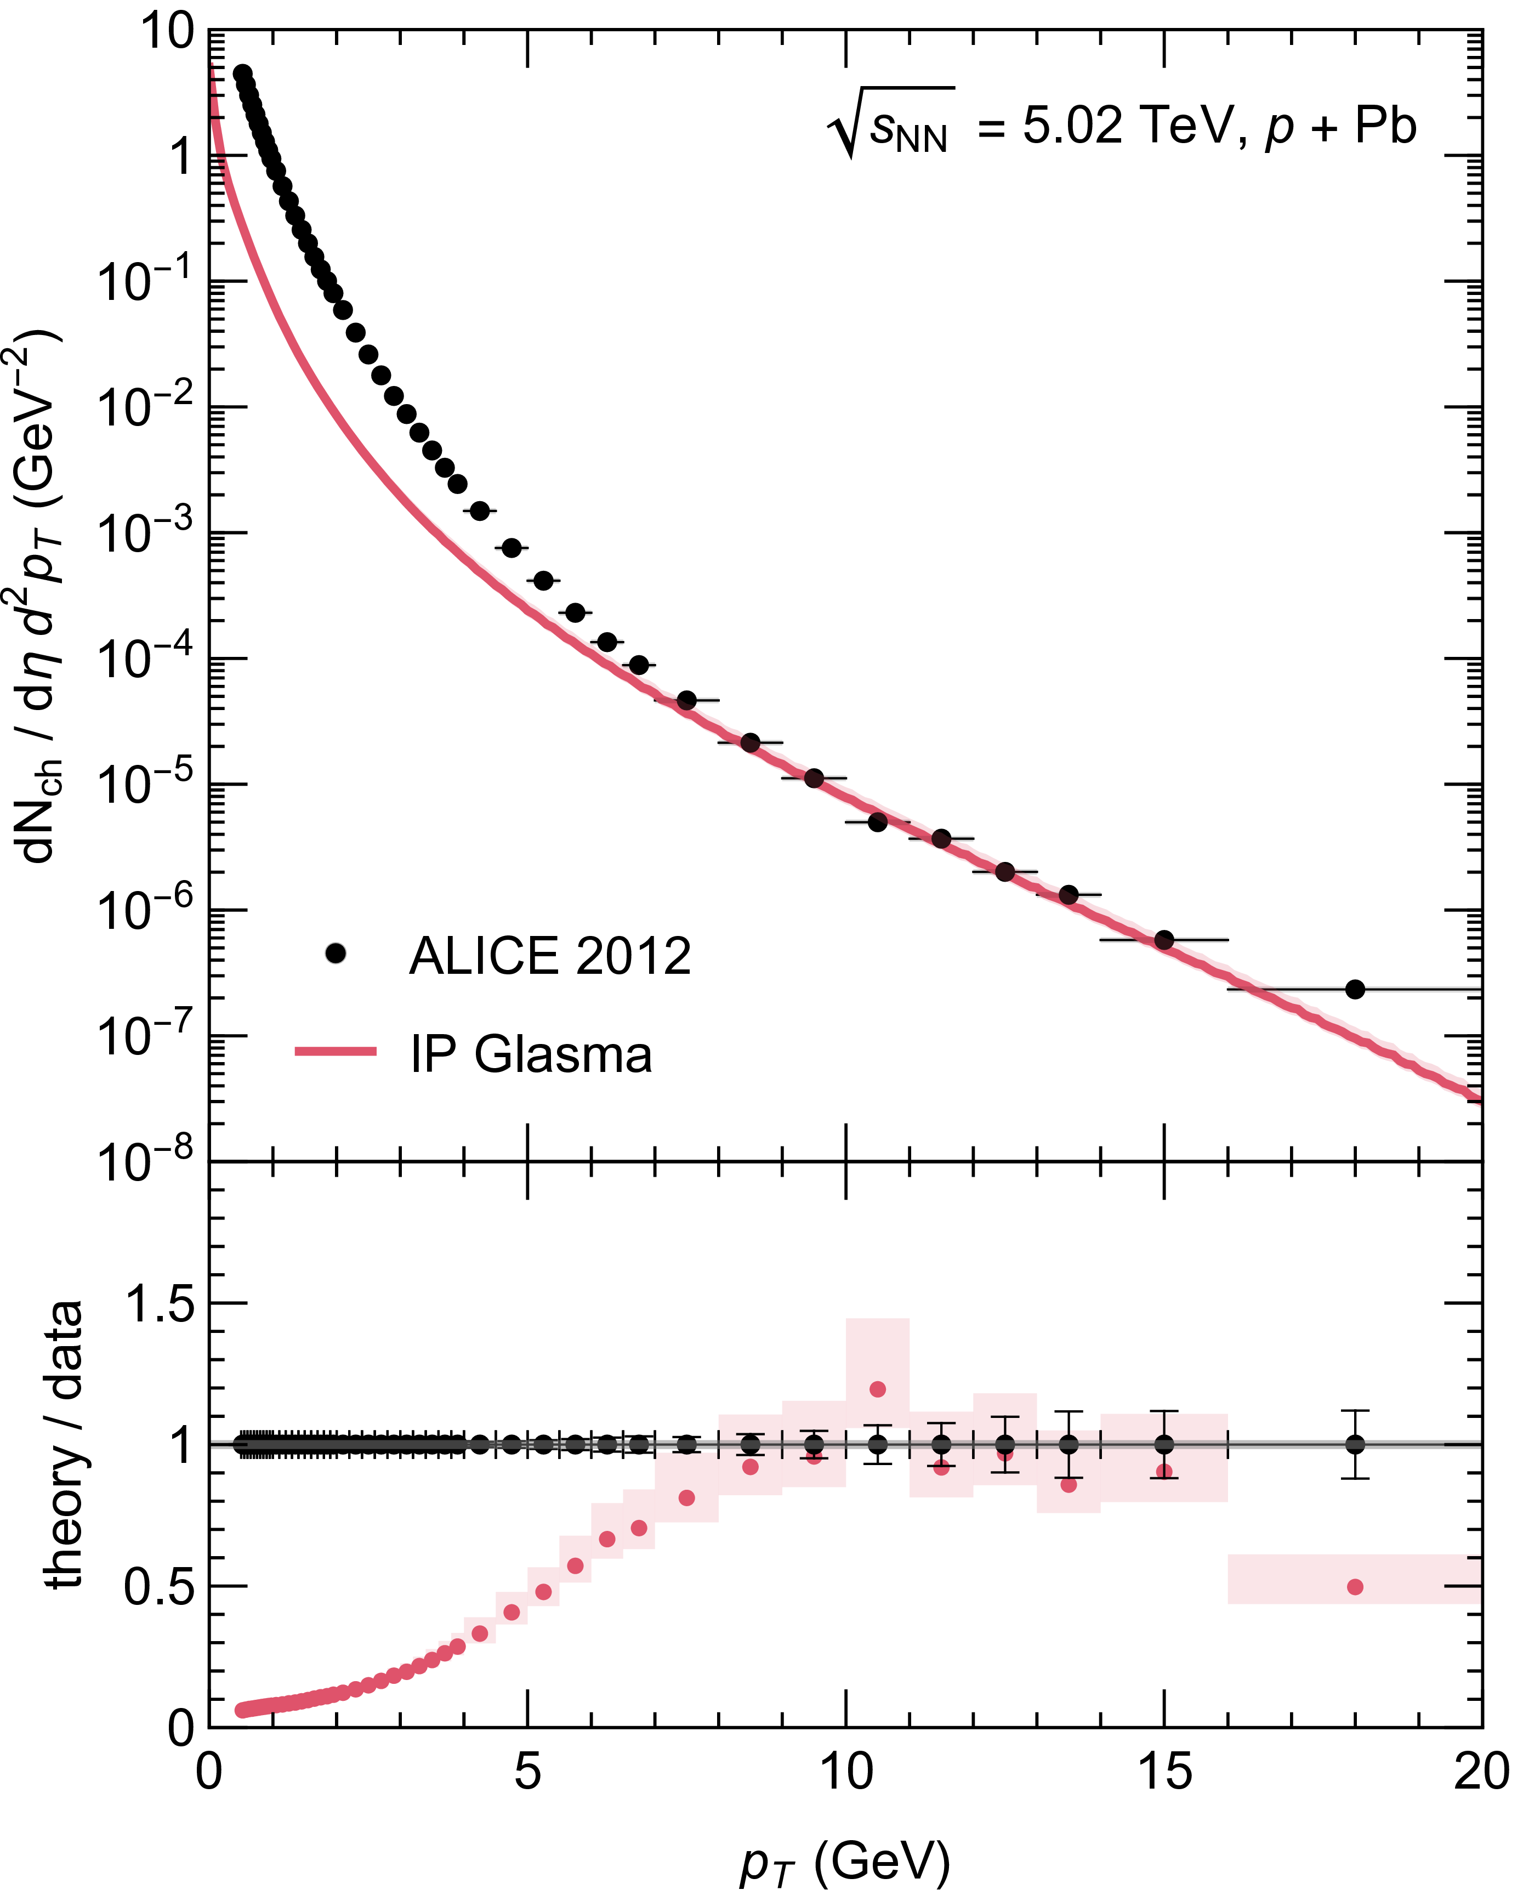
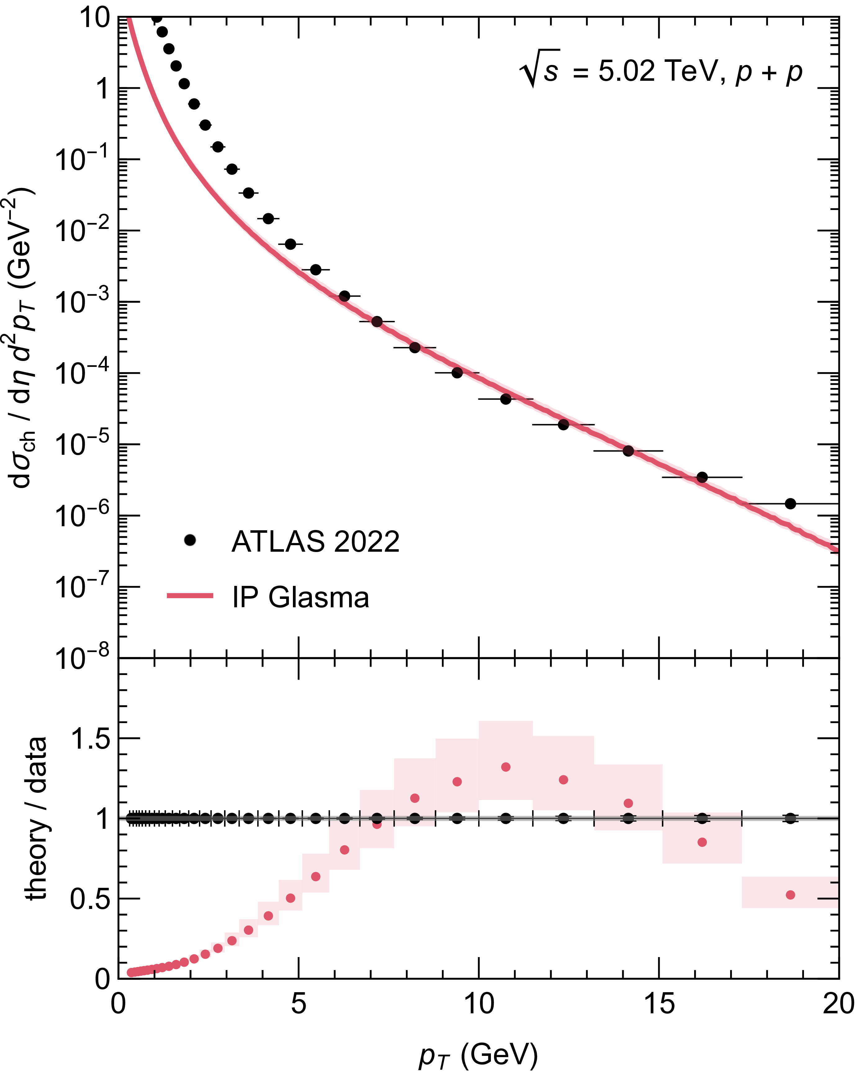
IP-Glasma spectrum

