Slide 1
Postgraduate Showcase 2026
Notes:
Hi everyone, I'm Cole, a PhD student in the Horowitz group. We're theorists who study the hottest matter in the universe: the quark-gluon plasma.

Slide 2




Matter at the Extreme:
the Quark-Gluon Plasma
Coleridge Faraday
Horowitz Group, University of Cape Town
UCT Physics Postgraduate Showcase 2026
Supervisor: A/Prof. W. A. Horowitz
Notes:
Hi everyone, I'm Cole, a PhD student in the Horowitz group. We're theorists who study the hottest matter in the universe: the quark-gluon plasma.

Slide 3
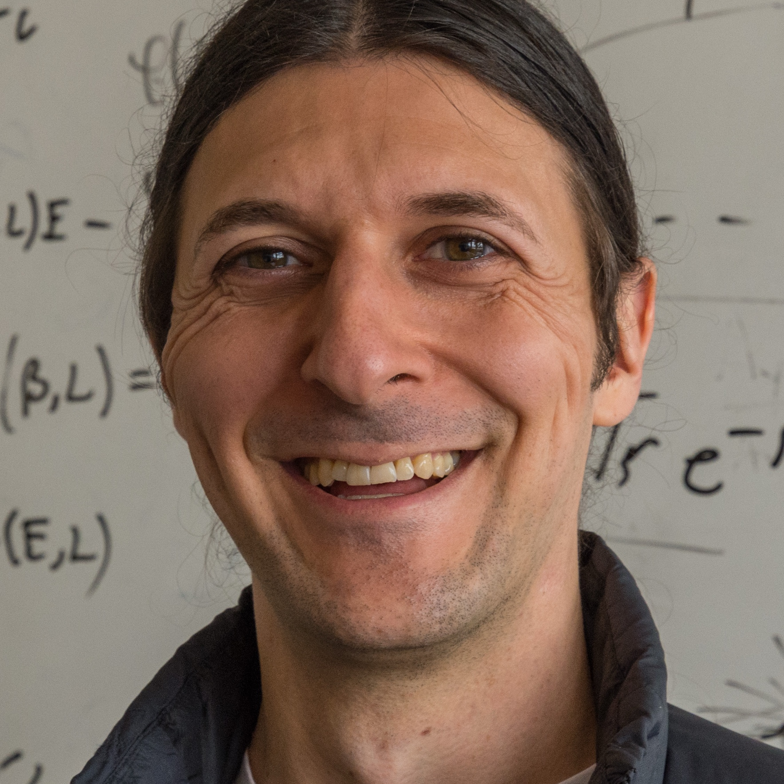
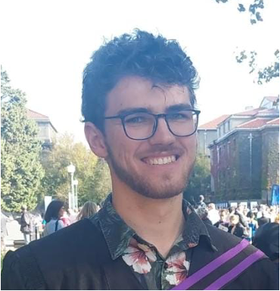
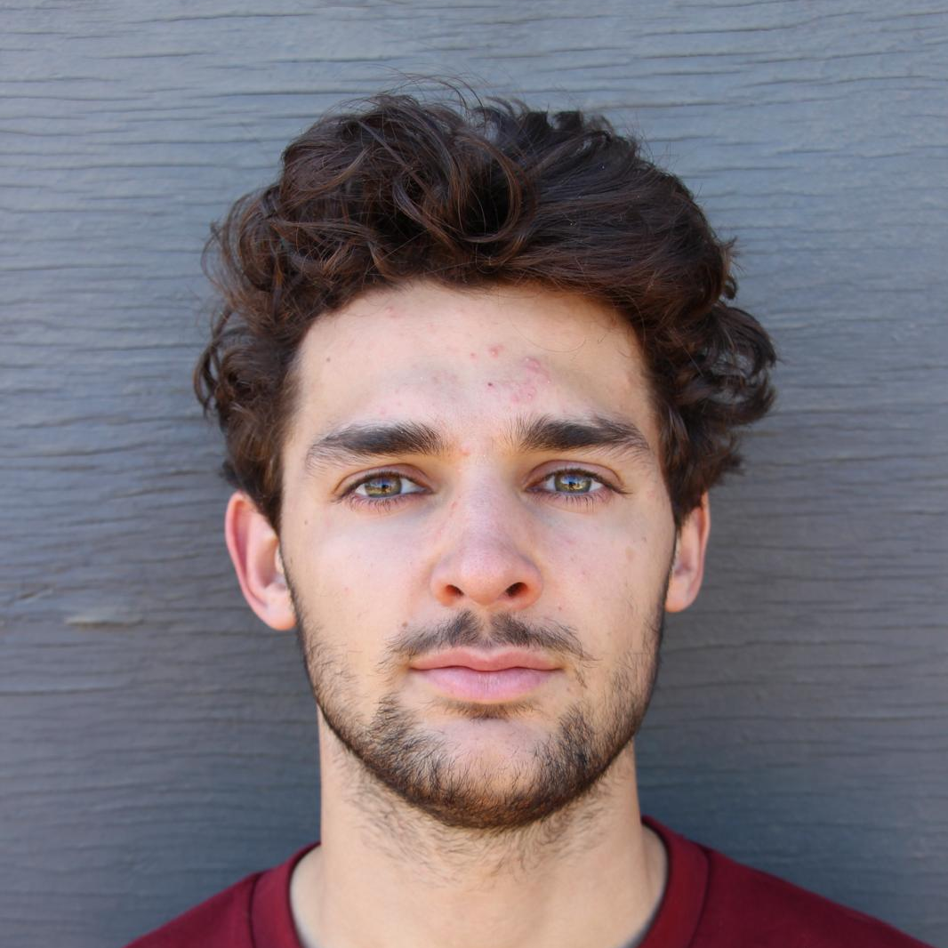
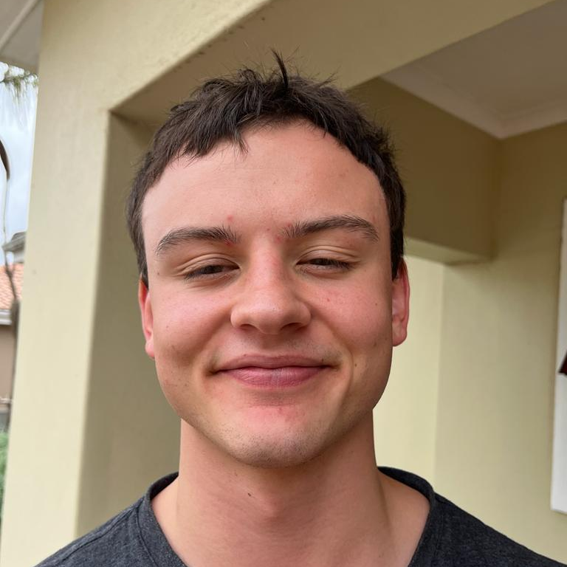


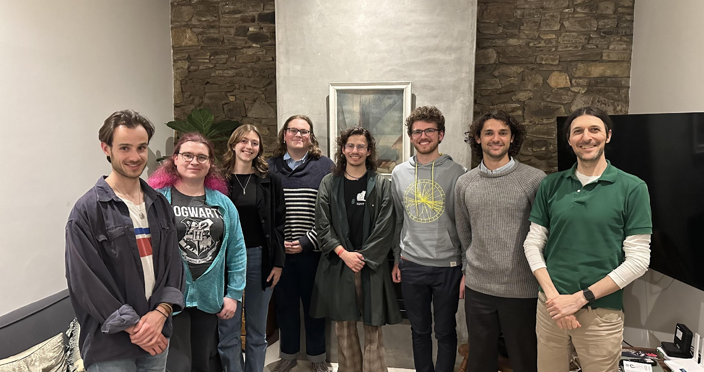

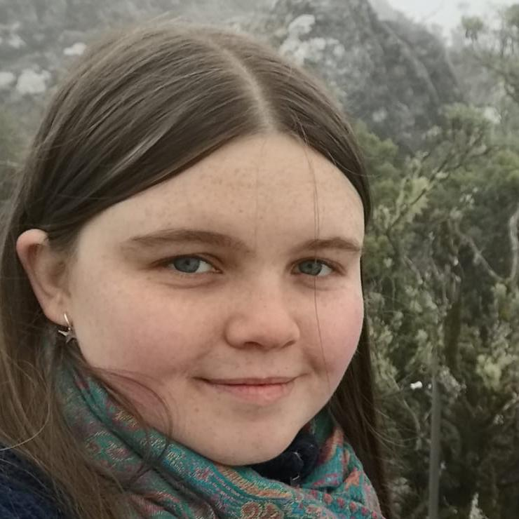

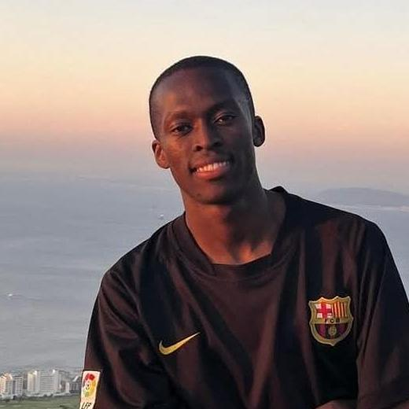
The Horowitz Group at UCT
Supervisor
PhD
MSc
Prof. W. A. Horowitz
Cole Faraday
Rens Roosenstein
Jack Brand
Tiaan van der Merwe
Jarryd Bath
Honours
3rd year
Daniel Broomhall
Caroline Cress
Amber Aspoas
Meya Kabeli
Recent graduates: Ben Bert (MSc), Nia O’Callaghan (MSc)
Notes:
This is our group: Prof. Horowitz, two PhD students, three Master's students, one Honours student and three third-year students doing projects with us. Ben and Nia recently graduated with their Master's.

Slide 4
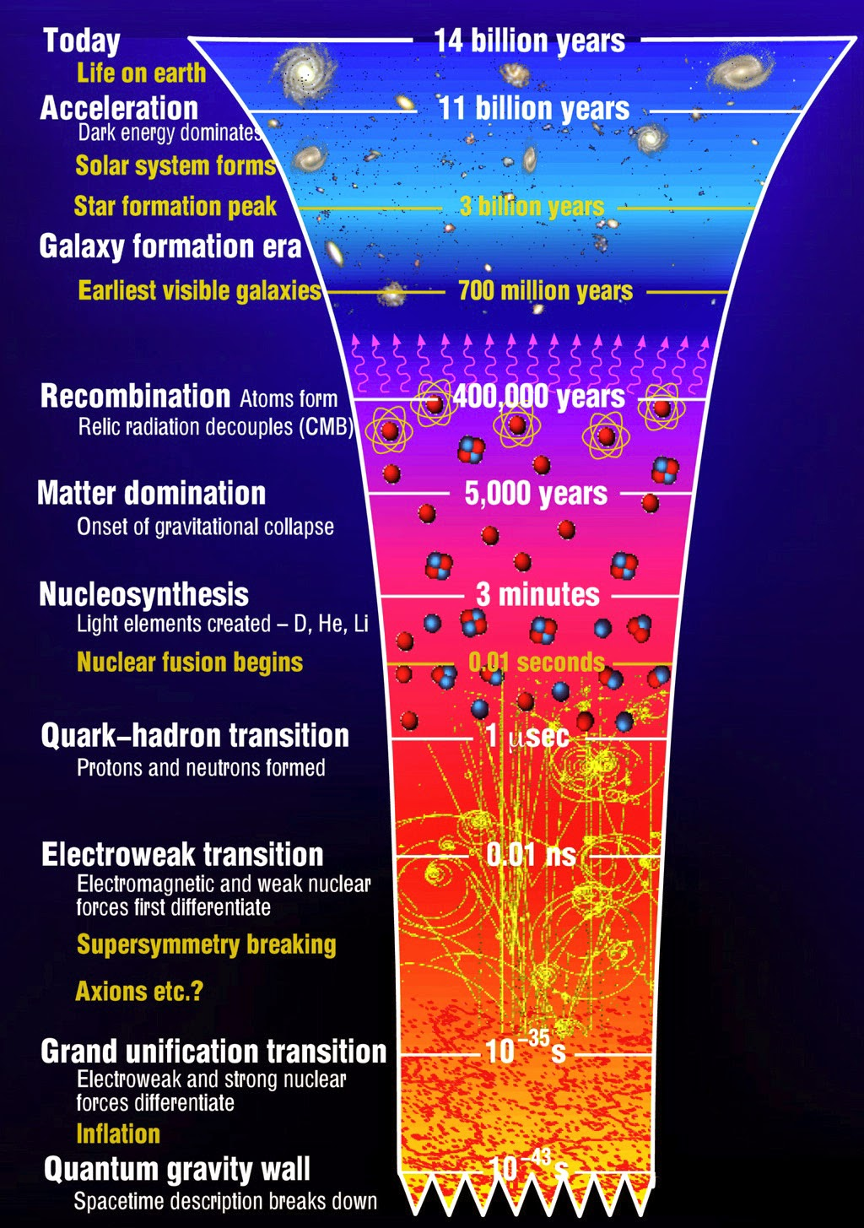
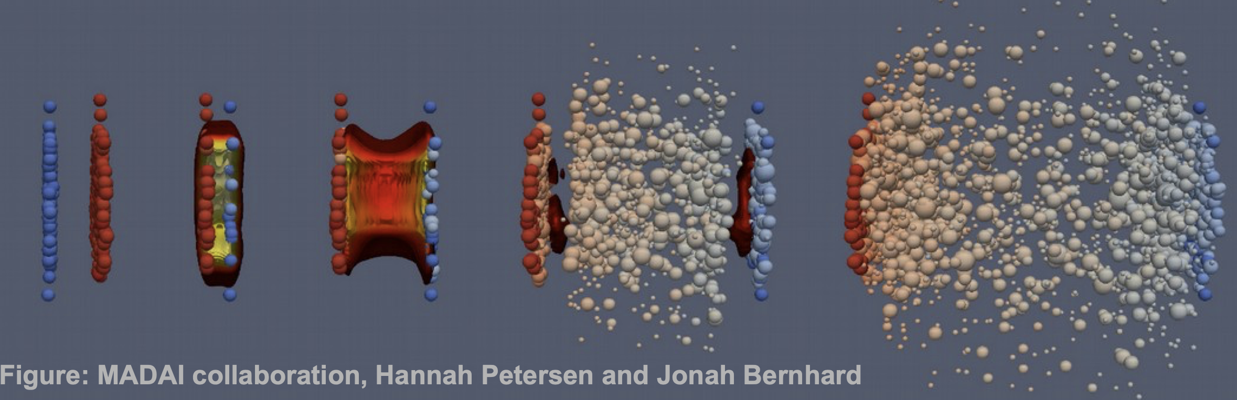
What is the Quark-Gluon Plasma?
Ice → water → steam: matter changes phase
At ~10¹² K (100 0000x the Sun’s core temp), nucleons melt
Free quarks and gluons: the quark-gluon plasma (QGP)
Filled the universe for its first ~10 microseconds
Flows like an almost perfect liquid
Recreate QGP by smashing lead nuclei together at the LHC
QGP era
Notes:
Everyone knows ice melts and water boils. If you keep heating ordinary matter to around two trillion kelvin, protons and neutrons themselves melt into quarks and gluons: the quark-gluon plasma. On the timeline of the universe, this is the era just before the quark-hadron transition, around a microsecond after the Big Bang. We recreate tiny droplets of it by colliding lead nuclei at the LHC, and surprisingly it behaves like an almost perfect liquid.

Slide 5
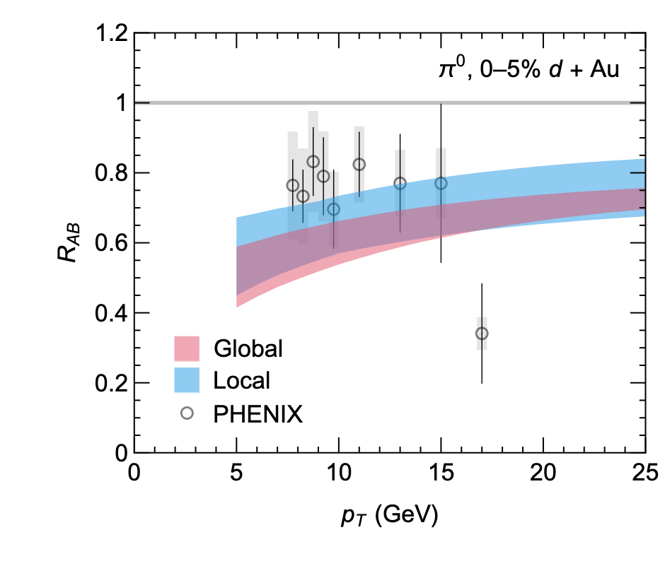
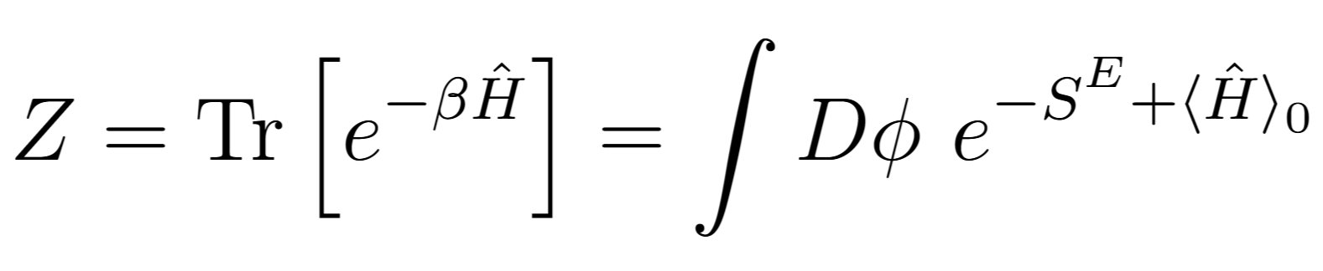
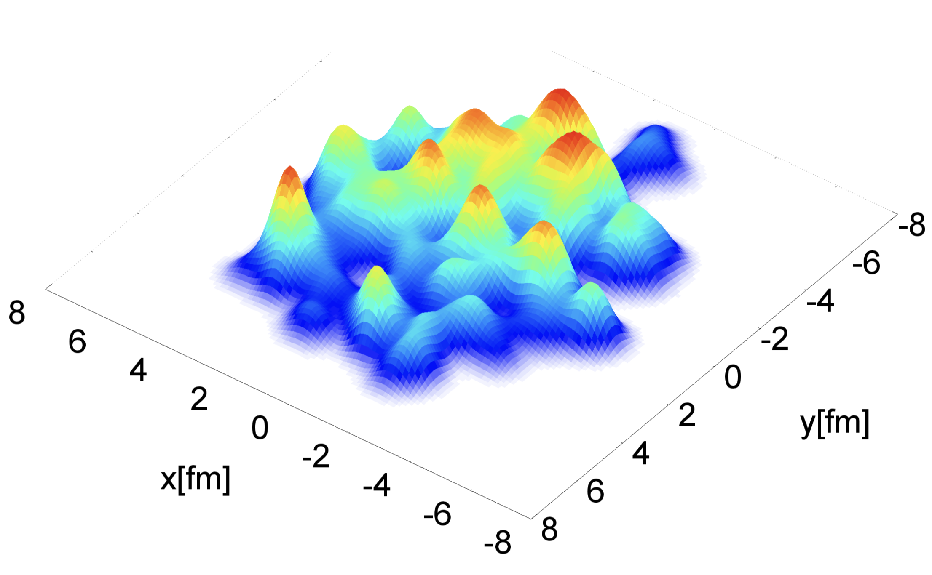
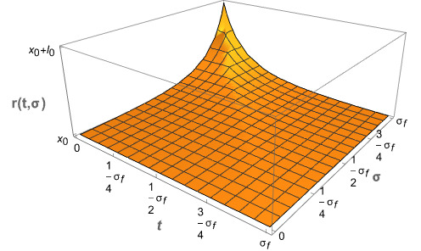
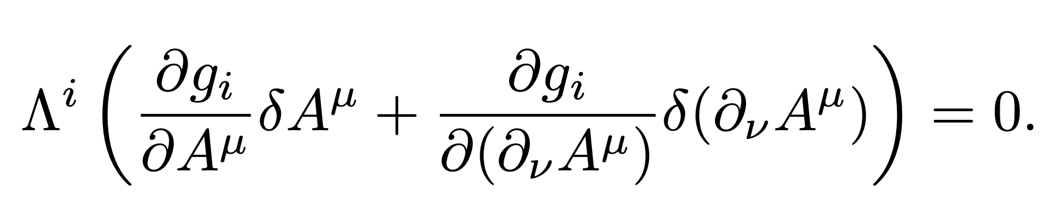
Our Research Directions
Jet quenching
Thermal field theory & quantum field theory
Fast quarks lose energy crossing the plasma: an “x-ray” of the QGP
Does QGP form in proton–lead or oxygen collisions?
How hot QCD matter behaves, from first principles
Analytic calculations in quantum field theory
Cole, Jack, Tiaan, Daniel, Caroline
Rens, Jarryd, Meya
Initial state
Classical mechanics
AdS/CFT
Energy density of the fireball at the instant of impact
Foundations: constraints, gauge freedom and symmetries
Strongly coupled plasma via a dual theory of gravity
Cole
Amber, Nia
Ben
Notes:
Our group works across five connected directions, from phenomenology that talks directly to experiment, to first-principles field theory, holography, and the foundations of classical mechanics.

Slide 6
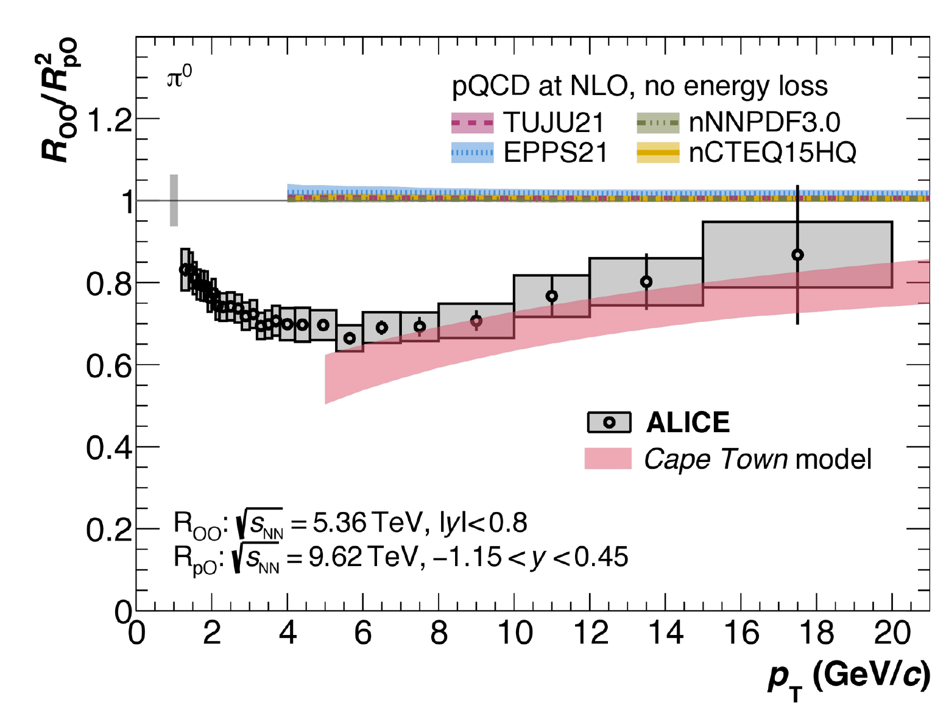
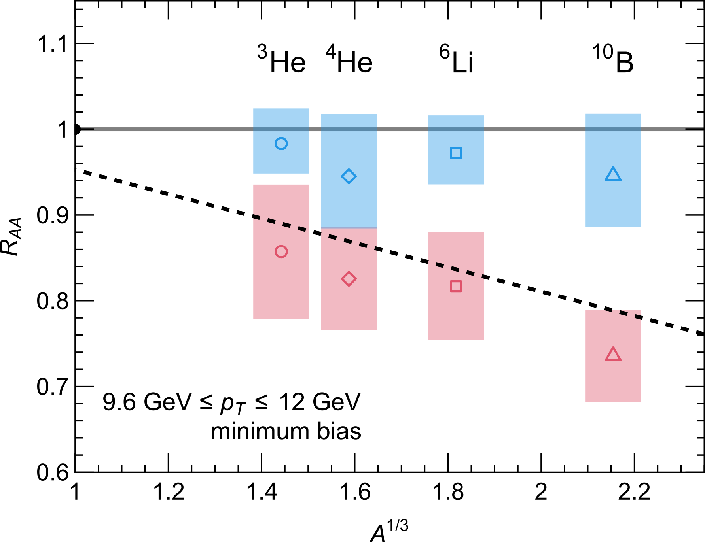
Predicting Oxygen Collisions
July 2025: the LHC collided oxygen nuclei for the first time
We published our prediction before the data came out
ALICE’s measurement agrees with our energy-loss model
Without energy loss, theory overshoots the data
Next: how small can we go?
Our predictions from lead down to helium: accepted in Phys. Rev. Lett.
Prediction: CF & Horowitz, JHEP 11, 019 (2025), arXiv:2505.14568; Data: ALICE, arXiv:2606.19967
Notes:
One highlight from this year. In July 2025 the LHC collided oxygen nuclei for the first time. We had published predictions for how much fast particles would be suppressed before the data came out, and when ALICE released their measurement it agreed with our energy-loss model, while calculations without energy loss overshoot the data. The natural next question is how small a system can be and still show this; our predictions for systems down to helium have just been accepted for publication in Physical Review Letters.

Slide 7
What You Could Work On
Research projects at 3rd-year, Honours, MSc and PhD level
Python & C++, Monte Carlo methods, Bayesian fitting to LHC data
Jet quenching
What you will learn
In every project:
Doing independent research
Coding & numerical methods
Connecting theory to experiment
Writing papers
Giving talks, at UCT and abroad
Simulations, high-performance computing, nuclear structure
Initial state
Quantum field theory, path integrals, statistical mechanics
Thermal field theory
General relativity, string theory ideas, numerical methods
AdS/CFT
Lagrangians, symmetries & constraints, Mathematica
Classical mechanics
Chat to A/Prof. Horowitz (wahorowitz@gmail.com)
Notes:
What would you actually do with us? Depending on the direction, you'd pick up different skills, from coding and Bayesian fitting to LHC data, to quantum field theory and general relativity. Every project involves independent research, coding, and communicating your results. Projects are shaped around your interests, so come chat to Prof. Horowitz.

Slide 8
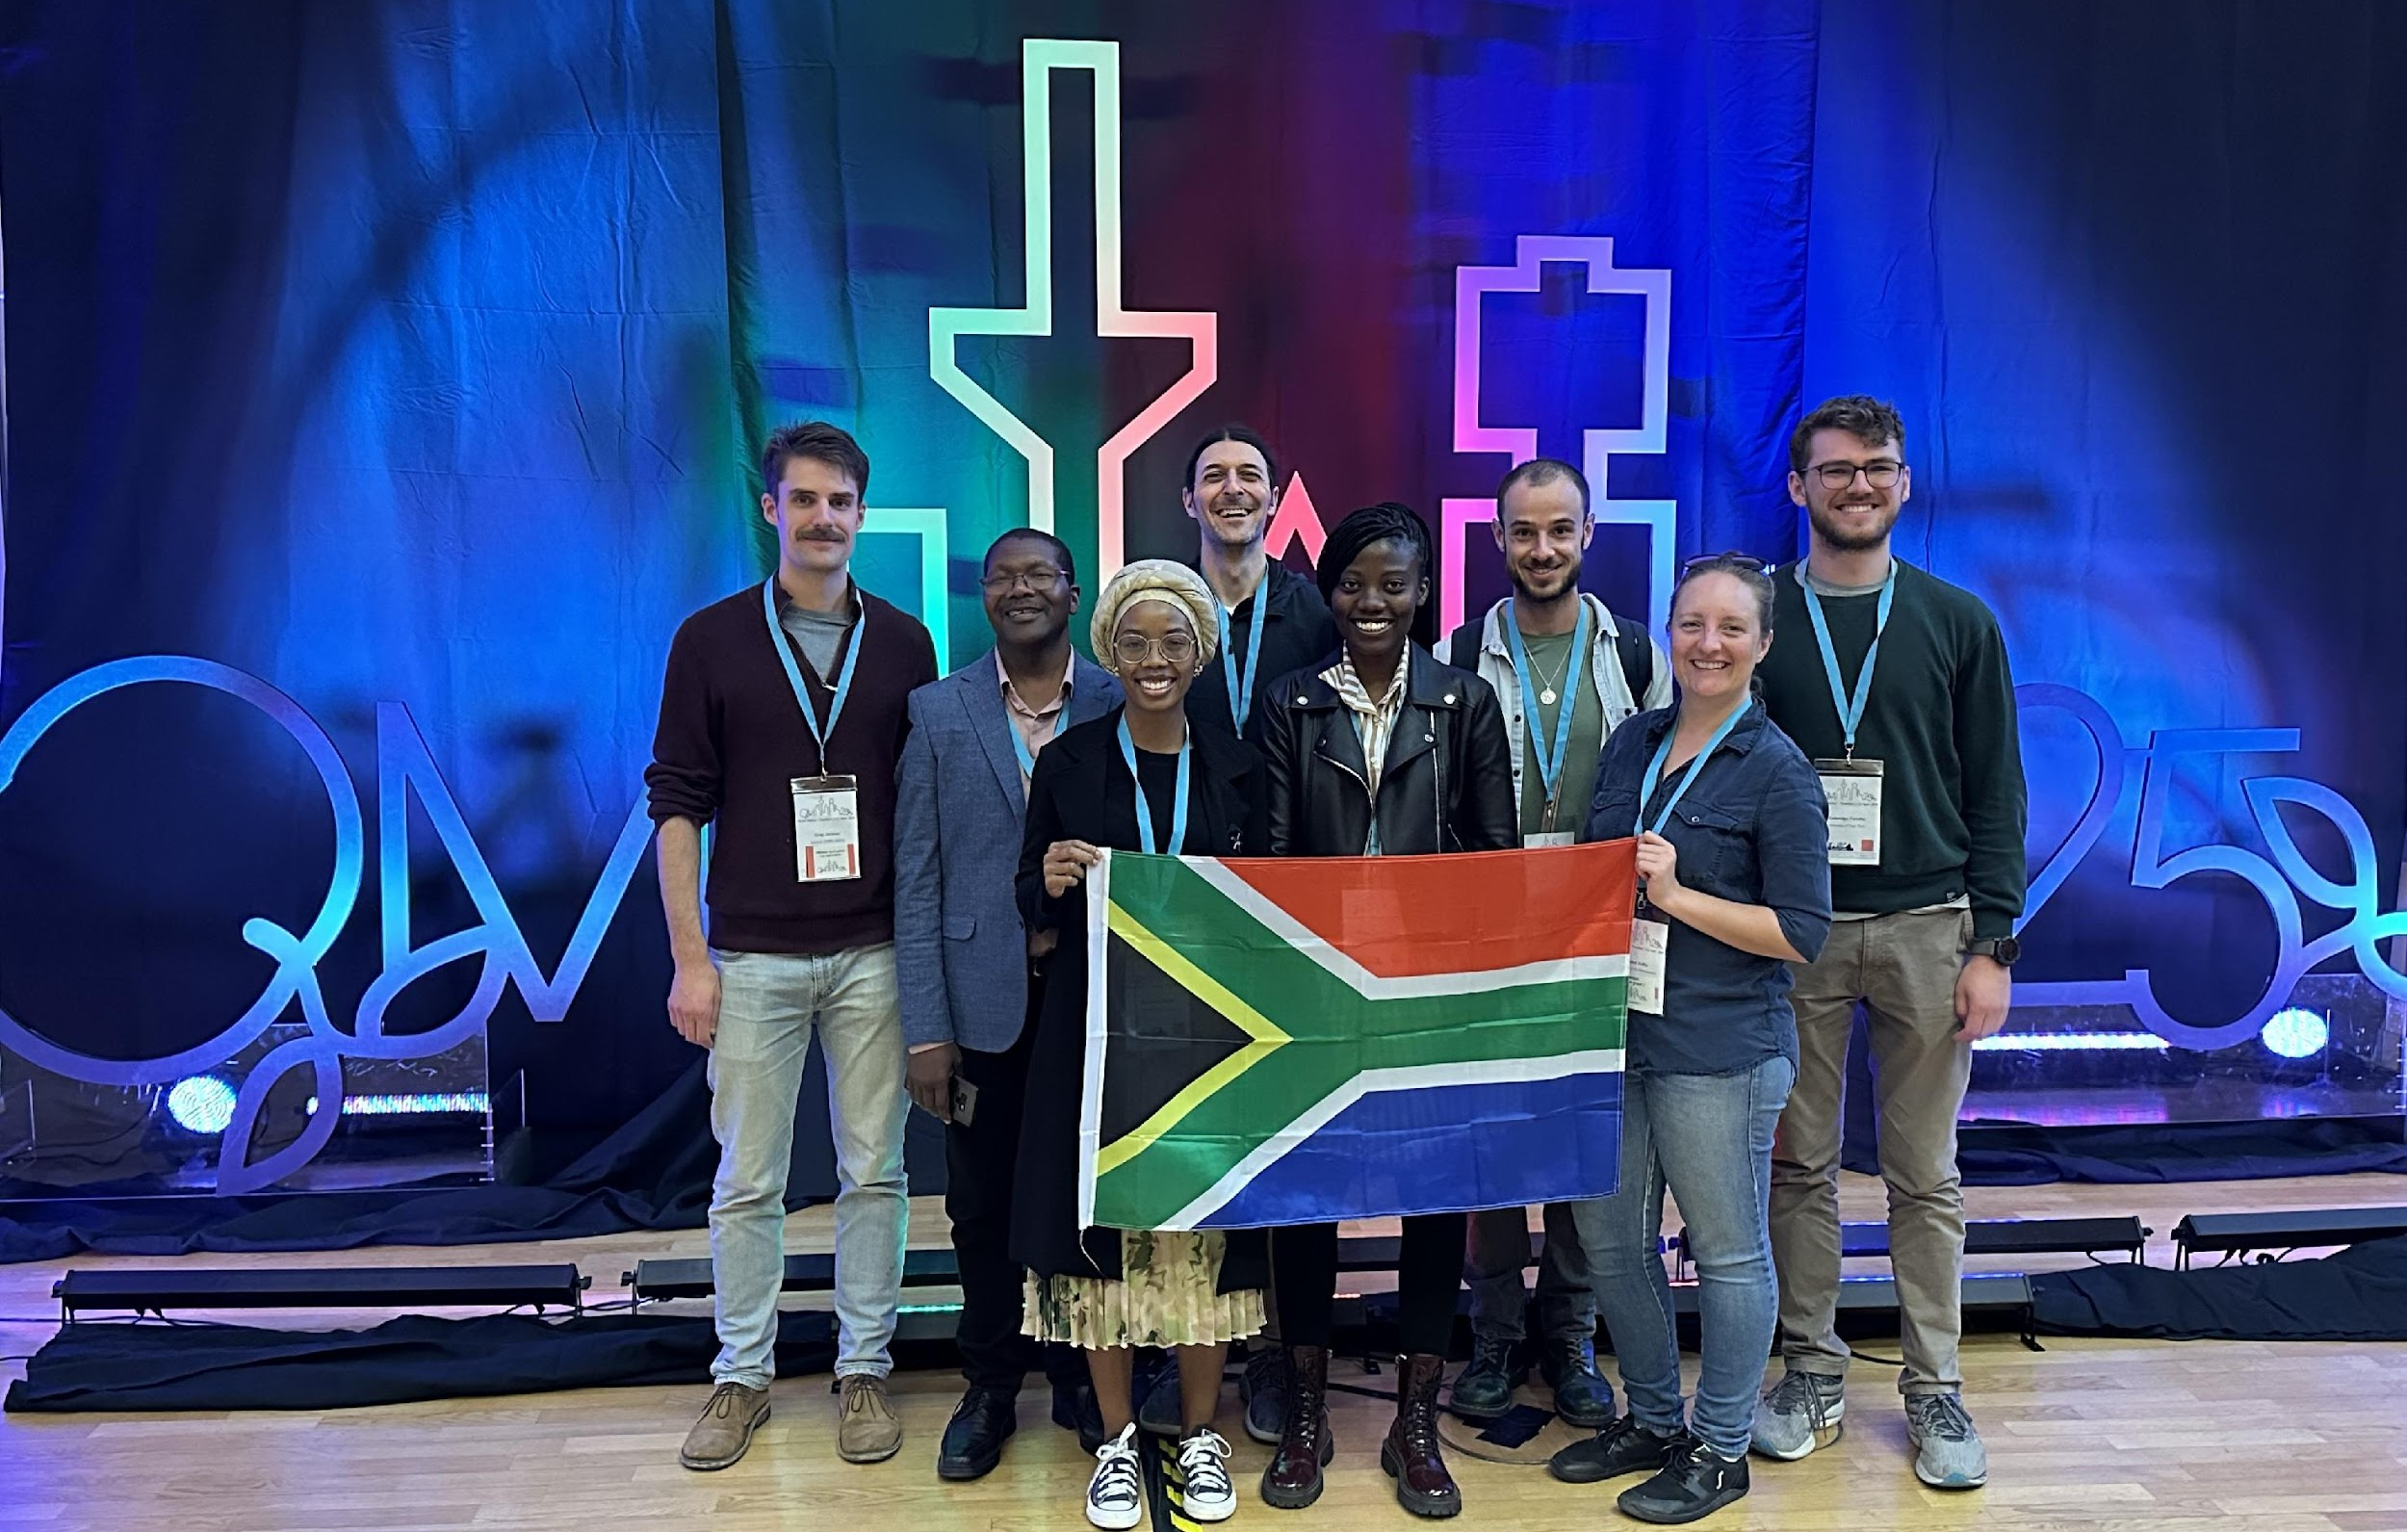
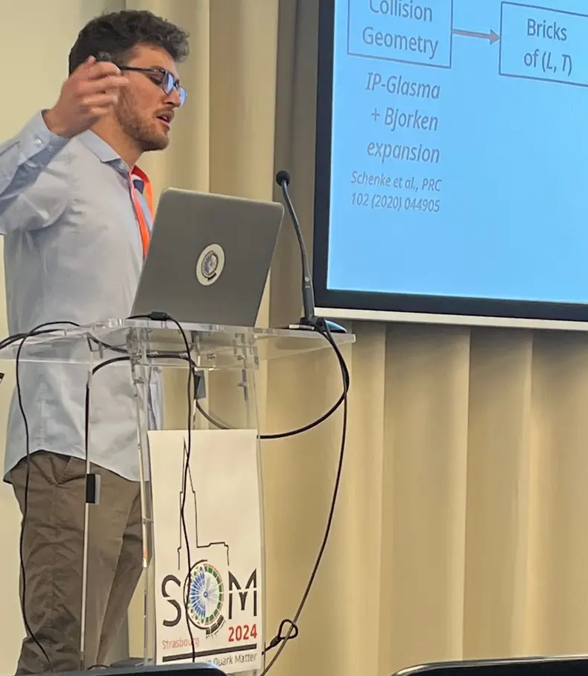
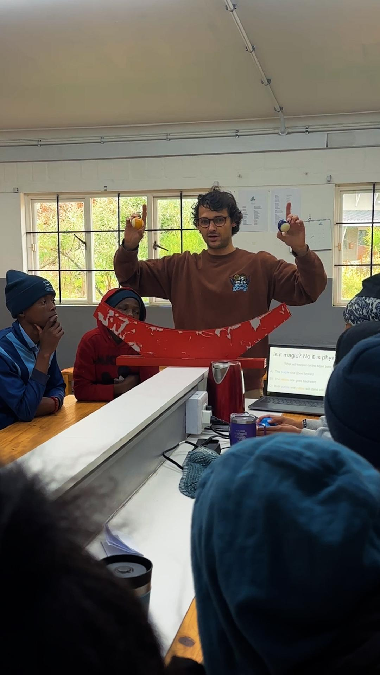
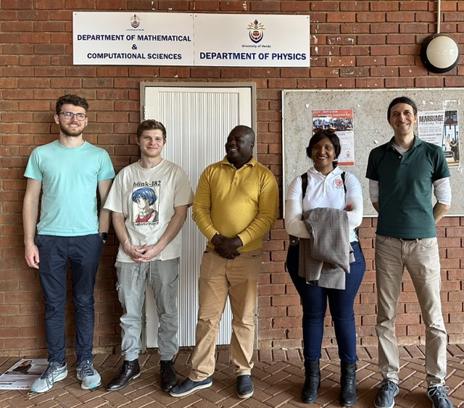
Join Us!
What postgrads in our group do
Publish papers and present at international conferences
Visit CERN and research groups abroad
Work closely with experimentalists on real data
Outreach in schools and at UCT
Conferences
SA-CERN Excellence Bursary
Postgrad funding + travel to CERN: sa-cern.tlabs.ac.za/bursary
Thanks for listening!
Interested in joining? Please email wahorowitz@gmail.com
Outreach
Notes:
If any of this sounds exciting, come talk to us. Postgrads in our group travel, publish and work with experimentalists, we do outreach, and the SA-CERN bursary is a great source of funding. Thanks!

