Slide 1




From Lead to Helium: Probing Matter at
Extreme Temperatures and Sizes
Coleridge Faraday
University of Cape Town, South Africa
7th October 2026, UCT Colloquium

Slide 2
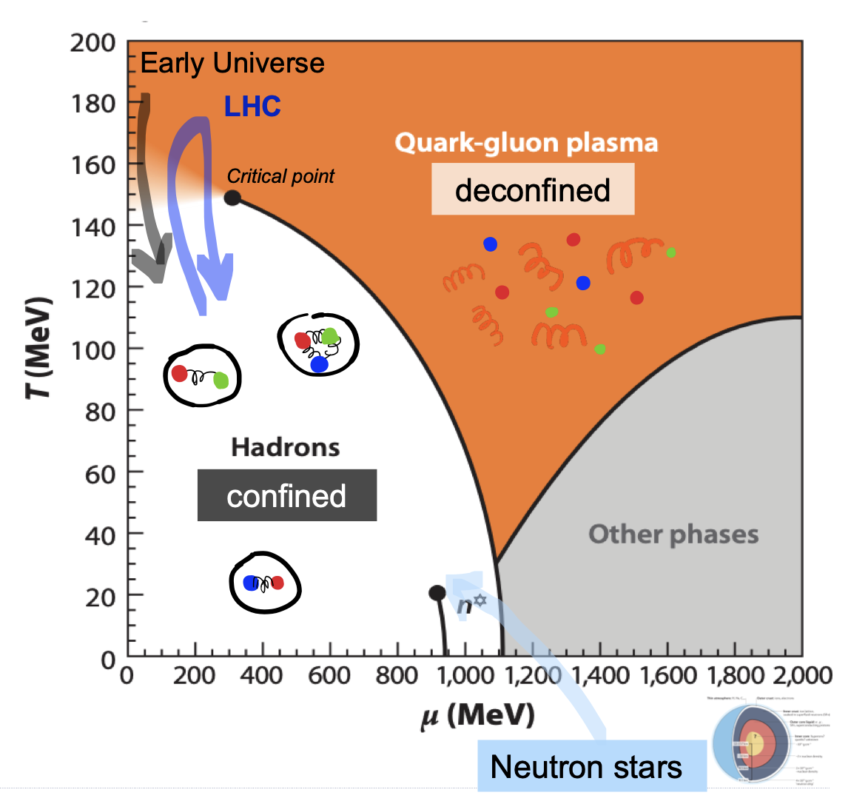
QCD Matter at the Extreme
Deconfined quarks and gluons with temperature ~1 trillion degrees
Filled the early Universe ~10 μs after the Big Bang
Learn about phase diagram of QCD
QGP formation established in collisions of large nuclei
New frontier: how small can a collision system be and still form a collective, nearly-perfect fluid?
System size
Image: https://opendata.atlas.cern/docs/documentation/introduction/heavy_ions

Slide 3

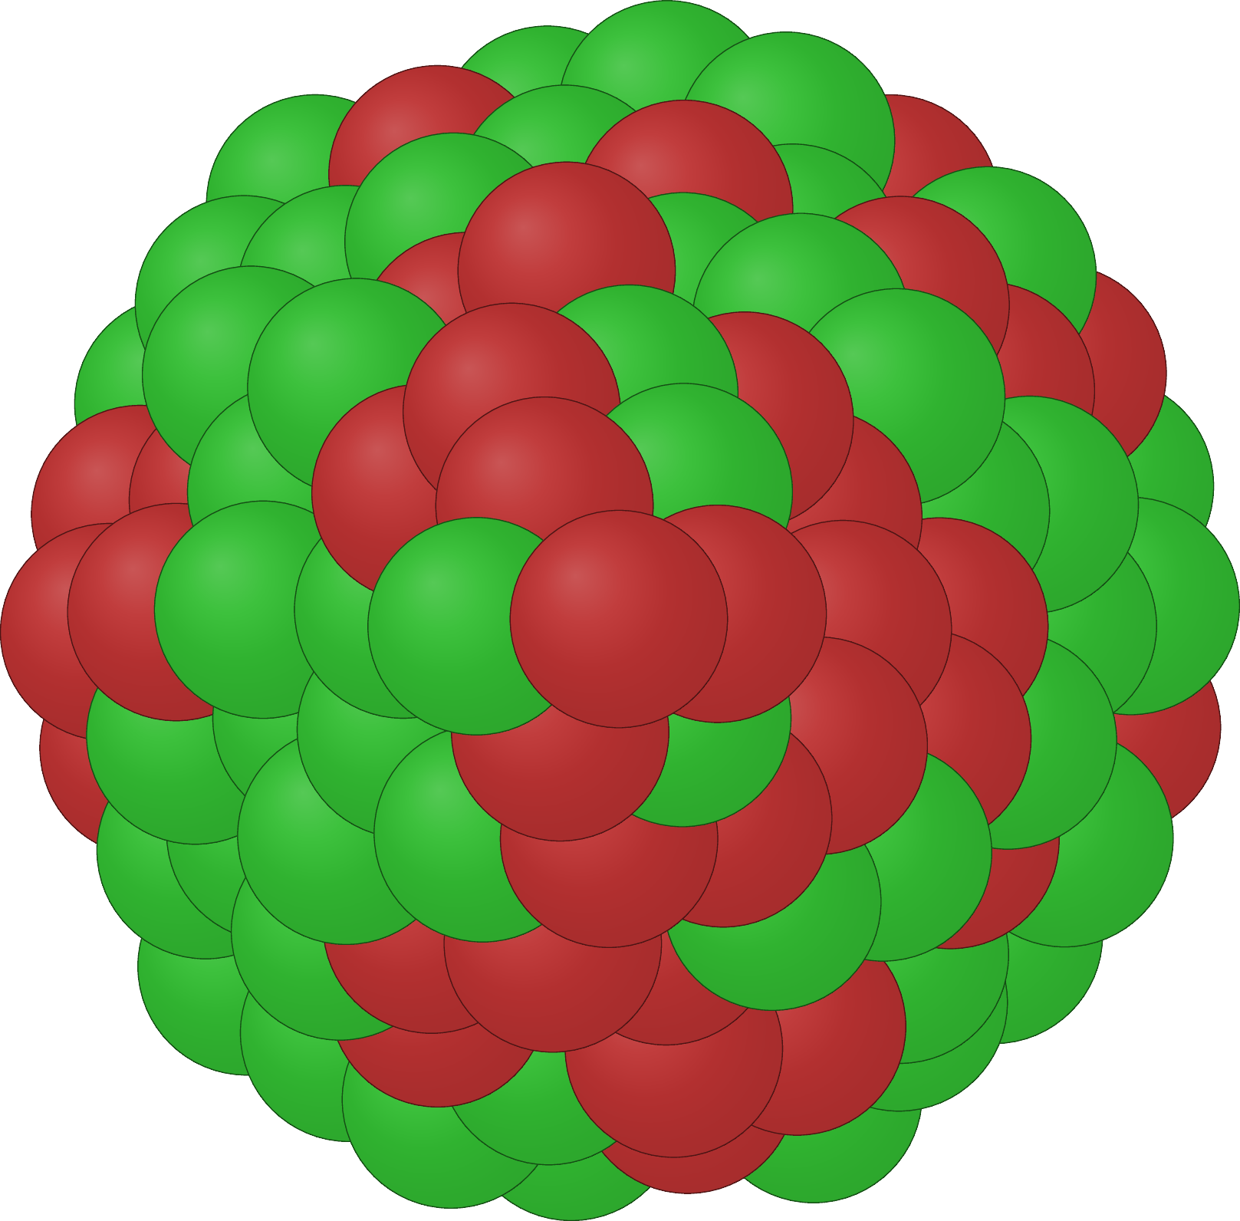
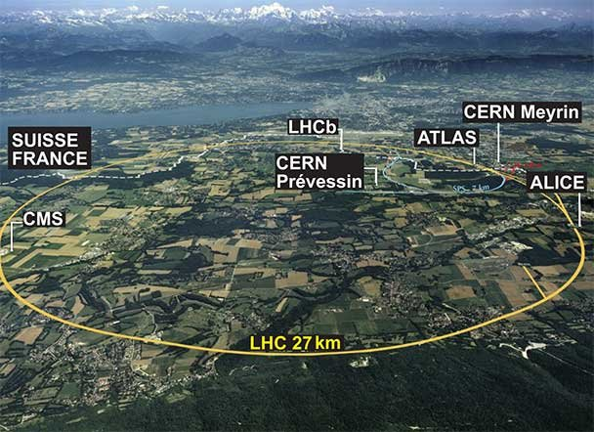
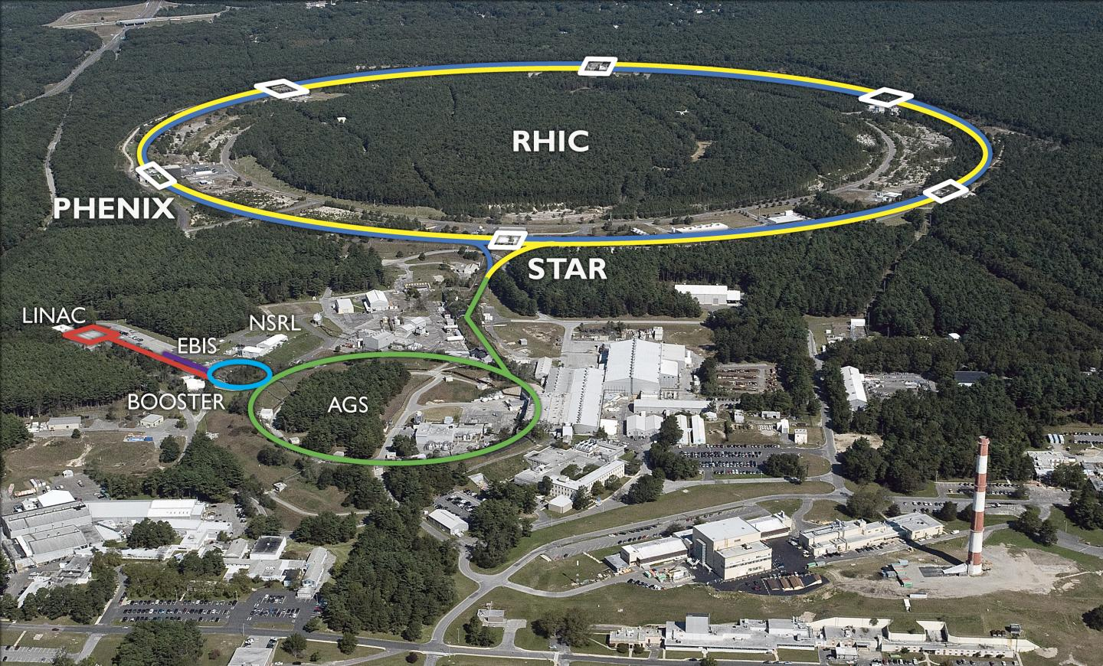
Heavy-ion colliders
>99.9999% of the speed of light
RHIC at BNL
LHC at CERN
frdcol002@myuct.ac.za
Coleridge Faraday
3

Slide 4
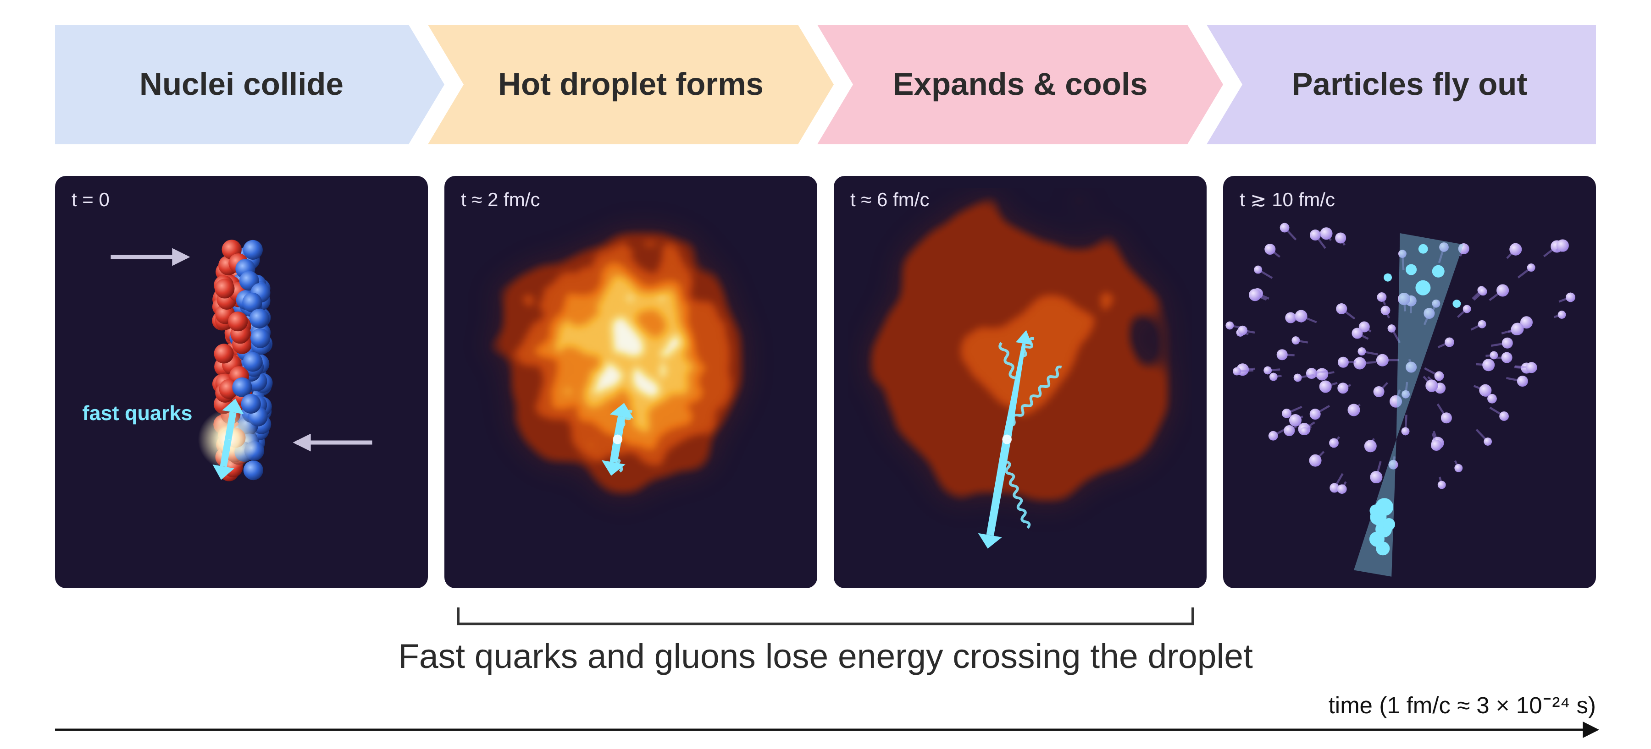
Anatomy of a Heavy-Ion Collision

Slide 5
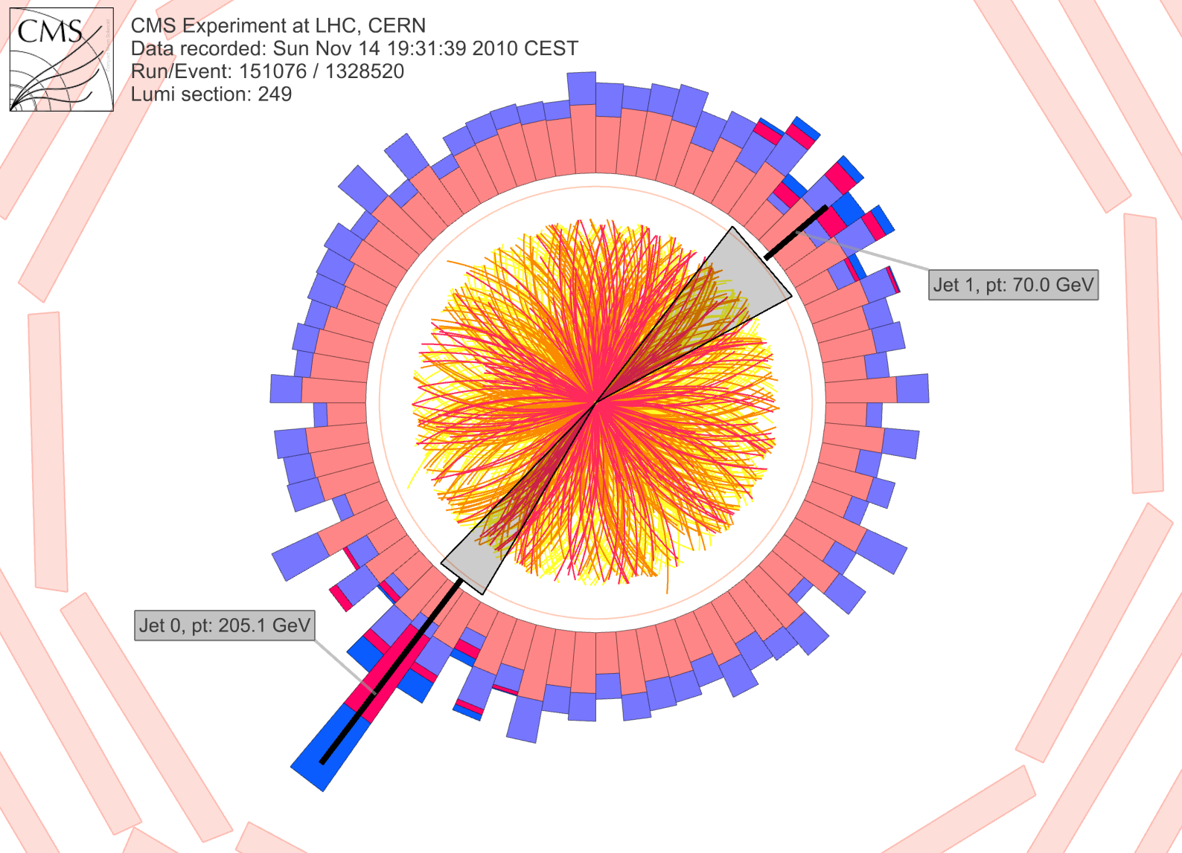
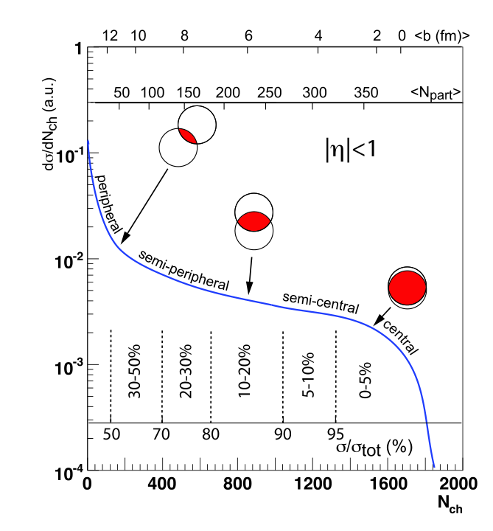
Energy = 70GeV
Where did the energy go?
A: Dissipated into the QGP!
Energy = 200GeV
https://cms.cern/news/jet-quenching-observed-cms-heavy-ion-collisions
frdcol002@myuct.ac.za
Coleridge Faraday
5

Slide 6
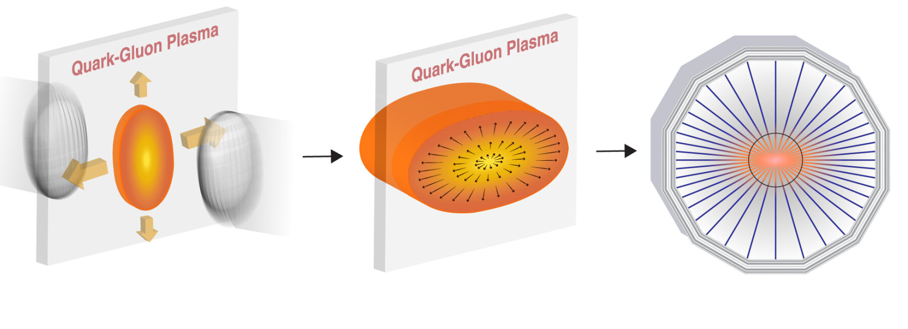
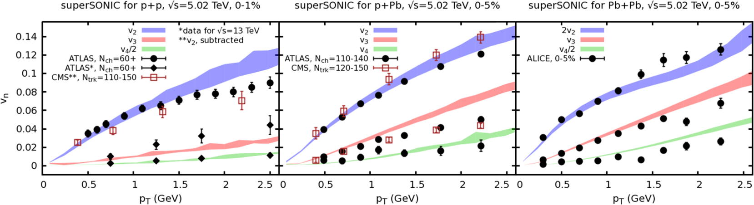

Collective phenomena in small systems
High-activity events in all collision systems show collective phenomena that hydrodynamics can describe qualitatively.
https://phys.org/news/2024-11-scientists-high-energy-heavy-ion.html
pp, 50 particles
pPb , 100 particles
PbPb, ${10}^{4}$ particles
Weller et al., PLB 774 (2017) 351-356

Slide 7
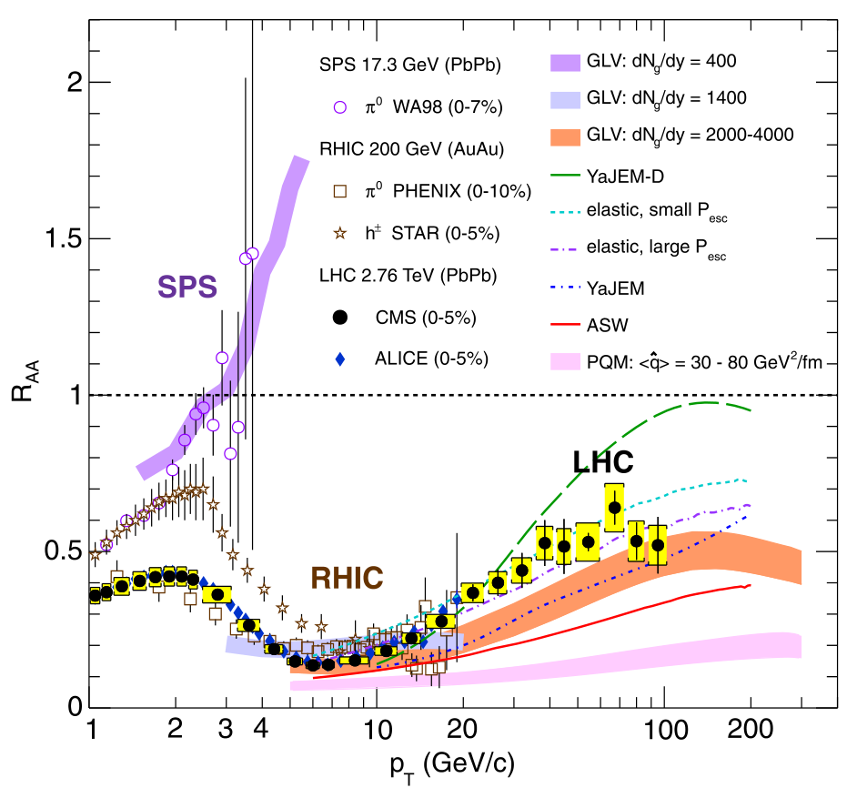
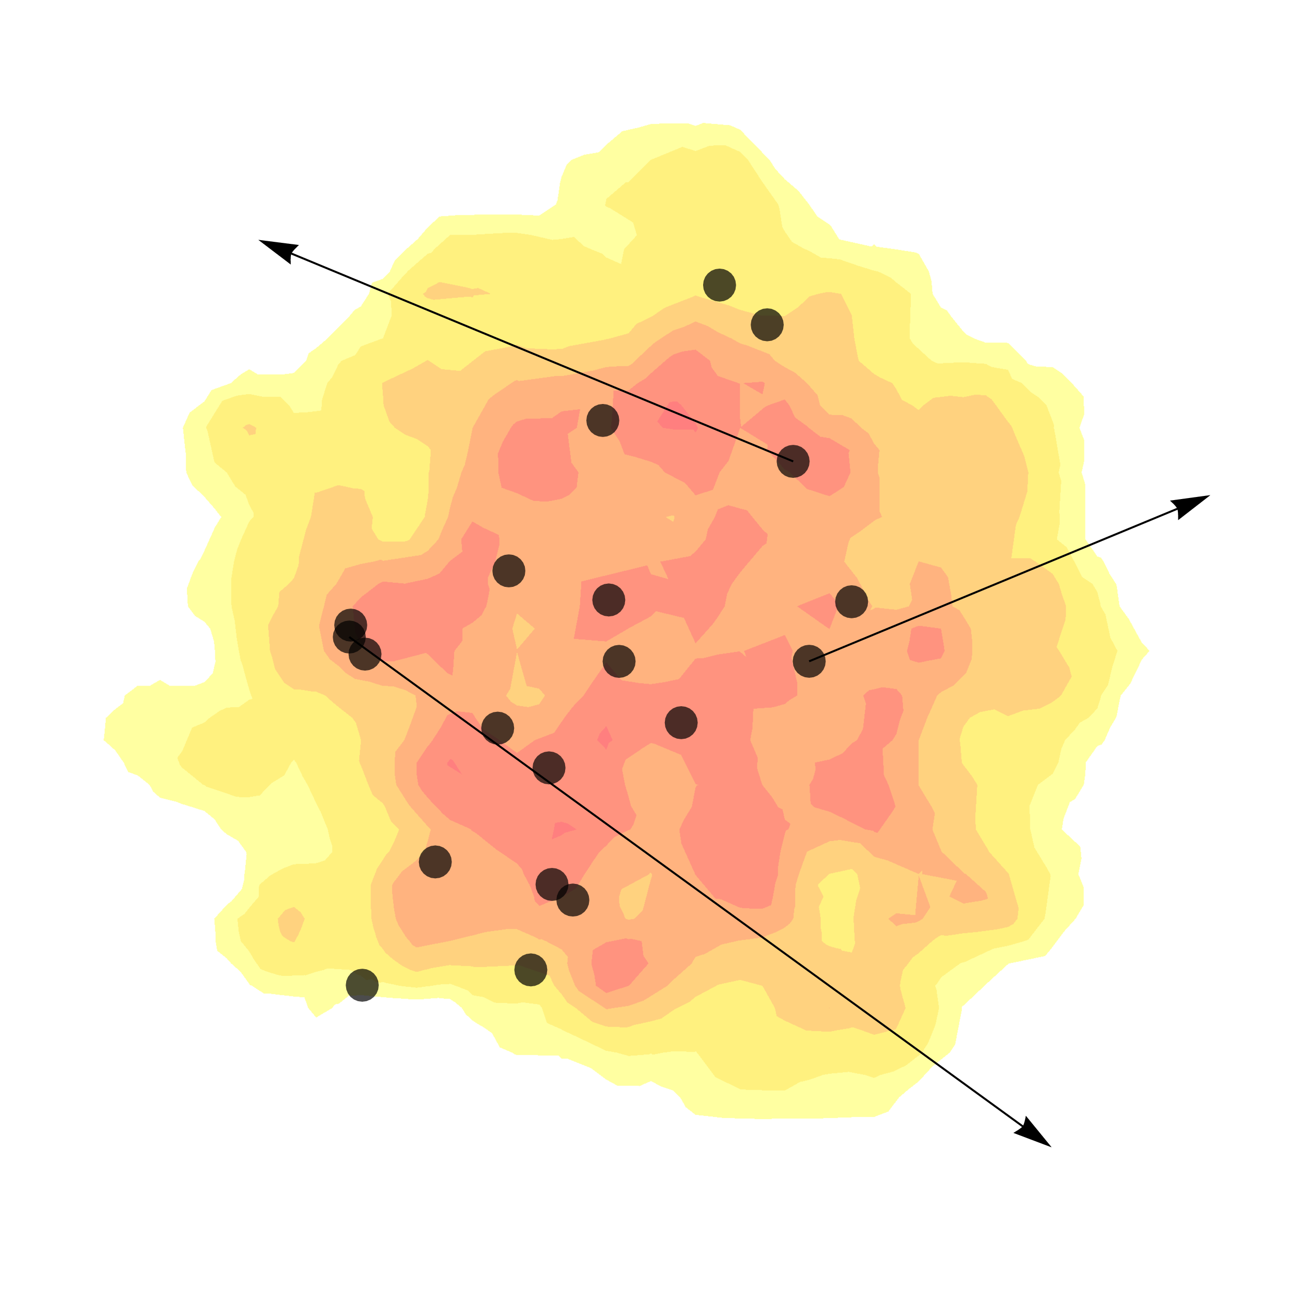
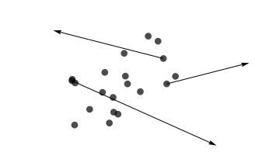
High momentum probes of the QGP
=
Quantifies how much energy is lost by high momentum particles

Slide 8
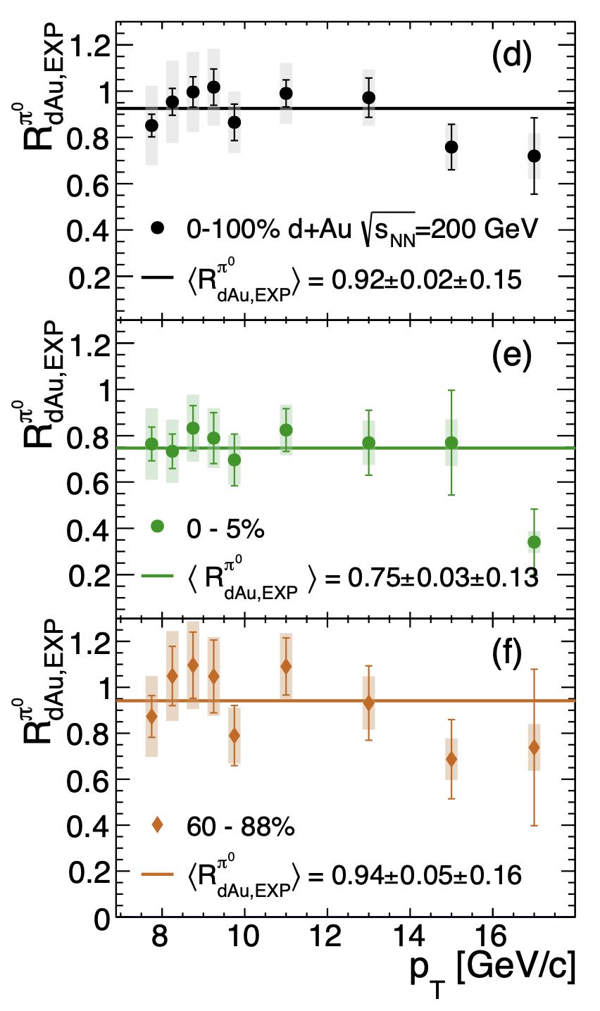
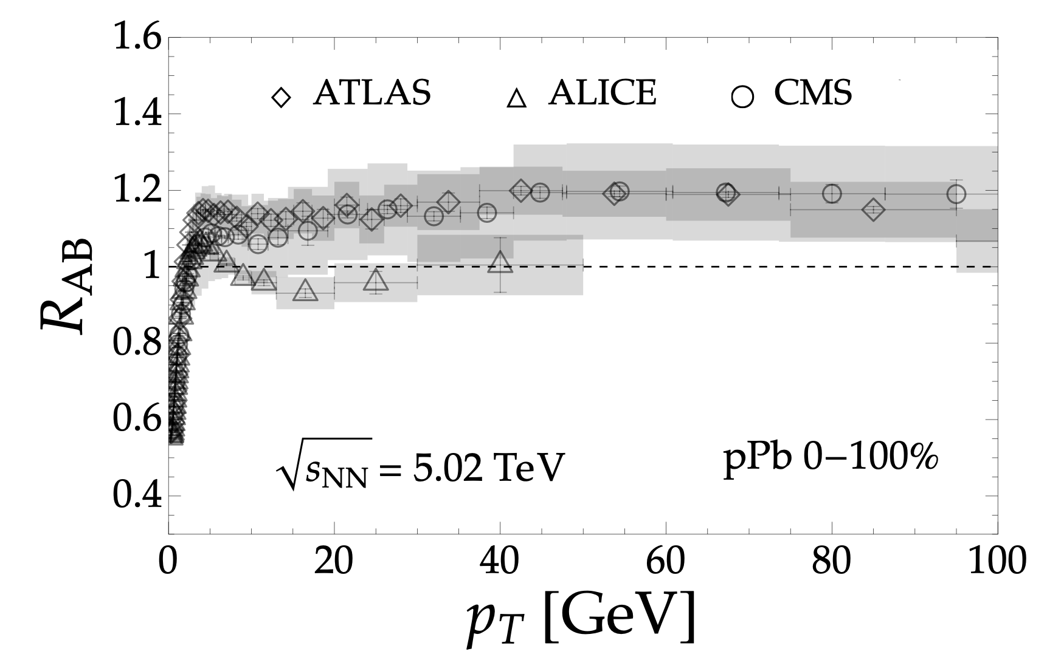
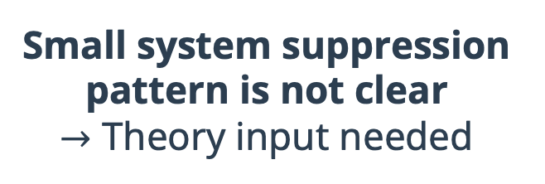
High momentum probes in small systems
No energy loss?
Bert, CF, and Horowitz, arXiv:2603.21861
Small system suppression pattern is not clear
$→$ Theory input needed
PHENIX, Phys. Rev. Lett. 134, 022302 (2025).

Slide 9
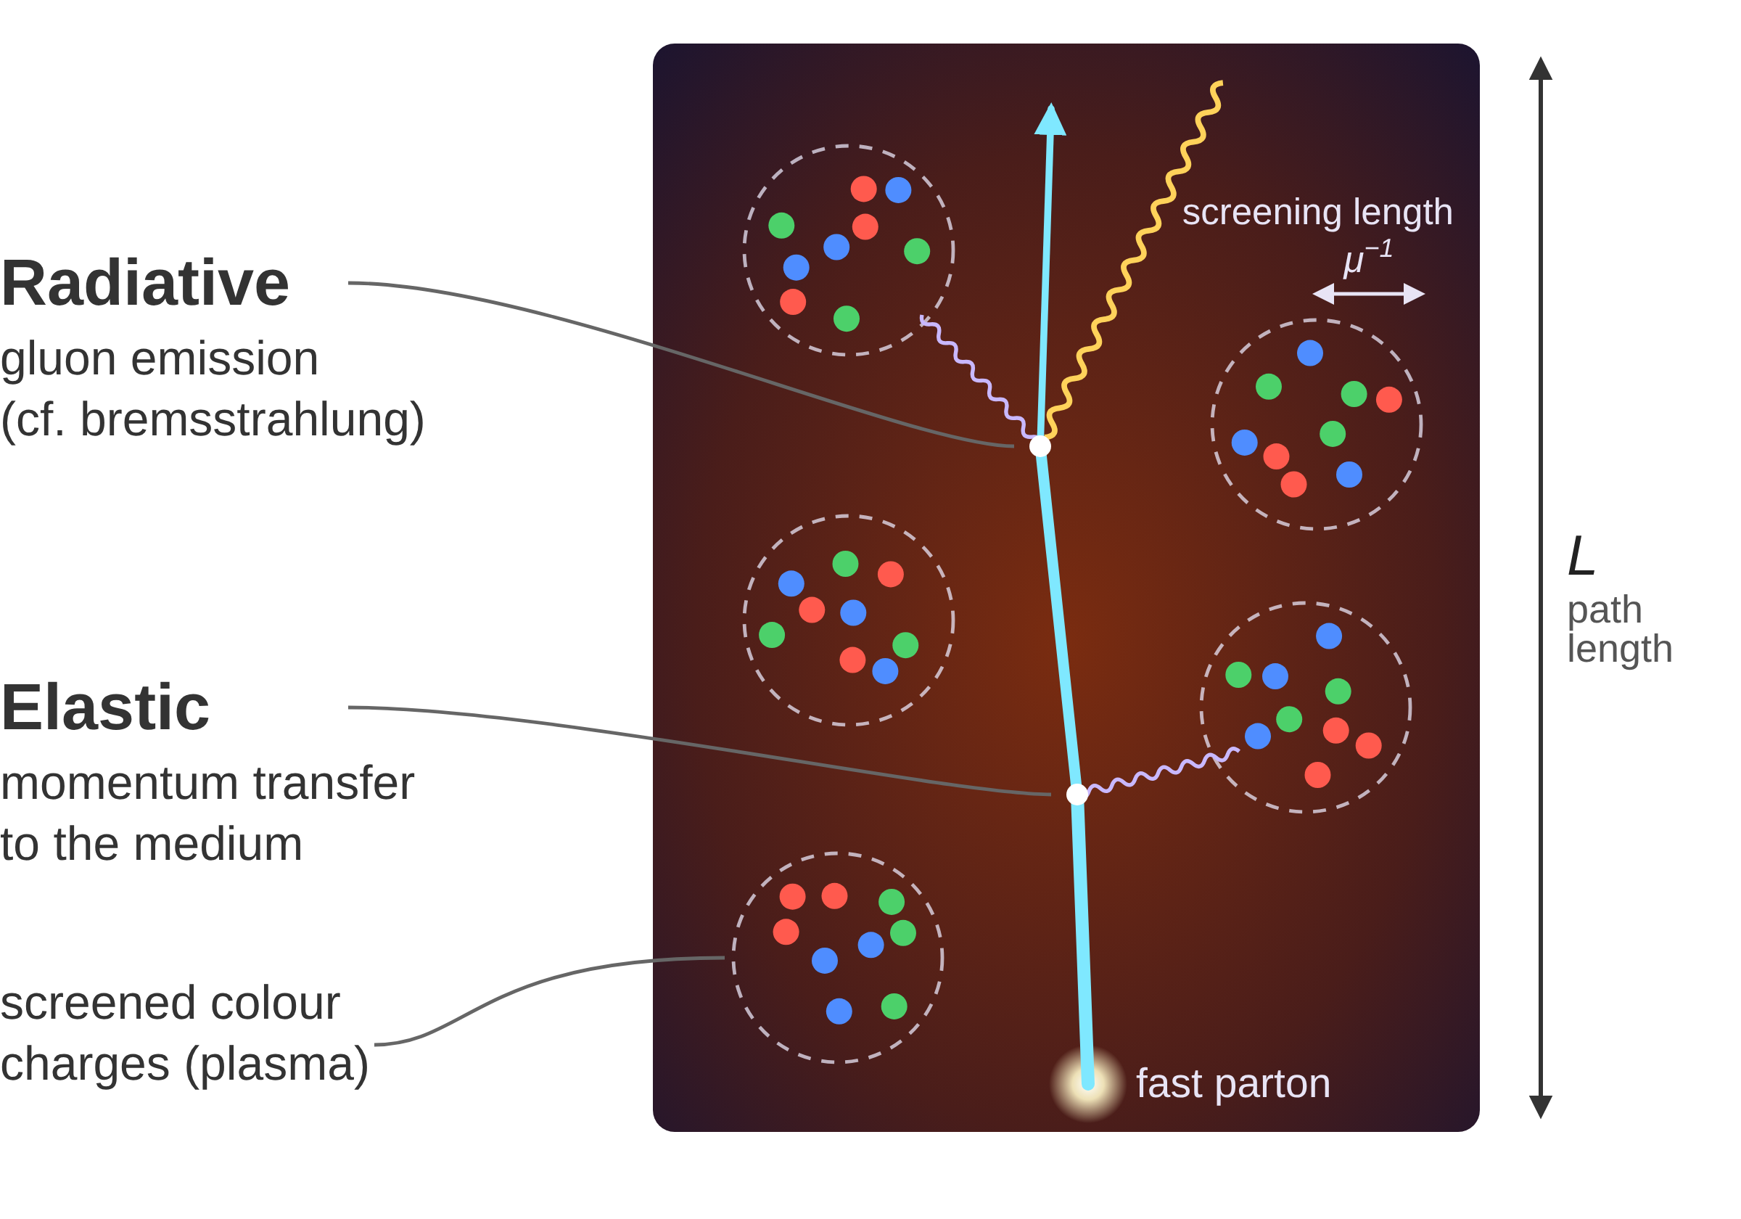
The Cape Town model
Parton: quark or gluon
QGP modelled as screened colour charges that undergo realistic hydrodynamic evolution
Elastic and radiative energy loss, computed in perturbative QCD
Strong coupling constant is the single free parameter
Small systems: few scatterings → small-system corrections
Fit results on large system data, make predictions for small systems
CF, W. A. Horowitz, JHEP 11, 019 (2025), arXiv: 2505.14568

Slide 10
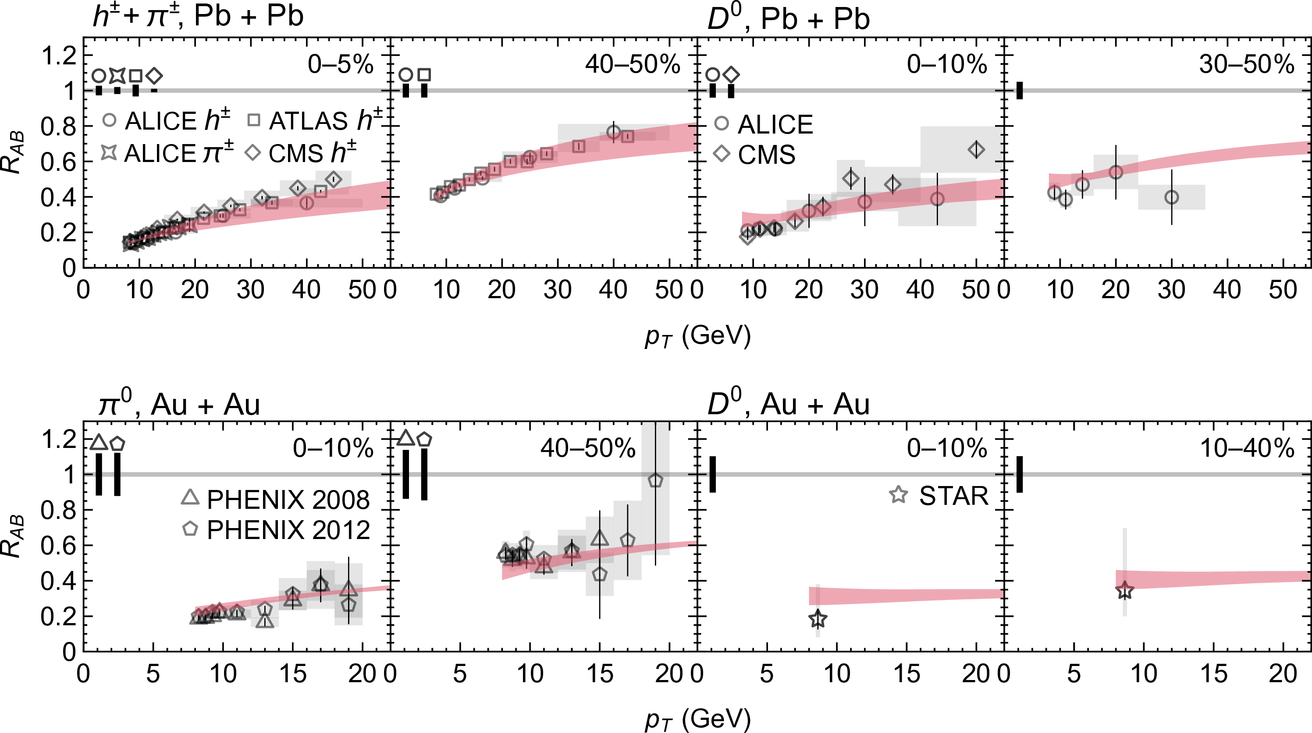
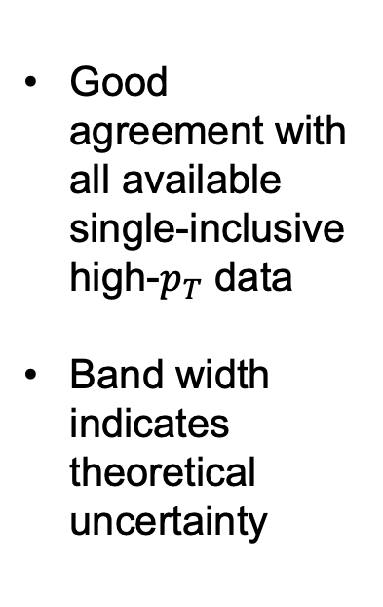
Sample of results post-fitting
Good agreement with all available single-inclusive high-$p_{T}$ data
Band width indicates theoretical uncertainty
CF, W. A. Horowitz, JHEP 11, 019 (2025), arXiv: 2505.14568

Slide 11
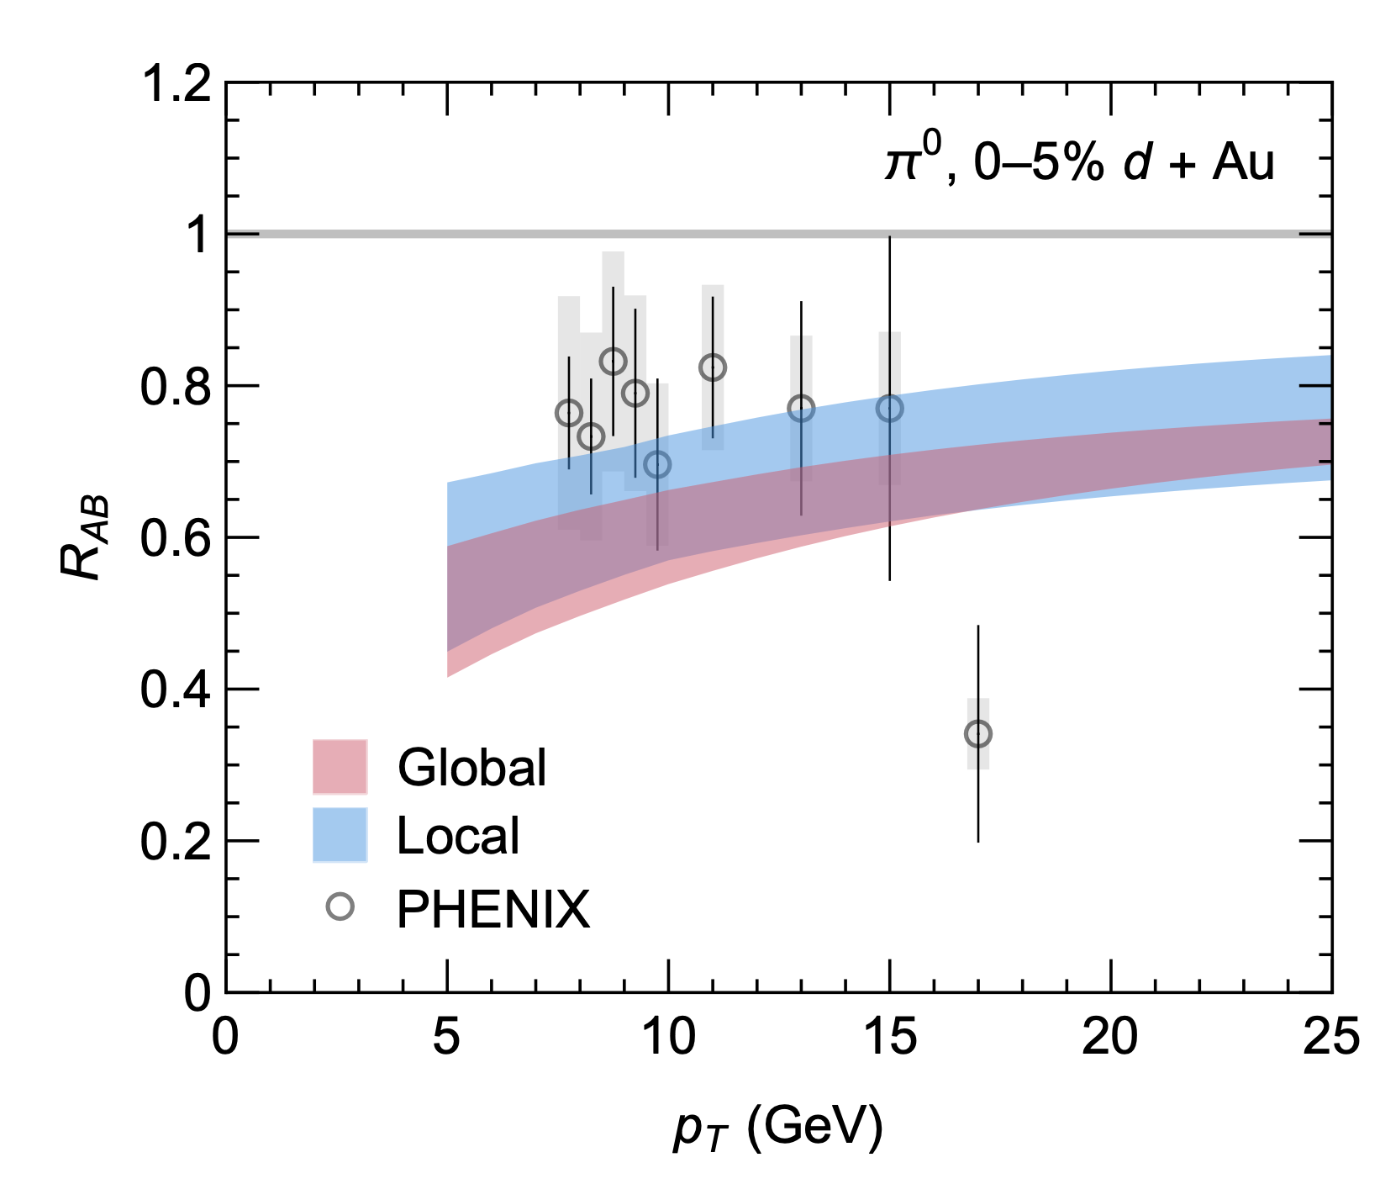
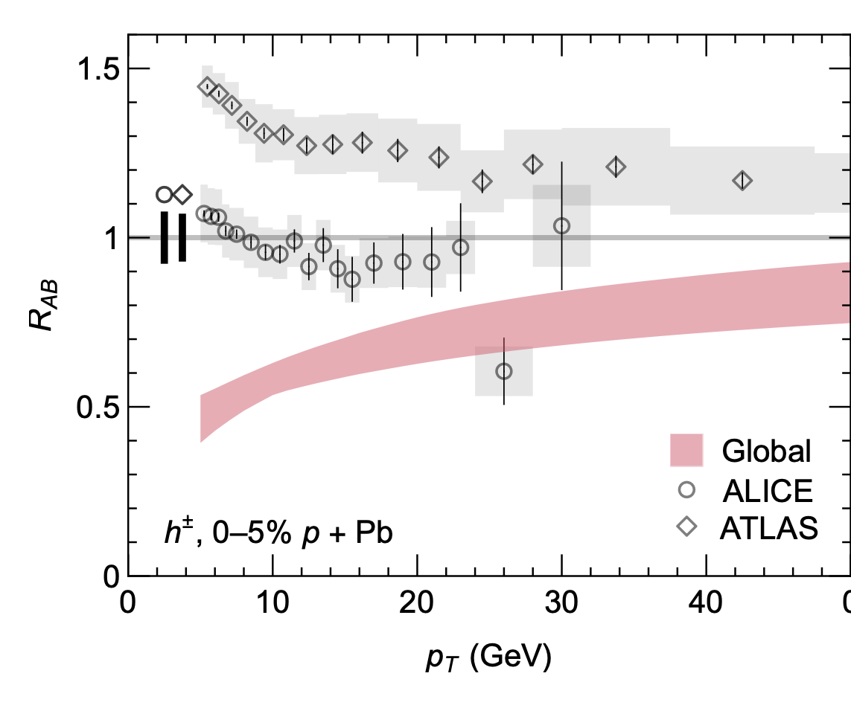
Predictions for small systems
Predictions agree with dAu data, but disagree with pPb data
We seek small systems that are under better theoretical control

Slide 12
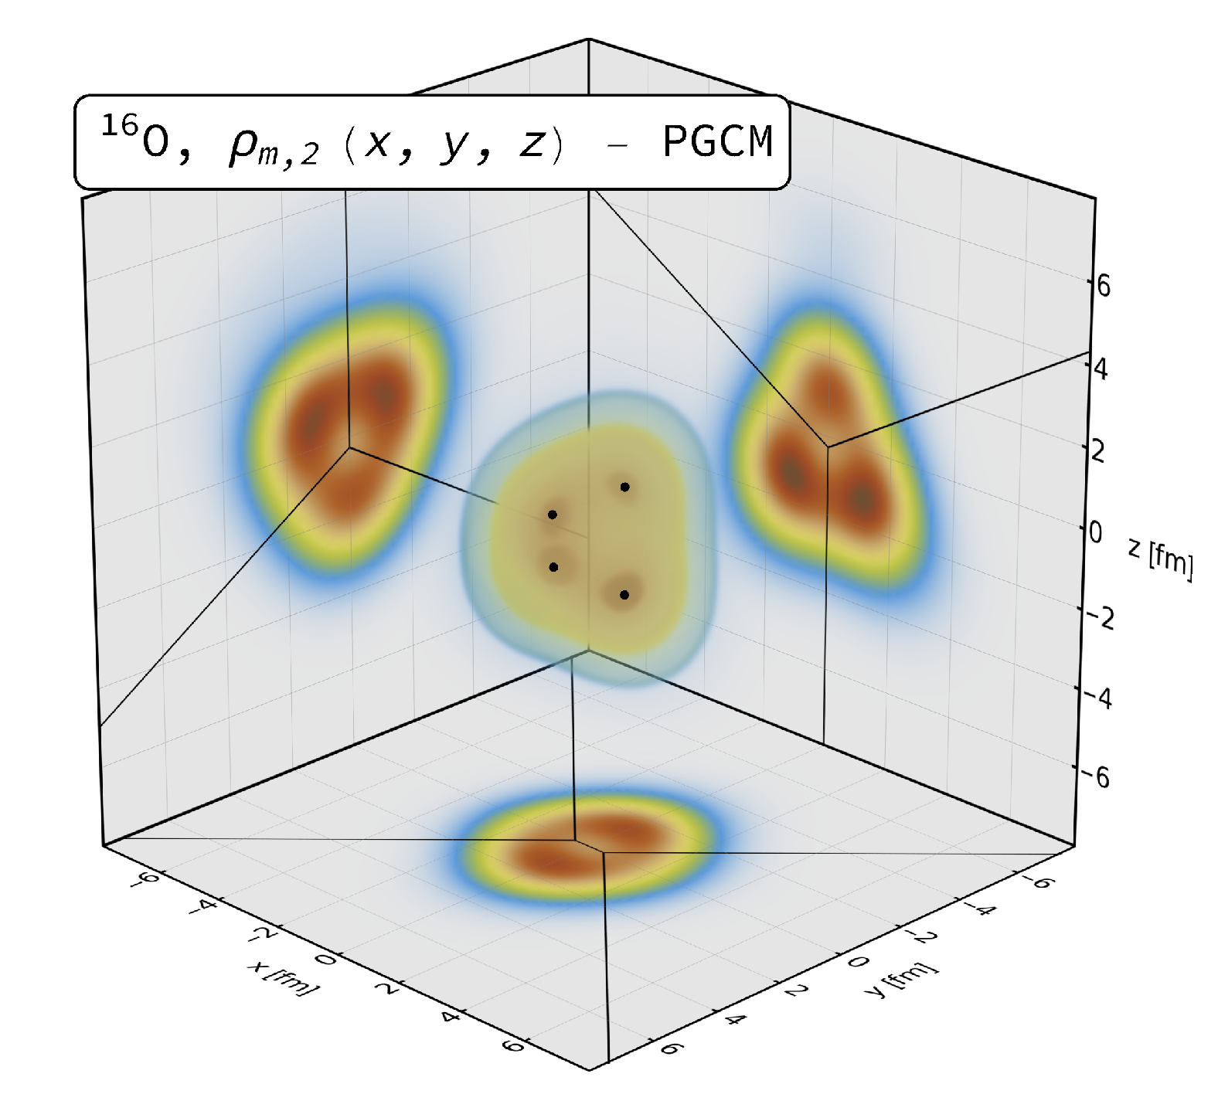
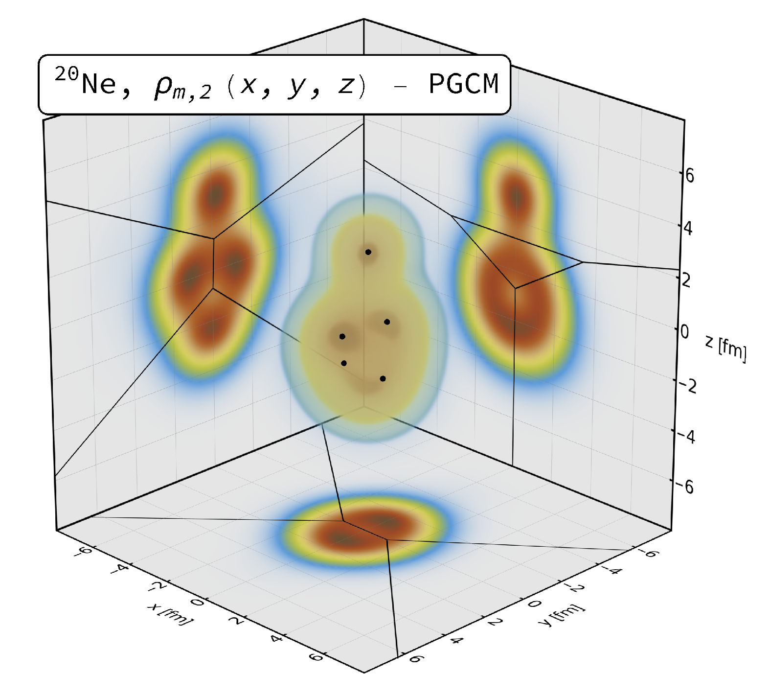
Light-ion collisions
Collisions of oxygen and neon are an ideal testing ground for small system energy loss
  Symmetric, meaning 3D hydro not mandatory
  No centrality-cuts needed
  Large enough to expect non-trivial energy loss signal
  Large enough to expect hydro to apply
  Good understanding of the nuclear geometry
Giacalone, G. et al. Phys. Rev. Lett. 135, 012302 (2025)

Slide 13
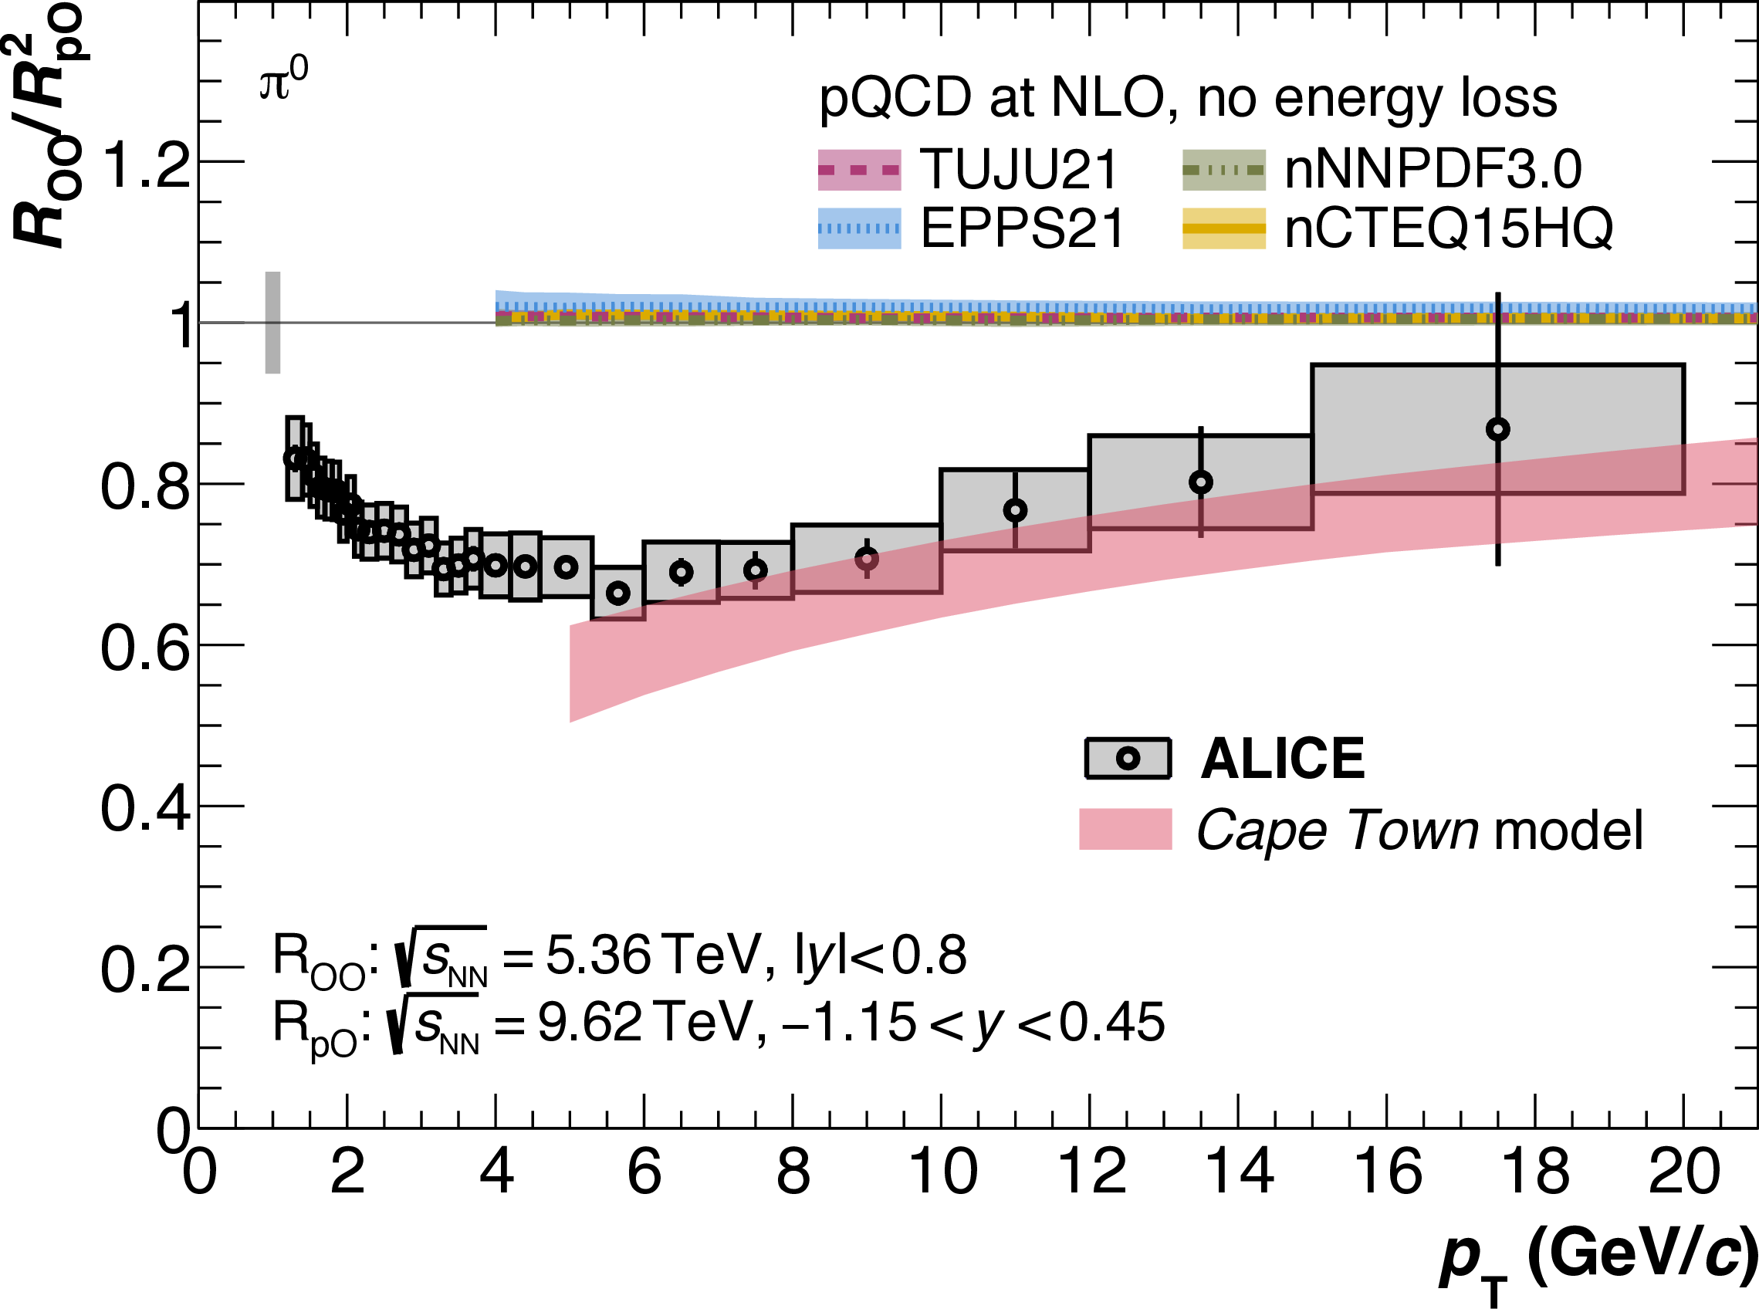
Predictions for oxygen
Good agreement between (blind) predictions and data!
ALICE, arXiv:2606.19967
CF, W. A. Horowitz, JHEP 11, 019 (2025), arXiv: 2505.14568

Slide 14
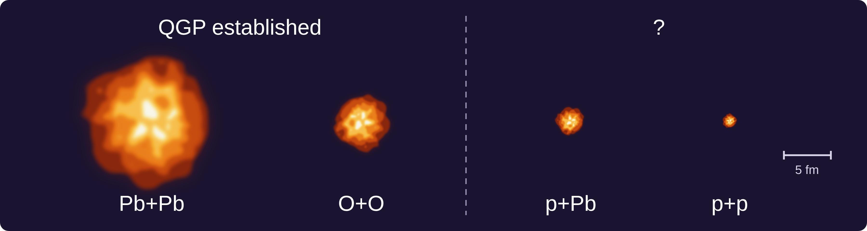
Can we go smaller?
Two paths:
Can we better model the physics of centrality-selected pPb?
What future light-ion runs in LHC run 4 / 5 would help us answer these questions?

Slide 15
Can we go smaller?
Two paths:
Can we better model the physics of centrality-selected pPb?
What future light-ion runs in LHC run 4 / 5 would help us answer these questions?

Slide 16
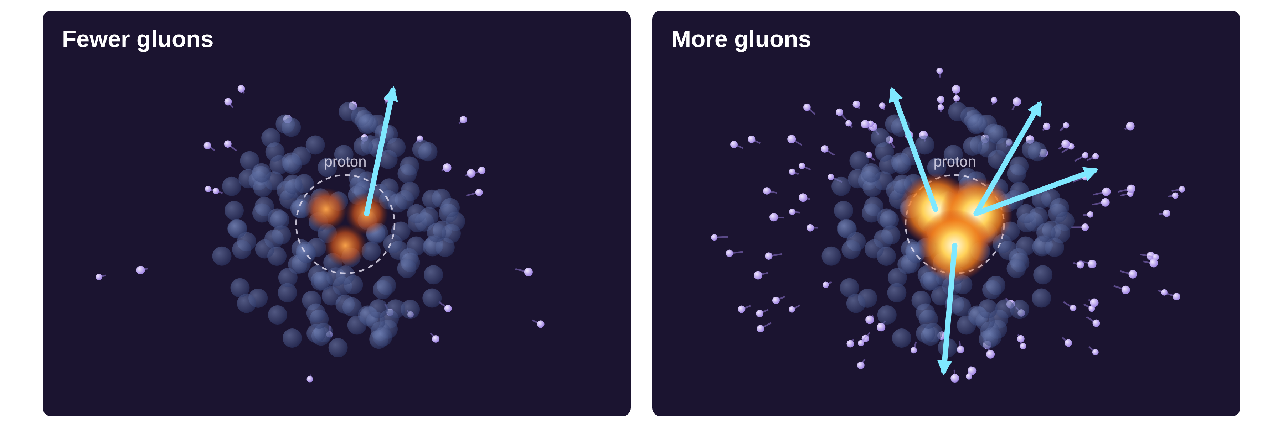
Centrality selection in pPb
Centrality in pPb is determined by the soft multiplicity
Proton fluctuations with more gluons give more soft particles and more hard processes → R_{pPb} ≠ 1 without energy loss
Modelled with IP-Glasma: event-by-event gluon fields, with proton substructure constrained by HERA data (NB: no energy loss)
CF, W. A. Horowitz, B. Schenke arXiv:2609.29886

Slide 17
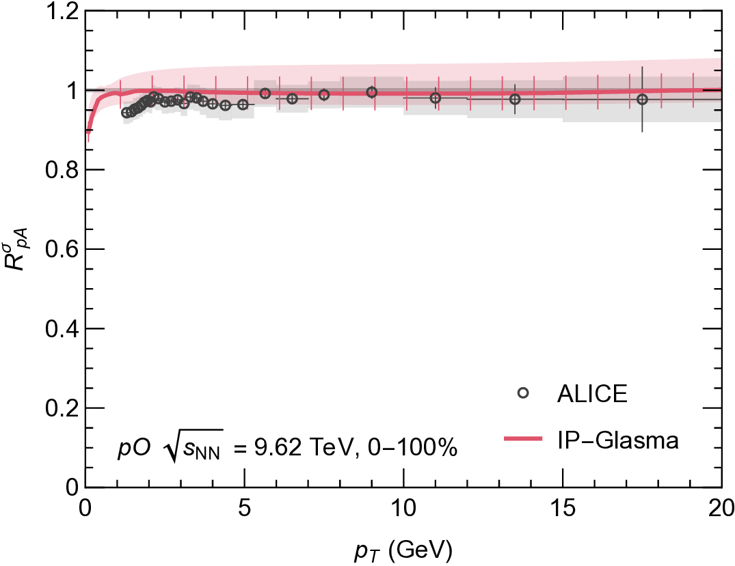
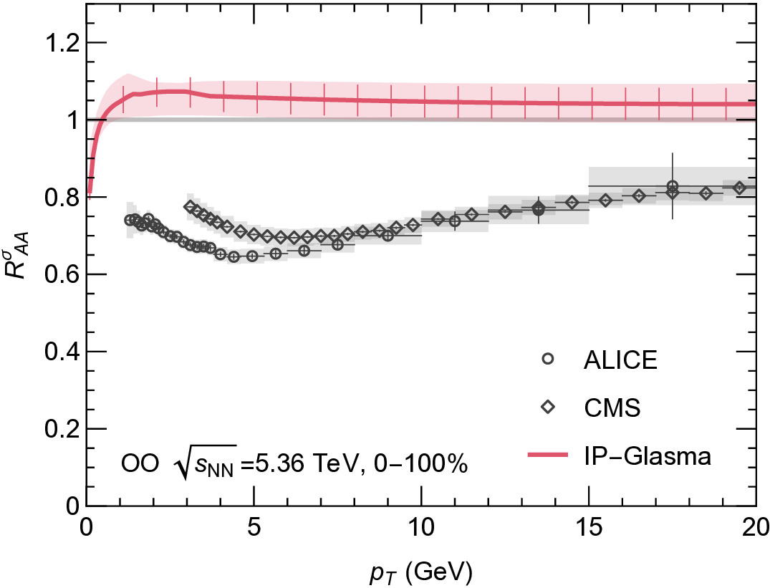
Oxygen baseline
Initial-state only agrees with pO but not with OO → supports partonic energy loss in OO
CF, W. A. Horowitz, B. Schenke arXiv:2609.29886

Slide 18
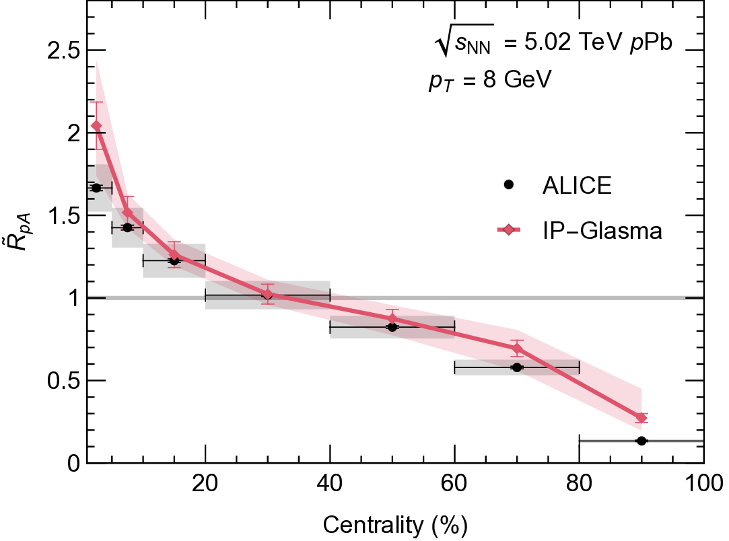
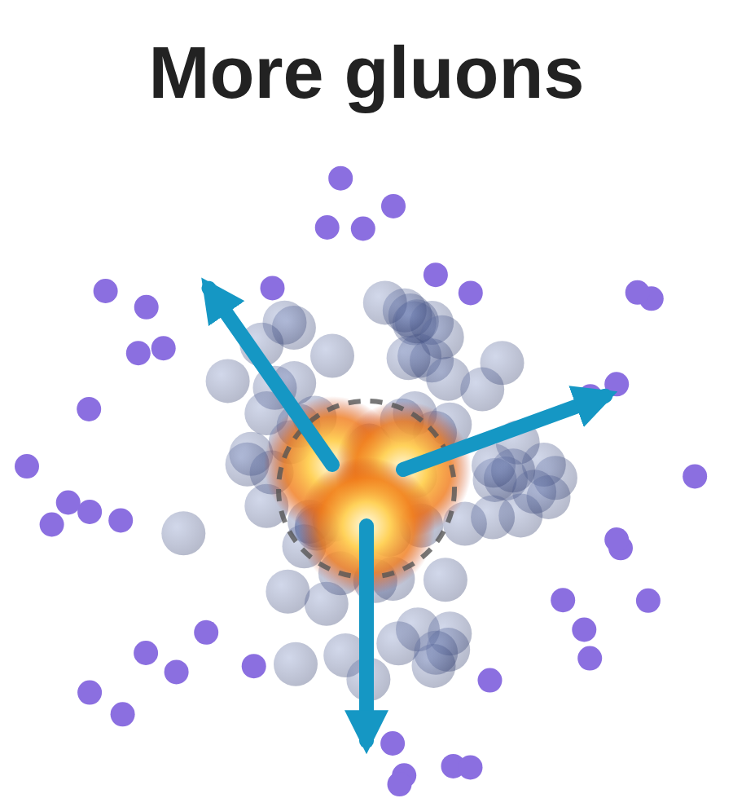
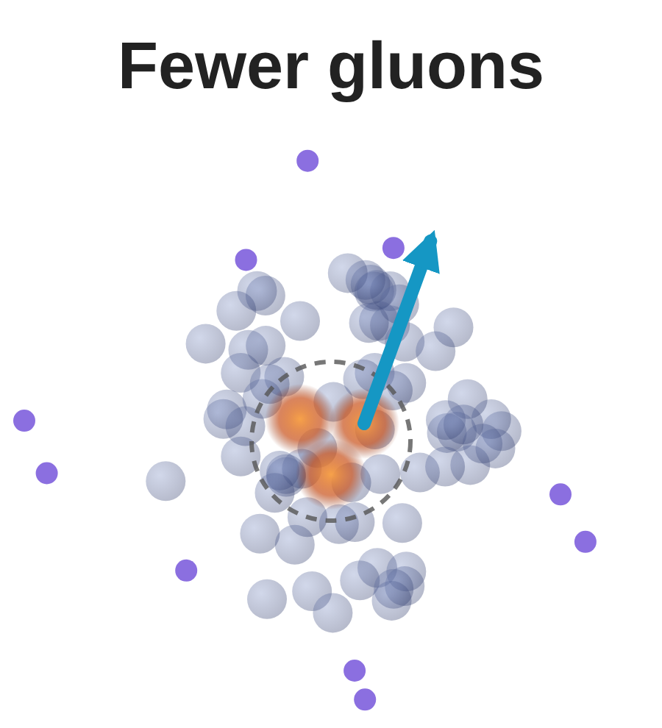

Centrality cut $R_{pA}$
Centrality determined by (soft) multiplicity at midrapidity
IP-Glasma reproduces the “strange” data very well!
Room for partonic energy loss?
CF, W. A. Horowitz, B. Schenke arXiv:2609.29886

Slide 19
Can we go smaller?
Two paths:
Can we better model the physics of centrality-selected pPb?
What future light-ion runs in LHC run 4 / 5 would help us answer these questions?

Slide 20
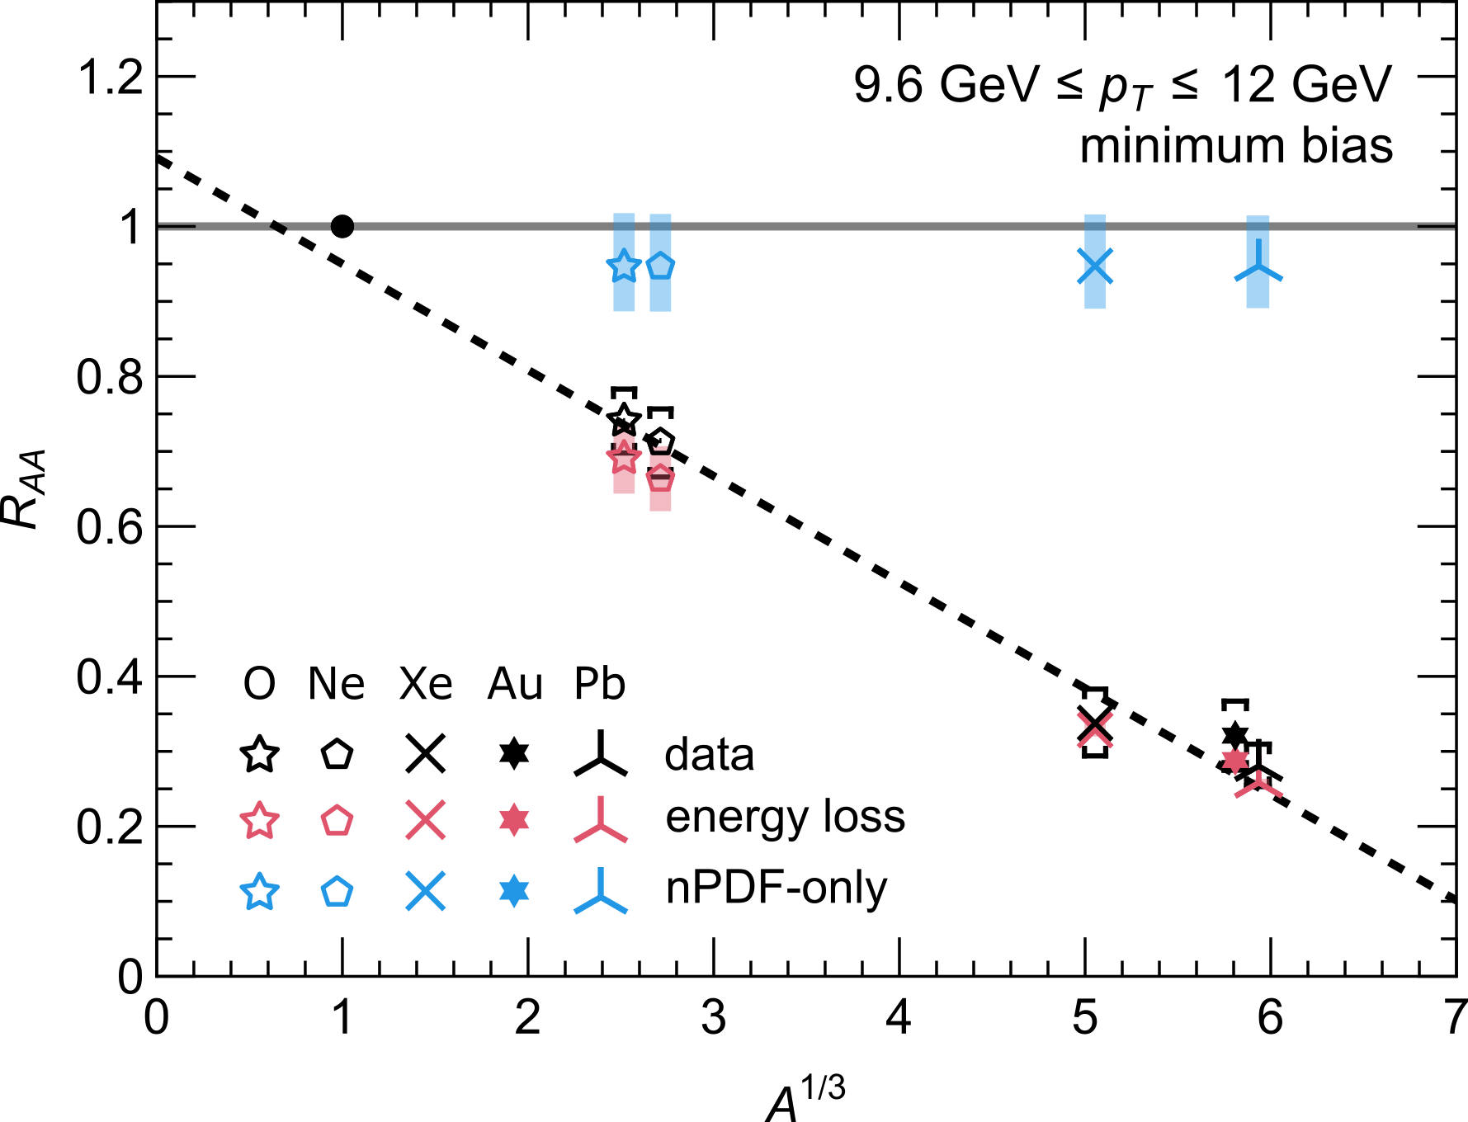
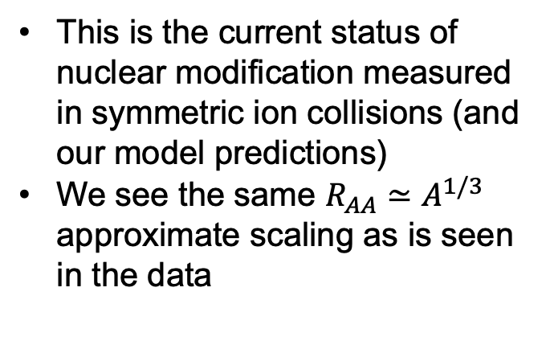
Current systems
This is the current status of nuclear modification measured in symmetric ion collisions (and our model predictions)
We see the same $R_{AA}≃A^{1/3}$ approximate scaling as is seen in the data
CF, B. Bert, J. Brand, W. Vogelsang, and W. A. Horowitz, arXiv:2512.17832 [hep-ph] (2025).

Slide 21
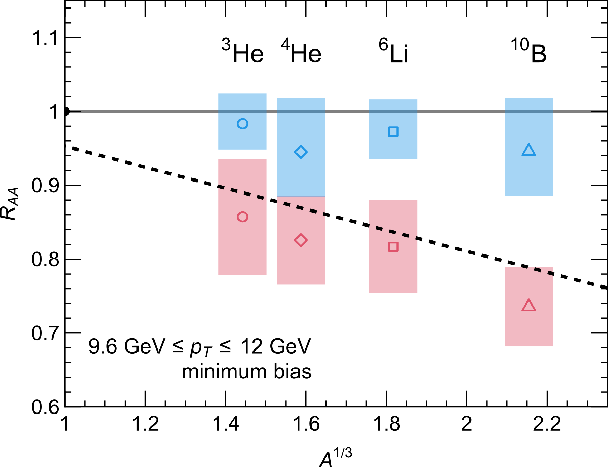
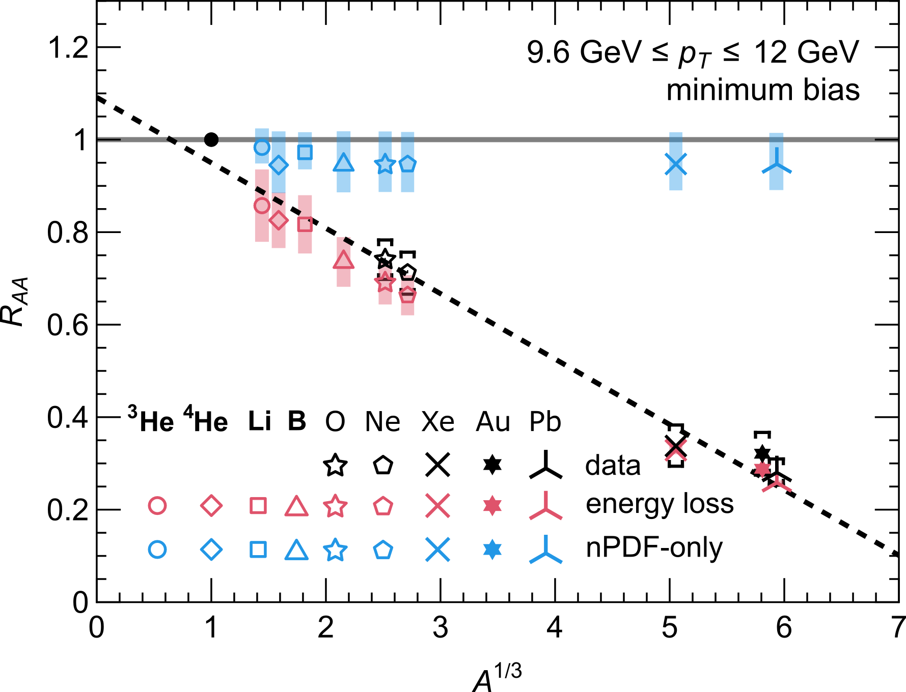
Can we go smaller?
³He and ⁶Li: best chance to discover energy loss in very small systems
⁶Li and ¹⁰B: can separate energy loss from initial-state effects
⁴He would also need a p + ⁴He reference run to cancel initial state effects
Each system needs ≲ 1 day of beam time
CF, B. Bert, J. Brand, W. Vogelsang, and W. A. Horowitz, arXiv:2512.17832 [hep-ph] (2025).

Slide 22
Summary
Cape Town model blind predictions for OO agree with ALICE data → supports partonic energy loss in OO
IP-Glasma describes centrality-dependent R_{pPb}; room for energy loss in the most central collisions
Future light-ion runs: lithium distinguishes energy loss from initial-state effects; helium would require a dedicated p + He run
How small can a droplet of QCD fluid be? Combining light-ion collisions with a better understanding of pPb provides a path to an answer.
Notes:
Data subsets can test model consistency and highlight missing physics.
Provides a quick way to identify sensitive observables and potential gaps in the model.

Slide 23
Backup

Slide 24
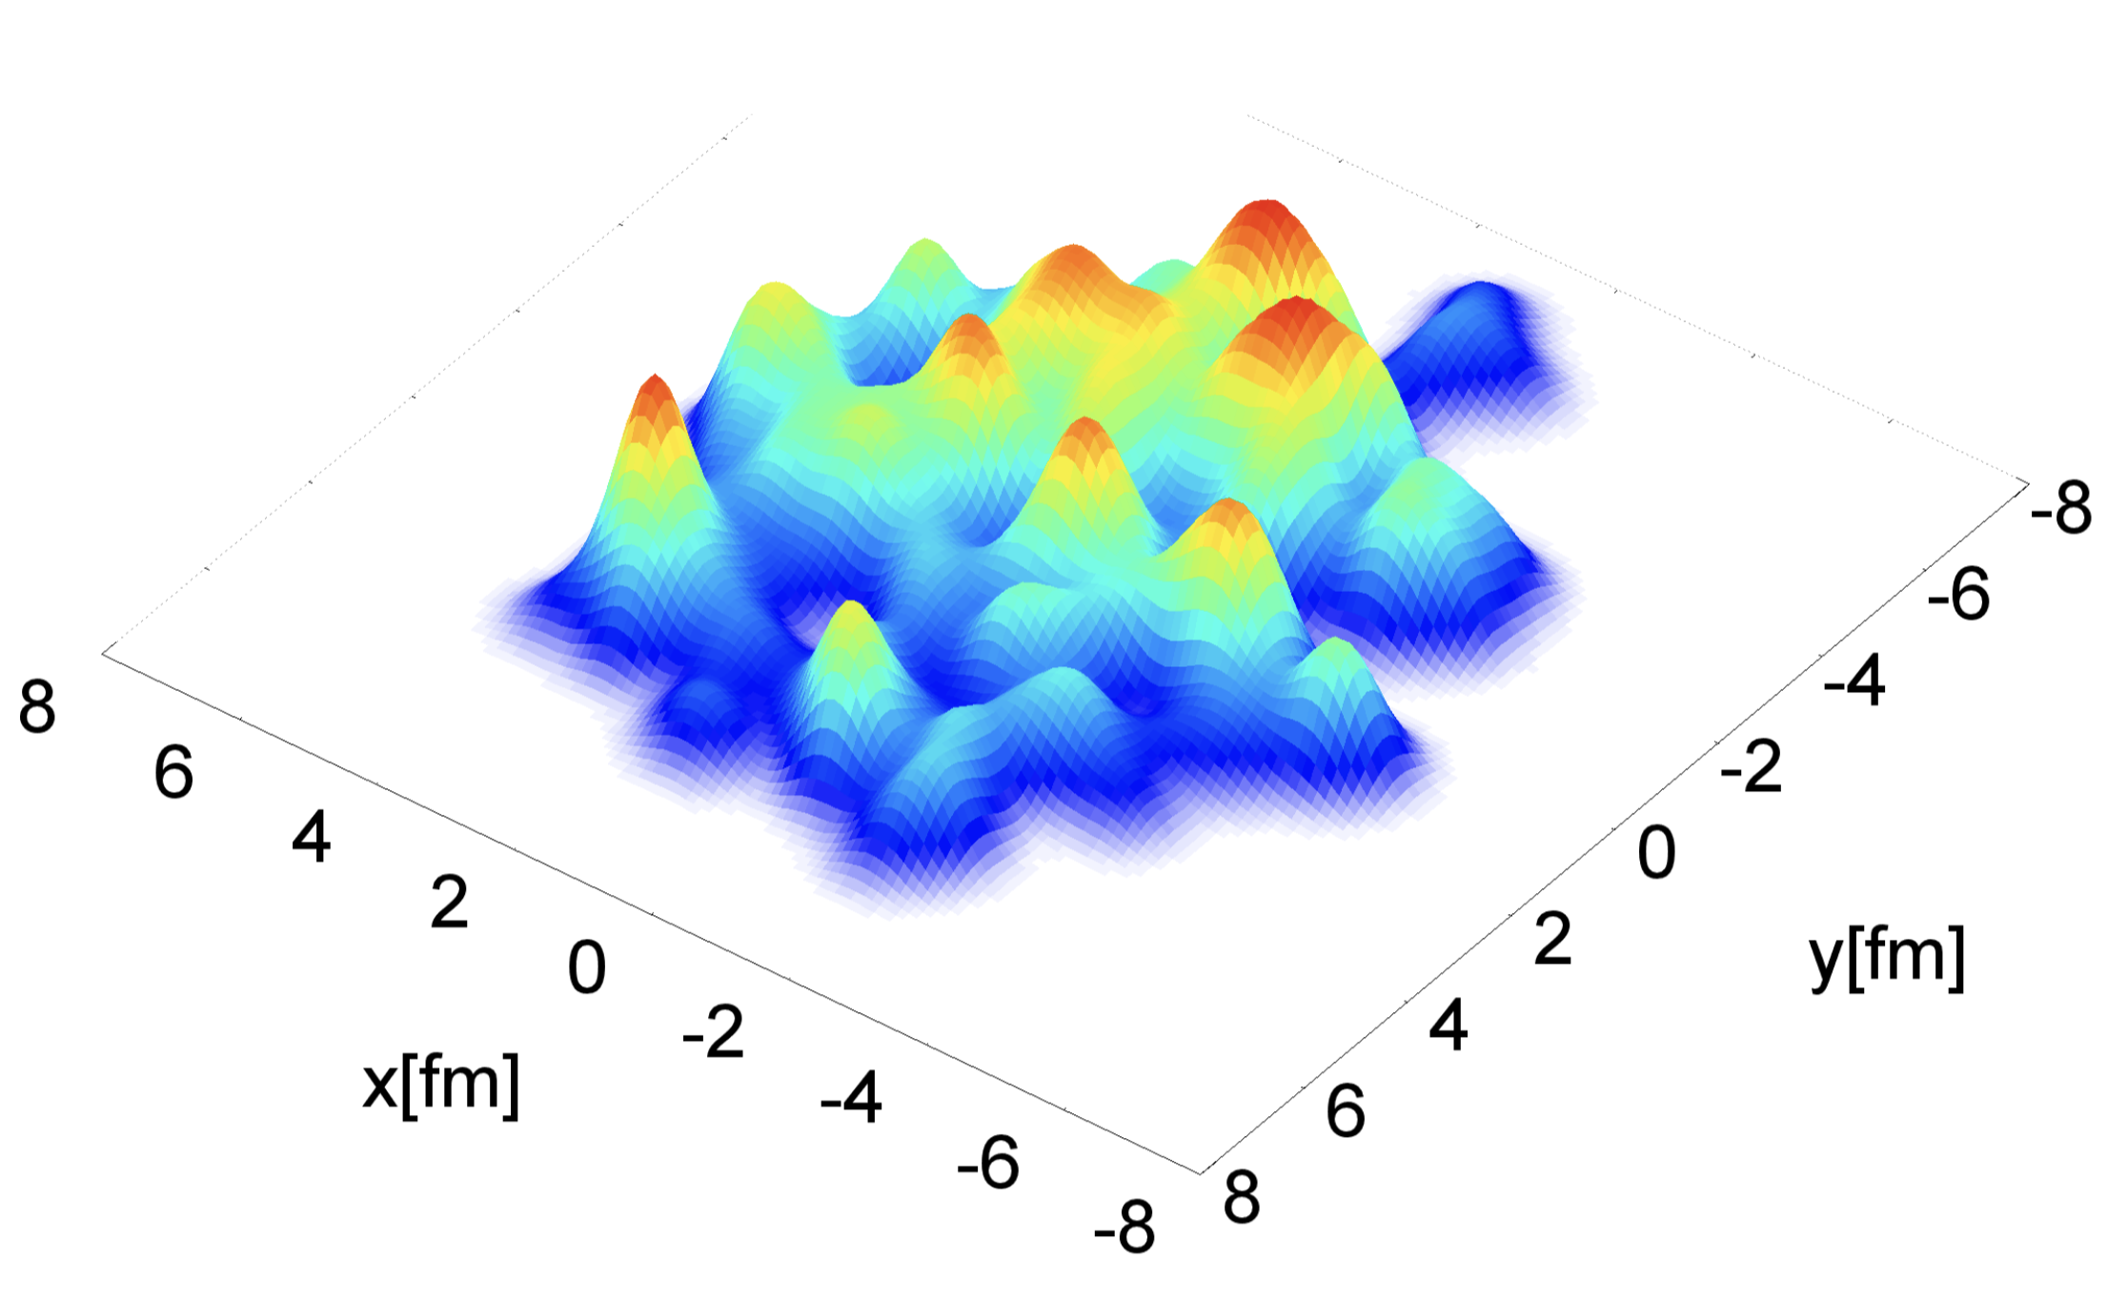
Backup: Tackling hard-soft correlations
IP-Glasma: solve classical Yang–Mills gluon fields (colour glass condensate), event by event
  QCD version of maxwell’s equations
Proton substructure (hot spots) constrained by HERA data
Soft and hard particles produced in the same event → hard-soft correlations included
Figure from B. Schenke, P. Tribedy, and R. Venugopalan, PRL 108, 252301 (2012).
CF, W. A. Horowitz, B. Schenke arXiv:2609.29886

Slide 25
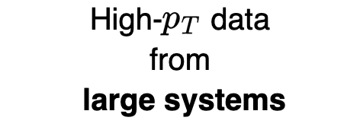
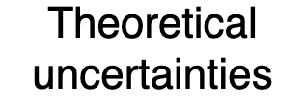
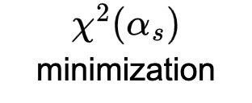
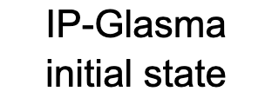
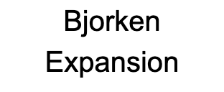

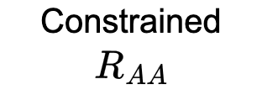
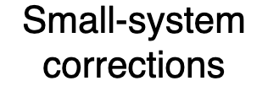

Backup: The “Cape Town” Model
Radiative (DGLV)
Elastic
(HTL, Braaten & Thoma)
CF, W. A. Horowitz, JHEP 11, 019 (2025)

Slide 26
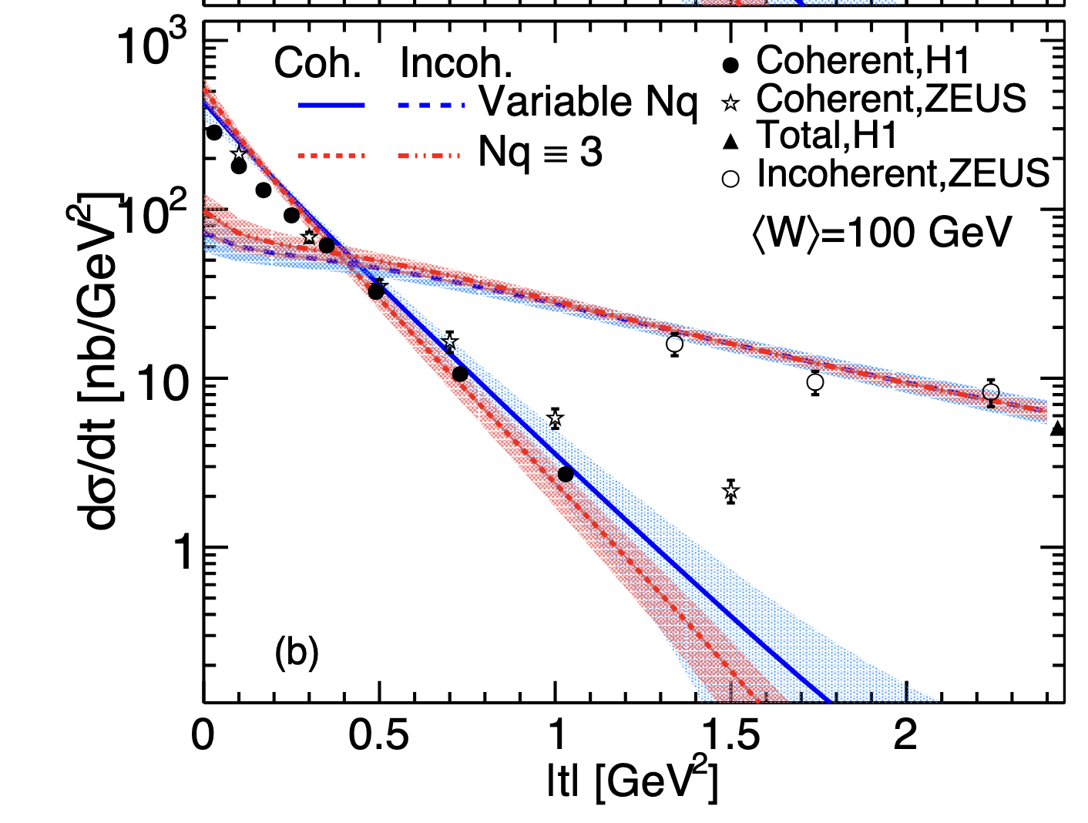
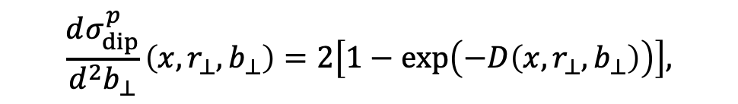

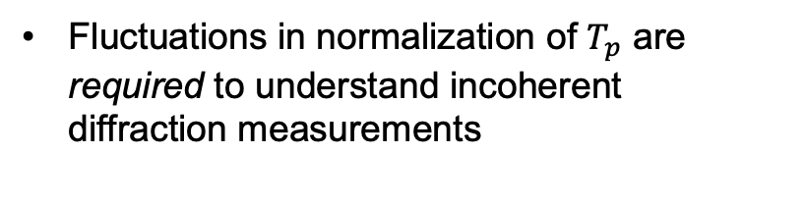
Backup: proton from HERA
All parameters are sampled from a prior Bayesian posterior on HERA data [H. Mäntysaari, B. Schenke, C. Shen, and W. Zhao, Phys. Lett. B 833, 137348 (2022).]
Fluctuations in normalization of $T_{p}$ are required to understand incoherent diffraction measurements
$$\frac{dσ_{dip}^{p}}{d^{2}b_{⊥}}\left(x,r_{⊥},b_{⊥}\right)=2\left[1−\exp\left(−D\left(x,r_{⊥},b_{⊥}\right)\right)\right],$$
Gluon PDF
Density profile
$$D\left(x,r_{⊥},b_{⊥}\right)∝xg\left(x,{\overset{˜}{μ}}^{2}\left(r_{⊥}\right)\right) T_{p}\left(b_{⊥}\right)$$
$$D∝Q_{s}^{2}$$
Saturation scale
B. Schenke, C. Shen, and P. Tribedy, Phys. Rev. C 102, 044905 (2020).

