Slide 1
Meiosis
An interactive educational application
By Cole Hudson

Slide 2
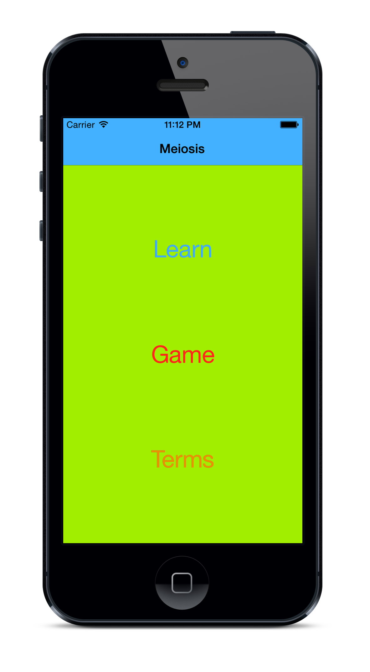
For all types of learners
This app has been designed for all types of learners: Visual, Interactive, and Auditory. It provides photos, audio, and an interactive game to help ingrain the knowledge.
Because this app was built with Apple’s Human Interface Guidelines in mind, it is intuitive for anyone familiar with the platform.

Slide 3

Built for IOS
This app is built for iPhone and iPad, some of the most popular electronic educational platforms available. This helps to make sure that Meiosis will be readily accessible on the App Store.

Slide 4
Demo

Slide 5
Questions?
If you’re interested in learning more about this project, head over to:
https://github.com/ColeHud/Meiosis

Slide 6
The End

