Slide 1
Progress 2/18

Slide 2
Enron Clustering
We compare our clusters with hyperbolic clustering using direct Poincare embedings
We can use different embedings to the plotting tool to compare the cohesion of the clusters

Slide 3
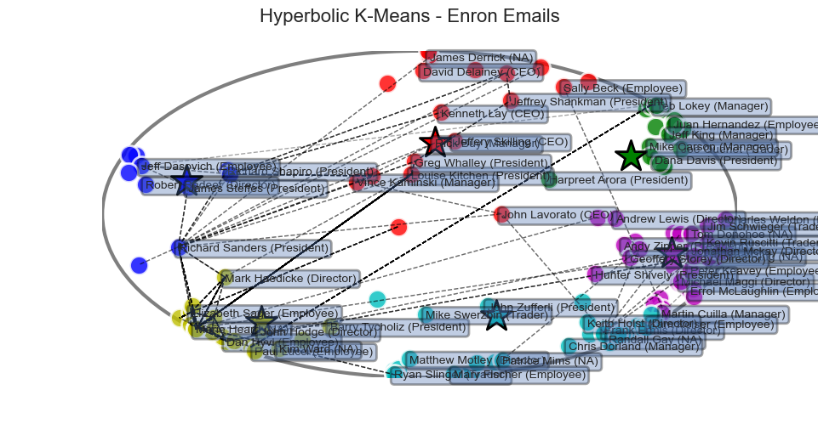
Enron Plot Hyperbolic (Their plots and clusters)

Slide 4
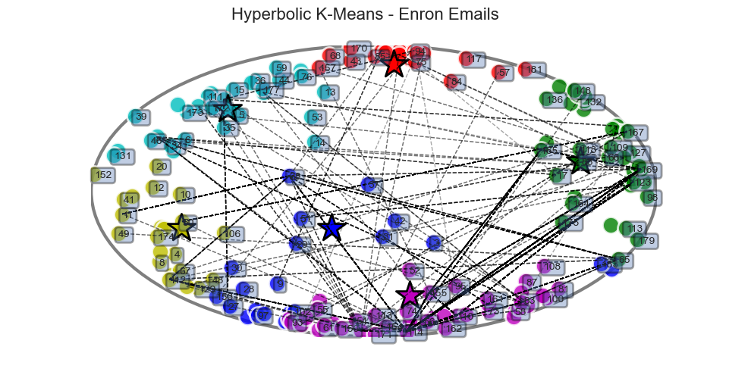
Enron Plot Hyperbolic (my plots and colors)

Slide 5
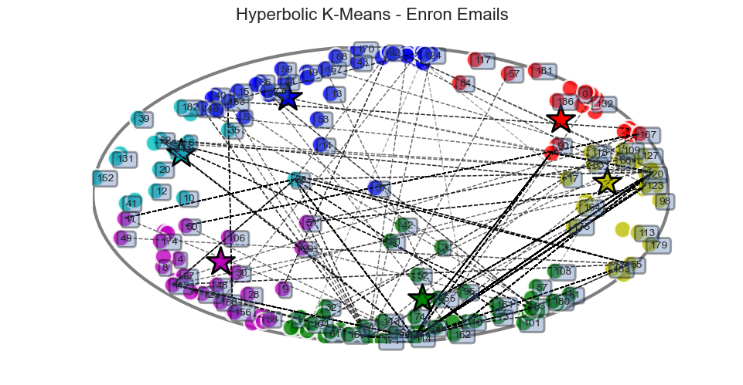
Enron Plot (My plot, their clusters)

Slide 6
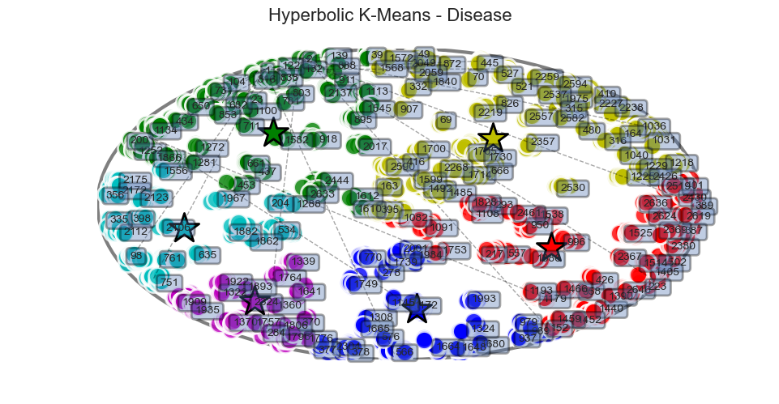
Disease Plotting vs direct poincare

Slide 7
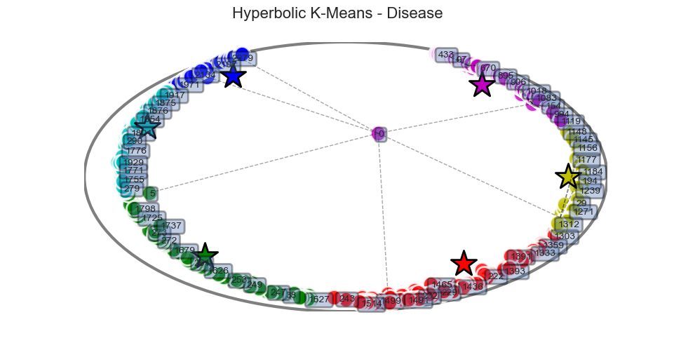
Mine using node feature

Slide 8
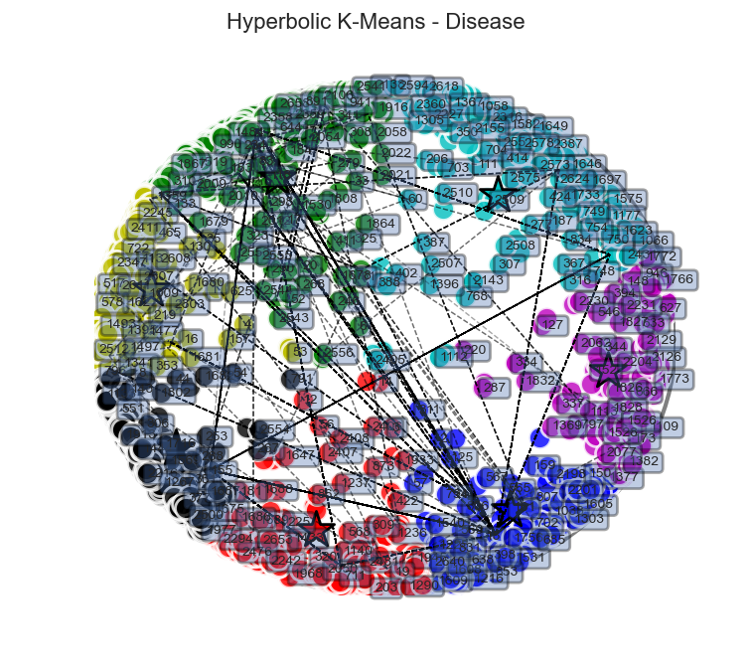
Disease (mine using node id ie. 2600 dim one hot)

Slide 9
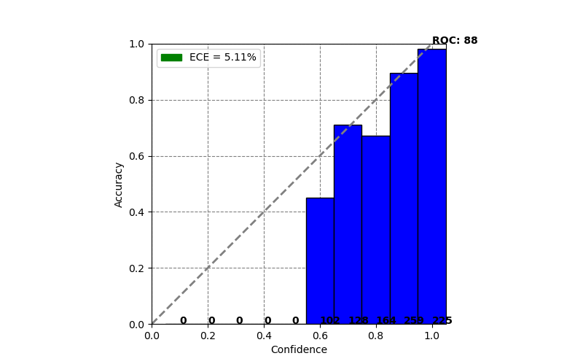
Model Calibration for disease

Slide 10
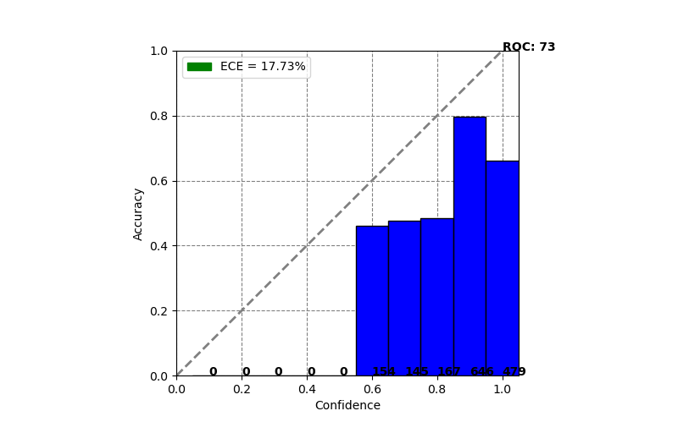
Model Calibration for disease w/ identity feature

Slide 11
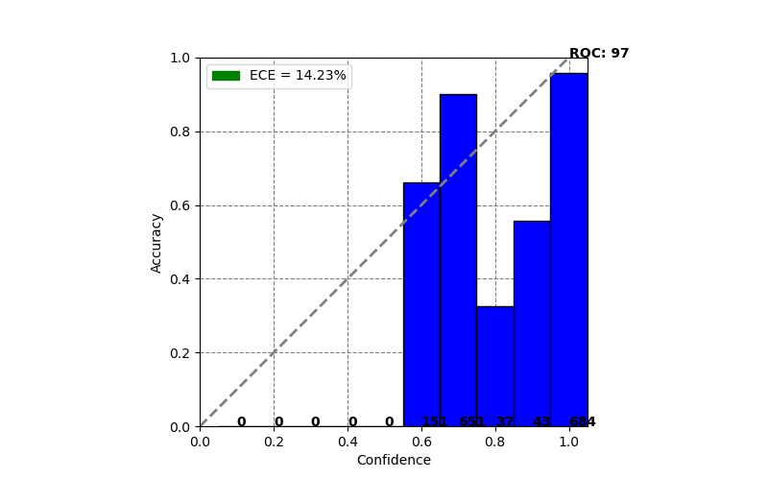
Model Calibration w/ good accuracy but poor calibration

