Slide 1
MG226FINALPROJECT
File created on: 12/11/23 5:39:21 PM EST

Slide 2
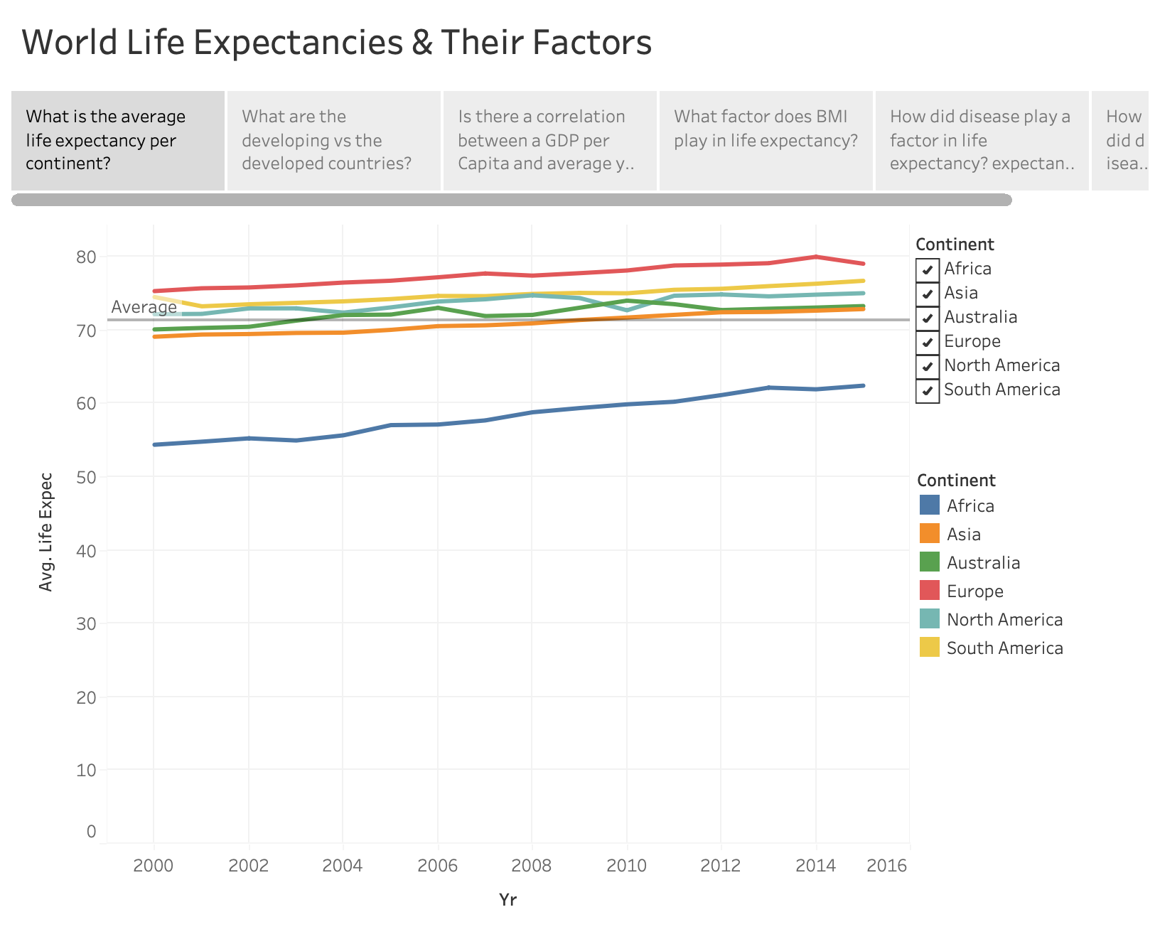

Slide 3
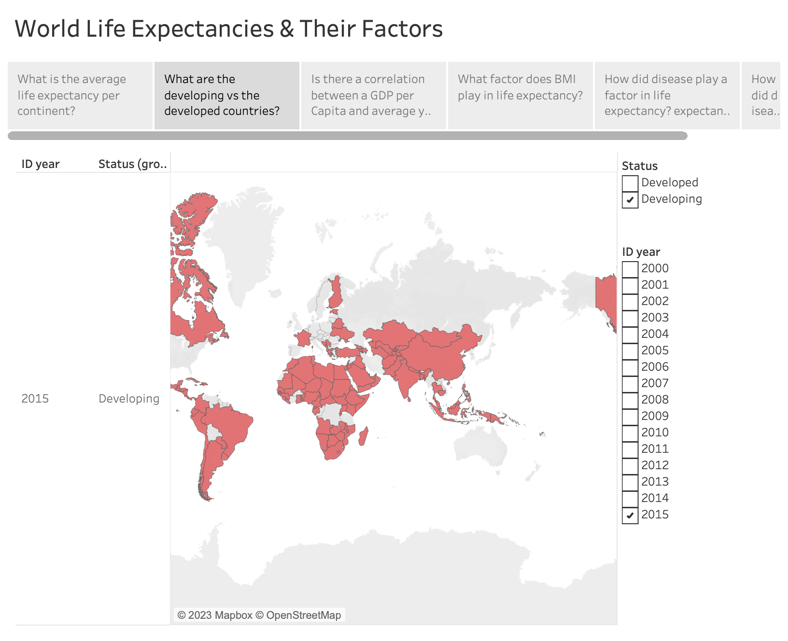

Slide 4
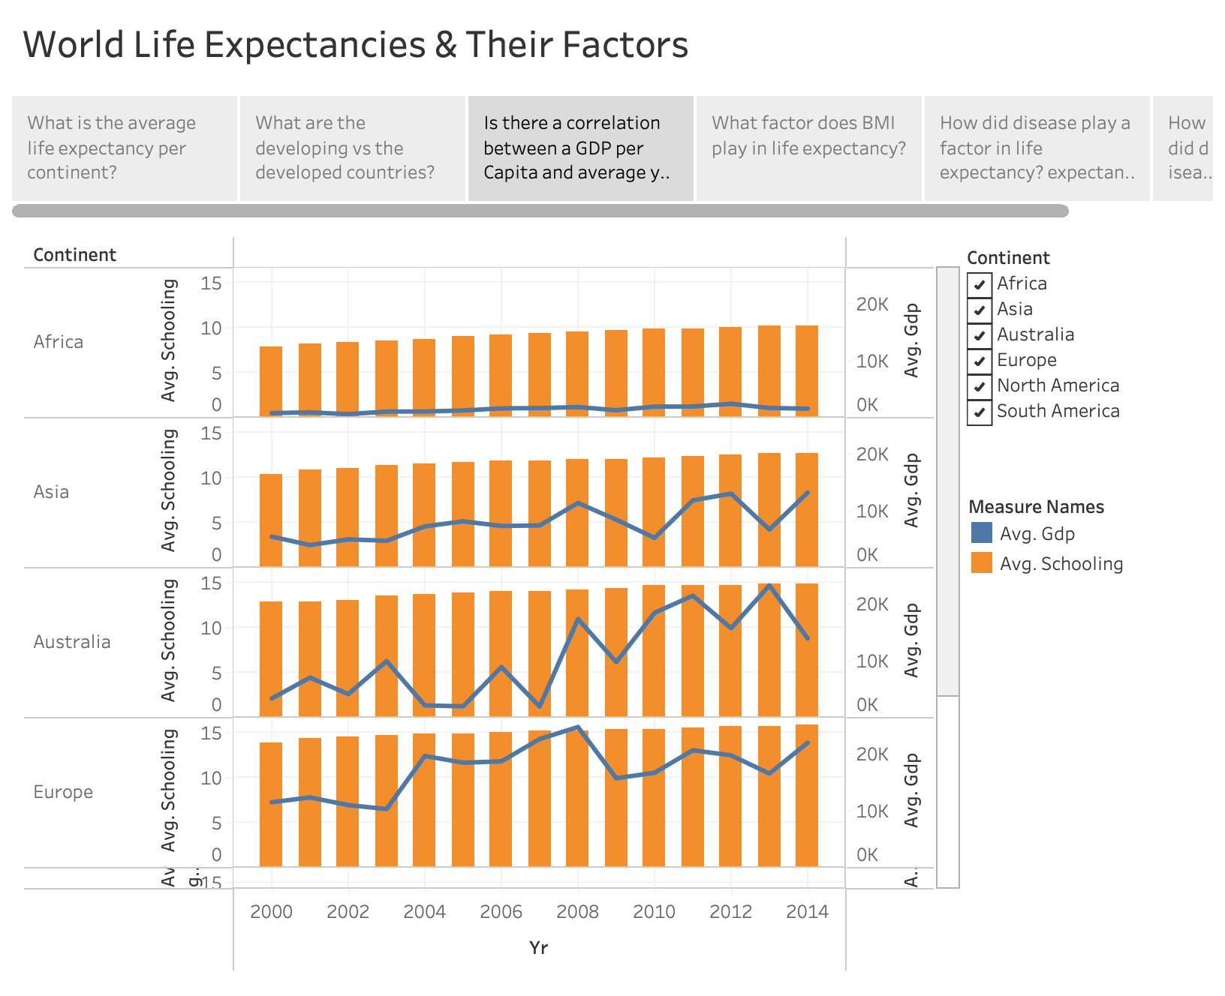

Slide 5
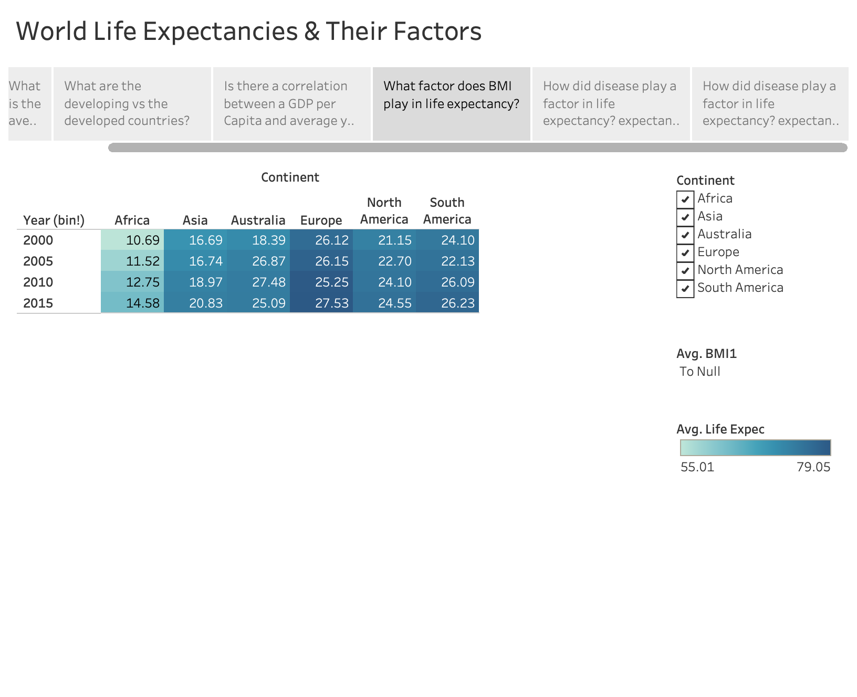

Slide 6
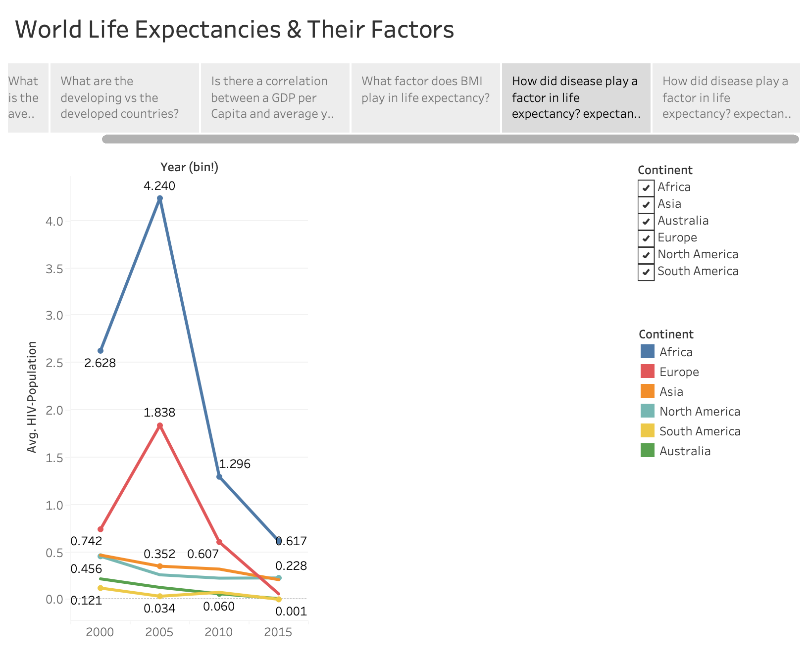

Slide 7
