Slide 1
CMPM163 Final Project
Cole Faust, Talon Baker, Kirby Choy, and Andy Long

Slide 2
Glow Effect - Cole
Idea from GPU Gems
Render only the things that glow, blur them, and then overlay that blur onto the non-glowing render.
Non rendered objects must still occlude glowing objects
Blur done with gaussian image kernel
Normally for a blur diameter of N, each pixel makes N^2 texture samples
This can be improved to 2N by first only blurring along one axis, then blurring the result of that along the other axis
This only applies to kernels with independant X and Y axis sampling

Slide 3
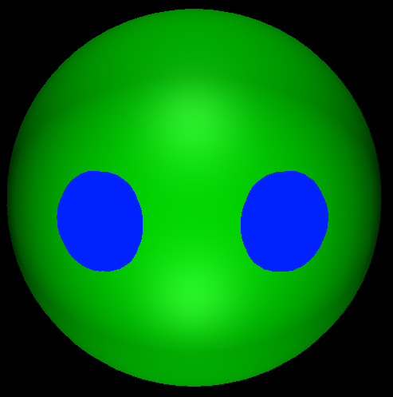
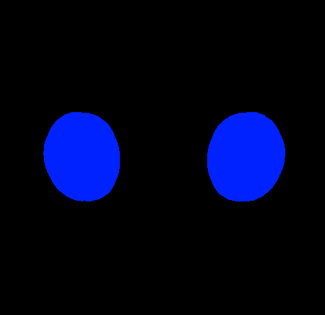
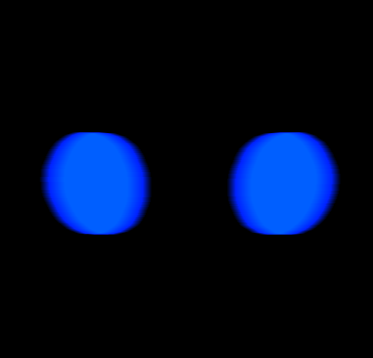
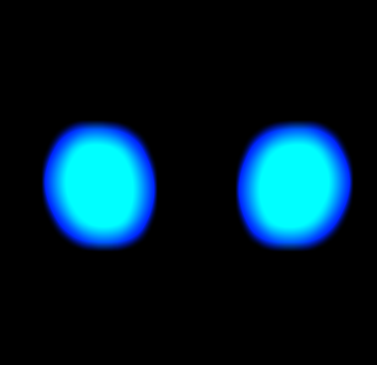
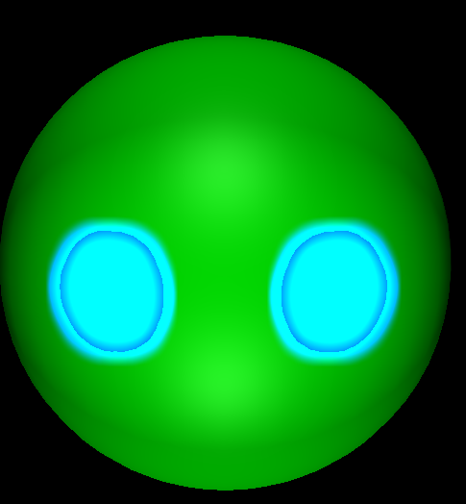
Glow Effect Phases
No Glow
Only rendering glowing objects
Image #1 + #4
Horizontal blur
Vertical blur

Slide 4
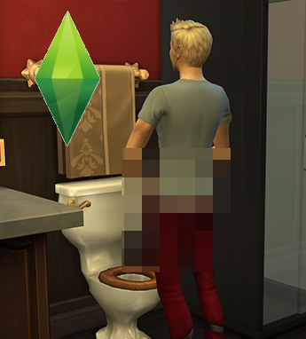
Pixelation Effect - Talon
Inspired by The Sims blur / censorship effect

Slide 5
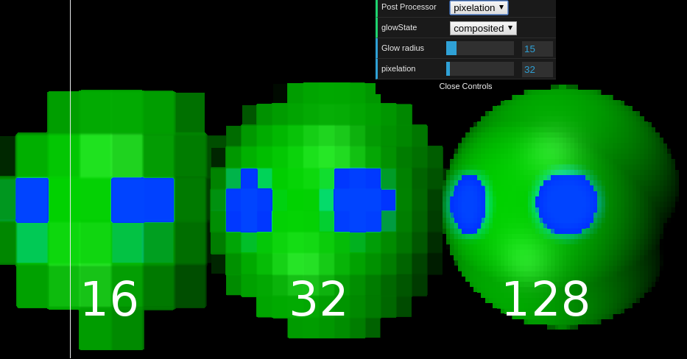
Pixelation Effect - Talon
Post Processing effect making all objects pixelated in appearance.

Slide 6
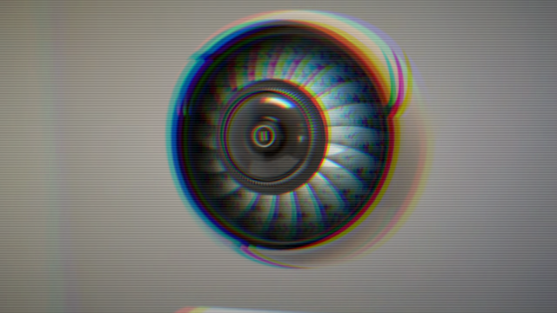
Bad TV Signal
Idea from Shadertoy.
Post-processing effect.
Blurs the image around the center.
Takes the color of the image and breaks it into red, green and blue.
Uses a scanline to distort the coloring

Slide 7
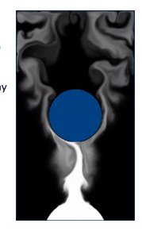
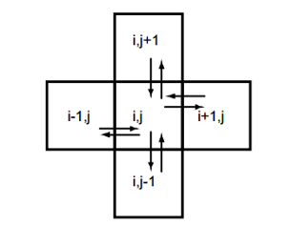
Smoke Simulation
Inspiration from PrideOut’s Fluid Simulation.
Divides a space into cells, where cell contains a velocity vector and other information, such as density and temperature.
Main equation: Navier-Stokes (hard to solve)

Slide 8
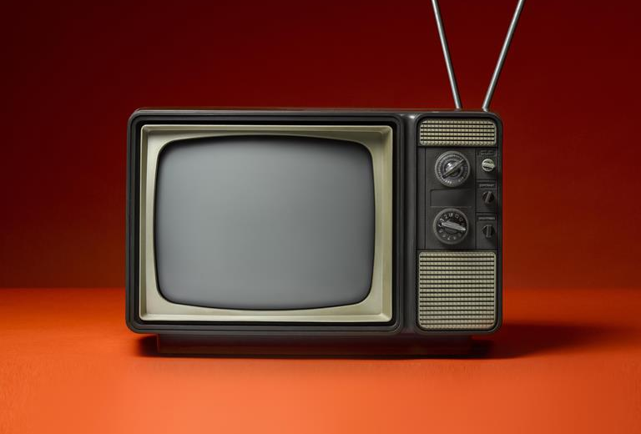
How It Might All Fit Together(?)
Bad T.V. Shader +
Pixelation Shader +
Glow Effect Shader +
Smoke Effect =
Broken T.V.!

