Slide 1

Revision: Arrays, Stacks, Queues & Naming Conventions
Overview of essential data structures and coding standards
Notes:
---

Slide 2
Introduction and Objectives
Notes:
Session Overview and Learning Goals

Slide 3

Session Overview and Learning Goals
Session Purpose
  Focus on revising data structures and coding standards for Level 3 learners over 90 minutes.
Core Learning Topics
  Cover arrays, stacks, queues, and Python naming conventions for variables, functions, and classes.
Interactive Learning
  Use hands-on coding exercises and discussions to enhance understanding and practical skills.
Notes:
This session is designed for Level 3 learners and will last for 1 hour and 30 minutes. The primary goal is to help students revise key concepts in data structures and coding standards, specifically focusing on Arrays, Stacks, Queues, and naming conventions in Python. By the end of the session, learners should be able to understand the theoretical foundations of these structures, implement them in Python, and apply best practices for naming variables, functions, and classes. The session will include interactive activities, coding exercises, and discussions to reinforce understanding. Objectives include: understanding arrays and their operations, implementing stacks and queues using Python lists and collections, and applying proper naming conventions to improve code readability and maintainability. The session will also emphasize practical coding examples and encourage learners to actively participate in hands-on exercises to solidify their knowledge.

Slide 4
Arrays in Python
Notes:
Understanding Arrays and Their Operations, Activity: Array Manipulation in Python

Slide 5
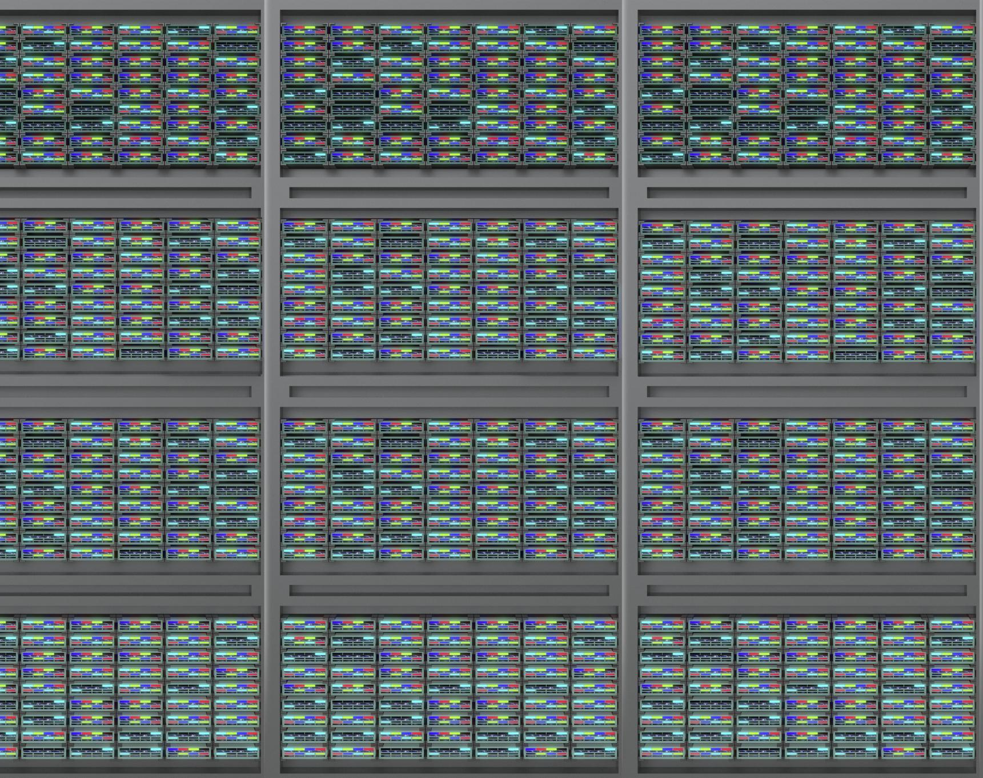
Understanding Arrays and Their Operations
Array Basics
  Arrays store elements in contiguous memory, allowing efficient access and ordered data storage.
Python List Operations
  Python lists are dynamic arrays supporting append, remove, pop, indexing, and slicing operations.
Arrays vs Static Arrays
  Python lists differ from static arrays in C or Java, offering flexibility but with different performance.
Foundation for Complex Structures
  Arrays form the basis for more complex data structures like stacks and queues in programming.
Notes:
Arrays are fundamental data structures that store elements in contiguous memory locations, allowing efficient access and manipulation. In Python, arrays are typically represented using lists, which are dynamic and can grow or shrink as needed. Key operations include adding elements using append(), removing elements with remove() or pop(), and accessing elements through indexing and slicing. Arrays are useful for storing ordered collections of data such as numbers or strings. For example, an array can be created as my_array = [1, 2, 3, 4], and operations like my_array.append(5) or my_array[1:3] can be performed. Understanding arrays is essential because they form the basis for more complex data structures like stacks and queues. During this section, learners will explore how arrays work internally, their advantages and limitations, and how Python's list implementation differs from static arrays in languages like C or Java.

Slide 6
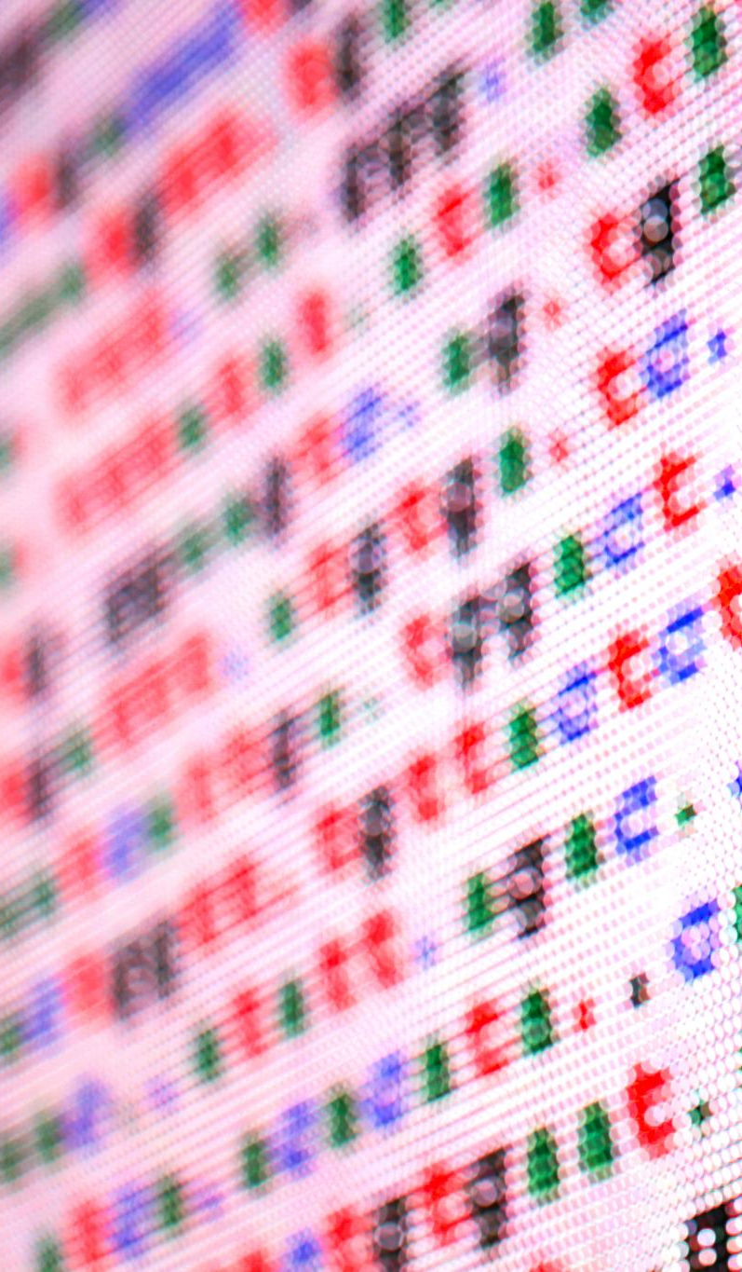
Activity: Array Manipulation in Python
Create and Modify Array
  Learners create an array of five numbers and add a new number using the append() method.
Remove Elements
  Remove the second element using pop() or del to understand dynamic array manipulation.
Slicing and Indexing
  Experiment with slicing and indexing to retrieve subsets of data from the array.
Discussion on Data Structures
  Discuss differences between arrays and other data structures and their appropriate applications.
Notes:
In this activity, learners will write a Python program to practice array operations. The steps include: 1) Create an array of five numbers, 2) Add a new number to the array using append(), 3) Remove the second element using pop() or del, and 4) Print the final array to verify changes. This exercise reinforces understanding of dynamic array behavior and basic list operations in Python. Learners should also experiment with slicing and indexing to retrieve subsets of data. After completing the task, students will discuss how arrays differ from other data structures and why they are suitable for certain applications. This hands-on activity ensures learners can apply theoretical concepts in practical coding scenarios.

Slide 7
Stacks
Notes:
Concept and Implementation of Stacks, Activity: Implementing Stack Operations

Slide 8
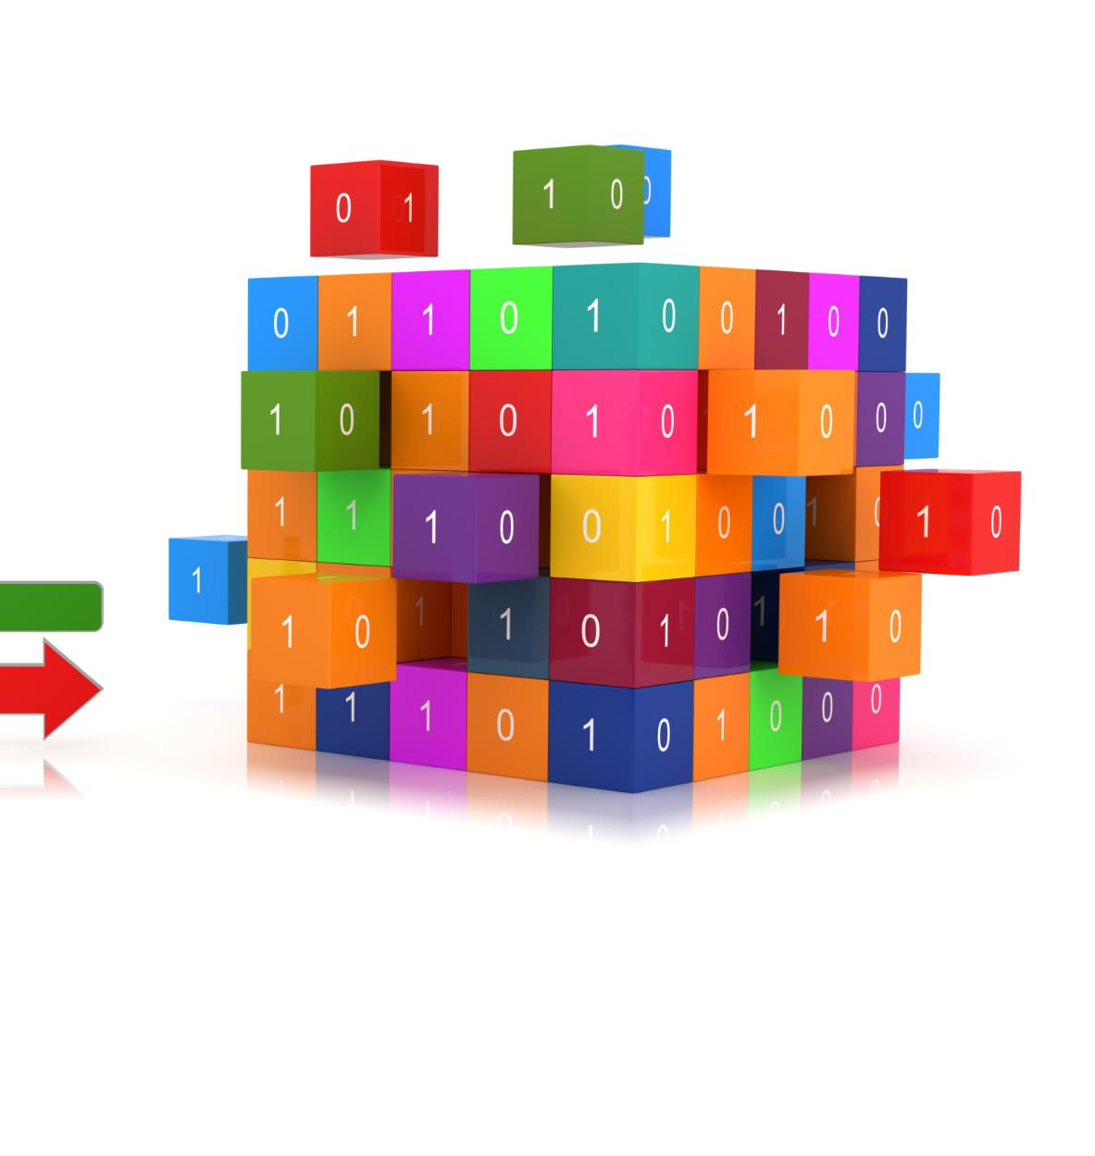
Concept and Implementation of Stacks
Stack Concept and LIFO
  Stacks use Last In, First Out (LIFO) principle where the last element added is removed first.
Python Stack Implementation
  Stacks can be implemented in Python using lists with append() for push and pop() for removal.
Real-World Stack Uses
  Stacks are used in function calls, undo features, and expression evaluation in computing.
Notes:
Stacks are a linear data structure that follows the Last In, First Out (LIFO) principle, meaning the last element added is the first to be removed. Common operations include push (adding an element) and pop (removing the top element). In Python, stacks can be implemented using lists, where append() acts as push and pop() removes the last element. For example: stack = [], stack.append(10), stack.pop(). Stacks are widely used in scenarios such as function call management, undo mechanisms in editors, and expression evaluation. Understanding stacks helps learners grasp how data can be organized and accessed in a controlled manner. This section will explain the concept, demonstrate Python implementation, and discuss real-world applications.

Slide 9

Activity: Implementing Stack Operations
Stack Implementation in Python
  Create an empty stack and add elements using append() to demonstrate basic stack operations.
Removing Elements with pop()
  Remove elements using pop() method and observe stack changes to reinforce LIFO concept.
Error Handling in Stacks
  Consider error handling when pop() is called on an empty stack to avoid runtime errors.
Applications and Comparisons
  Discuss practical uses of stacks and differences compared to arrays and queues.
Notes:
Learners will implement a stack in Python and perform basic operations. The task involves creating an empty stack, adding three elements using append(), removing one element using pop(), and printing the stack after each operation to observe changes. This activity reinforces the LIFO concept and demonstrates how Python lists can serve as stacks. Students will also be encouraged to think about error handling, such as what happens when pop() is called on an empty stack. After completing the exercise, learners will discuss practical applications of stacks and how they differ from arrays and queues.

Slide 10
Queues
Notes:
Concept and Implementation of Queues, Activity: Building a Queue in Python

Slide 11

Concept and Implementation of Queues
FIFO Principle in Queues
  Queues operate on the First In, First Out principle, ensuring ordered processing of elements.
Python Queue Implementation
  Python uses collections.deque for efficient queue operations like append and popleft.
Applications of Queues
  Queues are used in task scheduling, resource management, and handling system requests efficiently.
Queues vs Stacks
  Queues differ from stacks by processing elements in FIFO order rather than LIFO order.
Notes:
Queues are a linear data structure that follows the First In, First Out (FIFO) principle, meaning the first element added is the first to be removed. In Python, queues can be implemented using the collections.deque class, which provides efficient append and popleft operations. For example: from collections import deque; queue = deque(); queue.append(10); queue.popleft(). Queues are commonly used in scheduling tasks, managing resources, and handling requests in systems. This section will explain the concept, demonstrate Python implementation, and highlight differences between queues and stacks. Learners will understand why queues are essential for scenarios requiring ordered processing.

Slide 12

Activity: Building a Queue in Python
Queue Implementation Using deque
  Learners create a queue in Python using collections.deque for efficient FIFO operations.
Basic Queue Operations
  Key queue operations include append() to add and popleft() to remove elements, illustrating FIFO behavior.
Real-World Queue Applications
  Queues are applied in scenarios like print job management and customer service for orderly processing.
Notes:
In this activity, learners will create a queue using collections.deque and perform basic operations. The steps include adding three elements using append(), removing one element using popleft(), and printing the queue after each operation. This exercise helps learners understand FIFO behavior and how Python's deque simplifies queue implementation. Students will also discuss real-world applications of queues, such as print job management and customer service systems. This hands-on practice ensures learners can apply theoretical knowledge in coding tasks.

Slide 13
Naming Conventions
Notes:
Best Practices for Naming in Python, Activity: Improving Code Readability

Slide 14

Best Practices for Naming in Python
Python Naming Conventions
  Variables and functions use lowercase_with_underscores, classes use CapitalizedWords (PascalCase), constants use ALL_CAPS.
Meaningful Names Importance
  Meaningful names convey variable and function purposes, reducing confusion and enhancing collaboration.
Consistent Naming Benefits
  Consistent naming improves code readability, maintainability and helps teamwork efficiency.
Notes:
Naming conventions are essential for writing clean, readable, and maintainable code. In Python, variables and functions should use lowercase_with_underscores, classes should follow CapitalizedWords (PascalCase), and constants should be written in ALL_CAPS. Meaningful names help convey the purpose of variables and functions, reducing confusion and improving collaboration. For example, use student_scores instead of ss or calculate_average() instead of func1(). This section will explain why naming conventions matter, provide examples of good and bad practices, and discuss how consistent naming improves code quality and teamwork.

Slide 15

Activity: Improving Code Readability
Identify Unclear Variable Names
  Review poorly named variables to pinpoint names that reduce code clarity and hinder understanding.
Rename to Meaningful Alternatives
  Suggest clear and descriptive variable names that enhance the readability and maintainability of the code.
Discuss Impact on Readability
  Reflect on how improved naming conventions contribute to clarity and better software development practices.
Notes:
Learners will review a piece of poorly named Python code and suggest improvements based on naming conventions. The activity involves identifying unclear variable names, renaming them to meaningful alternatives, and discussing the impact on readability. This exercise emphasizes the importance of clarity and consistency in coding. After completing the task, students will share their revised code and reflect on how naming conventions contribute to better software development practices.

Slide 16
Summary and Wrap-Up
Notes:
Key Takeaways and Final Thoughts

Slide 17

Key Takeaways and Final Thoughts
Understanding Arrays
  Arrays are dynamic lists for storing ordered data efficiently in Python programming.
Stacks and LIFO Principle
  Stacks follow Last-In-First-Out to control access and manage data effectively.
Queues and FIFO Principle
  Queues implement First-In-First-Out for orderly data processing in programs.
Importance of Naming Conventions
  Naming conventions enhance code clarity and maintainability for better programming practice.
Notes:
In this session, learners explored arrays, stacks, queues, and naming conventions in Python. Arrays serve as dynamic lists for storing ordered data, stacks follow the LIFO principle for controlled access, and queues implement FIFO for orderly processing. Naming conventions ensure code clarity and maintainability. Through hands-on activities, learners practiced implementing these structures and applying best practices. The key takeaway is that understanding these fundamental concepts and coding standards is crucial for building efficient and readable programs. Learners are encouraged to continue practicing these concepts and apply them in real-world projects to strengthen their programming skills.

