Slide 1
Nashville City Cemetery
Rodney Coleman

Slide 2
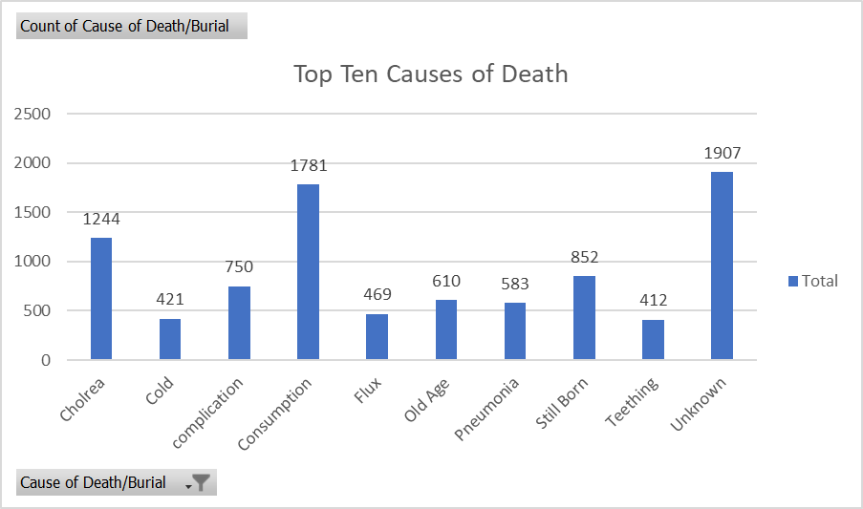
Causes of Death
Top causes of deaths/burials
From the year 1840s to the 1970s
Consumption was labeled for people who were consumed by a disease. This was later found out to most likely be Tuberculosis cases.

Slide 3
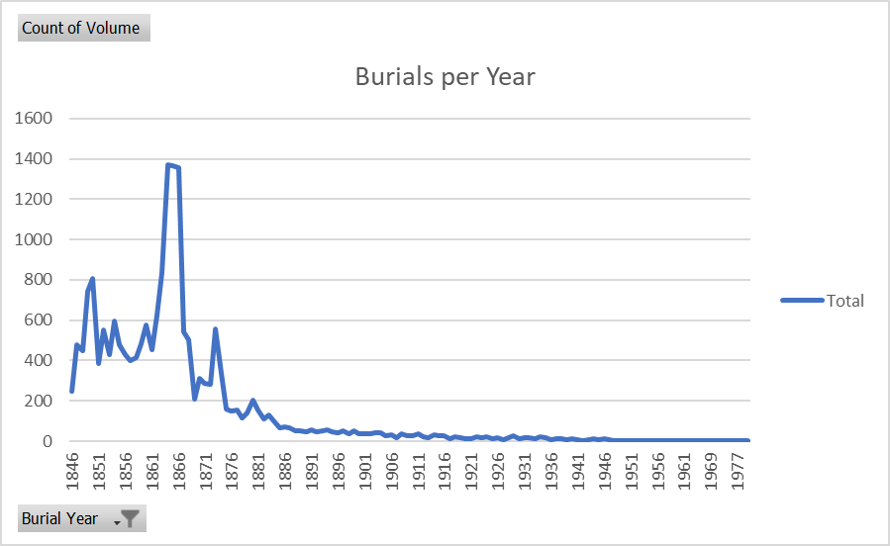
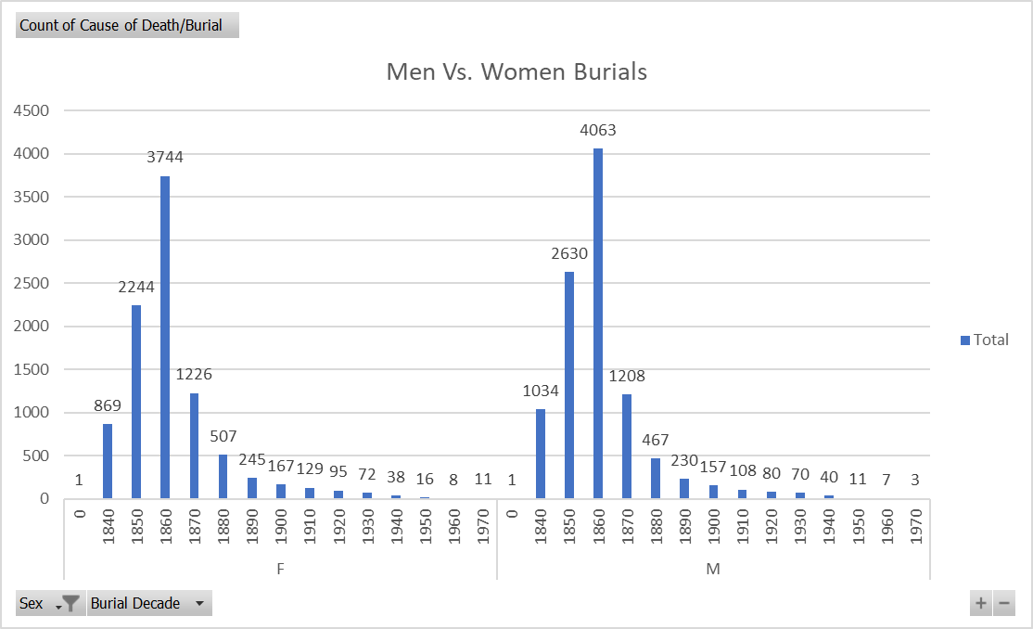
Burials Vs. Gender

Slide 4
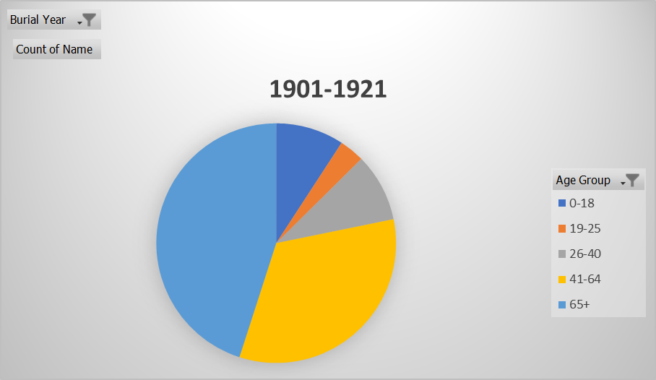
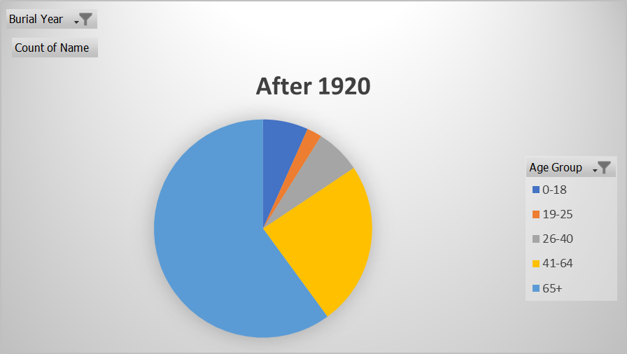
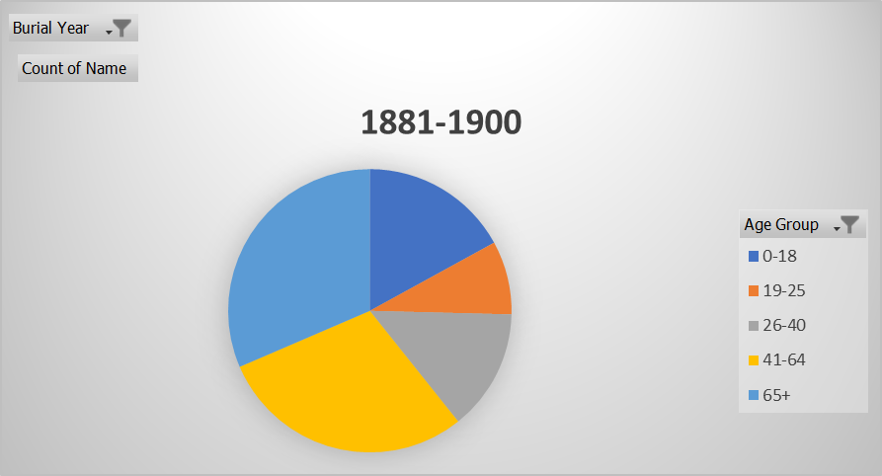
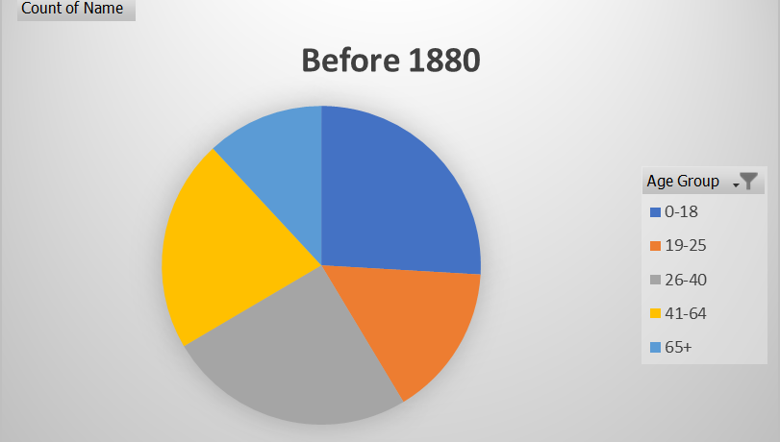
Burial Rates per Decade
Common Last Names
Brown 112
Green 60
Johnson 96
Jones 83
Moore 60
Smith 129
Thompson 55
Williams 70

