Slide 1
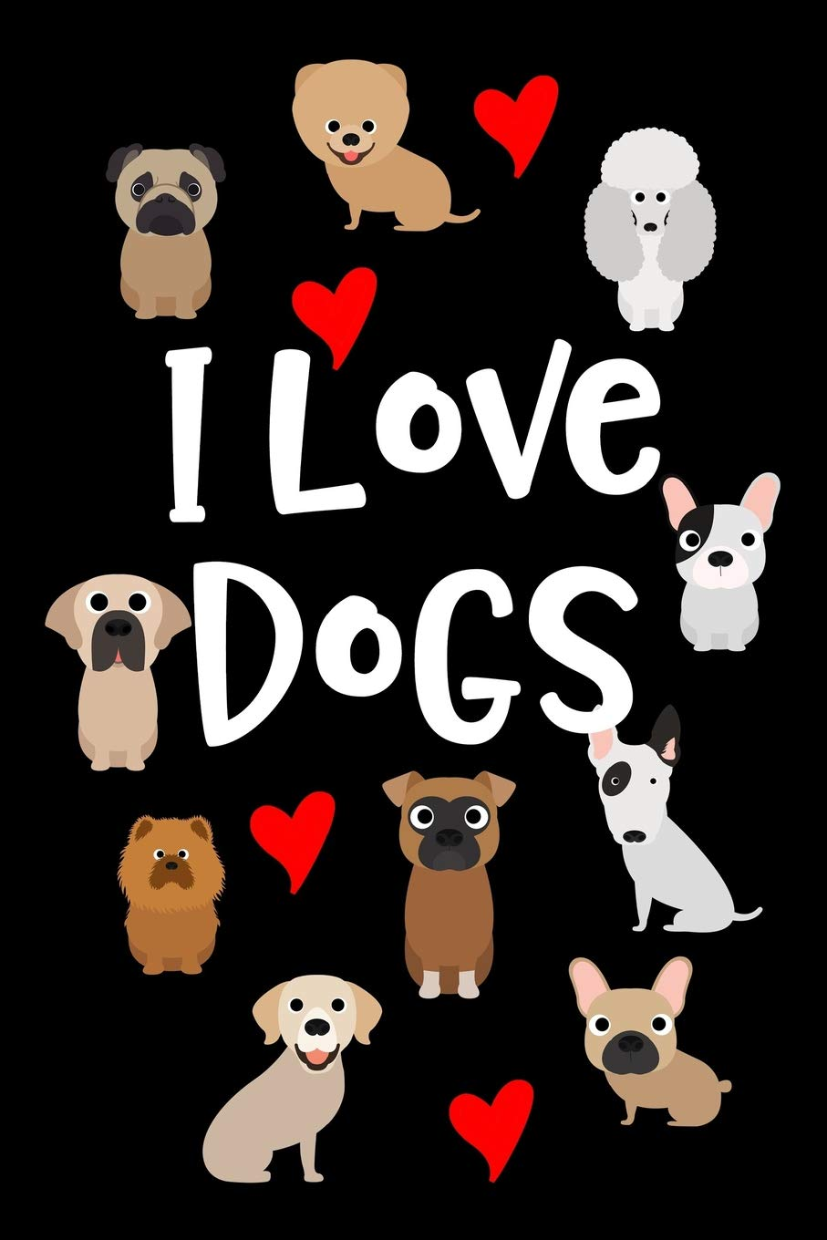
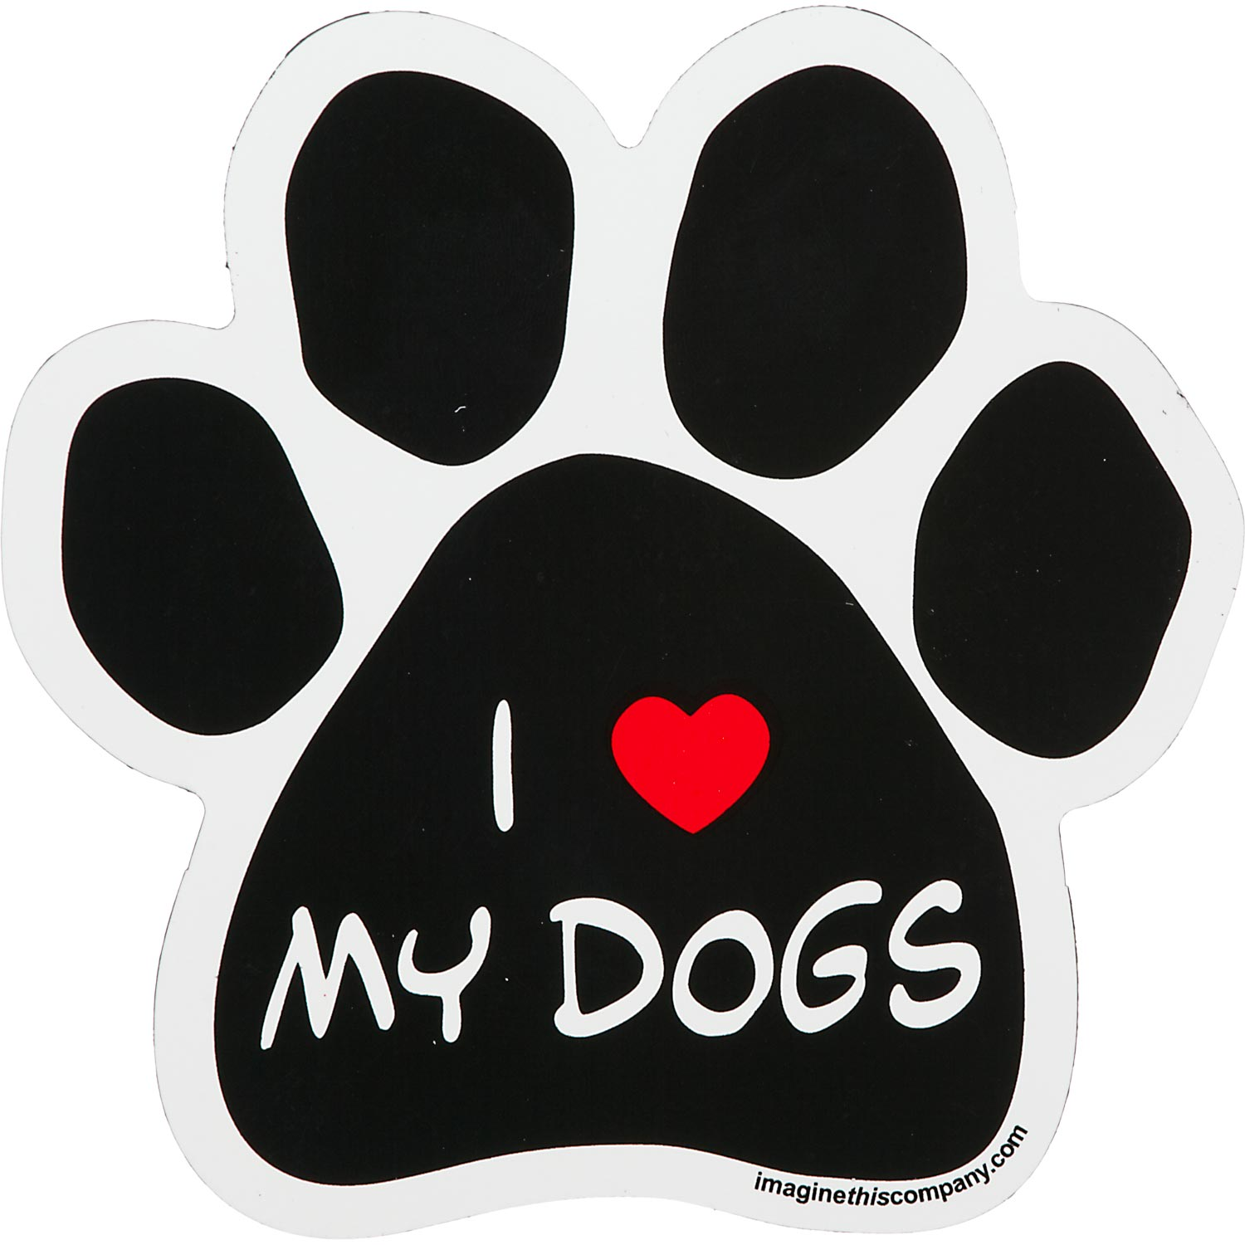
I love dogs
Truly mans best friend and someone who loves to be around you all of the time
Created with a trial version of Syncfusion Essential Presentation

